Slide 1
HR Analytics Insights: Understanding Employee Attrition and Trends
Krupa Patel

Slide 2
Purpose: Present HR analytics findings.
Key Performance Indicators:
Active Employees: 1233
Overall Employees: 1470
Attrition Count: 237
Attrition Rate: 16.12%
Average Age: 37

Slide 3
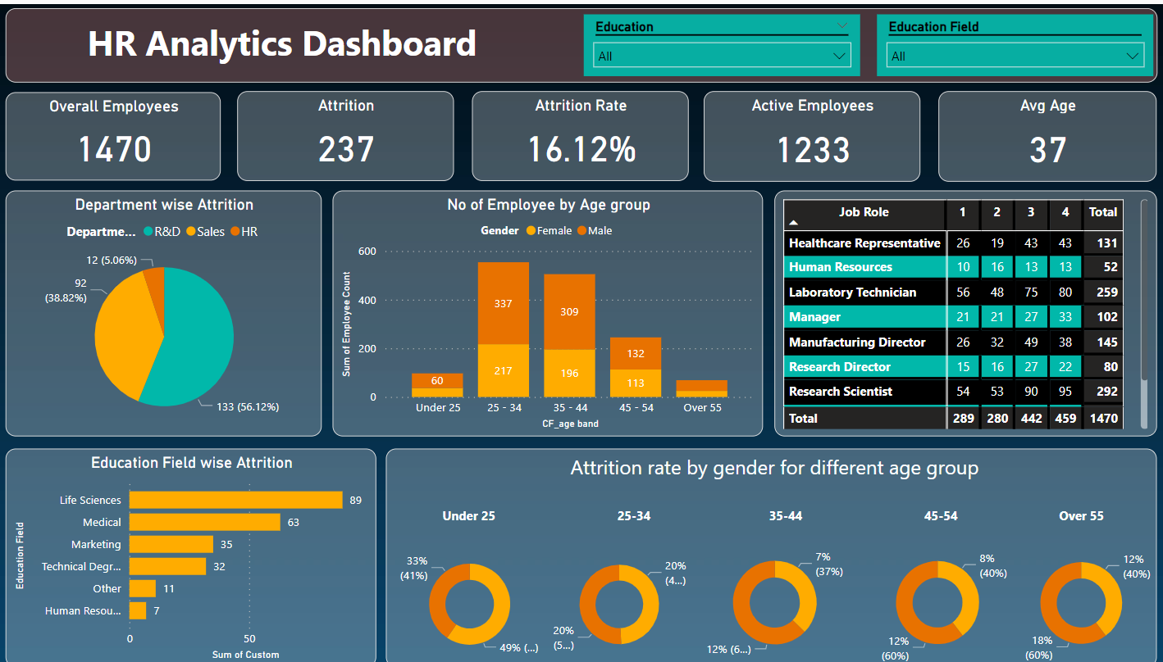

Slide 4
Purpose: Present HR analytics findings
How will attrition impact our workforce in the next year?
Observed
Active Employees: We currently have 1233 active employees out of a total of 1470.
Attrition Rate: Approximately 16.12% of employees have left.
Average Age: Our workforce’s average age is 37 years.
Use predictive modeling to estimate attrition trends and plan for replacements.
What age groups are most affected by attrition?
Implement strategies that aim to maintain age versatile environment, understands the work-pattern for each age group and set work atmosphere accordingly

Slide 5
Department-wise Attrition
Analyzed
R&D: Experiencing a significant attrition rate of 56.12%.
Sales: Demonstrating a moderate attrition rate of 38.82%.
HR: Observing a comparatively lower attrition rate of 12%.
Focus
Why is R&D experiencing such high attrition?
Conduct exit interviews and identify pain points (e.g., workload, growth opportunities).
How can we retain R&D talent?
Offer career development paths, mentorship, and recognition programs.

Slide 6
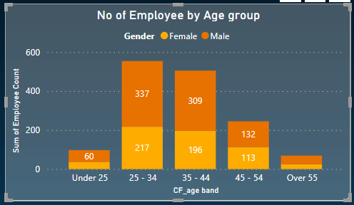
Employee Age Distribution
Why?
Internship Programs: (Offer structured internship), (Convert successful interns to full-time hires)
Digital Presence and Social Media: (Leverage platforms like LinkedIn and Instagram), (Showcase company culture and opportunities)
Female Mentorship Programs
Cross-Generational Pairing
Why do we have a very low count for the young employees who are under 25?
Why there are more males in number than females?

Slide 7
Job Roles Matrix
Which roles are critical for our organization?
Laboratory Technician and sales executives showed comparatively lower satisfaction rating
Sales representatives were less unsatisfied (14.45% only)
All other job roles' satisfaction ratings were between 17.9% to 20.5%
What can be done?
Regular Feedback and Recognition
Work-Life Balance

Slide 8
Education-wise Attrition
What is the scenario?
Life Sciences & Medical: Highest attrition
Why is attrition high in Life Sciences & Medical?
Analyze work conditions, career paths, and job satisfaction
Provide growth opportunities and recognize their contributions.

Slide 9
Attrition by Age Band
What did we find?
Solution
How can we retain experienced employees?
How can we stop attrition rate of females at early age?
Offer flexible retirement options and knowledge transfer programs.
Implement wellness initiatives and work-life balance policies
Age 45-54 and over 55: Elevated attrition, especially among males.
In under 25 age category of females showed highest attrition rate.

Slide 10
Future perspectives
What will attrition look like in the next 2 years?
How can we align HR practices with business goals?
Proactively anticipate workforce dynamics and trends
Use predictive models to anticipate workforce changes.
Regularly update workforce planning based on predictions

Slide 11
Decision-Making Tips
Recommendations for retention.
Continuous Learning: Invest in training and development programs.
Recognition and Rewards: Acknowledge achievements and provide incentives.
Feedback Culture: Foster open communication and address employee concerns.

Slide 12
Thank You
Krupa Patel
91-8780825775
Krupa25562@gmail.com

