Slide 1
Parallel Maximum/Minimum Search
Using OpenMP
Parallel Computing Lab Evaluation

Slide 2
1. Problem Definition
Find the maximum and minimum values in a large integer dataset.
Implement a sequential solution as the baseline.
Implement a parallel solution using OpenMP threads.
Measure execution time for different numbers of threads.
Study the effect of different data sizes.
Calculate speedup and efficiency.

Slide 3
2. Objectives
Implement maximum/minimum search using C.
Use OpenMP for shared-memory parallel execution.
Use OpenMP reduction for minimum and maximum values.
Compare sequential and parallel execution time.
Test 1, 2, 4 and 8 threads.
Test 1M, 5M and 10M data sizes.
Generate graphs and analyze performance.

Slide 4
3. Tools and Technologies
Programming Language: C
Parallel Model: OpenMP
Compiler: GCC
Operating Environment: Ubuntu on WSL2
Timing Function: omp_get_wtime()
Graph Generation: Python and Matplotlib
Version Control: Git and GitHub

Slide 5
4. Sequential Algorithm
Generate the dataset using a fixed random seed.
Initialize minimum to INT_MAX.
Initialize maximum to INT_MIN.
Traverse every element of the dataset.
Update minimum if the current value is smaller.
Update maximum if the current value is larger.
Measure the execution time of the search loop.
Time Complexity: O(N).

Slide 6
5. Parallel Design using OpenMP
The dataset is divided among OpenMP threads.
Each thread examines its assigned portion of the array.
Each thread calculates local minimum and maximum values.
OpenMP reduction combines the local minimum values.
OpenMP reduction combines the local maximum values.
The final values represent the global minimum and maximum.
Directive used:
#pragma omp parallel for reduction(min:minimum) reduction(max:maximum)

Slide 7
6. Dataset and Experimental Setup
Dataset contains random integers from 1 to 1,000,000.
Random seed = 42.
Default dataset size = 10,000,000 elements.
Thread counts tested = 1, 2, 4 and 8.
Additional data sizes = 1,000,000; 5,000,000; 10,000,000.
All runs produced Minimum = 1 and Maximum = 1,000,000.

Slide 8
7. Sequential Baseline Result
Data Size | Minimum | Maximum | Execution Time (s)
10,000,000 | 1 | 1,000,000 | 0.004681
The sequential result is used as the baseline for speedup.
The measured time is for the maximum/minimum search loop.

Slide 9
8. Thread Scaling Results
Threads | Data Size | Execution Time (s)
1 | 10,000,000 | 0.007940
2 | 10,000,000 | 0.007246
4 | 10,000,000 | 0.007538
8 | 10,000,000 | 0.005069
Minimum = 1 and Maximum = 1,000,000 for all runs.

Slide 10
9. Data Size Results — 8 Threads
Data Size | Threads | Minimum | Maximum | Execution Time (s)
1,000,000 | 8 | 1 | 1,000,000 | 0.001475
5,000,000 | 8 | 1 | 1,000,000 | 0.003315
10,000,000 | 8 | 1 | 1,000,000 | 0.008019
Execution time increases as the data size increases.

Slide 11
10. Speedup and Efficiency
Threads | Sequential (s) | Parallel (s) | Speedup | Efficiency (%)
1 | 0.004681 | 0.007940 | 0.5895 | 58.95
2 | 0.004681 | 0.007246 | 0.6460 | 32.30
4 | 0.004681 | 0.007538 | 0.6210 | 15.52
8 | 0.004681 | 0.005069 | 0.9235 | 11.54
Speedup = Sequential Time / Parallel Time.
Efficiency = (Speedup / Number of Threads) × 100.

Slide 12
11. Result Analysis
The lowest measured parallel execution time was obtained with 8 threads.
The speedup is below 1 for the measured runs.
The maximum/minimum search performs very little computation per element.
OpenMP introduces thread management, scheduling and reduction overhead.
For this workload, the overhead is significant compared with the short sequential computation.
Execution time increases when the number of data elements increases.

Slide 13
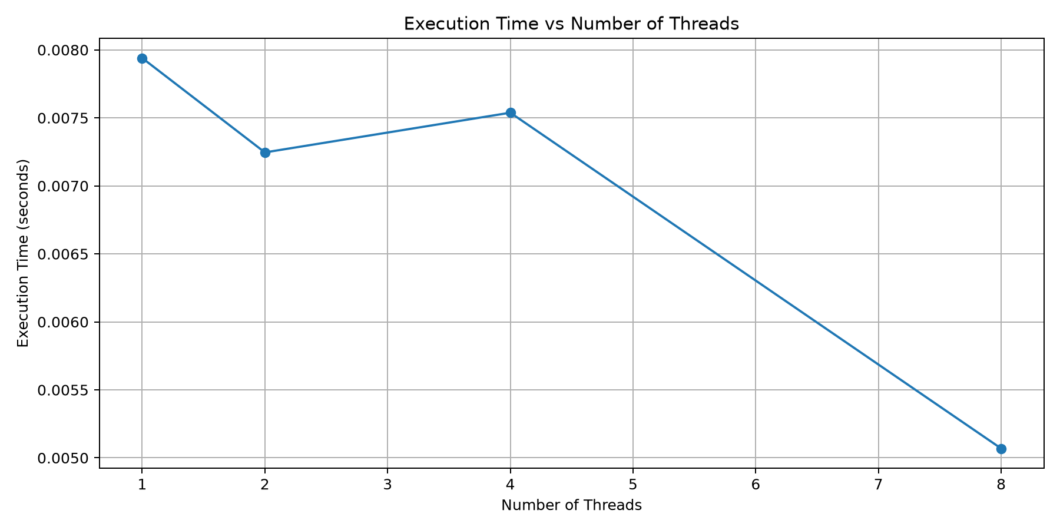
12. Graph — Execution Time vs Threads

Slide 14
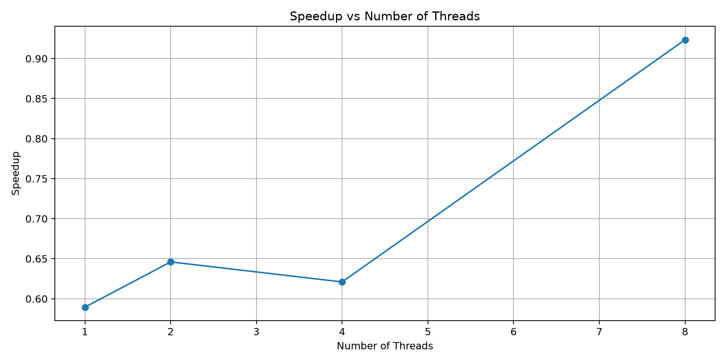
13. Graph — Speedup vs Threads

Slide 15
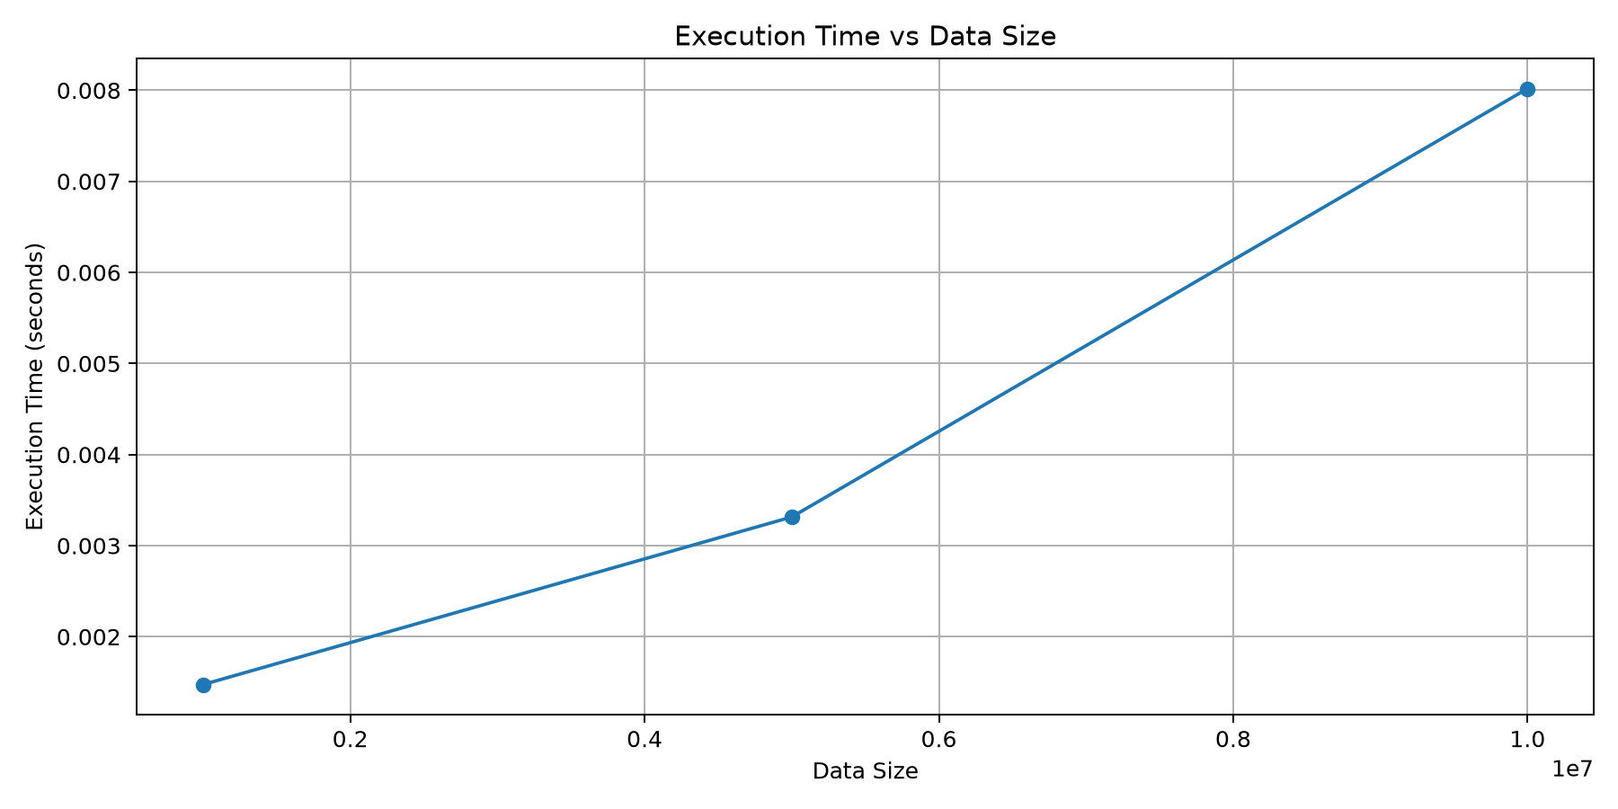
14. Graph — Execution Time vs Data Size

Slide 16
15. Lab Evaluation Checkpoints
Checkpoint | Completed Work
1 | Problem definition, sequential algorithm and parallel design
2 | Working OpenMP implementation
3 | Different thread counts and data sizes tested
4 | Graphs, speedup, efficiency and analysis
5 | Final demonstration and technical viva

Slide 17
16. GitHub Project Structure
PGC-parallel-maximum-minimum-openmp/
├── README.md
├── src/ — C source files
├── results/ — CSV results and analysis
├── graphs/ — generated performance graphs
├── screenshots/ — experiment evidence
├── generate_graphs.py
└── presentation/ — lab evaluation PPT

Slide 18
17. Conclusion
Maximum and minimum search was implemented using sequential C and OpenMP.
OpenMP reduction was used to combine minimum and maximum values safely.
The experiment studied thread scaling and data-size scaling.
Speedup and efficiency were calculated from measured execution times.
The results demonstrate that parallel overhead can dominate a simple workload.
The complete experiment is organized in the GitHub project.

Slide 19
18. Technical Viva — Key Points
Why OpenMP? — It provides shared-memory parallelism using compiler directives.
Why reduction? — It combines thread-local minimum and maximum values safely.
Why can speedup be below 1? — Parallel overhead can exceed the benefit for a small computation.
Time complexity? — O(N), because every element must be examined.
What happens with more threads? — Work is divided among threads, but parallel overhead also exists.
How was correctness verified? — Minimum and maximum values were checked for every experiment.

Slide 20
Thank You
Questions?

