Slide 1
Viewer POC

Slide 2
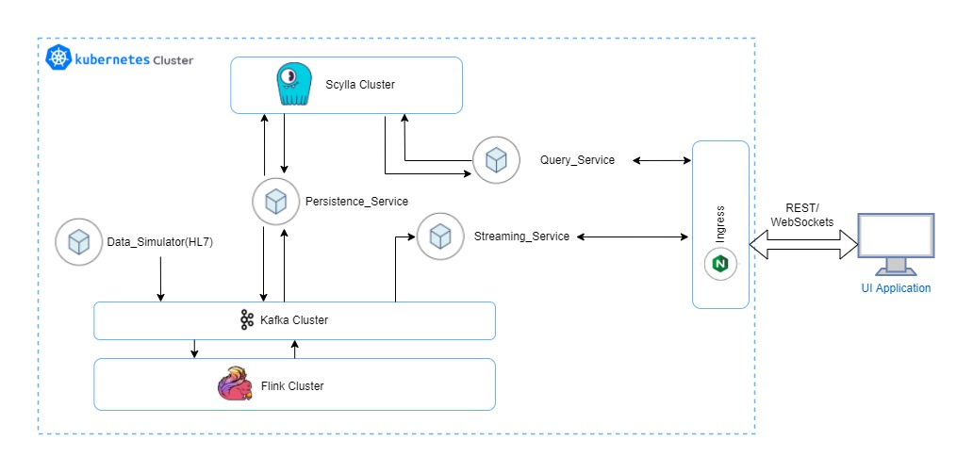
High Level Diagram
Services
Data_Simulator
Spring boot service to generate sample data. Numeric, Waveform.
Use a custom json message format for each kind or you can use HL7 messages also.
Persistence_Service
Service which persist the aggregated data to Scylla DB.
Service can consume aggregated messages from waveform_aggregated kafka topic.
Query_Service
This will expose end points to query historic data from Scylla DB.
Query parameters can be PID, from_time,to_time etc and can be passed as headers for REST API call.
Streaming_Service
Service which stream aggregated 10 sec data to UI. The data can be consumed from waveform_aggregated kafka topic.
The streaming should be based on a subscription of PID. Service can expose a REST end point for subscribe data. For streaming, data format is JSON and we can use STOMP protocol over web sockets.
We can make use of STOMP topics to differentiate and stream different kind of data.
Kafka Topics
numeric_raw
waveform_raw
waveform_aggregated
Flink Stream Processing
Create an application cluster in Flink.
Flink data source is kafka. Use FlinkKafkaConsumer for getting data from kafka.
Use Tumbling Window operator for aggregating 10 sec raw data.
Aggregated bundle should be published to waveform_aggregated kafka topic.
UI Application
Create a minimal Angular UI application to show the data.
Use Nginx as ingress for routing and load balancing.

