Slide 1
Analytic Task 1
Shooting Accuracy:
Knockout vs Group-Stage Eliminated Teams
Do teams that reached the knockout stage have higher average shooting accuracy than teams eliminated in the group stage?
FIFA
WORLD CUP
2026
Presenter
Unit
Krupa Maria Salim
HIT140 • Foundations of Data Science
FOUNDATIONS OF DATA SCIENCE
Data source: FBref • 2026 World Cup Squad Shooting

Slide 2
1. Methodology
A reproducible Python workflow from raw FBref data to statistical inference
01
Question
02
Prepare
03
Construct
Compare shooting accuracy between knockout and group-stage-eliminated teams.
Select Squad, Sh, SoT and SoT%; clean team names and check data quality.
Create Shooting Accuracy = SoT / Sh × 100 and validate against FBref SoT%.
04
Sample
05
Describe
06
Infer
Use proportionate stratified random sampling: 24 knockout + 12 eliminated teams.
Summarise means, medians, spread, boxplot and 95% confidence intervals.
Check normality, then apply a one-sided Welch two-sample t-test at α = 0.05.
All data wrangling, statistical analysis and visualisation were completed in Python.
2

Slide 3
2. Research Question & Study Design
A focused team-level comparison using FBref squad shooting data
RESEARCH QUESTION
Do knockout-stage teams have higher average shooting accuracy than group-stage-eliminated teams?
Variable of interest
Study design
Shooting Accuracy (%)
Population
48 teams at FIFA World Cup 2026
Shots on Target ÷ Total Shots × 100
Unit
One national team
Why a rate? It is more comparable than raw shot totals when teams play different numbers of matches.
Groups
32 knockout • 16 eliminated
Sample
36 teams: 24 knockout • 12 eliminated
Sampling frame: 48 FBref teams
Unit: one national team
Method: proportionate stratified random sampling
Source: FBref, Squad Shooting — 2026 World Cup.

Slide 4
3. Data Preparation, Validation & Sampling
The workflow was kept simple, reproducible and aligned with the analytic question
01
02
03
04
05
Select
→
Clean
→
Construct
→
Validate
→
Sample
Squad, Sh, SoT, SoT%
Remove country prefixes from team names
Shooting Accuracy = SoT / Sh × 100
Compare with FBref SoT% and check data quality
24 knockout + 12 eliminated teams
Validation checks
Sampling logic
0
0
0
0
Population ratio
32 : 16 = 2 : 1
random_state = 42 → reproducible sample
Missing values
Duplicate teams
Teams with zero shots
SoT > total shots
Sample ratio
24 : 12 = 2 : 1
Feature construction and validation were performed in Python; Excel was not used for analysis.

Slide 5
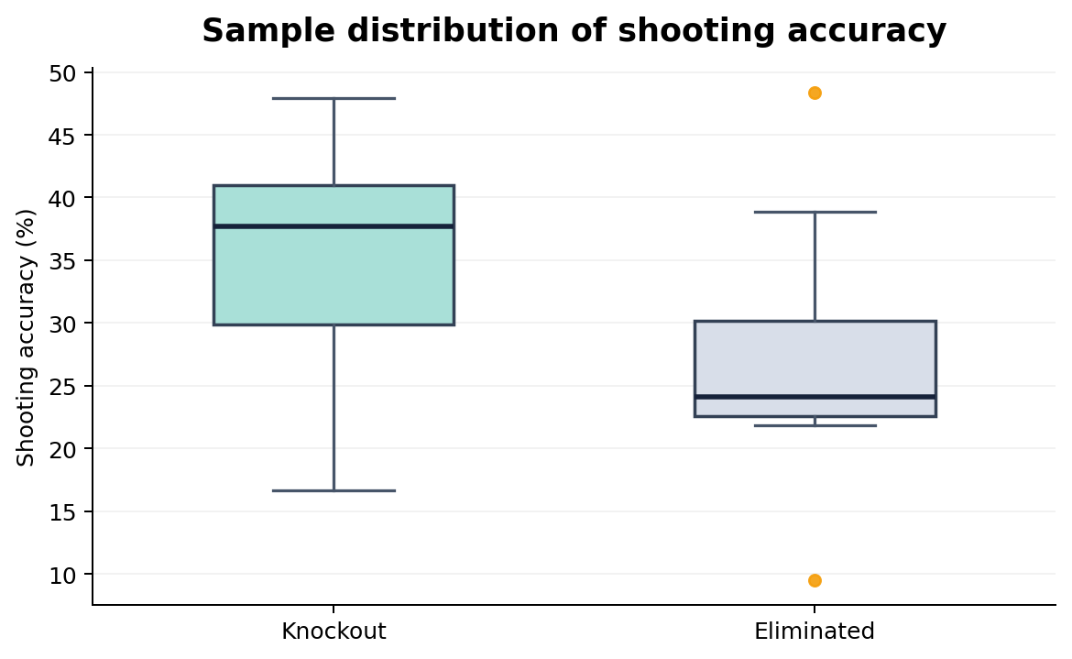
4. Descriptive Results & 95% Confidence Intervals
Knockout teams show higher central tendency in the sample
Sample means
35.48%
27.28%
Knockout
Eliminated
Difference = +8.20 percentage points
95% confidence intervals
Knockout
32.02% — 38.94%
Eliminated
20.91% — 33.66%
Boxplot of sample shooting accuracy
The descriptive pattern favours knockout teams, but inferential testing is still required.
Sample: n = 24 knockout teams; n = 12 group-stage-eliminated teams.

Slide 6
5. Hypothesis Test & Assumptions
One-sided Welch two-sample t-test
Hypotheses
Welch two-sample t-test
H₀: μK = μE
Hₐ: μK > μE
t = 2.449
p = 0.0122
p < 0.05 → Reject H₀
Assumption check
Shapiro–Wilk
Knockout p = 0.676
Eliminated p = 0.149
Statistical decision
Both > 0.05 → no significant evidence of non-normality.
Reject H₀ because p = 0.0122 < 0.05.
Significance level: α = 0.05

Slide 7
6. Lessons Learned
What this analytic task taught me about practical data science
Meaningful metrics
Validate before testing
Interpret evidence carefully
Rates and percentages can make comparisons fairer than raw totals when exposure differs.
Cleaning, logical checks and source validation reduce the risk of drawing conclusions from bad data.
A small p-value supports evidence of a difference, but it does not establish causation.
Practical improvement
Compare group-stage matches only so both groups are evaluated over the same tournament phase and exposure.
7

Slide 8
7. Conclusion
What the analysis shows — and what it does not
KEY FINDING
Knockout-stage teams had higher average shooting accuracy.
35.48% vs 27.28% • difference = +8.20 percentage points • p = 0.0122
STATISTICAL INTERPRETATION
LIMITATION
NEXT STEP
There is statistically significant evidence that knockout-stage teams had higher average shooting accuracy.
FBref reports whole-tournament squad statistics, so knockout teams played more matches and faced different opponents.
Compare group-stage matches only so both groups are evaluated over the same tournament phase and exposure.
This analysis shows an association/difference — not that shooting accuracy caused knockout qualification.
8

