Slide 1
Systems Building: Methods
Information Systems Development Methodologies

Slide 2
What is an Information System Development Methodology?
‘An Information Systems Development Methodology can be defined as a collection of procedures, techniques, tools and documentation aids which will help the systems developers in their efforts to implement a new information system. A methodology will consist of phases, themselves consisting of subphases, which will guide the systems developers in their choice of the techniques that might be appropriate at each stage of the project and also helps them plan, manage, control, and evaluate information systems projects. . . . It is usually based on some ‘philosophical’ view.’
Avison & Fitzgerald (2006), p. 24

Slide 3
System Development Life Cycle
Do we need new / to improve software?
Deming & Shewhart quality improvement cycle (first introduced in 1930s):
Analysis and Design – PLAN – investigate / establish / determine the main aims of process to achieve expected results
Development – DO - execute your plan. It may involve implementation new modules or obtaining and configuration COTS.
Testing – CHECK - examine if results of what you done fulfil/satisfy planed expectations
Deployment – ACT or ADJUST - operate what you done and checked.
Are we going to undertake such a project?
NO
Deployment & Integration
Analysis & Design
Development
Needs analysis
Exploration & Maintenance
Feasibility study
NO
YES
ACT
PLAN
DO
CHECK
YES
based on: Deming, W.E. (1991) Quality, Productivity and Competitive Position. Quality Enhancement Seminary.
Notes:
investigate, analyse, design, an Information System’s purpose, functions, structure, appearance & behaviour
deploy the IT that will deliver these within required cost, time & efficiency constraints
within a particular context
taking account of integration with other systems.

Slide 4
What the modelling actually is?
A simplified representation or description of a system or complex entity, especially one designed to facilitate calculations and predictions
Domain
Model
Language
Syntactic
Semantic
Users
Pragmatic
Conceptual model – a high level representation of the system composed of concepts (entities) and relationships between them
Logical model – a lower level, more detailed, representation of the system
Physical model – the lowest level representation of the system. Contains implementation information

Slide 5
Methods : Structured system development
https://todaysmeet.com/week2

Slide 6
Lecture Objectives - Lecture 2
To explain the structured approach to information systems development
To present the techniques used in structured systems analysis and design.
To introduce a Structured Information Systems Development Methodology (SSADM)
To become acquainted with other structured methods and their extensions

Slide 7
Once upon time... (Parnas, Haberman, 1972)
Input
Circular Shift
Alphabetizing
Output
Master Control
Line Storage
Benefits of Modularisations:
Changeability – modules can be changed without affecting others
Independent Development each of module
Comprehensibility – easy to understand piece by piece
Input module
Circular Shift
Alphabetizing
Output
Master Control
Modularization 1 Modularization 2
Parnas, D.L. (1972) On The Criteria To Be Used In Decomposing Systems Into Modules. Programming Techniques

Slide 8
Structured System development
Based on waterfall lifecycle
Top-down functional decomposition
Structured design introduced:
information hiding
coupling
cohesion
Structured visual modelling
Included both technical and managerial elements
Initially process-driven.

Slide 9
Structured TECHIQUES
Process and data are modeled separately to emphasis procedural aspects of the development:
Data modelling
entity diagrams
Function modelling
data flow diagrams
Process specification
decision tables
decision tree
structured English
Program structure modelling & module specification
structure charts
Time-dependent behaviour
State transition diagram:
Structured programming
Jackson Structured Development and Programming

Slide 10
Entity Diagrams: Data Modelling
Conceptual | Logical | Physical
Defines the scope and context based on information gathered from the business / customer | Provides a key information about logical aspects of development implied by the business concept | Defines how data should be structured and related in a database
No attributes shown | Attributes are optional | Atomic attributes are required
Relationship between entities is optional | Relationship between entities shown | Many-to-many relationship resolved
Data dictionary
Notation
= is composed of
+ and
() optional element
{} iteration
[] alternative choice
| separates alternatives
in [ ] construct
** comment
@ identifier (store key)
Example
Name = Title + FirstName + LastName
Tile – [Mr|Mrs|Ms|Dr]
FirstName = {legal-character}
LastName = {legal-character}
LegalCharacter = [A-Z|a-z|’|-| |]
Entity-relationship diagram
Customer
Customer
name
address
Customer
name varchar (255)
address varchar (255)
Customer
Order
Order
id
date
Order
id int(5)
date date
places
Order
Product
Product
view
size
Product
view int(10)
size ???
specifies
Product

Slide 11
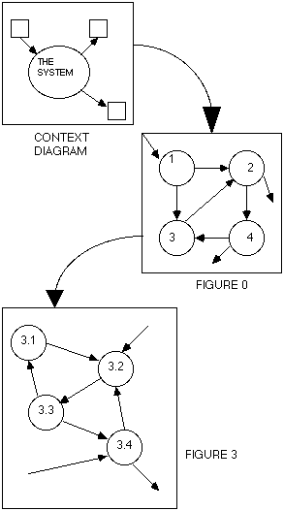
Data Flow Diagrams: functions modelling
The context diagram shows the system as a single process in environment represented by external entities
Suppliers
Product
Store system
Customer
No process specification for these bubbles
Money
A terminator
A dialog flow
Transporting company
A process
1.
Place order
2.
Process order
3.
Dispatch product
A input flow
These bubbles on the leveled diagrams get process specifications, assuming that they are bottom-level bubbles
3.2. Generate documents
Stock document
A store
3.3. Update inventory
An output flow
A diverging flow
3.1. Produce valid order
3.4. Ship product
Customer

Slide 12
Process specification
Decision Tables & Structured English
Decision table describe:
Describe the conditions
Identify possible decision alternatives
Indicate which actions should be performer
Describe actions for the decision alternatives
Helps to avoid: incompleteness, impossible situation, contradictions, redundancy
Structured English subset of the language with structure that may consist of an algebraic equation. Typical used words:
GET (or ACCEPT or READ)
PUT (or DISPLAY or WRITE)
ADD, PRINT, SORT, MOVE, MERGE, SUBTRACT, MULTIPLY, DIVIDE, COMPUTE, FIND, VALIDATE, REPLACE, SET, SORT, DELETE, SELECT, INSERT…
Conditions/ Courses of action | Rules
 | 1 | 2 | 3
Transaction type | P | W | W
Correct PIN number | - | Yes | No
Insert money | x
Withdraw money |  | x
Reject |  |  | x
Structured English
BEGIN Transaction
IF customer selects pay in THEN
DO Allow inserting money
ELSE
IF customer selects withdraw THEN
DO WHILE correct PIN number provided
DO Allow withdrawing money
ENDDO
ENDIF
EXIT
Notes:
A – transaction
B – pay in
C – withdraw
D – insert your money
E – provide a PIN number

Slide 13
Structure Chart: Program Modelling
A module
Breakdown of the system into a three hierarchy – smaller, easier to understand and develop, modules
Top-down communication with taking under consideration strength of association of the system elements.
Do not divide highly cohesive module
A data couple
Execute transaction
A connection
Start
Verify PIN
Collect money
Top up phone
Initialise everything
A strong cohesion
PIN
Response
A weak cohesion
Get input
Get edit data
Dispense cash
Edit input
OK
Yes
No

Slide 14
State transition diagram: Time-dependent behaviour
Waiting for a card
A high-level tool for describing behaviour, specify a process by representing the changes of the entity (bubbles from data flow diagram) state(s).
Card inserted
Display options
A state
A condition
Waiting for a choice
“Pay in cash” selected
“Withdraw cash” selected
Display “enter PIN”
Pay in cash
Waiting for a PIN number
Customer provides PIN
Display “PIN incorrect”
Display “how much?”
Waiting for input
A action
Customer enters amount
Display “take your cash”
Dispensing cash

Slide 15
Structured programming
Jackson Structured Development and Jackson Structured Programing
Modelling phase
Entity action step – conceptual real world modelling (dynamic behaviour not static data model) providing a list of entities and their attributes
Entity structure step – structured process modelling (JSD)
Network phase
Initial model step – process (activity) modelling for each of the entities with the use of system specification diagrams and structured text
Function step – elaborating the models and structured text
System timing step – specification of timing constrains
Implementation phase
Physical system specification step – system implementation modelling
JS diagram
JS text
A sel <cond-1>
do D;
A alt <cond-2>
C iter <cond-3>
do E
C end
A end
Pseudocode
if <cond-1> then
do D;
else if <cond-2> then
while <cond-3>
do E
endwhile
endif
* – an iteration
^{O} – a sequence
A
B º
D
C º
E *
A – transaction
B – pay in
C – withdraw
D – insert your money
E – provide a PIN number

Slide 16
Structured systems analysis and design
FS Feasibility Study
S0 Feasibility
RA Requirements Analysis
S1 Investigation of Current Environment
S2 Business System Options
RS Requirements Specification
S3 Definition of Requirements
LS Logical System Specification
S4 Technical System Options
S5 Logical Design
PD Database & Physical Process Design
S6 Physical Design
SSAD
Feasibility Study
System requirements
Analysis
Program design
Coding
Testing
Software requirements
Operating

Slide 17
Feasibility study
An optional stage, that may not be needed when risk is low and/or requirements are clear, consists in conducting a mini-study of the current system, requirements and possible solutions with the use of structured techniques.
The stage includes some project planning activities and ought to result in the first critical decision – whether the project is feasible, and can be carried on, or not and should be halted at this point.
What you need to do:
Prepare for feasibility study
Define the problem
Select feasibility option
Create feasibility report

Slide 18
Investigation of the current environment
Establish analysis framework
Investigate and define requirements
Investigate current processing and data
operations and data, modelled using Data Flow Model and Logical Data Model
do not forget to indicate problems with the current system
Derive logic view of current services
Assemble investigation results

Slide 19
Business system options (BSO)
Define business system options
develop a range of possible solutions, shortlisting two or three in detail
Select business system options
Define requirements
considers cost/benefit analysis, impact analysis and system integration
selected BSO taken forward to next stage

Slide 20
Requirements specification
The most complex stage of SSADM aims at:
producing a logical specification of the requirements of the proposed system
defining system functions
identifying critical dialogues
these may be prototyped
performing detailed modelling of data and of events
Relational Data Analysis
Entity-Event Modelling
What you need to do:
Define required system processing
Develop required model
Derive system functions
Enhance required data model
Develop specification Confirm system objectives
Assemble requirements specification

Slide 21
Technical system options (TSO)
Define technical system options
present user with range of options from which to select one which best meets business requirements
Select technical system options
Define physical design module

Slide 22
Logical and Physical design
The stages aims at producing a logical, implementation-independent design in following steps:
Define user dialogues
concentrates on human computer interaction (HCI)
Define update processes
detail of process design
Define enquiry process
Assemble logical design
The stages aims at preparing for the implementation in the selected physical environment.
Create physical data design
Create function component implementation map
Optimise physical data design
Complete function specification
Consoled process data interface
Assemble physical design
The product is checked against user’s and technical requirements. A quality review takes place, as at the end of every stage.

Slide 23
SSADM concepts
Logical and Physical aspects are separated
An independent implementation and re-use is involved
There is three views data, process, event (time)
There is a system development template that looks as follow:
Investigation:
Decide what is to be done
Decision
Structure:
Select
BSO
And
TSO
Specification:
Define conceptual services
Map to user organisation and
interface technology
Map to data store technology
User
Environment:
Decide who
is to use
the IS and
How
Policies
And
Procedures:
Technical
Policies &
Standards
Construction:
Build and integrate

Slide 24
Pressures for the Change: SSADM4+ (1996)
The Business Context
Business Activity Modelling
Requirements Definition
Data Modelling
Logical Data Modelling
Relational Data Analysis
Function Modelling
Data Flow Modelling
Function Definition (back-end)
User Centre Design
Work Practice Modelling
User Object Modelling
Function Definition (front-end)
User Interface Design
Prototyping and Evaluation
Behaviour and Process Design
Entity Behaviour Modelling
Conceptual Process Modelling
Database and Physical Process Design
Database Design
Physical Process Design
Business Activity Modelling (part of ‘Investigation’):
Business perspective (why)
Logical activity (what)
Business events (when)
Business rules (how)
Work Practice Modelling (‘User environment’):
User roles (who)
Organisation structure and geography (where)

Slide 25
Structured Analysis / Structured Design (Yourdon, DeMarco, Yourdon, Constatntine, late ‘70)
Structured analysis
Decomposition gathered information into detailed functions and data
Illustrate with the use of a graphic models such as:
Data Flow Diagram
Data Dictionary
Structured English
Decision Table
Decision Tree
Structured design
Formalisation of modules structure
Mapping each function to a module structure on the structure chart
Notes:
“ The purpose of SASD is to develop a useful, high quality information system that will meet the needs of the end user.”
Yourdon, 1989
Divide and conquer
Top-down approach
DeMarco, Yourdon, Constatntine late 1970

Slide 26
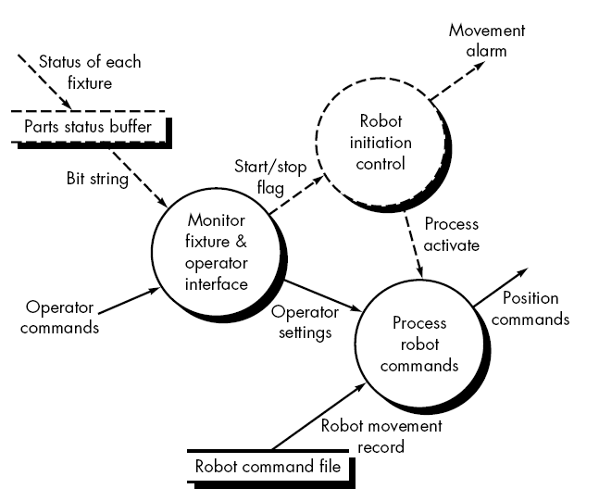
Structured Design for Real-Time Systems (Ward & Mellor, Mid ‘80)
Also called Real-Time Structured (RTSA) Analysis extension for a real-time systems by:
receiving or sending an information flow on a time-continuous basis
passing control information throughout the system and associated control processing
allowing multiple instances of the same transformation to be encountered in multitasking situations
enabling systems to have states and a mechanism causes transition between states
A multiple instance
A control flow
A control process
A control store
Software Engineering-Extensions for Real-Time Systems (2012)
http://www.1000sourcecodes.com/2012/05/software-engineering-extensions-for.html

Slide 27
Yourdon System Methods (Yourdon early ‘90)
Analysis: WHAT the system is required to do
Define / describe:
the totality of a system and its component parts
how parts communicate
relationships between them
The essential model
The environmental model
Context diagram
The behavioural model
The implementation model
The processor environmental model (PEM)
The software environmental model (SEM)
The code organisation model (COD)
Event list
DFD
STD
ERD
DFD
STD
DFD
ERD
Program structure chart
STD
Describe the external view of the system
Describe the system behaviour
system functions
system behaviour with time
the information contained within the system
Design: HOW the system is implemented
Define how the design can be implemented on the available technology
partition the total system allocate to individual process
task, data area, communication for each process
task structure
Cooling (1991) p 345-346
Notes:
Separates enterprise and system perspective and suggests to model some of the aspects at department rather than system level as organisation has a longer life-span and wider view on development.
http://doc.utwente.nl/80530/1/Dehne_Wieringa_-_The_Yourdon_Systems_Method_and_the_Toolkit_for_Conceptual_Modeling.pdf

Slide 28
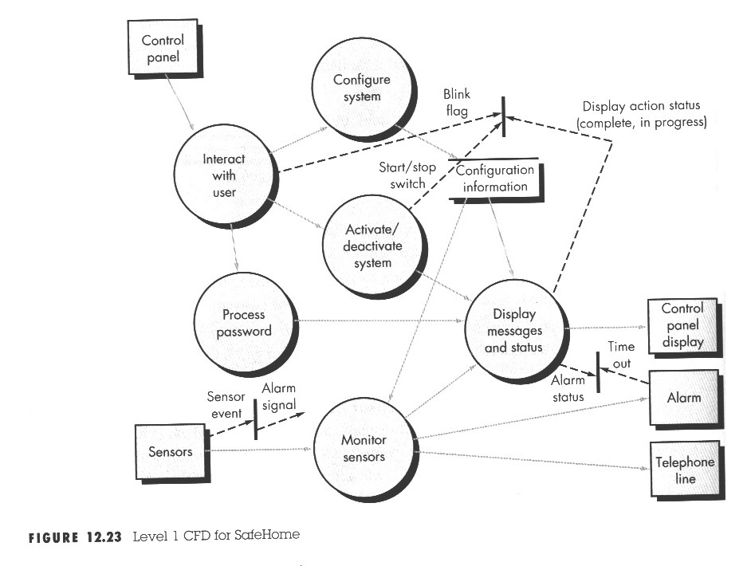
Behavioural modelling - an extension to control-oriented aspects of the system (Hatlei-Pirbhai, late ‘80)
A decision rule
Process Activation Table (PAT)
Input events | Process activation
Sensor events | 0 | 0 | 0 | 0 | 1 | 0
Blink flag | 0 | 0 | 1 | 1 | 0 | 0
Start/stop switch | 0 | 1 | 0 | 0 | 0 | 0
Display action status | 0 | 0 | 0 | 1 | 0 | 0
Complete in progress | 0 | 0 | 1 | 0 | 0 | 0
Output
Alarm signal | 0 | 0 | 0 | 0 | 1 | 0
Process activation
Monitor and control system | 0 | 1 | 0 | 0 | 1 | 1
Activate/ deactivate system | 0 | 1 | 0 | 0 | 0 | 0
Display message and status | 1 | 0 | 1 | 1 | 1 | 1
Interact with user | 1 | 0 | 0 | 1 | 0 | 1
A control flow
Pressman, R.S. (2010) Software engineering: a practitioner's approach McGraw-Hill

Slide 29
Summary: What should be memorised
The Structured approach to systems development is based upon the separation of process, data and time/event (for a newer methods). A separate models are built to represent these aspects of a system. Is good to know this models, how they are constructed and in which stage of modelling and design can be used.
SSADM is a structured information systems development methodology widely used in the U.K.
The methodologies and their extensions have been developed in response to current trends and industry needs.

Slide 30
References/Bibliography
Pressman, R.S. (2010) Software engineering: a practitioner's approach McGraw-Hill
Kendall, K.E. & Kendall, J.E. (2005) Systems Analysis and Design. 6th. ed. Prentice-Hall.
Yeates, D. Wakefield, T. (2004) Systems Analysis and Design. 2nd. Ed. Pearson.
Hoffer, J.A., George, J.F. & Valacich, J. S. (2004) Modern Systems Analysis & Design. 4th. ed. Prentice-Hall.
Robinson, B. & Prior, M. (1995) Systems Analysis Techniques. ITP.
Tudor, D.J. & Tudor, I.J. (1995) Systems Analysis and Design: a comparison of structured methods. NCC Blackwell
Cooling, J. E. (1991) Software Design for Real-time Systems Springer-Sciene+Business Media
Yourdon, Ed. (1988) Modern Structured Analysis Prentice Hall
Page-Jones, M. (1988) The Practical Guide to Structured Systems Design. Prentice-Hall.
Ward, P.T. & Mellor, S.J. (1985) Structured Development for Real-Time Systems, Yourdon Press
DeMarco, T. (1979) Structured Analysis and System Specification. Yourdon Press

