Slide 1
There’s an App for That:
Using Smartphones in Medical Education

Slide 2
Smartphones
According to the Wall Street Journal:
  72% of all doctors in the U.S. own smartphones
  95% of these doctors download apps
  Whalen J. Drug Makers Replace Reps With Digital Tools. wsj.com. 2011. Available at: http://online.wsj.com/article/SB10001424052748703702004576268772294316518.html?mod=rss_Health. Accessed June 5, 2011.

Slide 3
Smartphones
According to Apple:
  63% of all students enrolled in colleges and universities own smartphones
  College students are the fastest growing sector of the market
  Expected growth for 2011 is almost 50%
  Apple - Education - Challenge Based Learning. Available at: http://www.apple.com/education/challenge-based-learning/#cbl-engaging-video. Accessed June 5, 2011.

Slide 4
Tablet Devices
According to Epocrates:
  After its introduction in April of 2010, 20% of doctors planned on purchasing an iPad
  Smartphones in Healthcare | Doody’s Views. Available at: http://www.medinfonowblog.com/wordpress/index.php/healthcare-technology/smartphones-in-healthcare. Accessed June 5, 2011.

Slide 5
Mobile Devices
Why are mobile devices so popular?
  Combine the functionality of a computer with portability
  Lower cost
  Connect to Internet wirelessly
  Apps

Slide 6
What are Apps?
The term ‘app’ stands for a computer application on the mobile device.
Apps can be e-books, interactive reference materials, training modules, medical software devices, data collection tools, interactive patient handouts, etc.

Slide 7
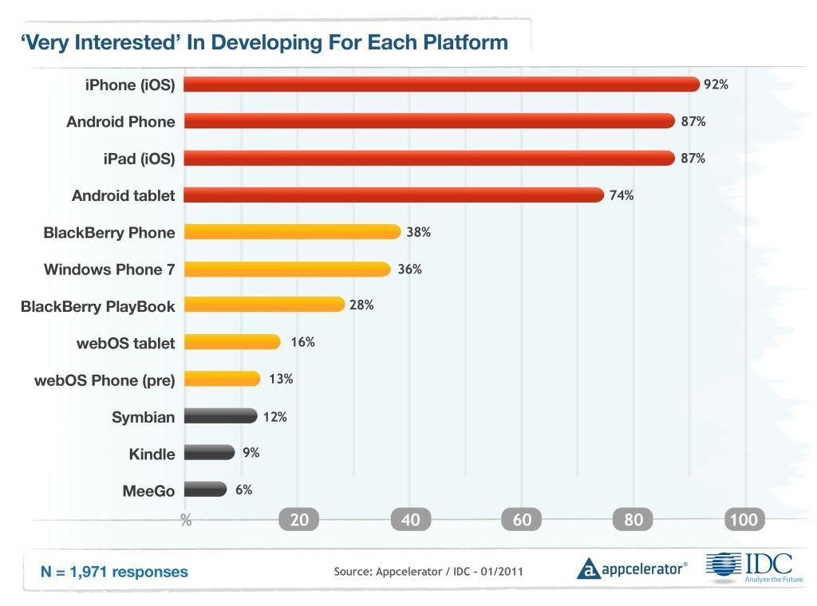
Apps … wait, what’s my device?

Slide 8
Medical Apps vs. Health Apps
Health apps help consumers to maintain a healthy lifestyle or offer health-related services.
Health Apps are targeted at consumers rather than medical professionals.
The most popular categories of downloaded health apps are exercise, stress, and diet.

Slide 9
Finding Apps
Apple’s App Store for iPod, iPhone and iPad
Google’s Android Market for Android mobile devices
Blackberry’s App World for RIM mobile devices
Nokia’s Avi Store for Nokia mobile devices
Windows 7 Phone Marketplace
Third-party app stores (Caveat emptor)

Slide 10
Finding Apps
  Apple Apps Store
  http://www.apple.com/iphone/apps-for-iphone/
  Largest store - Over 350,000 apps
  Apps for both iPhone and iPad
  Some apps can also be used on some models of iPod Touch

Slide 11
Finding Apps
  Android Market
  https://market.android.com/
  Fastest growing market - Over 250,000 apps in less than two years
  Apps for both phones and tablets
  Some apps only work on Android devices made by certain manufacturers

Slide 12
Finding Apps
  BlackBerry App World
  http://appworld.blackberry.com/webstore/?lang=en
  Over 35,000 apps
  Apps for both phones and tablets
  Some apps only work on certain BlackBerry devices

Slide 13
Finding Apps
Skyscape
Modality (Epocrates)
Unbound Medicine
PEPID
Medical Wizards
Lexi-Comp
Best Buy App Discovery Center

Slide 14
Review Sites
Medical Smartphones.com
Created by Dr. Joseph Kim, content on this site is written by doctors, medical students and other authors. Submissions on this site are international, so not all products are available in the United States. All types of mobile devices are covered.
http://www.medicalsmartphones.com/

Slide 15
Review Sites
iPhone Medicine Blog
Created and maintained by Dr. Salvatore Volpe. Not updated as often as other pages on this list, but Dr. Volpe does have a Twitter feed on related topics. iPhone only, but links to related sites.
http://iphonemedicine.blogspot.com/

Slide 16
Review Sites
iMedicalApps
The most widely read of all medical app review sites, receiving over 400,000 page views per month. Content is written by a team of doctors and medical students. iPhone, iPad, Android and Blackberry reviews.
http://www.imedicalapps.com/

Slide 17
Review Sites
MobiHealthNews
A newsletter that chronicles the healthcare sector’s adoption of mobile technology
http://mobihealthnews.com

Slide 18
Library Review Sites
BU Medical Library - use our Mobile Devices subject guide.
Stanford School of Medicine - Featured Apps List

Slide 19
App Reviews in Pubmed
Pubmed
  Use MeSH term “Computer, Handheld”
  keywords such as mobile health, mhealth, smartphone, cell phone, tablet, iphone, ipad, telemedicine, app, application, etc.

Slide 20
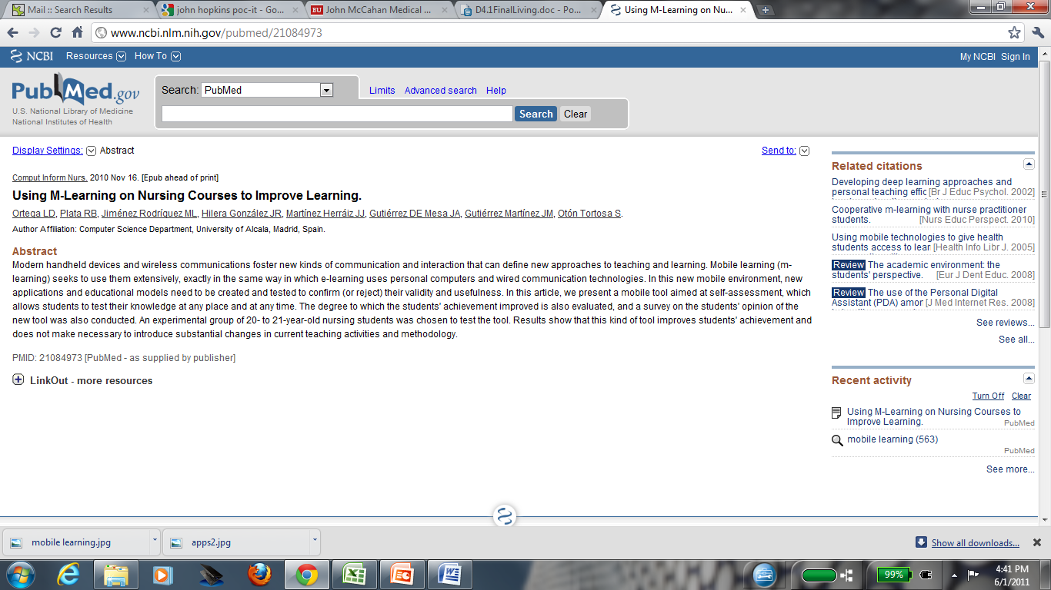
Mobile Learning

Slide 21
Mobile Learning
Any sort of learning that happens when the learner is not at a fixed, predetermined location, or learning that happens when the learner takes advantage of the learning opportunities offered by mobile technologies.
"Guidelines for learning/teaching/tutoring in a mobile environment". MOBIlearn. October 2003. pp. 6. Retrieved June 1, 2011.

Slide 22
Evaluating Apps
The Five Cs for Evaluation

Slide 23
C #1: Creator
Creator:
Who made the app?
Is this individual or organization credible?
Creator information should be easy to find; if not, this may be an indication of questionable quality.

Slide 24
C #1: Creator
Individual Creator(s)
  Professional developer vs. enthusiast developer
  Healthcare professional vs. non-healthcare professional
  For profit, non-profit, affiliation, disclaimer, etc.
  Doctor, medical resident, medical student
  Business entrepreneur

Slide 25
C #1: Creator
Organization(s)
  Government agency, institute, etc.
  Non-profit vs. for-profit
  Well established company vs. start-up company
  Pharmaceutical company
  Health insurance company

Slide 26
C #2: Content
Content:
What is the scope of the app?
What does it contain?
Who is the intended audience?

Slide 27
C #2: Content
Apps that quiz, test or educate via games
  TopDoc – a visual medical quiz app developed by Elsevier and Legacy Interactive.
  Speed Muscles MD - a quiz by a developer specializing in medical education.
  Brush It Up! – a game to teach kids how to brush their teeth.

Slide 28
C #2: Content
Apps that replace or enhance medical books
  Once you download the free Inkling app, you are able to view various interactive textbooks. Ganong’s Review of Medical Physiology is one of these texts. Another exciting medical e-book that will soon be released is Essential Clinical Anatomy.
  Renal Physiology is the textbook on Anatomy and Physiology by Dr. Jonathan Kibble

Slide 29
C #2: Content
If you’re going to recommend an app to a particular audience first try to categorize its content and the level of content
  General reference
  Drug information
  Guidelines
  EBM resources, Medical textbooks, Medical calculators
  Study guides
  Educational resources, Patient Education
  Productivity (note-taking, citation management, etc.)
  Communication tools

Slide 30
C #3: Context
Context:
Is this app easy to use?
To read? To view images?
To navigate?
Does it load quickly? Do I need internet connection?
Does it crash often?
Software updates

Slide 31
C #4: Comments
Comments:
From users:
What do users think of this app?
Do multiple users have the same comments or complaints?
How many people have made comments?

Slide 32
C #4: Comments
Comments:
From Tech Experts:
What do magazines and web sites devoted to technology say about this app or device?

Slide 33
C #4: Comments
Comments:
From Medical Professionals:
What do doctors / dentists / medical students / other Health Professionals have to say about this app?

Slide 34
C #5 Connect
Connect:
There are thousands of free apps, and most paid apps have “lite” or free versions.
Many paid apps cost less than $5, so if you are interested take the plunge.

Slide 35
Challenges Ahead: Medical Apps and FDA
Draft Guidance for Industry and Food and Drug Administration Staff; Availability: Mobile Medical Applications
Document ID: FDA-2011-D-0530-0001
Document Type: Notice
Docket ID: FDA-2011-D-0530

Slide 36
Let’s take a look at some medical apps
QUESTIONS?
COMMENTS?

Slide 37
Need Help?
David Flynn MS (LIS), Head of Library and Information Management Education
(617) 638-4271 dflynn@bu.edu
Konstantin Starikov MLIS, MPhil, MA, Head of Circulation & Interlibrary Loan Services
(617) 638-4224 kstar@bu.edu

