Slide 1


E-COMMERCE SALES, CUSTOMER & PRODUCT ANALYTICS
Power BI Dashboard Project
Presented by: Krupakar Injeti

Slide 2

ABOUT ME
I am Krupakar Injeti B.Tech Computer Science and Engineering graduate with an interest in Data Analytics, SQL, Python and Data Visualization. I completed an E-Commerce Sales, Customer & Product Analytics project using Microsoft Power BI. The project combines customer, product, order and order-item data to explore business performance.
Profiles
LinkedIn: Krupakar Injeti | LinkedIn
GitHub: Krupakar-injeti · GitHub
E-Commerce Analytics
2

Slide 3
AGENDA
1
Project Overview
5
Business Insights
2
22
2
Project Objectives
6
Problem Statement
7
Challenges / Experiences
3
Dataset Description
Dashboard Analysis
Conclusion
4
9
3
E-Commerce Sales

Slide 4
PROJECT OVERVIEW
Business Areas
E-Commerce Sales, Customer & Product Analytics
E-Commerce
Sales Analytics
Customer Analytics
Built an interactive e-commerce analytics report in Microsoft Power BI. Combined four related CSV datasets: customers, products, orders and order items. Created three report pages covering Executive Overview, Customer & Payment Analysis, and Product Analysis. Added KPI cards, charts and slicers for interactive exploration.
Analysis Focus
Revenue trends
Customer contribution
Payment method analysis
Product and category performance
Report Flow
CSV Files → Power Query → Data Model → DAX Measures → Power BI Dashboards
5
E-Commerce Analytics

Slide 5
PROJECT OBJECTIVES
E-Commerce Sales, Customer & Product Analytics
Sales Performance Analysis: To analyse total revenue, order volume, and sales trends over time.
Customer Analysis: To understand customer purchasing behaviour and identify customer distribution.
Product Analysis: To identify top-performing products and analyse category-wise sales performance.
Payment Analysis: To evaluate different payment methods and their contribution to total orders.
Business Insights: To identify sales patterns, customer trends, and growth opportunities through data visualization.
Data-Driven Decisions: To develop an interactive Power BI dashboard that supports better business decision-making.
5
E-Commerce Analytics

Slide 6
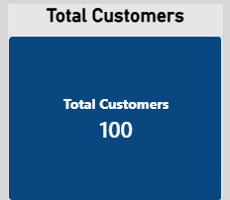
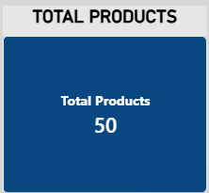
DATASET DESCRIPTION
Four CSV files were imported and used in the Power BI model
ect count(*) as total_number_ofcustomcers from customers;oy
;
1
Q1
2
Q2
CUSTOMERS
100 rows
Customer ID, country, city and customer details
.
PRODUCTS
50 rows
Product ID, product name and category details
6
E-Commerce Sales

Slide 7
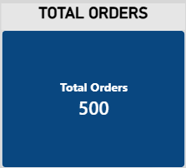
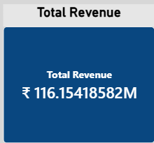
DATA PREPARATION & MODELLING
POWER BI
Power Query and relationships prepared the data for analysis
oy
3
ORDERS
500 rows
Order ID, customer ID, order date and payment method.
4
TOTAL_REVENUE
116M
Payment Method.
E-Commerce Sales, Customer & Product Analytics
7

Slide 8
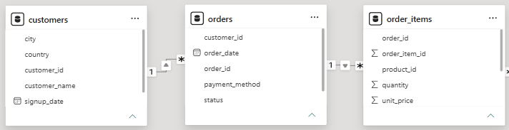
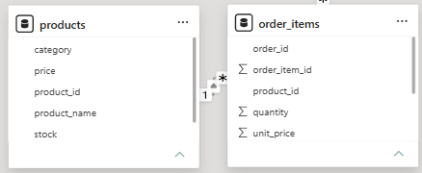
DATA MODEL & RELATIONSHIPS
POWER BI / DATA MODEL
Three active one-to-many relationships connect the source tables
SELECT
delivery_zone_id,
COManual leads with 604 listings.
Automatic (TC) follows with 357 listings.
Automatic (EV) has 202 listings.
AMT has 119 listings.
DCT has 81 listings.
CVT has 27 listings.
Automatic has 12 listings.
ECVT has 11 listings.
IMT has 4 listings.
UNT(order_id) AS total_orders
FROM orders
GROUP BY delivery_zone_id
ORDER BY total_orders DESC
LIMIT 1;
Q6
5
Q5
6
RELATIONSHIP 1
customers → orders
RELATIONSHIP 2
orders → order_items
RELATIONSHIP 3
products → order_items
These relationships allow customer, product and order-item information to work together in the report.
8
E-Commerce Sales

Slide 9
DAX MEASURES
Last-Mile Delivery/SQL
Measures calculate the key metrics used across the report
Q7
8
Q8
7
TOTAL REVENUE
SUMX(order_items, quantity × unit_price)
TOTAL ORDERS
DISTINCTCOUNT(orders[order_id])
TOTAL CUSTOMERS
DISTINCTCOUNT(customers[customer_id])
TOTAL PRODUCTS
DISTINCTCOUNT(products[product_id])
TOTAL QUANTITY SOLD
SUM(order_items[quantity])
AVERAGE ORDER VALUE
Total Revenue ÷ Total Orders
AVERAGE SELLING PRICE
Total Revenue ÷ Total Quantity Sold
9
E-Commerce Sales

Slide 10
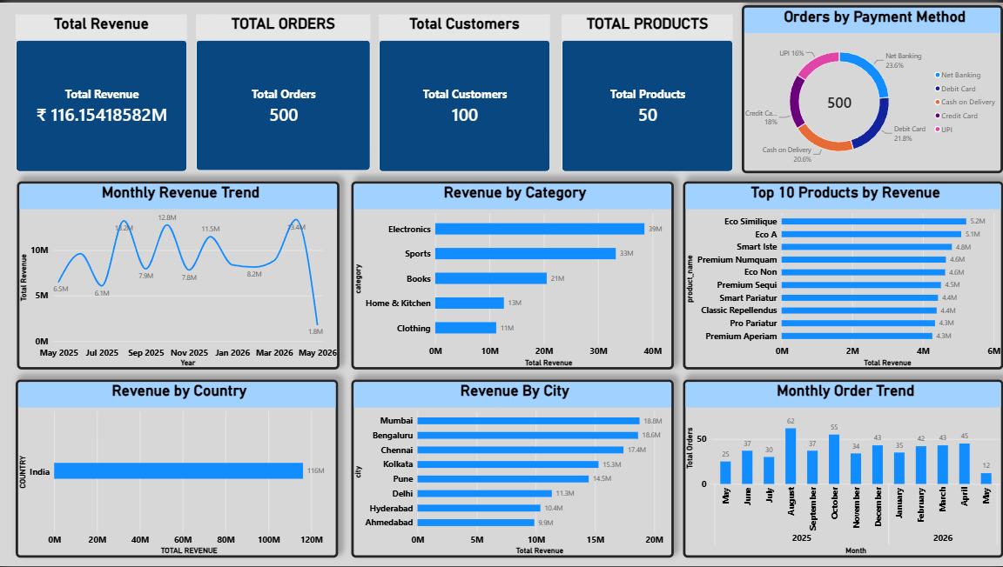
DASHBOARD 1 — EXECUTIVE OVERVIEW
High-level view of sales and order performance.
KPI SUMMARY
What this dashboard shows?
The overview page presents the main sales and order metrics, with monthly revenue trend, revenue by category, top products, city comparison and payment mix.
What this Dash Board shows?
This dashboard focuses on analysing e-commerce business performance using Power BI. The main objective is to transform raw sales data into meaningful insights that help businesses understand revenue performance, customer behaviour, product trends, and payment patterns.
10
E-Commerce Analytics

Slide 11
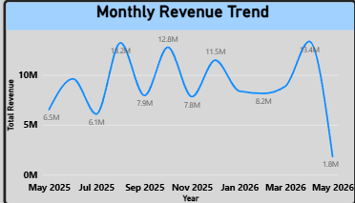
MONTHLY REVENUE TREND
Line chart showing revenue by month.
REVENUE BY CATEGORY
Bar chart comparing category performance.
11
E-Commerce Analytics

Slide 12
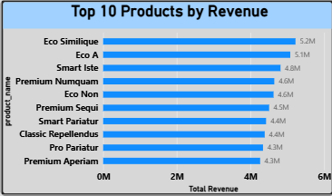
DASHBOARD 1 — PRODUCT & CITY VISUALS
TOP 10 PRODUCTS BY REVENUE
Bar chart ranking the leading products by revenue.
REVENUE BY CITY
12
E-Commerce Analytics

Slide 13
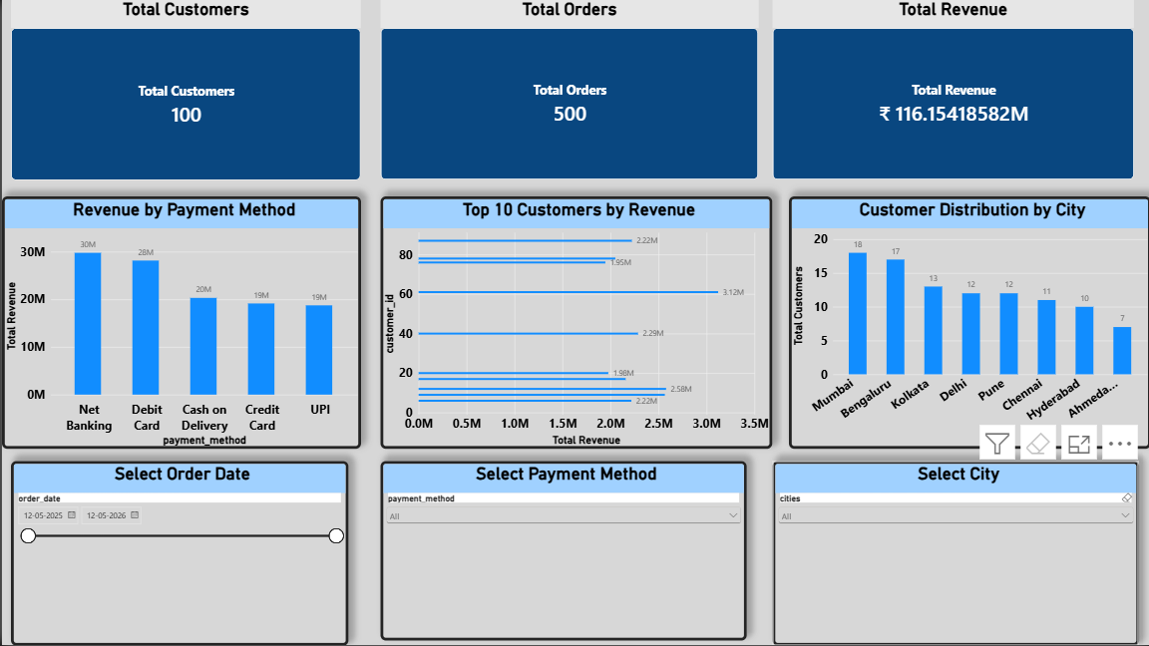
DASHBOARD 2 — CUSTOMER & PAYMENT ANALYSIS
CUSTOMER ANALYSIS
Top 10 Customers by Revenue
Customer Distribution by City
Shows customer counts across the 8 cities.
E-Commerce Analytics

Slide 14
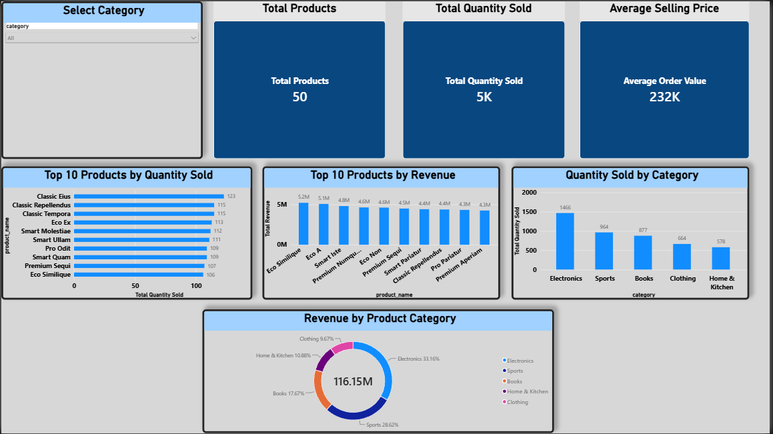
DASHBOARD 3 — PRODUCT ANALYSIS
PRODUCT PERFORMANCE
Total Products: 50
Revenue by Product Category
Top 10 Products by Quantity Sold
Top 10 Products by Revenue
14
E-Commerce Analytics

Slide 15
BUSINESS INSIGHTS
Sales Insights
•The report provides total revenue, order count and monthly revenue trends.
•Category and city comparisons help identify sales contribution.
Customer Insights
•Top 10 customers by revenue highlight high-value customers.
•Customer distribution is compared across 8 cities.
Payment Insights
•Revenue is compared across 5 payment methods.
•City and date slicers support focused payment analysis.
Product Insights
•Top 10 products are ranked by revenue and quantity sold.
•Category visuals compare revenue share and quantity.
Report Interactivity
•Slicers allow users to explore city, payment method, date range and product category.
15
E-Commerce Analytics

Slide 16
PROBLEM STATEMENT
What the project is designed to accomplish
E-commerce data is stored across multiple related tables. Without combining and analysing these records, it is difficult to quickly understand revenue, order activity, customer contribution and product performance. Business users need a clear way to compare sales across time, customers, cities, payment methods and product categories.
This project addresses this gap by preparing the source data, building relationships between the four datasets, creating DAX measures and developing interactive Power BI dashboards for business analysis.
4
E-Commerce Analytics

Slide 17
CHALLENGES / EXPERIENCES
Last-Mile Delivery/SQL
Project work reflected in the report workflow
Challenges
Experiences
•Reviewing four related CSV tables.
•Checking column names and data types.
•Creating and validating table relationships.
•Building DAX measures and testing slicer behaviour.
•Gained practical experience with Power Query.
•Learned data modelling and one-to-many relationships.
•Created reusable DAX measures.
•Designed interactive Power BI report pages.
WHAT I LEARNED
•Developed an end-to-end Power BI workflow from data import to dashboards.
•Learned to interpret sales, customer, payment and product metrics.
16
E-Commerce Analytics

Slide 18
CONCLUSION & KEY FINDINGS
Successfully built an interactive Power BI report using four related e-commerce datasets. Prepared customer, product, order and order-item data; created DAX measures for revenue, orders, customers, products and quantity sold; and developed three report pages covering executive overview, customer and payment analysis, and product analysis. Interactive slicers allow users to explore performance by city, payment method, order date and product category.
17
E-Commerce Analytics

Slide 19

THANK YOU
E-Commerce Sales, Customer & Product Analytics
18
E-Commerce Analytics

