Slide 1
Name : Krupal patel
En. No. : 21162101018
ESFP-II
Project: Banking and atm.

Slide 2
Header Used in this project :
1) #include<iostream>
2) #include<string.h>
3) #include<stdlib.h>
4) #include<fstream>

Slide 3
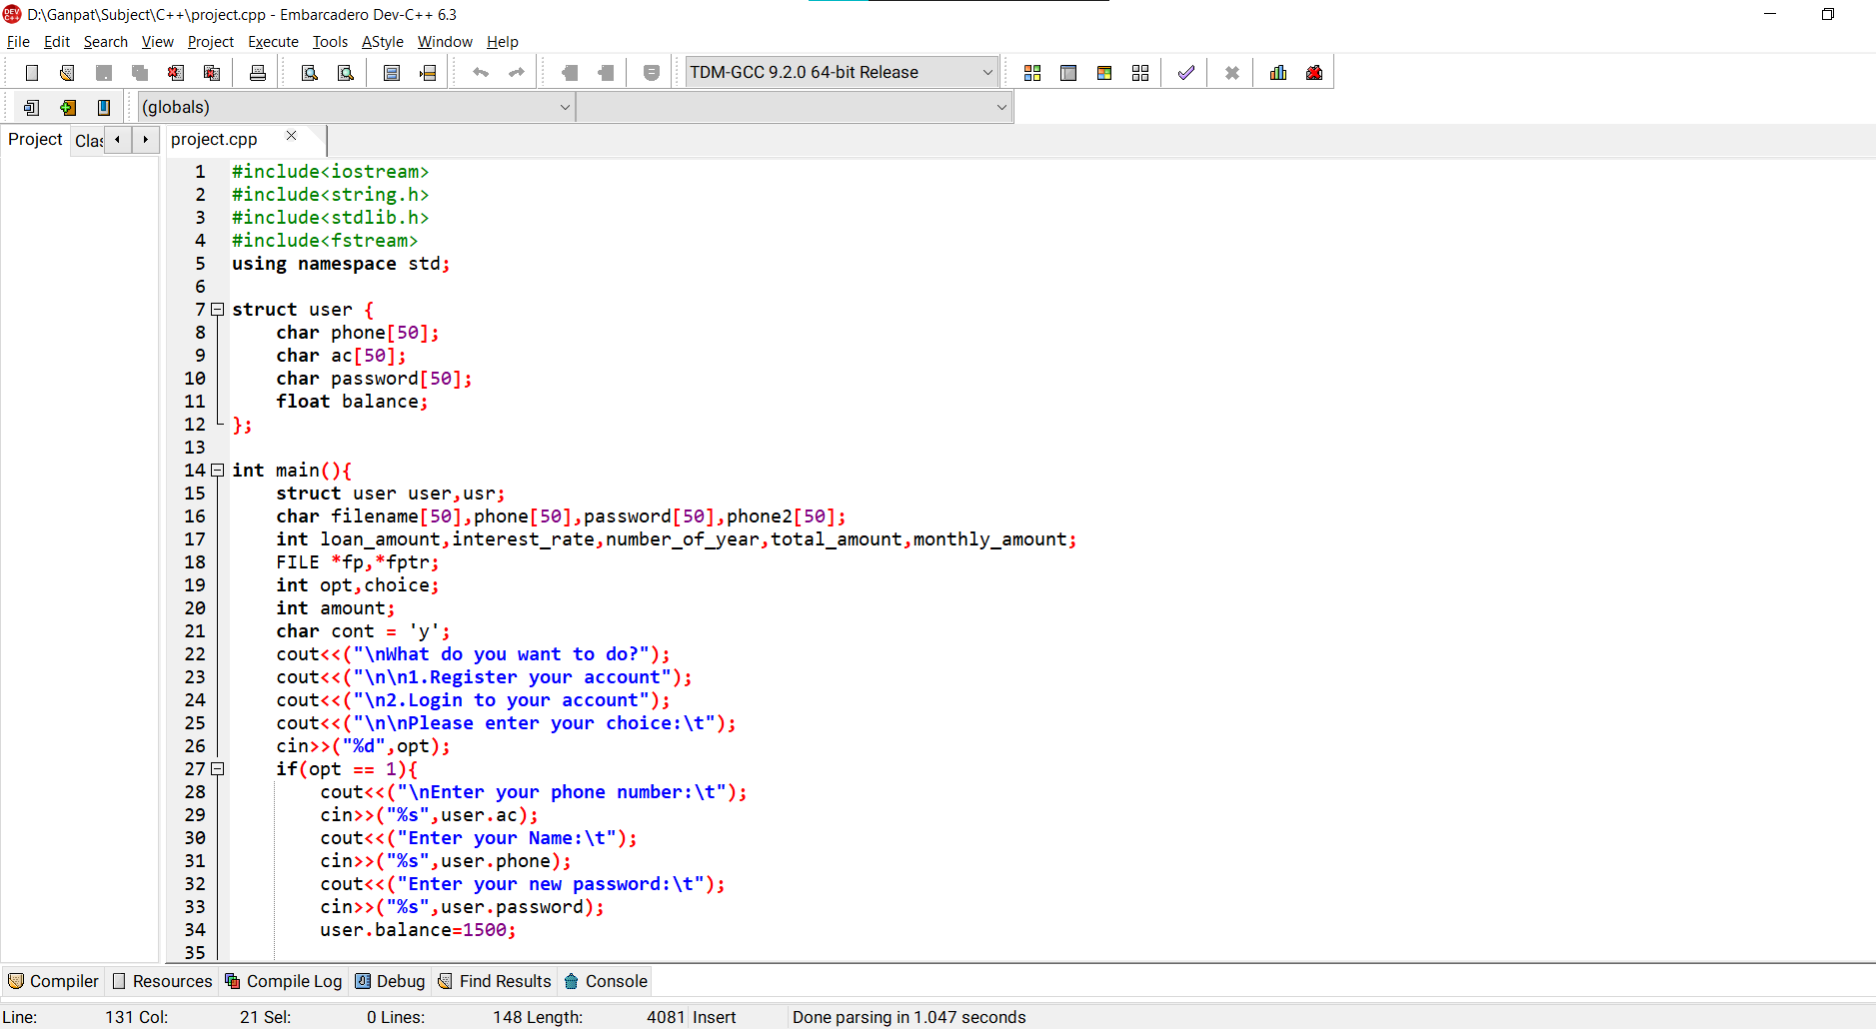
Code :

Slide 4
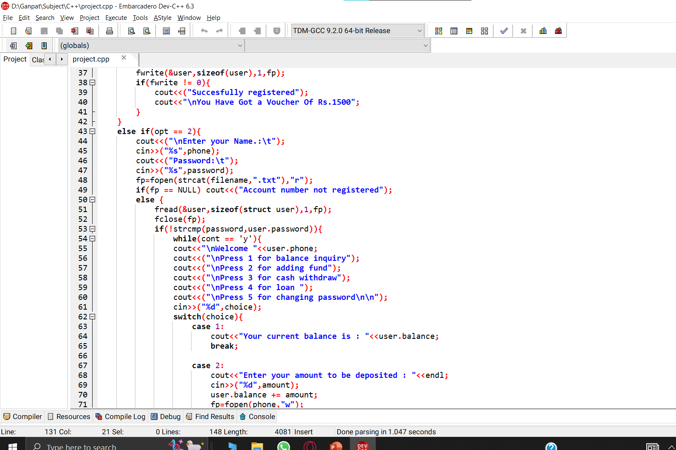
CODE :

Slide 5
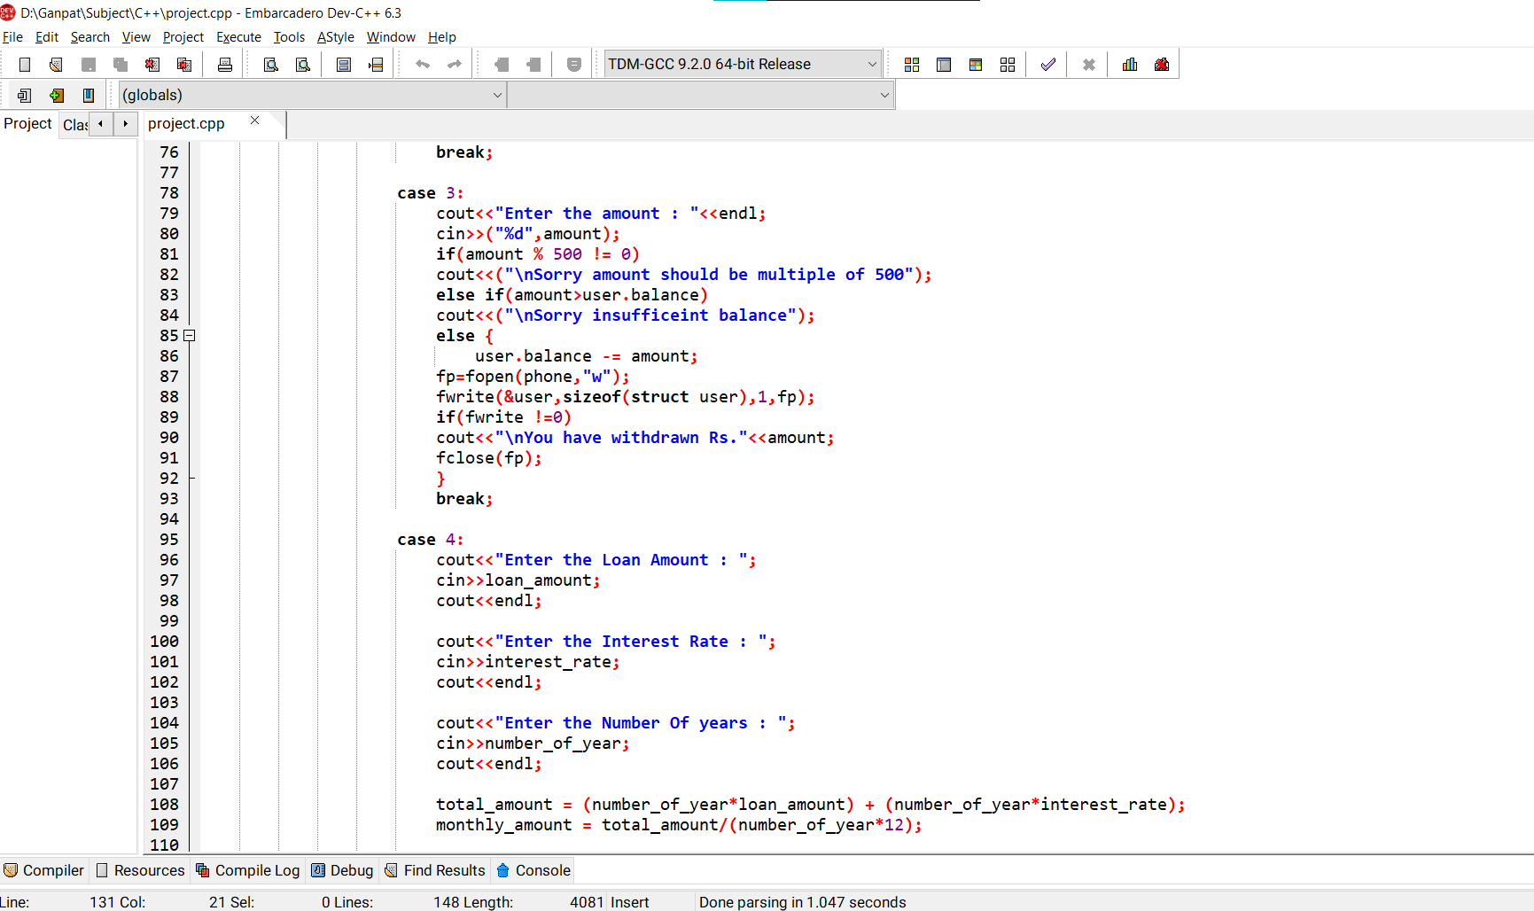
CODE :

Slide 6
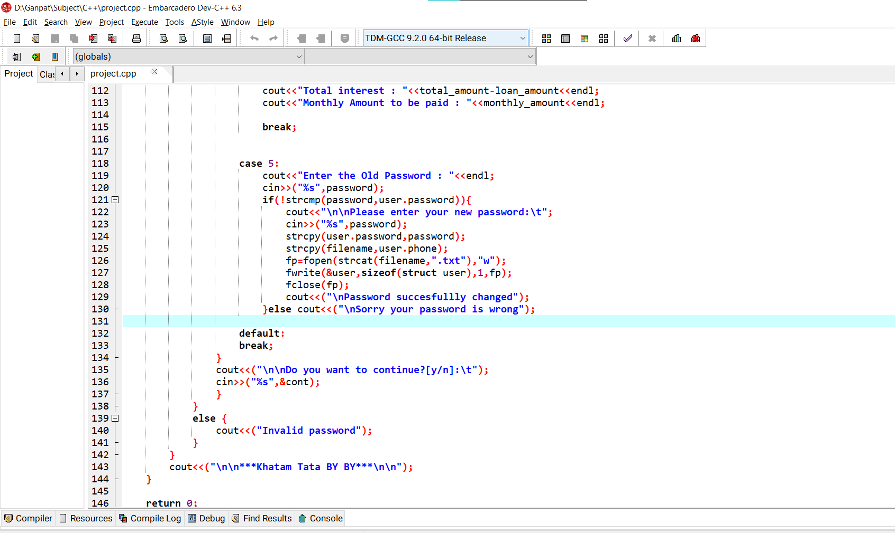
Code :

Slide 7
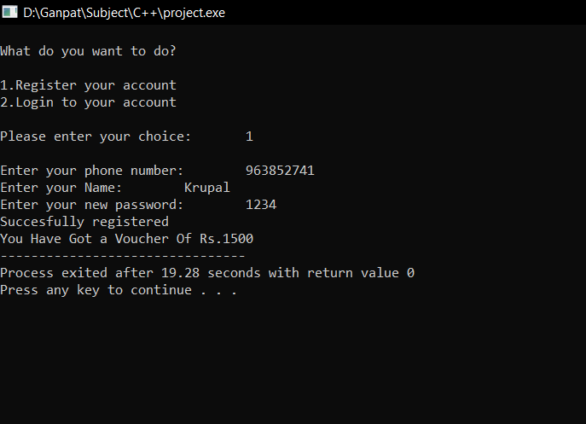
Output :

Slide 8
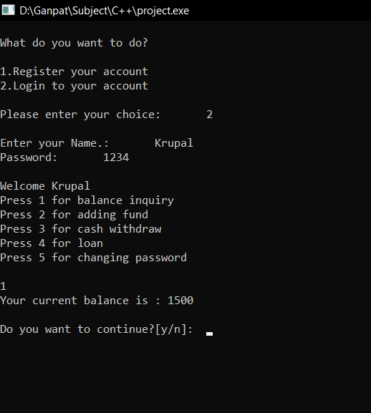

Slide 9
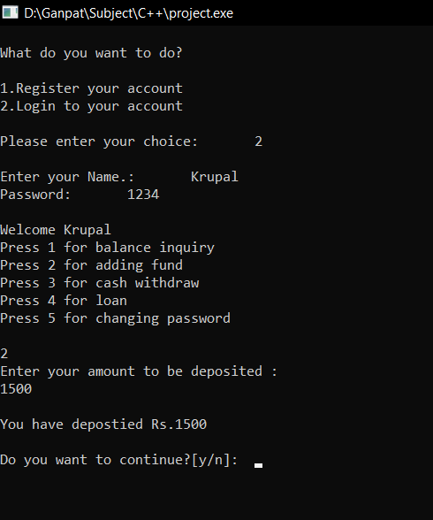

Slide 10
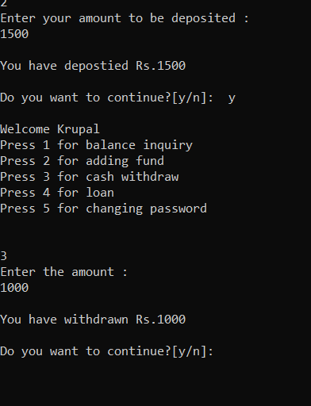

Slide 11
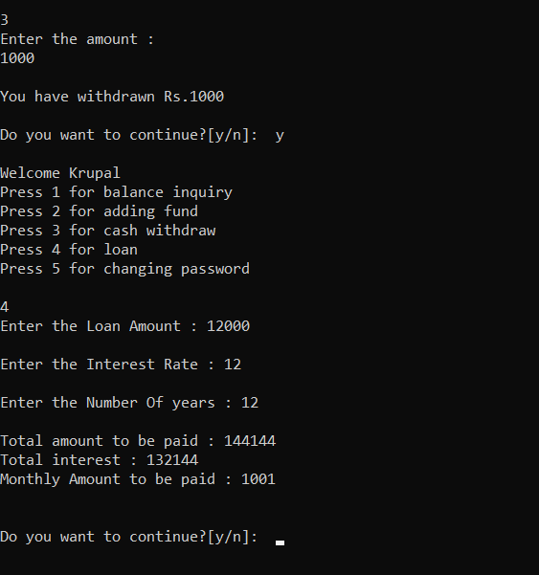

Slide 12
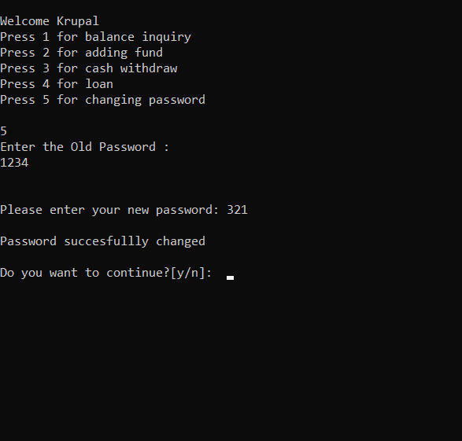

Slide 13
THANK YOU

