Slide 1

Unit-03 Classification
Machine Learning (ML)
2301CS621
Prof. Jayesh D. vagadiya
Computer Engineering Department
jayesh.vagadiya@darshan.ac.in
9537133260

Slide 2

Looping
Topics to be covered
Introduction
Decision trees
Probabilistic (conditional and generative)
k- Nearest Neighbour
Support vector classification
Model Selection & Evaluation techniques
Ensemble Learning: Bagging, Random Forest, Boosting

Slide 3
Classification
One method of data analysis uses a model derived from previously collected data to predict a class label for fresh data.
Such model is known as classifiers to predict categorical (discrete, unordered) class labels.
Example:
we can build a classification model to categorize bank loan applications as either safe or risky.
The goal of classification is to learn a model that can automatically determine the appropriate class for new, unseen data based on patterns it has learned from a labeled training dataset.

Slide 4
Steps in Classification
Classification is two step process.
First Step:
We build a classification model based on previous data.
Classification algorithm builds the classifier by analyzing or “learning from” a training set made up of database tuples and their associated class labels.
First step also know as learning step (or training phase)
Second Step:
We use the model to classify new data.
Second step also know as classification step.

Slide 5
Example
Name | Age | income | loan_decision
Sandy Jones | youth | low | risky
Bill Lee | youth | low | risky
Caroline Fox | middle_aged | high | safe
Rick Field | middle_aged | low | risky
Susan Lake | senior | low | safe
Claire Phips | senior | medium | safe
Joe Smith | middle_aged | high | safe
Juan Bello | senior | low | safe
Sylvia Crest | middle_aged | low | risky
Anne Yee | middle_aged | high | safe
Class Label
Tanning Data Set
Testing Data Set
Class Label is provided in so this learning is known as supervised machine learning

Slide 6
Example
Step - 1
Classification
Algorithms
Training
Data
Classifier
(Model)
Name | Age | income | loan_decision
Sandy Jones | youth | low | risky
Bill Lee | youth | low | risky
Caroline Fox | middle_aged | high | safe
Rick Field | middle_aged | low | risky
Susan Lake | senior | low | safe
Claire Phips | senior | medium | safe
Joe Smith | middle_aged | high | safe
IF age = youth THEN loan_decision = risky;
IF income = high THEN loan_decision = safe;
IF age = middle_aged AND income = low THEN
loan_decision = risky;

Slide 7
Example
Step - 2
Classifier
(Model)
Unseen Data
Testing
Data
(XYZ, youth, low)
loan_decision ?
Name | Age | income | loan_decision
Juan Bello | senior | low | safe
Sylvia Crest | middle_aged | low | risky
Anne Yee | middle_aged | high | safe
Risky
7

Slide 8
Decision Tree Induction
Decision tree induction is the learning of decision trees from class-labeled training tuples.
A decision tree is a flowchart-like tree structure.
The Inner node represents an attribute.
An Edge represents a test on attribute.
Leaf represent one of the classes.
A decision tree for the concept buys computer, indicating whether an AllElectronics customer is likely to purchase a computer.
age?
youth
senior
middle_aged
student?
Yes
credit_rating?
no
yes
fair
excellent
No
yes
No
Yes

Slide 9
History of Decision Tree
During the late 1970s and early 1980s, J. Ross Quinlan, a researcher in machine learning, developed a decision tree algorithm known as ID3 (Iterative Dichotomiser).
This work expanded on earlier work on concept learning systems, described by E. B. Hunt, J. Marin, and P. T. Stone. Quinlan later presented C4.5 (a successor of ID3).
In 1984, a group of statisticians (L. Breiman, J. Friedman, R. Olshen, and C. Stone) published the book Classification and Regression Trees (CART), which described the generation of binary decision trees.
ID3, C4.5, and CART adopt a greedy (i.e., non-backtracking) approach in which decision trees are constructed in a top-down recursive divide-and-conquer manner.

Slide 10
Decision Tree Induction Algorithm
Basic algorithm (a greedy algorithm):
Tree is constructed in a top-down recursive divide-and-conquer manner
At start, all the training examples are at the root
Attributes are categorical (if continuous-valued, they are discretized in advance)
Examples are partitioned recursively based on selected attributes
Test attributes are selected on the basis of a heuristic or statistical measure (e.g., information gain)
Conditions for stopping partitioning:
All samples for a given node belong to the same class
There are no remaining attributes for further partitioning – majority voting is employed for classifying the leaf
There are no samples left

Slide 11
Decision Tree Induction Algorithm
INPUT:
Data partition, D, which is a set of training tuples and their associated class labels;
Attribute list, the set of candidate attributes;
Attribute selection method, a procedure to determine the splitting criterion that “best” partitions the data tuples into individual classes. This criterion consists of a splitting attribute and, possibly, either a split-point or splitting subset.
Output:
A decision tree.

Slide 12
Decision Tree Induction Algorithm
create a node N ; if tuples in D are all of the same class, C, then
return N as a leaf node labeled with the class C; terminate;
if attribute list is empty then
return N as a leaf node labeled with the majority class in D; terminate; // majority voting
Apply Attribute_selection_method(D, attribute list) to find A with highest Attribute selection measure and Label node N with A
if A is discrete-valued and multiway splits allowed then // not restricted to binary trees
attribute list ← attribute list − A;
For each value v of A:
// partition the tuples and grow subtrees for each partition
let D_{j} be the set of data tuples in D with V=D_{j};
if D_{j} is Empty then
attach a leaf labeled with the majority class in D to node N; terminate; //
else
attach the node returned by Generate_decision_tree(D_{j}, attribute list) to node N;
End for
Return N;

Slide 13
Attribute Selection Measures
Attribute selection measures are known as splitting rules because they determine how the tuples at a given node are to be split.
An attribute selection measure is a heuristic for selecting the splitting criterion that “best” separates a given data partition, D, of class-labeled training tuples into individual classes.
The tree node created for partition D is labeled with the splitting criterion, branches are grown for each outcome of the criterion, and the tuples are partitioned accordingly.
Three popular attribute selection measures
Information gain
Gain ratio
Gini index

Slide 14
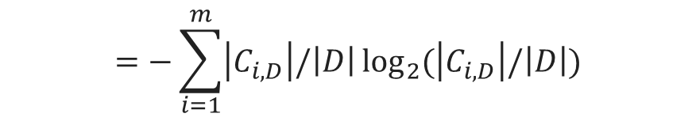
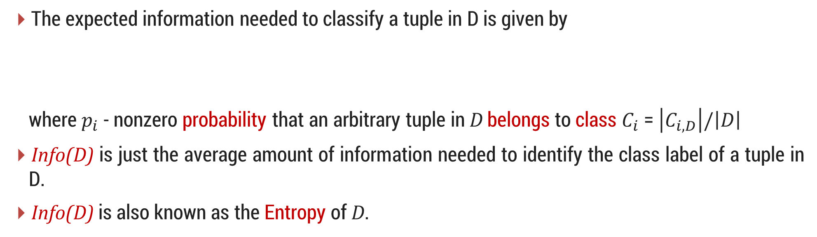
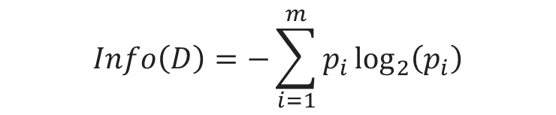
1. Information Gain
ID3 uses information gain as its attribute selection measure.
Let node N represent or hold the tuples of partition D. The attribute with the highest information gain is chosen as the splitting attribute for node N.
This attribute minimizes the information needed to classify the tuples in the resulting partitions and reflects the least randomness or “impurity” in these partitions.
The expected information needed to classify a tuple in D is given by
where $p_{i}$ - nonzero probability that an arbitrary tuple in D belongs to class $C_{i}$ = $\left|C_{i,D}\right|/\left|D\right|$
Info(D) is just the average amount of information needed to identify the class label of a tuple in D.
Info(D) is also known as the Entropy of D.
$$Info\left(D\right)=−\sum_{i=1}^{m}{p_{i}\log_{2}\left(p_{i}\right)}$$
$$=−\sum_{i=1}^{m}{\left|C_{i,D}\right|/\left|D\right|\log_{2}{(\left|C_{i,D}\right|/\left|D\right|)}}$$

Slide 15
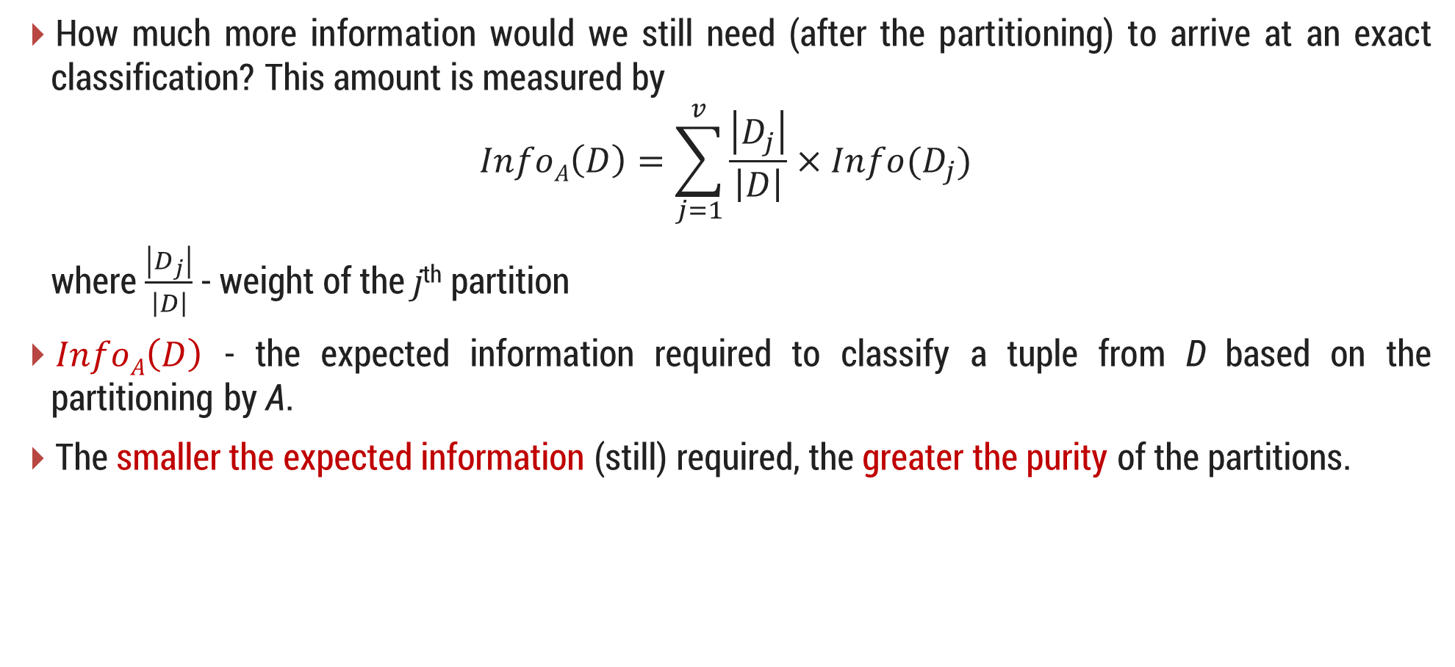
1. Information Gain Cont..
How much more information would we still need (after the partitioning) to arrive at an exact classification? This amount is measured by
$$InfoA\left(D\right)=\sum_{j=1}^{v}{\frac{\left|D_{j}\right|}{\left|D\right|}×Info(D_{j})}$$
where $\frac{\left|D_{j}\right|}{\left|D\right|}$ - weight of the j^{th} partition
$InfoA\left(D\right)$ - the expected information required to classify a tuple from D based on the partitioning by A.
The smaller the expected information (still) required, the greater the purity of the partitions.

Slide 16

1. Information Gain Cont..
Information gain is defined as the difference between the original information requirement (i.e., based on just the proportion of classes) and the new requirement (i.e., obtained after partitioning on A).
$$Gain\left(A\right)=Info\left(D\right)−InfoA(D)$$
The attribute A with the highest information gain is chosen as the splitting attribute at node N.

Slide 17
Information Gain - Example
RID | age | income | student | credit_rating | Class: buys_computer
1 | youth | high | no | fair | no
2 | youth | high | no | excellent | no
3 | middle_aged | high | no | fair | yes
4 | senior | medium | no | fair | yes
5 | senior | low | yes | fair | yes
6 | senior | low | yes | excellent | no
7 | middle_aged | low | yes | excellent | yes
8 | youth | medium | no | fair | no
9 | youth | low | yes | fair | yes
10 | senior | medium | yes | fair | yes
11 | youth | medium | yes | excellent | yes
12 | middle_aged | medium | no | excellent | yes
13 | middle_aged | high | yes | fair | yes
14 | senior | medium | no | excellent | no

Slide 18
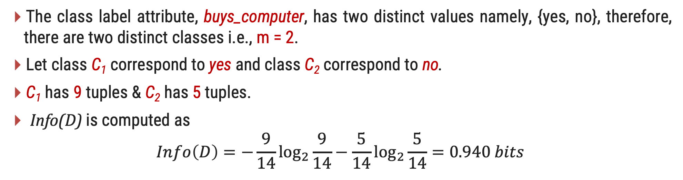
Information Gain - Example
The class label attribute, buys_computer, has two distinct values namely, {yes, no}, therefore, there are two distinct classes i.e., m = 2.
Let class C₁ correspond to yes and class C₂ correspond to no.
C₁ has 9 tuples & C₂ has 5 tuples.
Info(D) is computed as
$$Info\left(D\right)=−\frac{9}{14}\log_{2}{\frac{9}{14}}−\frac{5}{14}\log_{2}{\frac{5}{14}}=0.940 bits$$
Distinct Values | Count
Yes | 9
No | 5
Total | 14

Slide 19
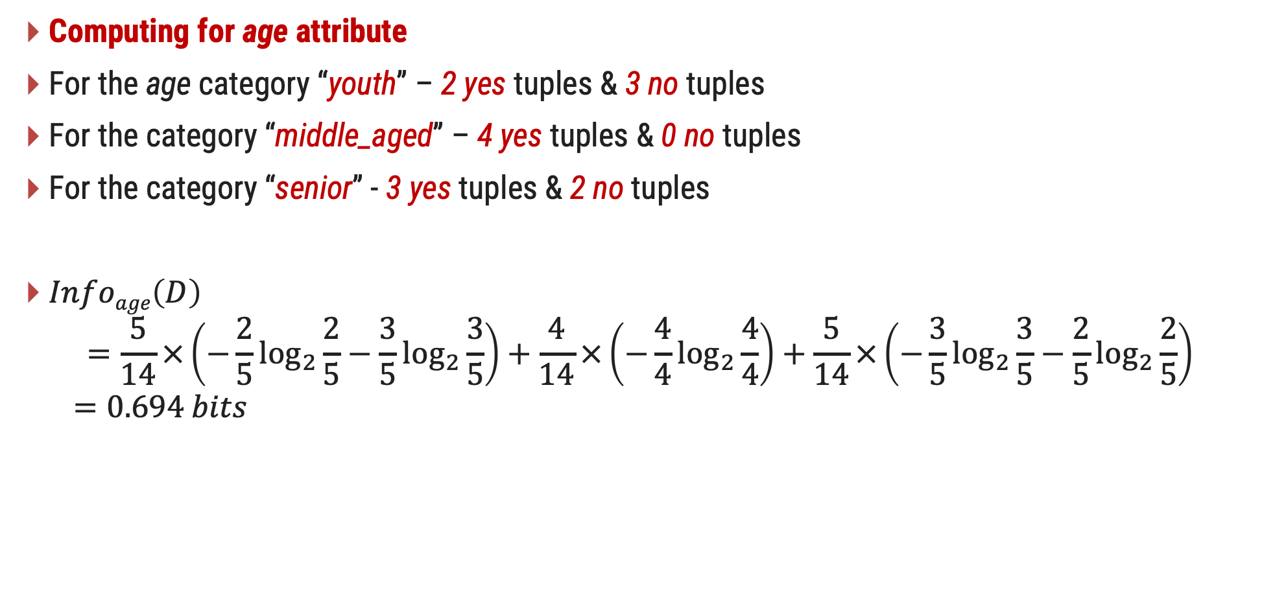
Information Gain - Example
Computing for age attribute
For the age category “youth” – 2 yes tuples & 3 no tuples
For the category “middle_aged” – 4 yes tuples & 0 no tuples
For the category “senior” - 3 yes tuples & 2 no tuples
$Infoage\left(D\right)$
$$=\frac{5}{14}×\left(−\frac{2}{5}\log_{2}{\frac{2}{5}}−\frac{3}{5}\log_{2}{\frac{3}{5}}\right)+\frac{4}{14}×\left(−\frac{4}{4}\log_{2}{\frac{4}{4}}\right)+\frac{5}{14}×\left(−\frac{3}{5}\log_{2}{\frac{3}{5}}−\frac{2}{5}\log_{2}{\frac{2}{5}}\right)$$
$$=0.694 bits$$
Distinct Values | Yes | No | Total
youth | 2 | 3 | 5
middle_aged | 4 | 0 | 4
senior | 3 | 2 | 5
Info(youth)
Info(middle_age)
Info(senior)

Slide 20
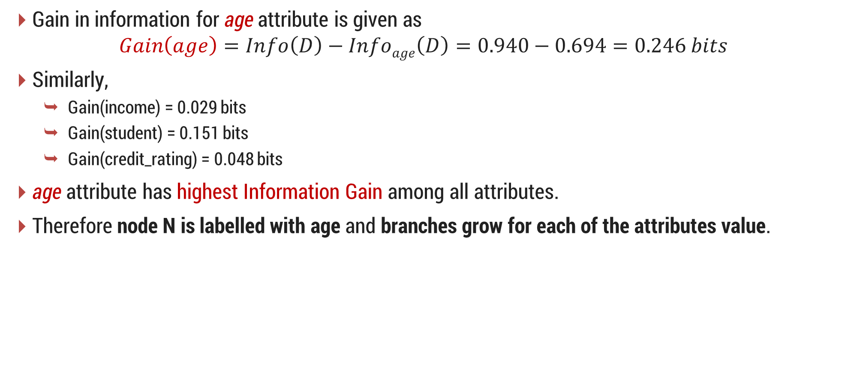
Information Gain - Example
Gain in information for age attribute is given as
$$Gain\left(age\right)=Info\left(D\right)−Infoage\left(D\right)=0.940−0.694=0.246 bits$$
Similarly,
Gain(income) = 0.029 bits
Gain(student) = 0.151 bits
Gain(credit_rating) = 0.048 bits
age attribute has highest Information Gain among all attributes.
Therefore node N is labelled with age and branches grow for each of the attributes value.

Slide 21
Information Gain - Example
Splitting Attribute age at Root node
age?
youth
senior
middle_aged
income | student | credit_rating | class
high | no | fair | no
high | no | excellent | no
medium | no | fair | no
low | yes | fair | yes
medium | yes | excellent | yes
income | student | credit_rating | class
medium | no | fair | yes
low | yes | fair | yes
low | yes | excellent | no
medium | yes | fair | yes
medium | no | excellent | no
income | student | credit_rating | class
high | no | fair | yes
low | yes | excellent | yes
medium | no | excellent | yes
high | yes | fair | yes

Slide 22

2. Gain Ratio
The information gain measure is biased toward tests with many outcomes.
For example, consider an attribute that acts as a unique identifier such as product_ID.
A split on product_ID would result in a large number of partitions each one containing just one tuple.
$Infoproduct_ID\left(D\right)=0$ for product_ID attribute which results in maximum information gain. Clearly, such a partitioning is useless for classification.

Slide 23
2. Gain Ratio Cont..
C4.5 uses an extension to information gain known as gain ratio.
It applies a kind of normalization to information gain using a “split information” value defined with $Info\left(D\right)$ as
$$SplitInfoA\left(D\right)=−\sum_{j=1}^{v}{\frac{\left|D_{j}\right|}{\left|D\right|}×}\log_{2}\left(\frac{\left|D_{j}\right|}{\left|D\right|}\right)$$
This value represents the potential information generated by splitting the training data set, D, into v partitions, corresponding to the v outcomes of a test on attribute A.
Gain Ratio is defined as
$$GainRatio\left(A\right)=\frac{Gain(A)}{SplitInfoA\left(D\right)}$$
The attribute with the maximum gain ratio is selected as the splitting attribute.

Slide 24
2. Gain Ratio - Example
RID | age | income | student | credit_rating | Class: buys_computer
1 | youth | high | no | fair | no
2 | youth | high | no | excellent | no
3 | middle_aged | high | no | fair | yes
4 | senior | medium | no | fair | yes
5 | senior | low | yes | fair | yes
6 | senior | low | yes | excellent | no
7 | middle_aged | low | yes | excellent | yes
8 | youth | medium | no | fair | no
9 | youth | low | yes | fair | yes
10 | senior | medium | yes | fair | yes
11 | youth | medium | yes | excellent | yes
12 | middle_aged | medium | no | excellent | yes
13 | middle_aged | high | yes | fair | yes
14 | senior | medium | no | excellent | no

Slide 25
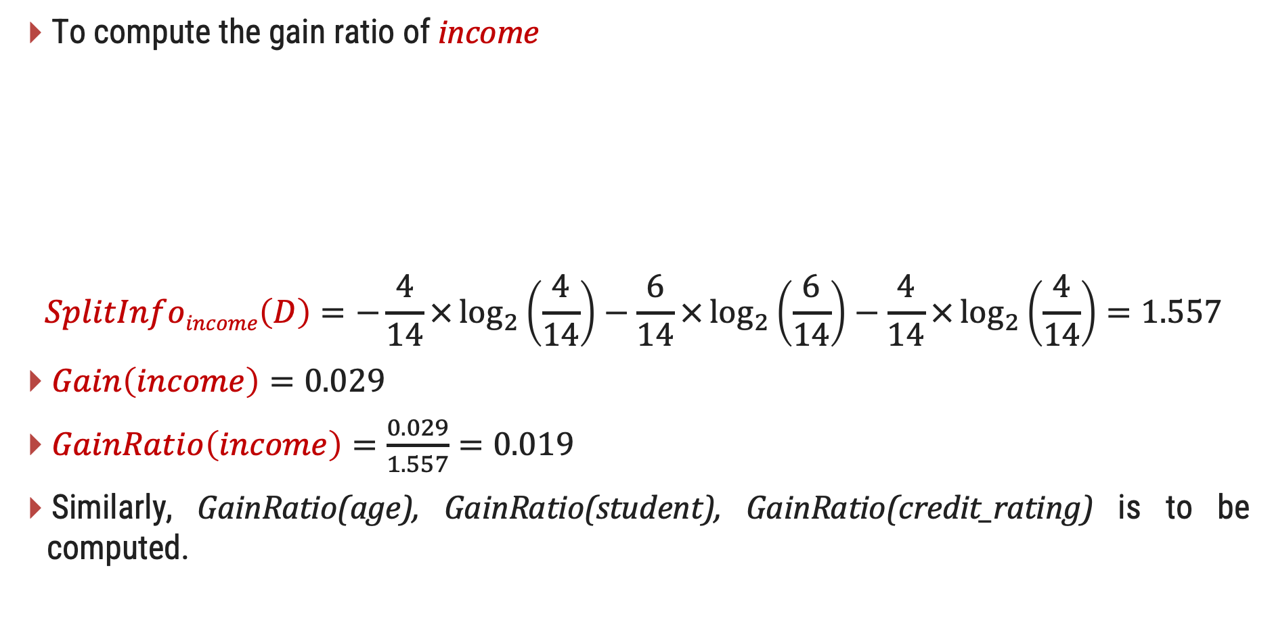
Gain Ratio for the attribute income - Example
To compute the gain ratio of income
$$SplitInfoincome\left(D\right)=−\frac{4}{14}×\log_{2}\left(\frac{4}{14}\right)−\frac{6}{14}×\log_{2}\left(\frac{6}{14}\right)−\frac{4}{14}×\log_{2}\left(\frac{4}{14}\right)=1.557$$
$Gain\left(income\right)=0.029$
$GainRatio\left(income\right)=\frac{0.029}{1.557}=0.019$
Similarly, GainRatio(age), GainRatio(student), GainRatio(credit_rating) is to be computed.
Distinct Values | Total
high | 4
medium | 6
low | 4

Slide 26
3. Gini Index
CART uses Gini Index.
The Gini index measures the impurity of D, a data partition or set of training tuples, as
$$Gini\left(D\right)=1−\sum_{i=1}^{m}{p_{i}^{2}}$$
where $p_{i}$ is the probability that a tuple in D belongs to class $C_{i}$ and is estimated by $\left|C_{i,D}\right|/\left|D\right|$.
The Gini index considers a binary split for each attribute.

Slide 27
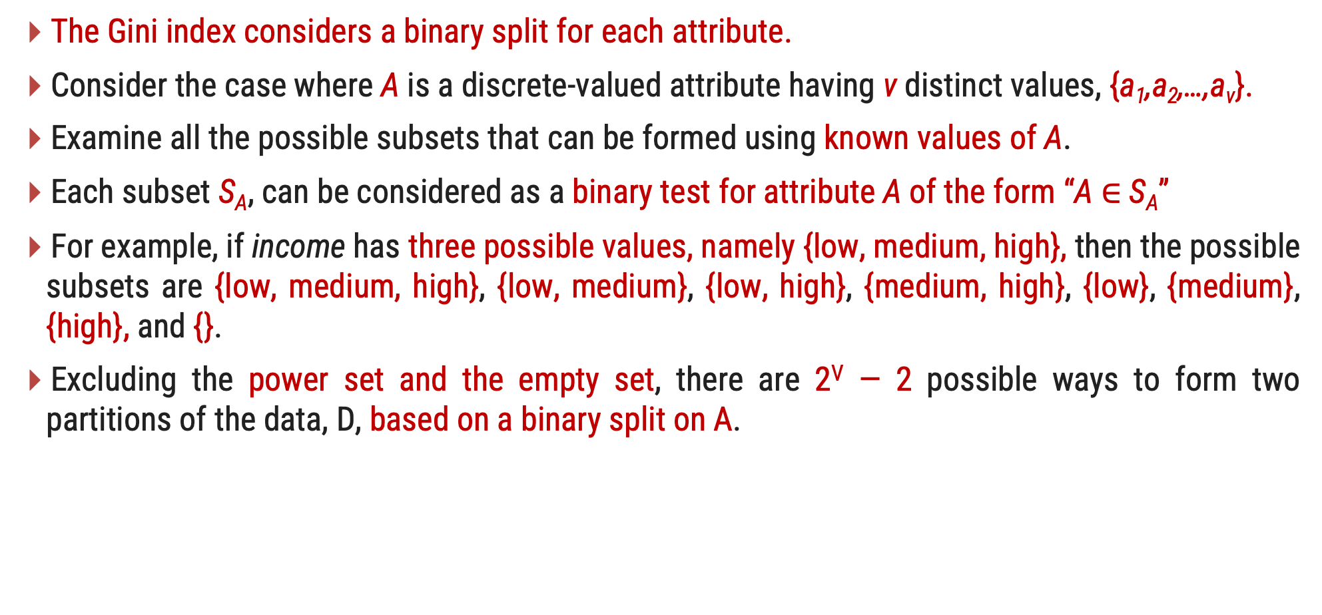
3. Gini Index Cont..
The Gini index considers a binary split for each attribute.
Consider the case where A is a discrete-valued attribute having v distinct values, {a₁,a₂,…,a_{v}}.
Examine all the possible subsets that can be formed using known values of A.
Each subset S_{A}, can be considered as a binary test for attribute A of the form “A $∈$ S_{A}”
For example, if income has three possible values, namely {low, medium, high}, then the possible subsets are {low, medium, high}, {low, medium}, {low, high}, {medium, high}, {low}, {medium}, {high}, and {}.
Excluding the power set and the empty set, there are 2^{V} — 2 possible ways to form two partitions of the data, D, based on a binary split on A.

Slide 28
3. Gini Index Cont..
Compute a weighted sum of the impurity of each resulting partition. For example, if a binary split on A partitions D into D₁ and D₂, the Gini index of D given that partitioning is
$$GiniA\left(D\right)=\frac{\left|D_{1}\right|}{\left|D\right|}Gini\left(D_{1}\right)+\frac{\left|D_{2}\right|}{\left|D\right|}Gini(D_{2})$$
For a discrete-valued attribute, the subset that gives the minimum Gini index for that attribute is selected as its splitting subset.

Slide 29
3. Gini Index - Example
RID | age | income | student | credit_rating | Class: buys_computer
1 | youth | high | no | fair | no
2 | youth | high | no | excellent | no
3 | middle_aged | high | no | fair | yes
4 | senior | medium | no | fair | yes
5 | senior | low | yes | fair | yes
6 | senior | low | yes | excellent | no
7 | middle_aged | low | yes | excellent | yes
8 | youth | medium | no | fair | no
9 | youth | low | yes | fair | yes
10 | senior | medium | yes | fair | yes
11 | youth | medium | yes | excellent | yes
12 | middle_aged | medium | no | excellent | yes
13 | middle_aged | high | yes | fair | yes
14 | senior | medium | no | excellent | no

Slide 30
3. Gini Index – Example Cont..
Considering the data of AllElectronics,
buys_computer = yes - 9 tuples
buys_computer = no - 5 tuples
Gini index to compute the impurity of D is
$$Gini\left(D\right)=1−{\left(\frac{9}{14}\right)}^{2}−{\left(\frac{5}{14}\right)}^{2}=0.459$$

Slide 31
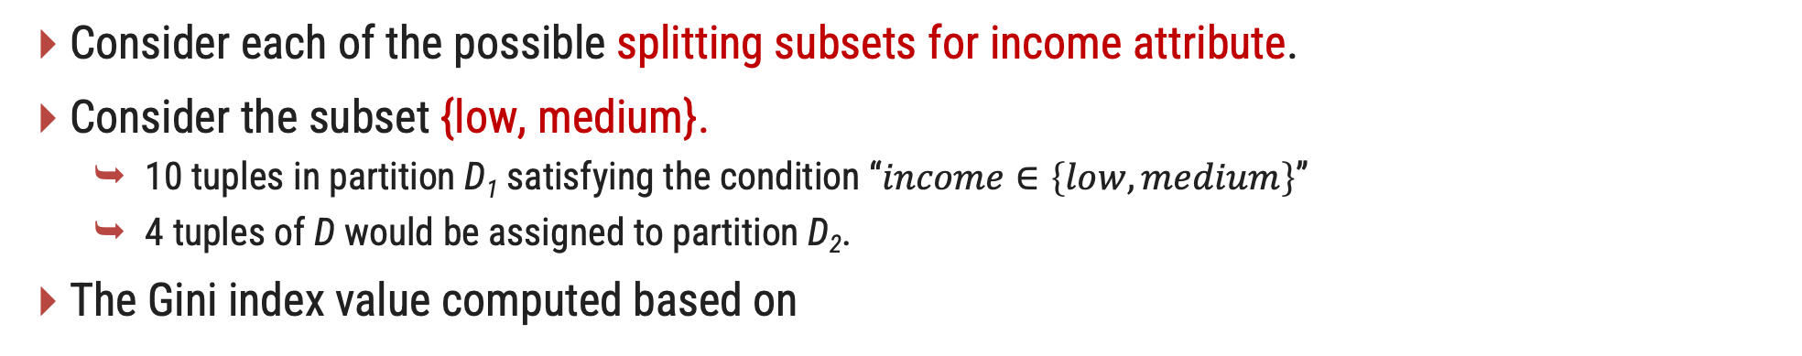
3. Gini Index – Example Cont..
Consider each of the possible splitting subsets for income attribute.
Consider the subset {low, medium}.
10 tuples in partition D₁ satisfying the condition “$income∈\left\{low,medium\right\}$”
4 tuples of D would be assigned to partition D₂.
The Gini index value computed based on
$$=\frac{10}{14}Gini\left(D1\right)+\frac{4}{14}Gini(D2)$$
$${Gini}_{income∈\left\{low,medium\right\}}\left(D\right)$$
$$=\frac{10}{14}\left(1−{\left(\frac{7}{10}\right)}^{2}−{\left(\frac{3}{10}\right)}^{2}\right)+\frac{4}{14}\left(1−{\left(\frac{2}{4}\right)}^{2}−{\left(\frac{2}{4}\right)}^{2}\right)$$
Distinct Values | Yes | No | Total
Low, Medium | 7 | 3 | 10
High | 2 | 2 | 4
$$=0.443$$
$$={Gini}_{income∈\left\{high\right\}}\left(D\right)$$

Slide 32


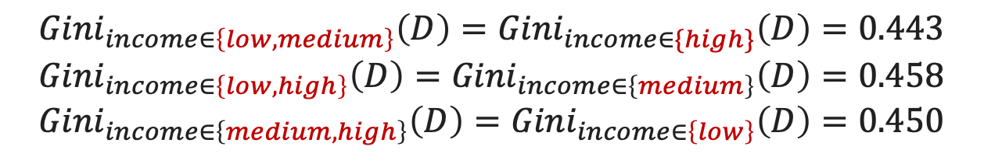

3. Gini Index – Example Cont..
$${Gini}_{income∈\left\{low,medium\right\}}\left(D\right)={Gini}_{income∈\{high\}}\left(D\right)=0.443$$
$${Gini}_{income∈\left\{low,high\right\}}\left(D\right)={Gini}_{income∈\left\{medium\right\}}\left(D\right)=0.458$$
$${Gini}_{income∈\left\{medium,high\right\}}\left(D\right)={Gini}_{income∈\left\{low\right\}}\left(D\right)=0.450$$
Income
Age
$${Gini}_{age∈\left\{youth,senior\right\}}\left(D\right)={Gini}_{age∈\left\{middle_aged\right\}}\left(D\right)=0.357$$
Student
$${Gini}_{student∈\left\{yes,no\right\}}\left(D\right)=0.367$$
Credit
Rating
$${Gini}_{credit_rating∈\left\{fair,excellent\right\}}\left(D\right)=0.429$$

Slide 33
K-NN (K- Nearest neighbors)
KNN algorithm is one of the simplest classification algorithm
Non-parametric
it does not make any assumptions on the underlying data distribution
lazy learning algorithm.
There is no explicit training phase or it is very minimal.
Also means that the training phase is pretty fast .
Lack of generalization means that KNN keeps all the training data.
Its purpose is to use a database in which the data points are separated into several classes to predict the classification of a new sample point.

Slide 34
K-NN (K- Nearest neighbors) - Example
K = 1
K = 3

Slide 35
K-NN - Algorithm
Step 1: Choose the number K of neighbors
Step 2: Take the K nearest neighbors of the new data point, according to the distance
Step 3: Among these K neighbors, count the number of data points in each category
Step 4: Assign the new data point to the category where you counted the most neighbors

Slide 36
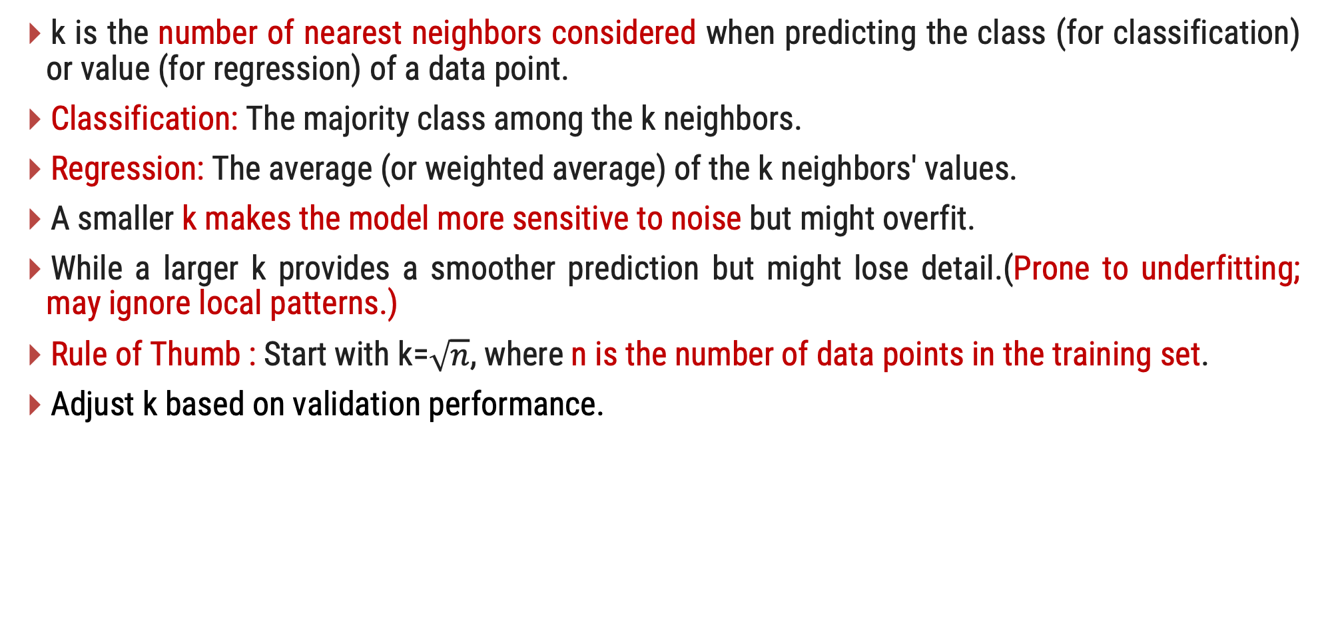
K-NN
k is the number of nearest neighbors considered when predicting the class (for classification) or value (for regression) of a data point.
Classification: The majority class among the k neighbors.
Regression: The average (or weighted average) of the k neighbors' values.
A smaller k makes the model more sensitive to noise but might overfit.
While a larger k provides a smoother prediction but might lose detail.(Prone to underfitting; may ignore local patterns.)
Rule of Thumb : Start with k=$\sqrt{n}$​, where n is the number of data points in the training set.
Adjust k based on validation performance.

Slide 37
Example
KNN.py
Dataset Columns : User ID, Gender, Age, EstimatedSalary, Purchased
1
2
3
4
5
6
7
8
9
10
11
12
13
14
15
16
17
18
19
20
21
22
import pandas as pd
import numpy as np
import matplotlib.pyplot as plt
from sklearn.model_selection import train_test_split
dataset = pd.read_csv('Social_Network_Ads.csv')
X = dataset.iloc[:, [2, 3]].values
y = dataset.iloc[:, 4].values
from sklearn.model_selection import train_test_split
X_train, X_test, y_train, y_test = train_test_split(X, y, test_size = 0.25, random_state = 0) from sklearn.preprocessing import StandardScaler
sc = StandardScaler()
X_train = sc.fit_transform(X_train)
X_test = sc.transform(X_test)
from sklearn.neighbors import KNeighborsClassifier
classifier=KNeighborsClassifier()
classifier.fit(X_train,y_train)
y_pred = classifier.predict(X_test)
from sklearn.metrics import confusion_matrix
cm = confusion_matrix(y_test, y_pred)

Slide 38
SVC (Support Vector Classification)
ε - Insensitive Tube
Y
Maximum Margin
Positive Hyperplane
Support Vector
ε
ε
Maximum margin hyperplane
(Maximum Margin Classifier)
Negative Hyperplane
X

Slide 39




Support Vector Classification
$$f\left(x\right)=sign(w.x+b)$$
x is the feature vector.
w is the weight vector (normal to the hyperplane).
b is the bias term.
f(x) determines which side of the hyperplane
x lies on.
$$y_{i}=+1$$
$$y_{i}=−1$$
A separating hyperplane
$$w.x+b=0$$
Classification Rule
If f(x)>0, classify x as class +1.
If f(x)<0, classify xx as class −1.

Slide 40
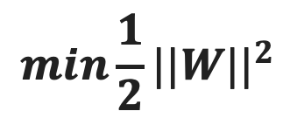
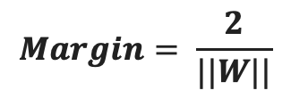
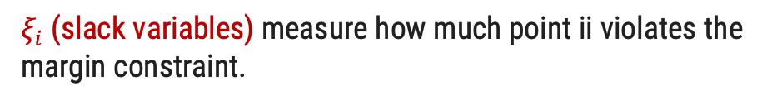
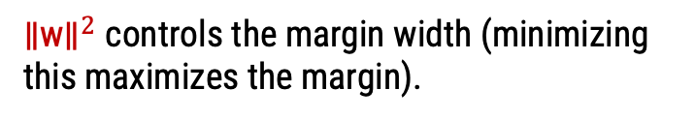
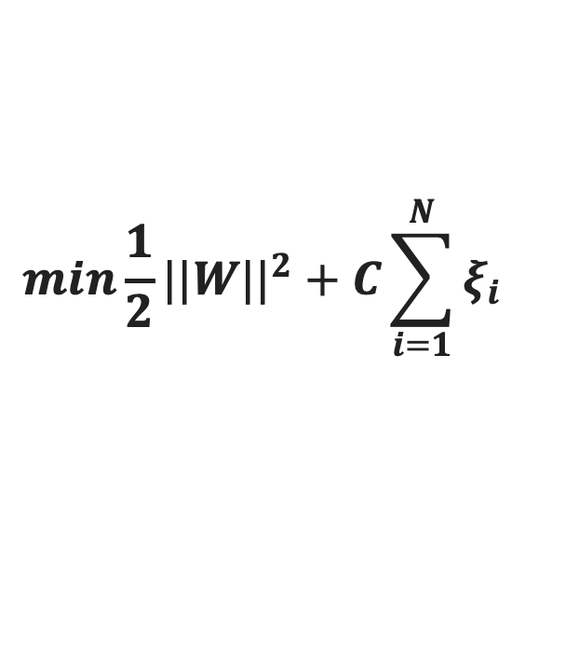
Support Vector Classification
$$Margin= \frac{2}{||W||}$$
The goal of SVC is to maximize this margin. The margin width is given by:
Hard Margin SVM (For Perfectly Separable Data)
Soft Margin SVM (For Overlapping Data / Real-World Use Case)
$$min\frac{1}{2}{||W||}^{2}$$
$$min\frac{1}{2}{||W||}^{2}+C\sum_{i=1}^{N}{ξ_{i}}$$
${\text{∥}\text{w}\text{∥}}^{2}$ controls the margin width (minimizing this maximizes the margin).
$ξ_{i}$ (slack variables) measure how much point ii violates the margin constraint.
yi​∈{+1,−1} are the class labels.
C is a hyperparameter that controls the trade-off between margin maximization and misclassification penalty.
(w.xi​+b) gives the signed distance from the hyperplane.

Slide 41
Support Vector Classification
Support Vector classification (SVC) is a supervised machine learning algorithm that applies the principles of Support Vector Machines (SVM) to classification problems.
Terminology in SVC:
Hyperplane:
A decision boundary that separates data points of different classes. In 2D, it's a line; in 3D, it's a plane; in higher dimensions, it's a hyperplane.
Margin (ε-insensitive loss):
The distance between the hyperplane and the closest data points (called support vectors). SVM aims to maximize this margin to improve classification performance and generalization.
If the margin is larger in between the classes, then it is considered a good margin, a smaller margin is a bad margin.
Support Vectors:
The data points closest to the hyperplane, which are critical in defining its position and orientation. They "support" the hyperplane.

Slide 42
Support Vector Classification
Linear vs. Nonlinear Data:
Linear SVM: Works when data is linearly separable, meaning classes can be separated by a straight line (or hyperplane).
Nonlinear SVM: For complex, nonlinearly separable data, SVM uses the kernel trick to project data into a higher-dimensional space where a hyperplane can separate the classes.
Y
Y
Nonlinear Data
Linear Data
X
X

Slide 43
Kernel
A kernel function in Support Vector Machine (SVM) is a trick to transform non-linearly separable data into a higher-dimensional space.
Where linear separator can be applied. This is called the Kernel Trick.
Real-world data is often non-linearly separable.
A simple linear SVM won't work well for complex patterns.
Kernel functions map input data to a higher-dimensional space, making it easier to classify with a linear hyperplane.
Imagine a dataset where classes are circularly distributed. A linear SVM cannot separate them, but using a Radial Basis Function (RBF) Kernel, we can transform it into a higher dimension where it is separable.

Slide 44
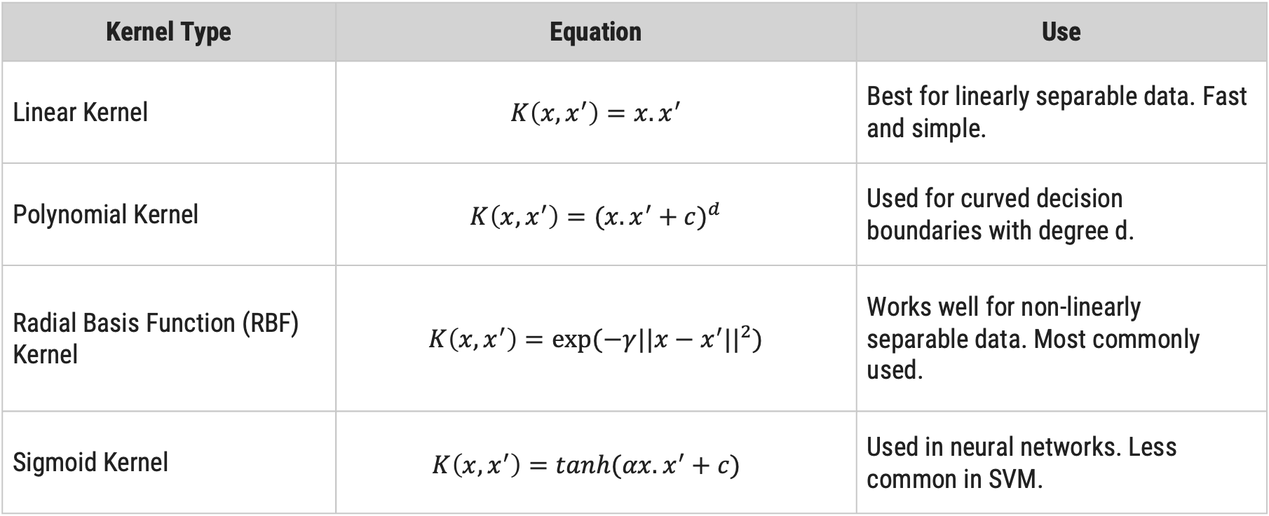
Kernel - Types
Kernel Type | Equation | Use
Linear Kernel | $$K\left(x,x^{′}\right)=x.x^{′}$$ | Best for linearly separable data. Fast and simple.
Polynomial Kernel | $$K\left(x,x^{′}\right)={(x.x^{′}+c)}^{d}$$ | Used for curved decision boundaries with degree d.
Radial Basis Function (RBF) Kernel | $$K\left(x,x^{′}\right)=exp⁡(−γ{||x−x^{′}||}^{2})$$ | Works well for non-linearly separable data. Most commonly used.
Sigmoid Kernel | $$K\left(x,x^{′}\right)={tanh(αx.x^{′}+c)}^{}$$ | Used in neural networks. Less common in SVM.

Slide 45
Example
SVC.py
Output
1
2
3
4
5
6
7
8
9
10
11
12
13
14
15
16
17
18
19
20
21
from sklearn import datasets
from sklearn.model_selection import train_test_split
from sklearn.preprocessing import StandardScaler
from sklearn.svm import SVC
from sklearn.metrics import accuracy_score
data = datasets.load_iris() x = data.data
y = data.target
x_train, x_test, y_train, y_test = train_test_split(x, y, test_size=0.2, random_state=42)
scaler = StandardScaler()
x_train = scaler.fit_transform(x_train)
x_test = scaler.transform(x_test)
model = SVC(kernel='rbf', C=1.0)
model.fit(x_train, y_train)
y_pred = model.predict(xxw_test) print("Accuracy:", accuracy_score(y_test, y_pred))
Accuracy: 1.0

Slide 46
Bayesian Classification
The Naive Bayes classifier works on the principle of conditional probability, as given by the Bayes theorem.
They can predict class membership probabilities such as the probability that a given tuple belongs to a particular class.

Slide 47
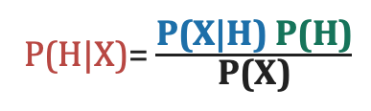
Bayes’ Theorem
Bayesian classification is used to find conditional probabilities.
Consider a data set D with a tuple X in Bayes Theorem X works as an evidence.
P(H|X) :
The probability of customer X purchasing a computer, considering the information about the customer's age and income.
Here H conditioned on X.
The Bayes Theorem:
P(H|X)= $\frac{\text{P}\text{(}\text{X}\text{|}\text{H}\text{) }\text{P}\text{(}\text{H}\text{)}}{\text{P}\text{(}\text{X}\text{)}}$
Let H be some hypothesis such as that the data tuple X belongs to a specified class C.
X is a customer with age 35 and income 40,000 Rs.

Slide 48
Bayes’ Theorem
P(X|H) :
The probability that customer X is 35 years old and earns 40,000 Rs., given that we are aware that he/she intends to purchase the computer.
Here X conditioned on H.
P(H) :
The probability that the customer will buy the computer.
P(X) :
The probability the customer X from a set of customers is 35 years old and earns 40,000 Rs.
The Bayes Theorem:
P(H|X)= $\frac{\text{P}\text{(}\text{X}\text{|}\text{H}\text{) }\text{P}\text{(}\text{H}\text{)}}{\text{P}\text{(}\text{X}\text{)}}$

Slide 49
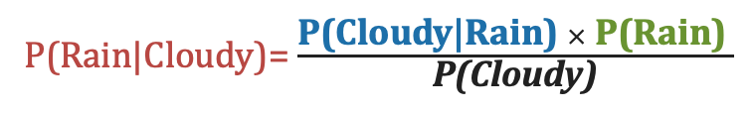
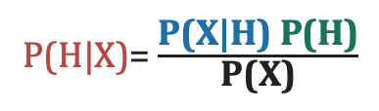
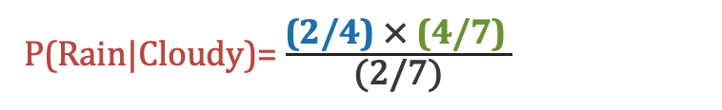
Example
Day | Weather | Rain
1 | Sunny | No
2 | Rainy | Yes
3 | Cloudy | Yes
4 | Sunny | No
5 | Rainy | Yes
6 | Sunny | No
7 | Cloudy | Yes
The Bayes Theorem:
To find the probability of rain given that it's cloudy (P(Rain|Cloudy))
P(H|X)= $\frac{\text{P}\text{(}\text{X}\text{|}\text{H}\text{) }\text{P}\text{(}\text{H}\text{)}}{\text{P}\text{(}\text{X}\text{)}}$
P(Rain|Cloudy)= $\frac{\text{P}\text{(}\text{Cloudy}\text{|}\text{Rain}\text{) }× \text{P}\text{(}\text{Rain}\text{)} }{\text{P}\text{(}\text{Cloudy}\text{)}}$
P(Rain|Cloudy)= $\frac{\text{(2/}\text{4}\text{) }\text{×} \text{(4/7)} }{\text{(2/7)}}$
P(Rain|Cloudy)=1
the probability of rain given that it's cloudy is approximately 100%
X
H

Slide 50
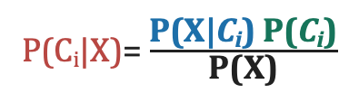
Naive Bayesian Classification : Steps
The naive Bayesian classifier, or simple Bayesian classifier, works as follows:
Step:1
Let D be a training set of tuples and their associated class labels, and each tuple is represented by an n-D attribute vector X = (x1, x2, …, xn)
Step:2
Suppose there are m classes C1, C2, …, Cm.
Given a tuple, X, the classifier will predict that X belongs to the class having the highest posterior probability, conditioned on X.
We find maximum P(C_{i}|X).
This can be derived from Bayes’ theorem
P(C_{i}|X)= $\frac{\text{P}\text{(}\text{X}\text{|}\text{C}\text{i}\text{) }\text{P}\text{(}\text{C}\text{i}\text{)}}{\text{P}\text{(}\text{X}\text{)}}$

Slide 51
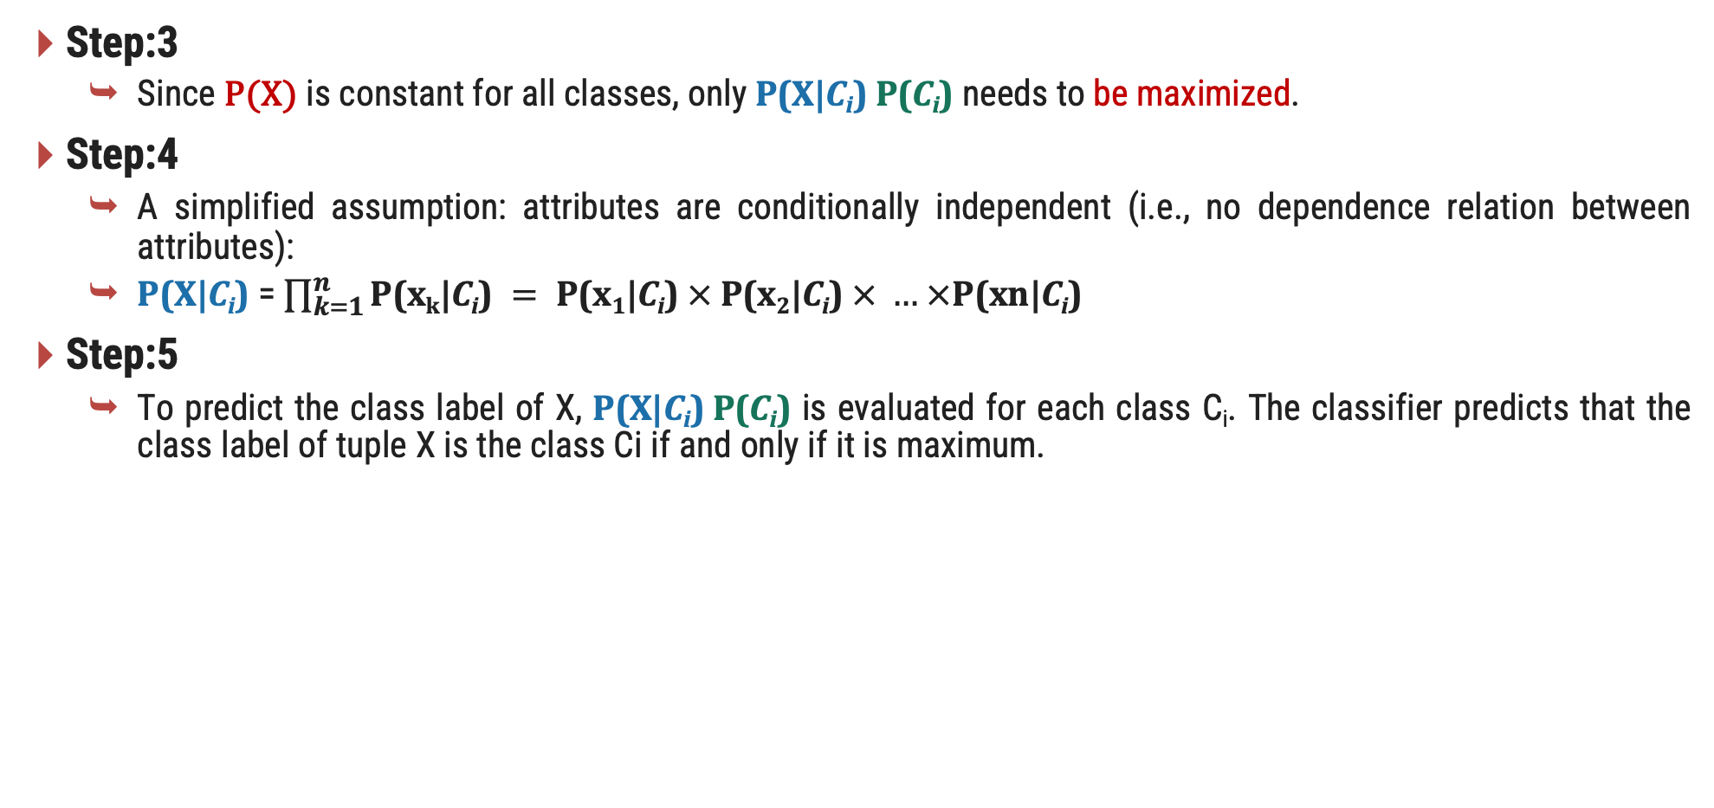
Naive Bayesian Classification : Steps
Step:3
Since P(X) is constant for all classes, only $\text{P}\text{(}\text{X}\text{|}\text{C}\text{i}\text{) }\text{P}\text{(}\text{C}\text{i}\text{)}$ needs to be maximized.
Step:4
A simplified assumption: attributes are conditionally independent (i.e., no dependence relation between attributes):
$\text{P}\text{(}\text{X}\text{|}\text{C}\text{i}\text{)}$ = $\prod_{k=1}^{n}{\text{P}\text{(}\text{x}\text{k}\text{|}\text{C}\text{i}\text{)} = \text{P}\text{(}\text{x}\text{1}\text{|}\text{C}\text{i}\text{)} × \text{P}\text{(}\text{x}\text{2}\text{|}\text{C}\text{i}\text{)} × … ×\text{P}\text{(}\text{xn}\text{|}\text{C}\text{i}\text{)}}$
Step:5
To predict the class label of X, $\text{P}\text{(}\text{X}\text{|}\text{C}\text{i}\text{) }\text{P}\text{(}\text{C}\text{i}\text{)}$ is evaluated for each class C_{i}. The classifier predicts that the class label of tuple X is the class Ci if and only if it is maximum.

Slide 52
Naive Bayesian : Example
Day | Outlook | Temperature | Humidity | Wind | PlayTennis
1 | Sunny | Hot | High | Weak | No
2 | Sunny | Hot | High | Strong | No
3 | Overcast | Hot | High | Weak | Yes
4 | Rain | Mild | High | Weak | Yes
5 | Rain | Cool | Normal | Weak | Yes
6 | Rain | Cool | Normal | Strong | No
7 | Overcast | Cool | Normal | Strong | Yes
8 | Sunny | Mild | High | Weak | No
9 | Sunny | Cool | Normal | Weak | Yes
10 | Rain | Mild | Normal | Weak | Yes
11 | Sunny | Mild | Normal | Strong | Yes
12 | Overcast | Mild | High | Strong | Yes
13 | Overcast | Hot | Normal | Weak | Yes
14 | Rain | Mild | High | Strong | No
Given a new instance,
x’=(Outlook=Sunny, Temperature=Cool, Humidity=High, Wind=Strong)
P(Play=Yes) = 9/14
P(Play=No) = 5/14

Slide 53
Naive Bayesian : Example
Outlook | Yes | No
Sunny | 2/9 | 3/5
Overcast | 4/9 | 0/5
Rain | 3/9 | 2/5
Temp. | Yes | No
Hot | 2/9 | 2/5
Mild | 4/9 | 2/5
Cool | 3/9 | 1/5
Humidity | Yes | No
High | 3/9 | 4/5
Normal | 6/9 | 1/5
Wind | Yes | No
Strong | 3/9 | 3/5
Weak | 6/9 | 2/5
x’=(Outlook=Sunny, Temperature=Cool, Humidity=High, Wind=Strong) = ?
P(C_{i}|X) = $\text{P}\text{(}\text{x}\text{1}\text{|}\text{C}\text{i}\text{)} \text{× }\text{P}\text{(}\text{x}\text{2}\text{|}\text{C}\text{i}\text{) }\text{× … ×}\text{P}\text{(}\text{xn}\text{|}\text{C}\text{i}\text{) }\text{×} \text{P}\text{(}\text{C}\text{i}\text{)}$
P(Yes|x’) = [P(Sunny|Yes) * P(Cool|Yes) * P(High|Yes)* P(Strong|Yes)] * P(Play=Yes)
= [2/9 * 3/9 * 3/9 * 3/9 ] * 9/14 = 0.0053
P(No|x’) = [P(Sunny|No) * P(Cool|No) * P(High|No) * P(Strong|No)] * P(Play=No)
= [3/5 * 1/5 * 4/5 * 3/5 ] * 5/14 = 0.0206
we label x’ to be “No”.

Slide 54
Example
NB.py
Output
1
2
3
4
5
6
7
8
9
10
11
12
13
14
15
16
17
18
19
20
21
from sklearn import datasets
from sklearn.model_selection import train_test_split
from sklearn.naive_bayes import GaussianNB
import numpy as np
iris = datasets.load_iris()
X, y = iris.data, iris.target
X_train, X_test, y_train, y_test = train_test_split(X, y, test_size=0.2, random_state=42)
nb = GaussianNB()
nb.fit(X_train, y_train)
probabilities = nb.predict_proba(X_test)
for i in range(5):
print(f"Test Sample {i+1}: {X_test[i]}")
print(f"Class: {nb.predict([X_test[i]])[0]}")
print(f"Class Probabilities: {probabilities[i]}")
print("-" * 50)
Test Sample 1: [6.1 2.8 4.7 1.2] Predicted Class: 1 Class Probabilities: [5.97327448e-90 9.95635767e-01 4.36423302e-03]
--
--
Test Sample 5: [6.8 2.8 4.8 1.4] Predicted Class: 1 Class Probabilities: [1.13877801e-105 8.70022596e-001 1.29977404e-001]

Slide 55
Model Evaluation and Selection
Now that you may have built a classification model, there may be many questions going through your mind.
For example, suppose you used data from previous sales to build a classifier to predict customer purchasing behavior.
You would like an estimate of how accurately the classifier can predict the purchasing behavior of future customers, that is, future customer data on which the classifier has not been trained.
You may even have tried different methods to build more than one classifier and now wish to compare their accuracy.
Derive
model
Estimate
accuracy
Training
Set
Data
Test
Set

Slide 56
Metrics for Performance Evaluation: Confusion Matrix
Actual\ predicted | Yes | No
Yes | TP | FN
No | FP | TN
TP :True Positive
FN :False Negative
FP : False Positive
TN : True Negative
True Positive: These refer to the positive tuples that were correctly labeled by the classifier.
True negatives: These are the negative tuples that were correctly labeled by the classifier.
False positives: These are the negative tuples that were incorrectly labeled as positive.
False negatives: These are the positive tuples that were mislabeled as negative.
confusion_matrix.py
1
2
3
4
from sklearn.metrics import confusion_matrix
cm = confusion_matrix(y_test, y_test_pred)
print("Confusion Matrix:\n", cm)

Slide 57
Metrics for Performance Evaluation: Confusion Matrix
Patient | BP | BMI | Diabetes
1 | 120 | 25.5 | No
2 | 130 | 30.1 | Yes
3 | 110 | 22.8 | No
4 | 140 | 28.7 | Yes
5 | 125 | 24.0 | No
6 | 118 | 26.3 | No
7 | 135 | 31.2 | Yes
8 | 128 | 27.5 | Yes
9 | 130 | 23.8 | No
10 | 122 | 29.6 | Yes
11 | 115 | 24.9 | No
12 | 142 | 32.0 | Yes
13 | 127 | 26.7 | No
14 | 138 | 30.5 | Yes
Actual\ predicted | Yes | No
Yes | TP | FN
No | FP | TN
Traning Data Set
Model
Predicated by
Model
Actual\ predicted | Yes | No
Yes | 2 | 2
No | 1 | 2
Testing
Yes
Yes
Yes
No
No
No
No

Slide 58
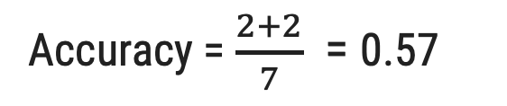
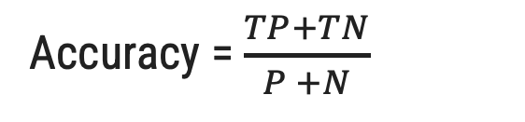
Accuracy(Recognition rate)
The accuracy of a classifier on a given test set is the percentage of test set tuples that are correctly classified by the classifier.
Actual\ predicted | Yes | No
Yes | TP | FN
No | FP | TN
Total
Accuracy = $\frac{TP+TN}{P +N}$
P
Accuracy = $\frac{2+2}{7}$ = 0.57
N
Accuracy.py
1
2
3
4
from sklearn.metrics import accuracy_score
accuracy_score(y, model.predict(x))
# OR
model.score(x,y)
Actual\ predicted | Yes | No
Yes | 2 | 2
No | 1 | 2
Total
4
3

Slide 59
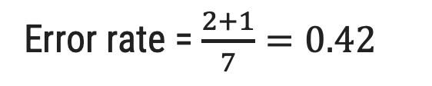
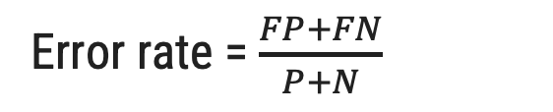
Error rate (Misclassification rate)
Error rate or misclassification rate of a classifier M, is simply 1−accuracy(M), where accuracy(M) is the accuracy of M. This also can be computed as
Actual\ predicted | Yes | No
Yes | TP | FN
No | FP | TN
Total
Error rate = $\frac{FP+FN}{P+N}$
P
N
Actual\ predicted | Yes | No
Yes | 2 | 2
No | 1 | 2
Total
Error rate = $\frac{2+1}{7}=0.42$
4
3

Slide 60
Class imbalance problem
where the main class of interest is rare.
In medical data, there may be a rare class, such as “cancer.”
Suppose that you have trained a classifier to classify medical data tuples, where the class label attribute is “cancer” and the possible class values are “yes” and “no.”
An accuracy rate of, say, 97% may make the classifier seem quite accurate, but what if only, say, 3% of the training tuples are actually cancer? Clearly, an accuracy rate of 97% may not be acceptable.
Sensitivity (the proportion of positive tuples that are correctly identified) = $\frac{TP}{P}$
specificity (the proportion of negative tuples that are correctly identified ) =$\frac{TN}{N}$
Accuracy = Sensitivity $\frac{P}{P+N}$ + specificity$\frac{N}{P+N}$

Slide 61
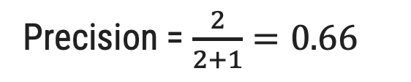
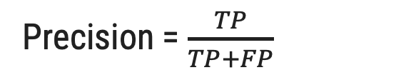
Precision
Exactness – what % of tuples that the classifier labeled as positive are actually positive.
It calculates the ratio of correctly predicted positive instances to the total number of instances predicted as positive.
Actual\ predicted | Yes | No
Yes | TP | FN
No | FP | TN
Total
P
Precision = $\frac{TP}{TP+FP}$
N
Actual\ predicted | Yes | No
Yes | 2 | 2
No | 1 | 2
Total
Precision = $\frac{2}{2+1}=0.66$
4
3

Slide 62
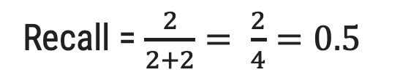
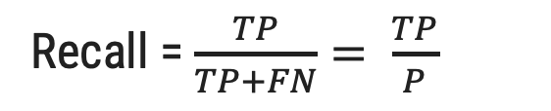
Recall
Completeness – what % of positive tuples did the classifier label as positive?
It calculates the ratio of true positives to the total number of actual positive instances.
Actual\ predicted | Yes | No
Yes | TP | FN
No | FP | TN
Total
Recall = $\frac{TP}{TP+FN}= \frac{TP}{P}$
P
N
Actual\ predicted | Yes | No
Yes | 2 | 2
No | 1 | 2
Total
Recall = $\frac{2}{2+2}= \frac{2}{4}=0.5$
4
3

Slide 63
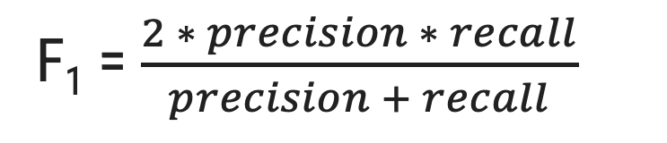
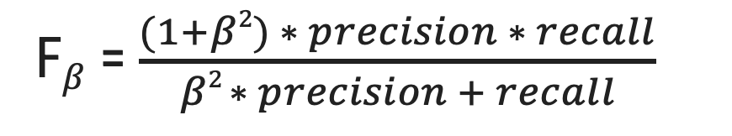
F₁ and F$β$ Measure
F measure also known as the F₁ score or F-score. it is harmonic mean of precision and recall.
It provides a balanced assessment of a model's performance by taking both false positives and false negatives into account.
The F1-score ranges between 0 (worst) and 1 (best).
The F_{β} measure is a weighted measure of precision and recall.
where β is a non-negative real number.
It allow you to control the emphasis on precision or recall using the parameter β. When β > 1, it emphasizes recall more than precision, and when 0 < β < 1, it emphasizes precision more than recall.
F$β$ = $\frac{(1+β2) ∗ precision ∗ recall}{β2 ∗ precision + recall}$
F₁ = $\frac{2 ∗ precision ∗ recall}{precision + recall}$

Slide 64
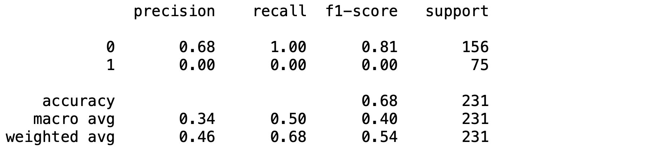
Classification Report
Accuracy.py
1
2
3
from sklearn.metrics import classification_report
print(classification_report(y_test, model.predict(x_test)))

Slide 65
Evaluating Classifier Accuracy: Holdout
Holdout method:
Given data is randomly partitioned into two independent sets
Training set (e.g., 2/3) for model construction
Test set (e.g., 1/3) for accuracy estimation
Random sampling:
A variation of holdout
Repeat holdout k times, accuracy = avg. of the accuracies obtained
Derive
model
Estimate
accuracy
Training
Set
Data
Test
Set

Slide 66
Evaluating Classifier Accuracy: Cross-Validation Methods
Cross-validation:
Also know as k fold, where k is 10 recommend.
Randomly partition the data into k mutually exclusive subsets, each approximately equal size
Training and testing is performed k times.
At i-th iteration, use Di as test set and others as training set
That is, in the first iteration, subsets D2,..., Dk collectively serve as the training set to obtain a first model, which is tested on D1

Slide 67
Evaluating Classifier Accuracy: Cross-Validation Methods
Data
K = 10
1
2
3
4
5
6
7
8
9
10
Iteration
Training and testing is performed k times.
1
Test
Train
Train
Train
Train
Train
Train
Train
Train
Train
2
Train
Test
Train
Train
Train
Train
Train
Train
Train
Train
…
10
Train
Train
Train
Train
Train
Train
Train
Train
Train
Test

Slide 68
Evaluating Classifier Accuracy: Cross-Validation Methods
Kfold.py
Output
1
2
3
4
5
6
7
8
9
10
11
12
13
14
15
16
17
18
19
20
21
from sklearn.model_selection import KFold
from sklearn.datasets import load_iris
from sklearn.tree import DecisionTreeClassifier
from sklearn.metrics import accuracy_score data = load_iris()
X, y = data.data, data.target
kf = KFold(n_splits=3, shuffle=True, random_state=42) model = DecisionTreeClassifier()
fold = 1
for train_index, test_index in kf.split(X):
print(f"Fold {fold}:")
X_train, X_test = X[train_index], X[test_index]
y_train, y_test = y[train_index], y[test_index]
model.fit(X_train, y_train)
y_pred = model.predict(X_test)
accuracy = accuracy_score(y_test, y_pred)
print(f"Accuracy: {accuracy:.2f}\n")
fold += 1
Fold 1: Accuracy: 0.96
Fold 2: Accuracy: 0.92
Fold 3: Accuracy: 0.92

Slide 69
Evaluating Classifier Accuracy: Bootstrap
Bootstrap:
The bootstrap method samples the given training tuples uniformly with replacement.
That is, each time a tuple is selected, it is equally likely to be selected again and re-added to the training set.
There are several bootstrap methods. A commonly used one is the .632 bootstrap, which works as follows
A data set with d tuples is sampled d times, with replacement, resulting in a training set of d samples.
The data tuples that did not make it into the training set end up forming the test set.
About 63.2% of the original data end up in the bootstrap, and the remaining 36.8% form the test set (since (1 – 1/d)d ≈ e-1 = 0.368)

Slide 70
Comparing Classifiers Based on ROC Curves
Receiver operating characteristic curves are a useful visual tool for comparing two classification models.
ROC curves come from signal detection theory that was developed during World War II for the analysis of radar images.
An ROC curve for a given model shows the trade-off between the true positive rate (TPR) and the false positive rate (FPR).
The area under the ROC curve is a measure of the accuracy of the model.
Any increase in TPR occurs at the cost of an increase in FPR.
Sensitivity (the proportion of positive tuples that are correctly identified) (TPR) = $\frac{TP}{P}$
specificity (the proportion of negative tuples that are correctly identified ) (FPR) = $\frac{FP}{F}$

Slide 71
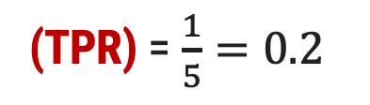
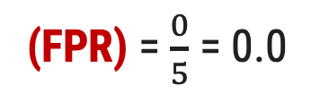
Comparing Classifiers Based on ROC Curves
Tuple | Class | Prob. | TP | FP | TPR | FPR
1 | P | 0.90 | 1 | 0 | 0.2 | 0.0
2 | P | 0.80 | 2 | 0 | 0.4 | 0.0
3 | N | 0.70 | 2 | 1 | 0.4 | 0.2
4 | P | 0.60 | 3 | 1 | 0.6 | 0.2
5 | P | 0.55 | 4 | 1 | 0.8 | 0.2
6 | N | 0.54 | 4 | 2 | 0.8 | 0.4
7 | N | 0.53 | 4 | 3 | 0.8 | 0.6
8 | N | 0.51 | 4 | 4 | 0.8 | 0.8
9 | P | 0.50 | 5 | 4 | 1.0 | 0.8
10 | N | 0.40 | 5 | 5 | 1.0 | 1.0
(TPR) = $\frac{1}{5}=0.2$
Returned by a probabilistic classifier for each of the 10 tuples in a test set, sorted by decreasing probability order.
Vertical axis represents the true positive rate
Horizontal axis represents the false positive rate
A model with perfect accuracy will have an area of 1.0
(FPR) = $\frac{0}{5}$ = 0.0

Slide 72
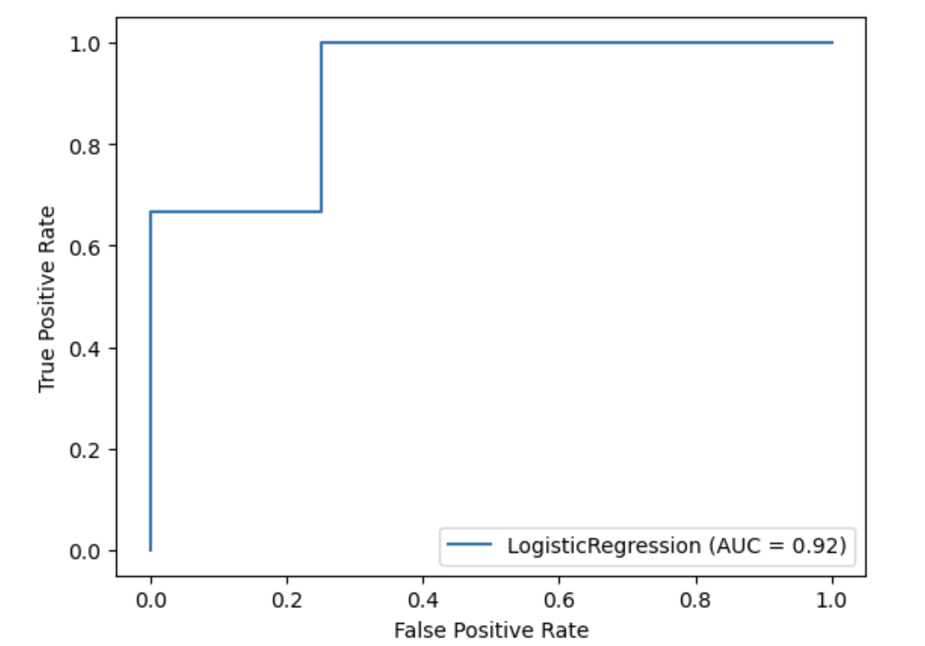
ROC AUC Curve
ROC.py
Output
1
2
3
4
5
6
7
8
9
10
11
12
13
14
15
16
17
18
19
import numpy as np
from sklearn.metrics import roc_curve, RocCurveDisplay, auc
from sklearn.linear_model import LogisticRegression
X = np.array([[1], [2], [3], [4], [5], [6], [7], [8], [9], [10]])
y = np.array([0, 0, 0, 1, 1, 0, 1, 1, 1, 1])
model = LogisticRegression()
model.fit(X, y) y_score = model.predict_proba(X)[:, 1]
fpr, tpr, thresholds = roc_curve(y, y_score)
roc_auc = auc(fpr, tpr)
RocCurveDisplay(fpr=fpr, tpr=tpr, roc_auc=roc_auc, estimator_name="LogisticRegression").plot()
print(f"Area Under the Curve (AUC): {roc_auc:.2f}")
Area Under the Curve (AUC): 0.92

Slide 73
Techniques to Improve Classification Accuracy – Ensemble Learning
We focus on ensemble methods for improvement of classification accuracy.
It involve combining the predictions from multiple individual models (classifiers) to improve the overall performance.
The individual classifiers vote, and a class label prediction is returned by the ensemble based on the collection of votes.
Combine a series of k learned models, M₁, M₂, …, M_{k}, with the aim of creating an improved model M*
C₁
New Data
Sample
C₂
Combine
Vote
Class
Predication
Data
.
.
C_{T}

Slide 74
Bagging
Analogy: Diagnosis based on multiple doctors’ majority vote.
Training:
Given a set D of d tuples, at each iteration i, a training set D_{i} of d tuples is sampled with replacement from D (i.e., bootstrap)
A classifier model M_{i} is learned for each training set D_{i}
Classification: classify an unknown sample X
Each classifier M_{i} returns its class prediction
The bagged classifier M* counts the votes and assigns the class with the most votes to X
Prediction can be applied to the prediction of continuous values by taking the average value of each prediction for a given test tuple.

Slide 75
Bagging
Input:
D, a set of d training tuples;
k, the number of models in the ensemble;
a classification learning scheme (decision tree algorithm etc.)
Output:
The ensemble composite model, M∗.
for i=1 to k do // create k models:
create bootstrap sample, Di, by sampling D with replacement;
use Di and the learning scheme to derive a model, Mi;
endfor
To use the ensemble to classify a tuple, X:
let each of the k models classify X and return the majority vote;

Slide 76
Bagging
Bagging.py
1
2
3
4
5
6
7
8
9
10
11
12
13
14
15
16
17
from sklearn.ensemble import BaggingClassifier
from sklearn.tree import DecisionTreeClassifier
from sklearn.datasets import load_iris
from sklearn.model_selection import train_test_split
from sklearn.metrics import accuracy_score
iris = load_iris()
X, y = iris.data, iris.target
X_train, X_test, y_train, y_test = train_test_split(X, y, test_size=0.3, random_state=42)
bagging_clf = BaggingClassifier(base_estimator=DecisionTreeClassifier(), n_estimators=5)
bagging_clf.fit(X_train, y_train)
y_pred = bagging_clf.predict(X_test)
accuracy = accuracy_score(y_test, y_pred)
print(f"Accuracy = {accuracy}")
Output
Accuracy = 1.0

Slide 77
Random Forest
Random Forest:
Each classifier in the ensemble is a decision tree classifier and is generated using a random selection of attributes at each node to determine the split
During classification, each tree votes and the most popular class is returned
Random forests can be built using bagging
A training set, D, of d tuples is given.
The general procedure to generate k decision trees for the ensemble is as follows.
-> For each iteration, i a training set, Di, of d tuples is sampled with replacement from D.
-> That is, each Di is a bootstrap sample of D
-> Let F be the number of attributes to be used to determine the split at each node, where F is much smaller than the number of available attributes.
-> To construct a decision tree classifier, Mi, randomly select, at each node, F attributes as candidates for the split at the node.
-> The CART methodology is used to grow the trees.
it is also know as random input selection, are called Forest-RI

Slide 78
Random Forest
Random Forest.py
1
2
3
4
5
6
7
8
9
10
11
12
13
14
15
16
from sklearn.ensemble import RandomForestClassifier
from sklearn.datasets import load_iris
from sklearn.model_selection import train_test_split
from sklearn.metrics import accuracy_score
iris = load_iris()
X, y = iris.data, iris.target
X_train, X_test, y_train, y_test = train_test_split(X, y, test_size=0.3, random_state=42)
rf = RandomForestClassifier(n_estimators=5, max_features='sqrt',)
rf.fit(X_train, y_train)
y_pred = rf.predict(X_test)
accuracy = accuracy_score(y_test, y_pred)
print(f"Accuracy = {accuracy:.2f}")
Output
Accuracy = 1.0

Slide 79
Boosting
Analogy: Consult several doctors, based on a combination of weighted diagnoses—weight assigned based on the previous diagnosis accuracy.
How boosting works?
Weights are assigned to each training tuple.
A series of k classifiers is iteratively learned.
After a classifier M_{i} is learned, the weights are updated to allow the subsequent classifier, M_{i+1}, to pay more attention to the training tuples that were misclassified by M_{i}.
The final M* combines the votes of each individual classifier, where the weight of each classifier's vote is a function of its accuracy.
Boosting algorithm can be extended for numeric prediction
Comparing with bagging: Boosting tends to have greater accuracy, but it also risks overfitting the model to misclassified data.

Slide 80
Boosting
Original Training Data
Correctly Classified
Misclassified
Final Vote
Model 1
Model 1
Model 2
Model 3
Correctly Classified
Misclassified
Weight & prediction
Weight & prediction
Weighted data
Weight & prediction
Model 2
Class
Predication
Weighted data
Correctly Classified
Misclassified
Model 3
Model Creation

Slide 81
Bagging vs Boosting
Bagging | Boosting
Aim to decrease variance, not bias. | Aim to decrease bias, not variance.
Each model receives equal weight. | Models are weighted according to their performance.
Each model is built independently. | New models are influenced by the performance of previously built models.
Example: The Random forest model uses Bagging. | Example: The AdaBoost uses Boosting techniques
Different training data subsets are selected using row sampling with replacement | Iteratively train models, with each new model focusing on correcting the errors of the previous models

Slide 82
AdaBoost
AdaBoost (short for Adaptive Boosting) is a popular boosting algorithm.
It is used to boost the accuracy of a learning method.
We are given D, a data set of d class-labeled tuples, (X1,y1),(X2,y2),...,(Xd,yd), where yi is the class label of tuple.
Initially, AdaBoost assigns each training tuple an equal weight of 1/d.
Generating k classifiers for the ensemble requires k rounds through the rest of the algorithm.
In round i, the tuples from D are sampled to form a training set, Di, of size d.
Sampling with replacement is used -the same tuple may be selected more than once.
Each tuple’s chance of being selected is based on its weight.
A classifier model, Mi, is derived from the training tuples of Di.
its error is then calculated using Di as a test set. The weights of the training tuples are then adjusted according to how they were classified.

Slide 83
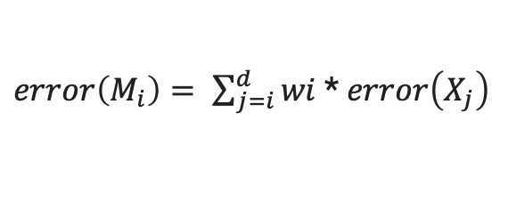
AdaBoost
If a tuple was incorrectly classified, its weight is increased. If a tuple was correctly classified, its weight is decreased.
A tuple’s weight reflects how difficult it is to classify. the higher the weight, the more often it has been misclassified.
These weights will be used to generate the training samples for the classifier of the next round.
To compute the error rate of model Mi, we sum the weights of each of the tuples in Di that Mi misclassified
where err(Xj) is the misclassification error of tuple Xj: If the tuple was misclassified, then err(Xj)is 1; otherwise, it is 0.
If the performance of classifier Mi is so poor that its error exceeds 0.5, then we abandon it. Instead, we try again by generating a new Di training set, from which we derive a new Mi.
$error\left(M_{i}\right)= \sum_{j=i}^{d}{wi}$ * $error\left(X_{j}\right)$

Slide 84
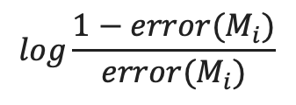
AdaBoost
The error rate of Mi affects how the weights of the training tuples are updated.
If a tuple in round i was correctly classified, its weight is multiplied by error(Mi)/(1−error(Mi)).
Once the weights of all the correctly classified tuples are updated, the weights for all tuples (including the misclassified ones) are normalized so that their sum remains the same as it was before.
Once boosting is complete, how is the ensemble of classifiers used to predict the class label of a tuple, X?
The weight of classifier Mi’s vote is
$$log\frac{1−error(M_{i})}{error(M_{i})}$$

Slide 85
AdaBoost
Input:
D, a set of d training tuples;
k, the number of models in the ensemble;
a classification learning scheme (decision tree algorithm etc.)
Output:
The ensemble composite model, M∗.
initialize the weight of each tuple in D to 1/d;
for i=1 to k do // for each round:
sample D with replacement according to the tuple weights to obtain Di;
use training set Di to derive a model, Mi;
compute error(Mi), the error rate of Mi
if error(Mi)>0.5 then
go back to step 3 and try again;
endif
for each tuple in Di that was correctly classified do
multiply the weight of the tuple by error(Mi)/(1−error(Mi)); // update weights
normalize the weight of each tuple;
endfor

Slide 86
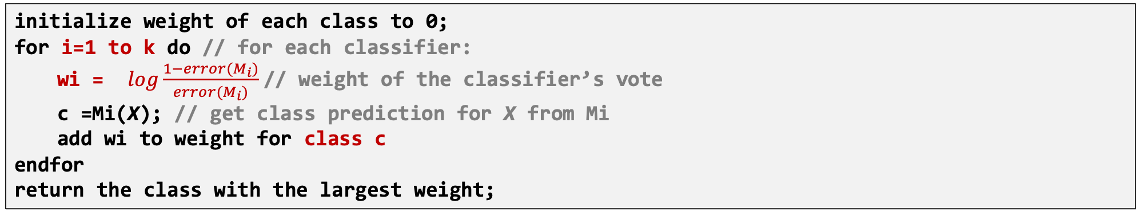
AdaBoost
To use the ensemble to classify tuple, X:
initialize weight of each class to 0;
for i=1 to k do // for each classifier:
wi = $log\frac{1−error(M_{i})}{error(M_{i})}$// weight of the classifier’s vote
c =Mi(X); // get class prediction for X from Mi
add wi to weight for class c
endfor
return the class with the largest weight;

Slide 87
AdaBoost
AdaBoost.py
1
2
3
4
5
6
7
8
9
10
11
12
13
14
15
16
17
18
19
20
import numpy as np
from sklearn.datasets import load_iris
from sklearn.model_selection import train_test_split
from sklearn.preprocessing import StandardScaler
from sklearn.neighbors import KNeighborsClassifier
from sklearn.ensemble import AdaBoostClassifier
from sklearn.metrics import accuracy_score
data = load_iris()
X, y = data.data, data.target
X_train, X_test, y_train, y_test = train_test_split(X, y, test_size=0.3, random_state=42, stratify=y)
scaler = StandardScaler()
X_train = scaler.fit_transform(X_train)
X_test = scaler.transform(X_test)
knn = KNeighborsClassifier(n_neighbors=3)
knn.fit(X_train, y_train)

Slide 88
AdaBoost
AdaBoost.py
21
22
23
24
25
26
27
28
29
30
y_pred_knn = knn.predict(X_test)
accuracy_knn = accuracy_score(y_test, y_pred_knn)
print(f"kNN Accuracy: {accuracy_knn}")
adaboost = AdaBoostClassifier( n_estimators=50, random_state=42)
adaboost.fit(X_train, y_train)
y_pred_adaboost = adaboost.predict(X_test)
accuracy_adaboost = accuracy_score(y_test, y_pred_adaboost)
print(f"AdaBoost : {accuracy_adaboost}")
Output
kNN Accuracy: 0.91
AdaBoost : 0.93

