Slide 1

Unit-4 Data Annotations, Validations, Model Binding & Data Passing
ASP.NET Core
#2301CS412
Prof. Naimish R. Vadodariya
Computer Science & Engineering Department
naimish.vadodariya@darshan.ac.in
8866215253

Slide 2

Looping
Outline
Validation/Data Annotations
Client Side
Server Side
Data Passing Techniques
ViewBag
ViewData
TempData
Model Binding
Default Model Binder
IFormCollection Interface
Bind Attribute

Slide 3
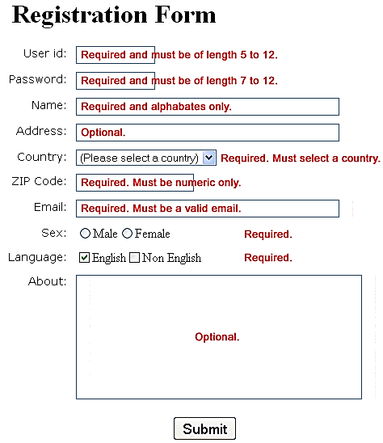
Validations
Section – 4.1

Slide 4
Why Validation?
When we developed any type of application such as web, desktop or mobile app, in all applications one key part of development is Data Validation & Proper Navigation.
The validations always ensure us that the data is accurate & correct, whenever in future if we want to analyze the data all necessary information comes to us in proper form of data.
Normally users always fill the data with necessary information and submit it or select it.
Still sometimes the user make few mistakes while filling or selecting data.
In this case, validations is required to ensure that the user always prompts with proper validation messages like..
The field First Name is required
Please enter valid Email Address
Please enter Age value between 1 to 110 etc
Incorrect URL, enter valid URL
This type of message known as user defined validations messages to collect proper data.

Slide 5
What Are the Validations?
Validation is the set of rules which we define on the input fields on the webform page.
When user fills the data anywhere on web or mobile, applications must validate those data first weather it is correct or not, because nowadays too much dirty/noisy data on web (Data Cleaning & other techniques are required to clean those data)
If it is correct, then application send those data to the server for processing in the database.
If it not in correct format, then it throws/displays an error messages providing necessary information about what are the corrections needs to be done by the user.
We have certain types of validations which we can use as per the user requirements:
Client-Side Validation
Server-side Validation

Slide 6
1. Client Side Validation
Client-side validation in ASP.NET Core is essential for enhancing user experience by providing immediate feedback on form inputs.
For Client-Side Validation, Install Required Libraries:
jQuery | <script src="~/lib/jquery/dist/jquery.min.js"></script>
jQuery.validate | <script src="~/lib/jquery-validation/dist/jquery.validate.min.js"></script>
jQuery.validate.unobtrusive | <script src="~/lib/jquery-validation-unobtrusive/jquery.validate.unobtrusive.min.js"></script>
You can install these using the Library Manager or via CDN.
Add references to these libraries in your respective files like _Layout.cshtml, _ValidationScriptsPartial.cshtml or in a view whenever it is required.
jQuery.validate.unobtrusive
Unobstrusive validation will add data-val- attributes in the HTML, so you can read the validation even in the HTML source.

Slide 7
Data Annotations
Data Annotations in ASP.NET Core MVC are attributes used to define metadata for model properties.
They help to enforce validation rules, define display formats, and control how data is presented and processed in your application.
Data Annotations are part of the System.ComponentModel.DataAnnotations namespace and are commonly used for model validation and UI rendering.
Here’s a breakdown of common Data Annotations and their usage in ASP.NET Core MVC:
Validation Annotations
Display Annotations
Scaffolding Annotations
Custom Error Messages

Slide 8
Common Data Annotations
Validation Annotations
Attribute | Description
[Required] | Ensures the property is not null or empty
[Range(min_val, max_val)] | Specifies a range of values for numeric properties
[RegularExpression(regex)] | Validates a property against a regular expression
[StringLength(value)] | Specifies the minimum and maximum length of a string
[Compare] | Compares two properties (e.g., password and confirm password)
[EmailAddress] | Validates that the property is a valid email address
Display Annotations
Attribute | Description
[Display] | Specifies the display name for a property
[DisplayFormat] | Defines how the data is formatted (e.g., date, currency)
[DataType] | Specifies the type of data (e.g., Password, Date, Email)

Slide 9
Common Data Annotations Cont..
Scaffolding Annotations
Attribute | Description
[HiddenInput] | Renders the property as a hidden input field
[ScaffoldColumn] | Determines whether the property should be included in scaffolding
Custom Error Messages You can customize error messages for validation attributes
Example | Description
[Required(ErrorMessage = "This field is required")] public string Name { get; set; } | It will display an error message like This field is required instead of in-built message.

Slide 10
[Required]
[Required]
public string Name { get; set; }
Empty The Name field is required.
[Required]
[Display(Name="First Name")]
public string Name { get; set; }
Empty The First Name field is required.
[Required(ErrorMessage ="Please Enter Name")]
public string Name { get; set; }
Empty Please Enter Name

Slide 11
[StringLength(value)]
[StringLength(10)]
public string Mobile { get; set; }
It will allow user to enter max 10 characters
[Required(ErrorMessage ="Enter Mobile No")]
[StringLength(10)]
public string Mobile { get; set; }
It will allow to enter max 10 characters
If field is empty then it will show error message Enter Mobile No
[StringLength(10, MinimumLength = 3,
ErrorMessage = "Minimum 3 characters are required")]
public string Mobile { get; set; }
It will allow to enter max 10 characters
Here, we have defined MinumumLength
property which will prompt user to enter
minimum 3 characters.
If anyone enters characters less than 3
then it will give error message
Minimum 3 characters are required

Slide 12
[Range(minvalue, maxvalue)]
[Range(1, 5)]
public double Rating { get; set; }
Empty The Rating field is required.
Characters The field Rating must be a number.
Value outside range The field Rating must be between 1 and 5.
[Range(1, 5, ErrorMessage = "Enter Range Between 1 to 5")]
public double Rating { get; set; }
Error Message:
Enter Range Between 1 to 5

Slide 13
[RegularExpression(regex)]
[RegularExpression("^[2-9]{1}[0-9]{3}\\s[0-9]{4}\\s[0-9]{4}$")]
public string AadharCard { get; set; }
Empty The AadharCard field is required
Invalid value The field AadharCard must match the regular expression '^[2-9]{1}[0-9]{3}\s[0-9]{4}\s[0-9]{4}$'.
[RegularExpression("^[2-9]{1}[0-9]{3}\\s[0-9]{4}\\s[0-9]{4}$",
ErrorMessage ="Invalid Aadhar Card No")]
public string AadharCard { get; set; }
Understand Regular Expression
^ represents the starting of the string.
[2-9]{1} represents the first digit should be any from 2-9.
[0-9]{3} represents the next 3 digits after the first digit should be any digit from 0-9.
\\s represents white space.
[0-9]{4} represents the next 4 digits should be any from 0-9.
\\s represents white space.
[0-9]{4} represents the next 4 digits should be any from 0-9.
$ represents the ending of the string.
Error Message
Invalid Aadhar Card No

Slide 14
[MinLength(value)] & [MaxLength(value)]
[MinLength(4)]
public string LastName { get; set; }
Empty The LastName field is required
String Less than 4 characters The field
LastName must be a string or array type with a
minimum length of '4'.
[MinLength(4,ErrorMessage = "Minimum 4 characters required")]
public string LastName { get; set; }
Minimum 4 characters required
[MaxLength(4,ErrorMessage = "Maximum 4 characters required")]
public string LastName { get; set; }
Here in this case error will not generate but MaxLength itself not allowed entry after 4th character

Slide 15
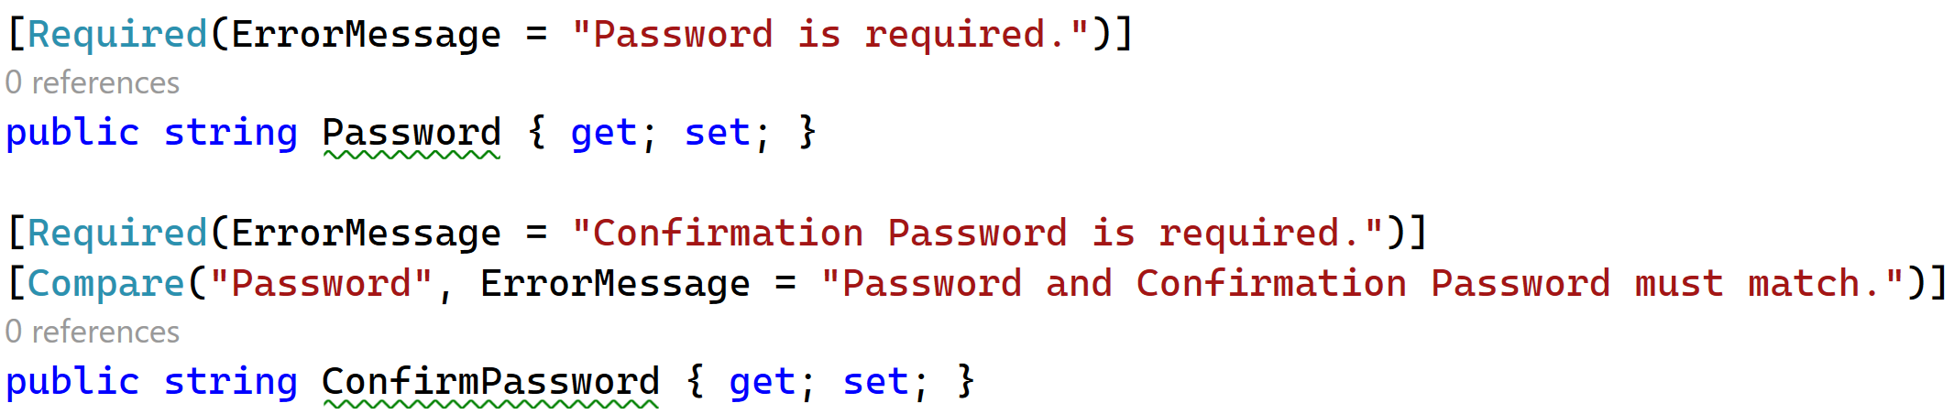
[Compare]
public string Password { get; set; }
[Compare(“Password",ErrorMessage =“Password does not match")]
public string ConfirmPassword { get; set; }
Password does not match
Example

Slide 16
[EmailAddress]
[EmailAddress]
public string Email { get; set; }
Empty The Email field is required.
String does not match The Email field is not a valid e-mail address.
[EmailAddress(ErrorMessage ="Please Enter Valid Email")]
public string Email { get; set; }
Invalid Email Please Enter Valid Email

Slide 17
Employee Model | [EmployeeModel.cs]
public class EmployeeModel
{
[Required(ErrorMessage = "First Name is Required")]
[Display(Name = "First name")]
public string FirstName { get; set; }
[Required]
[Display(Name = "Last Name")]
public string LastName { get; set; }
[Required]
[StringLength(10)]
public string MobileNo { get; set; }
[Required(ErrorMessage = "Enter Valid email")]
[EmailAddress]
public string Email { get; set; }
}

Slide 18
Employee.cshtml (View Page)
<div class="form-group col-md-4">
<h3>Employee Registrtion </h3> <hr />
</div>
<div class="form-row">
<form role="form" method="post" asp-controller="Employee" asp-action="Save">
<div class="form-group">
<div class="form-group col-md-4">
<label><span class="text-danger">*</span>First Name</label>
<input type="text" class="form-control" placeholder="Enter First Name"
asp-for="FirstName">
<span asp-validation-for="FirstName" class="text-danger"></span>
</div>
</div>
<div class="form-group">
<div class="form-group col-md-4">
<label><span class="text-danger">*</span>Last Name</label>
<input type="text" class="form-control" placeholder="Enter Last Code"
asp-for="LastName">
<span asp-validation-for="LastName" class="text-danger"></span>
</div>
</div>

Slide 19
Employee.cshtml (View Page) Cont..
<div class="form-group">
<div class="form-group col-md-4">
<label><span class="text-danger">*</span>Mobile No</label>
<input type="text" class="form-control" placeholder="Enter State Code"
asp-for="MobileNo">
<span asp-validation-for="MobileNo" class="text-danger"></span>
</div>
</div>
<div class="form-group">
<div class="form-group col-md-4">
<label><span class="text-danger">*</span>Email</label>
<input type="text" class="form-control" placeholder="Enter State Code"
asp-for="Email">
<span asp-validation-for="Email" class="text-danger"></span>
</div>
</div>
<br />
<button type="submit" class="btn btn-primary">Save</button>
</form>
</div>

Slide 20
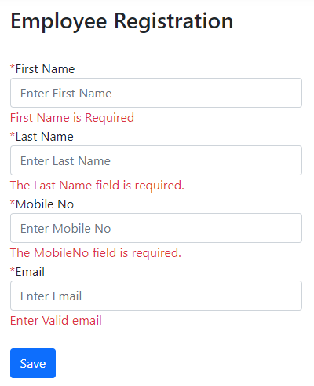
Example: Employee Registration | Client Side Validation

Slide 21
2. Server Side Validation
Server-Side Validation in ASP.NET Core MVC is a critical part of ensuring data integrity and security.
While client-side validation improves user experience by providing immediate feedback, it can be bypassed (e.g., by disabling JavaScript).
Server-side validation ensures that data is validated on the server before processing, making it a must-have for any application.
How Server-Side Validation Works?
When a form is submitted, the data is sent to the server. The model binding system maps the form data to the model properties. The ModelState object is used to track the validity of the model based on the Data Annotations applied to it. If any validation errors occur, they are added to the ModelState. The controller checks the ModelState.IsValid property to determine if the data is valid.

Slide 22
ModelState
ModelState is a property of controller that is used for validating data on server side.
ModelState is a collection of name and value pair that was submitted to the server during post.
It also contains a collection of error messages for each value submitted.
ModelState.IsValid property
ModelState.IsValid property is an inbuilt property which verifies two things:
Whether the Form values are bound to the Model.
All the validations specified inside Model class using Data annotations have been passed.
if (ModelState.IsValid)
{
... do something
}
else
{
... do something
}

Slide 23
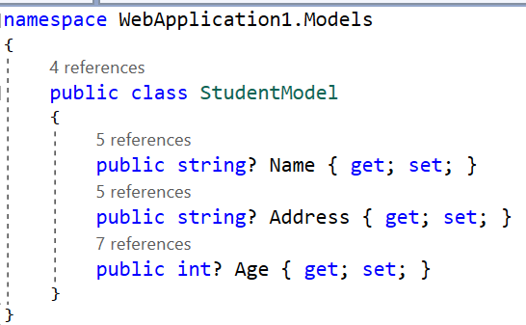
Student Model | Without Annotations

Slide 24
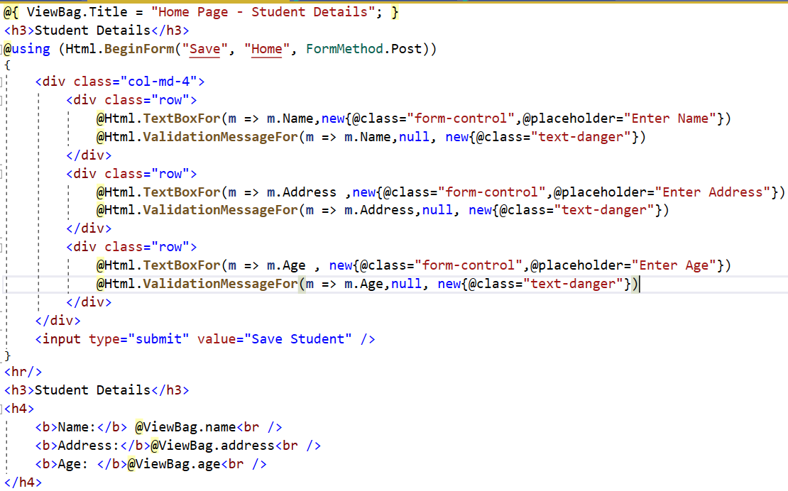
Student Form Design using HTML Tag Helpers

Slide 25
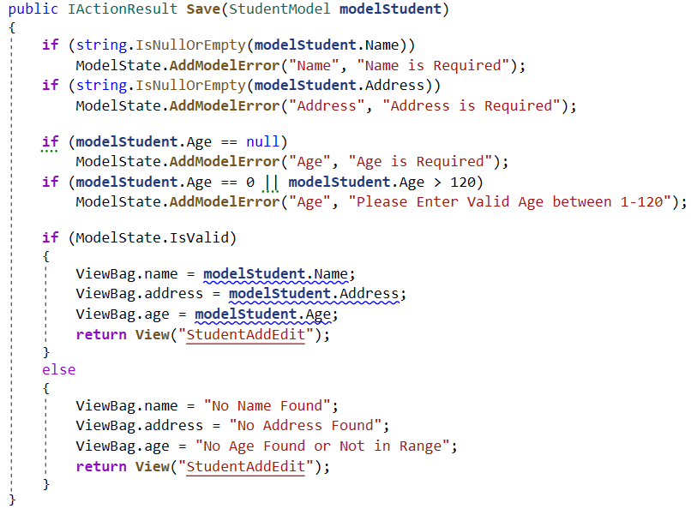
Home Controller Save Action Method | Custom Validation

Slide 26
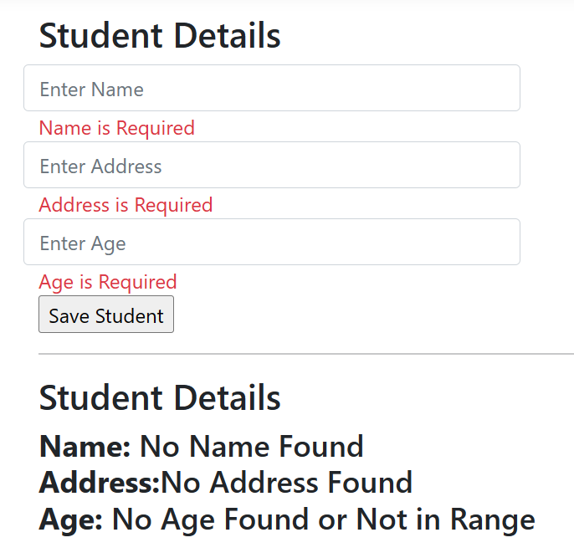
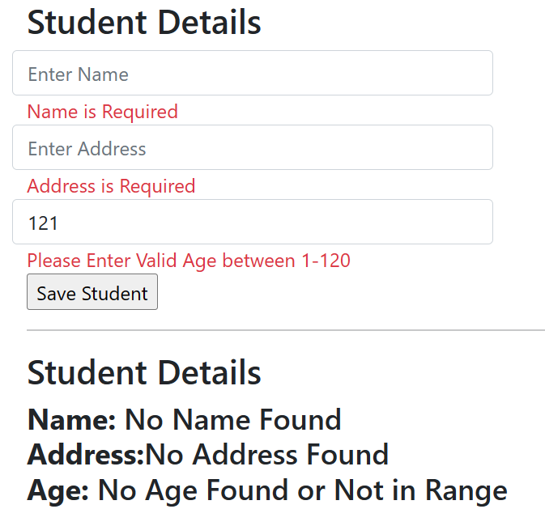
Output

Slide 27
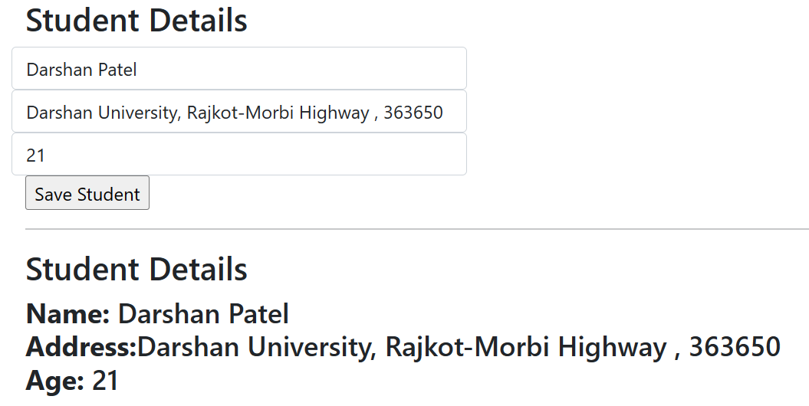
Output

Slide 28
Data Passing Techniques
Section – 4.2

Slide 29
Data Passing Techniques - Introduction
In ASP.NET Core MVC, data passing is a fundamental aspect of building dynamic web applications.
There are several techniques to pass data between the controller, view, and other components.
ViewData
ViewBag
TempData

Slide 30
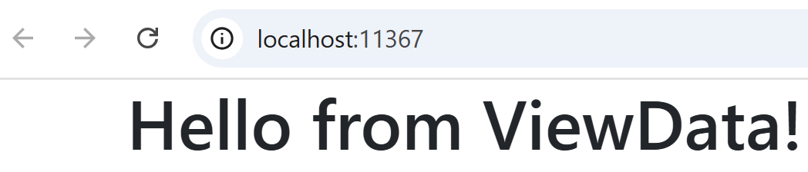
ViewData
ViewData is a dictionary-like object that allows you to pass data from a controller to a view.
It uses string keys to store and retrieve data.
Data is stored as object, so it requires type casting when retrieving.
Lifetime: Only available during the current request.
Example
Output
Controller File (HomeController.cs) | View File (Index.cshtml)
public class HomeController : Controller { public IActionResult Index() { ViewData["Message"] = "Hello from ViewData!"; return View(); } } | <h1>@ViewData["Message"]</h1>

Slide 31
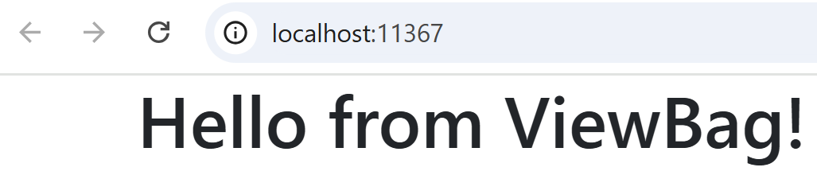
ViewBag
ViewBag is a dynamic wrapper around ViewData.
It uses dynamic properties instead of dictionary keys.
No type casting is required, but it is less type-safe.
Lifetime: Only available during the current request.
Example
Output
Controller File (HomeController.cs) | View File (Index.cshtml)
public class HomeController : Controller { public IActionResult Index() { ViewBag.Message = "Hello from ViewBag!"; return View(); } } | <h1>@ViewBag.Message</h1>

Slide 32
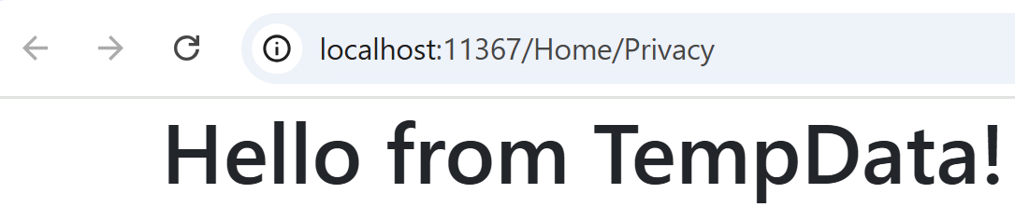
TempData
TempData is used to pass data between two consecutive requests (e.g., during redirects).
It is stored in session state by default.
Data persists until it is read or the session expires.
Useful for scenarios like passing data between actions (e.g., after a form submission).
Example
Output
Controller File (HomeController.cs) | View File (Privacy.cshtml)
public IActionResult Index() { TempData["Message"] = "Hello from TempData!"; return RedirectToAction("Privacy"); } public IActionResult Privacy() { var message = TempData["Message"]; return View(); } | <h1>@TempData["Message"]</h1>

Slide 33
Model Binding
Section – 4.3

Slide 34
Default Model Binder
Section – 4.3.1

Slide 35
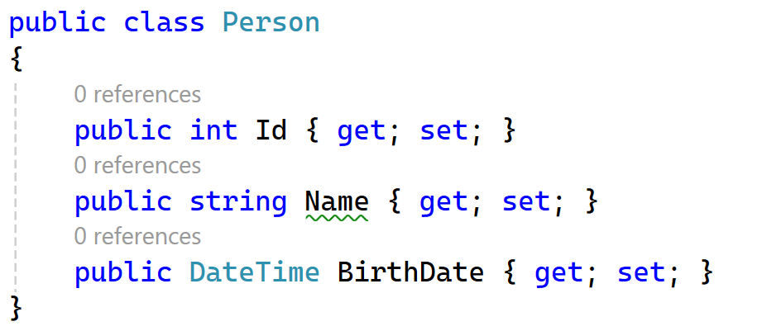
Default Model Binder
The default model binder in ASP.NET Core MVC is designed to handle most common data types and scenarios.
It automatically maps data from HTTP requests to action method parameters or model properties.
Here’s a simple example to illustrate how it works:
Let’s say you have a model class Person and a corresponding action method Create in your controller:

Slide 36
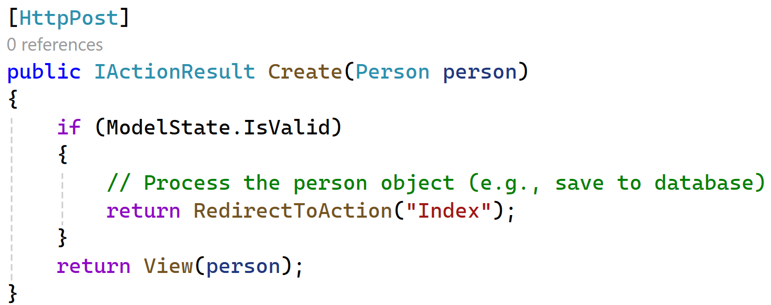
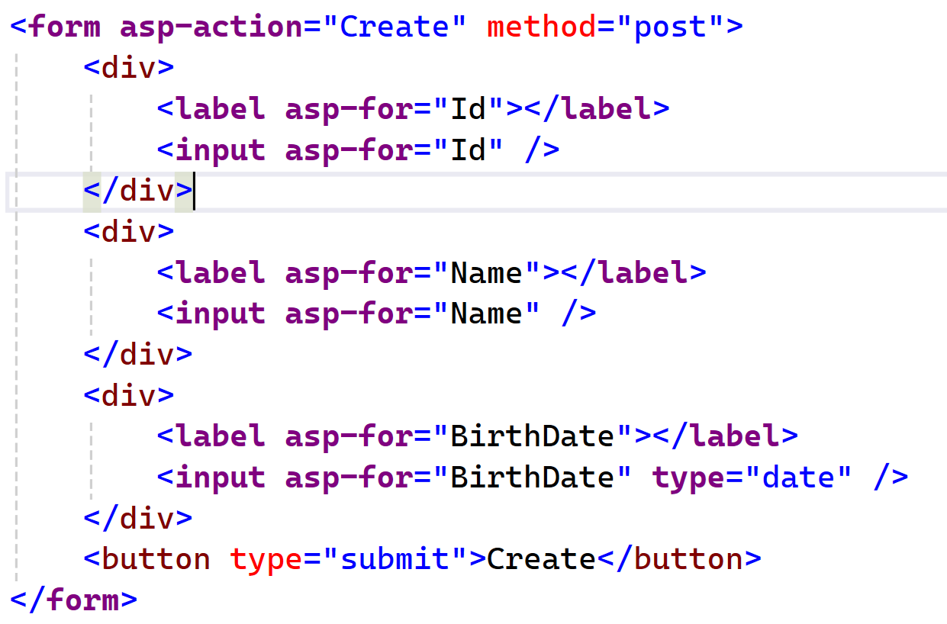
Default Model Binder Cont..
How It Works?
When the form is submitted, the default model binder:
Retrieves Data: Collects data from the form fields.
Converts Data: Converts the string values to the appropriate .NET types (e.g., int, string, DateTime).
Assigns Data: Assigns the converted values to the properties of the Person object.
Validates: Checks the ModelState to ensure all data is valid.

Slide 37
IFormCollection
Section – 4.3.2

Slide 38
IFormCollection
IFormCollection is a key-value pair collection that represents form data sent in an HTTP request.
A IFormCollection Object is used to retrieve form input values in action method.
We can retrieve all the controls values using IFormCollection object.
It provides a flexible way to access form data.
You need to manually extract and convert values.
Useful for dynamic forms or when you don’t have a strongly-typed model.
Sometimes we are not working with the model and still we want to get all data together using key value pair (HTML Id’s) of form so, IFormCollection object is helpful in that case also.

Slide 39
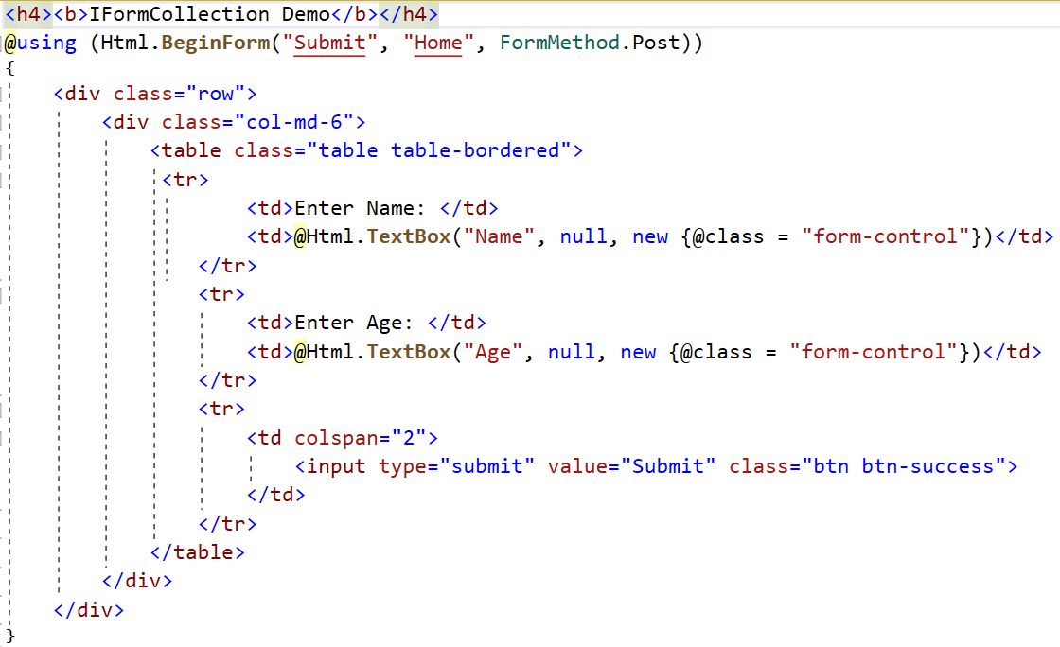
Index.cshtml | Form With Two Text Controls

Slide 40
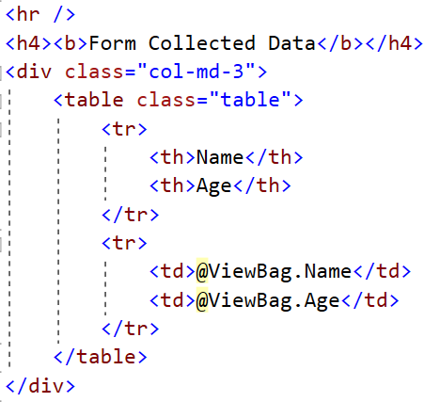
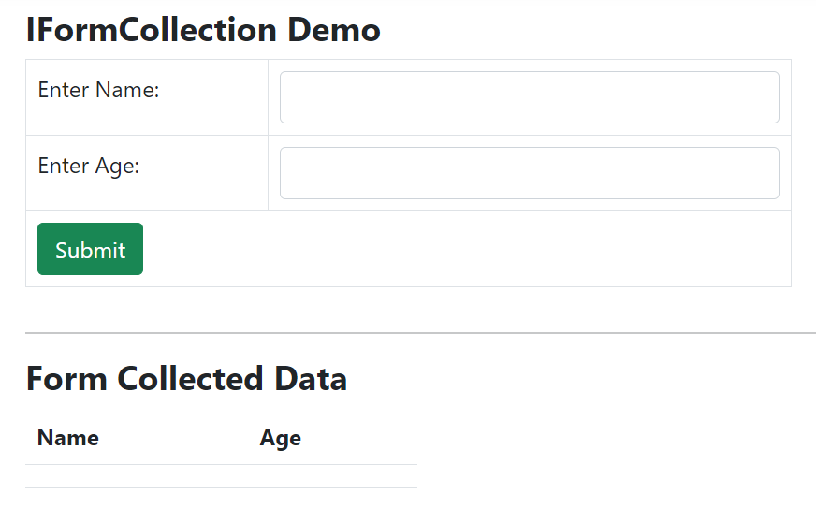
Index.cshtml | Form With Two Text Controls Cont..

Slide 41
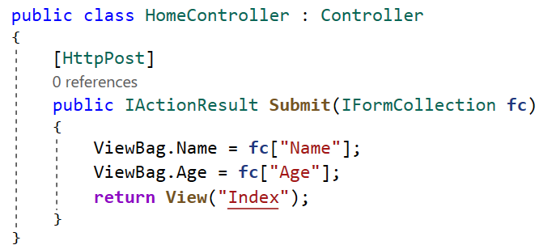
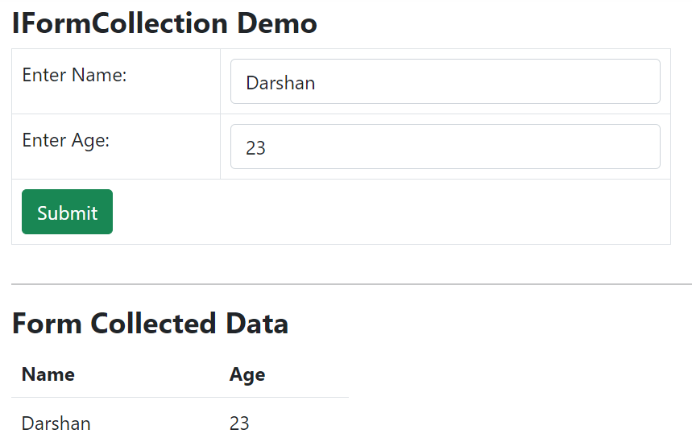
Controller Action Method Code

Slide 42
Bind Attribute
Section – 4.3.3

Slide 43
Bind Attribute
Model binding automatically maps form data to a strongly-typed model.
The [Bind] attribute allows you to control which properties are bound, enhancing security and preventing over-posting attacks.
It can be found in Microsoft.AspNetCore.Mvc namespace.
Example: You have a Employee Model as follows
public class EmployeeModel
{
public int ID { get; set; }
public string Name { get; set; }
public string Mobile { get; set; }
public string Email { get; set; }
public string City { get; set; }
}

Slide 44
Bind Attribute - Including Specific Properties
You can use the [Bind] attribute to include only specific properties for binding.
It uses a "whitelist" strategy, whereby only attributes that are explicitly mentioned in the action method arguments are bound by default, and all other properties are not.
For example, you want to bind only Id and Name property from employee model then?
public IActionResult EmployeeAdd([Bind("ID,Name")] EmployeeModel model)
{
// Only “ID” and “Name” properties will be bind from the request
return RedirectToAction("Index");
}
public class EmployeeModel
{
public int ID { get; set; }
public string Name { get; set; }
public string Mobile { get; set; }
public string Email { get; set; }
public string City { get; set; }
}

Slide 45
Bind Attribute - Prefixing
The [Bind] attribute can also be used to specify a prefix for properties that should be bound.
For example
<form role="form" method="post" asp-area="" asp-controller="FileUpload" asp-action="Employee">
<div class="form-group col-md-4">
<label>Employee Name</label>
<input type="text" name="Employee.Name" class="form-control" />
</div>
<div class="form-group col-md-4">
<label>Mobile</label>
<input type="text" name="Employee.Mobile" class="form-control" />
</div>
<div class="form-group col-md-4">
<label>Email</label>
<input type="text" name="Email" class="form-control" />
</div>
<div class="form-group col-md-4">
<label>City</label>
<input type="text" name="City" class="form-control" />
</div>
<button type="submit" class="btn btn-primary">Save</button>
</form>

Slide 46
Bind Attribute - Prefixing
In Controller we have Employee as follows:
Here only Name and Mobile property will be bound to model from the request. Remaining model properties will not be bound so it will be null.
public IActionResult Employee([Bind(Prefix = "Employee")] EmployeeModel model)
{
// Only 'Name' and 'Mobile' properties will be bind from the request
return RedirectToAction("Index");
}

Slide 47
ASP.NET Core
#2301CS412
Prof. Naimish R. Vadodariya
Computer Science & Engineering Department
naimish.vadodariya@darshan.ac.in
8866215253

