Slide 1


GUJARAT TECHNOLOGICAL UNIVERSITY
Chandkheda, Ahmedabad Affiliated
GOVERNMENT ENGINEERING COLLEGE BHAVNAGAR
DEPARTMENT OF COMPUTER ENGINEERING
A Presentation On :
Book E-sell
E-commerce Website
Under subject of
Summer Internship(3170001)
B. E. Semester –VII (Computer Engineering)
Submitted by:
Name of student: Krupali Bhut
Enrolment No.: 200210107513
External Guide
Mrs. Sweety Patel
Internal Guide
Prof. H. S. Sanghavi
Academic year 2022-23

Slide 2

OUTLINE
Project Definition
Abstract
Technology
Objective
Learnings to Project
Conclusion
Reference

Slide 3

Project Definition
The project “ Book E-sell E- commerce website “ has been developed on Web based application. The Book-e-sell provide the different type of book like technical books, Biography Books, novels etc…
The main for developing this project where customer can purchase and order books through online. Customer can buy the books from home through internet.
This web based application helps customers to choose their required book and add books to their shopping cart.

Slide 4
Abstract
The project “ Book E-sell E- commerce website “ has been developed on Web based application. The Book-e-sell provide the different type of book like technical books, Biography Books, novels etc.., Customer can buy or purchase that required book. and customer can added a books to cart.
Using this ecommerce website customer can save their time. Customer can easily buy that required Book from home through Internet. This system reduces lots of work load for customers as well as owner.

Slide 5
Technology
Technologies used in Book E-sell E-commerce Website
Fronted : Reactjs, HTML, CSS
Backend : .Net, Node.js
Database : PostgreSQL

Slide 6
Objective
User can see all types of book on online
User can check books price and concept about books
Provide 24 hour services

Slide 7
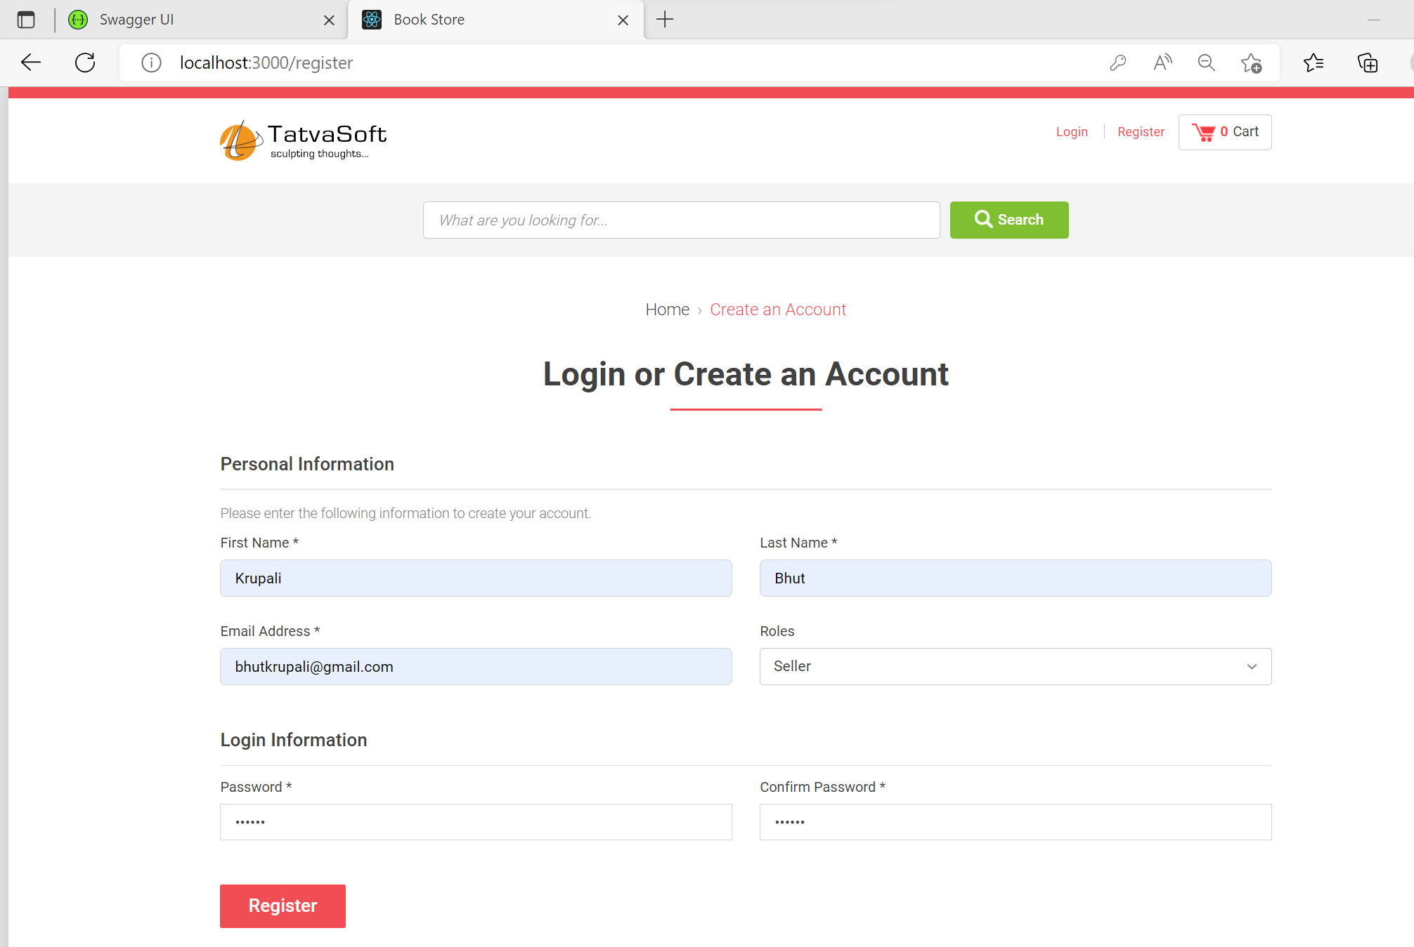
Learnings to Project
Here, some snapshot of the E-commerce website:
Registration page:
Registration Page

Slide 8
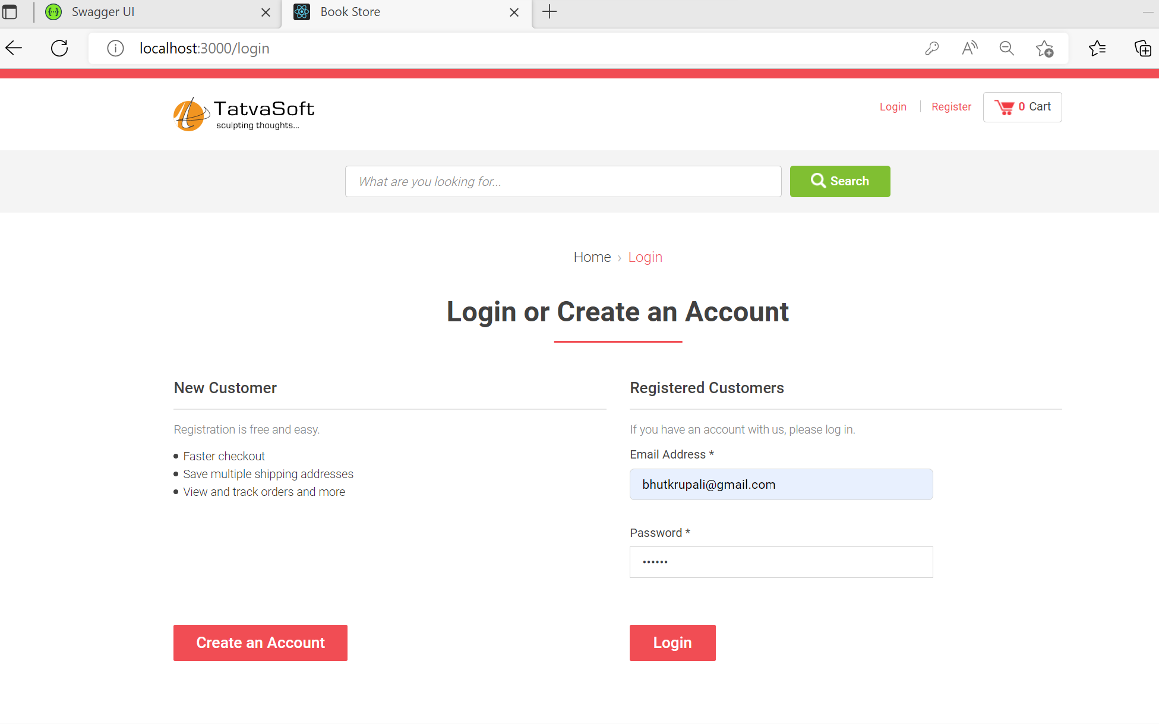
Learnings to Project
Login Page:
Login Page

Slide 9
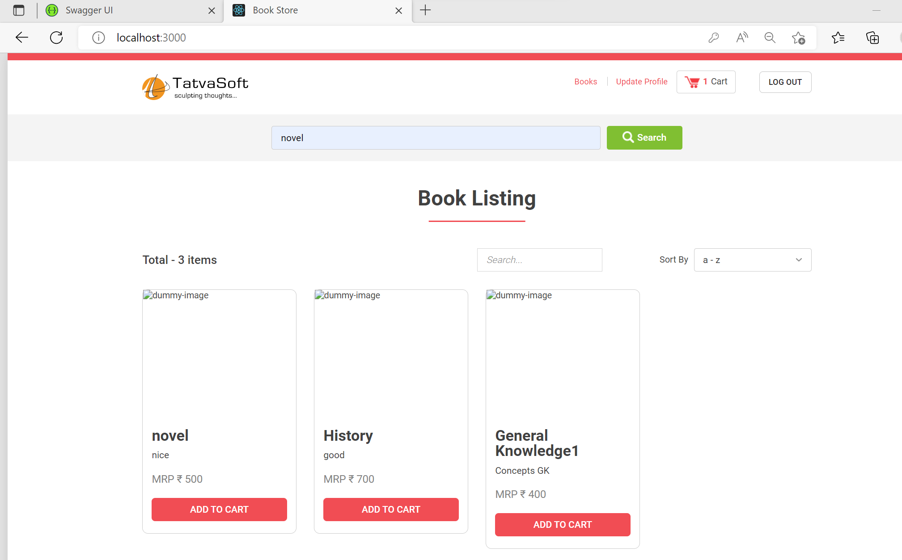
Learnings to Project
Book Listing Page:
Book Listing Page

Slide 10
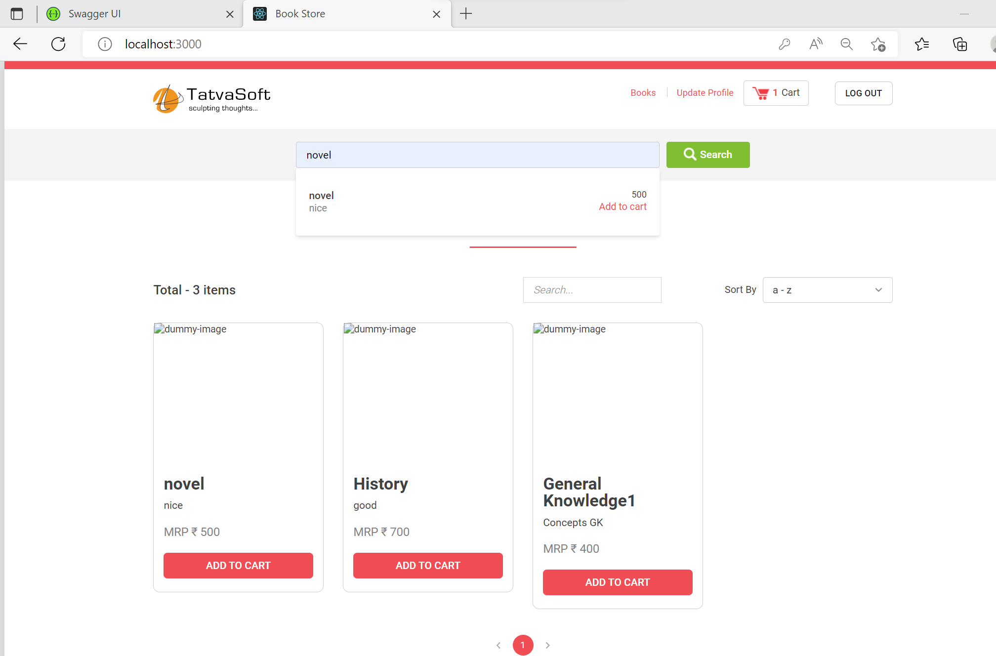
Learnings to Project
Book Searching Page:
Book Searching Page

Slide 11
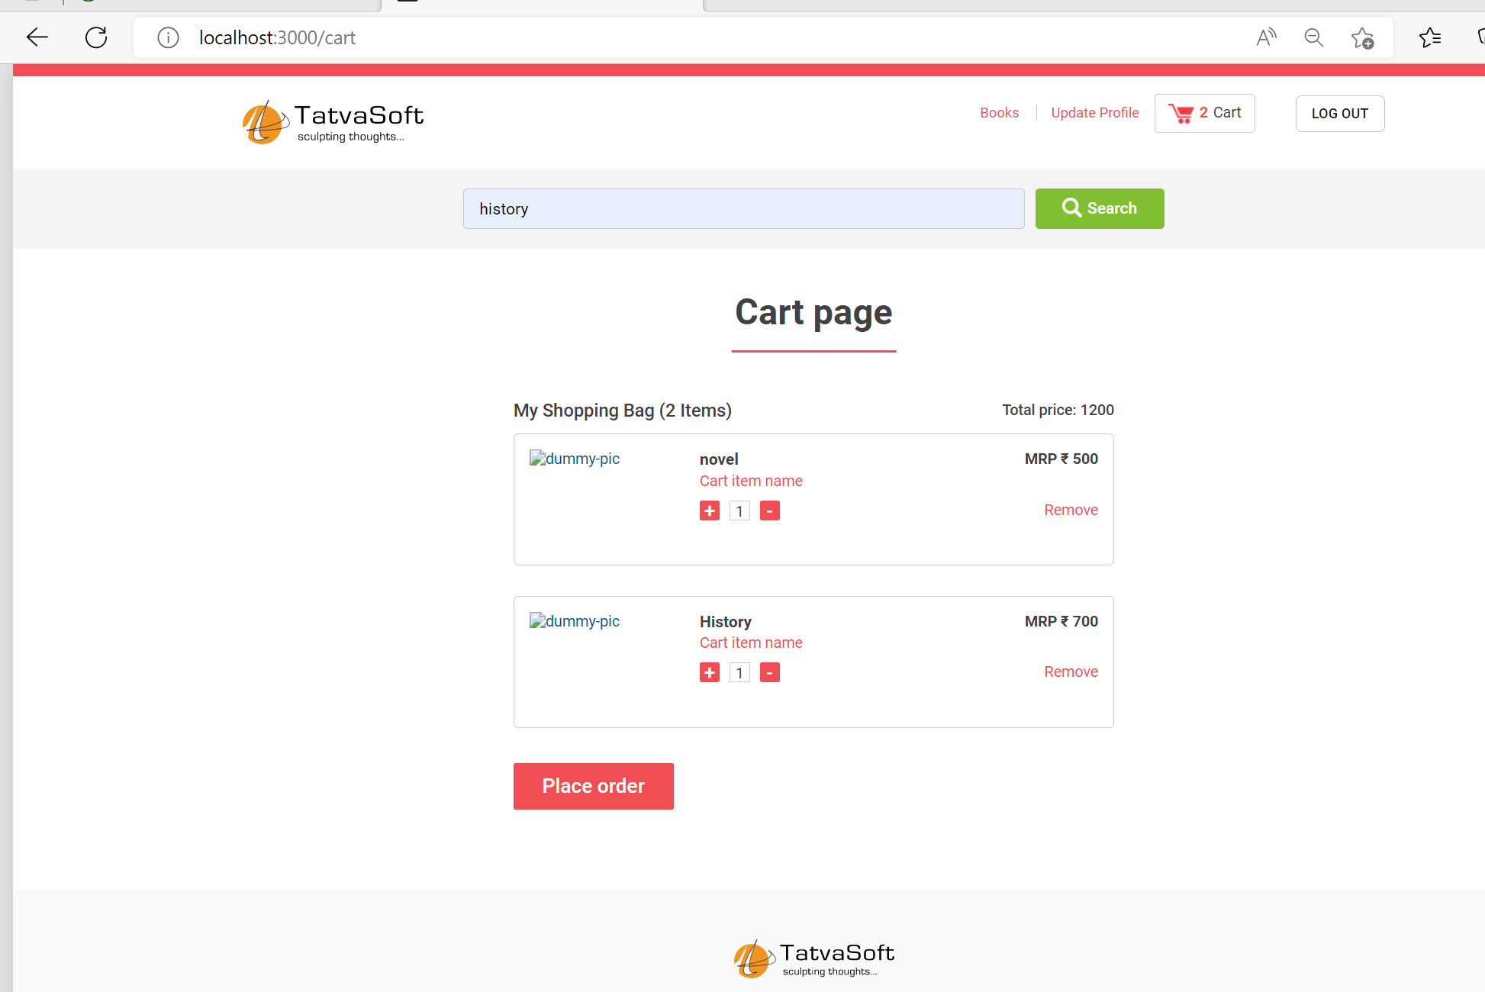
Learnings to Project
Cart Page:
Cart Page

Slide 12
Conclusion
Learned how end-to-end project of data analytics works.
learned a lot about react during my internship.
Deeply know about PostgreSQL.
Learn out is how to create a Context with ReactJS and create .net core web api.

Slide 13
Reference
Concepts of Reactjs
React – A JavaScript library for building user interfaces (reactjs.org)
Learning Formik in reactjs
ReactJS Form Validation using Formik and Yup - GeeksforGeeks
Learning reactjs
https://www.w3schools.com/react/default.asp
.Net Core Web API
.NET Core Tutorial (tutorialspoint.com)
Learning PostgreSQL
https://www.youtube.com/playlist?list=PLk1kxccoEnNEtwGZW-3KAcAlhI_Guwh8x

Slide 14
Thank you!

