Slide 1
Amazon Product Review
Sentiment Analysis
Machine Learning & Natural Language Processing

Slide 2
Project Overview
Objective: Predict customer sentiment from product reviews using machine learning
Implementation: Multiple classification algorithms compared for performance
Key Features: Natural language processing, TF-IDF vectorization, sentiment classification
Dataset: 40,249 Amazon product reviews with ratings and text
Outcome: Achieved 91% accuracy in predicting positive vs. negative sentiment

Slide 3
Dataset Information
40,249
6
78.8%
21.2%
Total Reviews
Features
Positive
Negative
Key Features:
• Text: Full review content
• Summary: Brief review summary
• Score: Rating (1-5 stars)
• Helpfulness metrics
• Timestamp

Slide 4
Data Preprocessing Pipeline
1. Data Cleaning
• Removed null values
• Selected relevant features
2. Sentiment Labeling
• Scores 1-3 → Negative (0)
• Scores 4-5 → Positive (1)
3. Text Cleaning
• Lowercase conversion
• Remove URLs & HTML tags
• Remove punctuation
• Remove stopwords
• Tokenization
4. Feature Engineering
• TF-IDF Vectorization
• Max 5,000 features
• Convert text to numerical
Result: Clean, structured data ready for ML models

Slide 5
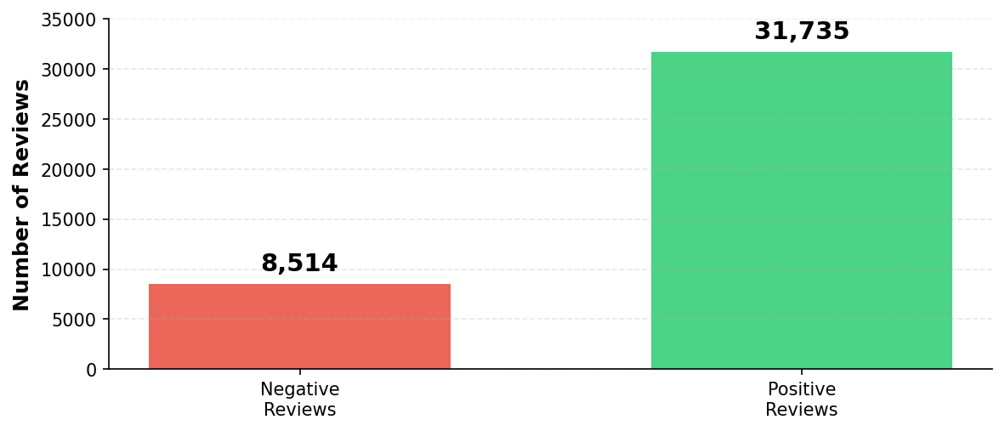
Class Distribution Analysis
Class Imbalance: Dataset skewed toward positive reviews (78.8% vs 21.2%) requires careful model evaluation

Slide 6
Machine Learning Models
Logistic Regression
Linear classification model
Interpretable baseline
Naive Bayes
Probabilistic classifier
Text-specific
Linear SVC
Support Vector Machine
High-dimensional
Decision Tree
Recursive splitting
Non-linear patterns
Random Forest
Ensemble method
Robust predictions

Slide 7
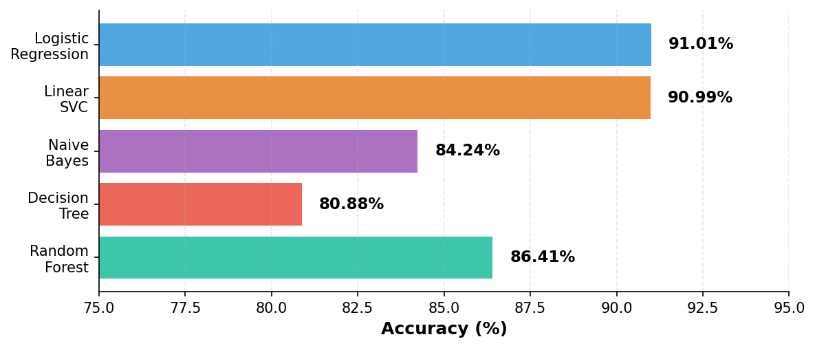
Model Performance Comparison
🏆 Best Model: Logistic Regression - 91.01% Accuracy

Slide 8
Logistic Regression - Performance Metrics
76%
75%
94%
95%
Precision (Negative)
Recall (Negative)
Precision (Positive)
Recall (Positive)
Overall Performance:
• Weighted Average Precision: 91%
• Weighted Average Recall: 91%
• F1-Score: 91%
• Strong performance across both sentiment classes

Slide 9
Most Influential Words
Predicting NEGATIVE Sentiment
Predicting POSITIVE Sentiment
• worst (3.77)
• terrible (3.45)
• disappointed (3.40)
• horrible (3.10)
• awful (2.97)
• disgusting (2.77)
• great (-4.00)
• good (-3.44)
• nice (-3.20)
• delicious (-3.05)
• love (-2.88)
• perfect (-2.79)
Weight values indicate feature importance in model predictions. Higher absolute values = stronger influence on classification.

Slide 10
Key Findings & Insights
Model Performance: Logistic Regression outperformed all models at 91.01% accuracy
Linear models (LR & Linear SVC) significantly better than tree-based models for text
TF-IDF vectorization proved highly effective for sentiment classification
Strong sentiment indicators identified: 'worst', 'terrible', 'great', 'excellent'
Class imbalance handled well - maintained 76% accuracy on minority class
Random Forest struggled with high-dimensional sparse text features (86.41%)

Slide 11
Conclusions & Future Work
Achievements:
• 91% prediction accuracy
• Identified key sentiment drivers
• Robust preprocessing pipeline
• Model comparison framework
Business Applications:
• Automated feedback analysis
• Real-time sentiment monitoring
• Product quality alerts
Future Improvements:
• Address class imbalance with SMOTE
• Experiment with deep learning
(LSTM, BERT transformers)
• Multi-class sentiment analysis
(1-5 star prediction)
• Deploy as REST API
• Real-time prediction system
• Integration with review platforms

Slide 12
Thank You
Questions?
Amazon Product Review Sentiment Analysis
Machine Learning & Natural Language Processing

