Slide 1
Live Inn –
a PG locator app
Presentation by :
Krushna Ramesh Khairnar.
Yash Mahendra Pawar.
Om Vilas Shimpi.
Sushnat Ashok Solase.
TYCM , RSM POlYTECHNIC NASHIK.

Slide 2
In short
PG locator is a mobile app that seamlessly connects and interacts with everyone globally. PG locator is a valuable tool for the modern business. In the present system a customer can get only little information like address, contact number and food. Due to lack of information like price, exact location, security measures, the customer is unable to find the best PG of their choice. Often the customer may be misguided.
So this app is helpfull in future.

Slide 3
The Main Objective
The main objective of the project is to develop an application that provides PG’s information regarding the location, facilities, food, price, maps, transportation facility, and safety measures. Any news, information, advertisements, displayed on this website reaches millions of potential customers.

Slide 4
Overview
The application is divided into 3 modules. User MODULE: After the registration the user can obtain the details of PG located in a place. A user can select the appropriate PG depending on information provided like security, address, and price. PG_OWNER MODULE: After the registration the pg owner has to submit the details of PG based on the verification process. The pg owner can provide information regarding location through address, cost, PG’s description, facilities and even security details. The pg owner can also update the status of the PG like whether it is filled or available. ADMINISTRATOR MODULE: This module provides administrator related functionality. Administrator manages all information and has access rights to add, delete, edit and view the data related to PG, User etc.

Slide 5
Flow Chart
Start
User
Vendor
Login
Register
Login
Register
View Pg/room
Add room/pg info
Search pg/room and select it.
Edit Pg/room info
View all details.
View info
contact
Manages booking
Log Out
End

Slide 6
USER: -
User Login: -
Description of User: -
This feature used by the user to login into system. A user must login with his user’s name and password to the system after registration. If they are invalid, the user not allowed to enter the system.
Functional requirement: -
Username and password will be provided after user registration is confirmed.
Password should be hidden from others while typing it in the field

Slide 7
Register New User: -
Description of feature: -
A new user will have to register in the system by providing essential details in order to view the products in the system.
Functional requirement: -
1) System must be able to verify and validate information.
2) The system must encrypt the password of the customer to provide security.
Viewing an Item: -
Description of feature: -
The user will be able to view different room/pg at different locations after login. The user should be able to search pg and even view their details.
Functional requirement: -
System must ensure that, only a registered customer can purchase items.

Slide 8
2) ADMIN: -
Manage User: -
Description of feature; -
The administrator can delete user, view user and block user.
Manage Vendors: -
Description of feature: -
The administrator can delete vendors, block vendors and search for a vendor.
Manage pg/room: -
Description of feature: -
The administrator can delete product and view room/pg.

Slide 9
3) Vendor’s: -
Add pg detail: -
Description of Feature: -
The Vendor can Add new details into the database with all its information.
Edit Product: -
Description of Feature: -
The Vendor can Edit the information of this pg and also Delete the pg from database;
View Product: -
Description of Feature: -
The Vendor will be able to View all the pg details in this tab and is given the option to delete all pg details from database.

Slide 10
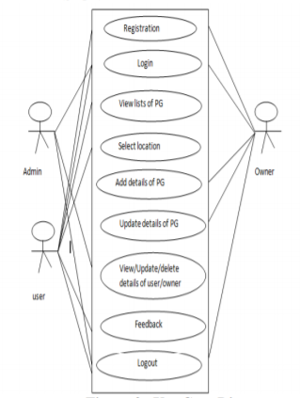
Use case diagram
Registration
Login
View list of pg
Select Location
Feedback
Logout
Login
View / update/delete
Of user
logout
Registration
Login
View list of pg
Select Location

Slide 11
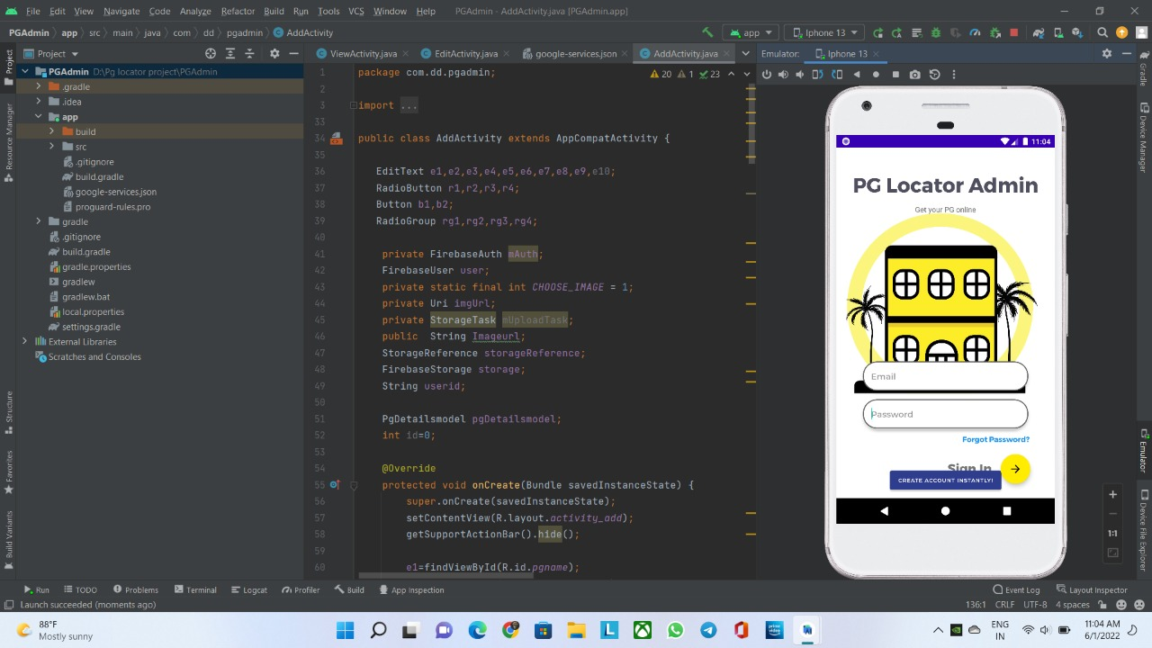
Output
1. PG Admin app Running & Working Perfectly!

Slide 12
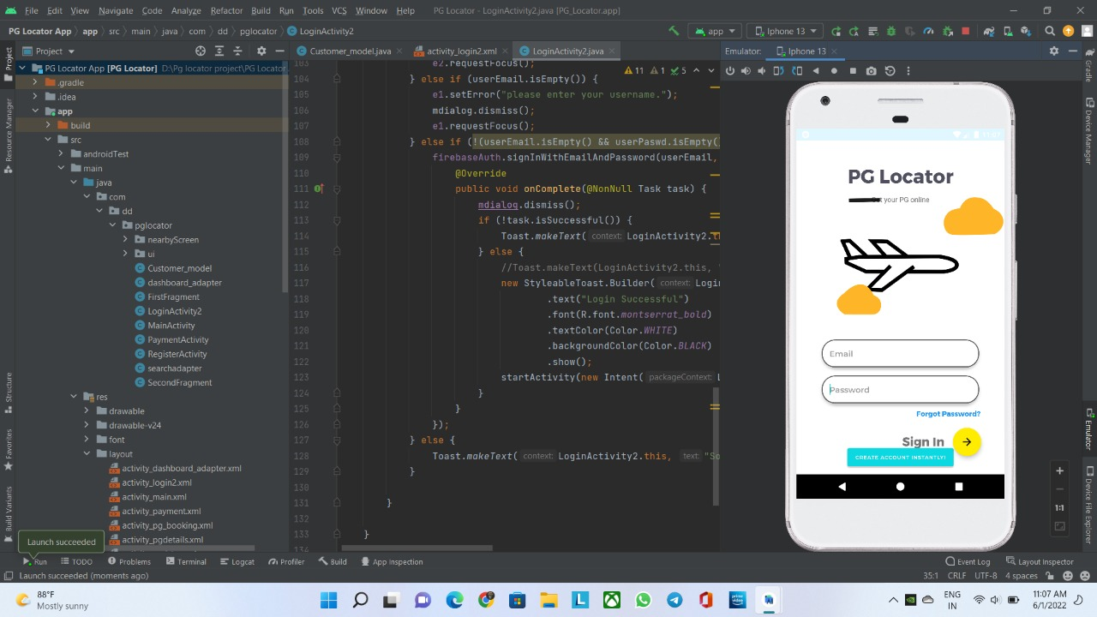
2. PG Locator App Working Smoothly.

Slide 13
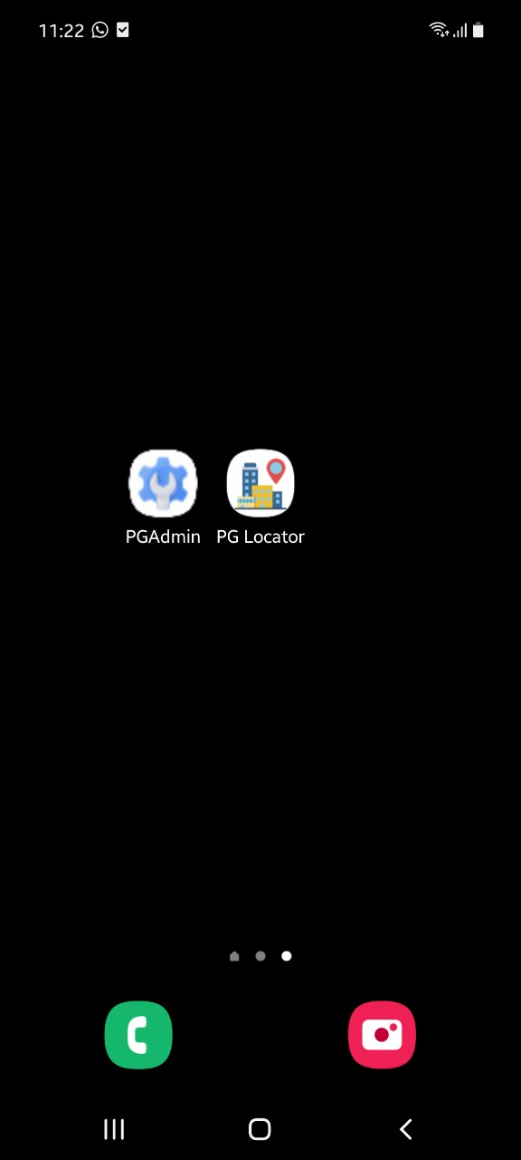
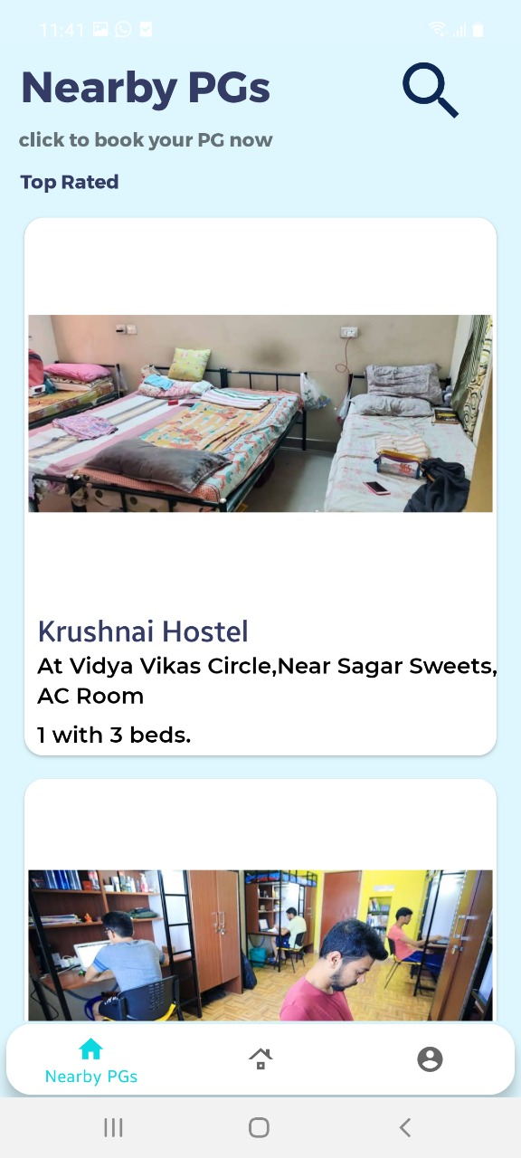
3. App Installed Perfectly on Phone!
4. UI of our PG locator App!

Slide 14
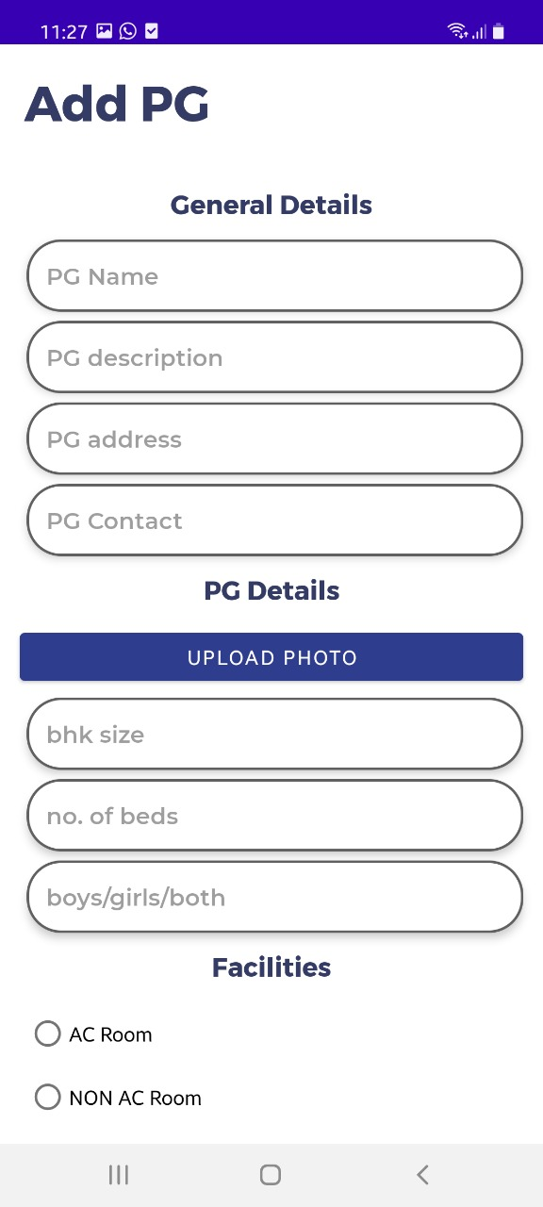
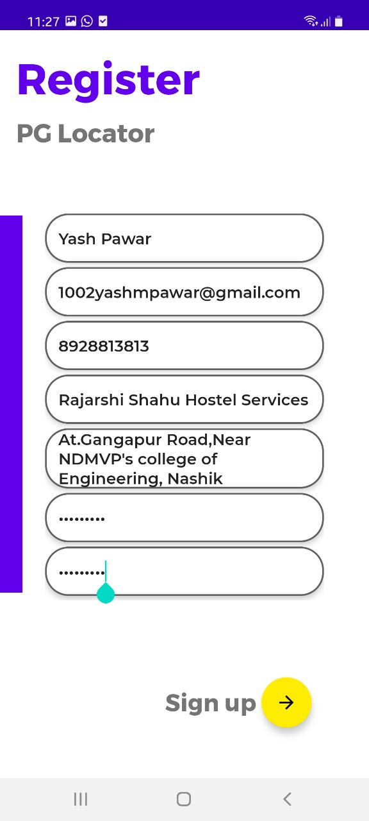
5. Control Pannel While Listing PG on app!
6. Login Page!

Slide 15
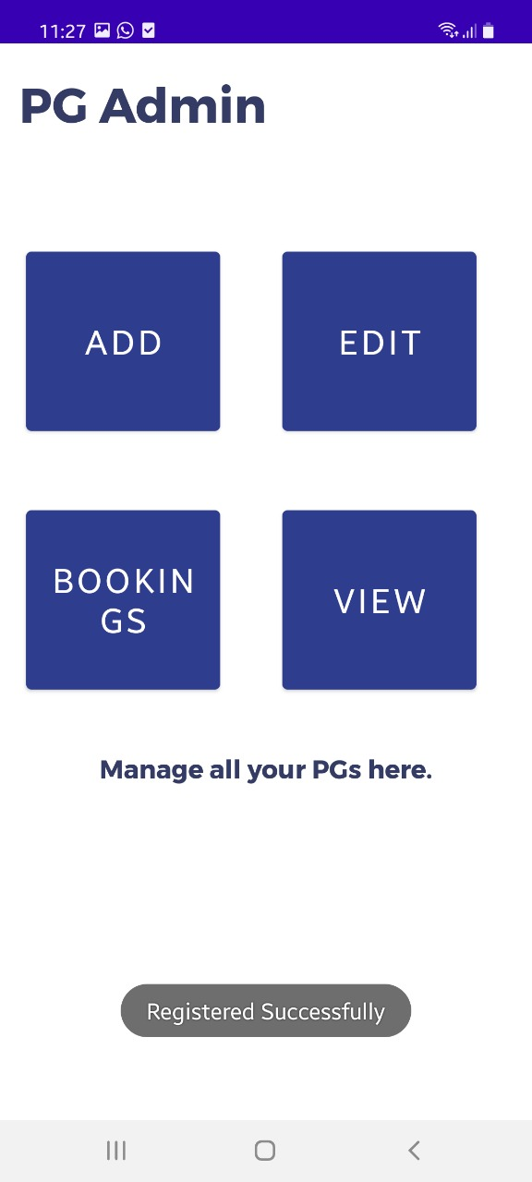
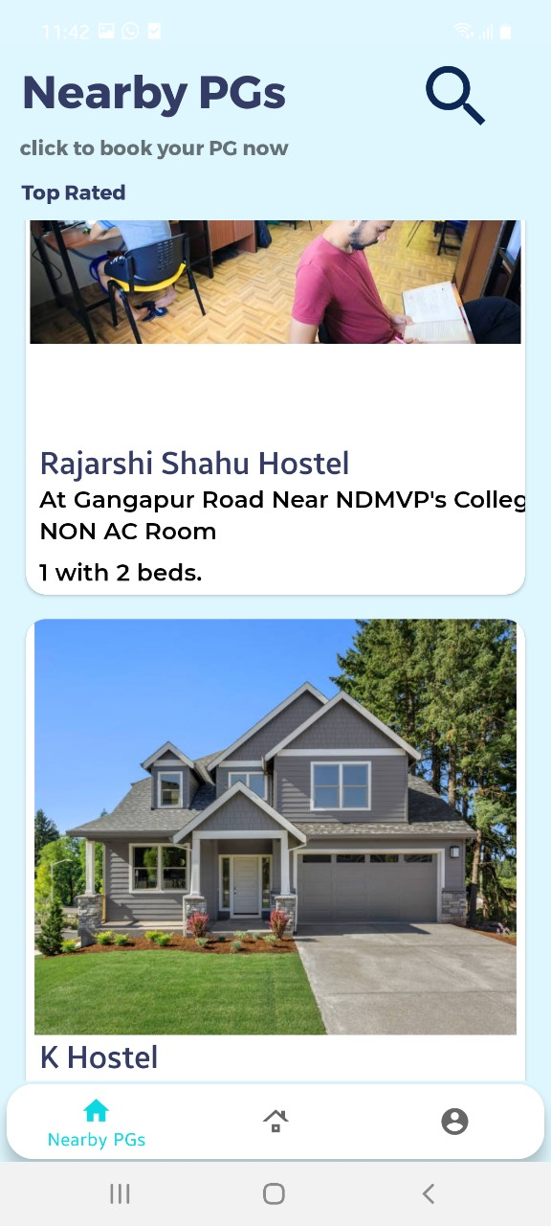
8. People getting helped with this App & Easy to use UI !
7. Various Options in Admin Pannel!

Slide 16
Conclusion & Future Scope
PG Locator is a user-friendly app which enables the people to easily locate authorized PGs only. time has been an important factor in everyone's life and when people move to different places to study or to work, they definitely have to waste time in searching for accommodation. This app turns to be very time saving for us. There have also been certain cons of this app. the app has been reported to hang/lag in underdeveloped phones. According to a survey conducted by the pew research Centre, in India ONLY 17% of people are using smart phones. so, if the app is reported to hang in underdeveloped phones, then it is something that is to be taken into account and a solution must be provided.

Slide 17
Thank You

