Slide 1

Topic :- STUDY OF MANUFACTURING FOR SIPOREX AAC BLOCKS & PAVER BLOCKS
Department of Civil Engineering
Project 1
Roll Nos : - 361003
361009
361015
361022
361063
BRACT’S, Vishwakarma Institute of Information Technology, Pune-48
(An Autonomous Institute affiliated to Savitribai Phule Pune University)
(NBA and NAAC accredited, ISO 9001:2015 certified)

Slide 2
INTRODUCTION : -
C4X blocks are a type of construction material that are made from a mixture of cement, sand, and fly ash.
These blocks are often used as an alternative to traditional concrete blocks, as they are stronger and more durable.
The use of a chemical instead of the cement-sand mix in C4X blocks is not a common practice
.
However, there are certain chemicals that can be added to the mix to improve the strength and durability of the blocks.
Department of Civil Engineering, VIIT, Pune-48

Slide 3
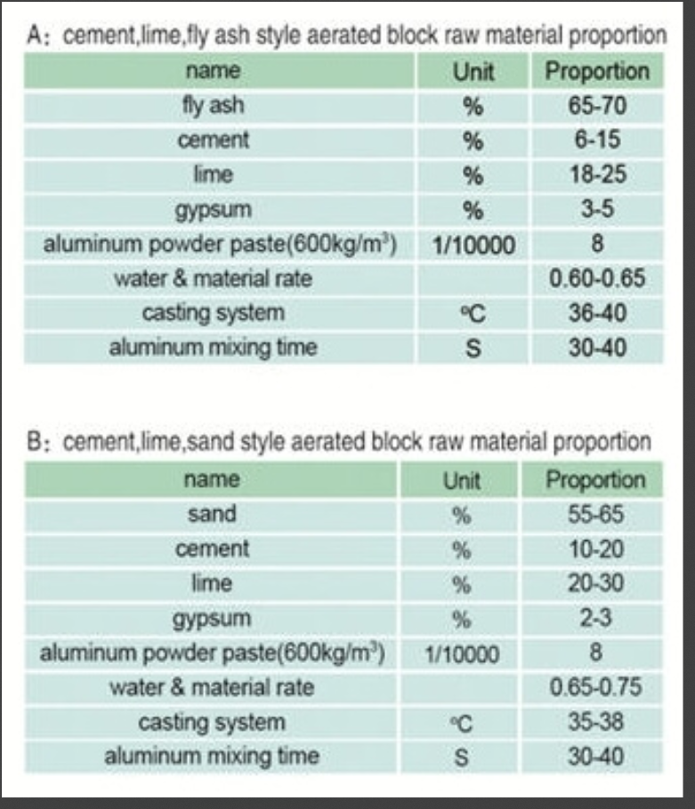
Mixing Proportions :-
Cement :- Typically, OPC (Ordinary Portland Cement) is used. The cement content can vary, but a common range is around 8-12% by weight of the dry mix.
Fly Ash : - Fly ash is used as a pozzolan and is a major component in AAC. It can vary from 55-65% by weight of the dry mix.
Lime : - Lime is usually used in the range of 18-25% by weight of the dry mix. It serves as a binder and aids in the curing process.
Aluminum Powder : - Aluminum powder is used as a foaming agent. The quantity can range from 0.03% to 0.08% by weight of the dry mix.
Silica Sand : - Silica sand is added in the range of 15-30% by weight of the dry mix. It provides structural integrity to the blocks.
Water : - The water content typically ranges from 60-65% of the dry mix weight. It is used to form the slurry that is poured into molds
Akhilesh Giram,Department of Civil Engineering, VIIT, Pune-48

Slide 4
Material : -
Silica Sand: The primary raw material, which is finely ground sand.
Cement: Typically Portland cement.
Lime: Sometimes used to improve workability and reduce the density.
Aluminum Powder: This acts as an expanding agent when mixed with water, creating tiny hydrogen gas bubbles.
Water: Needed for the chemical reaction that forms the AAC.
Department of Civil Engineering, VIIT, Pune-48

Slide 5
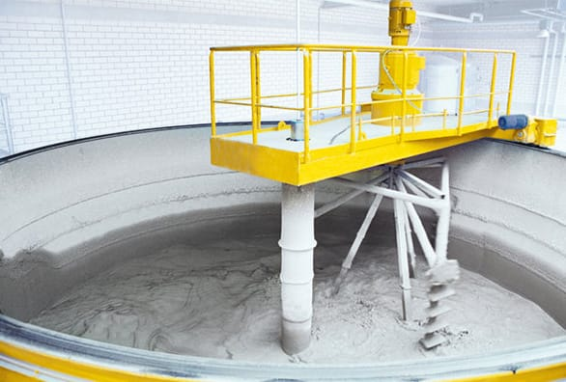
Procedure : - AAC (Autoclaved Aerated Concrete) blocks
Material Preparation: - Fly ash, cement, and lime are mixed in predetermined proportions to create the raw material mixture.Silica sand is washed and prepared for use.
Addition of Aluminum Powder : - A small amount of aluminum powder is added to the slurry. This acts as a foaming agent.
Mixing: - The slurry is thoroughly mixed to distribute the aluminum powder evenly.
Pouring into Molds: - The mixed slurry is poured into molds of the desired shape and size.
Curing: - The filled molds are kept in a controlled environment for a specific curing period. During this time, the aluminum powder reacts to release hydrogen gas, which creates tiny air bubbles in the mixture.
Slurry Preparation: - The raw material mixture is mixed with water to form a slurry.
Department of Civil Engineering, VIIT, Pune-48

Slide 6
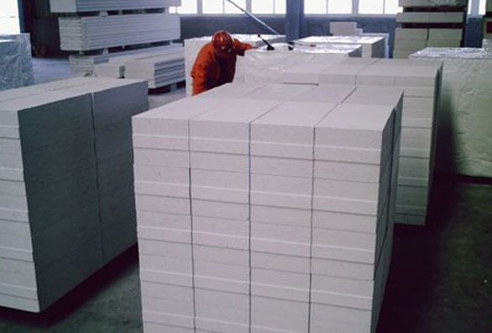
Autoclaving : - After curing, the molds are placed in an autoclave, which is a high-pressure steam chamber. The autoclaving process subject the blocks to high-pressure steam and temperature, which accelerates the hardening of the material. This step is crucial for the formation of AAC blocks as it strengthens and solidifies them.
Cutting and Trimming: - Once the blocks have been autoclaved, they are removed from the molds and cut to the desired dimensions.Any excess material is trimmed off.
Quality Control : - The blocks are inspected for quality, including dimensions, strength, and appearance.
Packing and Distribution : - The finished AAC blocks are packed and prepared for distribution to construction sites
Department of Civil Engineering, VIIT, Pune-48

Slide 7
How does ACC block achive it’s porous structure ???
AAC Blocks is a unique and excellent type of building material due to its super heat, fire and sound resistance, AAC blocks are lightweight and offers ultimate workability, flexibility and durability.
Its main ingredients include sand, water, quicklime, cement and gypsum.
The chemical reaction due to the aluminum paste provides AAC its distinct porous structure, lightness, and insulation properties, completely different compared to other lightweight concrete materials.
It allows liquid or air to pass through slowly .
Department of Civil Engineering, VIIT, Pune-48

Slide 8
Advantages for C4x blocks : -
Lightweight : - AAC blocks are significantly lighter than traditional concrete blocks, making them easier to handle and transport.
Insulation: - They provide excellent thermal insulation, which can help reduce energy consumption for heating and cooling.
Fire-resistant : - AAC blocks have good fire resistance properties, offering increased safety in case of a fire.
Sound insulation: - They offer good sound insulation, making them suitable for buildings in noisy environments.
Eco-friendly : - AAC blocks are made from sustainable materials and produce fewer greenhouse gas emissions during manufacturing compared to traditional concrete blocks.
Durability : - They are long-lasting and have low maintenance requirements.Easy to work with: AAC blocks are easy to cut, shape, and install, which can save on construction time and labor costs.
Department of Civil Engineering, VIIT, Pune-48

Slide 9
Disadvantage for C4x blocks : -
Cost: - AAC blocks can be more expensive than traditional concrete blocks, which can impact the overall cost of construction.
Limited availability : - In some regions, AAC blocks may not be readily available, making them less practical for certain construction projects.
Strength : - While AAC blocks are strong enough for most applications, they may not be as strong as conventional concrete in some high-stress situations.
Moisture absorption : - AAC blocks can absorb moisture, and if not properly sealed, this can lead to issues like mold and deterioration.
Skill required : - Specialized construction skills may be needed to work with AAC blocks effectively.
Transportation costs : - The lightweight nature of AAC blocks can make them vulnerable to damage during transportation, increasing costs .
Department of Civil Engineering, VIIT, Pune-48

Slide 10
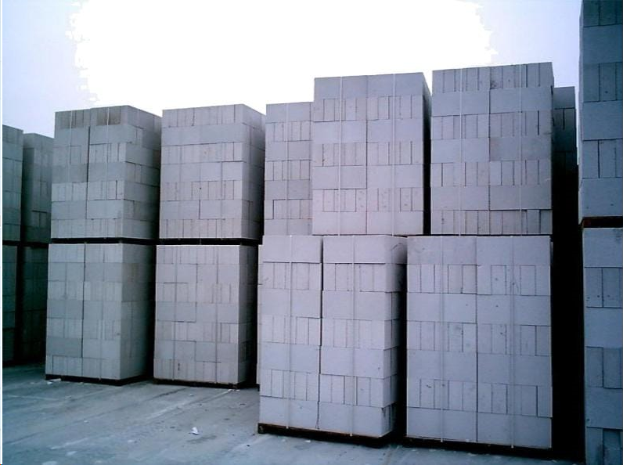
Casting Of Paver Blocks : -
Pavement blocks, also known as paving stones or pavers, are commonly used in outdoor flooring. They are typically made from concrete, clay, or natural stone. These blocks come in various shapes, sizes, and colors, allowing for versatile and aesthetic designs in walkways, driveways, patios, and other outdoor surfaces. The interlocking nature of pavement blocks provides stability and durability. Installation involves compacting a base material, such as sand or gravel, and then laying the blocks in a desired pattern. This type of paving offers easy maintenance and repair, as individual blocks can be replaced if damaged.
Department of Civil Engineering, VIIT, Pune-48

Slide 11
Concrete pavement blocks are typically made from a mix of Portland cement, aggregates (such as sand and crushed stone), water, and sometimes additives or pigments for color. The proportions of these components can vary, and the manufacturing process involves mixing, molding, and curing the concrete. The resulting blocks are durable, strong, and well-suited for various paving applications.
Department of Civil Engineering, VIIT, Pune-48

Slide 12
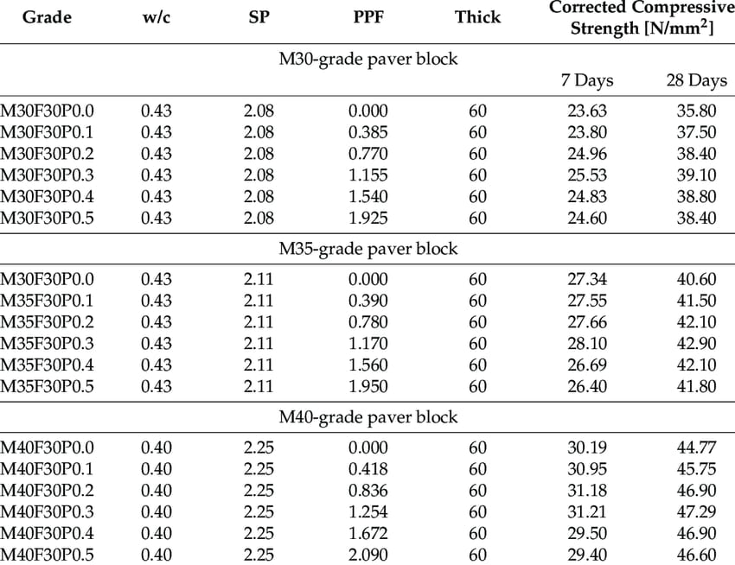
Mixing proportion chart : -
PPF : - polypropylene Fibre .
W/c : - water cement ratio .
SP : - Standard Practice .
Department of Civil Engineering, VIIT, Pune-48

Slide 13
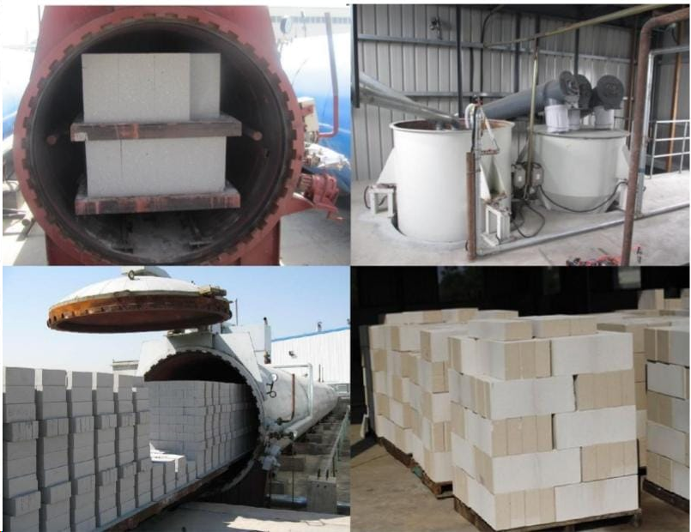
Photographs :-
Department of Civil Engineering, VIIT, Pune-48

Slide 14
Manufacturing Process : -
The manufacturing process of pavement blocks typically involves the following steps:
Raw Material Selection: Choose raw materials such as concrete, cement, aggregates (sand and gravel), and color pigments. The quality of these materials impacts the durability and appearance of the blocks.
Mixing: Combine the selected raw materials in precise proportions using a concrete mixer. This ensures a homogeneous mixture that will form the basis of the pavement blocks.
Molding: Place the mixed concrete into molds of desired shapes and sizes. The molds may have patterns or textures to create different surface finishes on the blocks.
Compaction: Compact the concrete within the molds to eliminate air gaps and achieve the desired density. This can be done through vibration or hydraulic pressure.
Curing: Allow the molded blocks to cure. This process involves maintaining the right conditions of temperature and humidity for a specific duration, ensuring the concrete reaches its designed strength.
Demolding: Once the blocks have sufficiently cured, remove them from the molds carefully. This step requires precision to avoid damaging the blocks.
Department of Civil Engineering, VIIT, Pune-48

Slide 15
Surface Finishing (optional): Depending on the desired appearance, the surface of the blocks may undergo additional treatments such as shot blasting or brushing to enhance texture or expose aggregates.
Quality Control: Inspect the blocks for any defects or irregularities. This may involve checking dimensions, color consistency, and overall quality.
Packaging: Prepare the pavement blocks for transportation by packaging them securely. This ensures they reach their destination without damage.
Distribution: Distribute the manufactured blocks to retailers or construction sites, depending on the production scale and business model.
Installation Guidelines (optional): Provide guidelines or recommendations for the proper installation of the pavement blocks. This may include details on base preparation, laying patterns, and jointing materials.
It's crucial for manufacturers to adhere to quality control standards and local regulations throughout the production process to ensure the durability and safety of the pavement block
Department of Civil Engineering, VIIT, Pune-48

Slide 16
Advantages : -
Advantages Durability: Resistant to wear and able to withstand heavy traffic over time .
Easy maintenance: Simple to replace individual blocks, making repairs more manageable compared to traditional pavement.
Versatile Design: Offers flexibility in design with various shapes, colors, and patterns, enhancing aesthetic appeal.
Stability: Provides a stable surface for walking, driving, or other activities.
Water Drainage: Permeable design allows efficient water drainage, reducing the risk of flooding and aiding in stormwater management.
Environmentally Friendly: Can be made from recycled materials, contributing to sustainability.
Reduced Runoff: Permeable surfaces help minimize water runoff and contribute to sustainable urban development.
These advantages collectively make pavement blocks a popular choice for various outdoor applications.
Department of Civil Engineering, VIIT, Pune-48

Slide 17
Disadvantages : -
Uneven Surface: Over time, pavement blocks can shift, leading to an uneven surface, which may pose tripping hazards.
Weed Growth: Gaps between blocks can allow weeds to grow, requiring additional maintenance efforts.
Cost: Initial installation costs can be higher compared to traditional asphalt or concrete surfaces.
Colour Fading: The colour of some pavement blocks may fade over time due to exposure to the elements.
Limited Load Capacity: While suitable for pedestrian and light vehicular traffic, pavement blocks may not be as suitable for heavy-duty applications.
Maintenance Challenges: Although individual block replacement is possible, maintaining the aesthetic appeal and structural integrity may require regular attention.
It's important to weigh these disadvantages against the specific requirements and priorities of a given project or application
Department of Civil Engineering, VIIT, Pune-48

Slide 18
References : -
1 . Site Visit .
2 . Web browser and chat Gpt .
3 . https://www.researchgate.net/publication/349366832_MANUFACTURING_PROCESS_OF_AAC_BLOCK
4. https://www.aac-plant.in/Force%20Engineering%2050m3%20Project%20Report.pdf

Slide 19


