Slide 1
WEEK 5 — VAPT TOOLS
Vulnerability Assessment & Penetration Testing
Practical Learning
DG Interns Hub — Cyber Security Internship
Tools: Nmap • Nikto • Burp Suite
Platform: Linux Mint
Authorized target: testasp.vulnweb.com
Assessment date: 7 October 2026
DG Interns Hub • Week 5 Cyber Security Internship
1

Slide 2
1. Objective & Methodology
Learn the basic VAPT workflow through practical security testing.
Use Nmap to discover ports and identify services.
Use Nikto to check common web-server security issues.
Use Burp Suite to inspect HTTP requests, headers, cookies and responses.
Document evidence and distinguish security observations from confirmed exploitation.
1 Discover
2 Enumerate
3 Inspect
4 Correlate
5 Document
DG Interns Hub • Week 5 Cyber Security Internship
2

Slide 3
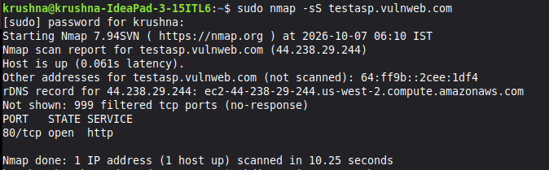
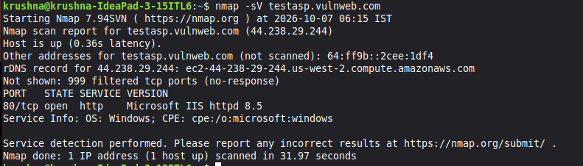
2. Nmap Assessment
Discovery → service identification → comprehensive enumeration
SYN scan: 80/tcp open; 999 filtered
Service detection: Microsoft IIS 8.5
Target resolved to 44.238.29.244 and was reachable.
TCP port 80 was open and identified as HTTP.
Nmap service detection identified Microsoft IIS httpd 8.5.
The basic scan did not establish that the open service was vulnerable.
DG Interns Hub • Week 5 Cyber Security Internship
3

Slide 4
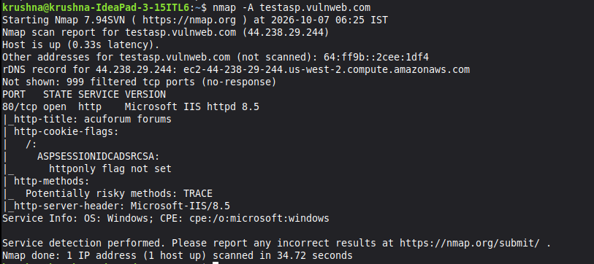
3. Nmap -A: Additional Observations
Application title: acuforum forums.
ASP session cookie reported without the HttpOnly flag.
TRACE was listed as a potentially risky HTTP method.
Traceroute completed in 5 hops.
Final OS fingerprinting was inconclusive — no definitive OS claim is made.
Observation ≠ proof of exploitation
DG Interns Hub • Week 5 Cyber Security Internship
4

Slide 5
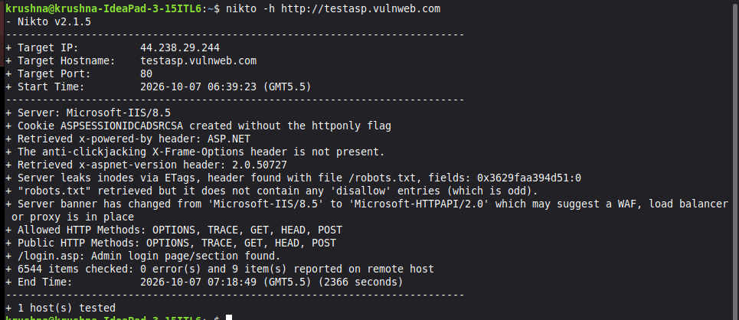
4. Nikto Web-Server Assessment
Automated checks against the authorized VulnWeb target
Microsoft-IIS/8.5 detected.
ASP session cookie created without the HttpOnly flag.
X-Frame-Options header not present.
ETag header exposes inode-related information.
Allowed methods included OPTIONS, TRACE, GET, HEAD and POST.
Login page found at /login.asp.
6,544 items checked; 9 items reported.
DG Interns Hub • Week 5 Cyber Security Internship
5

Slide 6
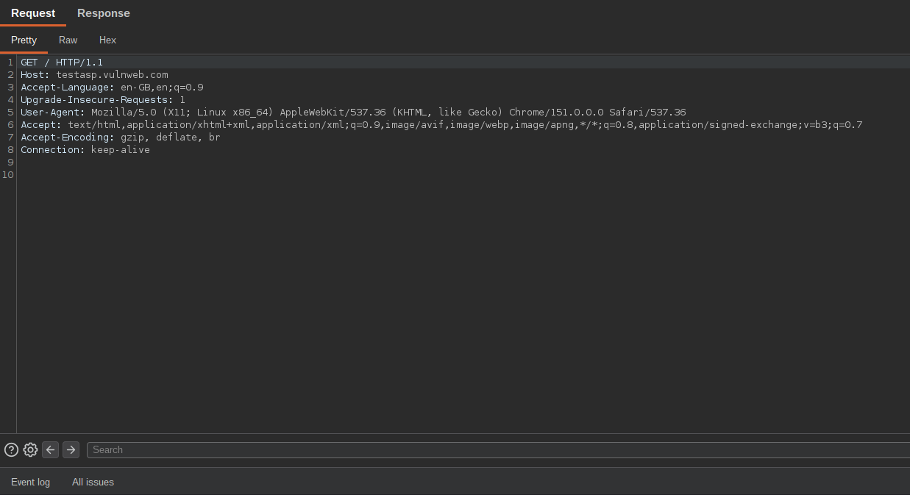
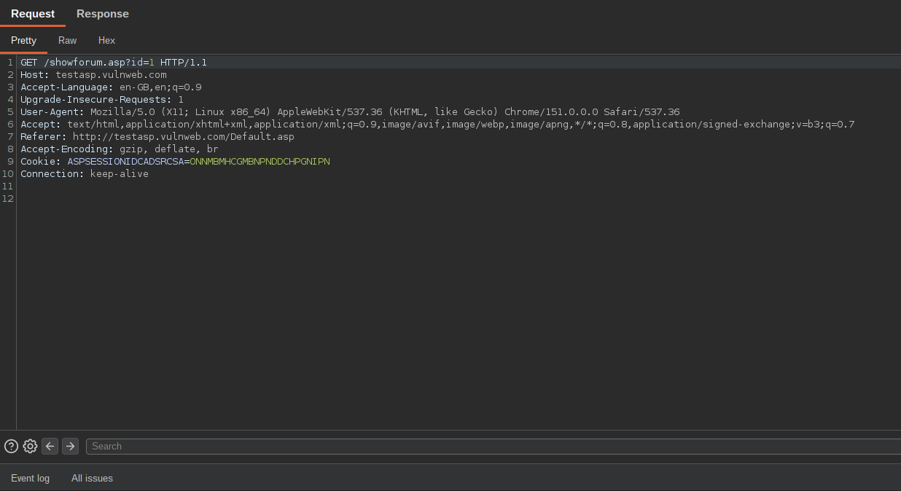
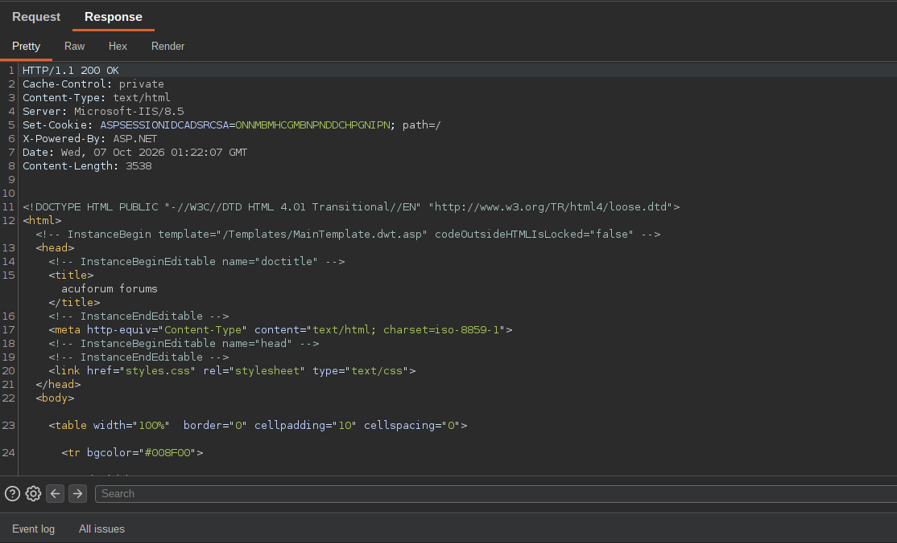
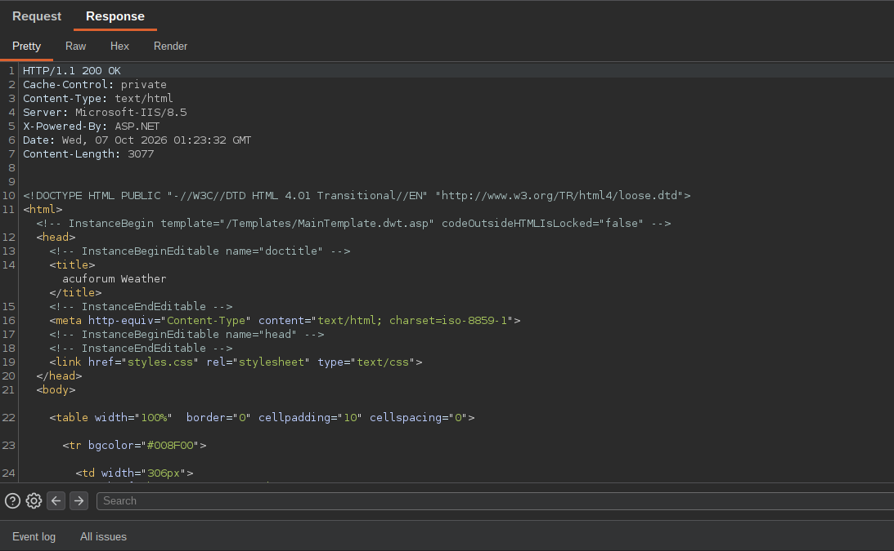
5. Burp Suite — HTTP Inspection
Captured GET /
Captured GET /showforum.asp?id=1
HTTP 200 response • IIS/ASP.NET • session cookie
HTTP 200 response • application content
DG Interns Hub • Week 5 Cyber Security Internship
6

Slide 7
6. Findings & Recommendations
F-01
ASP session cookie lacks HttpOnly
Set HttpOnly; review Secure/SameSite.
F-02
X-Frame-Options absent
Use an appropriate anti-framing policy.
F-03
TRACE enabled
Disable if not required.
F-04
Server/technology disclosure
Minimize unnecessary version disclosure.
F-05
ETag inode information
Review ETag configuration.
F-06
Login page exposed
Review authentication, authorization and rate limiting.
DG Interns Hub • Week 5 Cyber Security Internship
7

Slide 8
7. Conclusion
The Week 5 VAPT practical workflow was completed on an authorized VulnWeb training target.
Nmap identified the exposed service and technology stack.
Nikto provided automated web-server security observations.
Burp Suite correlated those observations with real HTTP requests and responses.
The exercise reinforced that automated findings are evidence/leads and should be validated before being described as exploitable vulnerabilities.
Practical status: Nmap ✓ Nikto ✓ Burp Suite ✓ Evidence ✓
DG Interns Hub • Week 5 Cyber Security Internship
8

