Slide 1












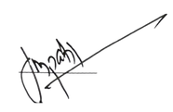
PCET’S
Pimpri Chinchwad College of Engineering, Pune
Department of Computer Engineering
ANA TYA
ANA TYA
ANANTYA 2026
ANANTYA 2026
This is to certify that
{{Name}}
has successfully participated in {{Event}} Under Techfest 2026 - Anantya, held at the Department of Computer Engineering, Pimpri Chinchwad College of Engineering, Nigdi, Pune from 23/01/2026 to 24/01/2026.
Dr. Sonali Patil
Head of Department

