Slide 1
#1 CDAC ACTS · PGCP-AC FEB 2026
AgriFlux
Smart Agriculture Platform with AI Assistant
A full-stack e-commerce & advisory platform empowering Indian farmers with AI-driven insights, real-time weather, and secure online commerce.
PRESENTED BY
Project Guide: Ms. Shweta Singh
Gaurav Mahadik
260240120061
Project No: 34 Batch: PGCP-AC February 2026
Harsh Jain
260240120070
Shrutik Choudhary
260240120179
Institute: CDAC ACTS, Pune
Krushnal Mahajan
260240120092
Vivek Bhogade
260240120043

Slide 2
Agenda
01
Problem Statement
Why Indian farmers need a unified digital platform
02
Key Features
What AgriFlux offers — commerce, AI, weather & more
03
System Architecture
How the frontend, backend and database connect
04
Technology Stack
Languages, frameworks and tools used
05
Database & APIs
Core schema and REST endpoint design
06
Screens Walkthrough
A look at the working application
07
Deployment & Future Scope
Hosting plan and roadmap ahead
AgriFlux — Smart Farming Marketplace with AI Assistant
2

Slide 3




Fragmented Buying
No Expert Access
Seeds, fertilizers & tools sourced from scattered, unreliable local vendors
Limited access to timely, personalized farming advice
The Problem
Farmers today juggle multiple disconnected sources for supplies, advice and weather — with no single trusted platform in their own language.
Weather Blind Spots
Language Barrier
Poor visibility into weather risk for planning field activities
Most digital platforms are English-only, excluding rural users
AgriFlux — Smart Farming Marketplace with AI Assistant
3

Slide 4



Key Features
A single platform combining commerce, intelligence and localisation
Multi-Role System
Weather Forecast
AgriBot — AI Advisor
Dedicated Farmer & Admin experiences with role-based access
Real-time weather with contextual, actionable farming advice
Groq-powered LLaMA 3.3 70B chatbot for farming Q&A in Hindi & English
JWT Authentication
Razorpay Payments
Bilingual UI
Stateless, secure login using Spring Security & JWT
Fast, secure online payment gateway integration
Instant English ⇄ Hindi switching across the entire app
AgriFlux — Smart Farming Marketplace with AI Assistant
4

Slide 5
System Architecture
Clean 3-tier architecture — React frontend, Spring Boot backend, MySQL database
Frontend
Backend
Database
React + Vite · Redux Toolkit
Spring Boot · REST APIs · Security
MySQL · Spring Data JPA
REST / JSON over HTTPS
SQL
PORT 5173
PORT 8080
PORT 3306
External & Third-Party Services
Groq API
OpenWeatherMap
Razorpay
AgriBot — LLaMA 3.3 70B
Weather & farming advice
Payment processing
Note: Invoice generation & PDF export are handled within the Spring Boot backend (no separate microservice).
AgriFlux — Smart Farming Marketplace with AI Assistant
5

Slide 6
Technology Stack — Frontend
React.js
Vite
Redux Toolkit
Component-based UI library powering the entire interface
Lightning-fast dev server & build tool
Global state — auth, cart & language
Tailwind CSS
Axios (REST client)
React Router DOM
Utility-first responsive styling
HTTP client with JWT interceptor
Client-side routing across pages
AgriFlux — Smart Farming Marketplace with AI Assistant
6

Slide 7
Technology Stack — Backend, Database & Tools
Java
Spring Boot
Spring Security + JWT
Core backend programming language
Business logic, REST APIs & app config
Stateless, token-based authentication
Spring Data JPA / Hibernate
MySQL
Postman
ORM & repository-based data access
Relational data persistence
API design, testing & documentation
AgriFlux — Smart Farming Marketplace with AI Assistant
7

Slide 8
Database Schema
Key tables and their relationships (MySQL)
Table | Key Columns | Relationship
users | id, name, email, password, role | Has many orders, addresses, one cart
products | id, name, price, stock_quantity, category_id | Belongs to category
categories | id, name, description, is_active | Has many products
cart | id, user_id | One per user, has many cart_items
cart_items | id, cart_id, product_id, quantity | Belongs to cart and product
orders | id, user_id, address_id, total_amount, status | Has many order_items
order_items | id, order_id, product_id, price_at_purchase | Price locked at order time
addresses | id, user_id, full_name, city, state, pincode | Belongs to user
AgriFlux — Smart Farming Marketplace with AI Assistant
8

Slide 9
REST API Highlights
Selected endpoints across core modules
Auth & Users
Products & Cart
Orders & Payments
Weather & AgriBot
POST
Public
GET
Public
POST
User
GET
Public
/api/auth/register
/api/products
/api/orders/place
/api/weather/forecast
POST
Public
POST
User
POST
User
POST
Public
/api/auth/login
/api/cart/add
/api/payment/create-order
/api/chatbot/chat
POST
Admin
PUT
Admin
/api/admin/products
/api/admin/orders/{id}/status
AgriFlux — Smart Farming Marketplace with AI Assistant
9

Slide 10
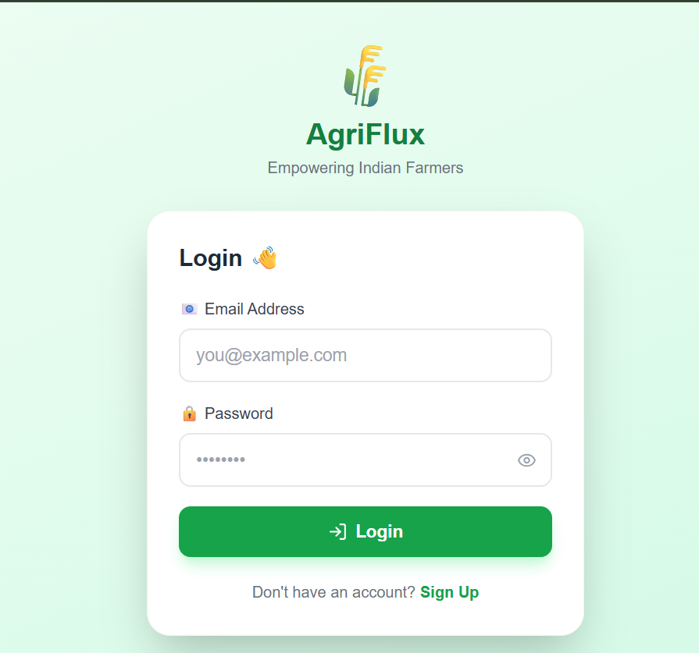
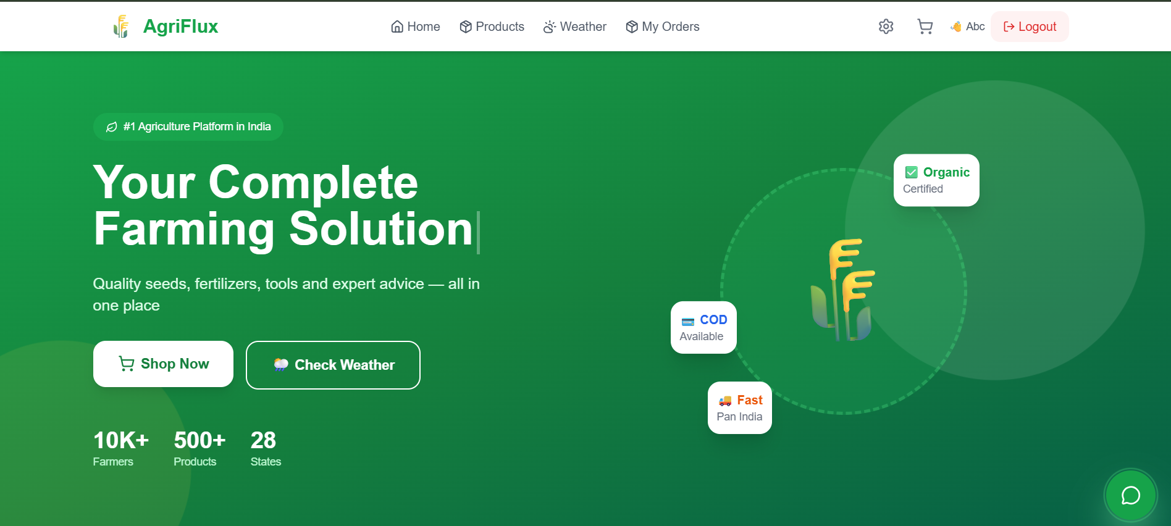
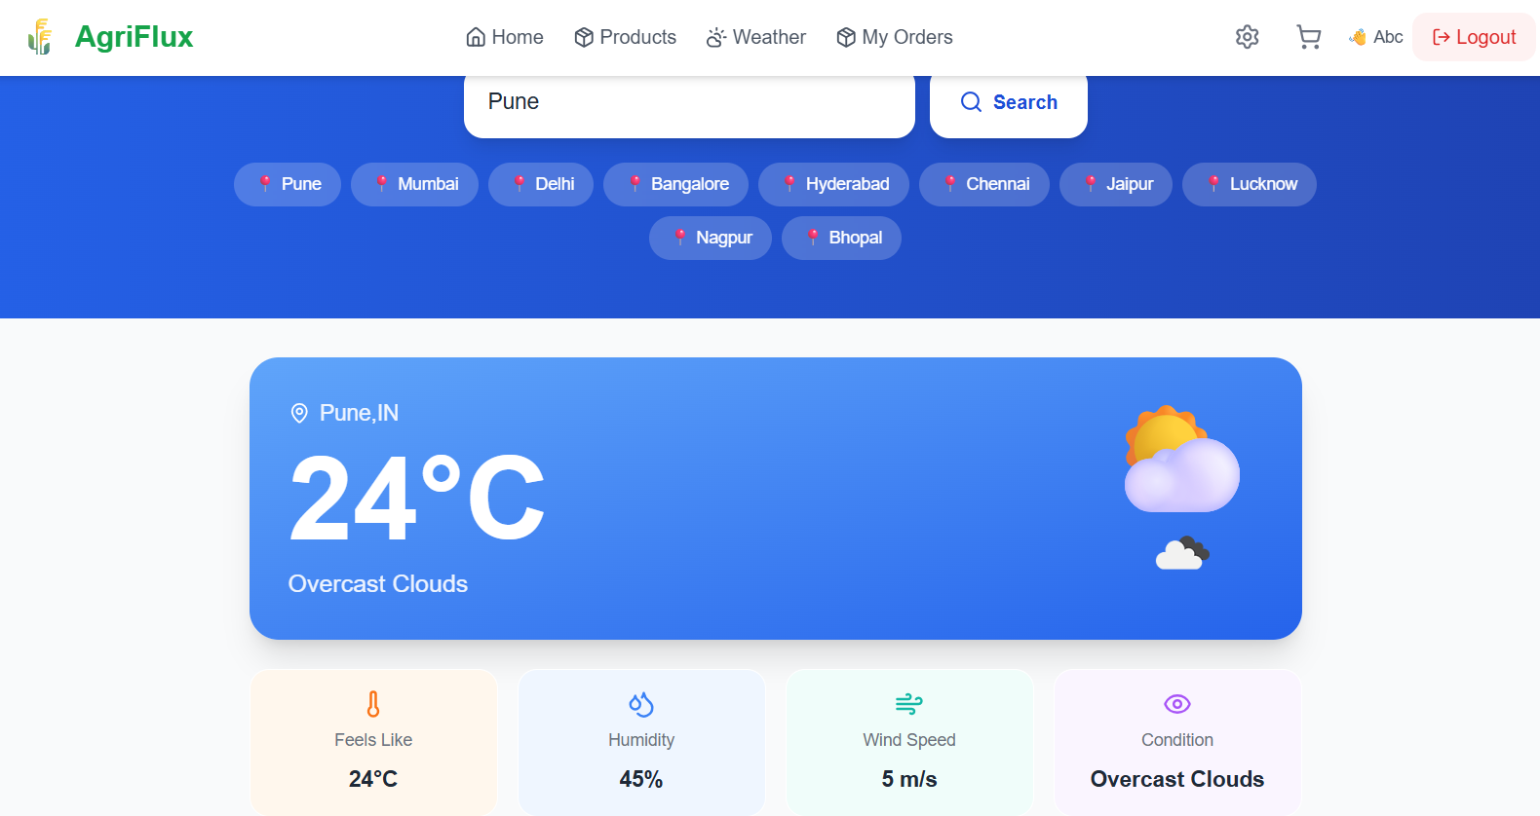
Application Walkthrough — I
Live screens from the working AgriFlux application
Login
Home
Weather Forecast
Clean, branded login screen with secure JWT-based authentication.
Landing page with hero banner, trust badges and quick actions.
City-wise live weather with farming-relevant metrics.
AgriFlux — Smart Farming Marketplace with AI Assistant
10

Slide 11
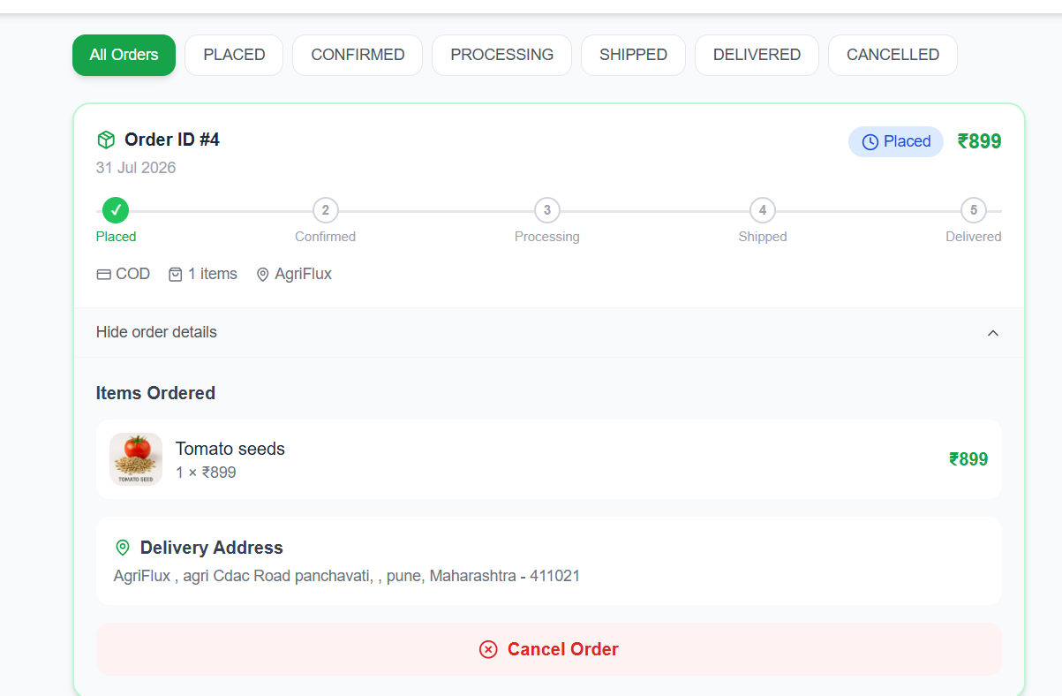
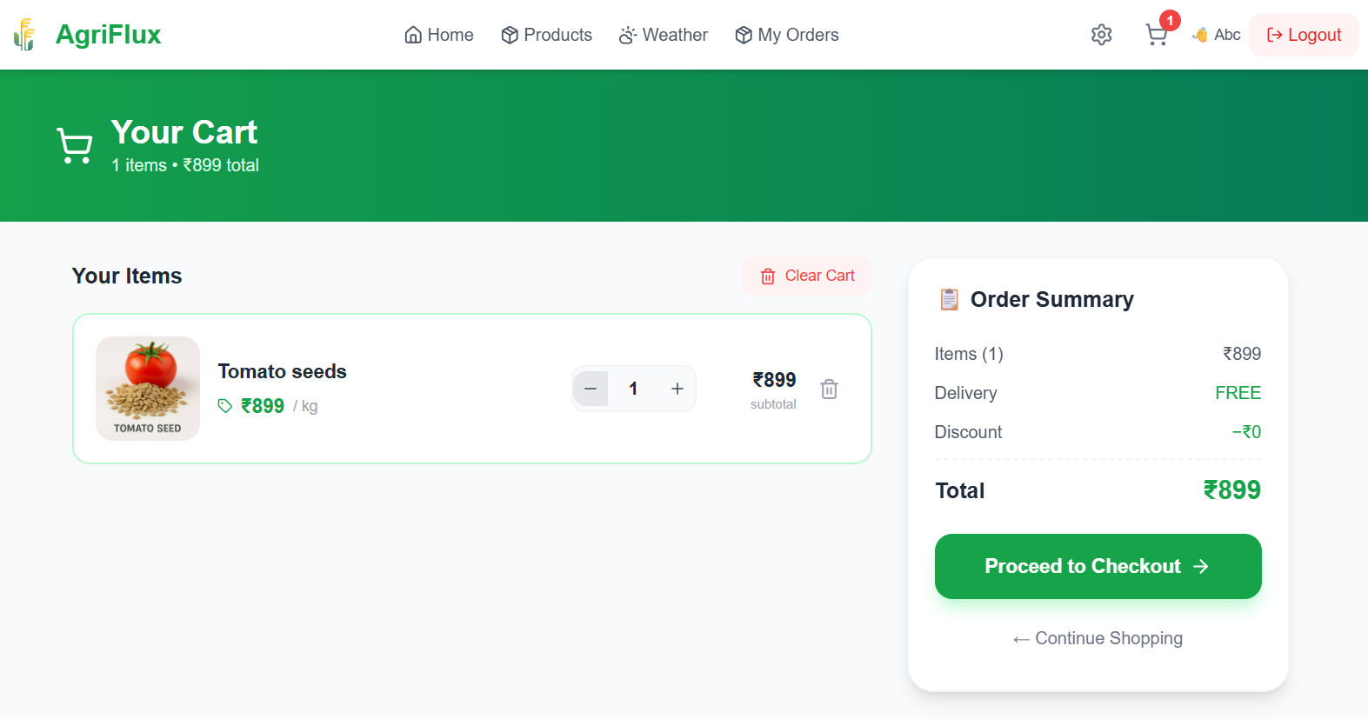
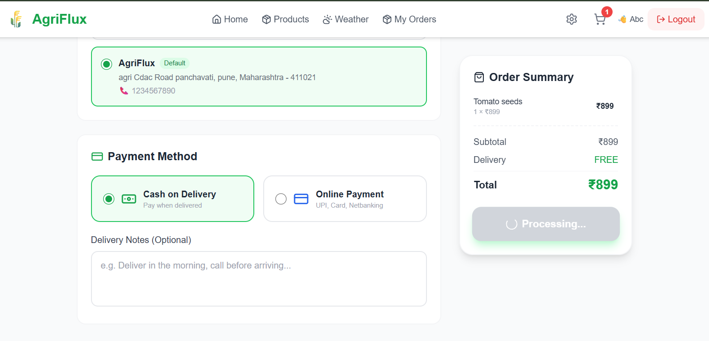
Application Walkthrough — II
End-to-end shopping and order management experience
Cart
Checkout
My Orders
Item management with live order summary and totals.
Address selection, COD / online payment via Razorpay.
Order history with a 5-stage live status tracker.
AgriFlux — Smart Farming Marketplace with AI Assistant
11

Slide 12
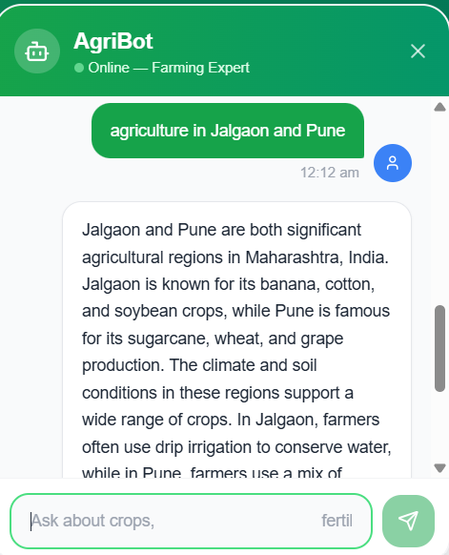
AgriBot — Your AI Farming Assistant
Instant, expert-level farming guidance — in Hindi & English
Powered by Groq API
Runs on LLaMA 3.3 70B for fast, high-quality responses
Bilingual Q&A
Farmers can ask questions naturally in Hindi or English
Region-aware advice
Answers factor in local crops, soil and climate context
Always accessible
Floating chat widget available across the entire app
AgriFlux — Smart Farming Marketplace with AI Assistant
12

Slide 13
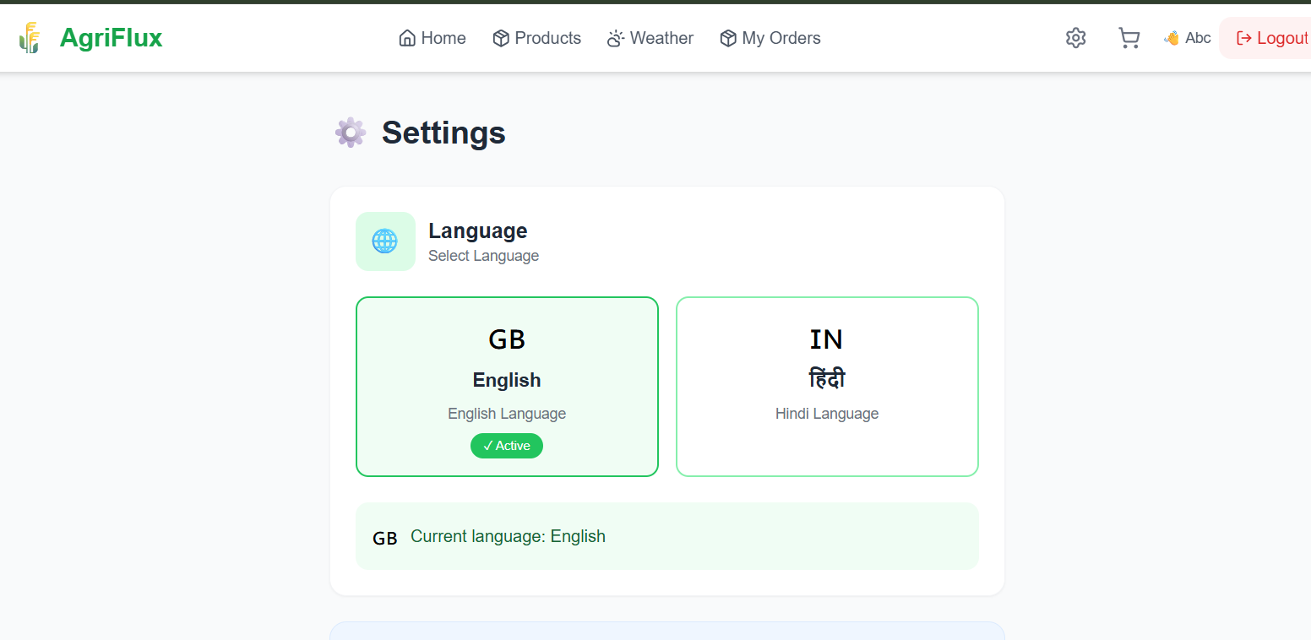
Bilingual Interface
Built for real reach across India — not just English-speaking users
Wider Reach
Removes the English-literacy barrier for rural & semi-urban farmers
Instant Switching
No page reload — language state managed via Redux Toolkit
Consistent Everywhere
Settings — Language Switch
Applied uniformly across navigation, forms and AgriBot
Farmers can instantly toggle the entire UI between English and हिंदी (Hindi) from Settings.
AgriFlux — Smart Farming Marketplace with AI Assistant
13

Slide 14



Deployment & DevOps
Containerised and cloud-hosted for reliable delivery
Docker
Render
Railway MySQL
Containerisation of frontend & backend services for consistent environments
Cloud hosting for the Spring Boot backend & React frontend
Managed cloud MySQL database for production data
AgriFlux — Smart Farming Marketplace with AI Assistant
14

Slide 15
Future Improvements
Roadmap beyond the current release
Google OAuth2 login
Email notifications for order updates
1
2
Product reviews & ratings
Admin analytics dashboard with charts
3
4
Cloudinary integration for product images
Redis caching for frequently accessed data
5
6
AgriFlux — Smart Farming Marketplace with AI Assistant
15

Slide 16
Thank You
AgriFlux — Smart Agriculture Platform with AI Assistant
Questions & Discussion
Guide: Ms. Shweta Singh | CDAC ACTS, Pune | Project No. 34

