Slide 1

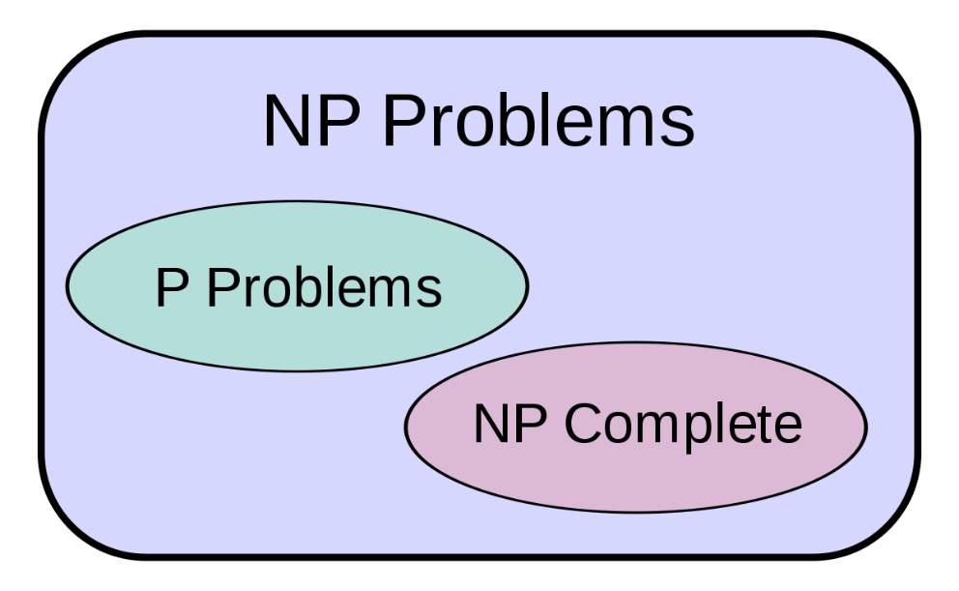
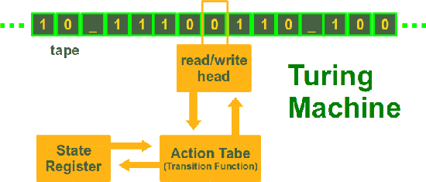

Prof. John Abela
Department of CIS
Faculty of ICT
University of Malta
john.abela@um.edu.mt
+ 365 79367936
Room 1A/27
FICT Building
©John Abela, 2018-2025
Data Structures
And
Algorithms 2
Module 2 2024-25
Turing Reductions & Approximation
Faculty of
ICT
Department of
Computer Information Systems
Last Updated
01-April-2025

Slide 2


Module Overview
2
Data Structures &
Algorithms 2
Present Books used for Material
Re-visit VC-IS-Clique Problem
Present general strategies for Turing Reduction
Approximation Algorithms
Genetic Algorithms
with applications in various domains
https://en.wikipedia.org/wiki/List_of_NP-complete_problems

Slide 3

We Cannot Throw NP-Complete and NP-Hard Problems out of the Window
3
Data Structures &
Algorithms 2
(Provably) Exponential Problems?
Non-Computable Problems?
There are, literally, thousands of important search, optimization, and decision problems that have been shown to be NP-Hard or NP-Complete.
We cannot throw these problems out of the window. Many are everyday problems like scheduling, routing, etc.
We cannot use brute force!
The only available option is to find polynomial-time approximations.
Some NP-Complete problems cannot be approximated in polynomial time.

Slide 4
Approximating NP-Hard Problems
4
Data Structures &
Algorithms 2
When we talk about approximation, we usually do not consider decision problems (unless the problem is, by nature a decision problem such as SAT).
Many hard problems are search and optimization problems where;
we have to find a solution in a large space of candidate solutions (the search space).
Examples: chess, timetabling, scheduling, etc.
Or we might have to maximize or minimize some cost function.
Example: routing, navigation, TSP, longest path in graph, vertex cover, set cover, etc.
All known optimal algorithms for these problems are super-polynomial.
To reduce the time required for solving such problems, we relax the problem, and try to obtain a feasible solution ‘close’ to an optimal solution.
What does ‘close’ mean?

Slide 5
Important Note!
5
Data Structures &
Algorithms 2
Many of the problems you encounter in business, industry, manufacturing, and academia (FYP, MSc, PhD) may not be known to be either polynomial or NP-Hard.
You must do an extensive search of the literature before you can decide on whether or not to approximate the problem.
Approximating a problem that has a polynomial-time optimal algorithm is not very clever (or advised).
Using a neural network, or some other machine learning technique, to approximate a problem should only be done after you have determined that the problem is NP-Hard.
You cannot just ‘think’ that a problem is NP-Hard.
Check the literature or else Turing reduce a known NP-Hard problem to your problem.

Slide 6
Choices we must make
6
Data Structures &
Algorithms 2
Tradeoff: Execution speed vs. solution quality
Solution
exact
approximation
fast
“Fast & exact”
“Quick & dirty”
Speed
slow
“Not feasible”
“Not clever”

Slide 7
The Curse of Local Minima
7
Data Structures &
Algorithms 2
Problem: Avoid getting trapped in local minima
Global optimum

Slide 8
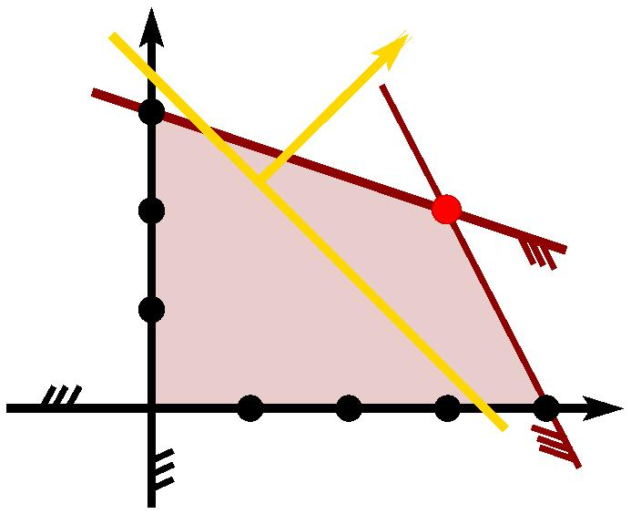
Approximation Algorithms
Idea: Some intractable problems can be efficiently approximated within close to optimal!
Fast:
Simple heuristics (e.g., greedy)
Provably-good approximations
Slower:
Branch-and-bound approaches
Integer Linear Programming relaxation

Slide 9

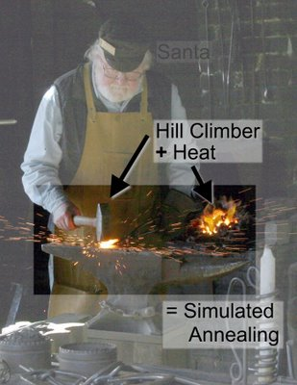
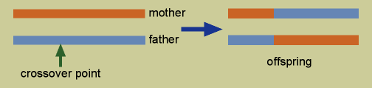
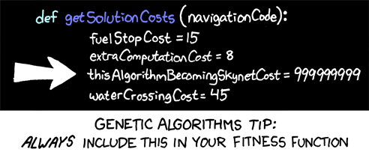
9
Approximation Strategies
Data Structures &
Algorithms 2
Approaches:
Simulated annealing
Genetic algorithms
Evolutionary Methods

Slide 10
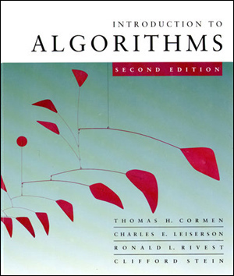
Cormen, Leiserson, Ronald, Stein
10
Data Structures &
Algorithms 2

Slide 11
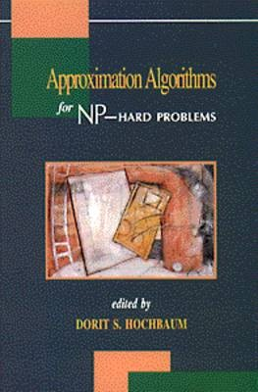
Book by Dorit S.Hochbaum
11
Data Structures &
Algorithms 2

Slide 12
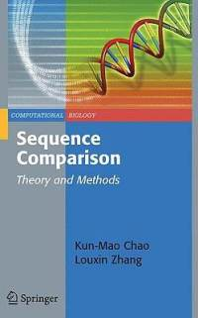
Sequence Comparison - Chao, Zhang
12
Data Structures &
Algorithms 2

Slide 13
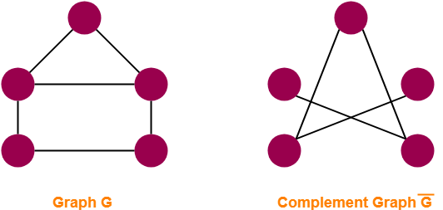
Complement of a Graph
13
Data Structures &
Algorithms 2
The complement of a G=(V,E) denoted by G^{c}=(V,E^{c}) is the graph with exactly the same vertices of G but such that any two distinct vertices in G^{c} are adjacent if and only if they are not adjacent in G.
Sometimes called the ‘inverse’ of G. Sometimes also denoted by G
To obtain G^{c} from G simply delete all existing edges from G and add edges between non-adjacent vertices.
Remember that a graph is complete if every pair of vertices is adjacent – i.e. there is an edge joining them.

Slide 14
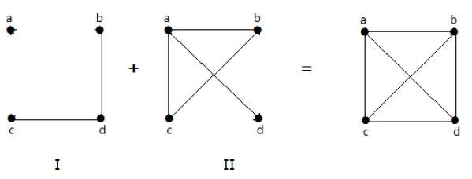
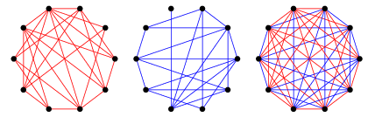
Examples of Graph Complement
14
Data Structures &
Algorithms 2

Slide 15
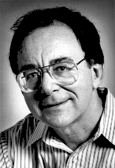
Dick Karp’s Work Remember this?
15
Data Structures &
Algorithms 2
constraint satisfaction
SAT
Dick Karp (1972) 1985 Turing Award
INDEPENDENT SET
DIR-HAM-CYCLE
GRAPH 3-COLOR
SUBSET-SUM
VERTEX COVER
HAM-CYCLE
PLANAR 3-COLOR
SCHEDULING
SET COVER
TSP
packing and covering
sequencing
partitioning
numerical

Slide 16

Dick Karp’s Work
16
Data Structures &
Algorithms 2
After Stephen Cook had proved that SAT is NP-Complete, Dick Karp (who would later on win the Turing Award) reduced SAT to many other problems and thus proved (by the transitivity of Turing Reduction) that these problems were also NP-Complete.
Question 1 Is it true that for any two NP-Complete problems A and B then A can be Turing Reduced to B and vice versa?
Question 2 What about if A is NP-Complete and B is simply in NP but not known to be NP-Complete?
Question 3 What if I can Turing Reduce a known NP-Complete problem A into a problem B which is known to be in P?

Slide 17
Question 1 Answer
17
Data Structures &
Algorithms 2
Question 1 Is it true that for any two NP-Complete problems A and B then A can be Turing Reduced to B and vice versa?
If A and B are NP-Complete then, by definition, they are also both in NP.
If A is NP-Complete then all problems in NP (including B) can be Turing Reduced to A.
If B is NP-Complete then all problems in NP (including A) can be Turing Reduced to B.
Therefore, A ∝ B and also B ∝ A. _{QED}
‘QED’ is quod erat demonstrandum, Latin for “I proved what I was trying to prove”. This is used to denote the end of the proof.

Slide 18
Polynomial Time Equilvalence
18
Data Structures &
Algorithms 2
Let A and B be two NP-Complete problems.
We say that A and B are polynomial-time equivalent.
This is because A ∝ B and also B ∝ A.
Bidirectional Reductions  We say that A and B are polynomial-time equivalent if there is a polynomial-time reduction from A to B and a polynomial-time reduction from B to A.
Implication on Solving the Problems  This equivalence implies that if you develop a polynomial-time algorithm for solving A, you can solve B in polynomial time as well (by first converting B to A using the polynomial-time reduction). The reverse is also true. So, both A and B essentially share the same computational difficulty (up to the polynomial reduction overheads).

Slide 19
The Equivalence Argument
19
Data Structures &
Algorithms 2
Lemma 4
If P₁ and P₂ belong to NP and P₁ ∝ P₂ then if P₁ is NP-Complete then so is P₂.
This follows from the transitivity of Turing Reduction and serves that to show that a given problem X is NP-Complete all we need to do is to reduce a known NP-Complete problem to X.
Note that Turing reductions are also known as Karp reductions.

Slide 20
20
Data Structures &
Algorithms 2
The Transitivity Argument
From Lemma 4 (previous slide), if all problems P_{i} in NP can be Turing Reduced to X and X can, itself, be Turing Reduced to a given problem NP problem P' then P' is also NP-Complete.
These results follow from the transitivity of Turing Reduction.
If we have a problem P and we want to show that P is NP-Complete then we have to:
First show that P is in NP (very easy), and;
then show that a known NP-Complete problem X can be Turing Reduced to P. This part involves constructing the Turing Reduction and is not always easy.
We shall only look at some easy examples.
Note that proving that a problem P is NP-Complete is not the same as proving the P is in NP.
Class NP
P₁
P₂
∝
∝
∝
X
∝
P'
P₃
∝
∝
P₄
P∞

Slide 21
Question 2 Answer
21
Data Structures &
Algorithms 2
Question 2 What about if A is NP-Complete and B is simply in NP but not known to be NP-Complete?
If A can be Turing Reduced to B then B is also NP-Complete by the transitivity of Turing Reduction.
If B can be Turing Reduced to A than this tells us that A is at least as hard as B. This does not tell us much about B. In fact, B could even be in P – think of an example.
If A can be Turing Reduced to B and vice versa (both of the above) then this means that B is also NP-Complete using the transitivity argument from Question 1.

Slide 22

Question 3
22
Data Structures &
Algorithms 2
Question 3 What if I can Turing Reduce a known NP-Complete problem A into a problem B which is known to be in P?
This is left as an exercise. Hint. You will be 1 million dollars richer.

Slide 23
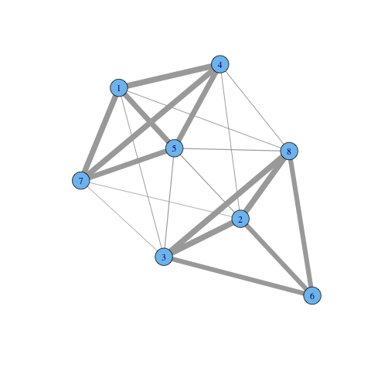
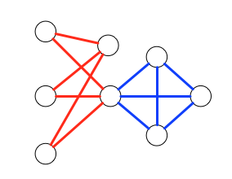
What is a Clique?
23
Data Structures &
Algorithms 2
CLIQUE: given a graph G=(V,E) of n vertices and parameter k, is there a set of k vertices V’ such that every two vertices in V’ are connected?
A Clique is therefore a set of vertices that are pairwise adjacent. A pair of vertices (a,b) is adjacent (connected) if there is an edge joining them.

Slide 24
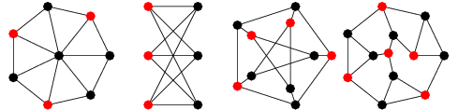
What is an Independent Set?
24
Data Structures &
Algorithms 2
INDEPENDENT SET: given a graph G=(V,E) of n vertices and parameter k, is there a set of k vertices V’ such that no two vertices in V’ are connected?
An independent set is therefore a set of vertices that are pairwise not adjacent (connected). For any pair of vertices (a,b) in the independent set there is no edge between a and b.
One can say that an independent set is the converse of a Clique.

Slide 25
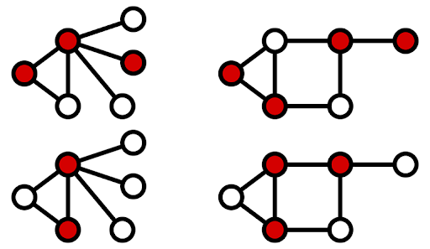
What is a Vertex Cover?
25
Data Structures &
Algorithms 2
Vertex Cover (VC): given a graph G=(V,E) of n vertices and parameter k, is there a set of k vertices V’ such that every edge has at least one end among selected nodes?
A vertex cover is a set of vertices such that every edge in the graph is adjacent (connected to) at least one of the vertices in the Vertex Cover.
Note that, for every edge in the graph, at least one of the adjacent vertices must be in a Vertex Cover.
Can you see that the vertices that are not in the Vertex Cover form an Independent Set?
Why?

Slide 26
VC-IS-Clique Problems – Simple but Cool
26
Data Structures &
Algorithms 2
Vertex Cover (VC): given a graph G=(V,E) of n vertices and parameter k, is there a set of k vertices V’ such that every edge has at least one end among selected nodes? NP-Hard Optimization problem: Minimize
CLIQUE: given a graph G=(V,E) of n vertices and parameter k, is there a set of k vertices V’ such that every two vertices in V’ are connected? NP-Hard Optimization problem: Maximize
INDEPENDENT SET: given a graph G=(V,E) of n vertices and parameter k, is there a set of k vertices V’ such that no two vertices in V’ are connected? NP-Hard Optimization problem: Maximize

Slide 27
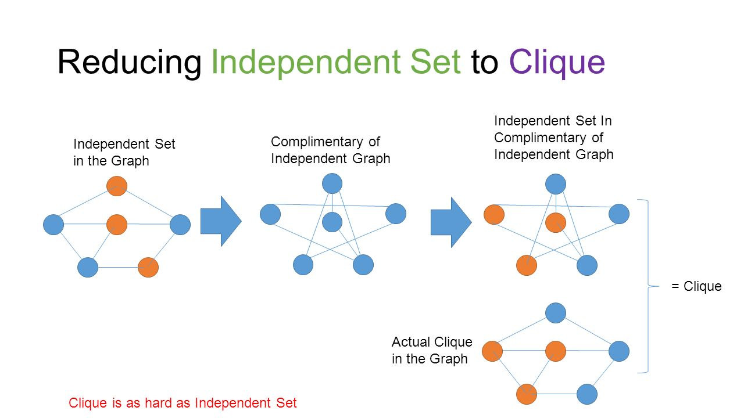
27
Data Structures &
Algorithms 2

Slide 28
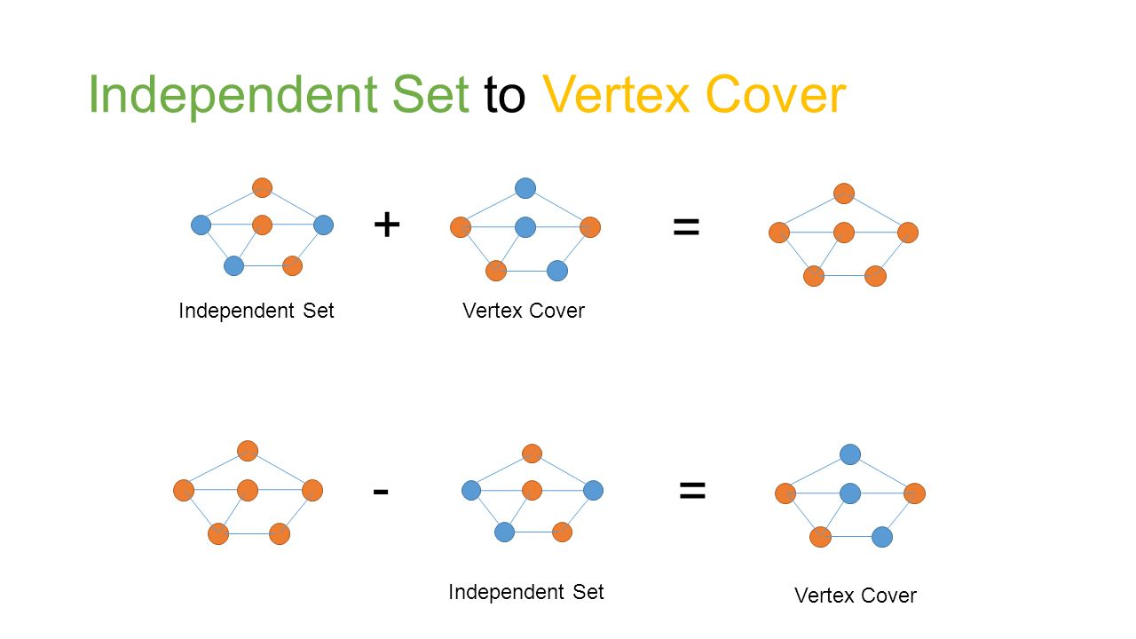
28
Data Structures &
Algorithms 2

Slide 29
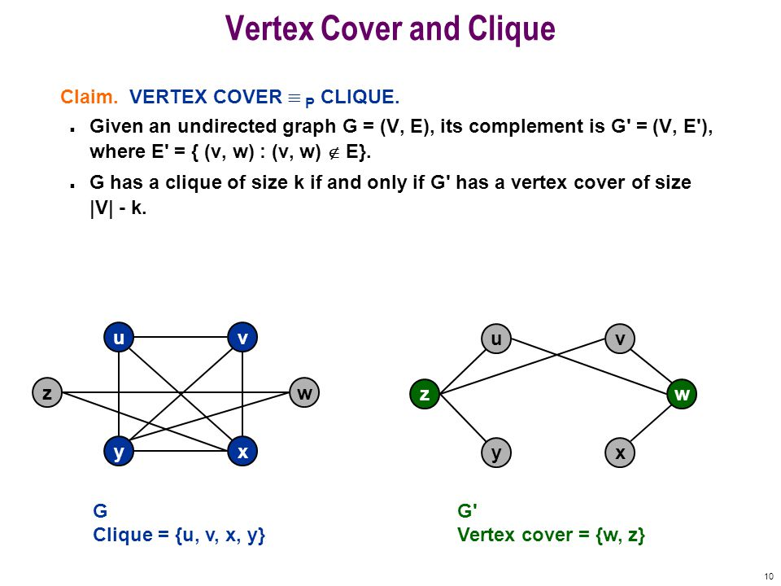
Vertex Cover to Clique (homework)
29
Data Structures &
Algorithms 2
∝

Slide 30
Strategies for Turing Reduction
30
Data Structures &
Algorithms 2
To show that P₁ Turing reduces to P₂
Restriction
This is the easiest reduction. Show that P₂ is a special case of P₁.
Local Replacement
More difficult but relatively uncomplicated. Ex. see proof of reduction of SAT to 3-SAT.
Component Design
The most difficult type of reduction. Ex. 3-SAT to VC or VC to Hamiltonian Circuit.

Slide 31
Approximation Algorithms
31
Data Structures &
Algorithms 2
The area of Approximation Theory is a very large area so we will introduce the basic theory and then proceed to discuss a number of approximation techniques.
One technique with no provable bounds will be Genetic Algorithms.

Slide 32
Approximation Algorithms
32
Data Structures &
Algorithms 2
We are going to see that there are many different ways to deal with NP-Complete and NP-Hard problems.
We will also see that some NP-Hard and NP-Complete problems can be approximated but others cannot be approximated.
If fact for some problems finding a bounded polynomial-time approximation is NP-Hard!

Slide 33

Dealing with NP-Hard/Complete Problems
33
Data Structures &
Algorithms 2
Sit down and Cry like a baby! ✗
If instance is small then use brute-force. ✓
Find certain conditions under which problem becomes tractable (feasible). ✓
Try to find near-optimal solutions in polynomial time. ✓
The last approach uses an approximation algorithm.

Slide 34
Some Approximation Techniques
34
Data Structures &
Algorithms 2
Greedy Algorithms.
Dynamic Programming.
Evolutionary Computation.
Other meta-heuristics used for approximation.
Polynomial Algorithms with approximation bounds.
Neural Networks and other Vector Space methods such as SVMs
The last approach includes a ‘learning’ component.

Slide 35
Some Definitions
35
Data Structures &
Algorithms 2
Approximation algorithm: An algorithm that returns near-optimal solutions (in polynomial time), i.e. is "provably good“ is called an approximation algorithm.
Performance Ratio (Ratio Bound): We say that an approximation algorithm for a problem P has a ratio bound of ρ(n) if for any instance of size n, the cost C of the solution produced by the approximation algorithm is within a factor of ρ(n) of the cost C* of an optimal solution:
max(C/C*,C*/C)≤ ρ(n)

Slide 36
Performance Ratios
36
Data Structures &
Algorithms 2
In Maximization problems:
0<C≤C* , ρ(n) = C*/C
In Minimization Problems:
0<C*≤C , ρ(n) = C/C*
ρ(n) is never less than 1.
A 1-approximation algorithm is the optimal solution.
The goal is to find a polynomial-time approximation algorithm with small constant approximation ratios.

Slide 37
Performance Ratios
37
Data Structures &
Algorithms 2
Minimization | Maximization
Travelling Salesman Problem (TSP) Find shortest Hamiltonian Tour. Vertex Cover (VC) Least number of vertices that cover all the edges. Set Cover (SC) Least number of subsets whose union is the set T. Bin Packing (BP) | Clique Largest number of pair-wise connected vertices. Independent Set (IS) Largest number of pair-wise non-adjacent vertices.
The estimate C will be larger than the optimum C*. | The estimate C will be smaller than the optimum C*

Slide 38
Approximation Schemes
38
Data Structures &
Algorithms 2
Approximation scheme is an approximation algorithm that takes Є>0 as an input such that for any fixed Є>0 the scheme is a (1+Є)-approximation algorithm.
Polynomial-Time Approximation Scheme is an approximation algorithm that runs in time polynomial in the size of the input and also in Є .
As the Є decreases the running time of the algorithm may increase rapidly:
For example, it might be O(n^{2/Є})
Є = epsilon

Slide 39
Approximation Schemes
39
Data Structures &
Algorithms 2
We have a Fully Polynomial-Time Approximation Scheme when the running time is polynomial not only in n but also in ¹/_{Є}
For example, it could be O((¹/_{Є})³n²)
This means the smaller Є becomes, the longer the algorithm takes to run. The reciprocal of Є is used in the time complexity function.

Slide 40
Approximation Schemes
40
Data Structures &
Algorithms 2
We shall later look at algorithms that find approximate solutions in polynomial time using a Fully Polynomial Time Approximation Algorithm
We shall discuss one NP-Hard problem for which even approximation is NP-Hard.
Finally, we will look at a problem where the running time of its approximation algorithms increases as Є decreases.

Slide 41
Some Algorithmic Paradigms
41
Data Structures &
Algorithms 2
Greedy algorithms
Dynamic programming

Slide 42
What is a Greedy Algorithm?
42
Data Structures &
Algorithms 2
Constructs a solution to an optimization problem step by step through a sequence of choices that are:
Feasible, i.e. satisfying the constraints.
Locally Optimal (with respect to some neighborhood definition).
Greedy (in terms of some measure), and irrevocable.
For some problems, it yields a globally optimal solution for every instance. For most, it does not but it can be useful for fast and efficient approximations.

Slide 43
The Greedy Technique
43
Data Structures &
Algorithms 2
Optimal solutions
Giving change “normal” coin denominations
Minimum Spanning Tree (MST)
Single-source shortest paths in graphs
Simple scheduling problems
Huffman Codes
Approximations & Heuristics
Traveling Salesman Problem (TSP)
Bin-packing & Knapsack problems
Many other combinatorial optimization problems

Slide 44
Giving Change
44
Data Structures &
Algorithms 2
Given unlimited amounts of coins of denominations.
d₁ > … > d_{m}, give change for an amount n with the least number of coins:
Example: d₁ = 25c, d₂ =10c, d₃ = 5c, d₄ = 1c and n = 48c
Greedy solution is <1,2,0,3>
Greedy solution is optimal for any amount and “normal’’ set of denominations.
It, however, may not be optimal for arbitrary coin denominations.
Example: d₁ = 25c, d₂ = 10c, d₃ = 1c, and n = 30c

Slide 45
Minimum Spanning Trees (MSTs)
45
Data Structures &
Algorithms 2
Spanning tree of a connected graph G: a connected acyclic subgraph of G that includes all of G’s vertices
Minimum spanning tree of a weighted, connected graph G: a spanning tree of G of the minimum total weight
6
c
6
c
c
a
a
a
4
1
4
1
1
2
2
d
d
d
b
3
b
b
3

Slide 46
Prim’s Greedy Algorithm for MST
46
Data Structures &
Algorithms 2
Start with tree T₁ consisting of one (any) vertex and “grow” the tree one vertex at a time to produce MST through a series of expanding subtrees T1, T2, …, T_{n}
On each iteration, construct Ti+1 from Ti by adding vertex not in Ti that is closest to those already in Ti (this is a greedy step!)
Stop when all vertices of the tree are included.

Slide 47
Prim’s Greedy Algorithm for MST
47
Data Structures &
Algorithms 2
4
c
4
c
4
c
a
a
a
6
1
1
1
6
6
2
2
2
d
d
d
b
3
b
3
b
3
4
c
4
c
a
a
1
1
6
6
2
2
d
d
b
3
b
3

Slide 48
Remarks on Prim’s Algorithm
48
Data Structures &
Algorithms 2
There is a proof by induction that this construction actually yields an MST (CLRS, Ch. 23.1). This proof relies on the Cut Theorem.
Needs a priority queue for locating closest fringe vertex.
Efficiency
O(n²) for weight matrix representation of graph and array implementation of priority queue.
O(m log₂ n) for adjacency lists representation of graph with n vertices and m edges and Min-Heap implementation of the priority queue.

Slide 49
The Cut Theorem for MSTs
49
Data Structures &
Algorithms 2
Claim: Let G = (V,E) be a weighted graph and (X,Y) be a partition of V (called a cut). Suppose that e = (x,y) is an edge of E across the cut, where x is in X and y is in Y, and e has the minimum weight among all such crossing edges (called a light edge). Then there is an MST containing e.
Y
y
x
X

Slide 50
The Coding Problem
50
Data Structures &
Algorithms 2
Coding: the assignment of bit strings to alphabet characters.
E.g. We can code {a,b,c,d} as {00,01,10,11} or {0,10,110,111} or {0,01,10,101}.
Codewords: bit strings assigned for characters of alphabet
Two types of codes
fixed-length encoding (e.g., ASCII)
variable-length encoding (e,g., Morse code)
Prefix-free codes (or prefix-codes) - no codeword is a prefix of another codeword since otherwise the receiver will not be able to decode the message. For above we can use the following {0,10,110,111}.
Problem: If frequencies of the character occurrences are
known, what is the best binary prefix-free code?
The one with the shortest average code length. The average code length represents on the average how many bits are required to transmit or store a character.

Slide 51
Building a Huffman Code
51
Data Structures &
Algorithms 2
Building a Huffman Code to solve the coding problem can be done using a very simple polynomial-time greedy algorithm.
An example is here HuffmanSample.ppt
Try at home and then we can discuss.

Slide 52
Dynamic Programming
52
Data Structures &
Algorithms 2
Dynamic Programming is a general algorithm design technique for solving problems defined by or formulated as recurrences with overlapping sub-instances.
Invented by American mathematician Richard Bellman in the 1950s to solve optimization problems.
“Programming” here means “planning”

Slide 53
Dynamic Programming
53
Data Structures &
Algorithms 2
Main Idea
set up a recurrence relating a solution to a larger instance to solutions of some smaller instances
solve smaller instances once
record solutions in a table
extract solution to the initial instance from that table

Slide 54
Dynamic Programming Examples
54
Data Structures &
Algorithms 2
Data Structures &
Algorithms 2
Computing a binomial coefficient
Longest Common Subsequence (LCS)
Warshall’s algorithm for transitive closure
Floyd’s algorithm for all-pairs shortest paths
Constructing an optimal Binary Search Tree BST
Some instances of difficult discrete optimization problems such as TSP
Computing Fibonacci Numbers
Levenshtein String-Edit Distance (using Wagner-Fischer Algorithm)

Slide 55
Main Loop of Wagner-Fischer Alg.
55
Data Structures &
Algorithms 2
for i=2:Len(S1)
for j=2:Len(S2)
if S1[i] = S2[j] then
M[i,j]=M[i-1,j-1]+2
else
M[i,j]=min(M[i-1,j]+1,
M[i,j-1]+1,
M[i-1,j-1]+2)
end
end
The above code segment requires n² steps.

Slide 56
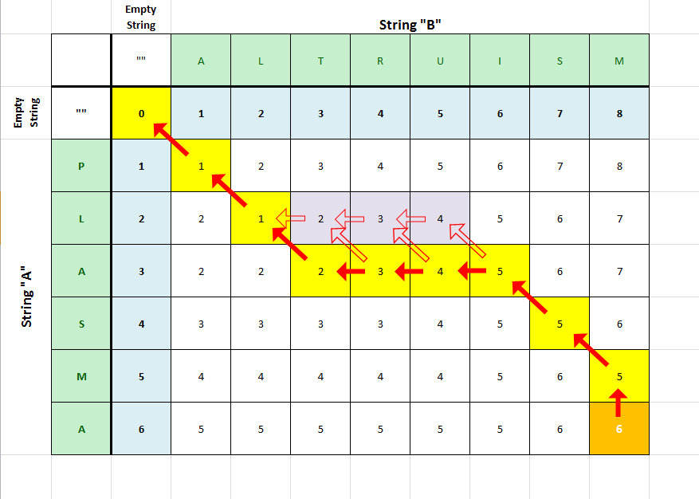
Levensthein Distance
56
Data Structures &
Algorithms 2

Slide 57
Some Examples of Approximation Algorithms
57
Data Structures &
Algorithms 2
Vertex Cover (VC)
2-approximation algorithm
Traveling Salesman Problem (TSP)
2-Approximation for Euclidean TSP only.
Set Cover (SC)
Time complexity increases with instance size.

Slide 58
The Vertex Cover Problem
58
Data Structures &
Algorithms 2
A vertex-cover of an undirected graph G is a subset of its vertices such that it includes at least one vertex from each edge.
The problem is to find minimum size of vertex-cover of the given graph.
As explained before this problem is an NP-Hard optimization problem.

Slide 59
The Vertex Cover Problem
59
Data Structures &
Algorithms 2
Finding the optimal solution is hard (its NP-Hard!) but finding a near-optimal solution is easy.
There is a very simple greedy 2-approximation algorithm that returns a vertex-cover that is not more than twice of the size optimal solution.

Slide 60
The Vertex Cover Problem
60
Data Structures &
Algorithms 2
APPROX-VERTEX-COVER(G)
1 C ← Ø
2 E′ ← E[G]
3 while E′ ≠ Ø
4 do let (u, v) be an arbitrary edge of E′
5 C ← C U {u, v}
6 remove every edge in E′ incident on u or v
7 return C

Slide 61
The Vertex Cover Problem
61
Data Structures &
Algorithms 2
Optimal
Near Optimal
size=6

Slide 62
The Vertex Cover Problem
62
Data Structures &
Algorithms 2
This is a polynomial-time 2-approximation algorithm. (Why?)
Because:
APPROX-VERTEX-COVER is O(V+E)
|C*| ≥ |A|
|C| = 2|A|
|C| ≤ 2|C*|
Selected Edges
Optimal
Selected Vertices

Slide 63
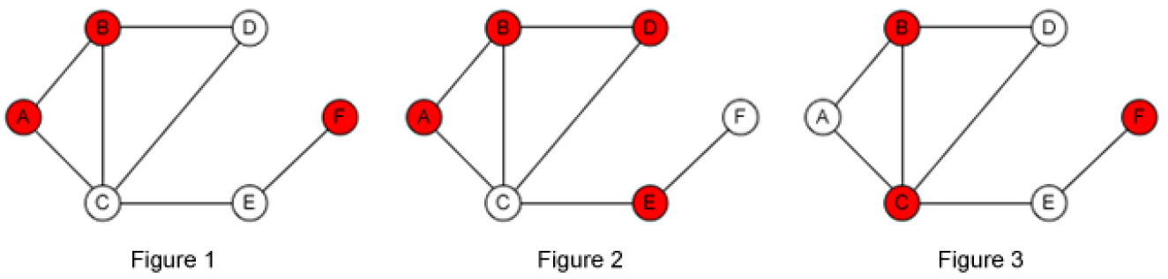
All Edges must be covered
63
Data Structures &
Algorithms 2

Slide 64
Explaining the 2-Approximation Bound
64
Data Structures &
Algorithms 2
APPROX-VERTEX-COVER is O(V+E)
|C*| ≥ |A|
|C| = 2|A|
|C| ≤ 2|C*|
Selected Edges
Optimal
Selected Vertices
Note that the nodes of selected edges A forms a vertex cover.
The optimal cover C* must therefore include at least one node from each edge in A.
The cover C is exactly the union of the nodes of each edge in A.
The result then follows.

Slide 65
TSP Approximation
65
Data Structures &
Algorithms 2
Given a complete, undirected, weighted Graph G we are to find a minimum cost Hamiltonian cycle.
Satisfying the triangle inequality or not this problem is NP-Hard. If the graph satisfies the triangle inequality the problem is called Euclidean TSP.
We now present a simple greedy polynomial-time 2-approximation algorithm for Euclidean TSP based on Prim’s MST algorithm.
Note that this algorithm will not work on general TSP.

Slide 66
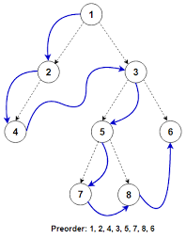
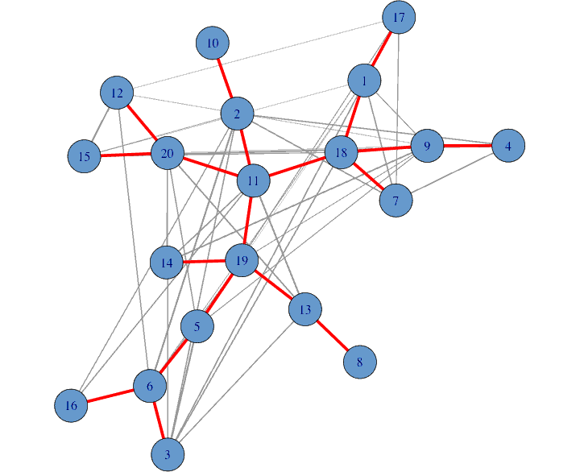
Euclidean TSP Approximation
66
Data Structures &
Algorithms 2
APPROX-TSP-TOUR(G, c)
Select a vertex r ϵ V[G] to be root.
Compute an MST for G from root r using Prim’s Alg.
L is the list of vertices in preorder walk of that MST. Preorder means you visit the root first and then the children left to right.
Return the Hamiltonian cycle H in the order L.
Note that a spanning tree is not necessarily binary.

Slide 67
Euclidean TSP Approximation
67
Data Structures &
Algorithms 2
root
MST
Pre-Order walk
Hamiltonian Cycle

Slide 68
Euclidean TSP Approximation
68
Data Structures &
Algorithms 2
Exercise
Can you show why the 2-approximation bound applies for this algorithm?
Hints
Let H be the Hamiltonian Cycle returned by the algorithm.
Let H* be the optimal (shortest) Hamiltonian Cycle.
Remove the longest edge from H*. This creates a spanning tree which is not necessarily an MST.
Can you proceed from here?
Use the previous slide.

Slide 69
TSP Approximation in General
69
Data Structures &
Algorithms 2
Theorem
If P ≠ NP, then for any constant ρ≥1, there is no polynomial-time ρ-approximation algorithm for TSP.
The proof is by contradiction. If this was true for general TSP then such an algorithm could be used to find a Hamiltonian Cycle which itself is NP-Complete and then P = NP!

Slide 70
Approximaton for Set Cover (SC)
70
Data Structures &
Algorithms 2
We have given (X,F) :
X : a finite set of elements.
F : family of subsets of X such that every element of X belongs to at least one subset in F.
Solution C : subset of F that Includes all the members of X.
The greedy approximation algorithm we shall present has a time complexity that increases with the size of the instance.

Slide 71
An Instance of Set Cover
71
Data Structures &
Algorithms 2
Minimal Covering set
size=3

Slide 72
A Greedy Set Cover Algorithm
72
Data Structures &
Algorithms 2
GREEDY-SET-COVER(X,F)
1 M ← X
2 C ← Ø
3 while M ≠ Ø do
4 select an S ϵ F that maximizes |S ∩ M|
5 M ← M – S
6 C ← C U {S}
7 return C

Slide 73
Greedy (Non-Optimal) Set Cover
73
Data Structures &
Algorithms 2
1st choice
3rd choice
2nd choice
Greedy
Covering set
size=4
4th choice

Slide 74
Greedy Set Cover – Time Complexity
74
Data Structures &
Algorithms 2
This greedy algorithm is polynomial-time ρ(n)-approximation algorithm
ρ(n)=H(max{|S| : S Є F})
The proof is beyond of scope of this course.
H(x) denotes the x^{th} Harmonic number.
A complete exposition of the proof can be found in CLRS.

Slide 75
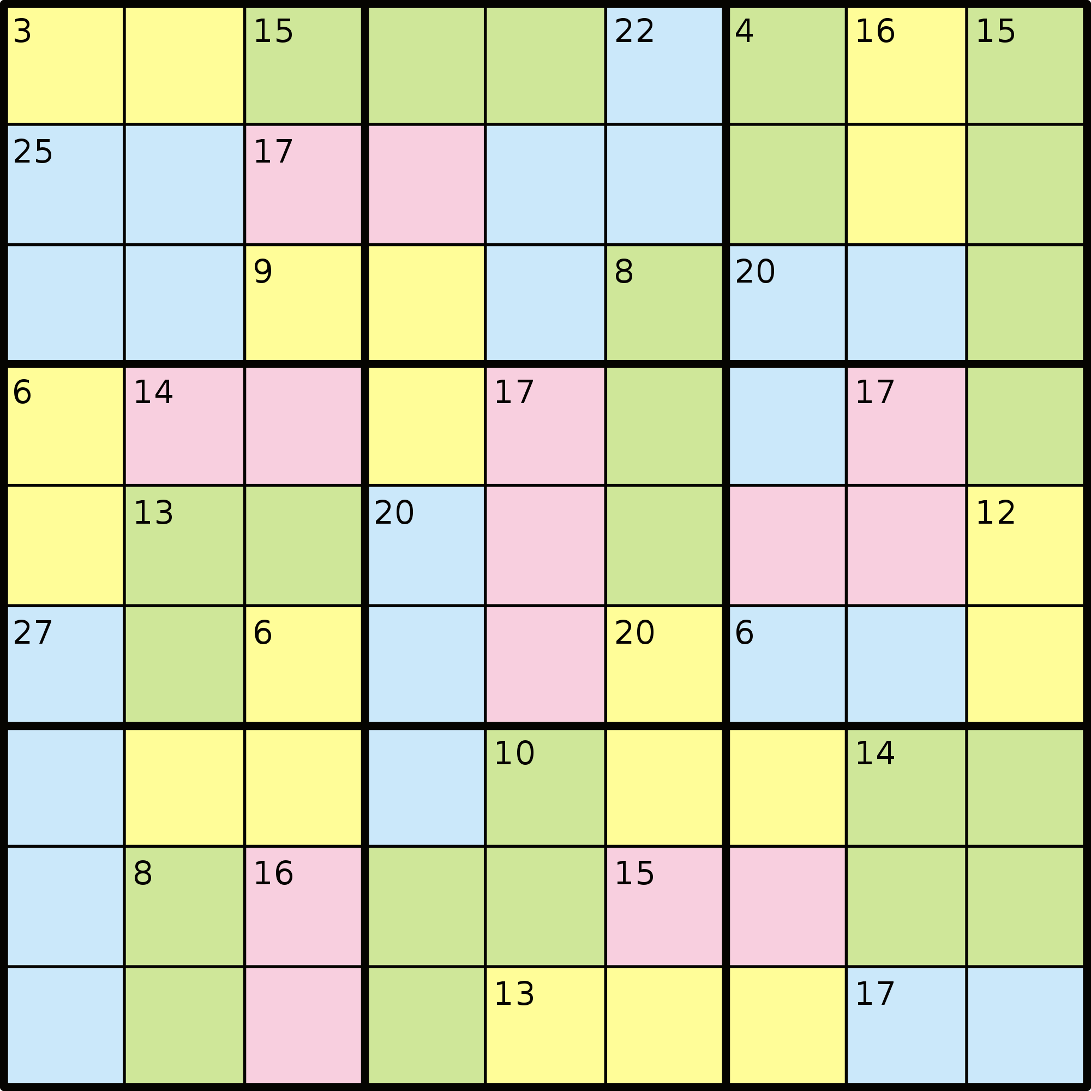
Common Mistakes in Academia
75
Data Structures &
Algorithms 2
Never assume a problem is NP-Complete (or NP-Hard) just because you think it is.
Think of the stable marriage and the assignment problems.
Suppose an FYP student wants to use a neural network to approximate Sudoku.
What does it mean to approximate Sudoku?
It is not very clever, or advised, that you use a neural network to approximate a problem that can be solved optimally in polynomial time.
Fortunately, in the academic literature there is a proof of the Turing reduction from SAT to Sudoku.
This proves that Sudoku is NP-Complete.
An optimal solution may require exponential time.
The student can proceed with using a neural network, or some other technique, to approximate Sudoku.

Slide 76
Genetic Algorithms
76
Data Structures &
Algorithms 2
A genetic algorithm (or GA) is a search technique used in computing to find optimal or approximate solutions to NP-Hard optimization and search problems.
Genetic algorithms are categorized as global search heuristics.
Genetic algorithms are a particular class of evolutionary algorithms that use techniques inspired by evolutionary biology such as inheritance, mutation, selection, and crossover (also called recombination).

Slide 77

Genetic Algorithms - Motivation
77
Data Structures &
Algorithms 2

Slide 78
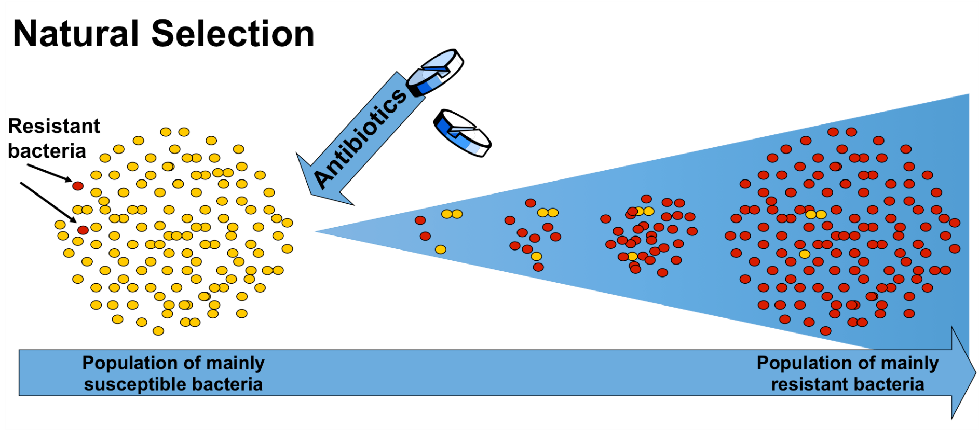
Genetic Algorithms - Motivation
78
Data Structures &
Algorithms 2

Slide 79
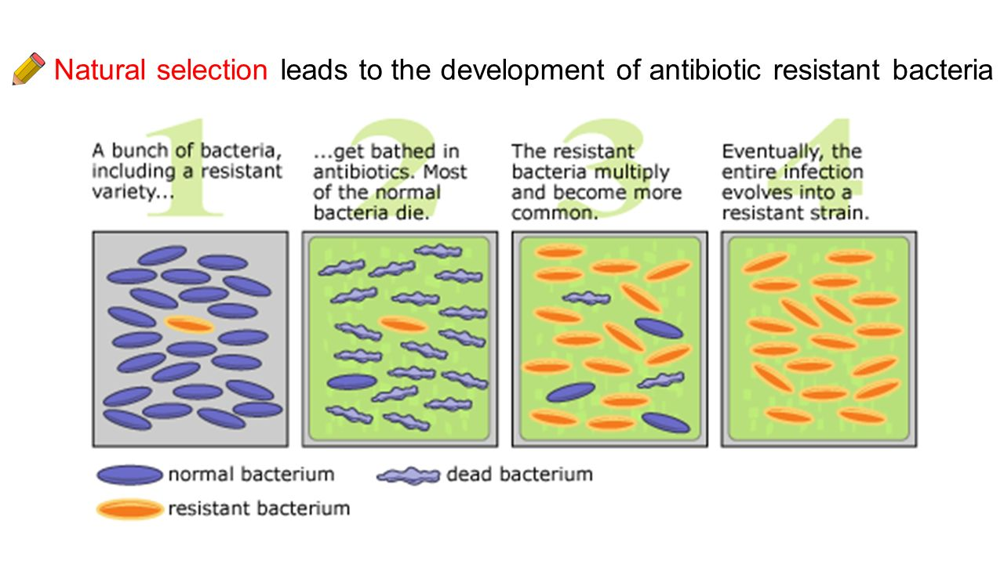
Genetic Algorithms - Motivation
79
Data Structures &
Algorithms 2

Slide 80
Genetic Algorithms - Motivation
80
Data Structures &
Algorithms 2
How do bacteria modify their genome to become resistant to antibiotics?
A genome has billions of DNA bases. How do you modify a genome to make a species ‘better’ – react to a changing environment?
Darwin explained how this happens in his The Origin of Species.
Species, Darwin argued, evolve in order to adapt to a changing environment.

Slide 81


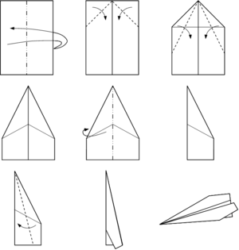
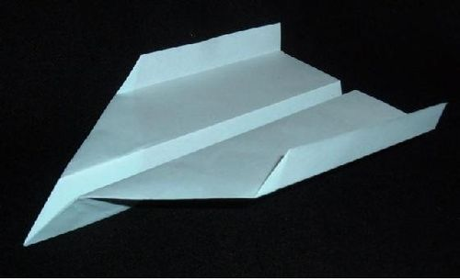

Genetic Algorithms - Motivation
81
Data Structures &
Algorithms 2
How does one design a paper plane?
Try many (billions) of different designs and choose the best one.

Slide 82
Genetic Algorithms
82
Data Structures &
Algorithms 2
Genetic Algorithms (GAs) are now a very popular approximation technique.
GAs have a stochastic component and can therefore be, in some sense, considered non-deterministic.
GAs are often referred to as a meta-heuristic. This is because they employ general, non-problem specific, heuristics.
Unlike Neural Networks, there is no general GA algorithm. One usually designs a GA for the task at hand.
Covered in more depth in ICS2207 / ICS3222

Slide 83
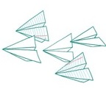
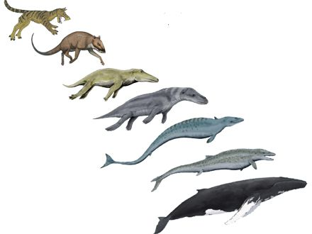
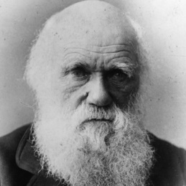
Genetic Algorithms
83
Data Structures &
Algorithms 2
Genetic Algorithms are a popular metaheuristic (search technique). based on Darwinian evolution.
Suppose you want to design a paper plane.
Represent a paper plane by a chromosome (a string).
Create an initial random population of chromosomes.
Use cross-over & mutation to increase the population.
Apply a fitness function to select the best individuals.
Repeat.
Charles Darwin

Slide 84
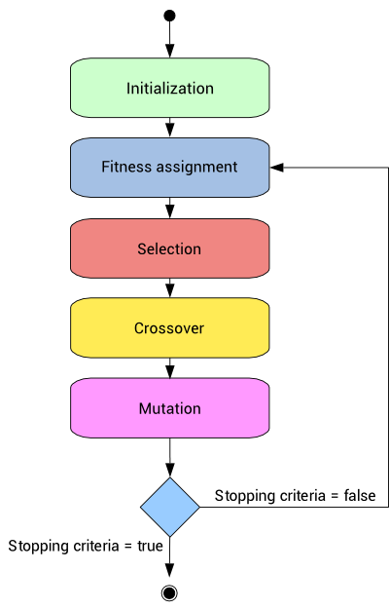
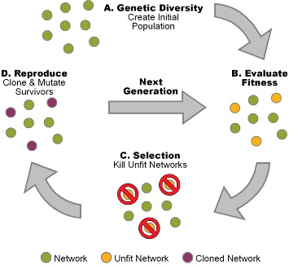
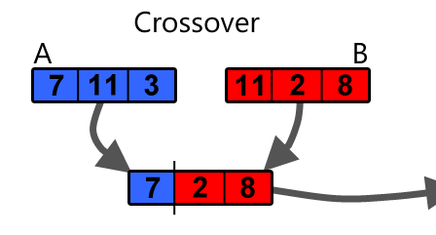
84
Data Structures &
Algorithms 2
How Genetic Algorithms Work

Slide 85

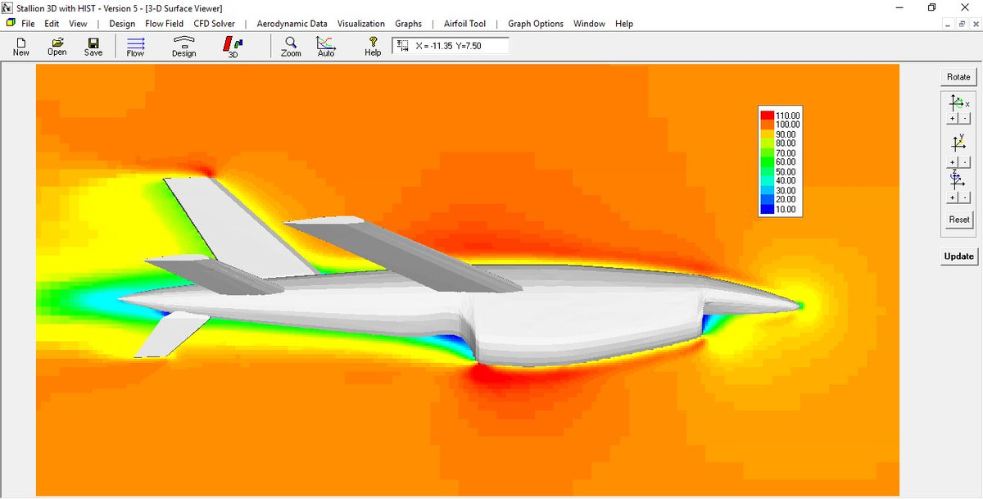
85
Create ‘baby’ planes using crossover
Data Structures &
Algorithms 2
How Genetic Algorithms Work
1. Apply fitness function
Randomly create 100 paper planes
101010101100010101
100010101110011100
100010101100010101
101010101110011100
CFD
Flow
Solver
101010101100010101
100010101110011100
000010101100010101
100010101100010100
100010101001010101
000010101100010101
100010101100010101
Encode the planes as binary strings
100010101100010100
100010101100010101
001010101100010100
100110101100000101
010010101001010100
100010101100010101
000010101101000010
Create more ‘baby’ planes using mutation
100010101000011000
100010101100011101

Slide 86

86
Data Structures &
Algorithms 2
Approximation of NP-Hard Problems

