Slide 1
Mobile Computing Presentation: Free Hour
By Christian Mercieca, Sean Gauci, Dean Zammit, Kieran Cassar and Elmuntaser Taher

Slide 2
Part 1: Business model

Slide 3
What is Free Hour and what does it solve?
Free Hour is a free app available for college and university students that offers convenient features such as timetable sharing.
It also offer extra features that make student life easier such as deadline tracking, weekly student offers, student events, student work opportunities and stipend tracking.
Free Hour aims to solve the hassles brought by college or university life by compiling them together and tracks them for you in a single, free and easy to use app.

Slide 4
Why do students choose Free Hour?
Local focus: Free Hour focuses on local students, making it more relevant to Maltese students than any other app. Benefits such as student offers would otherwise not be possible.
Community Engagement: Free Hour has a strong online social media community, where students can be engaged with the team and other students alike
Continuous Relativity: The app is frequently updated and community communication is given a high priority, meaning that news and features are always as up to date as possible.

Slide 5
Target Audience
The app is catered towards Gen Z students, aged from around 15 to 25 years old.
The chosen UX design is centered around such Maltese students to maximise student comfort and provide the best experience.

Slide 6
Key Partners
Keepmeposted: Provides student jobs which are displayed on the app. A student can also apply for such a job through the Free Hour app itself.
Restaurants and Retail: Provide exclusive discounts to the students through the Free Hour app.

Slide 7
Channels
Social Media: Free Hour has a strong presence on popular social media platforms.
Events: Events such as freshers’ week and other PR events are popular and important for Free Hour.

Slide 8
Cost Structure
Fixed costs: Employee salaries, app maintenance, brand marketing.
Variable costs: Server and hardware maintenance costs, advertising expenses, partnership related costs.

Slide 9
Revenue Streams
Banner ads and adsense revenue: Google generated ads, custom paid banner ads.
Paid service voucher parterships.
Social media advertising.

Slide 10
Part 2: Journey Maps

Slide 11
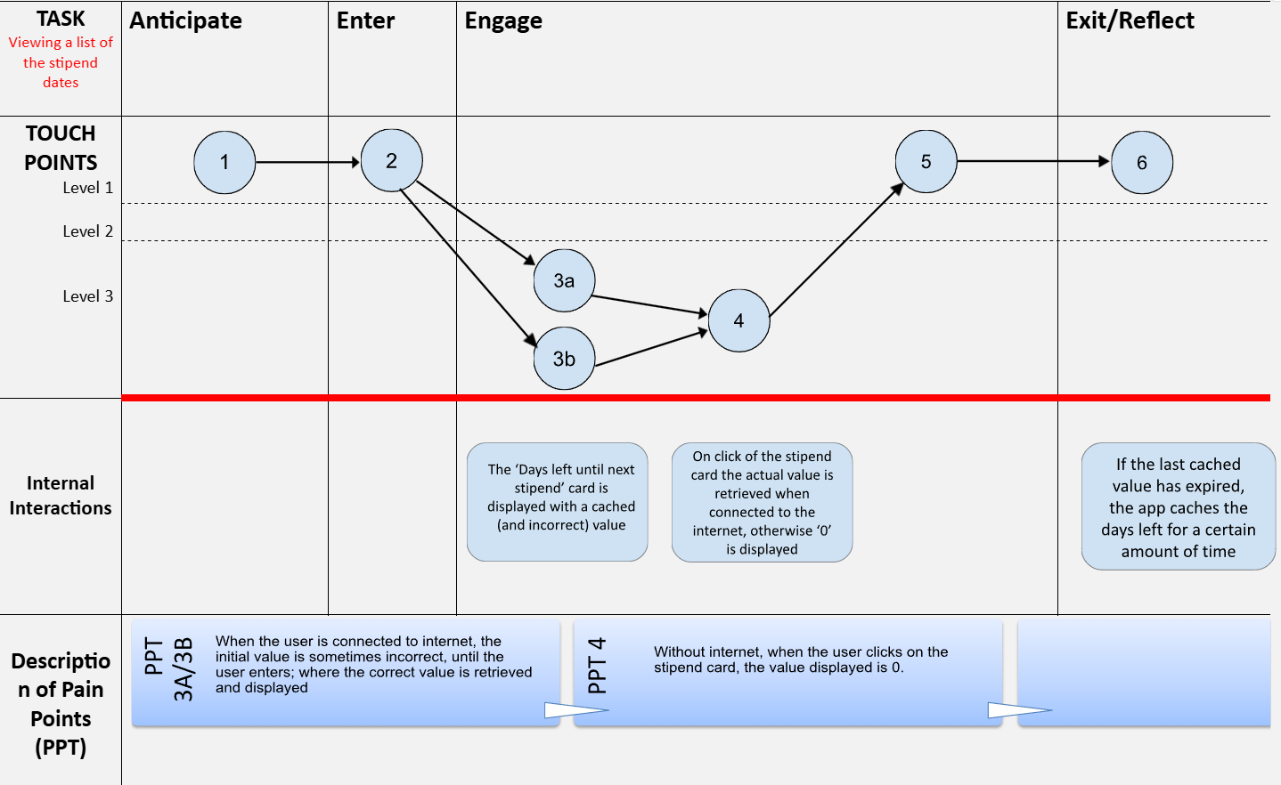
Journey Map 1: Viewing a list of stipend dates

Slide 12
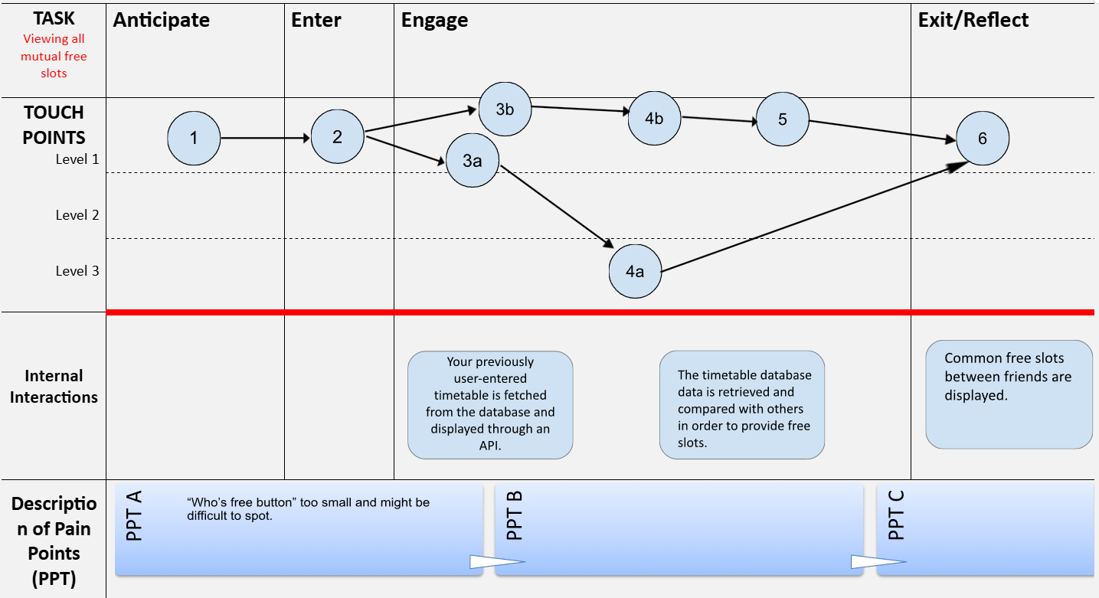
Journey Map 2: Viewing all mutual free slots

Slide 13
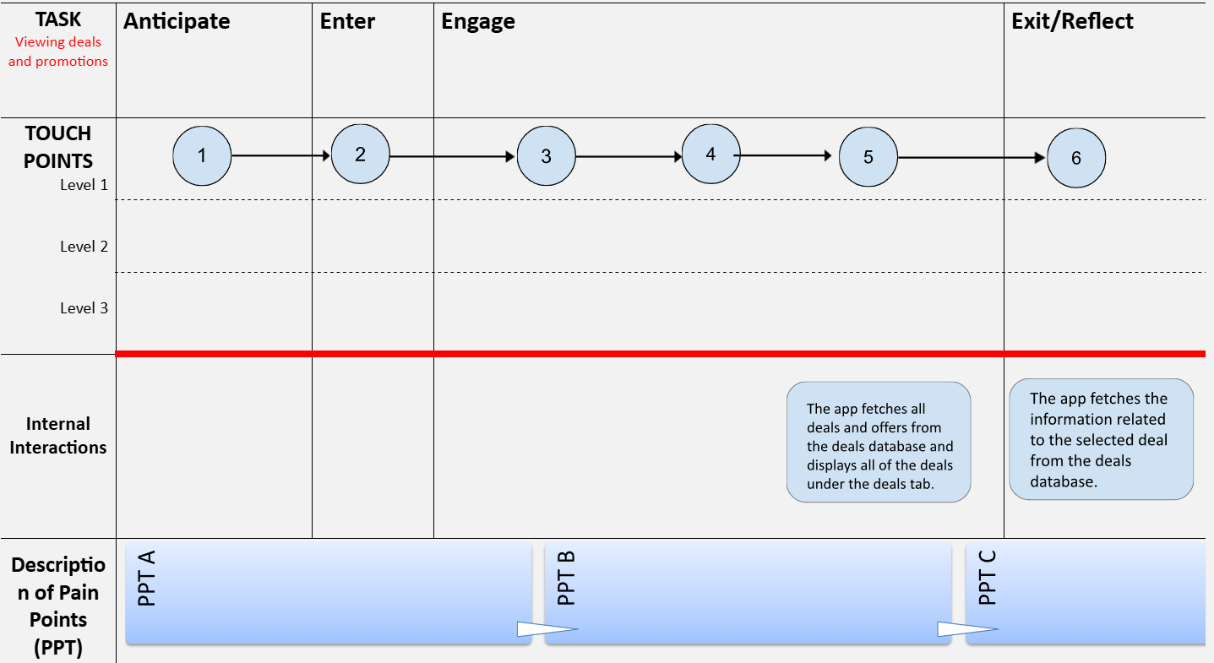
Journey Map 3: Viewing Deals and Promotions

