Slide 1
ASP.Net Core MVC
Dr Chris Porter
Notes:
“ASP.NET MVC gives you a powerful, patterns-based way to build dynamic websites that enables a clean separation of concerns and that gives you full control over markup for enjoyable, agile development. ASP.NET MVC includes many features that enable fast, TDD-friendly development for creating sophisticated applications that use the latest web standards.” – http://asp.net/mvc

Slide 2
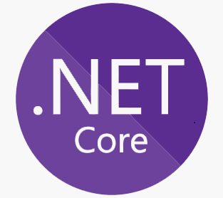
Notes:
Source: https://medium.com/@mindfiresolutions.usa/difference-between-net-core-and-net-framework-c0588e734b99
Understanding Major Differences between .NET Core and .NET Framework
Open Source: .NET Framework was releases as a licensed and proprietary software framework. Microsoft subsequently made certain components of .NET Framework open source. But the company has released .NET Core as an open source software framework. Hence, both enterprise and individual developers can build apps with .NET Core without paying any licensing fees.
Cross-Platform: .NET Framework enabled developers to build applications for a single platform — Windows. But .NET Core is cross-platform, and supports three distinct operating systems — Windows, OS X, and Linux. The compatibility makes it easier for developers to build cross-platform applications and port their existing applications from one platform to another.
Modular Collection of Libraries: Both .NET Framework and .NET Core allows developers to take advantage of robust class libraries. But .NET Core uses a redesigned common language runtime called CoreCLR, and features a modular collection of libraries called CoreFX. Hence, the developers have option to pick and use only the libraries required by each application, and enhance the application’s performance by removing unnecessary libraries.
ASP.NET: .NET Core comes with a redesigned version of ASP.NET. Developers can now use ASP.NET Core to build both web and cloud applications. In addition to being open source, ASP.NET Core is also available on three distinct platforms — Windows, OS X, and Linux
Deployment Options: Web applications developed with ASP.NET Core can be hosted in a number of ways. Developers can deploy ASP.NET Core applications directly in the cloud or self-host the application by creating their own hosting process.
Note: Kestrel is a cross-platform web server for ASP.NET Core. Kestrel is the web server that's included by default in ASP.NET Core project templates.
https://docs.microsoft.com/en-us/aspnet/core/fundamentals/servers/kestrel
https://docs.microsoft.com/en-us/aspnet/core/fundamentals/servers/

Slide 3
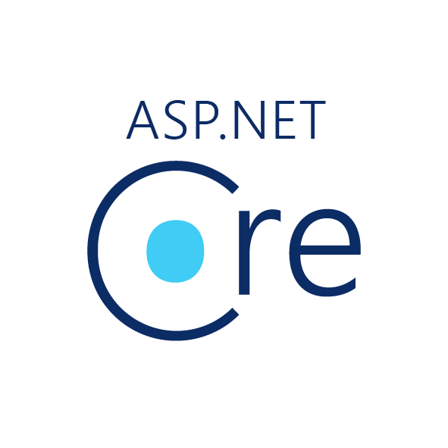

1990s
ASP.NET MVC
2002
2008
ASP.NET WebForms
2016
ASP.NET Core 1.0
2017
ASP.NET Core 2.0
2018
ASP.NET Core 2.1 (LTS)
ASP
ASP.NET Core 2.2
2019
ASP.NET Core 3.0
2020
ASP.NET Core 5.0
ASP.NET Core 3.1 (LTS)
2021
ASP.NET Core 6.0 (LTS)
2022
ASP.NET Core 7.0
2023
ASP.NET Core 8.0
Notes:
*LTS == Long Term Support (3 years)
ASP.Net Core code base can run on Windows, Linux, Mac, using any IDE (or not – via the dotnet CLI tool). It is a complete rewrite of the .Net Framework.
We will be using ASP.Net Core MVC (cross-platform).
Official def: “The ASP.NET Core MVC framework is a lightweight, open source, highly testable presentation framework optimized for use with ASP.NET Core. ASP.NET Core MVC provides a patterns-based way to build dynamic websites that enables a clean separation of concerns. It gives you full control over markup, supports TDD-friendly development and uses the latest web standards.

Slide 4
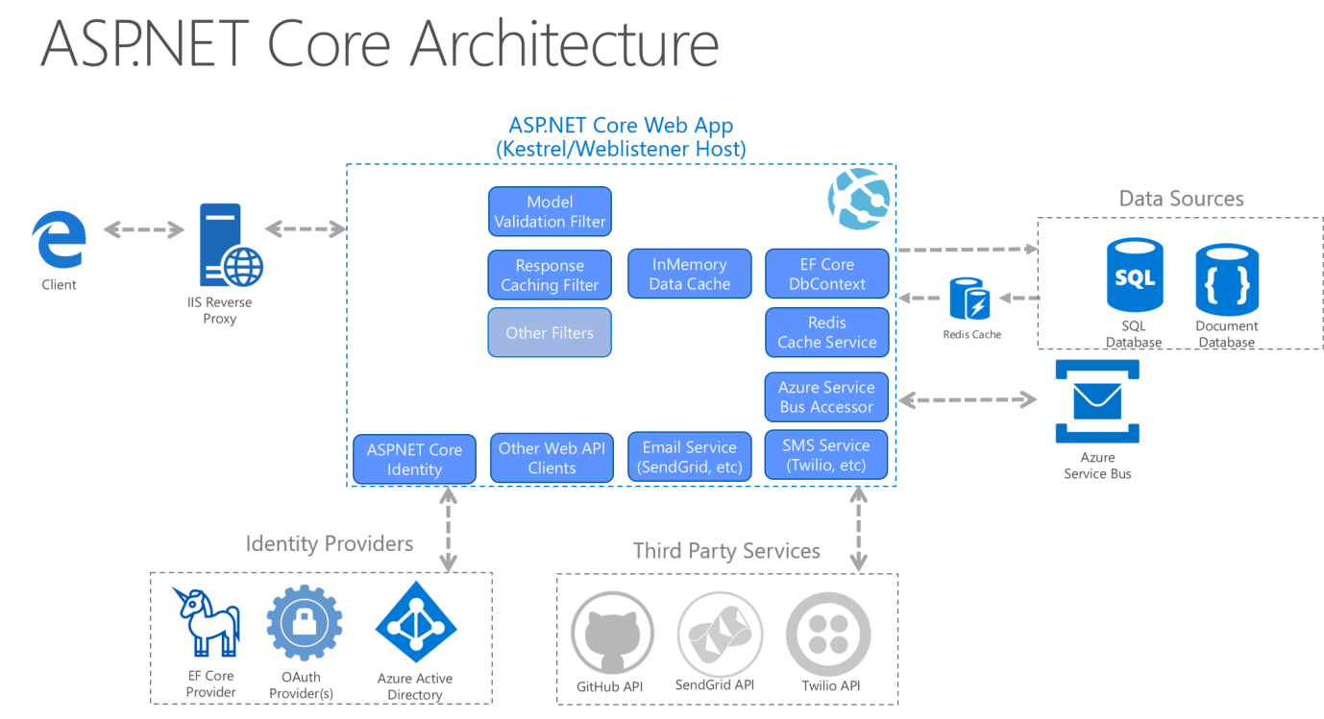
Common web application architectures | Microsoft Docs
Notes:
The image above depicts a non-trivial monolithic application – where the core application runs as a single unit.
Reverse Proxy: directs client requests to the appropriate backend server.

Slide 5

Conventions
Notes:
Conventions can be considered as a set of defined configurations that formalizes agreed upon best practices (from: https://www.youtube.com/watch?v=uVtXNNmvYwg)
Code is organized in a given folder structure
Routes follow a predefined convention
etc…
ASP.Net is convention oriented framework (or opinionated framework)
If followed, things will just work without too much configuration (and based on best practices)
E.g.
Views need to be saved in the right location
Views/[ControllerName]/ViewName
Shared views need to be placed in the Shared folder
Controller classes need to end with the word “Controller” (e.g. ProcessController)
And also, need to inherit ControllerBase which implements IController

Slide 6
Getting started
IDE
Windows
- Visual Studio 2022 Community Edition (>=17.4)
- with the ASP.NET and web development workload
Other platforms
- VS Code + C# plugin
SDK
.NET 6.0 or later
SQL Server
- SQL Server 2022 (Developer) and Management Studio 18
- https://www.microsoft.com/en-gb/sql-server/sql-server-downloads
Notes:
>=15.9.6: includes support for features such as LibMan (instead of Bower)

Slide 7
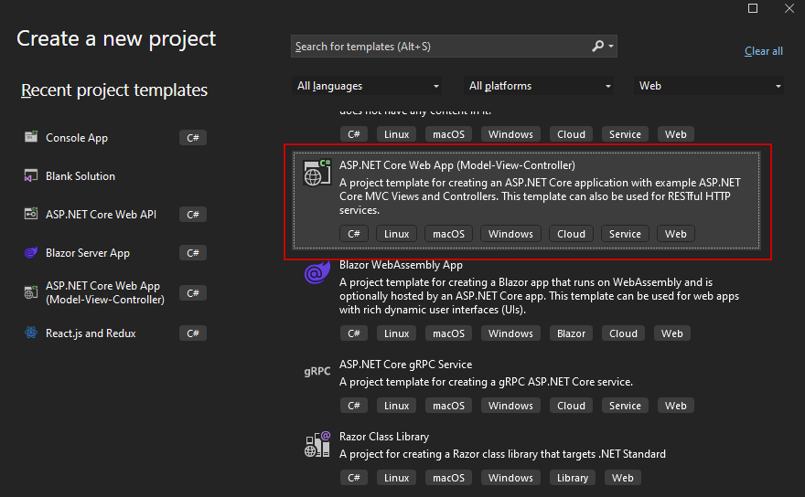
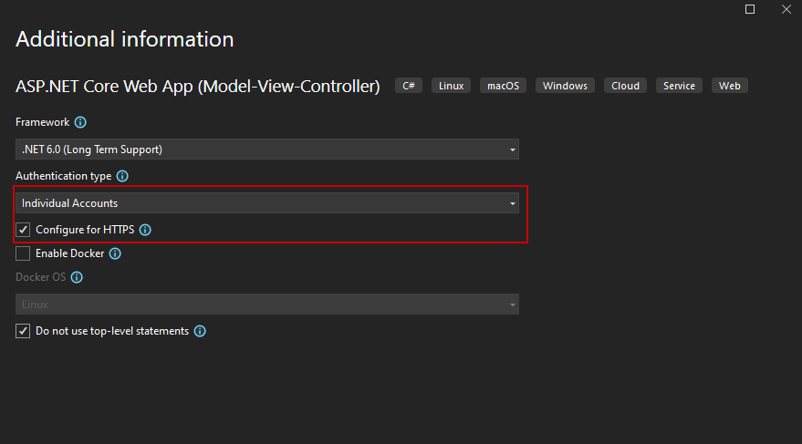
Getting started – with tooling

Slide 8
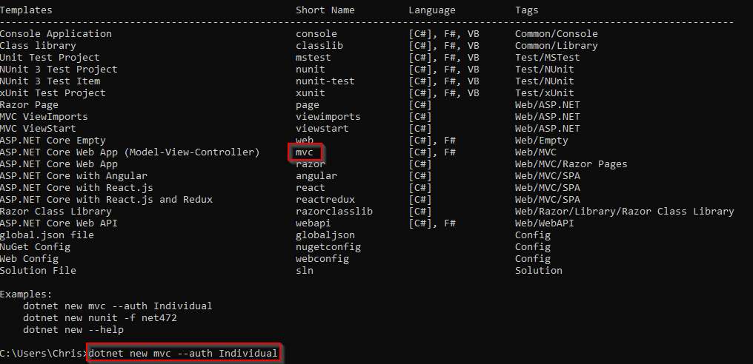
Getting started – CLI
Notes:
Open cmd
dotnet new list (and observe templates)
dotnet new mvc --auth Individual
(or dotnet new mvc --help for more options)
(Do not use top level statements can be toggled using “--use-program-main”)

Slide 9
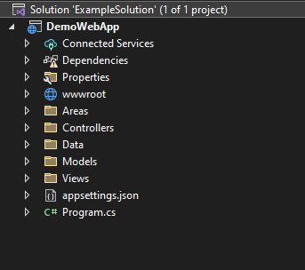
Getting started – scaffolding
Notes:
Model, View and Controller areas.
wwwroot is meant to hold static files such as images, stylesheets and javascript files. These are used by the views (app.UseStaticFiles() needs to be used in Startup.cs)
Dependencies, for .Net Core MVC and its dependencies (e.g. view engine, logging etc…).
Program have a very distinct role in the application’s lifecycle

Slide 10
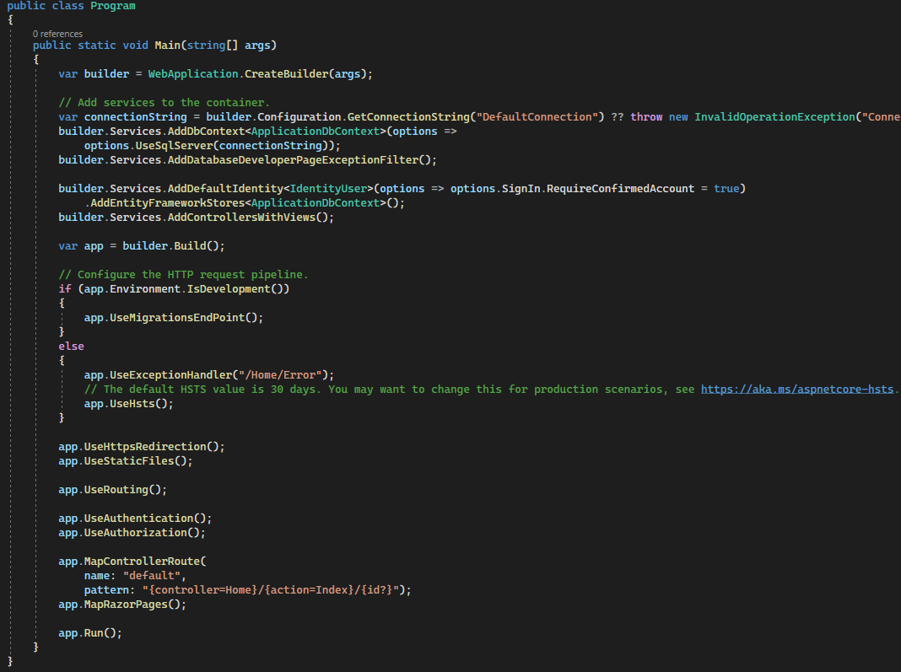
Program class Defaults and Kestrel
Notes:
ASP.NET Core MVC now unifies Startup.cs and Program.cs into a single Program.cs file.
Program.cs class is the entry point for all ASP.NET Core MVC applications. WebApplication.CreateBuilder() will create an instance of a web application
Then we add services to it (e.g. database context, MVC pattern-related services)
After we have the instance of the web app (builder.Build()), we then move on to configure the HTTP pipeline and routes.

Slide 11
Application starts
Registers services
(for dependency injection)
app.*
Configures request pipeline
(middleware)
app.Run()
Program class is executed
builder.Services.*
Web app is ready for requests
Notes:
When an ASP.Net Core application is starting:
Application starts by calling the main() method in the program class
We then register services/middleware that we want to use
Once the web app instance is created (Build()), we move on to specify the request pipeline
The application is then ready to handle incoming requests

Slide 12
Practical discussion

Slide 13
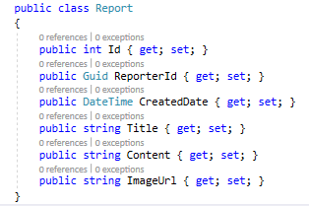
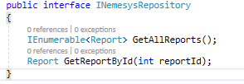
Model
Group of classes that
make up the domain data
and those that manage the data (logic)
a repository class allows our code to use objects without knowing how they are persisted
A simple repository API is exposed to the rest of the app
an interface that defines what the repository would do
… in principle hide data management from the rest of the system
Notes:
Model locations
Not many conventions specified for models
a \Models folder is created by default… but it’s just optional
models can live anywhere
In any folder (e.g. \Models\DTOs, \Models\ViewModels)
In any namespace
In any assembly (separate project altogether) – N-tier

Slide 14

Dependency Injection
Notes:
Refer to the Program.cs’s builder.Services section
ASP.NET Core uses a dependency injection (DI) system to obtain a loosely coupled architecture within our code.
ASP.Net Core uses a dependency injection system to obtain a loosely coupled architecture within our architecture.
Services are objects that have a certain functionality (i.e. system or our own).
Inversion of Control (IoC) refers to a programming style where a framework controls the program flow with the help of Dependency Injection.
DI is a software design pattern that allows us to develop loosely coupled code.
Traditionally, you would instantiate new classes whenever you need them.
Inversion of Control (IoC) is a design principle where the program flow is inverted from the program itself to an external framework or container. Traditionally, the application code typically controls the flow of execution by calling libraries or frameworks to perform specific tasks depending on some variables. However, with IoC, the control flow is inverted, and the framework manages the flow.
Dependency Injection is a common implementation of IoC, allowing us to develop loosely coupled code. With DI, a class’s dependencies are provided externally rather than created or managed internally (e.g. traditionally, you would instantiate instances of the class’s dependencies within the class’s code, generally, the constructor).
With DI, you get greater modularity, better testability and more maintainability in your application code, as dependencies can be managed without touching your core application logic – and by simply modifying the DI container configuration.
With IoC through DI, you achieve better SoC, you get decoupled components (i.e. dependencies are injected as needed rather than explicitly declared/instantiated), and therefore improves maintainability, testability, development flows/flexibility and your application can evolve more easily.
DI containers are responsible for resolving dependencies on the fly, and help you implement the IoC principle. DI containers exist for various frameworks, including ASP.NET, Angular, Spring etc...
…let’s assume that in a class Cart, we have a method for checkout, which depends on some database reader/writer. Typically, you would instantiate the database reader in the constructor of the class. However, that means that the class is tightly coupled with a specific database reader/writer implementation. If you need to change it to something else, then you would need to change both classes, most probably. This becomes more difficult if you want to run different variants of the database reader/writer based on the current environment (i.e. dev, staging, prod).
In that case, you would need to do something like this:
DatabaseServices dbs;
switch (env) {
case Settings.Environments.Production: dbs = new DatabaseServices(AppSettings.ConnectionStrings.Production); break;
case Settings.Environments.Test: dbs = new DatabaseServices(AppSettings.ConnectionStrings.Test); break;
…..
… as you can see, we have to add unnecessary logic to our code to control which classes to instantiate according to env. Adding more is inflexible.
DI aims at decoupling objects to the extent that no code has to be changed just because an object another object depends on needs to be modified/changed
So:
The Dependency Injection design pattern solves such problems. Classes will declare that they rely on some dependency that implments a specific interface (e.g. IBloggyRepository). Then the DI container is configured to inject a different variant depending on the current environment we’re on. The class doesn’t really care what instance it receives, as long as it implements that interface (a contract).
The Dependency Injection pattern describes how to solve such problems:
Separate object creation from an application:
Define a separate Injector object that creates and injects the objects a class requires.
A class accepts the objects it requires from an Injector object instead of creating the objects directly.
(From : https://learn.microsoft.com/en-us/aspnet/core/fundamentals/dependency-injection?view=aspnetcore-7.0 and http://w3sdesign.com/?gr=u01&ugr=proble#gf )
Practical example of why it is better: You can have multiple managers depending on same repository. Without DI you would end up with 2 instances of repository, ie less efficient. Additionally, you may need a configuration service or something that is singleton/ contains state throughout call. It would be very difficult to do without DI

Slide 15
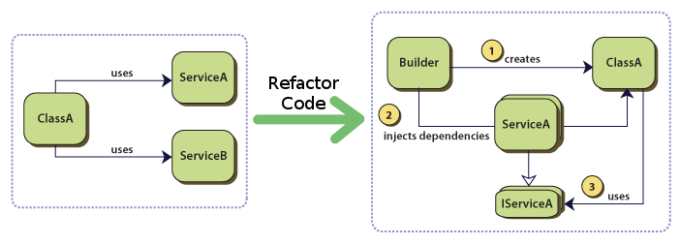
Source: https://medium.com/@elliotchance/a-new-simpler-way-to-do-dependency-injection-in-go-9e191bef50d5
Notes:
(on board)
Assume Class A requires ServiceA and ServiceB (which are other classes)
First version is what we’re used to (the Class constructs instances of Service A and Service B)
With IoC, we get:
Class A that depends on a service that implements IServiceA and IServiceB
Once the builder constructs ClassA, it will know that it also needs to create an instance of IServiceA and IServiceB, according (for instance), to the env we’re on, and injects these dependencies into Class A
So, we don’t instantiate objects ourselves in Class A, we simply say what it depends on, and the DI system would inject the correct version for us depending on some config.

Slide 16
Dependency Injection
Non-DI | DI
Hard wired object creation Creating objects is implemented (hard-wired) directly within a class (Client). This makes it hard to change the way objects are created independently from (without having to change) the class. | Separated object creation A separate Injector creates and injects the objects. The way objects are created is defined in separate configuration files. This makes it easy to change the way objects are created independently from (without having to change) existing classes
Distributed object creation Creating objects is distributed across the classes of an application. | Centralized object creation Creating objects is centralized in a single Injector class
http://w3sdesign.com/?gr=u01&ugr=proble#gf
Notes:
Rather than having a client (e.g. class) responsible to create dependencies, an external piece of code (injector) is given that role.
The injector constructs the services/classes and calls the client to inject them, therefore, the client is abstracted further, and there is no need for it to know how to construct the dependencies or what these dependencies (services) do.
All the client needs to be aware of are the services’ interfaces (defining how the client may use the services i.e. which methods it implements), separating responsibilities of use and construction.
Therefore, for unit testing, you write services following the given interface but which write, say, in RAM instead of a DB (mocking).
This also makes classes (e.g. controllers) more testable (we can write unit tests “easily”)
The use of interfaces is, therefore, extremely important – and the injector simply constructs whatever classes are necessary as long as they implement the required interface(s).
A DI Container is required to help us adopt this pattern.
Refer to SoC code example
Interface: IBookingRepository.cs
Mock Repo: MockBookingRepository.cs
Added repo service (mock or otherwise) to DI Container: Startup.cs -> ConfigureServices() (depending on environment, it will use a different repo which implements the same interface)
Request repo instance injection from client (BookingController.cs) constructor (constructor injection)
Rather than creating instances of our repo in our code, creating tight coupling, we can register our repository with a DI system.
- Example in Controller constructor – having to change code if we want to move from Mock to actual DB repo.
All other classes wanting to make use of our repository would ask the DI system for an instance of the repository.
This way, we’ll have more loosely coupled code – in line with the goals of MVC.

Slide 17
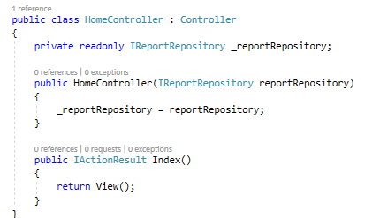
View
Necessary to visualize model data (e.g. reports) in HTML
They can be Plain or Strongly-Typed (with a View Model)
Razor is a view engine that allows us to use C# like logic to construct HTML dynamically based on our view models
Views receive data in various ways:
ViewBag: dynamic data type
ViewData: data dictionary
Typed views
Views\Home
Views\Home\Index.cshtml
Notes:
ASP.Net is based on conventions:
Views folder is used by convention. For each controller, we have a corresponding sub-folder with the name of the Controller (e.g. Views\Home → HomeController)
Each Action in the Controller corresponds to a view in the subfolder (e.g. Index action → Index.cshtml)

Slide 18

View templating
Notes:
In .Net, multiple view engines are available, although Razor is the preferred technology
Master pages (or Layout pages) are used to re-use as much code as possible.

Slide 19

Database access
Various database drivers:
JDBC
ADO.NET
ODBC
Psycopg2
SQLAlchemy
Notes:
Your code generally needs to connect to a database – to retrieve or persist data.
Database connectivity technologies, or database drivers, exist for the various languages and database servers around.
For instance, JDBC (Java Database Connectivity) as well as ADO.NET (ActiveX Data Objects), are used in the context of Java and .NET respectively.
Others exist, such as ODBC (Open Database Connectivity – used in certain reporting tools), SQLAlchemy (conncets various DBs in Python), psycopg2 (connects PostgresSQL in Python)
Then, more advanced technologies allow us to reach a DB, but also map our OOP logic/code with the underlying data model used in the database (e.g. OOP to Relational and back). Some of these build on top of these database technologies and provide more functionality.
This year, we’ll talk about Entity Framework.

Slide 20
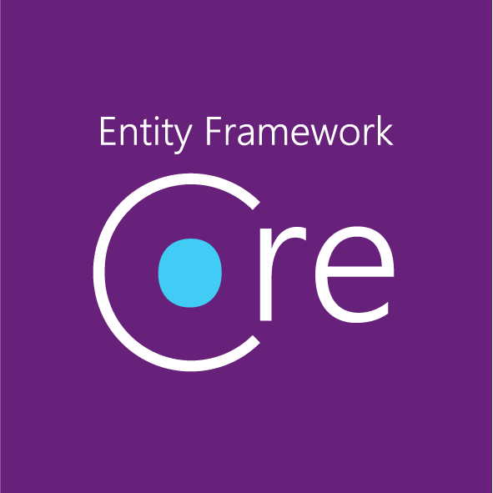

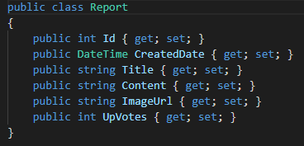
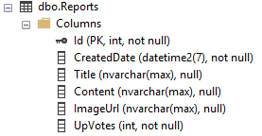
Entity Framework
Code
Database
Notes:
EF is an ORM from MS (Object Relational Mapper). OR Mapping helps in converting data between incompatible type systems using object-oriented programming languages. This creates, in effect, a "virtual object database" that can be used from within the programming language.
In practice, you use OOP code to interact with a relational data store.
Is it good practice? Well, there are many ifs and buts, but in practice, a middle-ground exists using procedural languages offered by most databases (E.g. PL/SQL, T-SQL etc…), which are then called via the ORM.
Language-Integrated Query (LINQ): LINQ statements allow us to interact with our data using Lambda statements.
It offers data querying capabilities directly into the C# language.
Traditionally, queries against data are expressed as simple strings without type checking at compile time.
With LINQ, a query is a first-class language construct, just like classes, methods, events.
EF Core can be used to interact with different DBs across platforms and across data models (e.g. xml, SQL DBs, relational and non-relational, etc…), using one query language.
EF Core only supports a Code-First approach

Slide 21
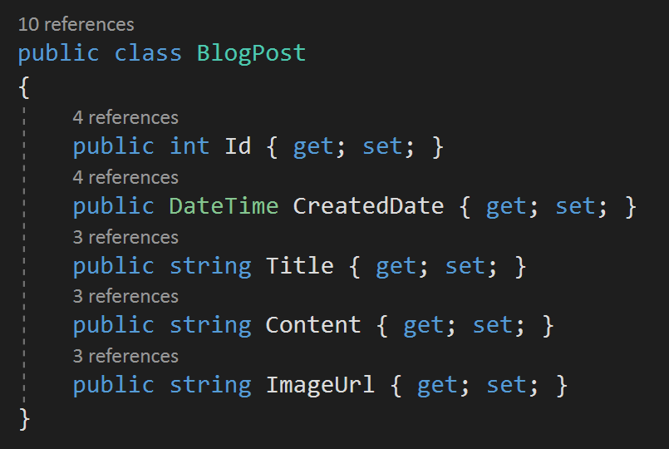
Code
Class
Database
Table
Id | Int (PK
CreatedDate | datetime
Title | nvarchar(MAX)
Content | nvarchar(MAX)
ImageUrl | nvarchar(2048)
Entity Framework
Notes:
Types will be mapped from your classes to your data store’s types.
Also, certain conventions exist: a property with Id in it (e.g. PieId or Id) will become the primary key in the DB.

Slide 22
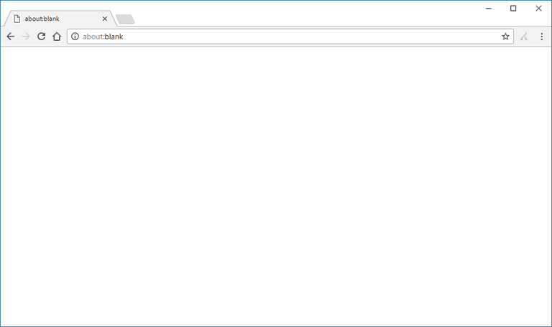

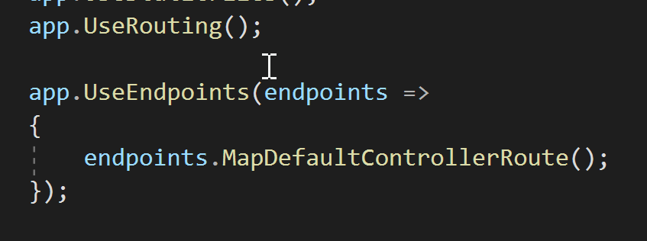
Routing
ASP.Net Routing
View Engine
Controller/Action
Startup.cs
Notes:
In ASP.Net MVC – incoming HTTP requests are captured, and mapped to the respective action within the respective controller.
There is no link between incoming request and static files on disk
How does MVC know which controller/action need to be invoked? Routing.
Routing engine will match URL with actions and controllers based on pre-defined URL patterns
By default we specify the app to use the default route (endpoints.MapDefaultControllerRoute()).
This will add a default route: {controller=Home}/{action=Index}/{id?}.
This will work for most applications with a default value if none are supplied.
“The ASP.NET Routing module is responsible for mapping incoming browser requests to particular MVC controller actions” – http://asp.net/mvc
Each route is a URL pattern, which will be mapped to a handler (action on the controller)
Patterns will be used to trigger the corresponding action
E.g. http://yoursite.com/reports/details/5 (first is controller, second is action while third parameter would be the id)
Routing engine will need to be set up to understand the above pattern e.g. {Controller}/{Action} → /reports/detail – with optional Id
Controller classes use the following naming convention "HomeController", "ProcessController", however routing engine only needs to first part "Home" or "Process" which would in turn look into the Controllers folder and look for the corresponding class that starts with that name
Custom routing can be specified globally, per controller or specific actions
Globally, you can have multiple patterns, and only the first matching pattern is picked up and executed.
There are very few scenarios where global routing is preferred (e.g. API versions).
“Default” Route == Catch-all route and should be specified last
i.e. {controller}/{action}/{id}
First part of the URL (after root path) is the controller name
Second part is the method to use
Third part is a parameter (named id)
Controller/action level custom routing is more flexible and granular.

Slide 23

Controllers
Notes:
Background
Controllers are .Net classes
Extends the Controller base class
Which gives us access to a lot of interactions required to orchestrate requests (based on best practices, such as constructing View responses etc…).
Actions
Public methods in Controllers == “Actions”
Actions are invoked by ASP.Net if there is a matching route (e.g. localhost/home/list/3)
Routing engine looks at the controller’s public methods and attempts to resolve a request
Actions’ job is to build up a model (if required) via the DAL, select a View and invoke it (and passing the model)
ASP.Net also allow us to use ViewData and ViewBag (in a second)
Action can return an ActionResult, which is the base class for a variety of types (practically creates the correct response including headers (e.g. content-type))
Example
ContentResult – return Content(“Hello World”);
EmptyResult - return new EmptyResult(); (or use void method)
FileResult – return File(info.OpenRead(), "text/plain");
HttpStatusCodeResult - return new HttpStatusCodeResult(500);
JsonResult – new Json(new { a = “1”, b=“2” });
RedirectResult – new Redirect(“URL”);
RedirectToRouteResult – e.g. new RedirectToAction(“Action”, “Controller”); or new RedirectToActionPermanent(“Action”, “Controller”);
ViewResult/PartialViewResult - view engine is delegated to return result (e.g. return View/PartialView)
Or void!
Give a couple of examples on existing code
Return Content
Return Json
Return HttpStatusCodeResult
If (User.IsInRole(“Admin”) { do something } else { return new HttpStatusCodeResults(403) }
Return RedirectToAction and RedirectToActionPermanent() – check headers (301/302)
ViewData, ViewBags
ViewData
Gets or sets a dictionary that contains data to pass between the controller and the view.
E.g. Return an IEnumerable of running processes
ViewData["ProcessList"] = Process.GetProcesses().ToList();
It’s now up to the View designer to know that there’s a ViewData entry “ProcessList” of a specific type so that he/she could handle it to display its contents while casting to the correct type!
ViewBag
Gets the dynamic view data dictionary.
E.g. Return an IEnumerable of running processes
ViewBag.CurrentProcesses = Process.GetProcesses().ToList();
Returning a Model
Actions should return a model - this is the neatest (and most MVCesque) approach – even if it’s just a simple API response (201 Ok)
When controller action returns a View, view models are then attached to it
return View(model);
View requires to be strongly typed (Strongly-typed views typically use ViewModel types designed to contain the data to display on that view. The controller creates and populates these ViewModel instances from the model)

Slide 24

Actions
Notes:
Public methods in controllers are “Actions”
Actions are the final destination for requests
When a request arrives
UrlRoutingModule receives it,
Checks the routing table for matching patterns (MvcRouteHandler)
Puts information together and invokes MvcHandler
Uses ControllerFactory to instantiate the relevant controller
Executes the controller
The Execute() method creates an ActionInvoker
ActionInvoker looks at routing data and finds the action parameter
Executes specific Action (e.g. List)
Routing mechanism looks for actions to serve HTTP requests
Actions can serve GET or POST requests (and other verbs)
By default, GET
But can be decorated with the POST filter
[HttpPost]
Generally an action has two flavours
GET – to prepare UI (return the form UI with model data)
POST – to receive user data (e.g. user submits form)
e.g.
[HttpGet]
public ActionResult BookHoliday()
{
}
[HttpPost]
public ActionResult BookHoliday(FormCollection form)
{
}

Slide 25
Action Results
Notes:
Action can return an ActionResult, which is the base class for a variety of types (practically creates the correct response including headers (e.g. content-type)).
There are several content types supported, including simple text, status codes, binary files, json responses, redirect instructions and so forth.
Give a couple of examples on existing codebase.
Return Content (simply comment out Index() and return “hello world”)
Return Json (use existing Index() and return model (list of blogs))
Return StatusCode
If (User.IsInRole(“Admin”) { do something } else {return new StatusCodeResult(StatusCodes.Status401Unauthorized); }
You can also use return return Unauthorized();
Return RedirectToAction and RedirectToActionPermanent() – check headers (301/302)
Be careful with the Permanent Redirect
https://moz.com/blog/can-you-reverse-a-301-redirect In a dev env, you can delete local cache and reverse the 301, however in a live env, you would need to either reverse the 301 with another 301, or else ask all of your thousands of users to clean their user agent in some way (no control on what agents are used - and is highly unprofessional).

Slide 26

Actions and Data
Notes:
Returning data using ViewData, ViewBags
ViewData
Gets or sets a dictionary that contains data to pass between the controller and the view.
E.g. Return an IEnumerable of running processes
ViewData["ProcessList"] = Process.GetProcesses().ToList();
It’s now up to the View designer to know that there’s a ViewData entry “ProcessList” of a specific type so that he/she could handle it to display its contents while casting to the correct type!
ViewBag
Gets the dynamic view data dictionary.
E.g. Return an IEnumerable of running processes
ViewBag.CurrentProcesses = Process.GetProcesses().ToList();
Returning a Model
Actions should return a model - this is the neatest (and most MVCesque) approach – even if it’s just a simple API response (201 Ok)
When controller action returns a View, view models are then attached to it (return View(model);)
View requires to be strongly typed (Strongly-typed views typically use ViewModel types designed to contain the data to display on that view. The controller creates and populates these ViewModel instances from the model)

Slide 27

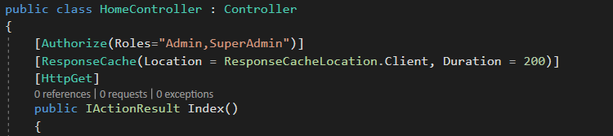
Action Filters
Notes:
“An action filter is an attribute that you can apply to a controller action -- or an entire controller -- that modifies the way in which the action is executed. The ASP.NET MVC framework includes several action filters:” - http://www.asp.net/mvc
Attributes applicable to
Controllers
Applicable globally for all public methods
Controller Actions
Applicable only to specific actions
Action Filters
- Attributes you can apply to Controllers and to Controller Actions
- Can allow us to inject pre and post processing before and after the action is invoked, such as:
- Authorization (is the user authorized to invoke this action)
- ResponseCaching (will the result of the action be cached? Making future requests faster)
Custom filters are also possible (e.t. Throttling, Localization, Logging)
Action Filters
Method
What HTTP method should this action respond to (get vs post etc…)
Authorization
Restrict access to an action/controller by users/roles
E.g. [Authorize(Roles = "Admin, SuperUser")]
E.g. [Authorize(Users= “Joe,Johnny")]
ResponseCache
[NOTE: in Chrome, cache will be invalidated if you hit F5. Simply add a link which points to the same page, and use that (e.g. in Bloggy or Nemesys)]
Caches the output of a controller action for a specified amount of time
E.g. [ResponseCach(Duration=10, VaryByQueryKeys=“…“, VaryByHeader=“…”)]
Careful use is required (e.g. dynamic data might result in issues .. Time?)
Full control on where to cache stuff
To cache or not to cache!
Is it dynamic content?
Is it important the latest stuff is returned (e.g. stock prices)?
Is a delay acceptable (in terms of content)?
Caching speeds up your apps
Caching reduces load on the server (no need to execute each and every time)
Custom Filters
E.g. handle authorization mechanisms, modify return data
ValidateAntiForgeryToken *
Protects against request forgery
* ValidateAntiForgeryToken (From stackoverflow): MVC's Anti-Forgery Token support writes a unique value to an HTTP-only cookie and then the same value is written to the form. When the page is submitted, an error is raised if the cookie value doesn't match the form value. It's important to note that the feature prevents cross site request forgeries. That is, a form from another site that posts to your site in an attempt to submit hidden content using an authenticated user's credentials. The attack involves tricking the logged in user into submitting a form. The feature doesn't prevent any other type of data forgery or tampering based attacks. To use it, decorate the action method or controller with the ValidateAntiForgeryToken attribute.

Slide 28

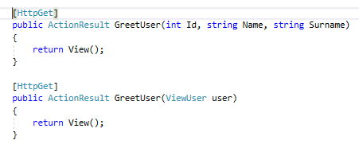
Action Params and Model Binding
Notes:
Actions can accept
Primitive parameters
Such as int, bool and string
Assume a parameter “id”
First action invoker looks at the route data
E.g. accepting /{id}
If not found in the URL, action invoker will look at
Form and query string values
If not found, id = null
If found, but incorrect, exception is thrown
Complex parameters
E.g. Action expects a Department object
Model binder is used
Get values from environment
Matches parameter values to public properties in that type (class)
Model binder maps properties (where possible)
Model Binding
MVC matches data coming from HTTP request with arguments that the Action method requires.
Objects required as input parameters in actions are initiated from HTTP request values (in body or URL query)
If an integer with name id is set in the action’s input parameter list, model binder will try and locate a similar value in the http request
Model binders will look at certain locations in the HTTP request and attempt to map them to the action parameter list. There are three types of model binders, which are invoked in the following sequence:
1) Form Data
2) Route Variables /path/var1/path/var2
3) Query String ?var1=&var2=
As soon as a match is found, the process is stopped and the value is passed to the action method parameter.

Slide 29

Views and Actions
Notes:
MVC views are HTML templates
With some templating logic to inject data
MVC views are built on some conventions
Every controller has a default views folder
E.g. HomeController → Views/Home/*.cshtml
Every controller action has a default view to render
E.g. HomeController’s Edit() can return View()
MVC will look for Views/Home/Edit.cshtml by default
If not found, it will look in the Views/Shared folder
Actions can return different Views
E.g. return View(“AnotherView”);
MVC framework will look for AnotherView.cshtml in the respective folder (and in the Shared folder if not found)
Alternatively, if you want to render another view related to a different Action from a different Controller
return RedirectToAction(“ActionName",“AnotherController");
Partial views
Partial views allow you to render portions of a page
Reusing HTML codes across multiple views
Especially useful for async updates

Slide 30
Tag Helpers
Notes:
Tag Helpers
Tag Helpers provide HTML-friendly development experience For the most part, Razor markup using Tag Helpers looks like standard HTML. Front-end designers conversant with HTML/CSS/JavaScript can edit Razor without learning C# Razor syntax
Tag helpers have been introduced to build dynamic HTML code.
Tag helper markup code will be executed server side – out of which HTML will be generated.
This also replaces HTML helpers in Asp.Net MVC (although it is still available) – HTML helpers make your views look quite messy
Tag helpers are also used for navigation.
To generate a link from the home page to the list page, one uses tag helpers in anchor tags (e.g. asp-controller and asp-action)
asp-controller: defines which controller to use
asp-action: defines which action to use
… these links will however be generated according to the default routing pattern we have defined earlier.
asp-route-* can be used to specify individual route parameters (e.g. asp-route-id="@Model.ReportId">).
If we change the routing pattern, then the links will be re-generated automatically – making it easier to maintain the code-base.
We can also specify the exact route by name should we want, using the asp-route tag helper (this links to a named route on an Action [Route(… Name=””)].
… if we create a link, then change the routing rules, the link will update itself automatically.
1) First, add TagHelper support
In Views/_ViewImports.cshtml
@addTagHelper *, Microsoft.AspNetCore.Mvc.TagHelpers
@addTagHelper *, AuthoringTagHelpers
2) Then create a dummy action in Home (Details returning View())
3) Then add this to Index.cshtml <a asp-controller="Home" asp-action="Index" asp-route-id="3">Click here</a>
… check URL generated
4) Add Custom Route to Action Details [Route("VeryDifferent/Route/{Id}")] and see
… check URL generated
Tag helpers are also used for form creation:
form tag helper – happens to have the same name as the HTML element
input tag helper
label tag helper
textarea tag helper
select tag heler
validation tag helpers
Examples:
<form asp-controller=“Home” asp-action="Index" method="post" role="form">
...
</form>
…results in
<form action="/Home/Index" method="post" role="form">
...
</form>
<label asp-for="Name"> //name is the model attribute used in the
</label>
… results in
<label for="Name">
Name
</label>
More details here: https://docs.microsoft.com/en-us/aspnet/core/mvc/views/tag-helpers/intro?view=aspnetcore-3.1

Slide 31
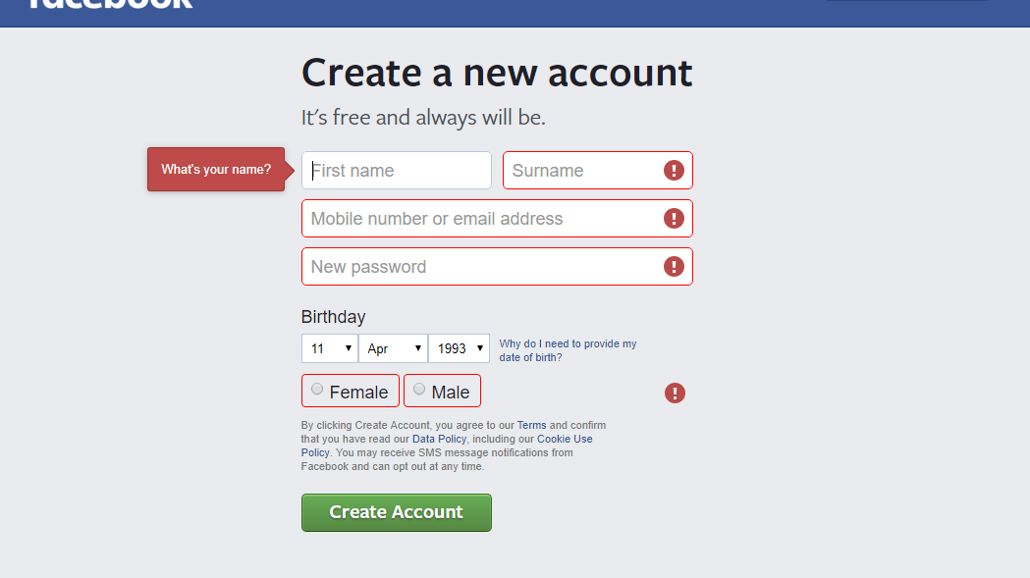
Validation
Notes:
As a framework, MVC offers powerful model validation technologies, for both back and front end. The central premise here, is the view model.
ASP.Net Core model binding engine can check whether values meet the requirement of the model object.
We have ModelState at our disposal, where we can use the IsValid property, which returns true if object has no validation errors.
Through this check, we can then decide whether to store the model and return the user to a different location or to simply return the user to the same view and show error messages.
Validation Attributes
ASP.Net Core MVC will do some validation automatically (e.g. type of data. Is parameter “Title” a string as expected in the model?).
However, most applications require more complex validation.

Slide 32
Validation Attributes
Buil-in Attribute | Description
[Credit Card] | This validates that the property has a credit card format.
[Compare] | This attribute validates that two property in model class match like password and compare password.
[EmailAddress] | This validates the property has email address format.
[Phone] | This validates that the property has a telephone number format.
[Range] | This validates that the property value within a specified range.
[RegularExpression] | This validates that the property value matches a specified regular expression.
[Required] | This validates that the field is not null.
[StringLength] | This validates that a string property value doesn't exceed a specified length limit.
[Url] | This validates that the property has a URL format.
[Remote] | This validates input on the client by calling an action method on the server.
https://www.c-sharpcorner.com/article/model-validation-in-asp-net-mvc-core-3-1/
Notes:
ASP.Net Core come with a number of attributes that we can use in our View Models (see table).
ViewModels must be specified, including validation attributes (e.g. [Required], [StringLength(100)], [DataType(DataType.Date)], [Range(0, 999.99)], [CreditCard], [EmailAddress], [Phone], [Url],
When receiving actions are bound to such models, you can then check the model state, which contains any validation errors in submitted HTML forms (by default, MVC keeps checking for up to 200 errors, but this can be modified)
3) Model validation occurs prior to each controller action being invoked, but it’s the action method's responsibility to inspect ModelState.IsValid and react appropriately.
4) In many cases, the appropriate reaction is to return an error response, ideally detailing the reason why model validation failed.
Further manual validations may be fired up using TryValidateModel(model);
Custom validation attributes can be created as well (e.g. [Postgraduate(“MSc”,”MA”] – which then goes about checking that if the course selected is MSc or MA, the student type must be Postgraduate (another attribute in the model). Alternatively, instead of implementing an Attribute class (public class PostgraduateAttribute : ValidationAttribute, IClientModelValidator), one can use the Validate() method in the model class itself.
Client-side validation is also possible. Immediate client-side validation improves the experience while allows for less processing on the server side (imagine Facebook having to validate every request at the server-side all the time).
The jQuery Unobtrusive Validation script is a custom Microsoft front-end library that builds on the popular jQuery Validate plugin. Without jQuery Unobtrusive Validation, you would have to code the same validation logic in two places: once in the server side validation attributes on model properties, and then again in client side scripts. MVC's HTML helpers are able to use the validation attributes and type metadata from model properties to render HTML 5 data- attributes in the form elements that need validation. MVC generates the data- attributes for both built-in and custom attributes. jQuery Unobtrusive Validation then parses these data- attributes and passes the logic to jQuery Validate, effectively "copying" the server side validation logic to the client. You can display validation errors on the client using the relevant tag helpers. Client-side validation prevents submission until the form is valid. The Submit button runs JavaScript that either submits the form or displays error messages. MVC determines type attribute values based on the .NET data type of a property, possibly overridden using [DataType] attributes.
More details here: https://docs.microsoft.com/en-us/aspnet/core/mvc/models/validation?view=aspnetcore-3.1

Slide 33

Identity
Notes:
ASP.Net Core Identity Framework is a membership system built into ASP.Net Core
We can authenticate and authorize users (e.g. roles, claims)
It also supports external providers
SQL Server is supported out of the box, but can also work with other data storage technology
Goals of ASP.Net Identity
One identity system for everything .Net (incl. MVC, WebForms, WebPages, WebAPI, SignalR, Phone, Store apps…)
Gives you control over the schema – i.e. user and profile information held in the data store (e.g. add/mod fields about users)
Gives you control as to where to store user information and how
Default uses DB (via EF), however other storage can be Azure Tables, NoSQL etc…
Role provider and claim based access
Role providers restrict access by roles (which is a boolean method – is user a member of Role X?).
Claims can include richer information about identities
Social logins (FB, Twitter, G+,…)
Various options exist in ASP.Net MVC
No Authentication: anonymous access to all
Individual User Account: traditional forms based authentication (store credentials in database, with hashed passwords). Apart from local logins, one can allow third party logins, without storing any passwords locally.
Organizational accounts: based on active directory federation services (Office 365, Windows Azure AD). Allows for SSO when multiple apps are involved. Generally used when building enterprise apps.
Windows authentication: works well for intranet applications – using AD – but not federated. App needs to sit within the firewall – asking users for their windows credentials.
Individual User Accounts
By default, a LocalDB is used out of the box, pointed to by the DefaultConnection. You can change the name of the DB from there, or, you can also point to a standalone SQL Server instance.
Core Identity
Implements authentication + an RBAC authorization component.
UserManager: API to user CRUD, claim and authentication information (an interface between you and UserStore)
UserStore and RoleStore: alks to the data store to store users, user roles, login providers, user claims…
IdentityUser: Is the class representing a user on your system and his/her properties
ApplicationUser: inherits IdentityUser (which you can use and customize) – managed via the ApplicationUserManager
RoleManager: Used to store and manage roles for users (via RoleStore
If you want to create a role – use RoleManager
If you want to get roles for a specific user, use UserManager
SignInManager: helps you sign users in
2-Factor Authentication support via OTPs via SMS or Email
EmailService
SMSService
Third party logins
Allows users to reuse credentials across domains, while saving you the hassle to manage user passwords (with all the associated risks)
Makes use of OAuth and Open ID protocols

