Slide 1

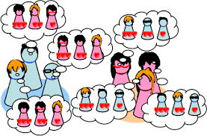


John Abela
Department of CIS
Faculty of ICT
University of Malta
john.abela@um.edu.mt
+ 365 79367936
Room 1A/27
FICT Building
Data Structures
And
Algorithms 2
Module 4
The
Stable Marriage Problem
Academic Year 2023-24
Faculty of
ICT
Department of
Computer Information Systems

Slide 2

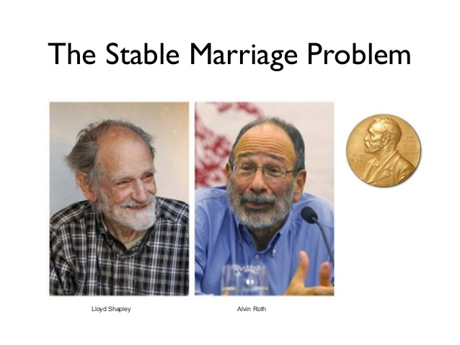

The Only Algorithm to ever win a Nobel Prize
Data Structures &
Algorithms 2
ICT
Partly based on slides by Safa S. Mahmoodian

Slide 3
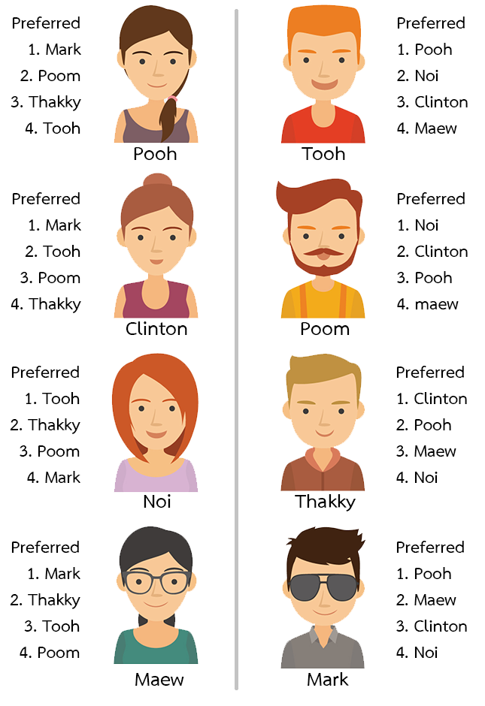

The Stable Marriage Problem
Data Structures &
Algorithms 2
In mathematics, economics, and computer science, the stable marriage problem (also stable matching problem or SMP) is the problem of finding a stable matching between two equally sized sets of elements Y & X (Y are boys and X are girls) given an ordering of preferences for each element.
A matching is a mapping from the elements of one set to the elements of the other set. A matching is not stable if:
There is an element A of the first matched set which prefers some given element B of the second matched set over the element to which A is already matched, and
B also prefers A over the element to which B is already matched.
In other words, a matching is stable when there does not exist any match (A, B) by which both A and B would be individually better off than they are with the element to which they are currently matched.
Assuming heterosexual pairings:
Given n boys and n girls, where each person has ranked all members of the opposite sex in order of preference, pair the boys and girls together such that there are no two people of opposite sex who would both rather have each other than their current partners. When there are no such pairs of people, the set of marriages is deemed stable.

Slide 4
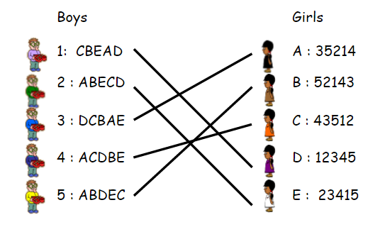
More formally…
Data Structures &
Algorithms 2
Consider a set Y of with n boys (denoted by numbers) and a set X of n girls (denoted by letters).
Every boy has a preference list of the girls organized in a decreasing order of desirability or preference.
Each girl has a similar list for the boys.
A marriage, or a matching, M is a 1-1 and onto mapping between the boys and the girls.
This will give a sparse bi-partite graph with 2n nodes.
The total number of persons (boys and girls) is always even.
ICT

Slide 5







Unstable Marriages
Data Structures &
Algorithms 2
A marriage is said to be unstable if there exist 2 marriage couples:
Boy₁ – Girl₁, and Boy₂ – Girl₂, such that:
Boy₁ desires Girl₂ more than Girl₁ and
Girl₂ desires Boy₁ more than Boy₂.
The pair Boy₁ - Girl₂ is said to be an ‘unstable couple’. They both prefer each other over their assigned partners.
A marriage M is called a ‘stable marriage’ if there are no unstable couples.
Boy₁
Girl₁
Girl₂
Boy₂
ICT

Slide 6

Important Notes
Data Structures &
Algorithms 2
The number of boys and girls must be equal.
All boys rank all the girls, and vice versa.
Rank-ordered lists are in decreasing order of preference.
Each boy is paired with one girl and vice versa.
Every person appears in exactly one pair.
Each boy or girl is assigned by a deterministic algorithm – they cannot make choices beyond submitting their list of preferences.
The algorithm must assign each boy to a girl in such a way that there are no unstable couples.
ICT

Slide 7
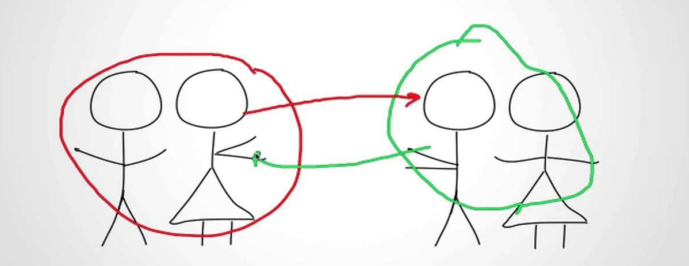
Remember – Unstable Marriage
Data Structures &
Algorithms 2
A boy prefers another girl (over his assigned girlfriend) who, in turn, prefers the same boy (over her assigned boyfriend).
ICT

Slide 8
The Stable Marriage Problem
Data Structures &
Algorithms 2
The problem is:
“Given the preference rankings of a group of k boys and k girls, construct a stable marriage arrangement.”
ICT

Slide 9
Stable Marriage Problem
Data Structures &
Algorithms 2
At least one stable marriage is always guaranteed to exist.
Boy-optimal or Girl-optimal matchings (marriages) can be found using the Gale-Shapely Algorithm.
The Gale-Shapely Algorithm is guaranteed to find one stable marriage (there may be many) in polynomial time.
Used for student-doctor assignment to hospitals, or assigning applicants to universities, etc.
Time complexity is O(n²).
Do not assume a problem is NP-Hard. You have to prove it. The SMP fooled some people.
Do not confuse with the Stable Roommate Problem which can also be solved in polynomial time (Irving, O(n²), 1985).
ICT

Slide 10
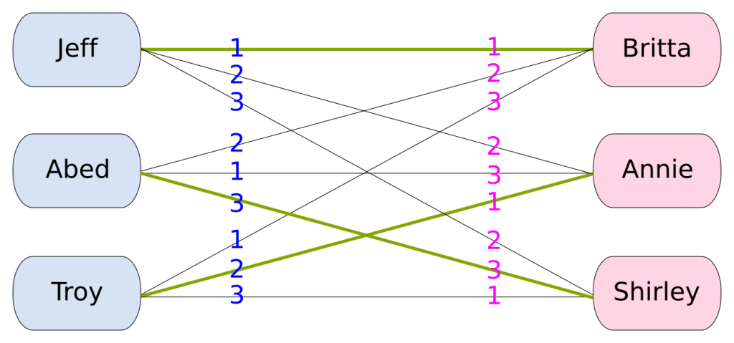
Formal Definition – Perfect Matching
Data Structures &
Algorithms 2
Suppose we have a set B of n boys and a set G of n girls.
Definition A matching M is a set of ordered pairs (b, g) with b ∈ B and g ∈ G such that:
Each boy b ∈ B appears in at most one pair of M.
Each girl g ∈ G appears in at most one pair of M.
Definition A matching M is perfect if |M| = |B| = |G| = n.
Sparse bi-partite graph.
ICT

Slide 11
Formal Definition – Unstable Pair
Data Structures &
Algorithms 2
Definition Given a perfect matching M, boy b and girl g form an unstable pair if both the following are true:
b prefers g to his matched girl in M.
g prefers b to her matched boy in M.
Key Point An unstable pair b and g could each improve by being assigned each other.
ICT

Slide 12
Formal Definition – Stable Matching
Data Structures &
Algorithms 2
Definition A stable matching is a perfect matching with no unstable pairs.
The Stable Marriage Problem Given the preference lists of n boys and n girls, find a stable matching (if one exists).
Note that a stable matching is guaranteed to exist and also the Gale-Shapley algorithm is guaranteed to find a stable matching.
There may, however, be more than one stable matching.
ICT

Slide 13
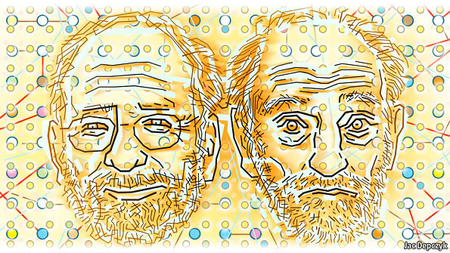
The Gale Shapely Algorithm
Data Structures &
Algorithms 2
In mathematics, economics, and computer science, the Gale–Shapley algorithm (also known as the deferred acceptance algorithm) is an algorithm for finding a solution to the stable marriage problem, named after mathematicians David Gale and Lloyd Shapley.
Published by Gale and Shapely in 1962.
In 2012, Shapely was a joint recipient of the Noble Prize in Economics (with Alvin Roth).
David Gale passed away before the award was given.
ICT

Slide 14

How it Works
Data Structures &
Algorithms 2
The method for solving this problem works something like this:
Initialize each boy or girl to be ‘free’
As long as there is a free boy* do following:
The first free boy (in some order) will propose to the first girl on his list.
The girl, having no better offer at this point, will accept.
The second boy will then propose to his first choice, and so on.
Eventually it may happen that a boy proposes to a girl who already has a partner.
* Boy optimal pairings
ICT

Slide 15

How it Works
Data Structures &
Algorithms 2
She will compare the new offer to her current partner and will accept whoever is higher on her list.
The boy she rejects will then go back to his list and propose to his second choice, third choice, and so forth until he comes to a girl who accepts his offer.
If this girl already had a partner, her old partner gets rejected and he, in turn, starts proposing to girls further down his list.
Eventually everything gets sorted out.
ICT

Slide 16
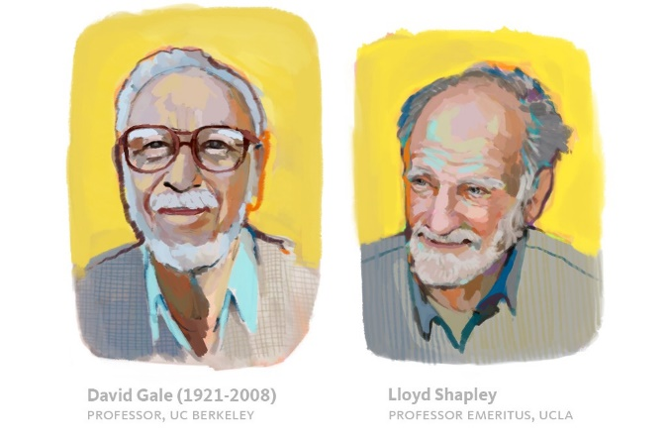

The Gale-Shapely Algorithm
Data Structures &
Algorithms 2
Algorithm:
Each person starts with no people ‘cancelled’ from his or her list (of preferences).
People will be cancelled from lists as the algorithm progresses.
For each boy m, call propose(m), as defined on the next slide.
The boys go first – more about this later.
ICT

Slide 17
The Gale-Shapely Algorithm
Data Structures &
Algorithms 2
propose(b):
Let G be the first uncancelled girl on boy b's preference list.
Do: refuse(G,b), as defined below.
refuse(G,b):
Let b' be G 's current partner (if any).
If G prefers b' to b, then she rejects b, in which case: cancel b off G 's list and G off b's list; call propose(b) (now b must now propose to someone else.)
Otherwise, G accepts b as her new partner, in which case: cancel b' off G 's list and G off b' 's list; do: propose(b'). (since b' must now propose to someone else.)
ICT

Slide 18
The Stable Marriage Problem – Stability
Data Structures &
Algorithms 2
How do we know the final arrangement will be stable?
Suppose there exists a boy Y and girl X such that they prefer each other over their own spouses. Since Y prefers X over his own spouse, then he must have proposed to her before proposing to his own spouse. So there are two possibilities of what happened at the time of that proposal.
Then either:
X rejected Y, which means that she was already engaged to someone she preferred over Y (she had scratched Y off her list). Therefore, she must either be married to that person or someone else who was on her list at the time of the proposal. Therefore, she could not prefer Y to her own spouse, contradicting our assumption.
X accepted Y, but dumped him later. Since she would have dumped him only in order to become engaged to someone higher ranked on her list, she must not prefer Y over her own spouse, again contradicting the assumption.
ICT

Slide 19
The Stable Marriage Problem – Stability
Data Structures &
Algorithms 2
In both cases, the assumption is contradicted. So, there cannot exist a boy Y and girl X such that they prefer each other over their own spouses.
➔ The arrangement must therefore be stable.
How do we know everyone gets paired off?
Since the number of boys and girls are equal, the only way for a boy to remain eligible at the end is for there to be an unengaged girl who rejects him. However, the only rejections come only from girls who are engaged.
ICT

Slide 20


Lemma 1 – The Improvement Lemma
Data Structures &
Algorithms 2
Improvement Lemma: If a girl is engaged to a boy, then she will always be engaged (or married) to someone at least as good.
This is because she would only let go of him in order to accept the proposal of someone better (higher up her list).
ICT

Slide 21
Lemma 2 – Boys Always Get Accepted
Data Structures &
Algorithms 2
Lemma: No boy can be rejected by all the girls.
Proof is by contradiction.
Suppose boy b is rejected by all the girls. At that point:
Each girl must have a suitor other than b. (By Improvement Lemma, once a girl has a suitor she will always have at least one).
The n girls have n suitors, b not among them. Thus, there are at least n+1 boys.
Corollary: Each girl will marry her absolute favorite of the boys who visit her during the GS Algorithm.
ICT

Slide 22
Unstable Couples – An Example
Data Structures &
Algorithms 2
Boys’ Preference List
Girls’ Preference List
Boy
1st
2nd
3rd
Girl
1st
2nd
3rd
Xavier
A
B
B
C
Amy
Y
X
Z
Yancey
B
A
C
Bertha
X
X
Y
Z
Zeus
A
B
C
Clare
X
Y
Z
The lavender assignment is a perfect matching. Are there any unstable pairs?
Yes. Bertha and Xavier form an unstable pair. They would prefer each other to current partners.
ICT

Slide 23
Stable Matchings – Examples
Data Structures &
Algorithms 2
Boys’ Preference List
Girls’ Preference List
Boy
1st
2nd
3rd
Girl
1st
2nd
3rd
Xavier
A
B
C
Amy
Y
X
Z
Yancey
B
A
C
Bertha
X
Y
Z
Zeus
A
B
C
Clare
X
Y
Z
Boys’ Preference List
Girls’ Preference List
Boy
1st
2nd
3rd
Girl
1st
2nd
3rd
Xavier
A
B
C
Amy
Y
X
Z
Yancey
B
A
C
Bertha
X
Y
Z
Zeus
A
B
C
Clare
X
Y
Z
ICT

Slide 24

The Gale-Shapely Algorithm - Example
Data Structures &
Algorithms 2
We have a list of 4 boys and 4 girls and their preference list as below:
Zeppi: Mary Anita Eileen Benna
Xandru: Anita Eileen Mary Benna
Kalanc: Eileen Mary Benna Anita
Dru: Mary Anita Eileen Benna
Anita: Zeppi Kalanc Dru Xandru
Benna: Dru Zeppi Xandru Kalanc
Eileen: Kalanc Xandru Dru Zeppi
Mary: Xandru Dru Kalanc Zeppi
ICT

Slide 25

The Gale-Shapely Algorithm - Example
Data Structures &
Algorithms 2
Zeppi: Mary Anita Eileen Benna
Xandru: Anita Eileen Mary Benna
Kalanc: Eileen Mary Benna Anita
Dru: Mary Anita Eileen Benna
Anita: Zeppi Kalanc Dru Xandru
Benna: Dru Zeppi Xandru Kalanc
Eileen: Kalanc Xandru Dru Zeppi
Mary: Xandru Dru Kalanc Zeppi
Stable Marriages!
Zeppi
Xandru
Kalanc
Dru
Anita
Mary
Eileen
Benna
Zeppi
Mary
Anita
Xandru
Anita
Eileen
Mary
Kalanc
Eileen
Dru
Mary
Anita
Eileen
Benna
ICT

Slide 26

The Gale-Shapely Algorithm - Example
Data Structures &
Algorithms 2
Who gets a better deal in this algorithm, the boys or the girls?
It turns out that since the unengaged girls in this algorithm accept any proposal, the boys end up happier on average!
For example, suppose there are 5 boys and 5 girls, and suppose every boys has a different first choice. Then they'll all get their first choice, regardless of the preferences of the girls!
You can, of course, let the girls go first.
This problem is typically applied to binary relationships somewhat more practical than marriage, such as dormitory room assignment, university admissions, matching graduating medical students to hospitals, etc.
ICT

Slide 27

Data Structures &
Algorithms 2
The Gale-Shapely Algorithm - Pseudocode
function stableMatching {
Initialize all m ∈ M and w ∈ W to free
while ∃ free man m who still has a woman w to propose to {
w = first woman on m’s list to whom m has not yet proposed
if w is free
(m, w) become engaged
else some pair (m', w) already exists
if w prefers m to m‘
m' becomes free
(m, w) become engaged
else
(m', w) remain engaged
}
}
ICT

Slide 28
The Gale-Shapely Algorithm – Notes
Data Structures &
Algorithms 2
Note that the master list of k boys (and k girls) has k² entries since each of the k boys ranks each of the k girls. The space complexity is therefore O(k²) where k is the number of boys (or girls).
At every step where at least one boy gets a ‘No’, at least one girl gets crossed off the boys’ master list.
Since the number of steps is bounded by the original size of the master list, then the number of steps is bounded by: n.(n-1) = n² – n which is O(n²) – a quadratic polynomial.
In the early 1970s, McVitie and Wilson, however, formulated a faster, straight-forward, backtracking, scheme for the stable marriage problem. Look it up.
In the Gale-Shapley algorithm, the specific stable matching found depends on which group initiates the proposals. When the boys propose, the algorithm produces a male-optimal and female-pessimal matching. Conversely, when the girls propose, it results in a female-optimal and male-pessimal matching.
ICT

Slide 29
Stable Marriage Problem Questions
Data Structures &
Algorithms 2
Suppose the a boy and a girl rank each first on their respective lists. Are they guaranteed that they will get each other?
Is it possible for a boy or a girl to remain unassigned?
Is the Gale-Shapley algorithm a greedy algorithm?
When a boy proposes to a free (available) girl will she accept his proposal?
Suppose all the boys propose to a different girl. How many iterations are required for the algorithm to converge?
How do you get worst case complexity for the Gale-Shapley algorithm?
In general, is there usually only one stable matching?
Does the order that the boys are visited affect the matching found?
ICT

Slide 30

Stable Marriage Problem Applications
Data Structures &
Algorithms 2
Matching kidney donors to patients awaiting a transplant.
Match college applicants to Universities.
Assigning of user queries to web servers.
Matching peers in a P2P network.
Resource allocation in 5G networks.
Assigning seamen to navy ships.
Assigning students to public schools.
Algorithmic Game Theory.
The Gale-Shapley algorithm did not win the Nobel Prize because of its complexity but probably because it was so ubiquitous and so wide in scope.
ICT

Slide 31



Prologue
Data Structures &
Algorithms 2
Please send me feedback and/or errata to john.abela@um.edu.mt
Feedback helps me improve the slide decks for future students.
Lecture slides are also uploaded to the VLE.

