Slide 1



Credit Score Classification
Final Project, Group - 4
Krutin Jayeshkumar Rathod
20022825
Dev Hitesh Satapara
20021369
Sri Naga Hansi Mamidi
20012906
CS 513-A

Slide 2
Outline
Dataset
Data Overview
Data Preparation
Model Prediction & Feature Analysis

Slide 3
Dataset
https://www.kaggle.com/datasets/parisrohan/credit-score-classification/data
The dataset involves financial and personal attributes of customers over several months.
The aim is to classify the person’s credit score into good, bad or standard category.
The data consists of person’s Annual Income, Number of bank accounts, Number of Credit cards, Outstanding Debt, Payment Behaviour, etc

Slide 4
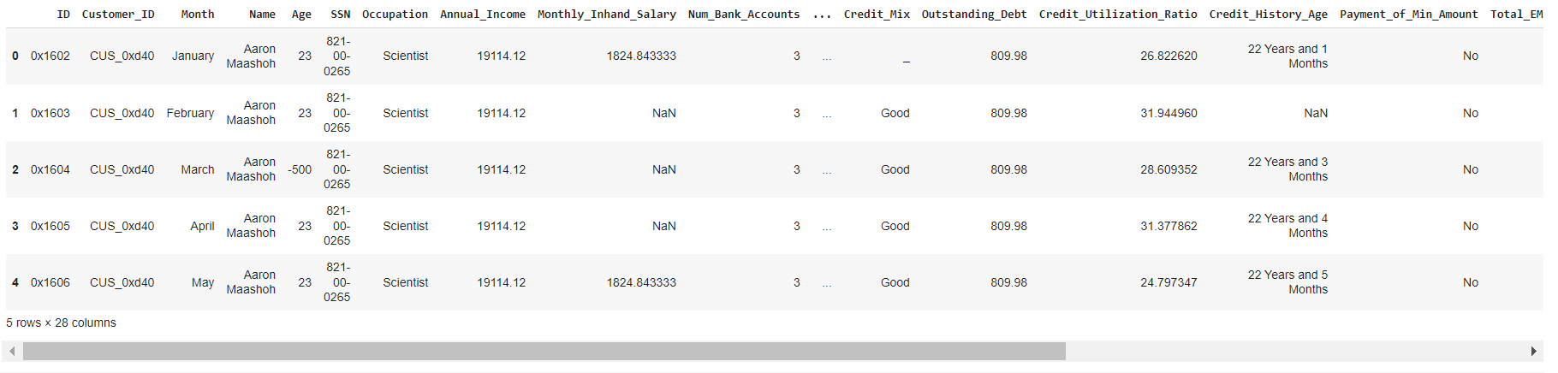
Data Overview

Slide 5
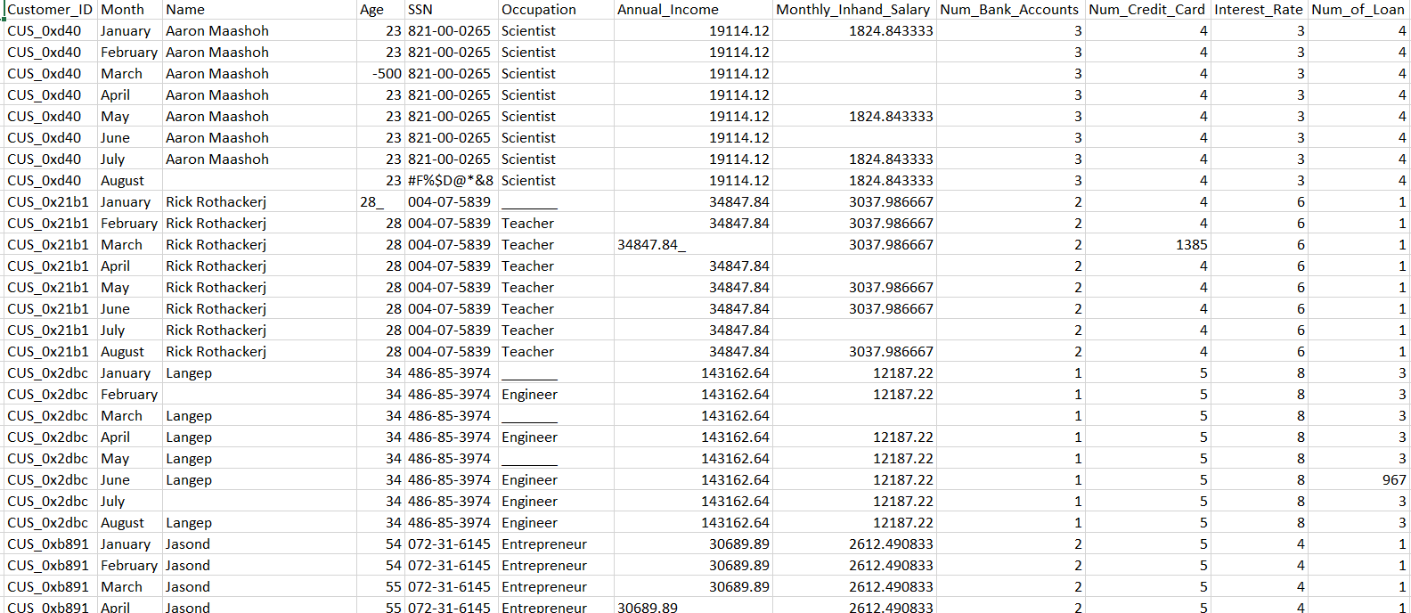
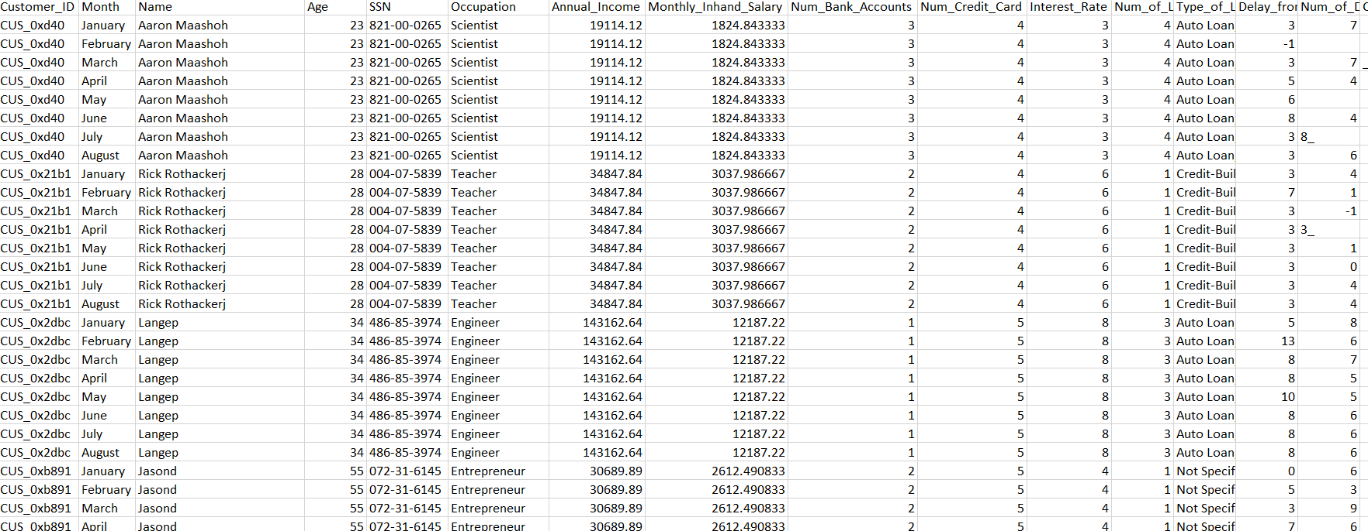
Data Cleaning
Utilizing the mode to impute missing or incorrect values in a column
Original Data
Data after utilizing mode

Slide 6
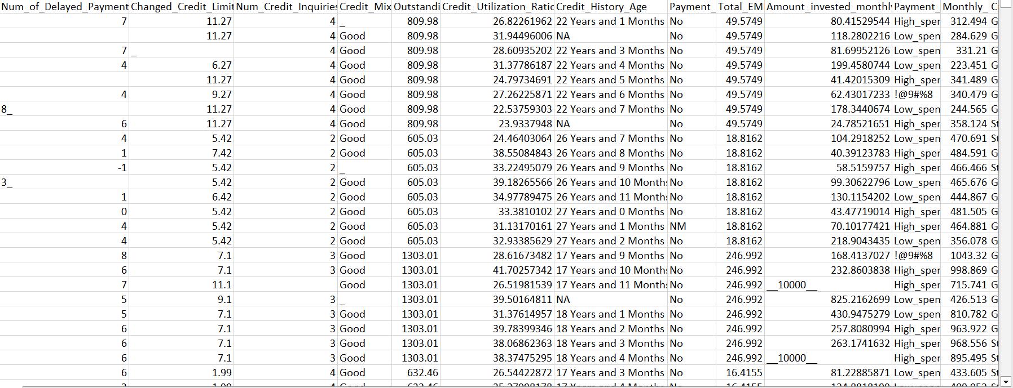
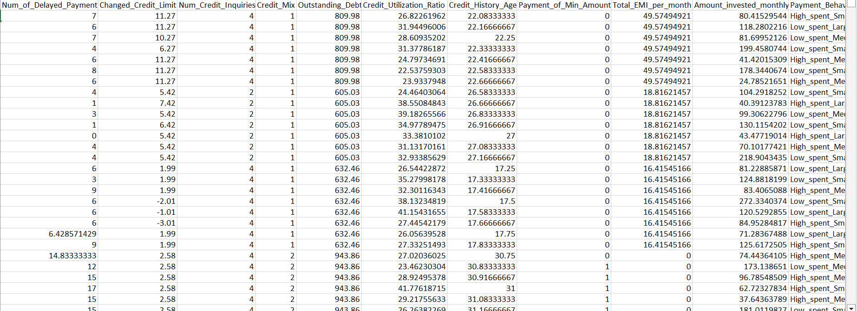
Utilizing the Mean to impute missing or incorrect values in a column
Original Data
Data after utilizing Mean

Slide 7
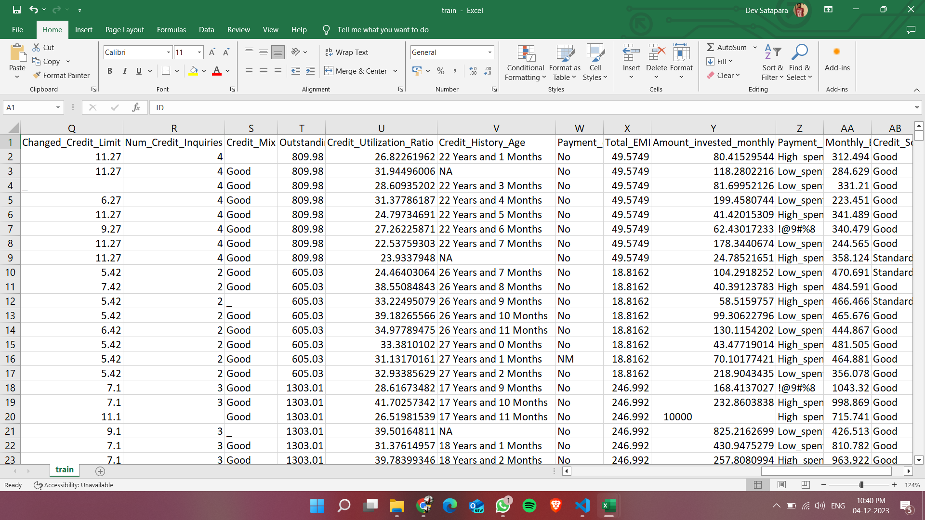
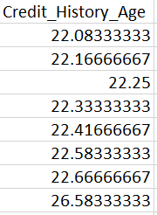
For Credit_History_Age, we imputed the missing values by identifying the sequence and adding the count
The column contains values like 12 years and 3 months
As it is in string format, we convert it into the floating value

Slide 8
Other approaches taken for data cleaning are: -
Removing the Outliers from the columns
Removing NaN values from the data
Mapping numeric value to categorical columns like Occupation, Credit_Mix, etc.

Slide 9

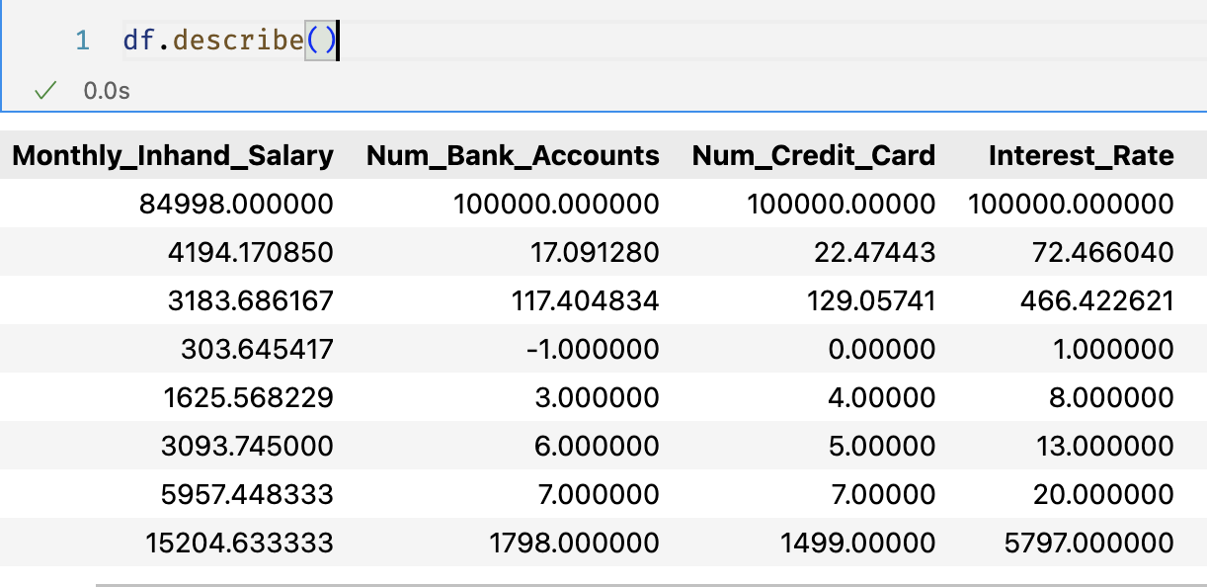
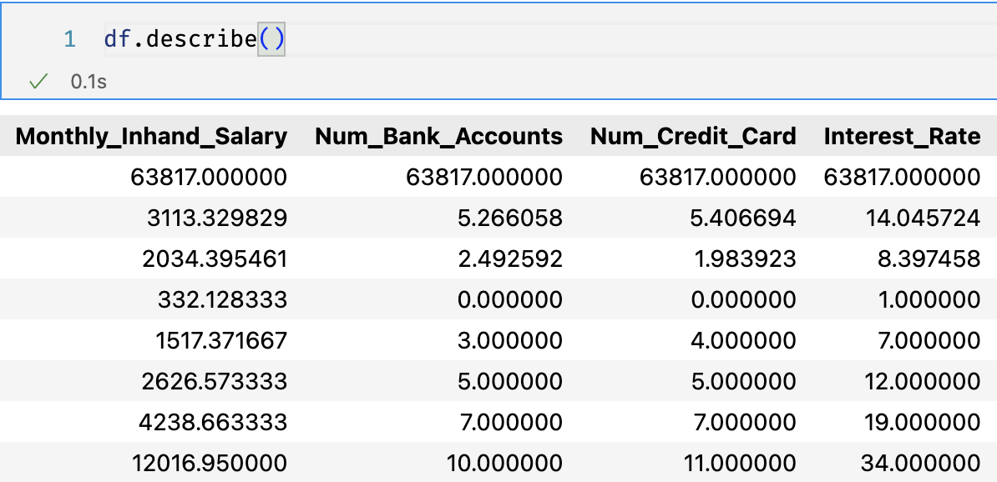
Outlier Removal
We calculated interquartile range and whisker limits, then removed the data outside those extreme range
Original Data (having outliers)
Cleaned Data (without outliers)

Slide 10
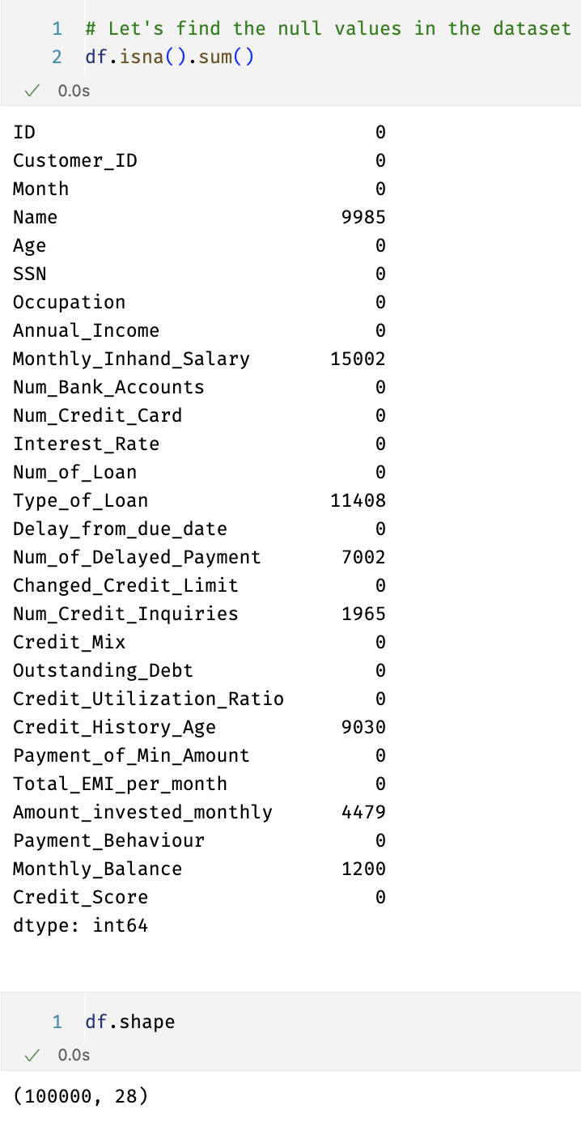
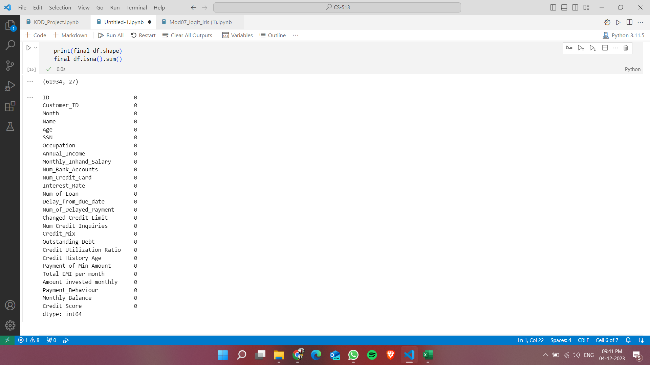
Data Information
Before Data Cleaning
After Data Cleaning

Slide 11
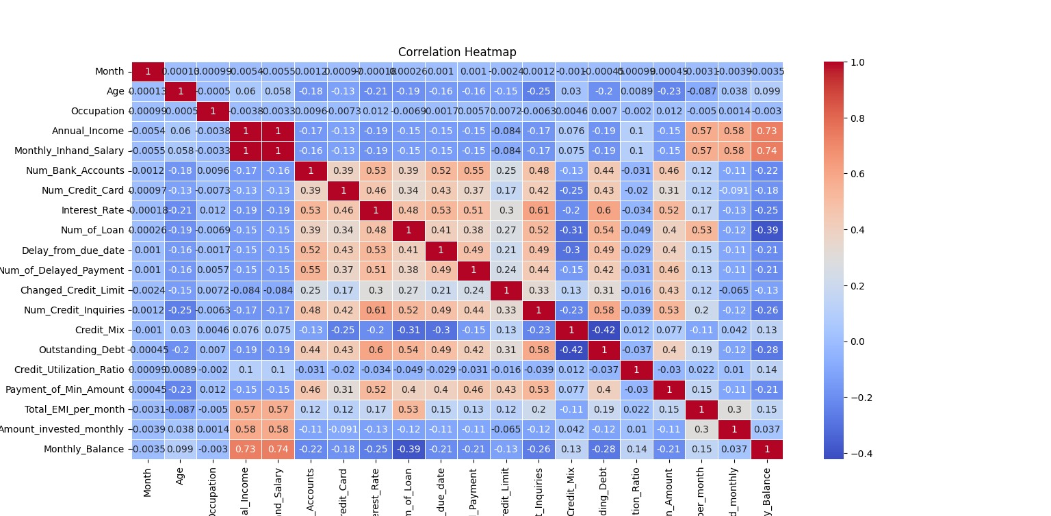
Correlation Heat Map

Slide 12
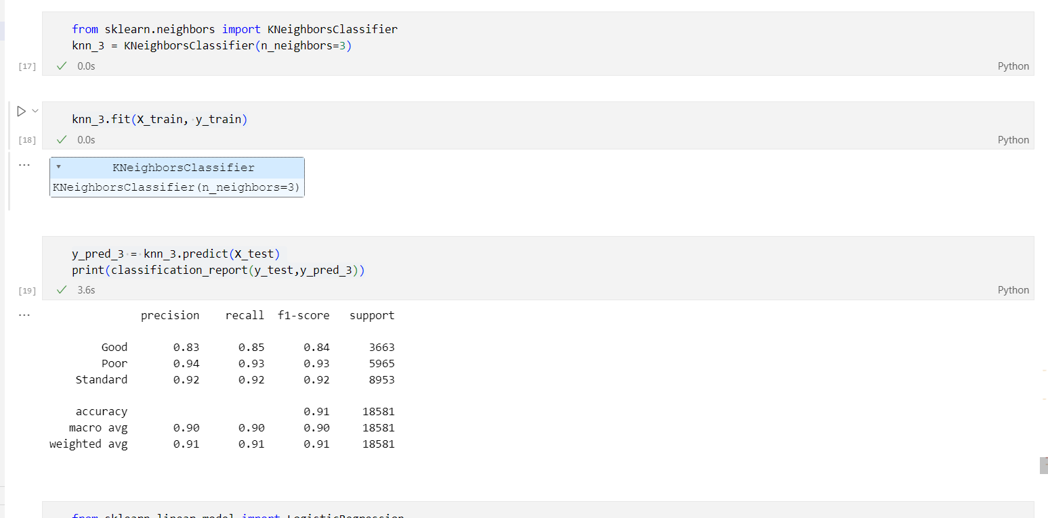
Model Predictions
KNN

Slide 13
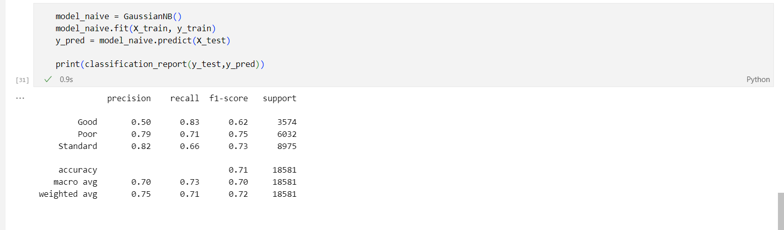
Model Predictions
Naive Bayes

Slide 14
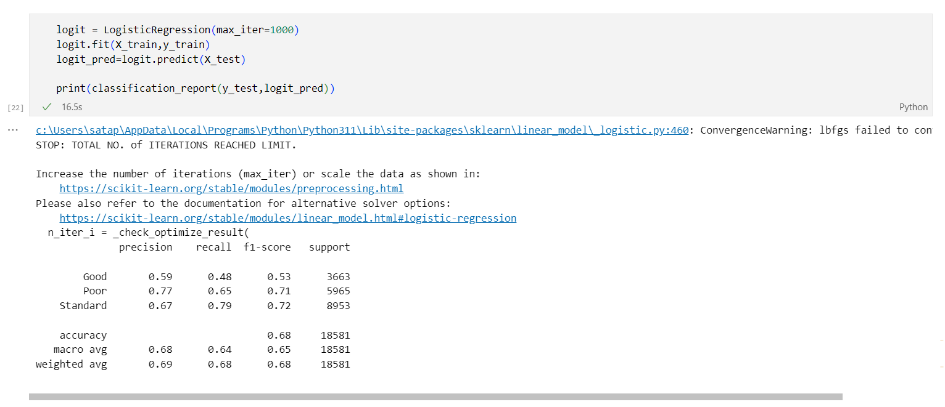
Model Predictions
Logistic Regression

Slide 15
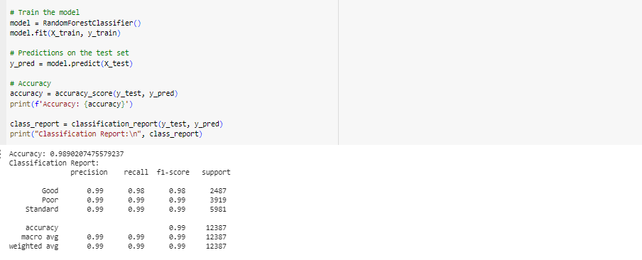
Model Predictions
Random Forest

Slide 16
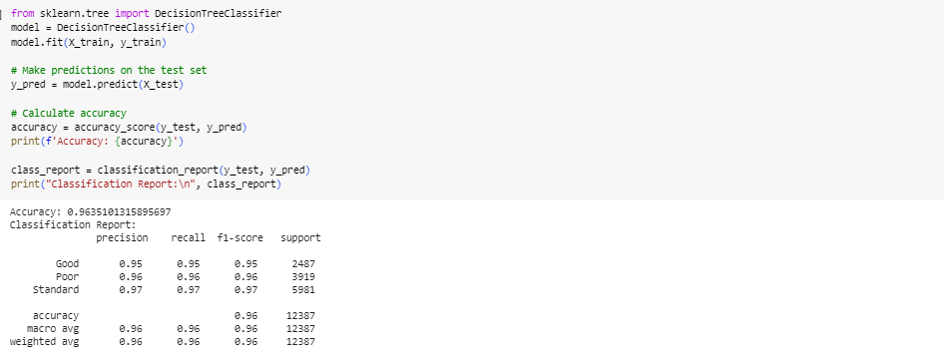
Model Predictions
Decision Tree

Slide 17
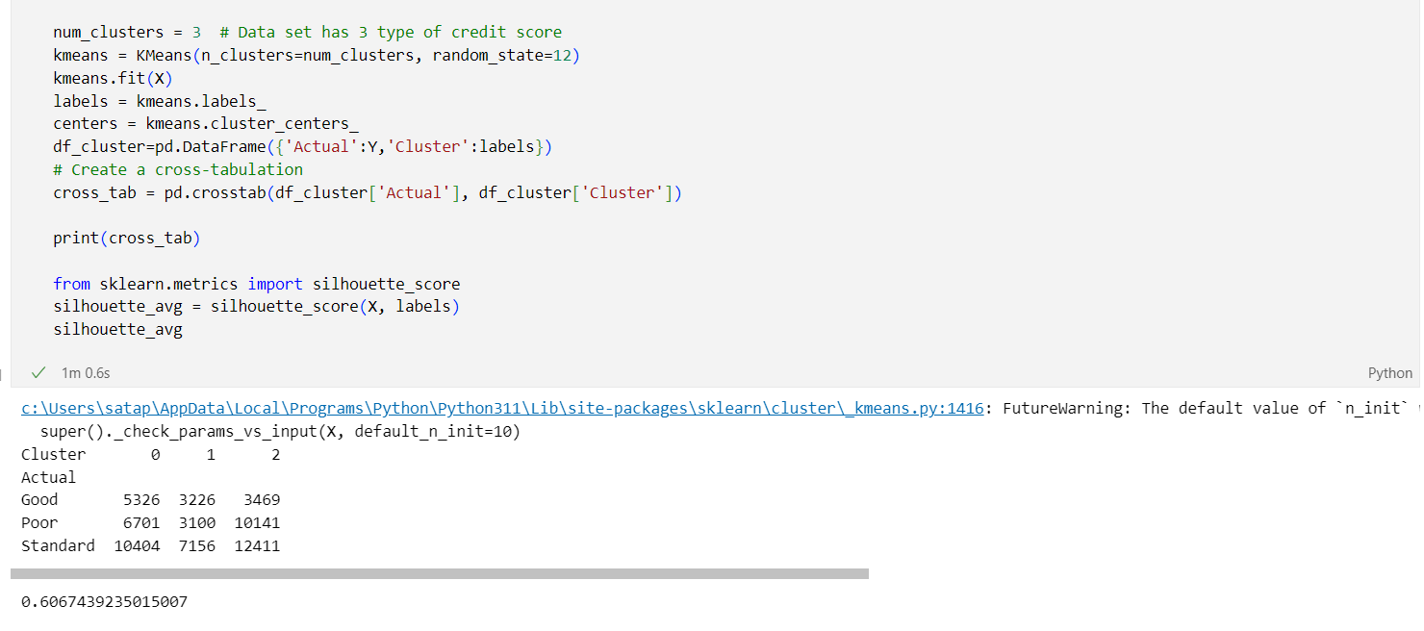
Model Predictions
K-Means Clustering

Slide 18
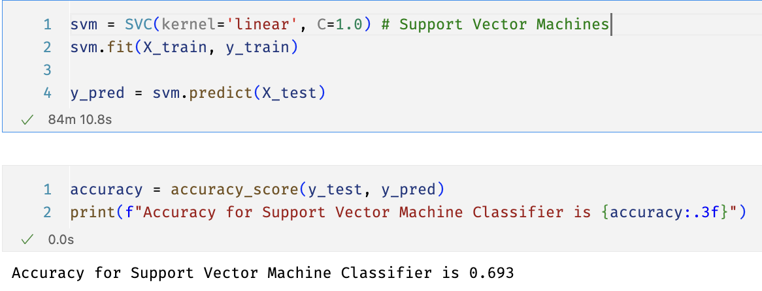
Model Predictions
SVM

Slide 19
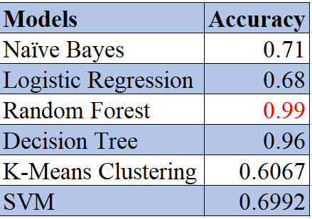
Accuracy Comparison

Slide 20
Summary
It can be summarized that after applying different type of cleaning methods data reduces to 61,934 rows from 100,000 rows.
Based on the above results, we summarize that the Random Forest performs better than other models for this particular data set

Slide 21
Thank you!

