Slide 1


Zafar Shabhai
Presented by:-
Zafar Shabhai

Slide 2
CSS:-
Cascading style sheet
Behind the technique of Creating web page.
Webpage gets a new attractive look.
Without CSS we can use HTML, But without HTML we can not use CSS.
It is computer language.
Easy to write.
To write the code we need text editor or code editor.
Zafar Shabhai

Slide 3
Advantages:-
CSS save time .
Helps the page load faster.
Easy to maintain.
Platform independent.
Ex:- all websites
Zafar Shabhai

Slide 4
Types of CSS:-
Inline CSS.
Use in tag:
Ex:- <h1 style=“color: ;background-color: ;”>HELLO</h1>
Internal CSS.
Use in head tag.
<head>
<style type=“text/css”></style>
tag{
color: ;
background-color: ;
}
</head>
Zafar Shabhai

Slide 5
Types of CSS:-
External CSS.
New file ‘.css’ .
Tag name {
color: ;
background-color: ;
}
Link to HTML file.
<link rel=“” type=“” href=“”>
Zafar Shabhai

Slide 6
How to add color in CSS ?
There are three types properties:
{
color: rgb(0,0,0);
background-color:#00ff00;
border: 5px solid colorname;
}
Color values:-
Color name.
Hexadecimal code.
RGB.
RGBA.
Color property use only for text and BG color or border use in any tags.
Zafar Shabhai

Slide 7
Background property:-
It’s most important.
Set background.
Increase readability our website,intractive and looking well.
Ex:-all website.
Multiple background, add png jpg combination.
Normally background is defined in the body elements.
Also use for particular elements ex:-<p> ,<h1> etc.
Zafar Shabhai

Slide 8
Background property:-
For control background many CSS properties.
Background-color.
Background-image. url()
Background-repeat.
Background-size.
Background-position.
Background-origin.
Background-clip.
Background-attachment.
Background-blend-mode. etc
Zafar Shabhai

Slide 9
Background-image: url(“”); (multiple images)
Background-size: auto,contain,cover , px px , % %;
Background-repeat: no-repeat,repeat,repeat-x, repeat-y,round,space;
Background-position: bottom,center,left,right,top,
px px , % %;
Background-origin: padding-box(default) ,border-box,
content-box;
Background-clip:padding-box, border- box(default), content-box;
Background-attachment:
Body:- fixed,scroll(default),local(no work);
Div :- fixed(default),scroll(no work), local;
Overflow:auto;
Zafar Shabhai

Slide 10
Gradients:-(background-image)
The gradient becomes a very smooth transition between two or more colors.
It’s use in background-image property. Use different different name.
Linear-gradient(to top,color name multiple),(to bottom right/45 deg)(color %)(rgba/rgb)
repeating-linear-gradient (color name %)(to top/deg),
radial-gradient(circle/ellipse,color name/%) at top/top right/at %,
(color name ,transparent) use multiple rg
Closest-side
Farthest-side(default)
Closest-corner
Farthest-corner
repeating-radial-gradient(color name%);
Zafar Shabhai

Slide 11
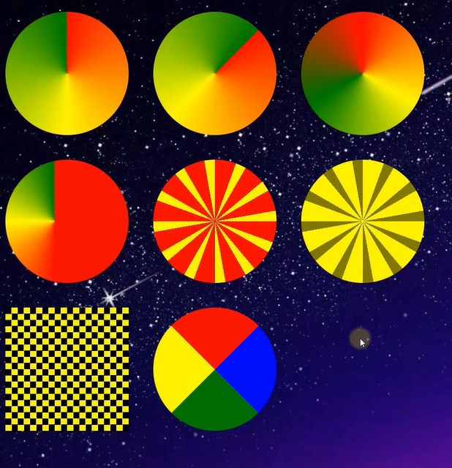
Conic-Gradient:-
Conic-gradient(colour names);
from deg,at%%,
Repeating-
Conic-Gradient:-
Repeating-conic-gradient(colour name
and deg);rgba
Zafar Shabhai

Slide 12

Logo with Conic-gradient:-
Conic-gradient();font-size:;
Font-family:;
Background-clip:;
-webkit-background-clip:;
Color:;
Zafar Shabhai

Slide 13
Background-blend-mode:-
The Background-blend-mode property defines the Blending mode of each background layer (Color and/or image).(multiple color or images)
Background-blend-mode:multiply;
Screen
Overlay
Darken
Lighten
Color-dodge
Saturation
Color
luminosity
Zafar Shabhai

Slide 14
Border:-
Border is group of property:-border-width, border-style, border-color.
Border-style:-1 2 3 4;
Solid ,none ,hidden ,dotted ,dashed ,double ,groove,ridge, inset,outset,
Border-width:-1 2 3 4, px,thin,thick,medium, px px, px px px px,
Border-color:-colorname(1,2,3,4),rgb,rgba.
Border-spacing:-px ;
Border-collapse:-separate , collapse;
Border-left:-px type colorname ;
Border-right:-;
Border-top(right , left , bottom)-style:-;
Border-top(right , left , bottom)-width:-;
Border-top(right , left, bottom)-color:-;
Zafar Shabhai

Slide 15
Border-image:-
Border-radius:-px,1 2 3 4;
Border-top-left(right)-radius:-px;
Border-bottom-left(right)-radius:-px;
Border-image-source:-url();
Border-image-slice:- numaric value;
Border-image-width:-;
Border-image-outset:-;
Border-image-repeat:-;
Zafar Shabhai

Slide 16
Box-Model:-
All HTML elements can be considered as a boxes. In CSS , the term “box model” is used when talking about design and layout.
Margin
Border
Padding
Content
Zafar Shabhai

Slide 17
Margin:-
Margin:- px(1 2 3 4);(auto)
Margin-top( left , right, bottom):-20px ;
Padding:-
Padding:- px(1 2 3 4);
Padding-top( left , right, bottom):- ;
Zafar Shabhai

Slide 18
Width:-
For content box .(No:-padding box ,border box , margin box)
Width:-auto(default), px,%
Max-width:-;
Min-width:-;
responsive(width :-%)
Zafar Shabhai

Slide 19
Height:-
For content box .(No:-padding box ,border box , margin box)
Height:-auto(default),px,%;
Max-Height:-;
Min-Height:-;
responsive(Height :-%)
Zafar Shabhai

Slide 20
Outline:-
Outline
Border
Content
Outline type same as border.
Everything is similar to border
elements.
Outline elements are not part of Dimensions.
However they are part of the border elements.
Outline has no effect on element size.
However border effects the elements size.
We can set the outline from offset to inside OR outside of any elements.
Outline cannot be rounded.
Outline:- px type color;
Outline-offset:-;
Zafar Shabhai

Slide 21
Text Property:-
We can Customize the look of text with the CSS text property.
How will the text look or its visual appearance, we can handle all this from the CSS text property.
It’s not a single property. they are group of properties.
Color property:-color:;
Letter-spacing:-letter-spacing:px;
Word-spacing:-word-spacing:px;
Text-indent:-text-indent:px;
Text-align:-right,left,center,justify;
Text-decoration:-none,underline,overline,line-througth;
Text-transform:-lowercase,capitalize,uppercase;
Text-shadow:-h-offset , v-offset , blur-radius , color;

Slide 22
CSS Font Property:-
Font-size:-px,em,%;
Font-family:-generic family,font family;
Font-style:-3type;
Font-weight:-4type;
Font-variant:-3type;
Line-height:-PX;
Font:-STYLE variant weight size/line height family;
Zafar Shabhai

Slide 23
Google Font:-
Google font is google’s online font library.
Google allows us to use fonts through the content delivery network(CDN).
It’s absolutely free.
Search:- google font
Made Website different languages.
Zafar Shabhai

Slide 24
Normal Layout:-
Zafar Shabhai

Slide 25
-:Properties :-
align-self
align-items
animation: ;
Animation(all Prperties)
align-content:;
appearance: ;
aspect-ratio: ;
all: ;
accent-color: ;
additive-symbols: ;
align-tracks: ;
alt: ;
ascent-override: ;

Slide 26
bottom: ;
border: (all properties);
background: (all properties);
border-radius: ;
box-sizing: ;
box-shadow: ;
backface-visibility: ;
backdrop-filter: ;
break-inside: ;
behavior: ;
bleed: ;
block-size: ;
border-block: ;
box-decoration-break: ;
break-after: ;
break-before: ;

Slide 27
color: ;
cursor: ;
content: ;
clear: ;
clear: ;
clip: ;
clip-path: ;
contain: ;
column-gap: ;
counter-increment: ;
column-count: ;
counter-reset: ;
caption-side: ;
caret-color: ;
color-scheme: ;
content-visibility: ;
column-rule: ;
column-count: ;
columns: ;
caret: ;
caret-shape: ;
clip-rule: ;
color-interpolation-filters: ;
column-fill: ;
column-rule-color: ;
column-rule-style: ;
column-rule-width: ;
column-span: ;
contain-intrinsic-block-size: ;
contain-intrinsic-height: ;
contain-intrinsic-inline-size: ;
contain-intrinsic-inline-size: ;
contain-intrinsic-size: ;
contain-intrinsic-width: ;
counter-set: ;

Slide 28
display: ;
direction: ;
descent-override: ;
empty-cells: ;
enable-background: ;
font: (all properties);
float: ;
flex-direction: ;
flex: (all properties);
fill: (all properties);
filter: ;
forced-color-adjust: ;
fallback: ;
flood-color: ;
flood-opacity: ;

Slide 29
grid: (all properties);
gap: ;
glyph-orientation-horizontal: ;
glyph-orientation-vertical: ;
height: ;
hyphens: ;
hanging-punctuation: ;
hyphenate-character: ;

Slide 30
justify-content: ;
justify-items: ;
justify-self: ;
justify-tracks: ;

Slide 31
image-rendering: ;
inset: ;
isolation: ;
image-orientation: ;
image-orientation: ;
image-resolution: ;
inherits: ;
initial-letter: ;
initial-letter-align: ;
initial-value: ;
inline-size: ;
input-security: ;
inset-block: ;
inset-block-end: ;
inset-block-start: ;
inset-inline: ;
inset-inline-end: ;
inset-inline-start: ;
kerning: ;

Slide 32
left: ;
line-height: ;
list-style: ;
letter-spacing: ;
list-style-type: ;
list-style-position: ;
list-style-image: ;
line-break: ;
lighting-color: ;
line-clamp: ;
line-gap-override: ;
line-height-step: ;
margin: (all properties);
max-width: ;
min-height: ;
min-width: ;
max-height: ;
mix-blend-mode: ;
marker: (all properties);
marks: ;
mask: (all properties);
masonry-auto-flow: ;
math-depth: ;
math-shift: ;
math-style: ;
max-block-size: ;
max-inline-size: ;
max-lines: ;
max-zoom: ;
min-block-size: ;
min-inline-size: ;
min-lines: ;
min-zoom: ;
motion: All Properties;

Slide 33
nav-down: ;
nav-index: ;
nav-left: ;
nav-right: ;
nav-up: ;
negative: ;
overflow: all;
opacity: ;
outline: all;
object-fit: ;
order: ;
orphans: ;
offset: all;
orientation: ;
overscroll:all ;

Slide 34
padding: all;
pointer-events: ;
perspective: ;
page-break-inside: ;
page-break-after: ;
page-break-before: ;
perspective-origin: ;
pad: ;
paint-order: ;
place-content: all;
prefix: ;
print-color-adjust:
quotes: ;
right: ;
resize: ;
row-gap: ;
range: ;
rotate: ;
ruby-align: all;

