Slide 1

TeamID: S312 Category: Software Theme: Rural Smart Education/ Healthcare Problem Statement: Village School happiness index including self-assessment, encompassing mental health and well-being.
Idea Submission Presentation

Slide 2

Abstract
The problem statement involves creating a happiness index for a village school that includes self-assessment and covers aspects related to mental health and well-being. The goal is to develop a comprehensive framework that allows students to evaluate their own level of happiness while considering their mental and physical health. This will help to identify areas that need improvement and enable the school to take proactive steps towards addressing these issues. Ultimately, the aim is to create a healthy and happy learning environment for students that promotes overall well-being and academic success.

Slide 3
Existing and Proposed SystemExpected outcome
Existing (Traditional) System/Approach/Methods/Technics in Villages
Meditation and Yoga
Community involvement
Celebrations and festivals
Traditional healing practices
Proposed (Modern) System/Methodology for Village people
Designing a comprehensive survey
Collecting data
Analyzing the data
Developing an action plan
Implementation and evaluation
Integration into the curriculum
Expected Outcome
Improved mental health, Enhanced academic performance, Increased self-awareness, Stronger community relationships, Long-term benefits.

Slide 4
Idea/Solution/Approach/Prototype Details
Describe your idea/Solution/Approach/Prototype here:
To develop a survey tool or assessment that is specifically tailored to the needs and experiences of students in a village school setting.
The survey tool could include questions related to various aspects of mental health and well-being, such as feelings of happiness, stress levels, social connectedness, and access to mental health resources. It could also include self-assessment questions that allow students to reflect on their own mental health and well-being and identify areas where they may need additional support or resources.
Once the survey tool is developed and administered to students, the data could be analyzed to create a happiness index that reflects the overall mental health and well-being of the village school community. This index could be used to track changes in mental health and well-being over time, identify areas where additional support or resources may be needed, and inform school policies and programs aimed at promoting mental health and well-being among students.
Describe your Technology stack here:
A suitable programming language for developing the happiness index survey tool could be Python, which has several libraries for data analysis and visualization.

Slide 5
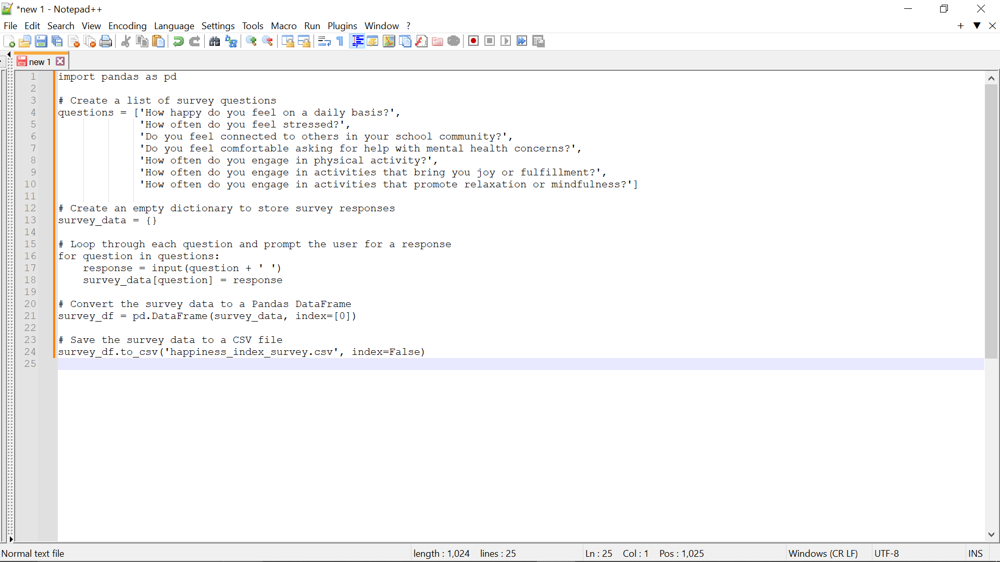
Idea/Solution/Approach/Prototype Details

Slide 6
Use Cases
The happiness index survey tool can be used by village schools, school administrators, and mental health professionals to monitor the mental health and well-being of students in a village school setting. The data collected from the survey can help identify areas where additional support or resources may be needed and inform school policies and programs aimed at promoting mental health and well-being among students.
Parents and caregivers could use the happiness index to monitor their child's well-being and identify any potential issues early on. They could then take appropriate action, such as seeking counseling or other forms of support.
The happiness index could be used as a tool for research, helping researchers better understand the factors that contribute to mental health and well-being in school settings.
The happiness index could also be used by policymakers to inform decisions about resource allocation and interventions to improve mental health and well-being in schools.

Slide 7
Advantages and limitations
Advantages:
Improved mental health and well-being: By providing a way for students and staff to assess their own well-being and track it over time, the happiness index can help promote improved mental health and well-being.
Early identification of mental health issues: By monitoring changes in the happiness index over time, school administrators, teachers, and parents can identify potential mental health issues early on and take appropriate action.
Increased awareness and understanding of mental health: By promoting open discussions about mental health and providing tools for self-assessment, the happiness index can help increase awareness and understanding of mental health issues in the school community.
Better support for students and staff: The happiness index can help school administrators and teachers better understand the needs of their students and staff and provide appropriate support, such as counseling or other interventions.
Limitations:
There are some limitations to the happiness index survey tool, including:
Self-reported data may be subject to bias or inaccuracies, as individuals may not always be honest or accurate in their responses.
The survey tool may not be suitable for all cultural or linguistic.

