Slide 1
MAVERICKS
Lakshmi A
Divya Umesh Deshnur
Kruthi J
Sanjana s

Slide 2
Agenda
Summary of Problem
Suggestions and their implementations
Designs/ Diagrams
Demo
Benefits of solution and Relation to the theme
Conclusion

Slide 3

Summary of Problem
PROBLEM STATEMENT - Diseases caused due to Indoor Air Quality and implementation of Indoor Air Quality Monitoring Systems Based on Internet of Things
The An IoT based indoor air quality monitoring system using indoor plants
Aim - To design and develop a smart system, which is not only aesthetically pleasing, but also continuously monitors the Indoor Environmental Parameters like air quality in ppm, concentration of harmful gases etc., using indoor plants and sensors. This helps in maintaining good air quality in a closed environment.
A plant holder and a natural air purifier system.
Incorporates an automated email system and live readings
If the air quality is bad, possible suggestions/solutions will be sent. The sensors can be inbuilt or used externally.

Slide 4
Hardware and Technologies used
HARDWARE -
SENSORS
MQ-135
MQ-2
OTHER COMPONENTS
NodeMCU (ESP8266)
Breadboard
Jumper wires
TECHNOLOGIES –
Arduino IDE
ThingSpeak IoT Platform
MS-Excel
HTML+CSS
Blynk IoT Platform

Slide 5
Designs and Diagrams

Slide 6
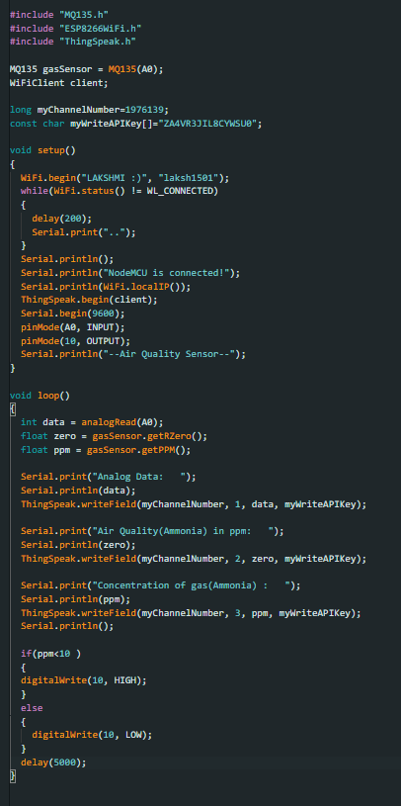
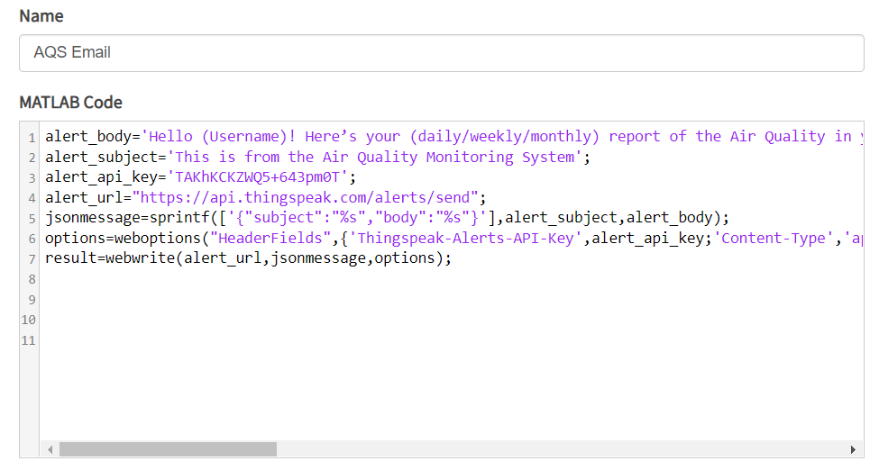
Code used for MQ-135
<- Code used on Arduino
Code used on the ThingSpeak IoT Platform

Slide 7
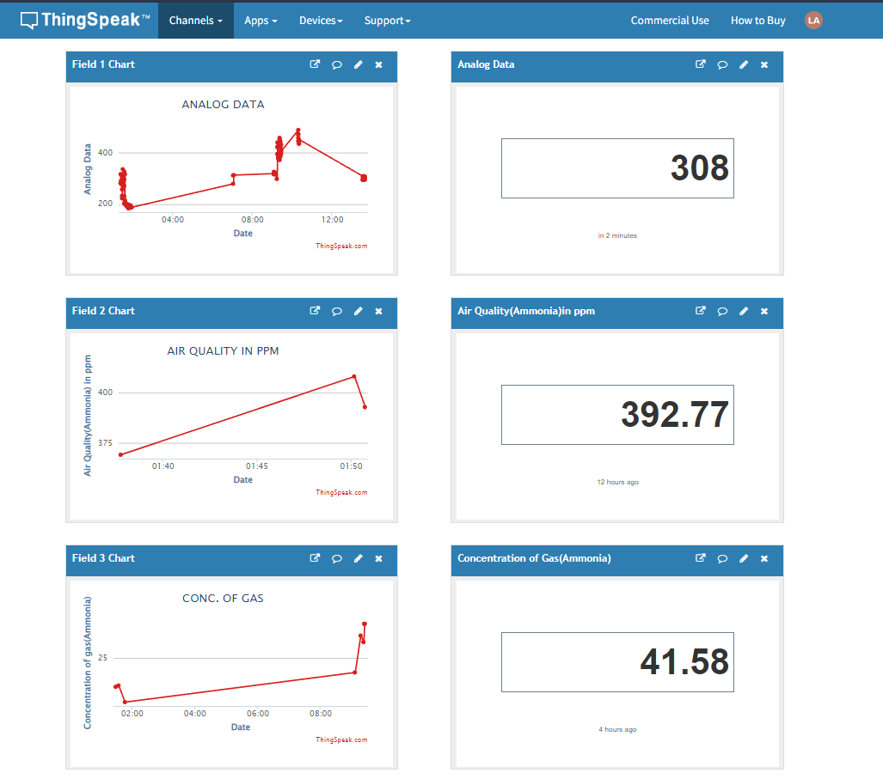
Representation of MQ-135 values

Slide 8
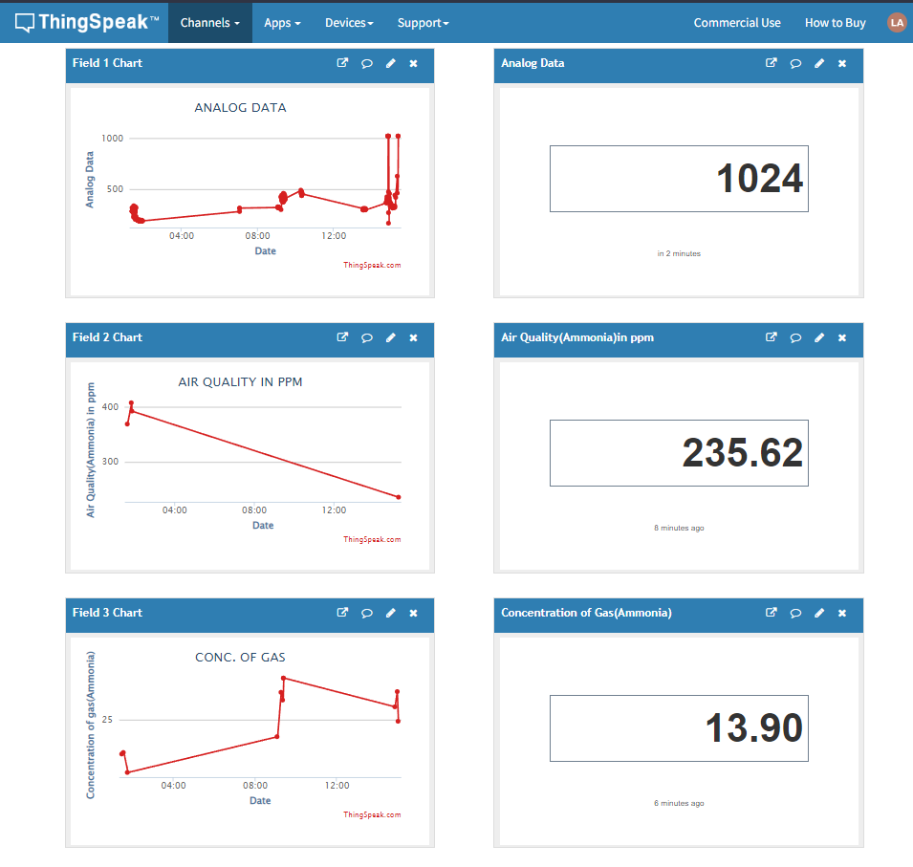
Representation of MQ-135 values
This is an example of the Air Quality crossing the threshold value (500 ppm).
It is considered as “Bad Air Quality” and an alert is sent immediately via the provided email.
Suggestions are provided as to what plants can be planted or how to maintain plants to maintain good air quality through a link to our website.

Slide 9
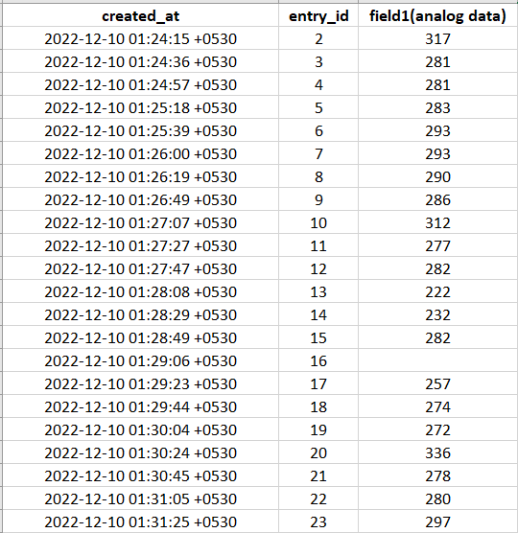
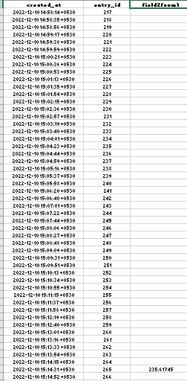
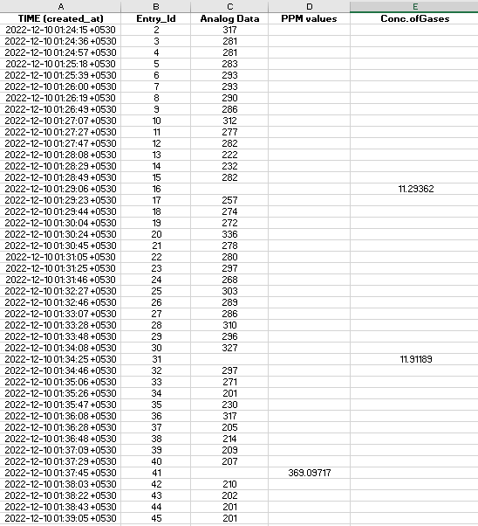
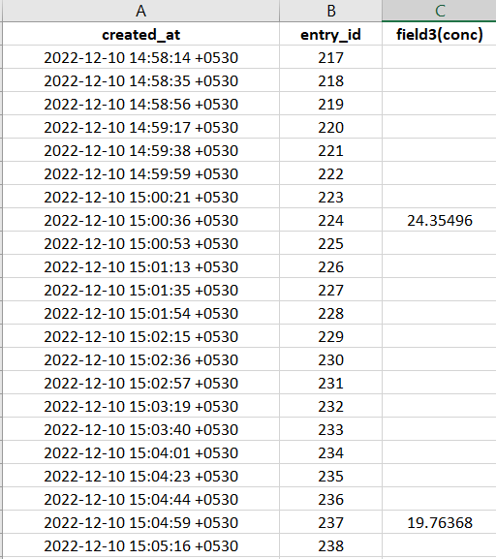
Storing Values in MS-Excel
Individual Values
All values together

Slide 10
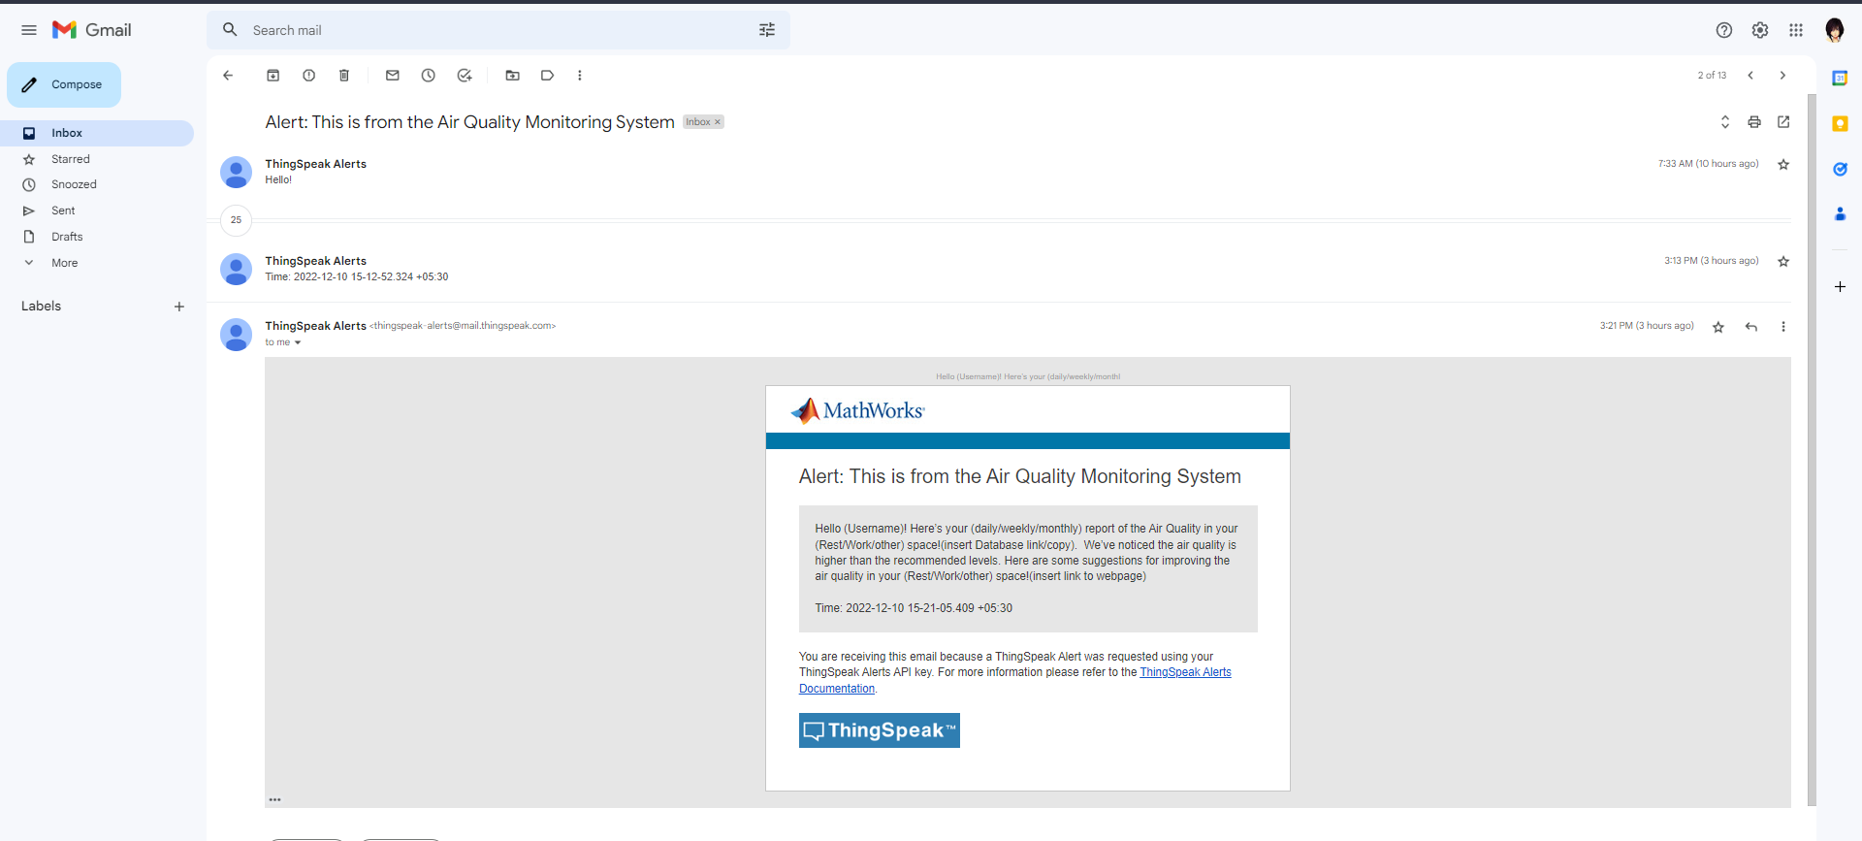
Automatic E-mail

Slide 11
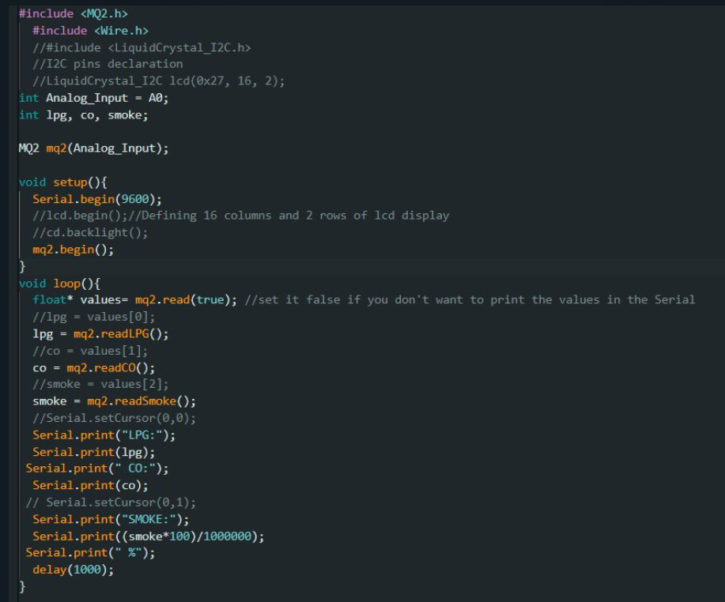
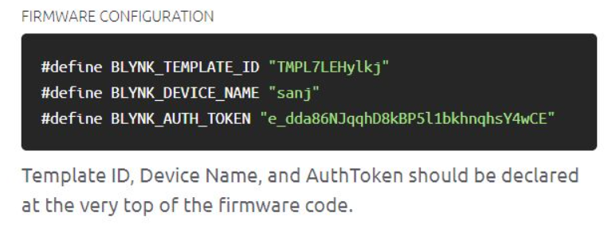
Code used for MQ-2
Code used on Arduino
Code used on Blynk

Slide 12
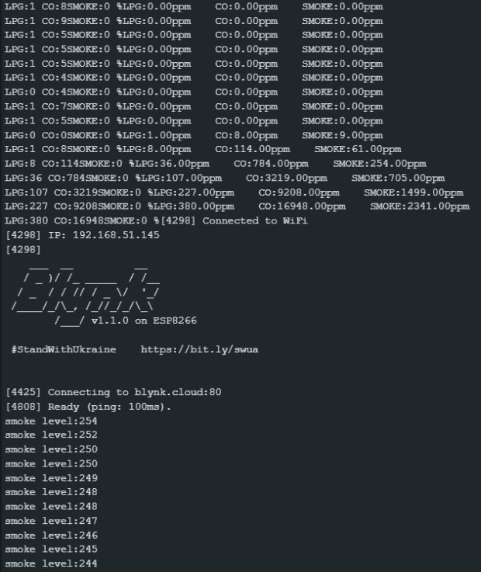
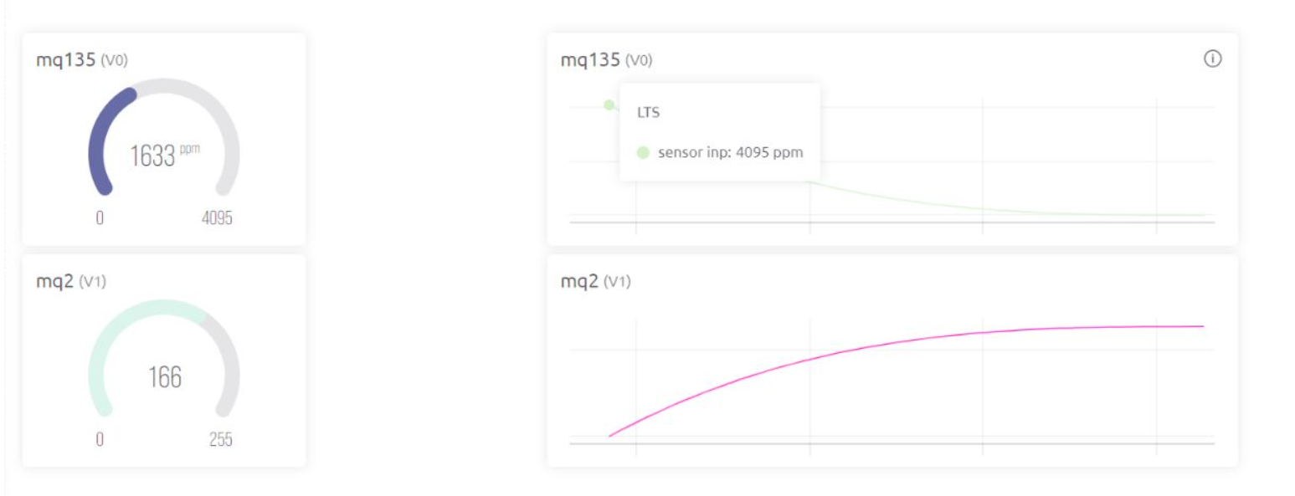
Representation of MQ-2 values
On Arduino Serial Monitor
On the Blynk IoT Platform

Slide 13
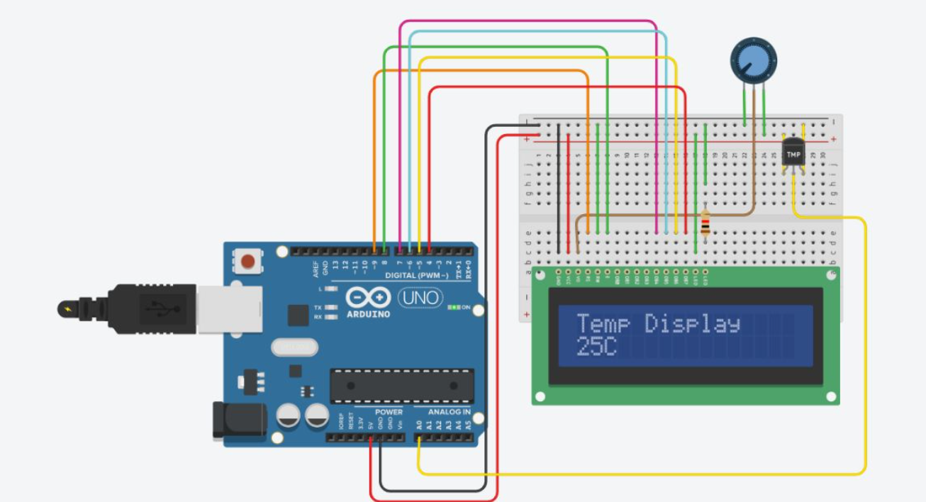
Simulation of LCD and Temperature & Humidity Sensors (with DEMO)

Slide 14
DEMO

Slide 15
Benefits of solution and Relation to the theme

Slide 16
Benefits of solution
There are several health, environmental and community benefits to our project-
Since most materials used are bio-degradable, it is not harmful to the environment.
The use of indoor plants helps with the following:
o Improves indoor air quality
o Helps reduce stress levels
o Sharpens our attention
o Therapeutic
o Helps recover from illnesses faster
o Boosts productivity
o Supports cognitive health
o Makes work environment feel welcoming
Cost effective
Easy availability of materials and resources
Contributes to improving air quality of the society in general
Implementation of the product provides jobs and hence reduces unemployment

Slide 17

Conclusion
Primary Aim – Being environmental friendly and help with the physical and mental health of all.
Scope for improvement –
More automations :
Automatic DB updates and forwarding without manual help
Embedded alarm systems when a sudden spike in concentration of gases is observed (eg, gas leakage and fires)
Ability to sense the surroundings and modify the air quality as required (eg, increase humidity when its low,i.e. act as a humidifier)
Usage of sensors which provide more accurate values

Slide 18
Thankyou

