Slide 1
Employee Data Analysis using Excel
STUDENT NAME: Kruthika P
REGISTER NO:2213331042110
DEPDEPARTMENT :Dpartment of commerce
COLLEGE: Bharathi women's college

Slide 2
PROJECT TITLE
Employee Atendance Analysis using Excel

Slide 3


AGENDA
Problem Statement
Project Overview
End Users
Our Solution and Proposition
Dataset Description
Modelling Approach
Results and Discussion
Conclusion
3/21/2024 Annual Review

Slide 4

PROBLEM STATEMENT
The organization is facing challenges with employee attendance, including absenteeism, tardiness, and unplanned leaves, which are impacting productivity and operational efficiency. The goal is to analyze attendance data to identify patterns, root causes, and areas of concern, enabling the development of targeted interventions to improve attendance, enhance workforce reliability, and optimize overall performance.

Slide 5

PROJECT OVERVIEW
The primary objective of this project is to conduct a comprehensive analysis of employee attendance data to identify trends, patterns, and underlying issues that may be affecting workforce productivity and operational efficiency. The insights gained will be used to develop actionable strategies to improve attendance, reduce absenteeism, and enhance overall employee performance.
.

Slide 6

WHO ARE THE END USERS?
The end users of an Employee Attendance Analysis are the individuals or groups who will directly benefit from the insights and findings of the analysis. These typically include:

Slide 7

OUR SOLUTION AND ITS VALUE PROPOSITION
Our solution offers a data-driven approach to comprehensively analyze employee attendance patterns, identify underlying issues, and provide actionable insights to improve workforce management. By leveraging advanced analytics, we transform raw attendance data into meaningful insights that can guide decision-making across the organization.

Slide 8
Dataset Description
To conduct a thorough employee attendance analysis, the dataset should include various fields that capture all aspects of attendance behavior. Below is a detailed description of the typical fields in such a dataset:

Slide 9

THE "WOW" IN OUR SOLUTION
The "Wow" Factor in Our Employee Attendance Analysis Solution Our employee attendance analysis solution stands out with several unique features and innovations that deliver exceptional value and set us apart from traditional methods. Here’s what makes our solution truly remarkable:
3/21/2024 Annual Review
9

Slide 10
MODELLING
Modeling employee attendance data involves using statistical techniques and machine learning algorithms to uncover patterns, predict future trends, and identify factors influencing attendance behavior. Here’s a structured approach to modeling in the context of employee attendance analysis
10

Slide 11
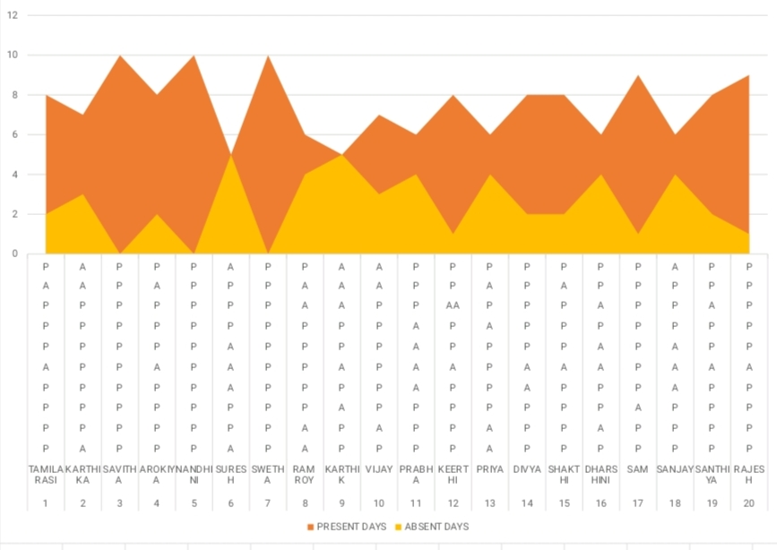
RESULTS
11

Slide 12
conclusion
The employee attendance analysis provides critical insights into the workforce's attendance behavior, uncovering patterns, trends, and potential issues that impact organizational productivity. By leveraging advanced data analysis and predictive modeling, this analysis enables organizations .

