Slide 1

BLOCK CHAIN FOR VOTING SYSTEM
DEEPIKA P
KRUTHIKA ELESWARAPU
THANUSHREE M K
REDDY SAI NIKHILA

Slide 2

BLOCK CHAIN
Blockchain is an immutable, distributed ledger that employs a combination of cryptographic techniques and decentralized consensus protocols to ensure the integrity, transparency, and immutability of data.
Decentralization: At the heart of blockchain is its decentralized nature, achieved through a peer-to-peer network of nodes, which eliminates the need for a central authority, thus reducing the risk of manipulation and single points of failure.
Consensus Mechanisms: Blockchains leverage consensus mechanisms, such as Proof of Work (PoW), Proof of Stake (PoS), or more recent variants like Delegated Proof of Stake (DPoS) and Byzantine Fault Tolerance (BFT), to ensure that transactions are validated and added to the ledger securely and transparently.
Cryptographic Security: Blockchain relies on advanced cryptographic techniques, such as digital signatures, hash functions, and asymmetric encryption, to protect the confidentiality, authenticity, and integrity of data
Smart Contracts: Smart contracts, self-executing code deployed on the blockchain, automate the execution of predefined rules and conditions,

Slide 3

BLOCK CHAIN FEATURES THAT ESTABLISH A SUCCESSFUL VOTING SYSTEM
The core of blockchain's security in a voting system is decentralization. By removing central authorities, it eliminates the risk of manipulation.
Advanced cryptographic techniques are integral in securing the voting process. Voter identification, transaction privacy, and integrity checks are accomplished using cryptographic keys and digital signatures.
Smart contracts are used to codify the rules and conditions of the voting process, automating tasks such as voter registration, vote counting, and result publication.
Blockchain's immutability feature safeguards the integrity of voting records. Once a vote is cast, it's virtually impossible to alter or delete without network consensus.

Slide 4
Security Against Double Voting , blockchain ensures that each voter can only cast one vote, mitigating the risk of double voting and electoral fraud through unique cryptographic tokens.
The challenge of scalability is addressed through solutions like sharding and Layer 2 protocols, enabling the system to handle a high volume of votes without compromising performance.
Casting Votes, Voters cast their votes electronically using secure wallets, where each vote is encrypted and linked to a unique cryptographic token, ensuring privacy and authenticity.

Slide 5
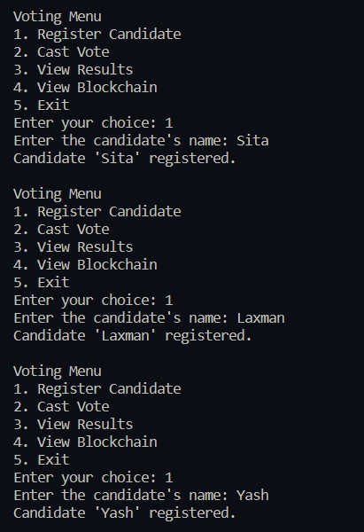
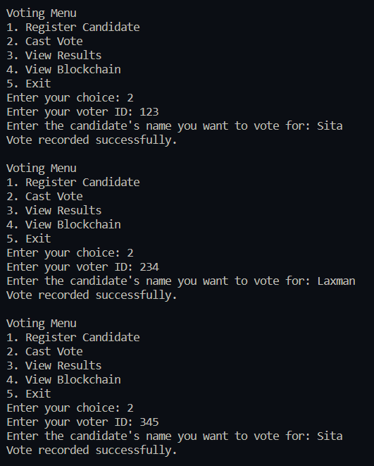

Slide 6
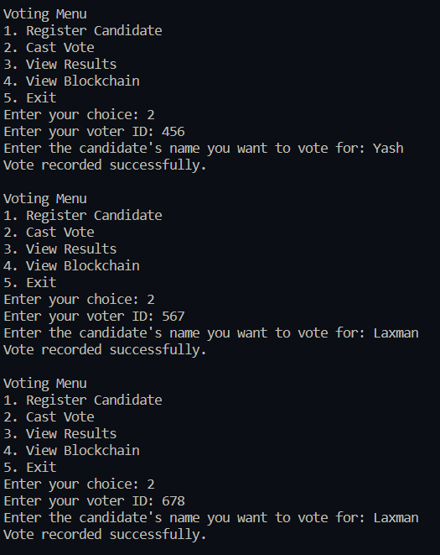
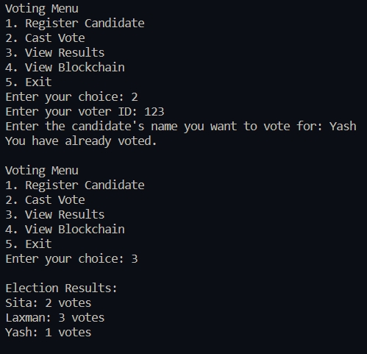

Slide 7
