Slide 1
Transmission Line Circuit for Simplified Hodgkin-Huxley Neuron Model
MSc Dissertation
Presented by: Kruthika Yogeesh Gowda
MSc Electronics, University of Southampton
Supervisor: Dr. Harold Chong

Slide 2
MOTIVATION
Biological relevance:
Neurons perform three vital functions - dendrites filter inputs, the soma generates spikes, and axons transmit signals with timing precision.
Existing models:
- Hodgkin - Huxley → highly accurate but too complex for hardware or real-time use.
- Memristive circuits → promising but experimental, costly and hard to reproduce.
Identified gap:
No simple analog model showing dendritic filtering, spiking, and transmission within biological ranges.
Long-term vision:
To lay the foundation for simple, low-power neuromorphic hardware that can support biomedical applications and future brain-inspired computing.

Slide 3
Aim and Objectives
Aim:
To design a simple analog circuit model of a neuron that demonstrates dendritic filtering, soma spiking, and axonal transmission, and compare its behaviour with biological ranges.
Objectives:
Build RC and comparator-based circuits for dendrite, soma, and axon stages.
Apply different biological and test input signals (EEG, HH spike, PQRST, multi-sine).
Validate performance using quantitative metrics (spike width, jitter, RMSE, SNR, gain error, phase lag).
Compare results with known biological data to assess realism.
Highlight limitations and propose future improvements for neuromorphic applications.

Slide 4
Tools and Simulation Setup
Multisim – Chosen for its ease of analog circuit simulation, component availability, and real-time probe visualization. → Enabled full hardware-level testing of neuron-like circuits.
→ Used for circuit design and oscilloscope outputs.
MATLAB – Used for generating complex input signals.
→ Used for FFT, Bode plots, jitter, RMSE, and cross-validation of results.
All signal paths tested in simulation, with block-wise validation and final output comparison.

Slide 5
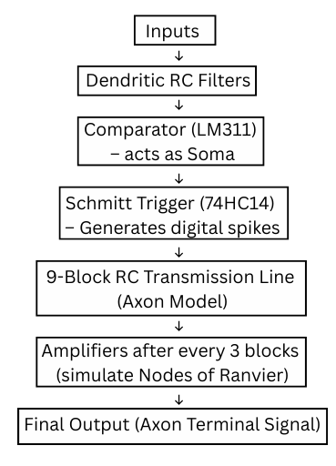
BLOCK DIAGRAM

Slide 7
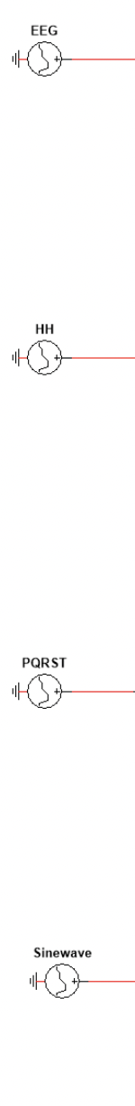
INPUT SIGNAL DESIGNS
EEG Input
– Real brain signal from PhysioNet.
–Validates dendritic frequency selectivity.
HH Spike
– Action potential from Hodgkin-Huxley model.
– Serves as biological action potential reference.
PQRST Pulse
– Synthetic, structured waveform.
– To test filters with complex biomedical waveform.
Sinewave
– Multi-frequency test input.
– Stresses filter with broad frequency content.
All signals passed through individual dendritic filters.

Slide 8
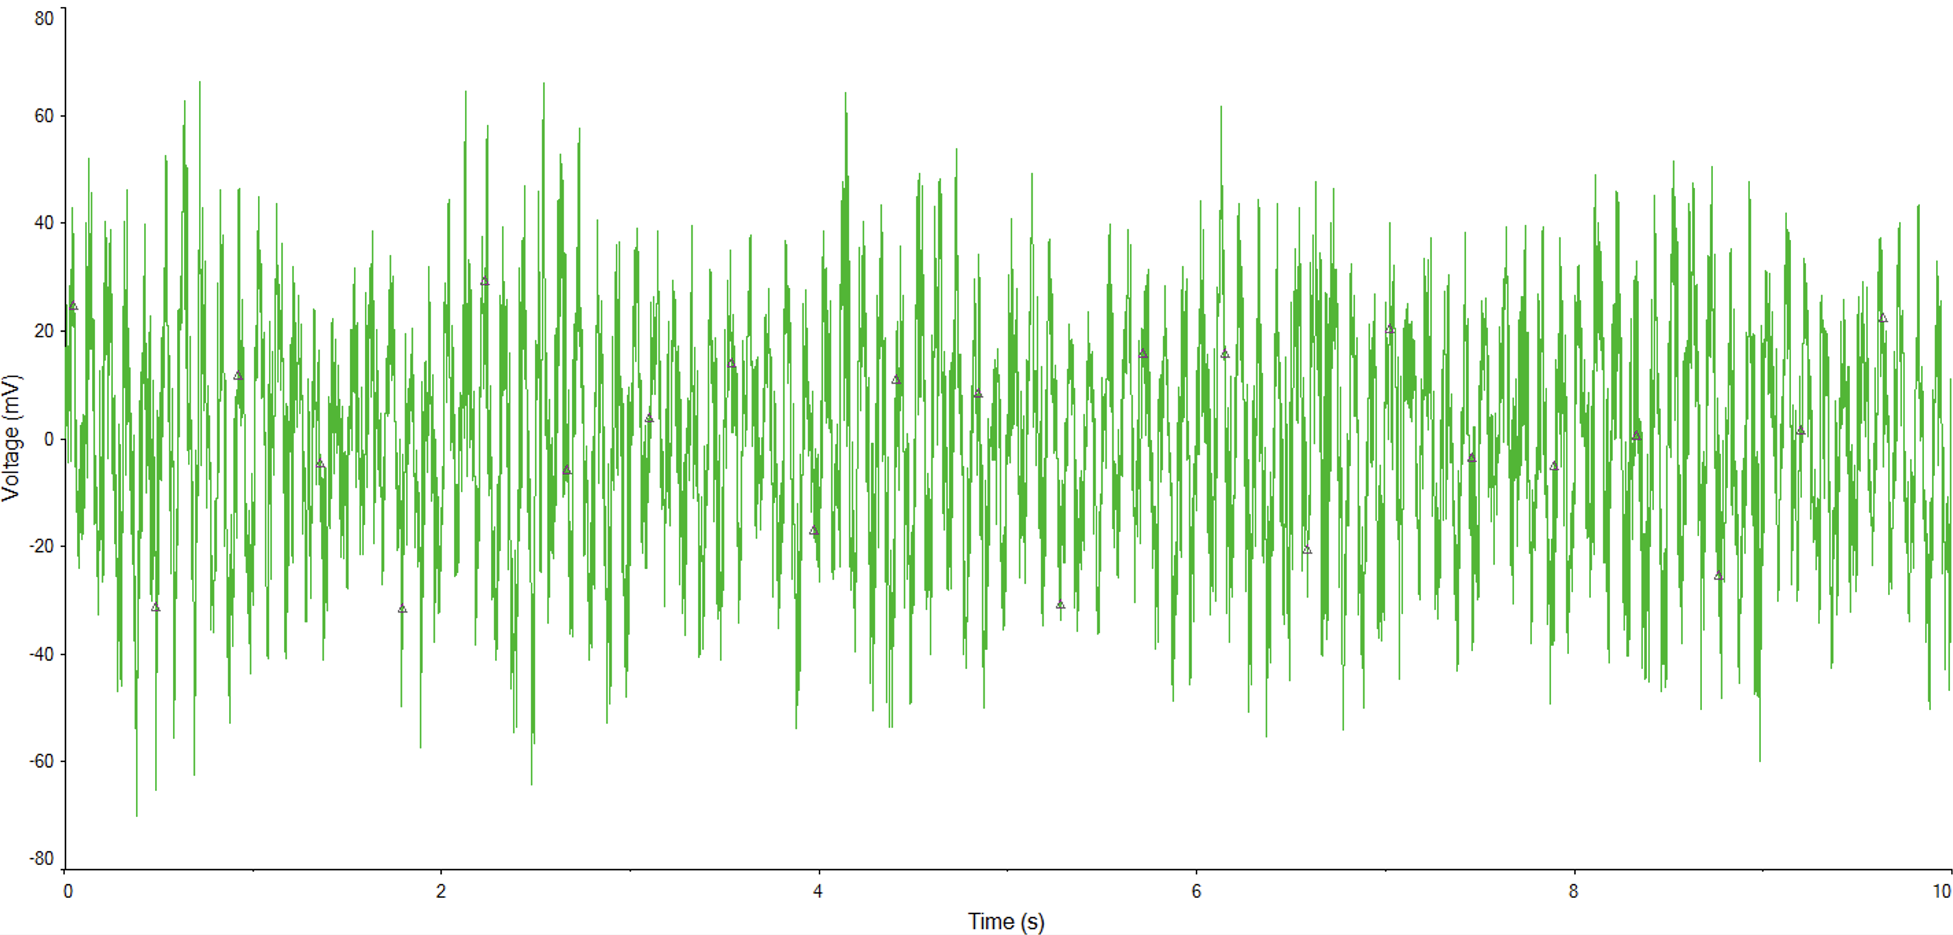
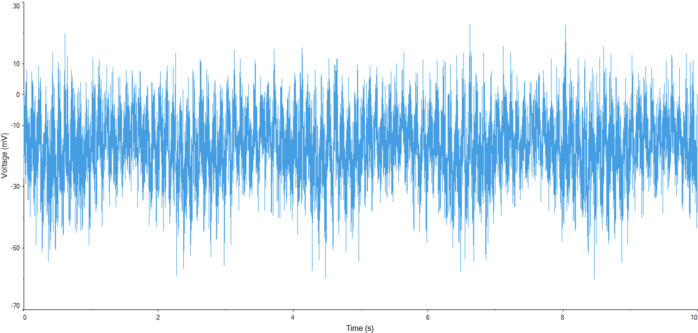
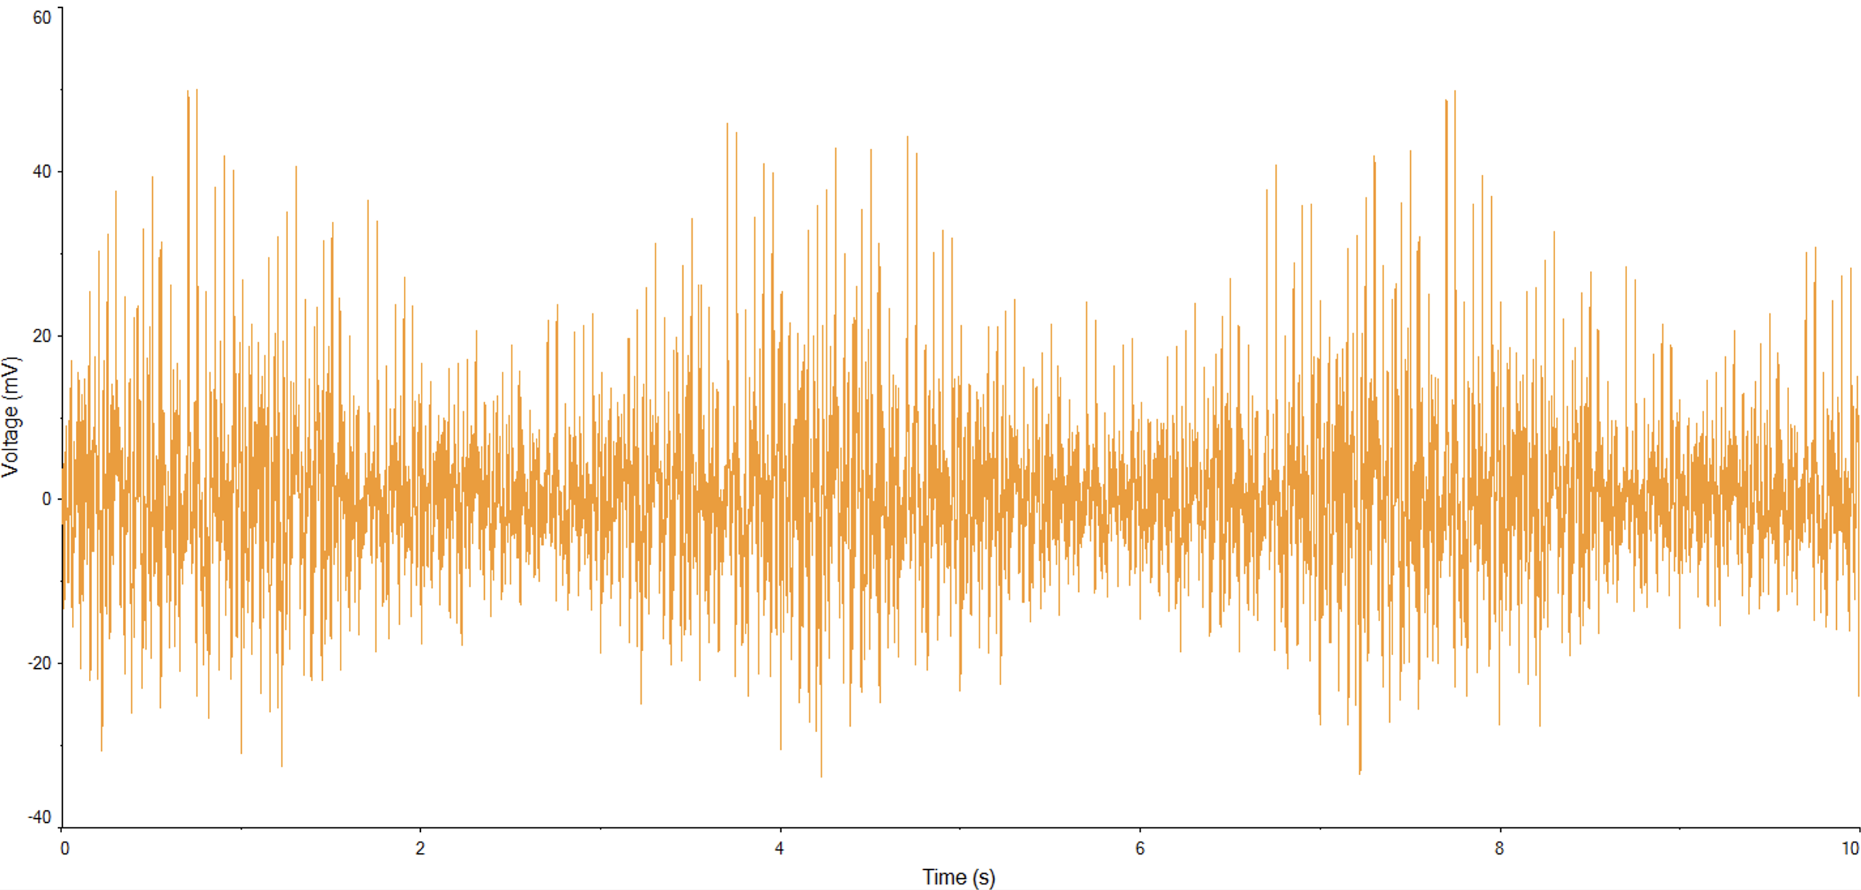
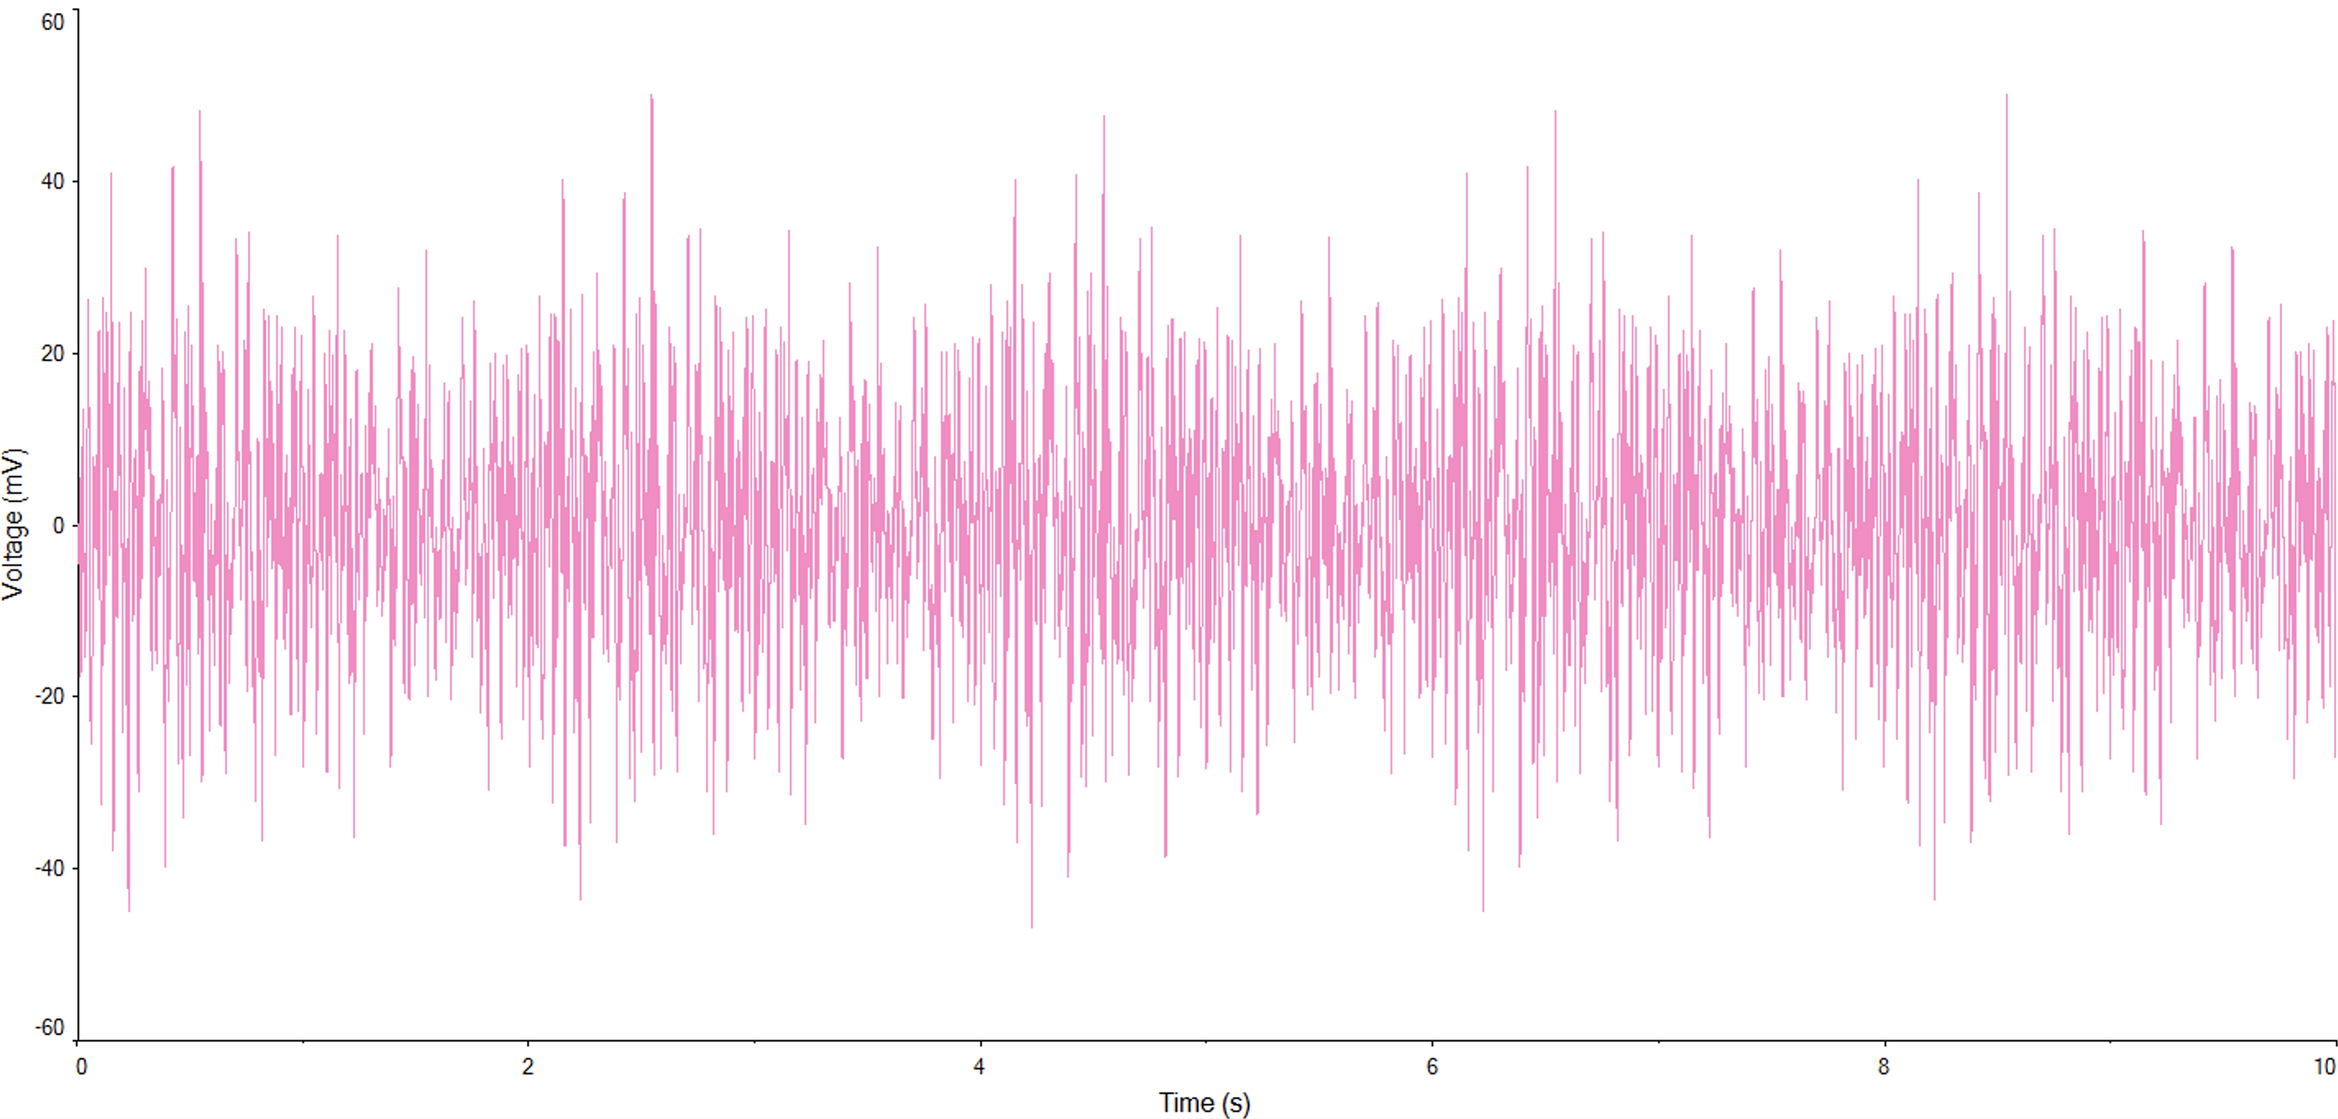
EEG
HH
PQRST
Sinewave

Slide 9
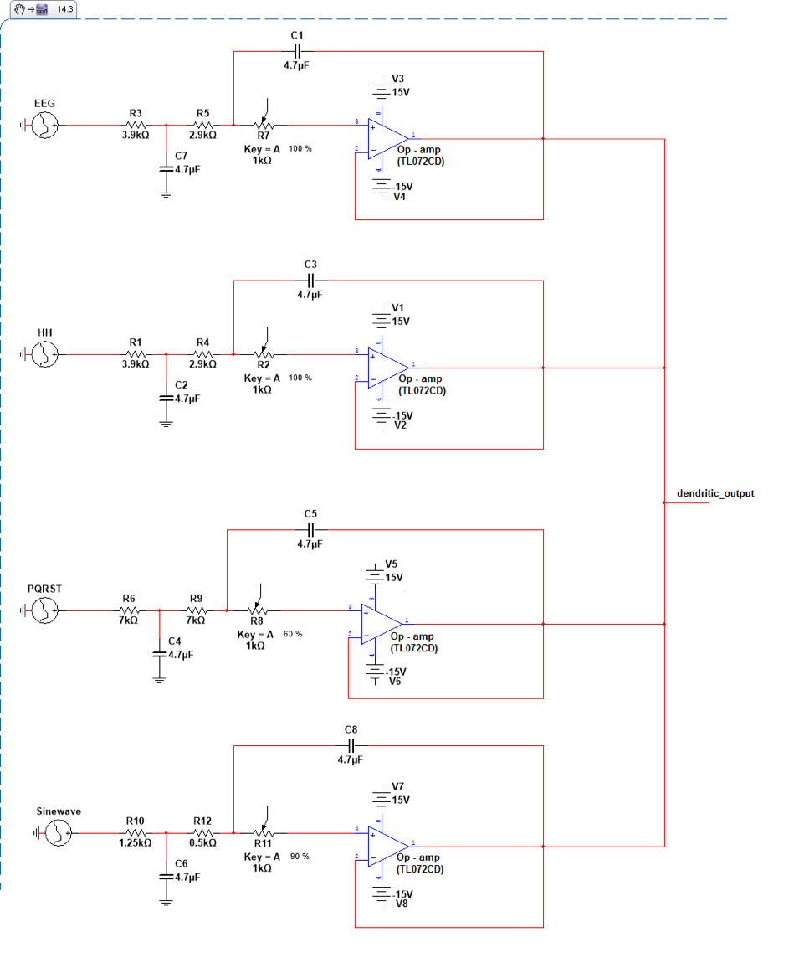
Dendritic Filtering
Each input signal goes through an RC band-pass filter, simulating dendritic attenuation.
Filters tuned to preserve 8 -13 Hz (α-band) – specifically around 10Hz, frequency components based on the inputs.
Outputs are summed before spike generation.
Purpose: Remove irrelevant frequencies, preserve biologically useful content.

Slide 10
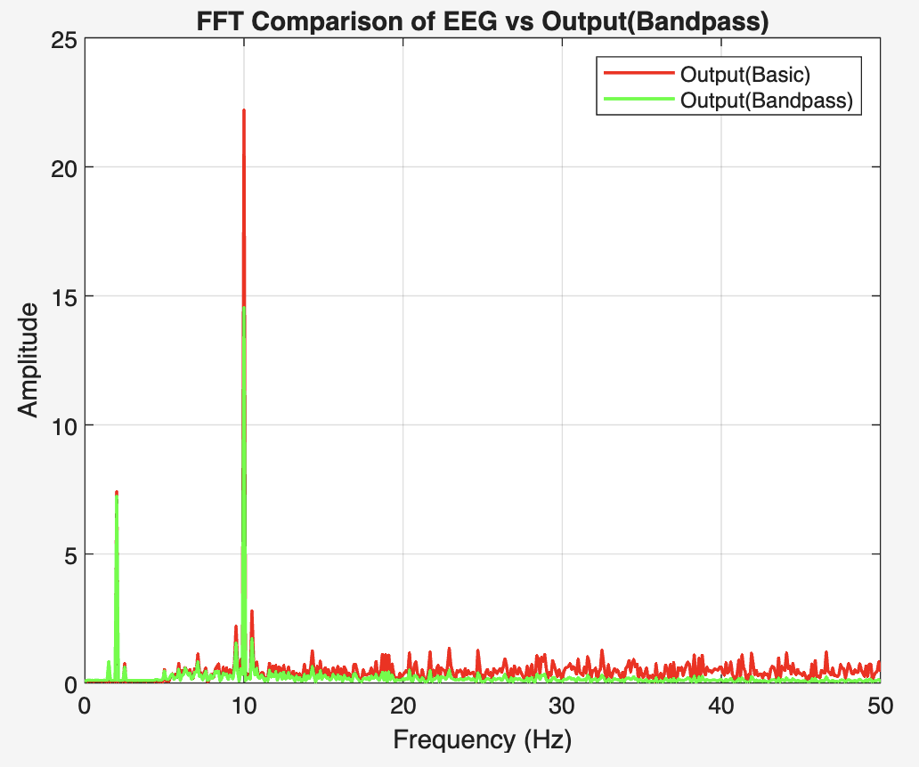
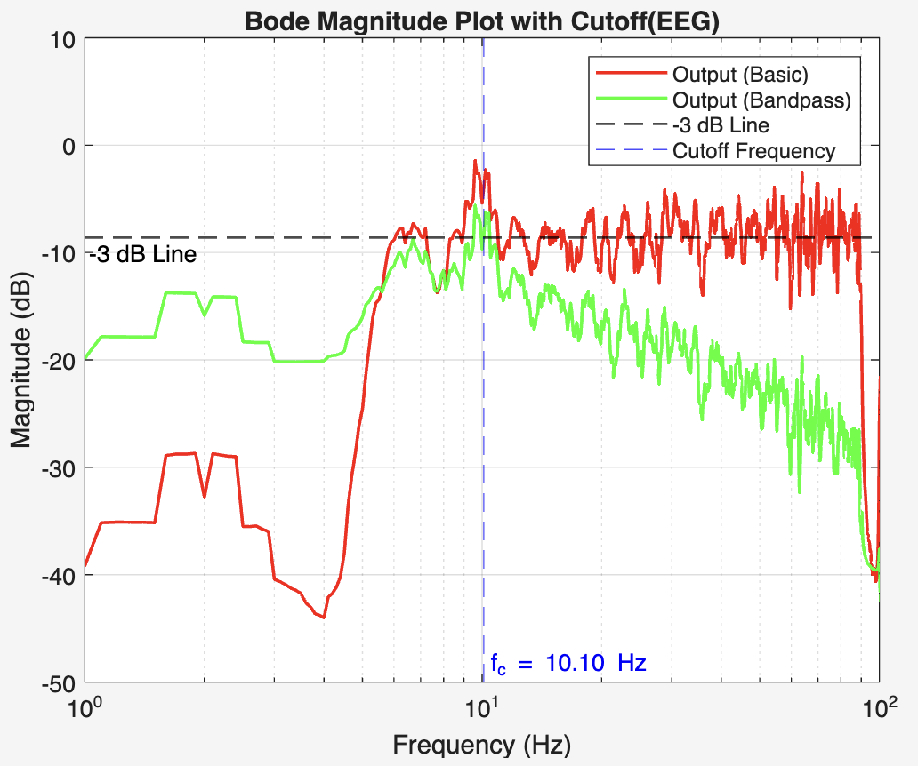
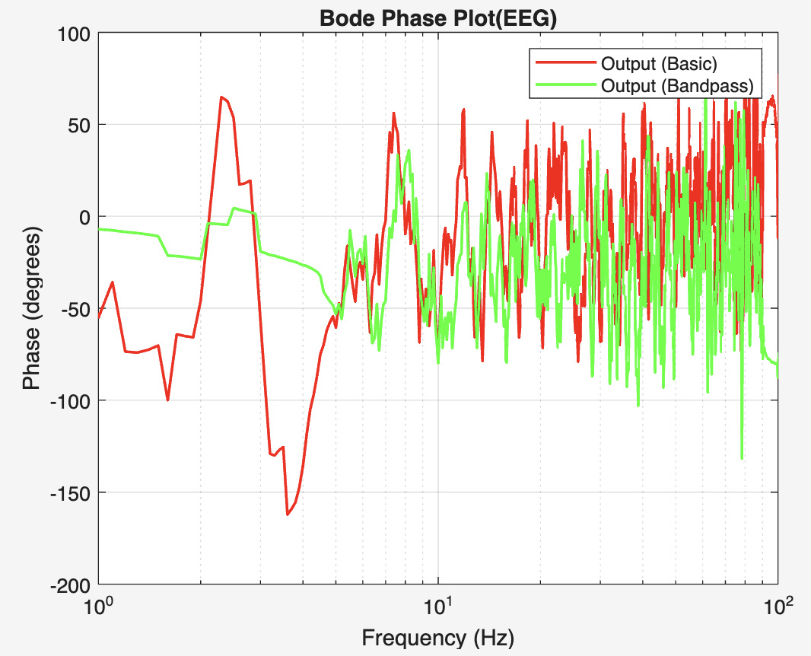
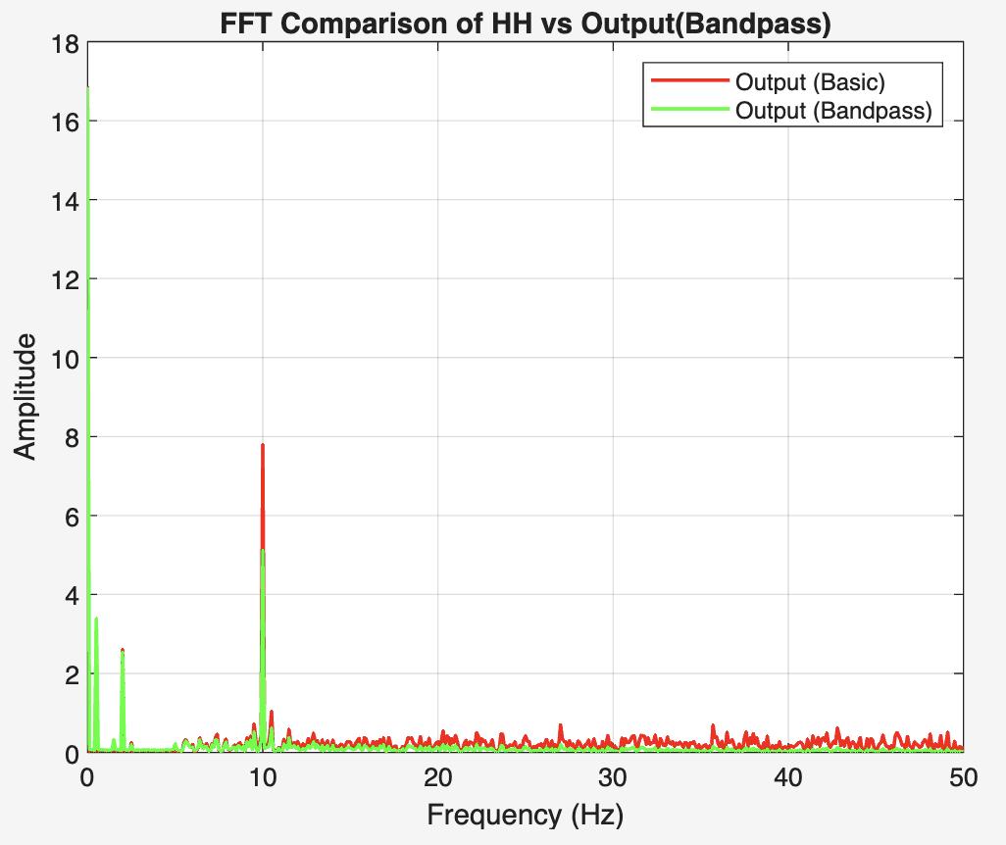
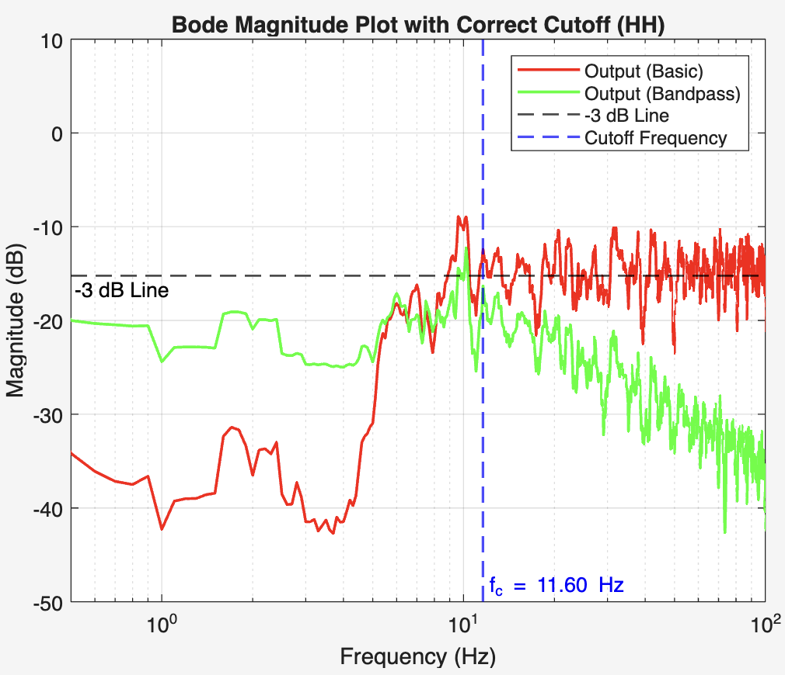
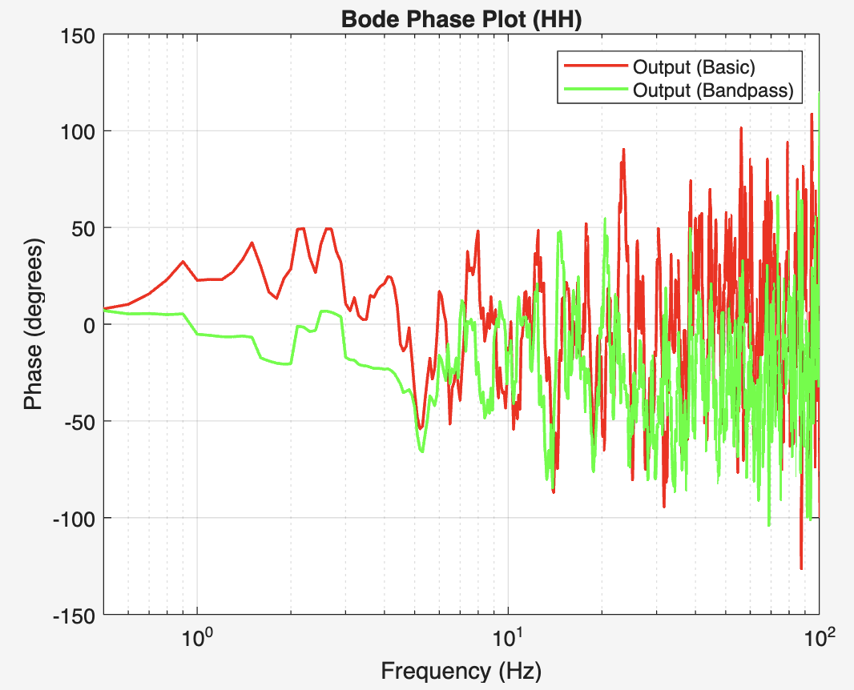

Slide 11
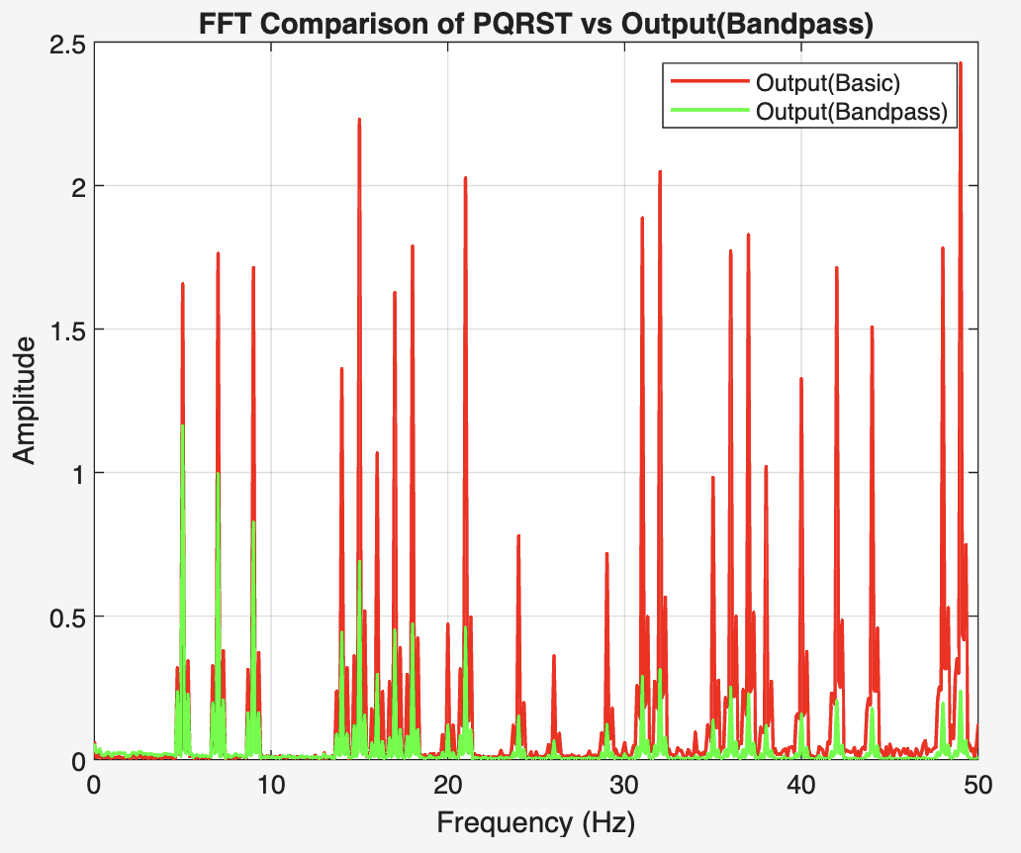
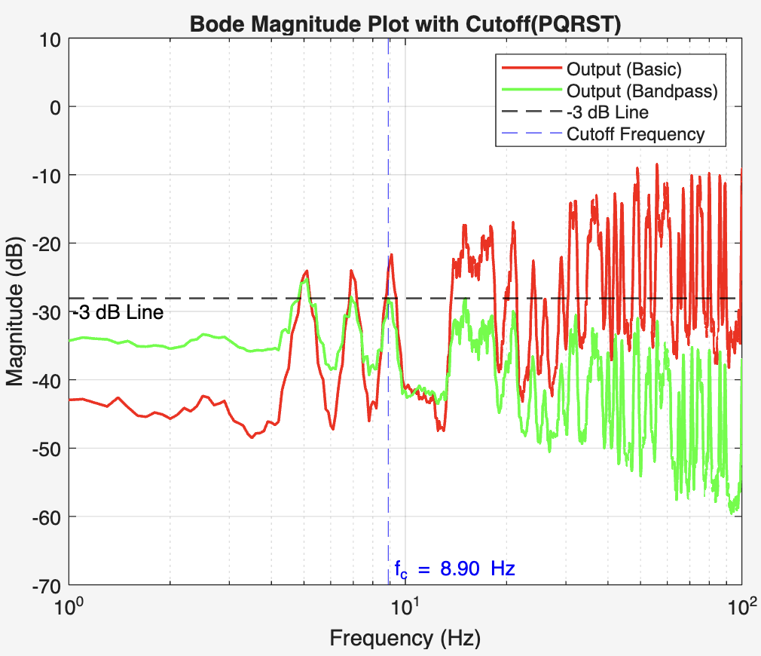
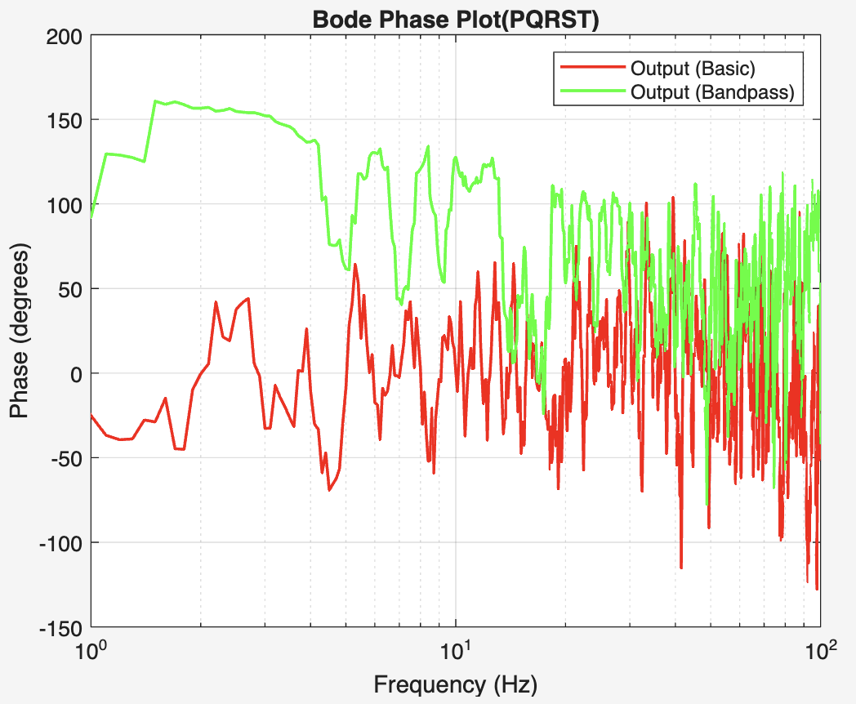
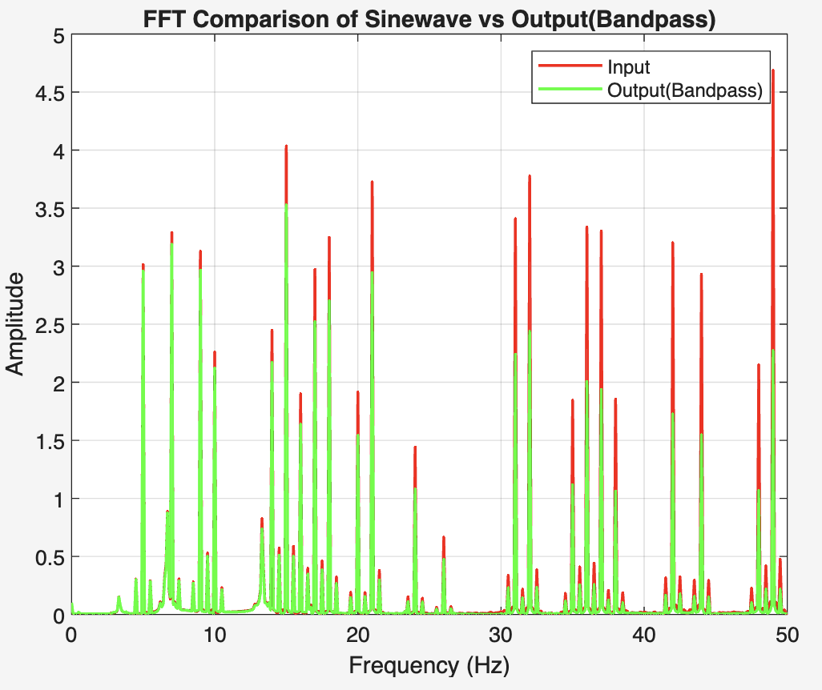
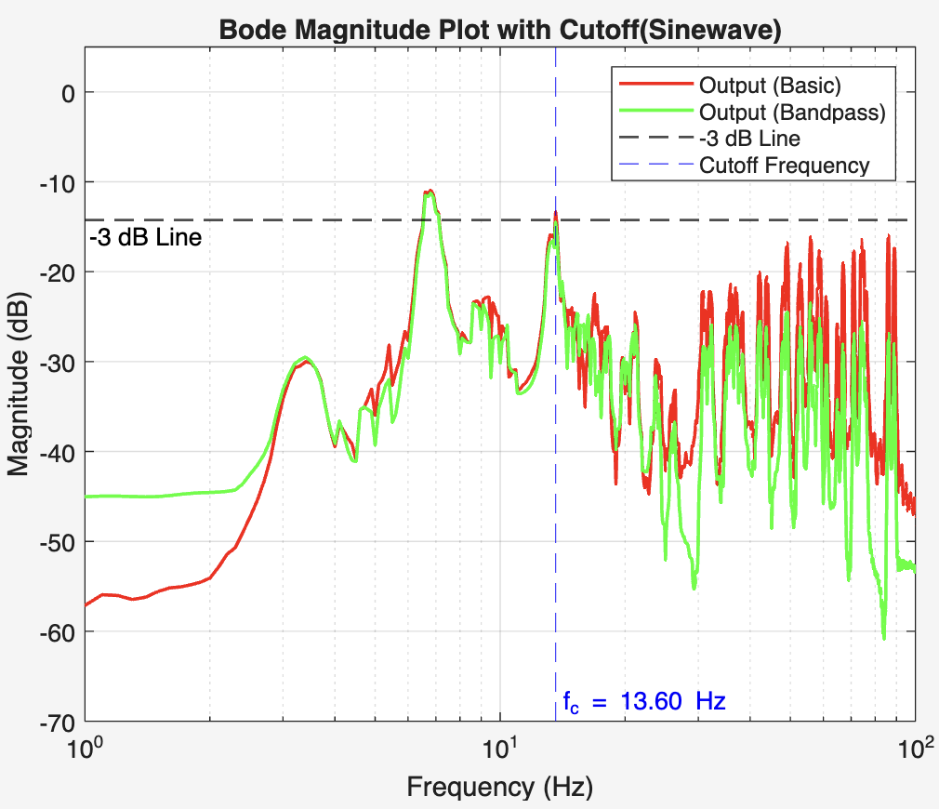
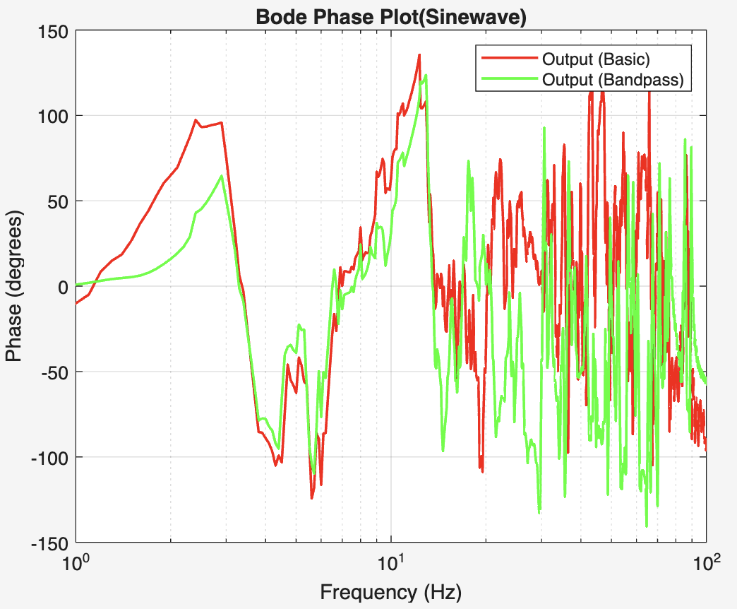

Slide 12
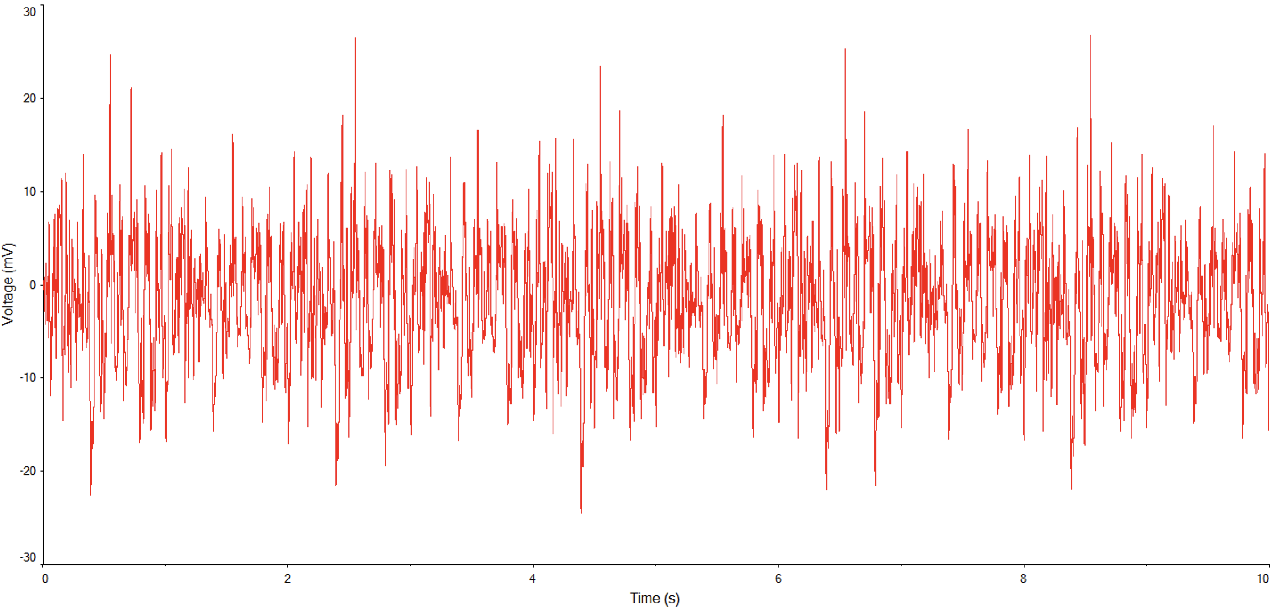
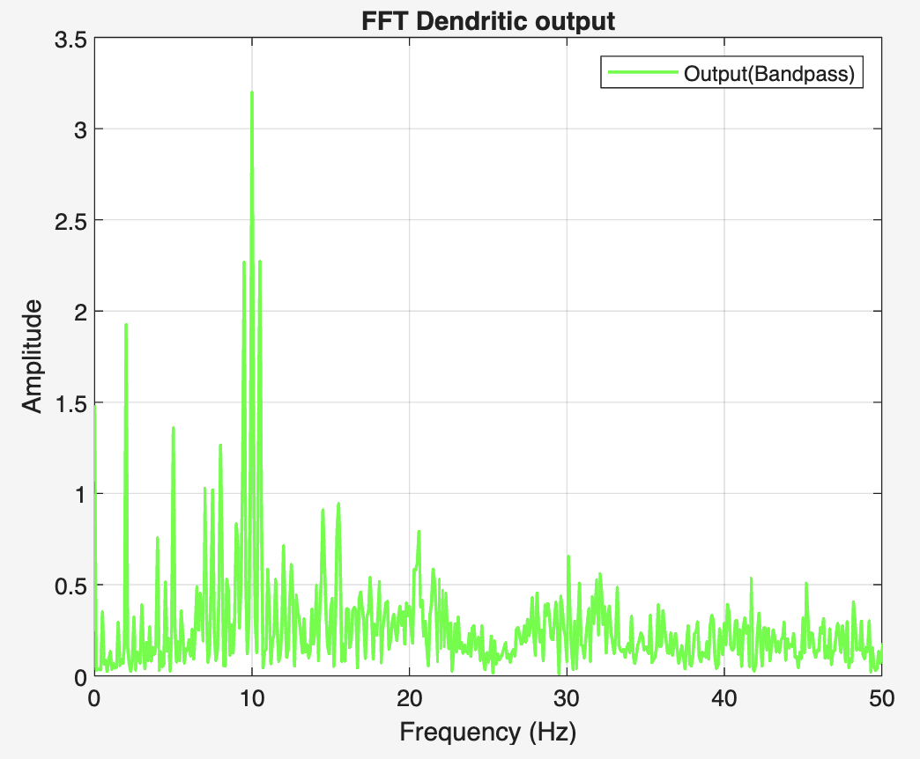
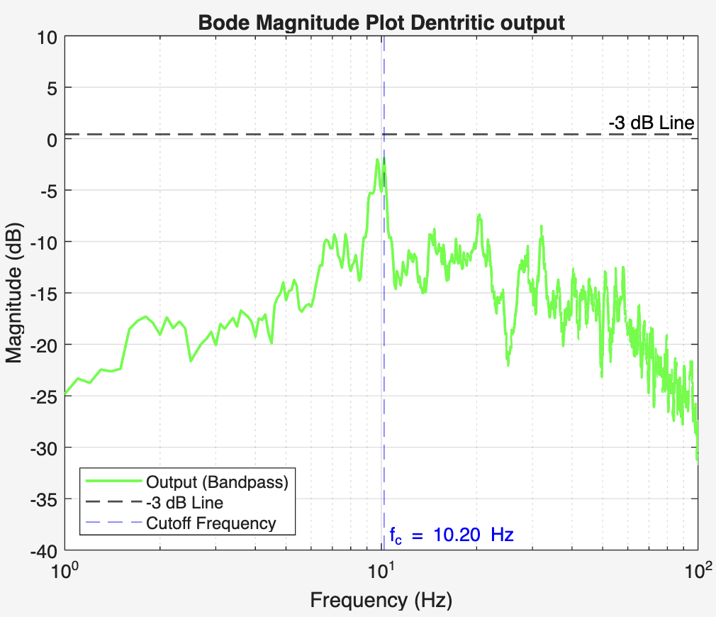
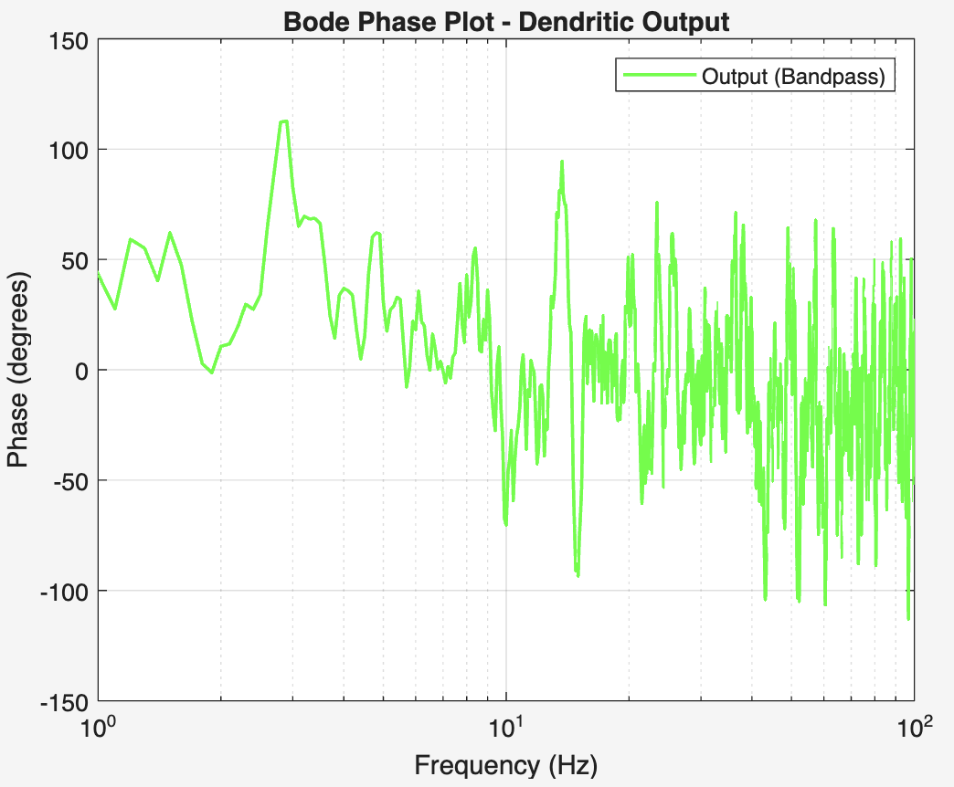

Slide 13
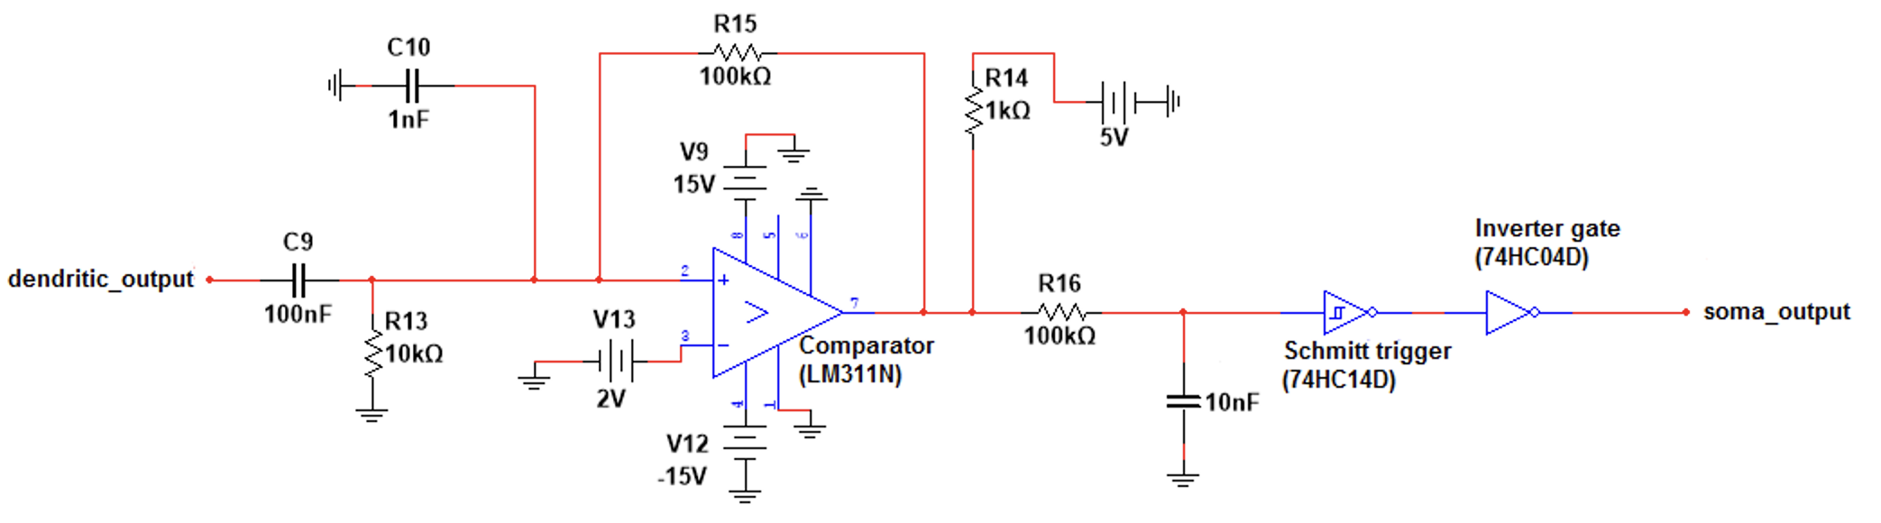
Soma Spike Generation
The combined dendritic output is fed into a comparator (LM311N).
Once the input crosses the threshold, a spike is triggered.
A Schmitt trigger is used for noise immunity, preventing false spikes.
This reflects the biological all-or-none principle → spikes occur only above threshold.
The output is a sharp and stable spike, ready to be passed along the axon for transmission.

Slide 14
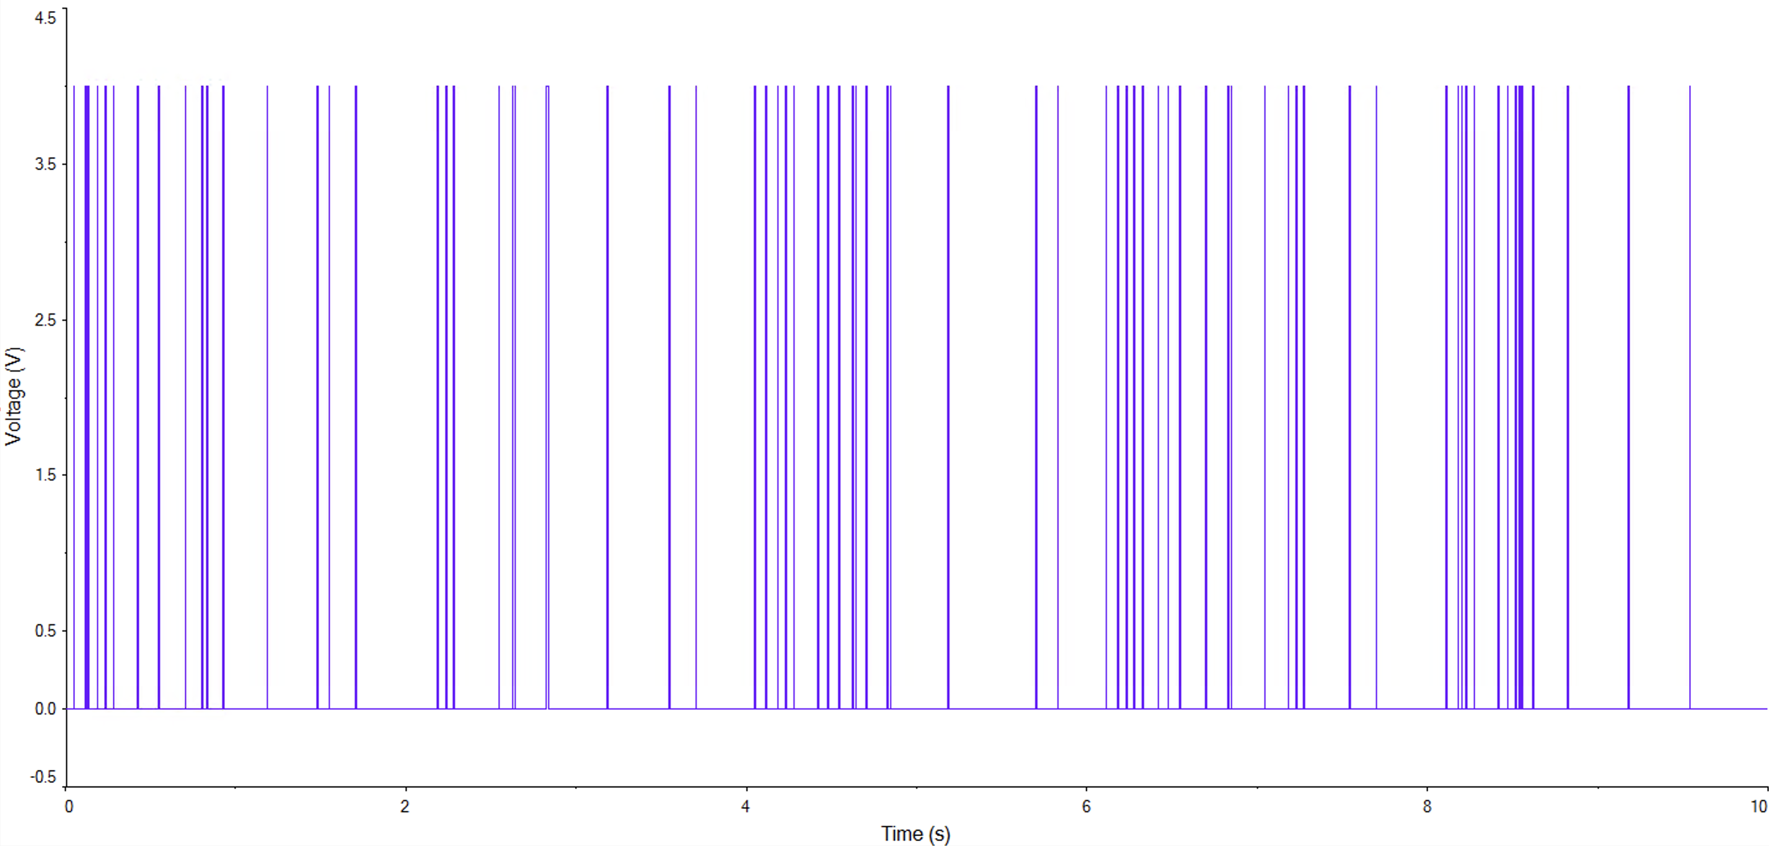
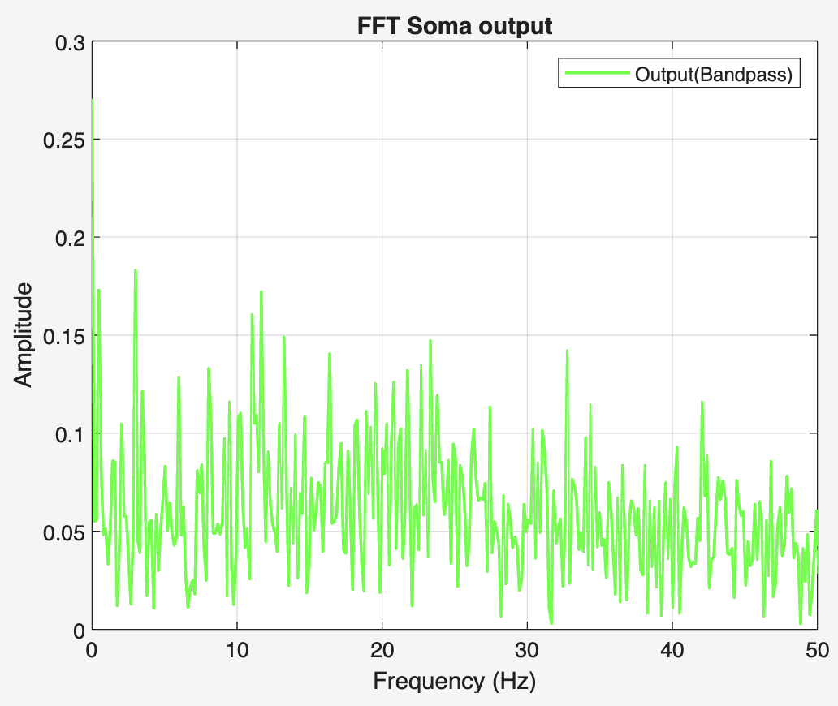
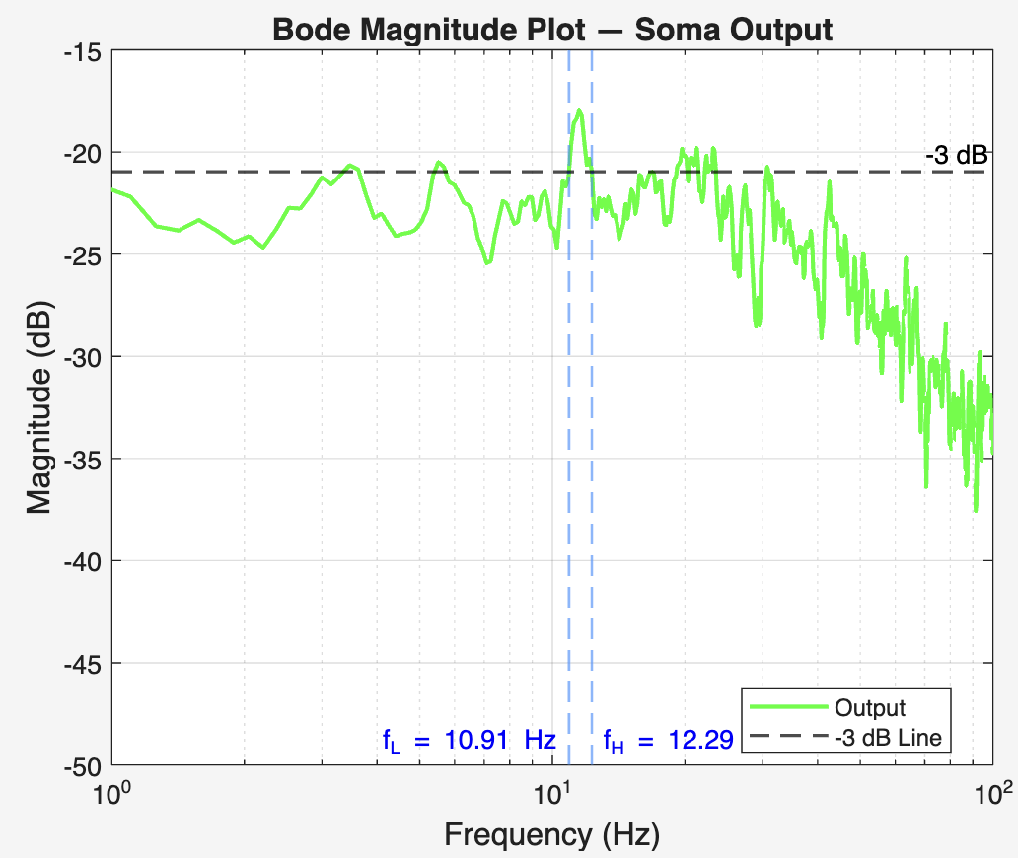
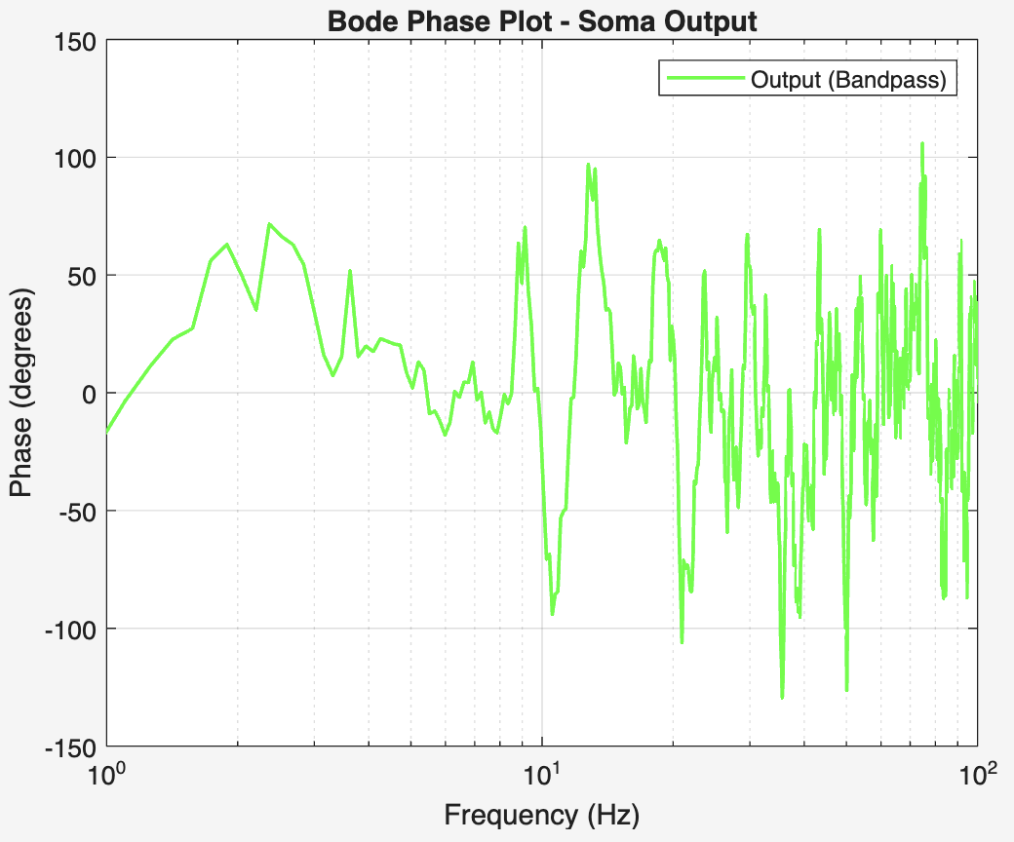

Slide 15
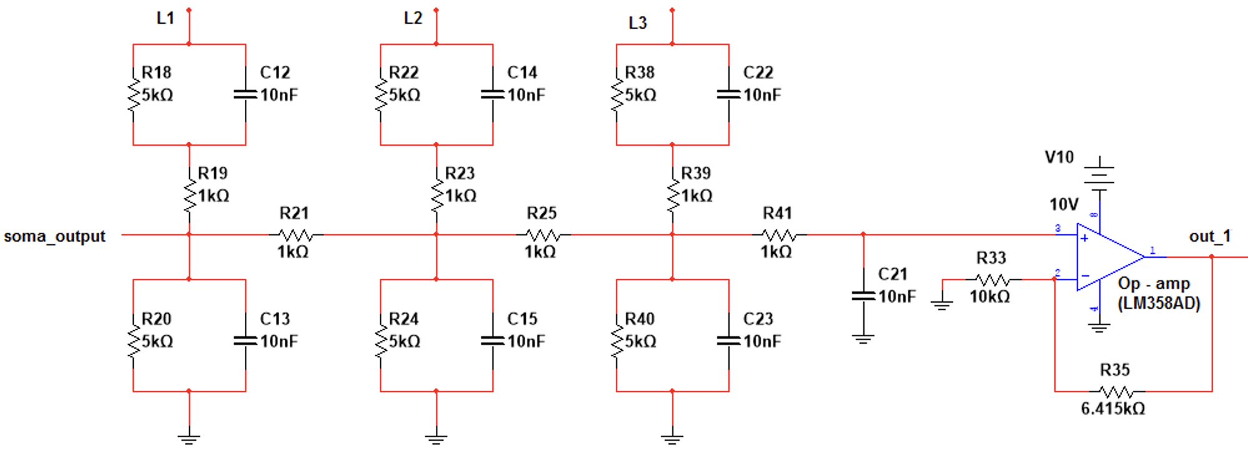
Axonal Transmission Line
9-stage RC circuit simulates axon.
Amplifiers are inserted after every 3 blocks to restore amplitude.
RC values tuned to minimize signal distortion.
Spike shape and frequency are preserved from input to final output.

Slide 16
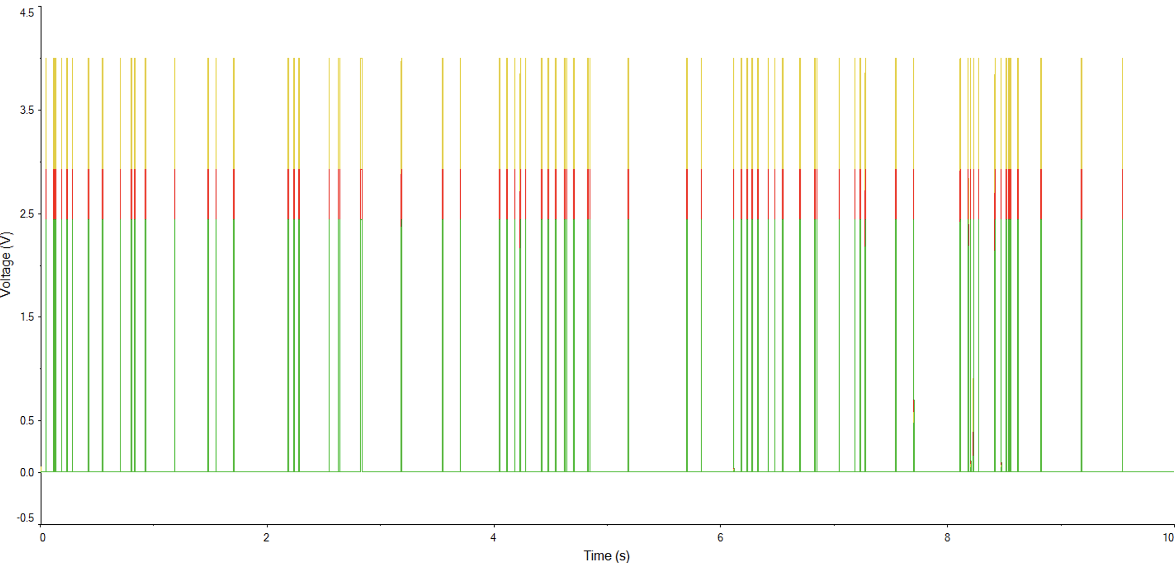
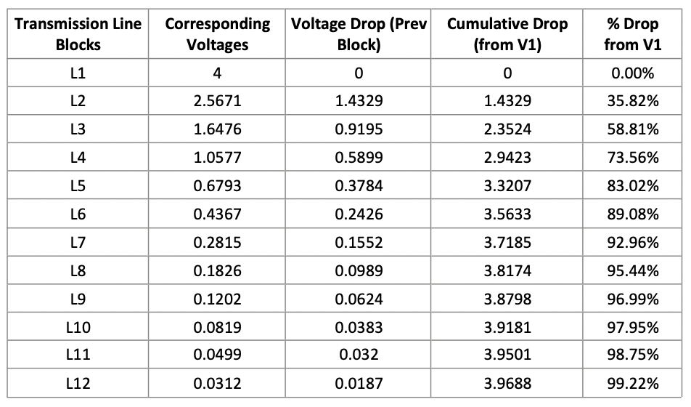
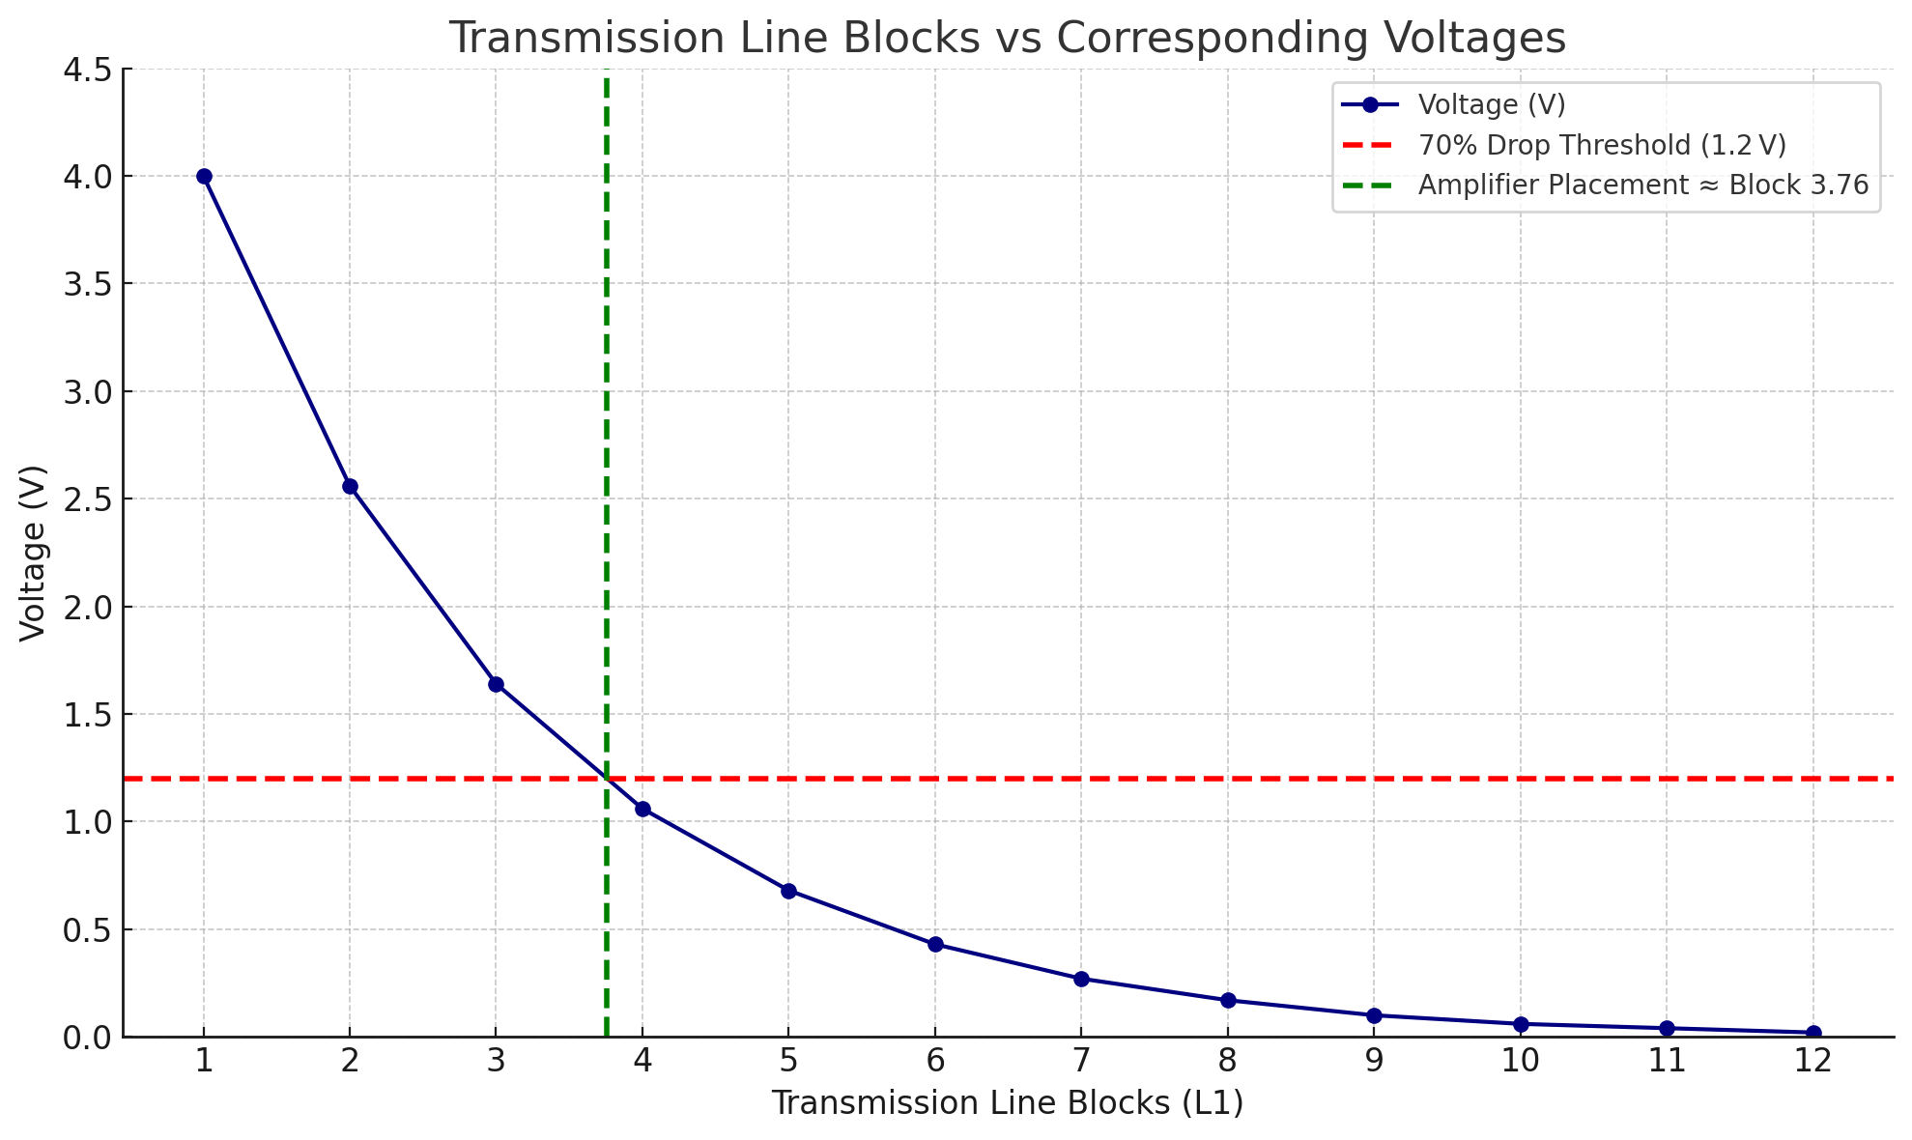

Slide 17
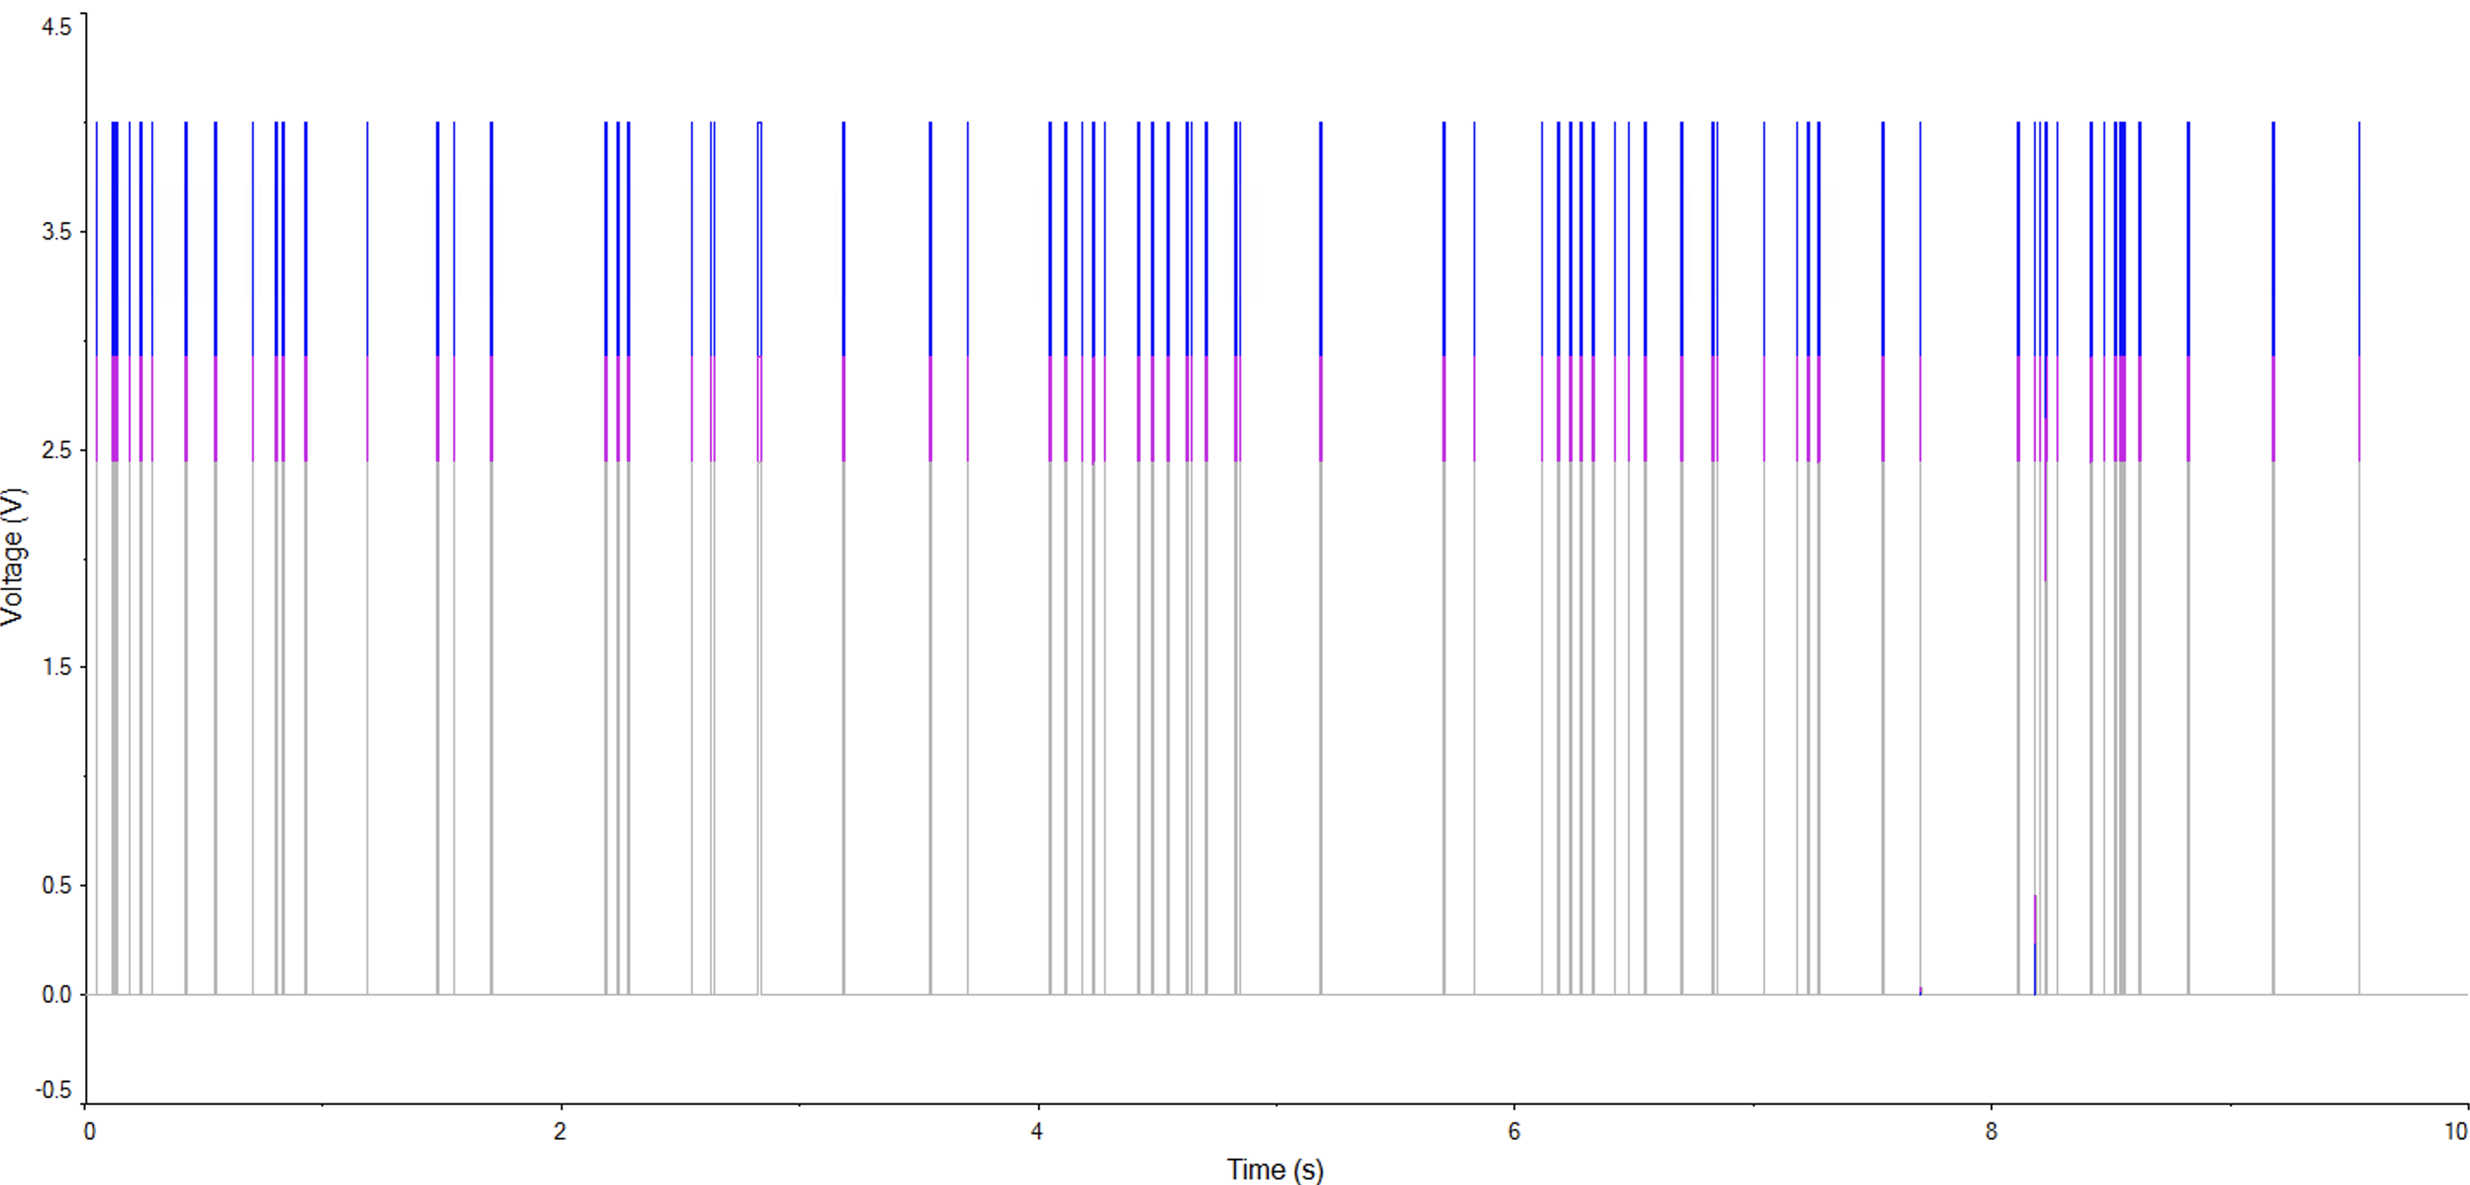
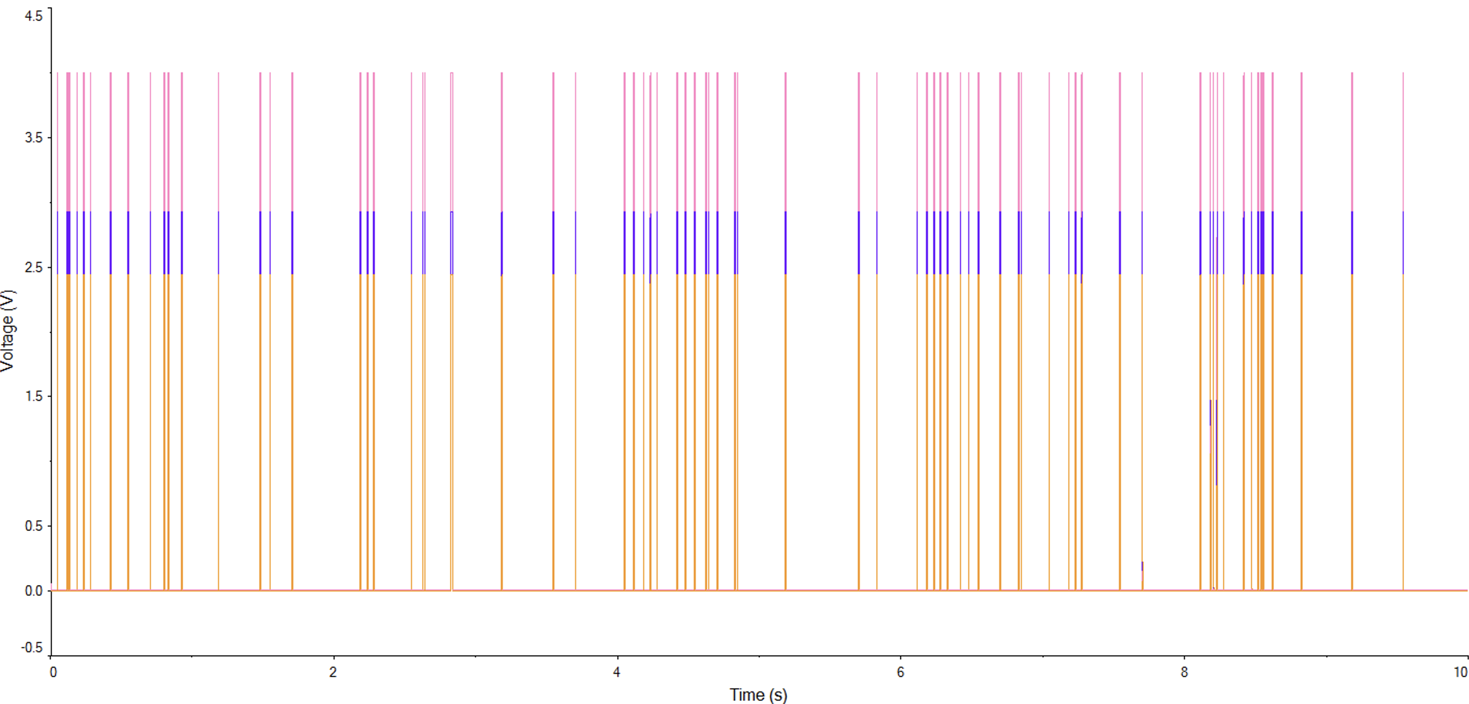
L1, L2, L3
L4, L5, L6

Slide 18
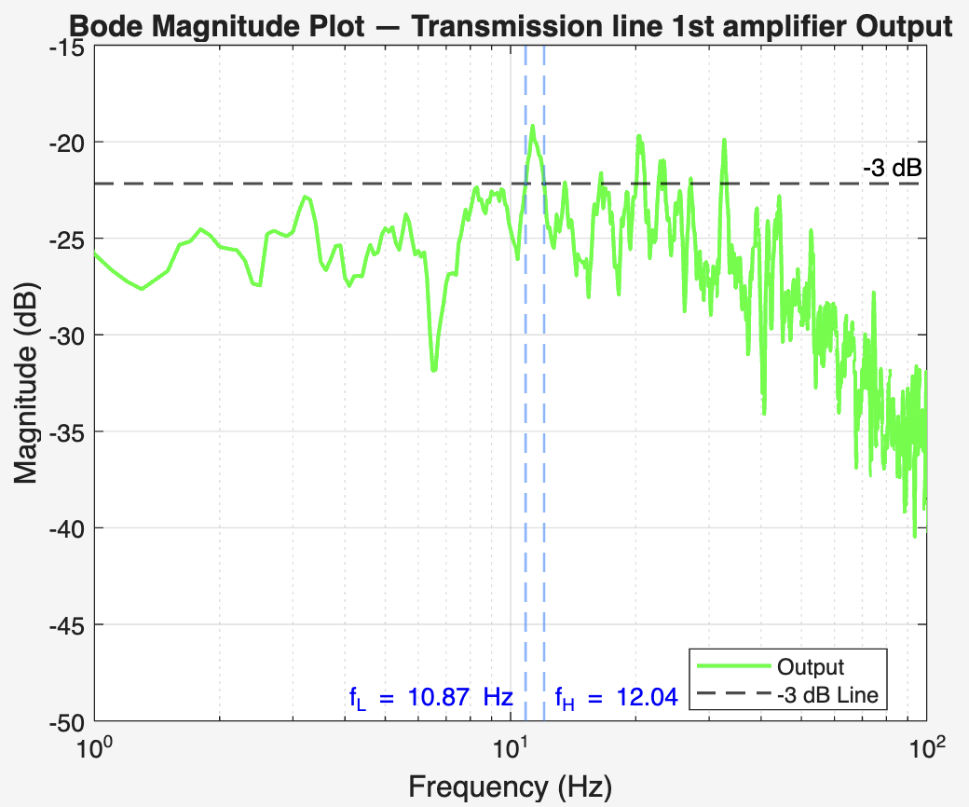

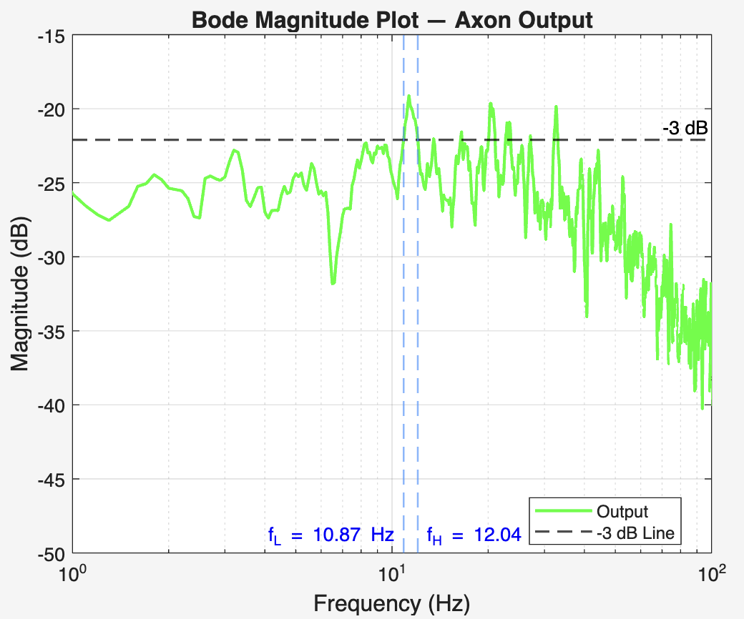
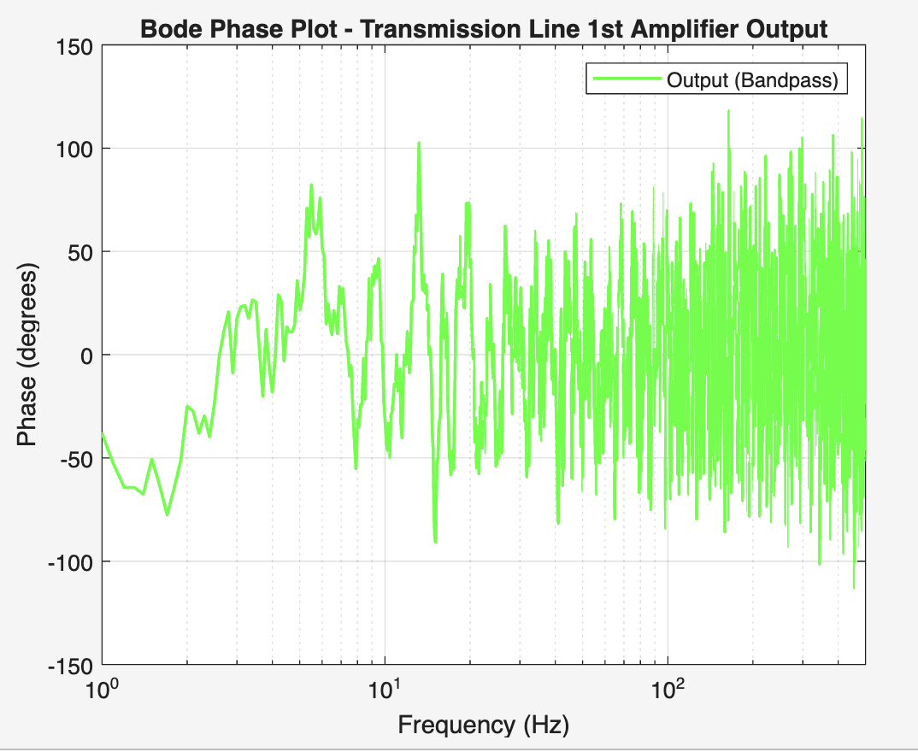
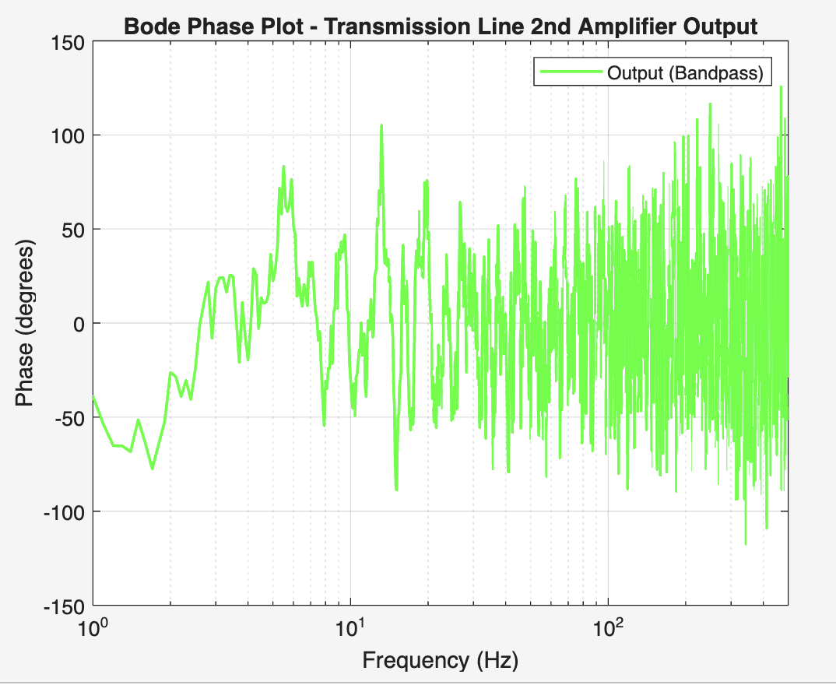
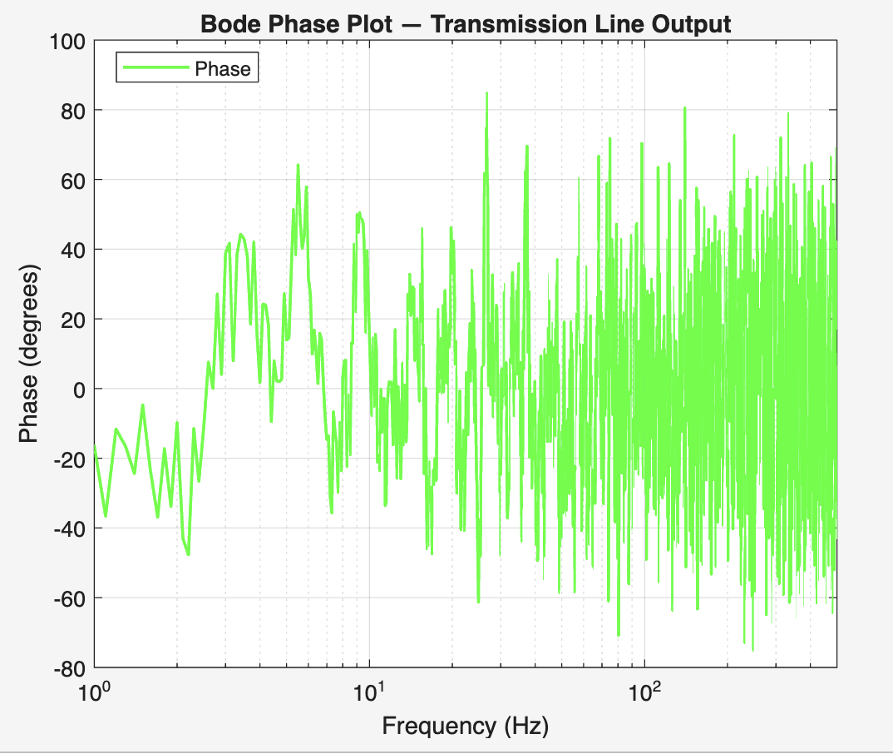

Slide 19
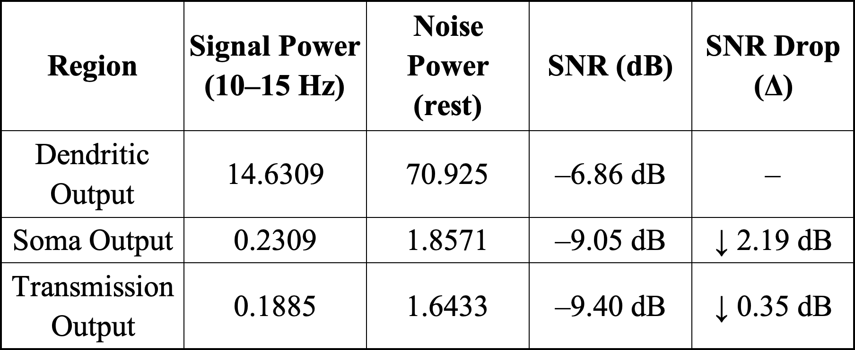
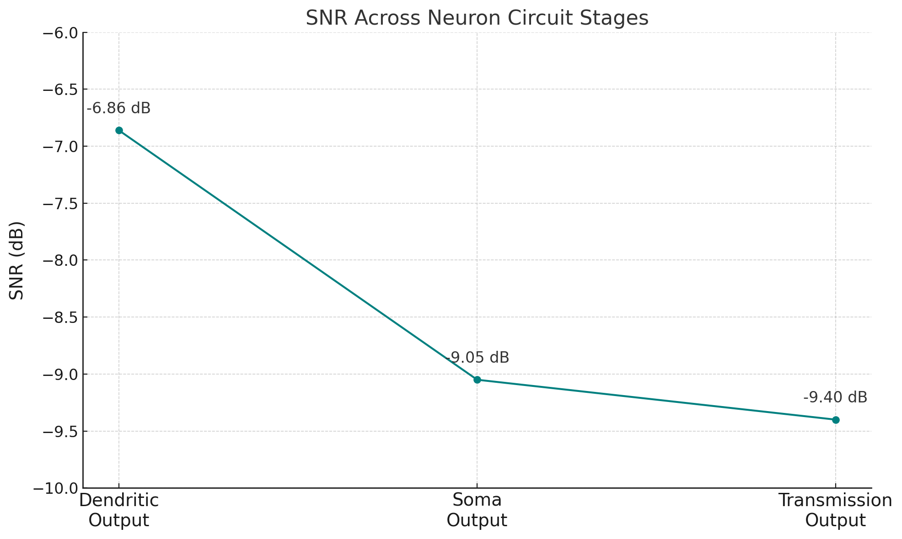
SNR Evaluation
SNR drops from Dendrite → Soma → Axon
Significant drop occurs at Soma due to threshold conversion
Minimal loss across axon shows proper spike preservation
Confirms low noise distortion during propagation

Slide 20
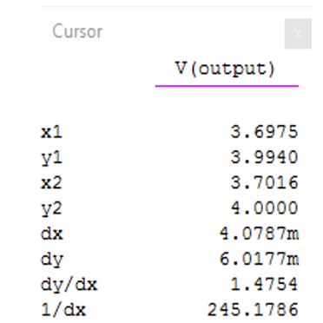
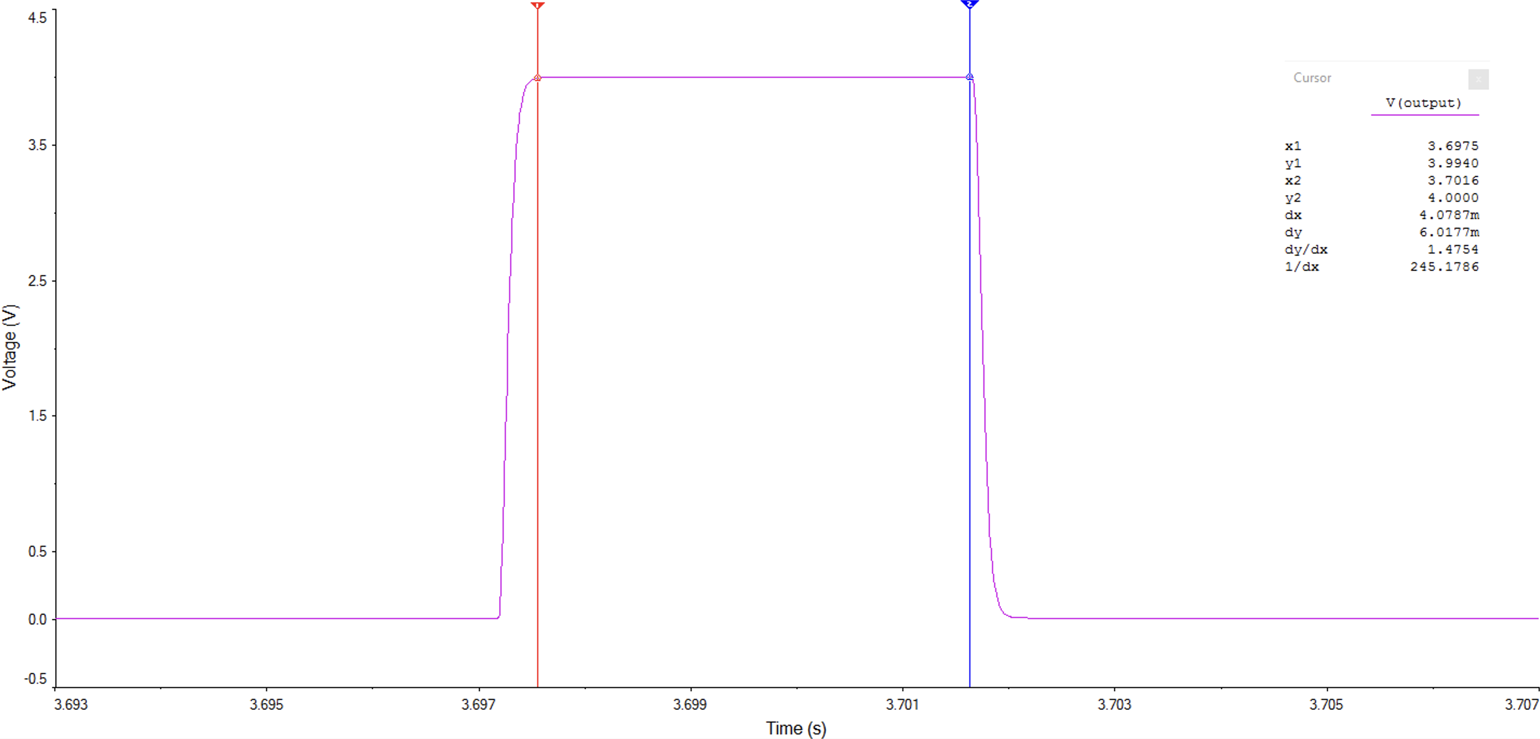
Pulse Width and Shape
Final spike has a pulse width ≈ 4.07 ms
Biological Range: 2–5 ms (typical action potentials)
Amplitude and sharpness maintained through stages
No visible distortion or elongation at transmission end
Ensures biological realism in spike behavior

Slide 21
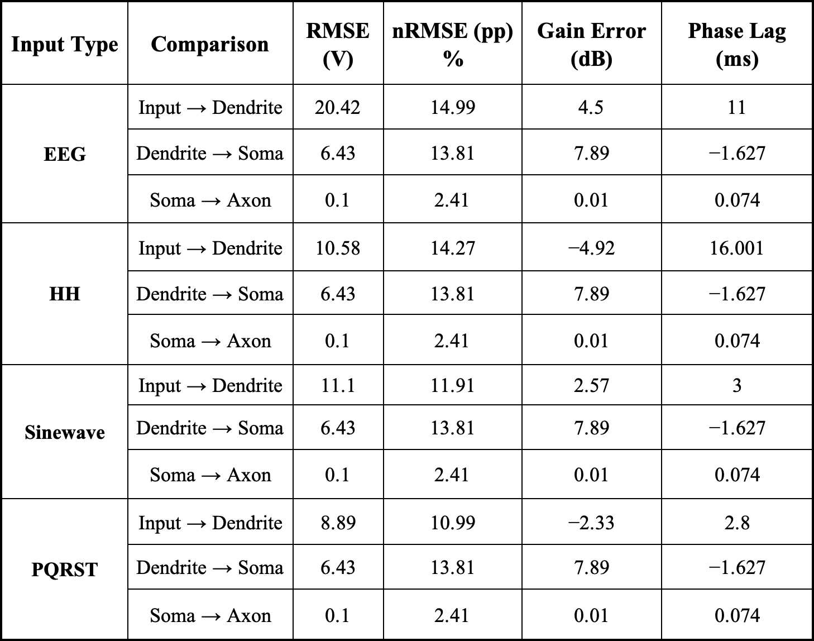
SIGNAL FIDELITY EVALUATION
RMSE / nRMSE(pp):
- Calculated as the difference between input and output waveforms, normalised to peak - to - peak.
- High at Input → Dendrite (filter removes extra parts).
- Very small at Soma → Axon (≈0.1 V, 2.4%) → shape kept well.
Gain Error (dB):
- Found by comparing output and input amplitudes in dB.
- Dendrite → Soma: 7–8 dB (signal reshaped into spikes).
- Soma → Axon: ≈ 0 dB → almost no amplitude change.
Phase Lag (ms):
- Measured as the time difference between input and output peaks.
- Input → Dendrite: 11–16 ms delay (from RC filter).
- Soma → Axon: ≈0.07 ms → almost no delay.

Slide 22
SPIKE TIMING JITTER
Jitter measures variation in spike timing between soma and axon.
Calculated using peak detection and time difference of aligned spikes.
Average jitter ≈ 0.94 ms.
Value lies within biological range (1–2 ms).
Confirms consistent spike transmission with minimal distortion.

Slide 23
Final Model Summary
Inputs: EEG, HH spike, PQRST, Sinewave
Dendrites: RC filters preserve key frequencies
Soma: Comparator triggers clean spikes
Axon: 9-stage RC line + amplifiers (every 3 blocks)
Quantitative measurements comparison with biology.
Complete analog model with realistic signal transmission
Metric | Result (This Work) | Biological Range / Context
Spike Width | 4.07 ms | 2–5 ms (typical action potentials)
Spike Jitter | ≈ 0.94 ms | 1–2 ms (cortical neurons)
SNR Change | Δ ≈ +0.35 dB (soma → axon) | SNR preserved during axonal conduction
RMSE / nRMSE | 0.1 V / 2.4% (soma → axon) | Minimal distortion expected
Gain Error | 7–8 dB (dendrite → soma) ≈ 0 dB (soma → axon) | Amplitude reshaping at soma; preserved in axon
Phase Lag | 11–16 ms (dendrite filter) ≈ 0.07 ms (axon) | Dendrites introduce ms delays; axons transmit with high precision

Slide 24
LimitationS
Built using only ideal circuit elements in simulation → cannot capture real-world noise, thermal drift, or hardware non-linearities
Dendritic and axonal pathways modelled as simplified linear cascades → loses spatial complexity of real neurons
Fixed parameter values (thresholds, time constants, pulse widths) → no plasticity or adaptive behaviours represented
Simulation assumes perfect components and interconnections → ignores impedance mismatches and environmental interference

Slide 25
Future Improvements
Adaptive Thresholding: Feedback-based comparators to model neuronal adaptation/fatigue
Pulse Width & Shape Control: Monostable circuits to vary spike duration and shape
Multi-Input Dendritic Integration: Combine multiple weighted inputs → excitatory & inhibitory modelling
Tuneable Propagation: Adjustable gain/delay to explore axonal conduction velocity
Improved Robustness: Better component selection, shielding, minimising noise

Slide 26
APPLICATIONS
Short-Term (Educational & Research):
Demonstrations of dendrite–soma–axon processing in labs
Transparent testbed for neuromorphic circuit design
Medium-Term (Engineering & Neuromorphic):
Low-power analog front-end for wearable/embedded biosignal processing
Benchmark platform for hybrid analog–digital neuromorphic systems
Long-Term (Biomedical):
Prosthetic spike encoders for EEG/ECG abnormality modelling
Potential adaptation for neuroprosthetics and implantable devices

Slide 27
Thank You!!
Questions?

