Slide 1

Predictive Modeling Approach for California’s Wildfire Threat
Group 33
04/11/2024
Wildfires in California—devastating and more frequent than ever. But what if we could predict them before they happen?
Sneha Manjunath Chakrabhavi
Kruthika Srinivas Vasisht

Slide 2
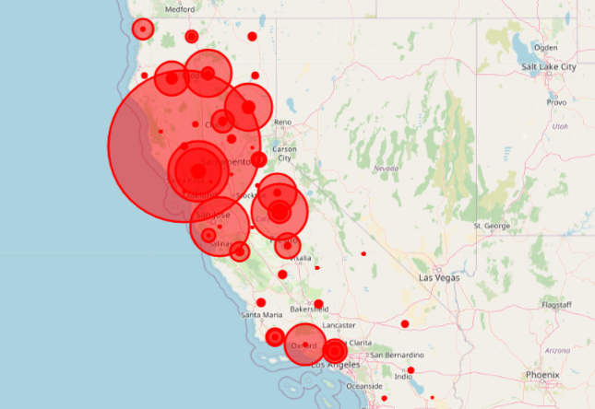
The Rising Threat
Wildfires in California have become more frequent and severe due to climate change and human activities, posing unprecedented challenges to disaster management and response.

Slide 3
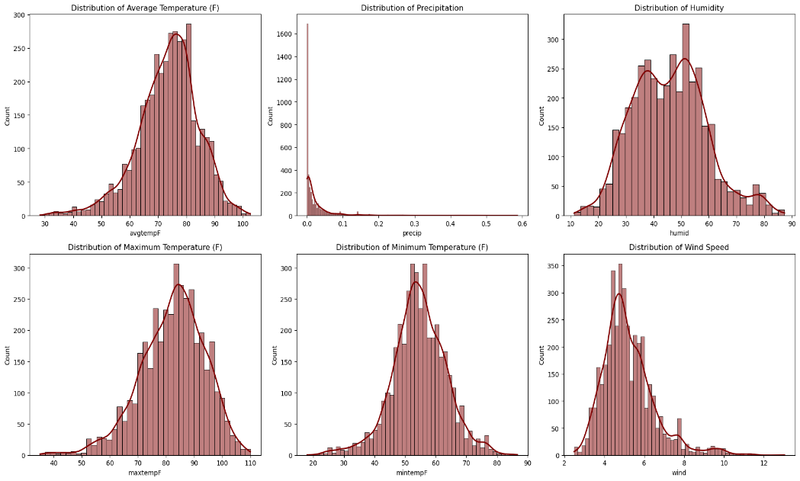
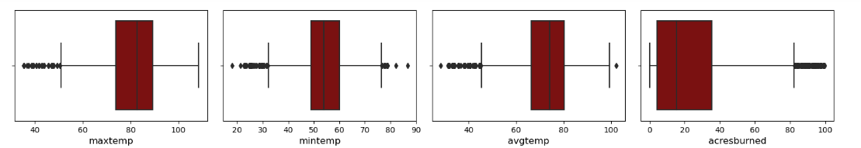
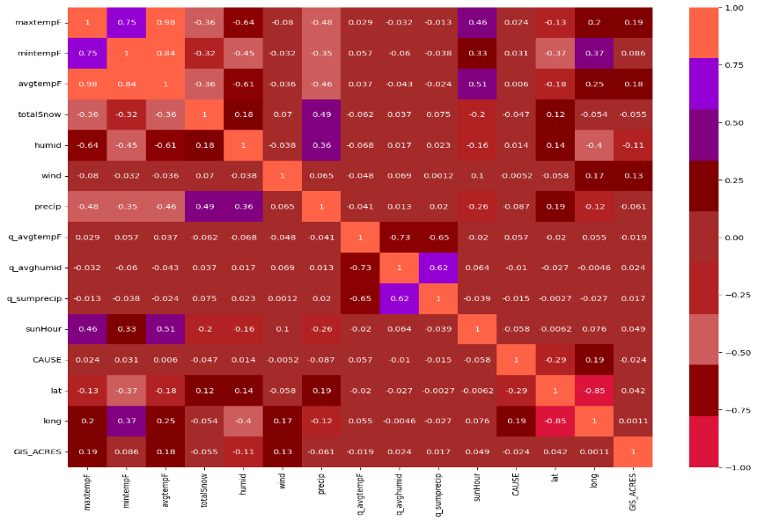
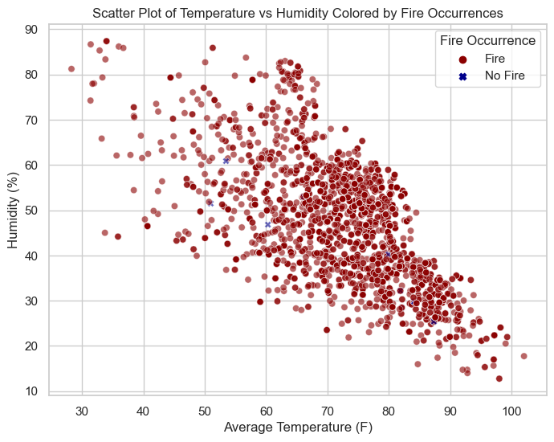
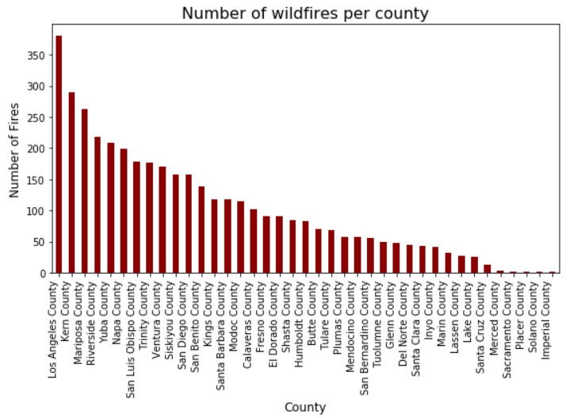
Harnessing Data to Fight Wildfires
Key Data Sources: Detailed historical wildfire records from Kaggle and real-time data from Fire.CA.gov
Data Utilization: Analyzing patterns from over 10,988 unique wildfire events to predict future occurrences
Visualization Techniques: Employing heatmaps and statistical analyses to identify critical factors influencing wildfires

Slide 4
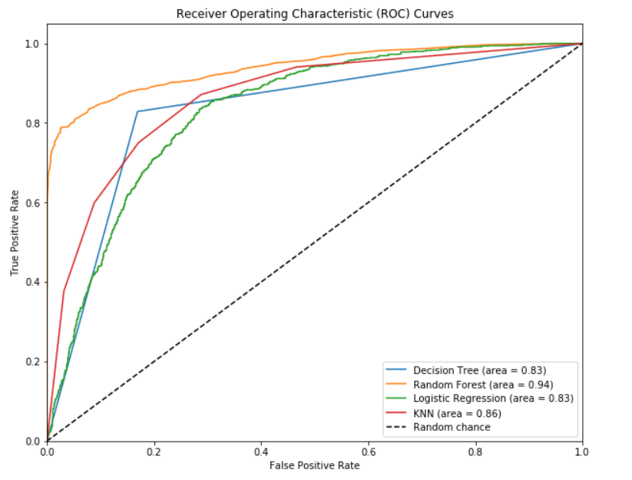
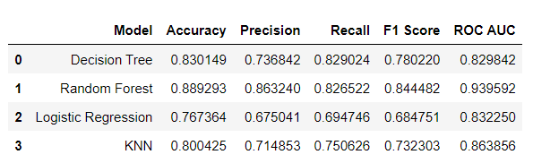
Identifying High-Risk Areas
Our predictive modeling utilizes a suite of sophisticated machine learning algorithms to accurately forecast high-risk wildfire zones
Models Deployed: Random Forest, Logistic Regression, K-Nearest Neighbors (KNN), and Decision Trees—each chosen for their robust performance in binary classification tasks. Best performing model was Random Forest.
Outcome: The ability to proactively identify and prioritize interventions in potential wildfire hotspots significantly enhances disaster readiness and resource allocation

Slide 5
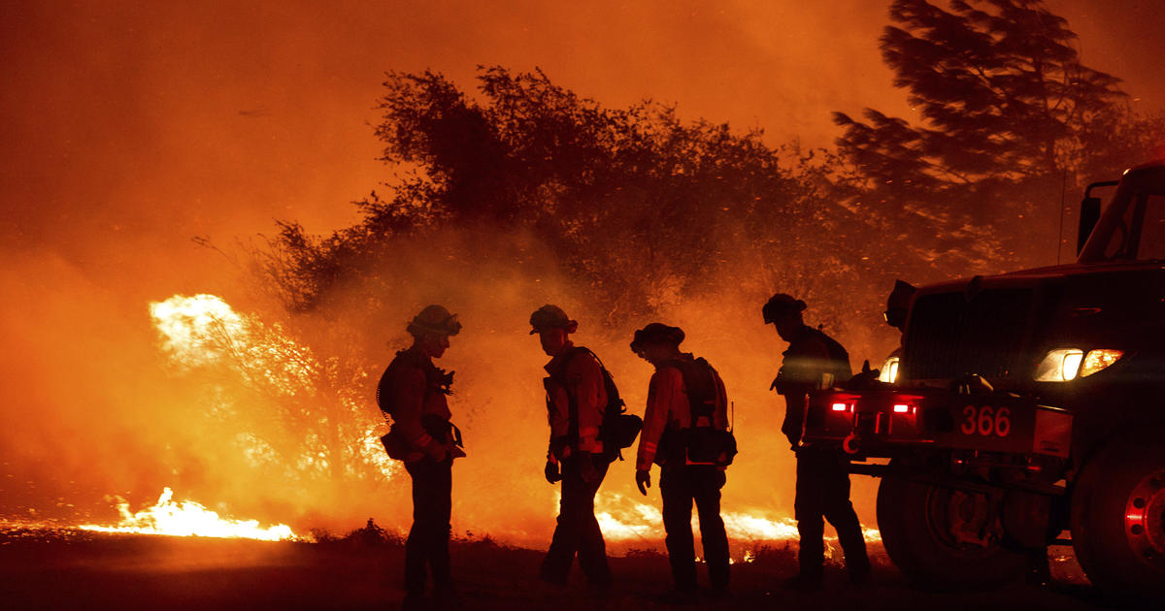
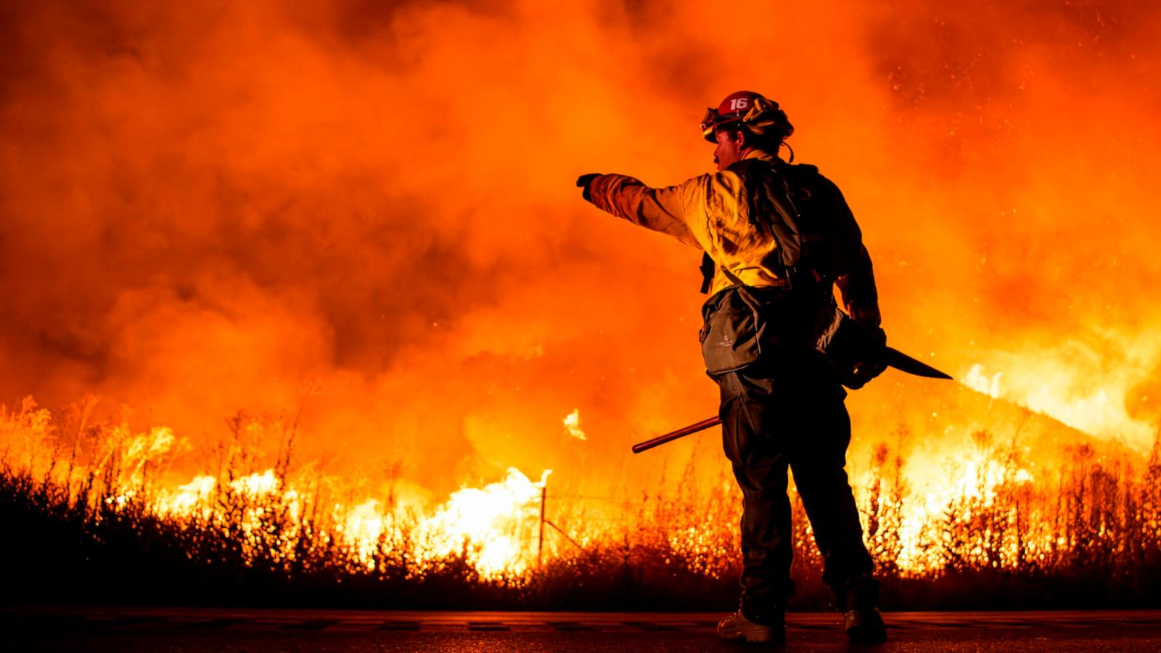
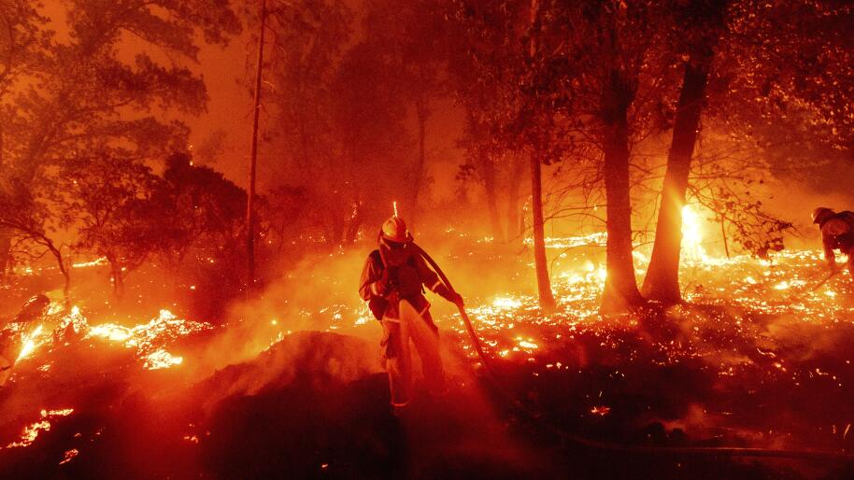
Enhancing Emergency Responses
Efficiency: Predictive insights facilitate faster mobilization of emergency resources
Precision: Targeted interventions in high-risk areas before a fire can spread
Effectiveness: Improved planning and readiness result in significantly reduced damage and faster recovery

Slide 6
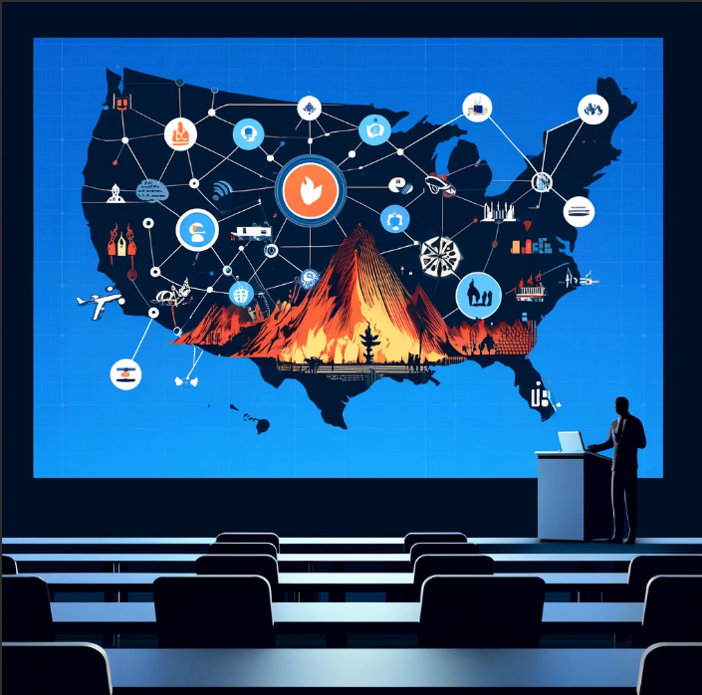

Predict and Protect
Our model not only predicts but also protects. By understanding where and when wildfires are most likely to occur, we equip California with the knowledge to mitigate risks effectively, safeguarding lives, property, and ecosystems.
Let’s Predict and Protect Together:
Join us in refining these models and expanding their reach. Together, we can turn data into action and make California a safer place for all

Slide 7
THANK YOU

