Slide 1
CalorieCheck Management
By
Krutika Deshpande
Nu ID : 001280718

Slide 2
Problem
Now-a-days every individual is health conscious concerned with how many calories they consume and burn each day.
It would be great and very helpful when customers can buy products based on the calories specified and the calories they know they can have.

Slide 3
Solution
The purpose of this project is to develop an application where the manufacturing enterprise creates a product
A Food Lab Enterprise assigns the proteins , fats and carbohydrates to the manufactured product
Based on the nutrition components, calories are assigned to the product
Customer can check the products and order them based on the calorie intake specified to him

Slide 4
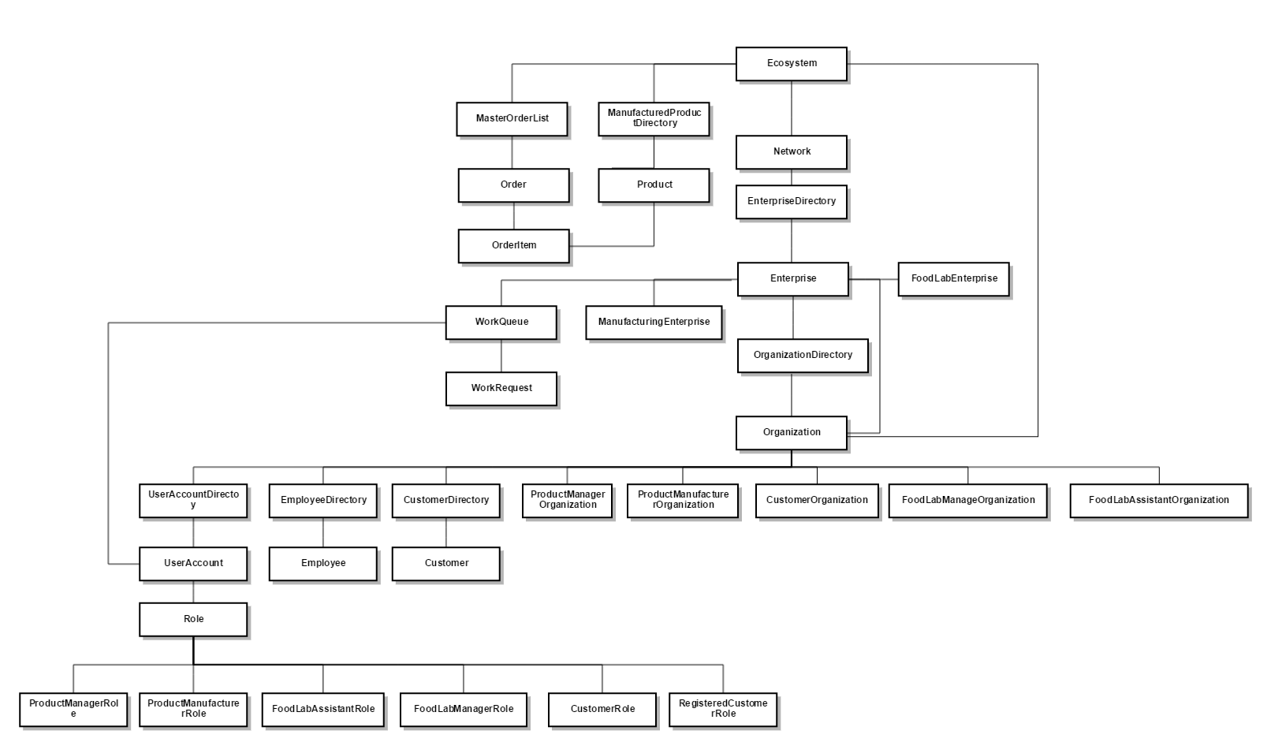
EcoSystem Architecture

Slide 5
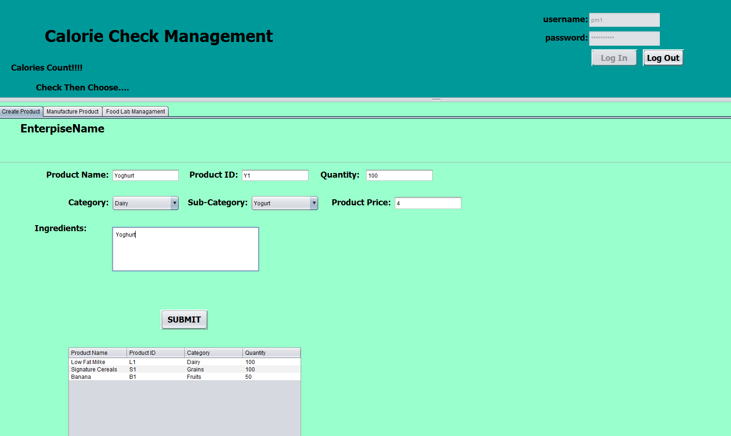
Manufacturer creates Product

Slide 6
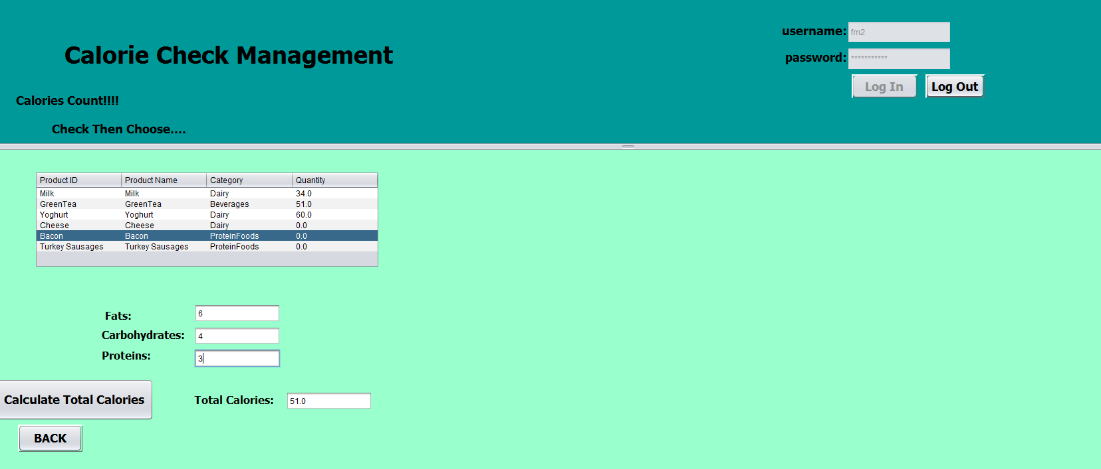
FoodLabAssistant Work Area JPanel

Slide 7
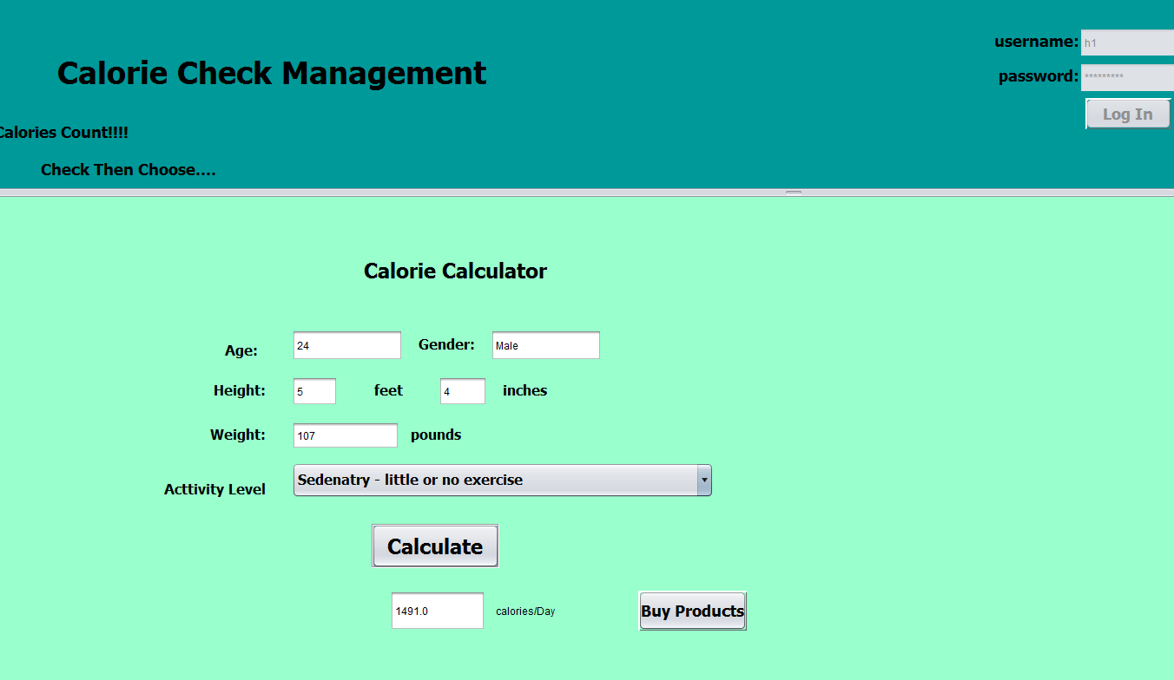
Customer Calorie Calculator

Slide 8
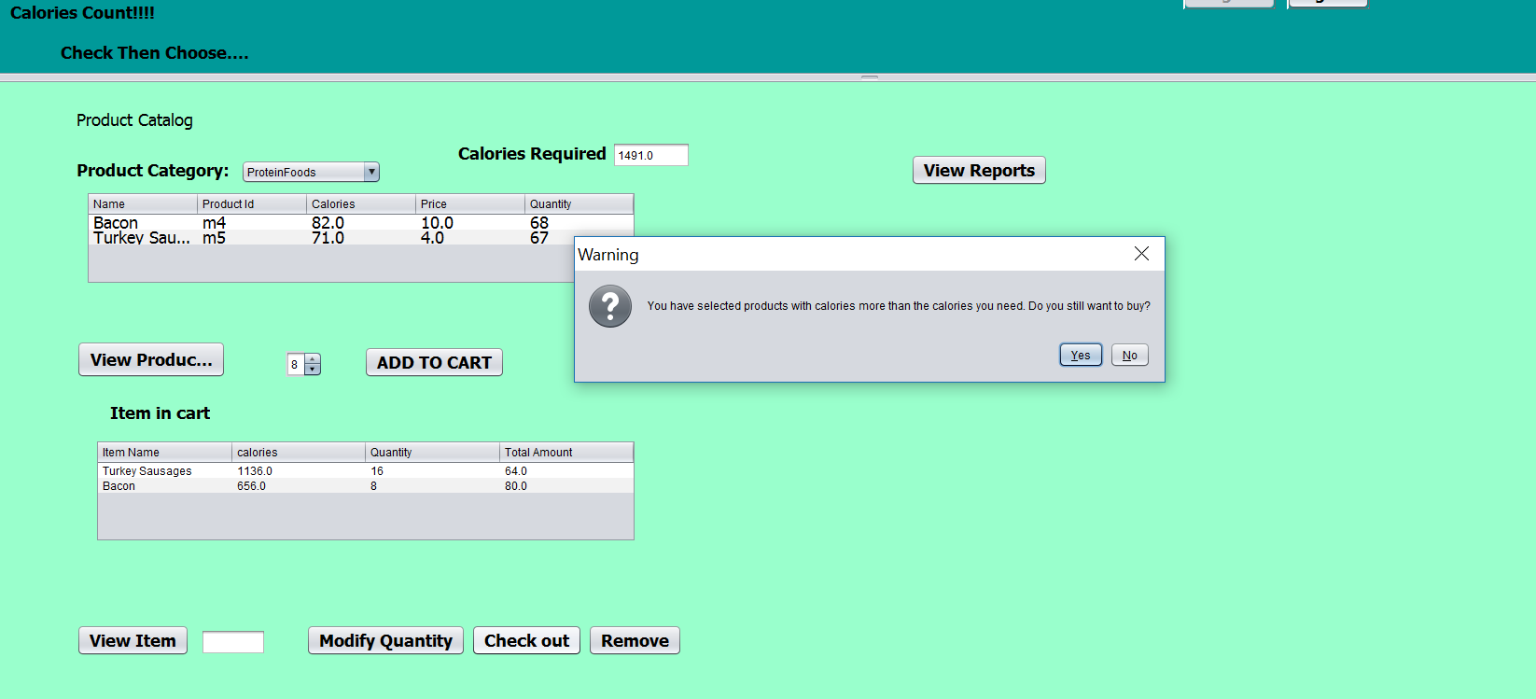
Customer Buy Products

Slide 9
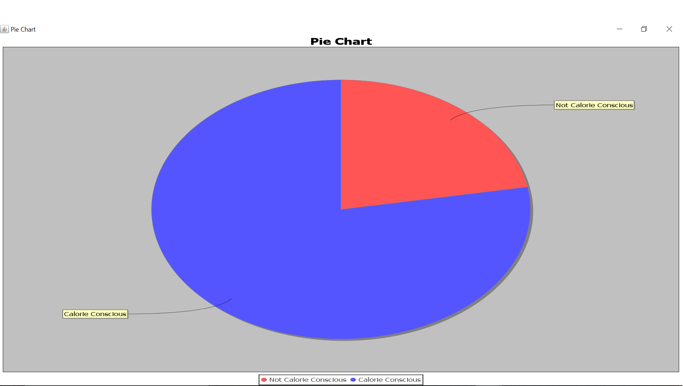
Calorie Conscious Customer Analysis

Slide 10
Future Scope
1. Daily workout duration can be tracked and help the customer get more accurate calorie needs.
2. Dieticians can be included to help customers select proper food products .
Benefits
Customers can buy product on the basis of calories they need.
Product Manufacturing Companies will manufacture low calorie products in more number.
Thank You…

