Slide 1
Retail Store Management System
NU ID: 001280718
Krutika Deshpande

Slide 2
Problem Statement
A retail store sells small quantities of products or services to the public.
This store generally buys products from the manufacturers in large quantities and sells it to the customer with a marked-up price.
The store needs to keep track of the products to be ordered from the manufacturers.
Based on the categories of products, the store should place order to the manufacturers
Customers buy products from the store as per their needs. The store wants to develop a database that will efficiently help to track the data of an entity. (i.e. Product, Supplier, ProductCategory, Orders etc.)

Slide 3
Use Case
Keep track of the orders placed to the SuPPLiers
Track products with quantity below a margin.
TRACK Expired PRODUCTS
Manage the customer buying habits.

Slide 4
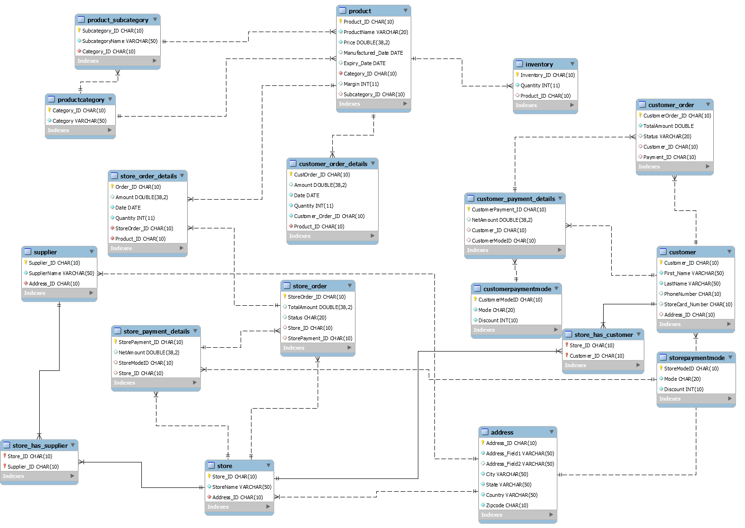

Slide 5
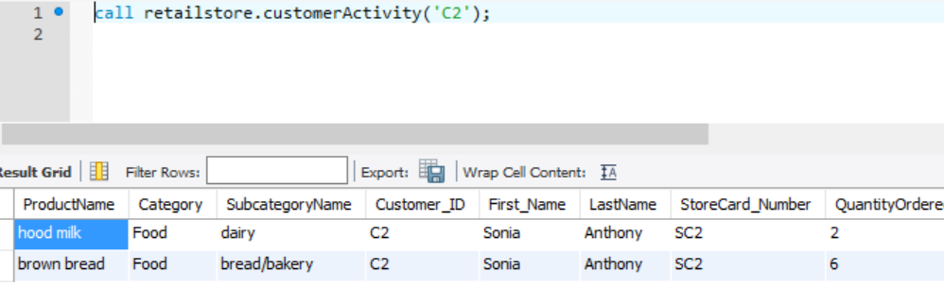
Stored Procedure - CustomerActivity
Tracks customer activity based on the number of products bought and the category of the product.

Slide 6
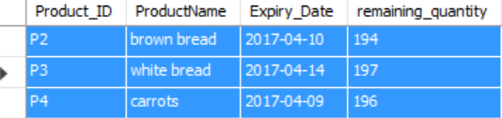
View – Expired Products
Displays the expired products and its remaining quantity

Slide 7
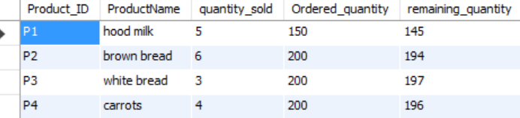
View – Inventory Tracking
Displays the quantity ordered, quantity sold and the remaining quantity

Slide 8
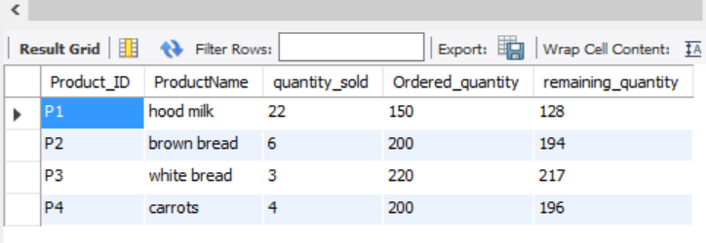
Triggers
To update the amount for the order from store to supplier
To update the amount for the order from customer to store
To track the products remaining in the store inventory

Slide 9
Thank YOU…

