Slide 1
Online Food Order System
Ms Krutika Rangari (219091) Ms Nidhi Pakhan (219112)

Slide 2
Introduction
It is known globally that, in today’s market, it is extremely difficult to start a new small-scale business and live-through the competition from the well-established and settled owners. In fast paced time of today, when everyone is squeezed for time, the majority of people are finicky when it comes to placing a food order. The customers of today are not only attracted because placing an order online is very convenient but also because they have visibility into the items offered, price and extremely simplified navigation for the order.
Online ordering system that we are proposing here, greatly simplifies the ordering process for both the customer and the restaurant. System presents an interactive and up-to-date menu with all available options in an easy to use manner. Customer can choose one or more items to place an order which will land in the Cart. Customer can view all the order details in the cart before checking out. At the end, customer gets order confirmation details. Once the order is placed it is entered in the database and retrieved in pretty much real time. This allows Restaurant Employees to quickly go through the orders as they are received and process all orders efficiently and effectively with minimal delays and confusion.

Slide 3
Scope
For placing any orders customers have to visit hotels or restaurants to know about food items and then place order and pay. In this method time and manual work is required.
While placing an order over the phone, customer lacks the physical copy of the menu item, lack of visual confirmation that the order was placed correctly. Every restaurant needs certain employees to take the order over phone or in-person, to offer a rich dining experience and process the payment. In today’s market, labor rates are increasing day by day making it difficult to find employees when needed.
Hence, to solve this issue, what we propose is an “Online Food Order System”. The main advantage of our system is that it greatly simplifies the ordering process for both the customer and the restaurant and also greatly lightens the load on the restaurant’s end, as the entire process of taking orders is automated.

Slide 4
Technology
We used Java Spring-Boot as backend and React JS as Frontend in our Project.
Spring-Boot :–
The main goal of the Spring Boot framework is to reduce overall development time and increase efficiency. React has become the first choice for frontend because it gives developers the ability to work with a virtual browser (more friendly than the real browser). Also, a JavaScript developer can become a productive developer in a few hours because there is a small API to learn, a few functions, and how to use them…
React :–
React allows developers to create large web applications that can change data, without reloading the page. The main purpose of React is to be fast, scalable, and simple. Spring

Slide 5
Modules
Admin
Restaurant Employee
User
Delivery Boy
Delivery Boy

Slide 6
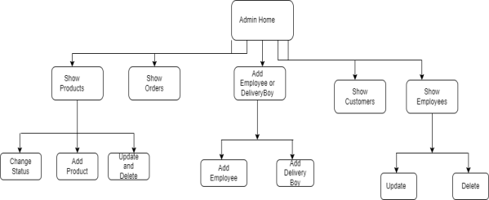
ADMIN
Add, Modify and Delete Category: Allows to add or update and delete food Category name .
Add, Modify and Delete Product: Allows to add or update and delete Product Name, Description, Price and choose particular Category .
Manages Restaurant Employee and Delivery Boy : Provides User Id and Password.

Slide 7
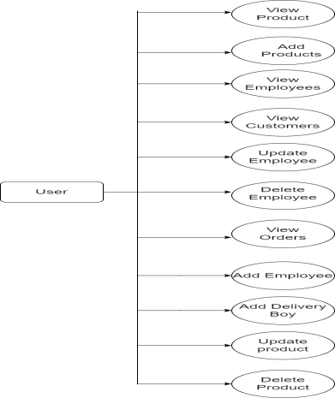
USE CASE DIAGRAM FOR ADMIN

Slide 8
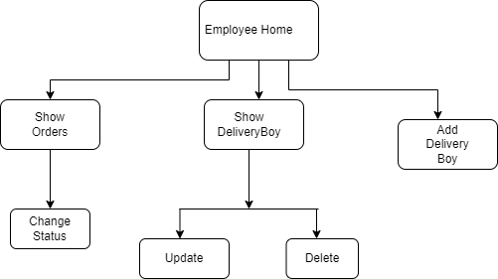
EMPLOYEE
Manages Delivery Boy: Allows to add or update and delete Delivery Boy profile. Also provides Id and password to the Delivery Boy.
Update Delivery status: Allows to change the delivery status from Pending to Delivered after the order is delivered.
Monitor the Orders : Keeps the track of all the orders.

Slide 9
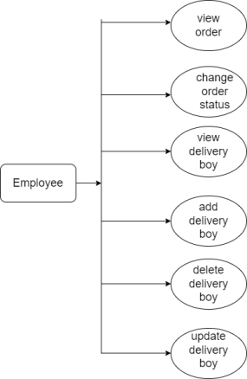
USE CASE DIAGRAM FOR EMPLOYEE

Slide 10
USERS
Customers of the Web Ordering system will interact with the application through an easy to use top navigation menu.
“Home” menu option: allows the users to select an item to place an order.
“Menu” option: Allows users to see all food items per category.
“My Cart (x)”menu option:
Allows users to see details of the items placed in cart. Details include Category, Product Name, Product Description, Price. It also allows to Remove item from cart . User can then use a submit order button to proceed further.
Once, Submit Order button is selected, user will be prompted to add address method . If the address already exist user can select ‘use existing address’ button .

Slide 11
Once, button is selected, user will be prompted for the payment method . Cash on delivery or Card payment.
User will then be presented with a “My Order” page, which will display order details to review. User can then use a ‘Place Order’ button to place an order.
Once order is placed, user will be presented with appropriate Order confirmation success/failure message.

Slide 12
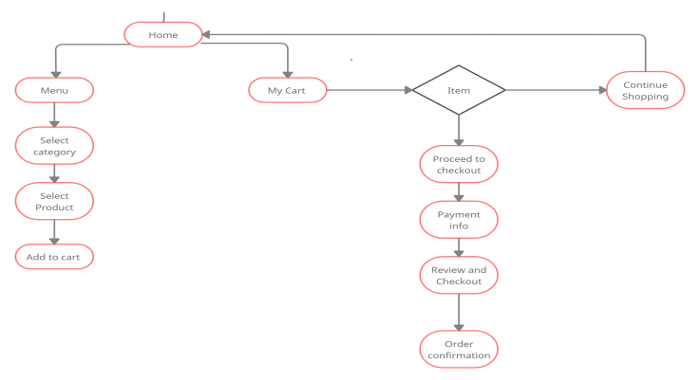

Slide 13
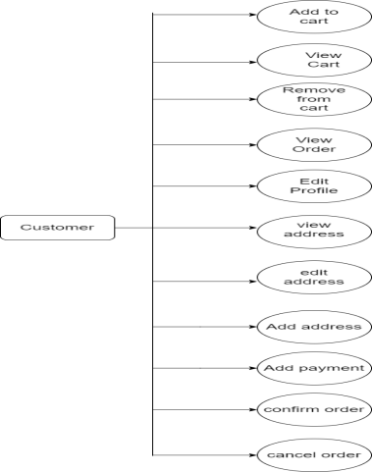
USE CASE DIAGRAM FOR USERS

Slide 14
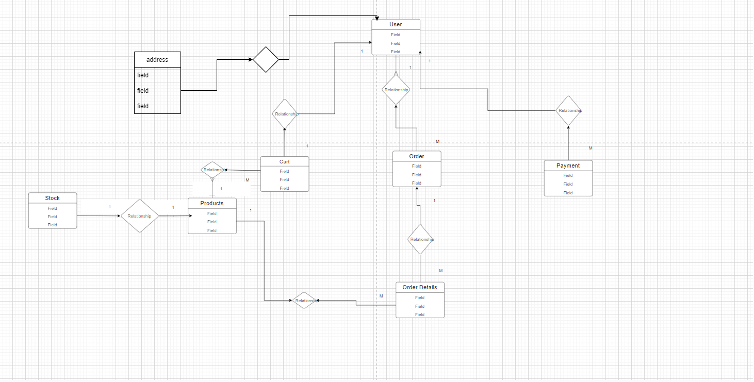
ER-DIAGRAM

Slide 15
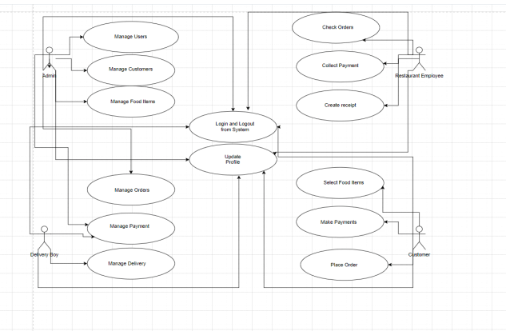
USE CASE DIAGRAM

Slide 16
Table 1: Addresses
Field | Type | Null | Key | Default | Extra
id | int | NO | PRI | NULL | Auto_increment
address_line_1 | varchar(45) | YES |  | NULL
address_line_2 | varchar(45) | YES |  | NULL
city | varchar(30) | YES |  | NULL
country | varchar(30) | YES |  | NULL
pincode | varchar(10) | YES |  | NULL
state | varchar(30) | YES |  | NULL
user_id | int | NO | MUL | NULL

Slide 17
Table 2: Users
Field | Type | Null | Key | Default | Extra
id | int | NO | PRI | NULL | Auto_increment
email | varchar(30) | YES | UNI | NULL
first_name | varchar(30) | YES |  | NULL
last_name | varchar(30) | YES |  | NULL
password | varchar(200) | NO |  | NULL
phone | varchar(10) | YES |  | NULL
role | varchar(100) | YES |  | NULL

Slide 18
Table 3: Cart
Field | Type | Null | Key | Default | Extra
id | int | NO | PRI | NULL | Auto_increment
cart_amt | double | YES |  | NULL
quantity | int | NO |  | NULL
product_id | int | NO | MUL | NULL
user_id | int | NO | MUL | NULL

Slide 19
Table 4: Order_details
Field | Type | Null | Key | Default | Extra
id | int | NO | PRI | NULL | Auto_increment
price | double | YES |  | NULL
quantity | int | YES |  | NULL
order_id | int | YES | MUL | NULL
product_id | int | YES | MUL | NULL

Slide 20
Table 5: Orders
Field | Type | Null | Key | Default | Extra
id | int | NO | PRI | NULL | Auto_increment
order_date | datetime(6) | YES |  | NULL
order_status | varchar(25) | YES |  | NULL
total_price | double | YES |  | NULL
customer_id | int | YES | MUL | NULL

Slide 21
Table 5: Payment
Field | Type | Null | Key | Default | Extra
id | int | NO | PRI | NULL | Auto_increment
amount | double | NO |  | NULL
payment_type | varchar(30) | YES |  | NULL
status | varchar(30) | YES |  | NULL
user_id | int | YES | MUL | NULL

Slide 22
Table 5: Products
Field | Type | Null | Key | Default | Extra
id | int | NO | PRI | NULL | Auto_increment
category_type | varchar(30) | YES |  | NULL
description | varchar(200) | NO |  | NULL
name | varchar(30) | YES |  | NULL
price | double | NO |  | NULL
status | varchar(20) | YES |  | NULL

Slide 23
Customer login

Slide 24
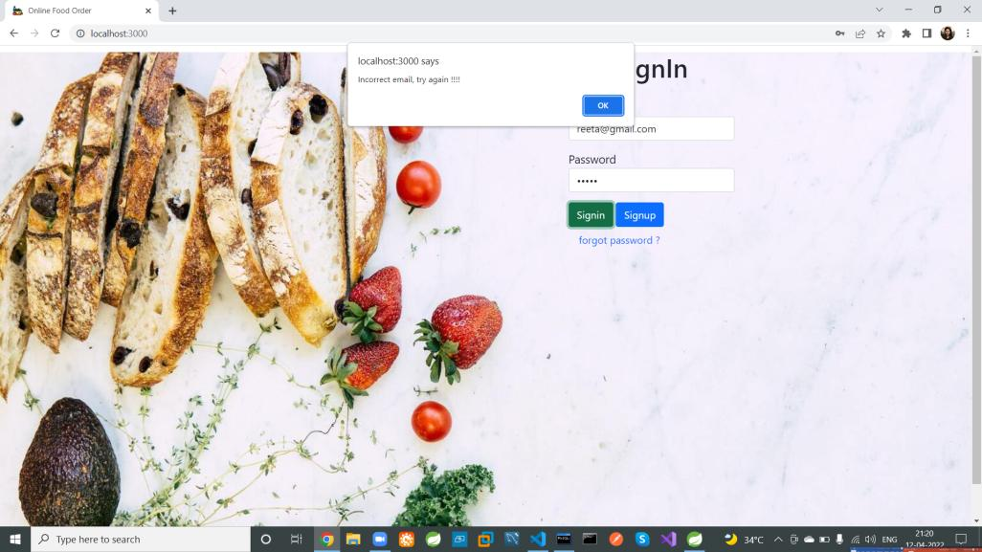

Slide 25


Slide 26
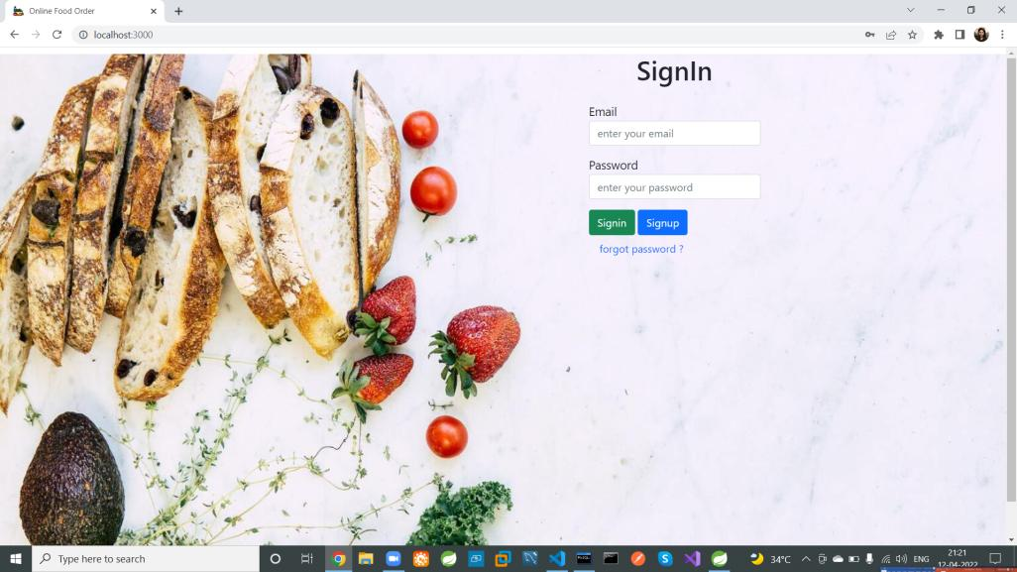

Slide 27
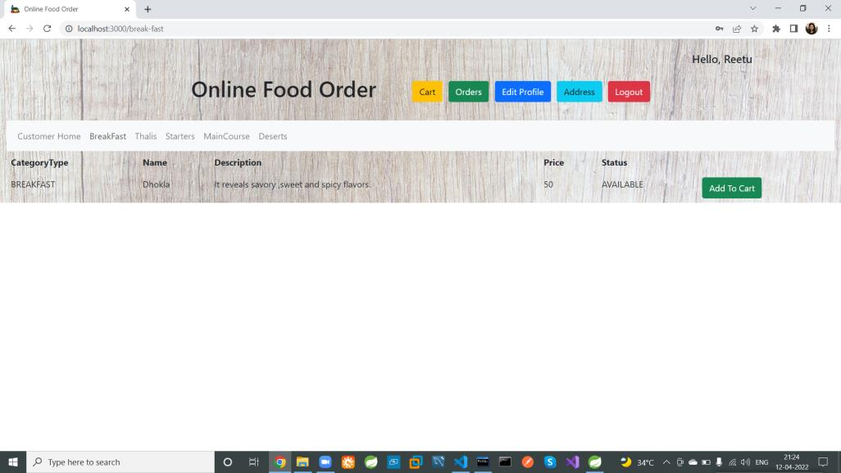

Slide 28
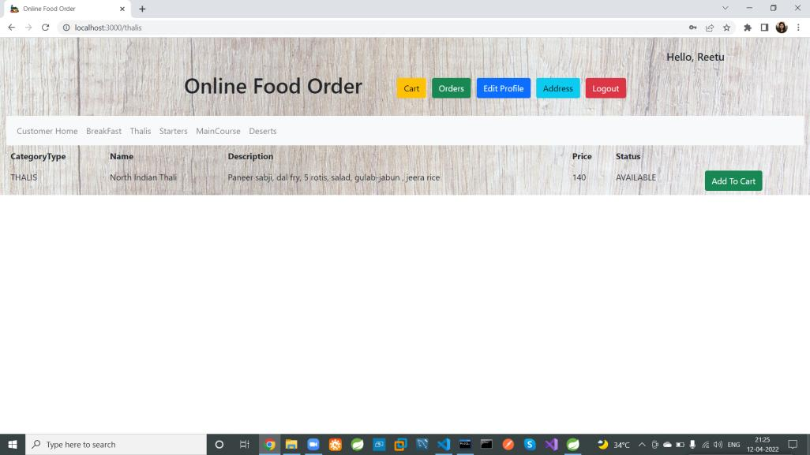

Slide 29
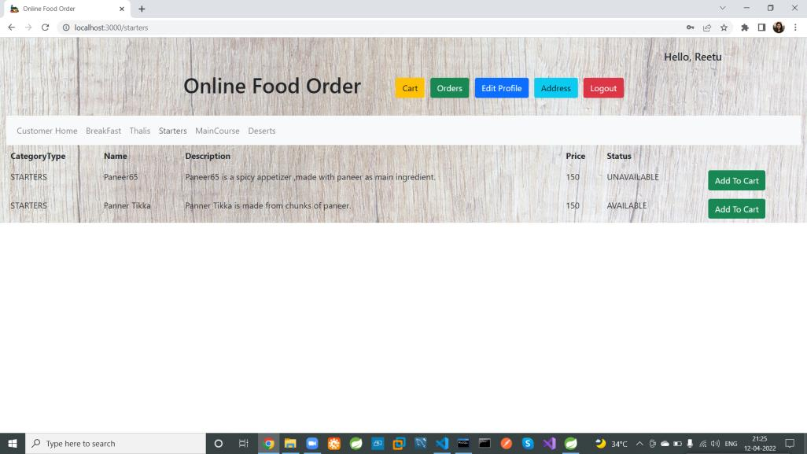

Slide 30
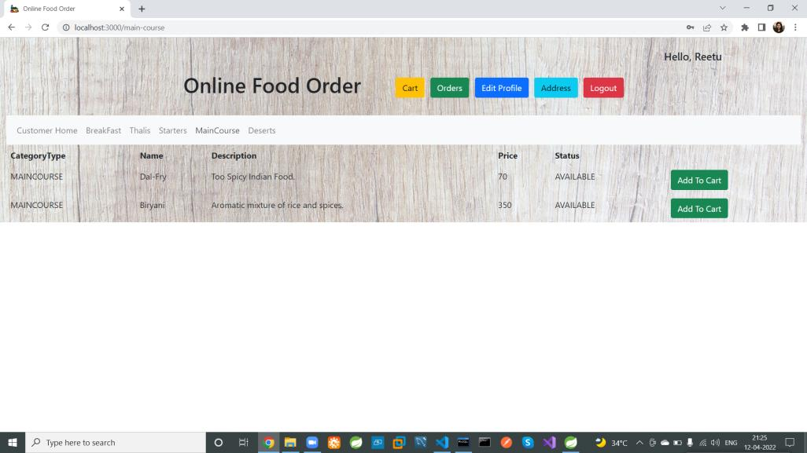

Slide 31


Slide 32
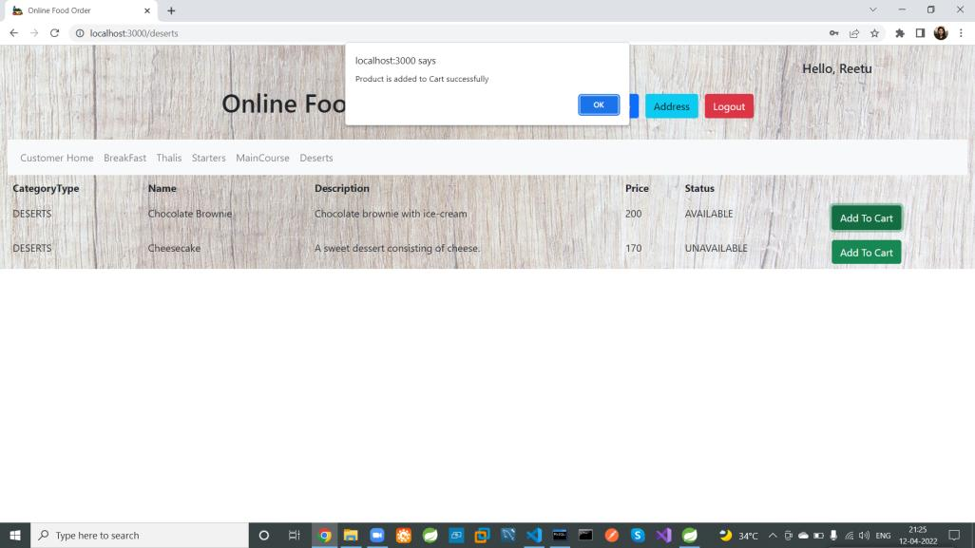

Slide 33


Slide 34
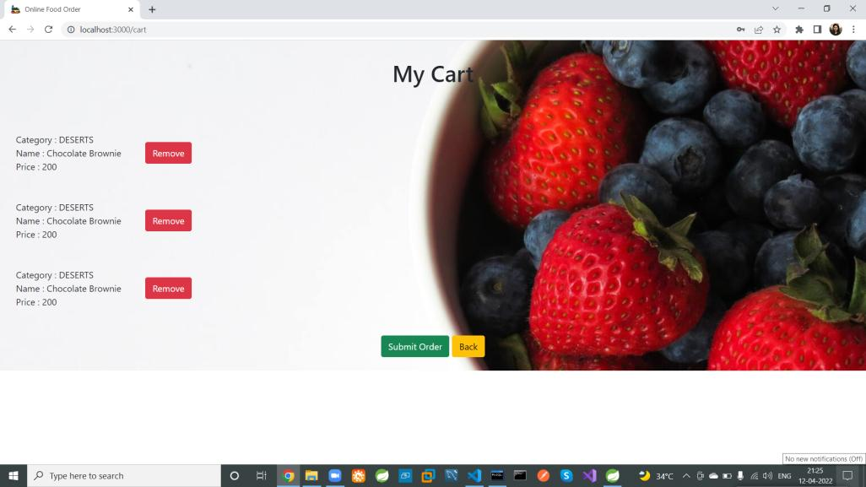

Slide 35
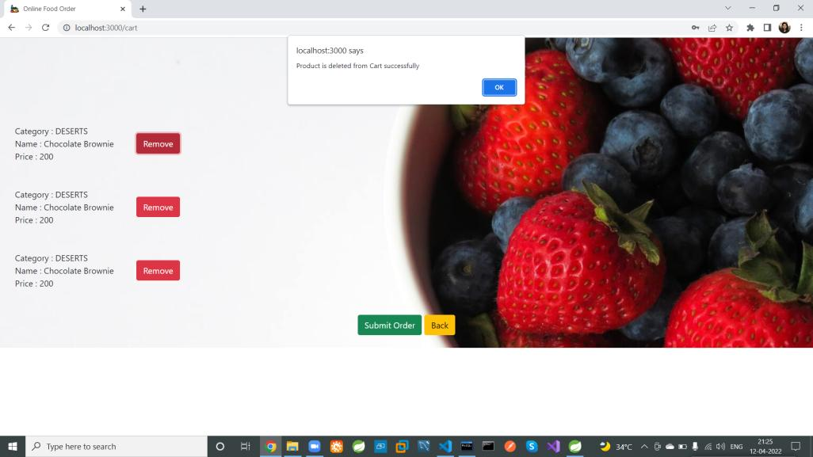

Slide 36
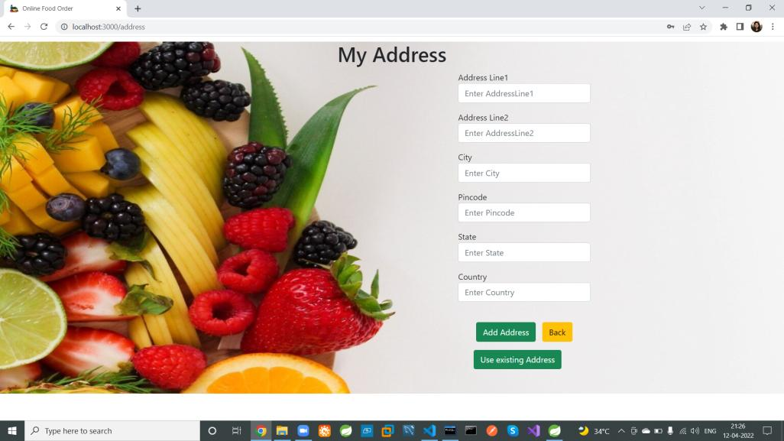

Slide 37
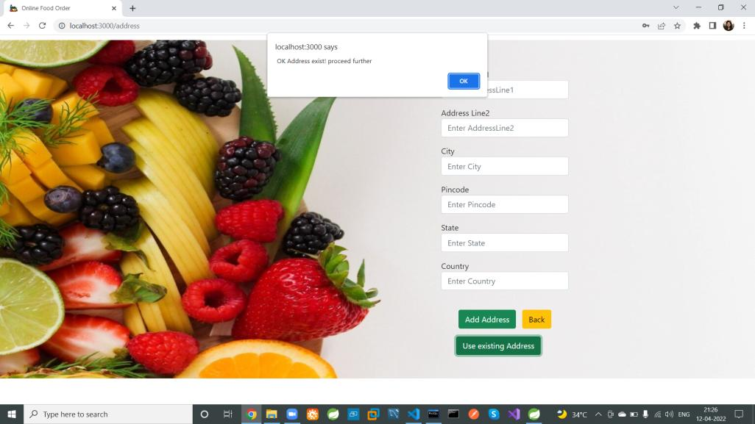

Slide 38
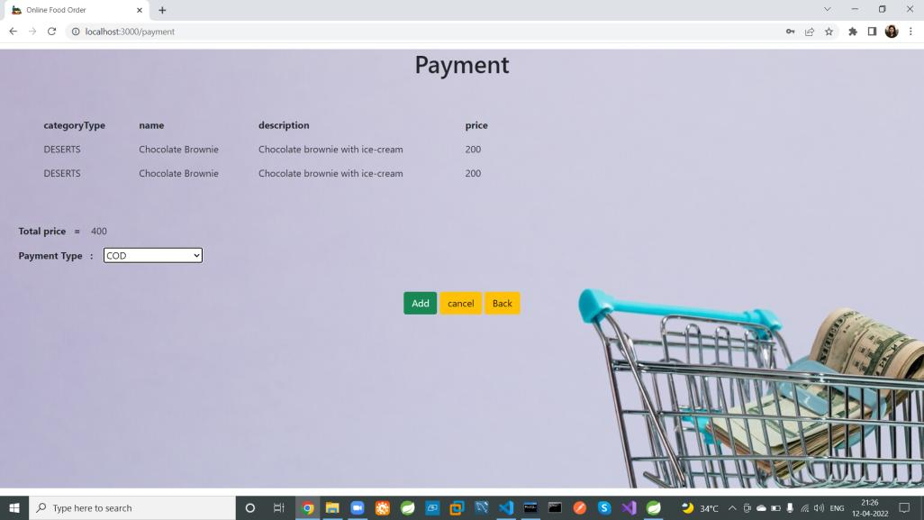

Slide 39
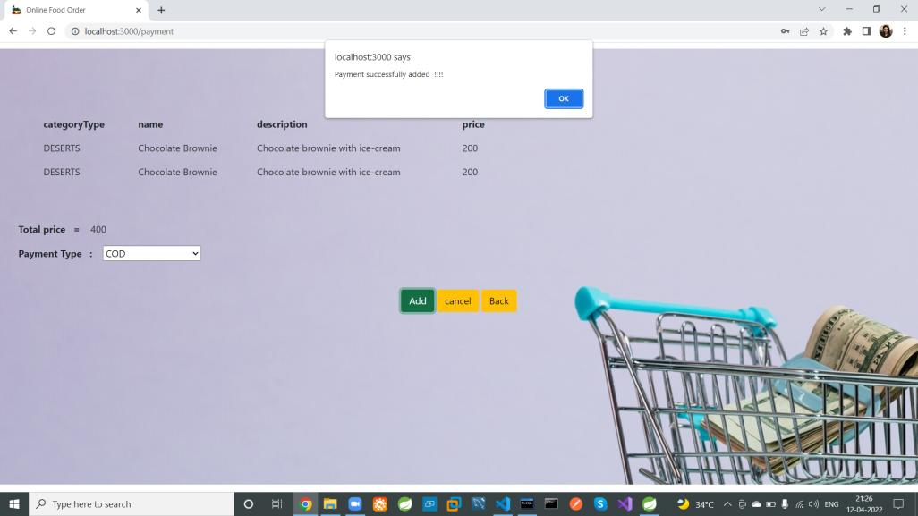

Slide 40
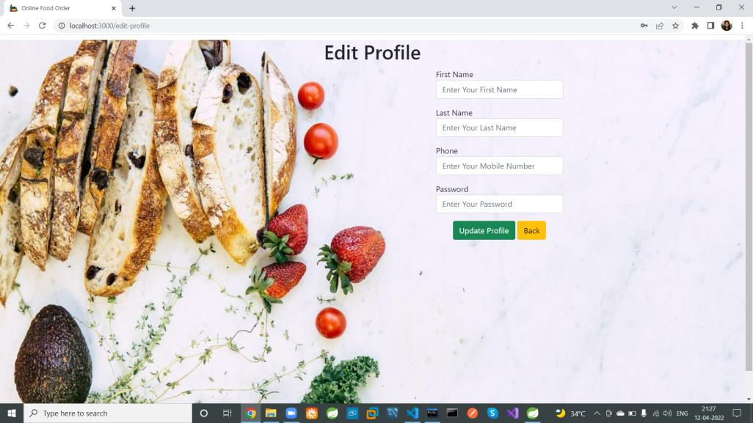
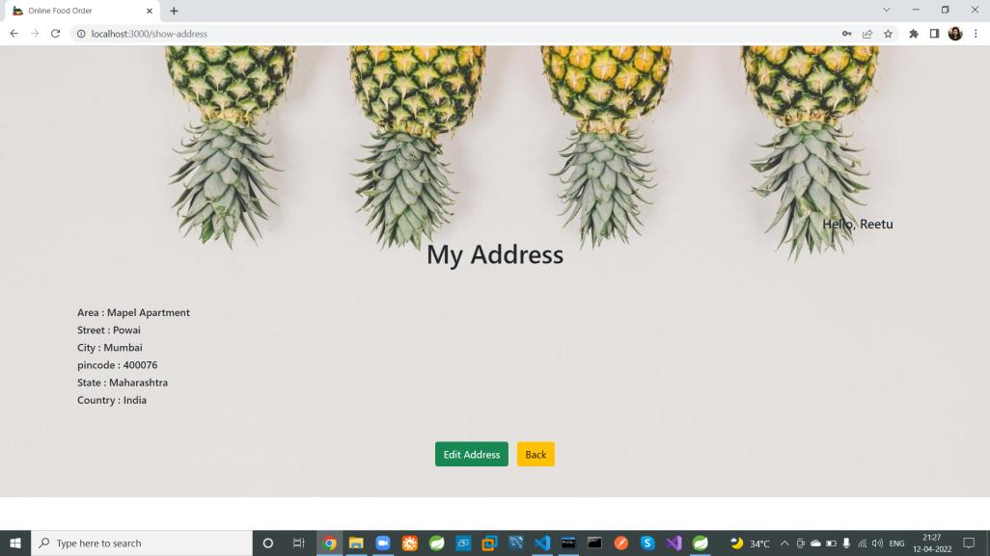
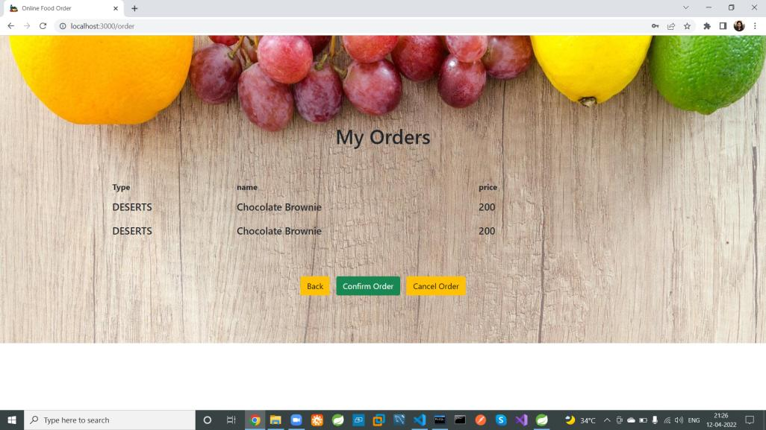
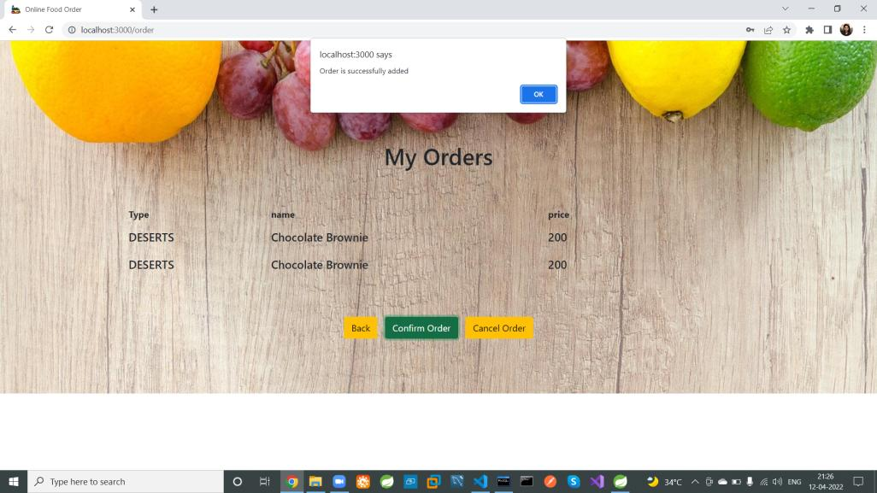

Slide 43
Restaurant Employee Login

Slide 44
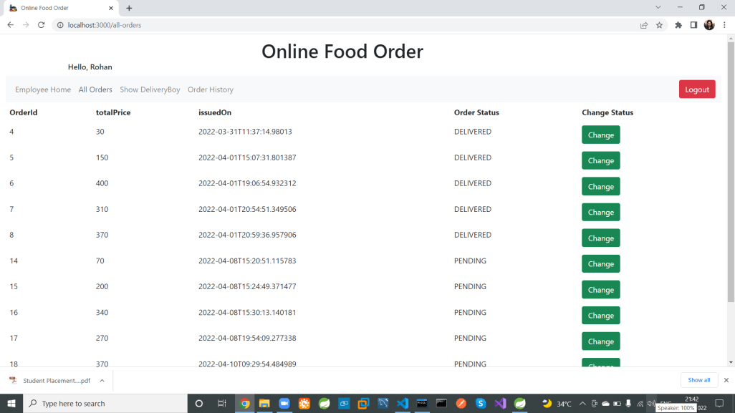

Slide 45
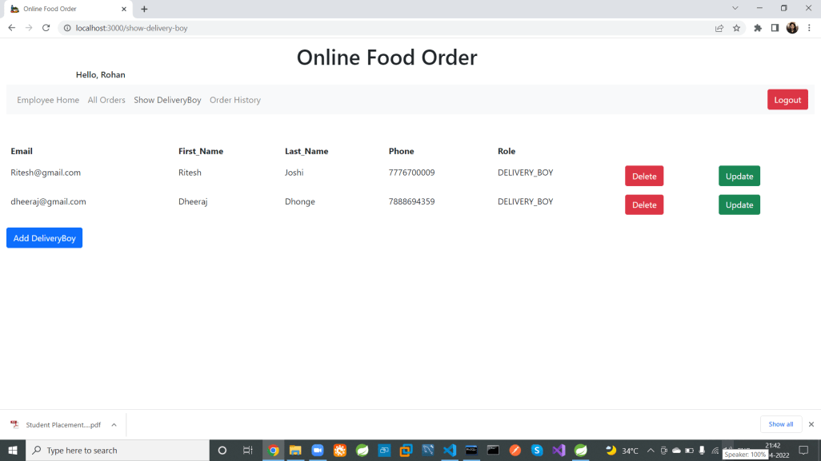

Slide 46
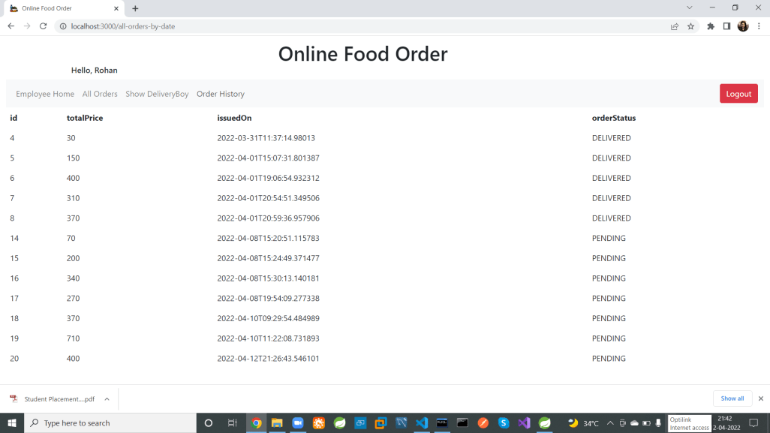

Slide 47
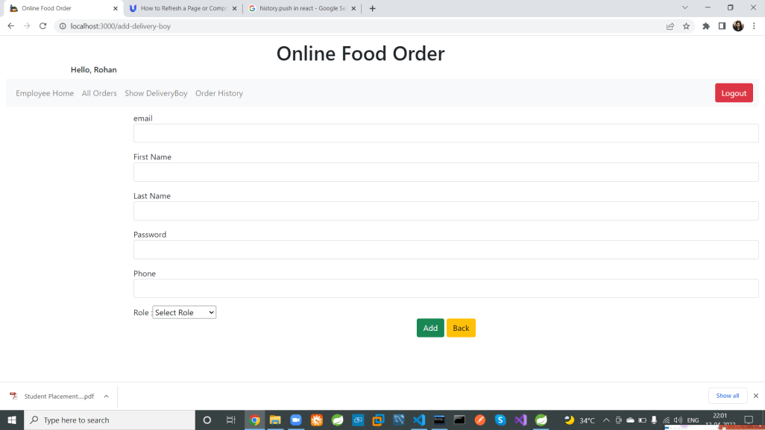

Slide 48
Admin Login

Slide 49
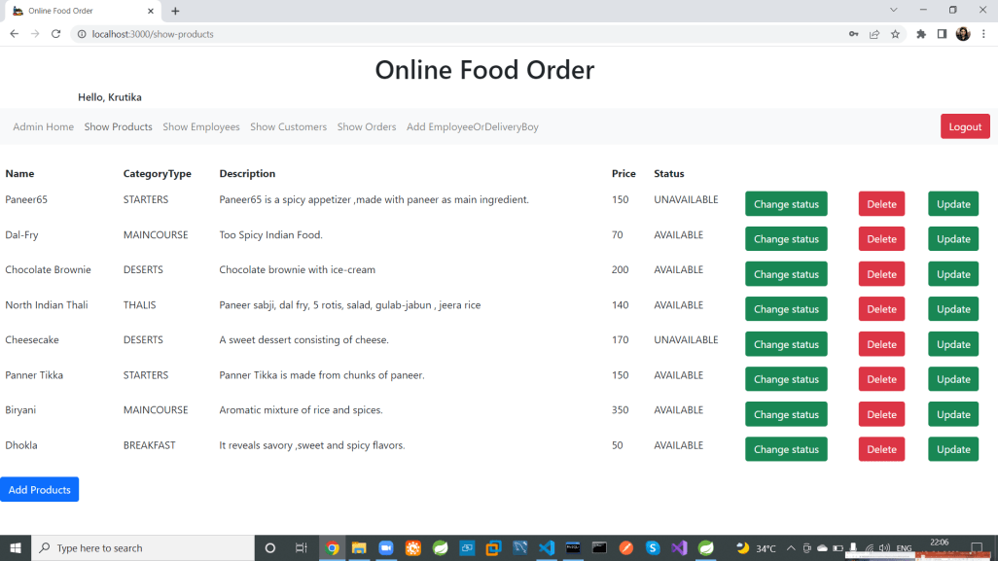

Slide 50
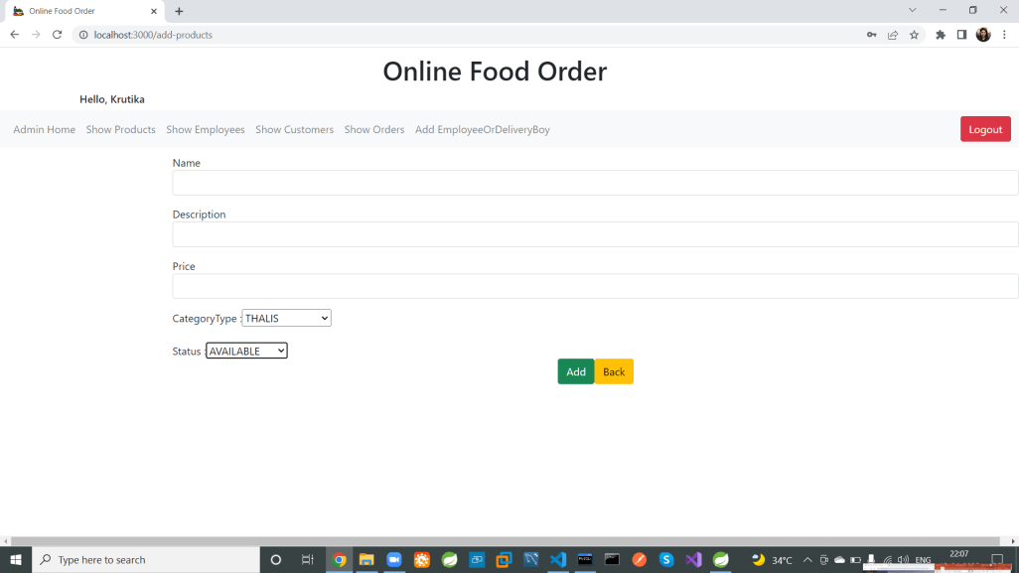

Slide 51
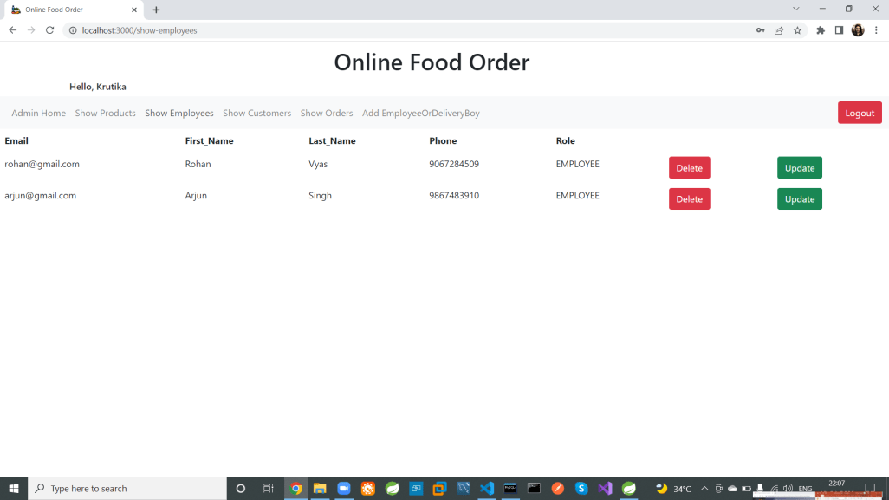

Slide 52
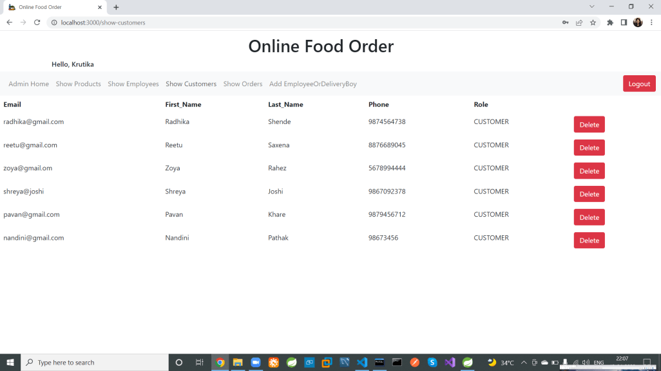

Slide 53
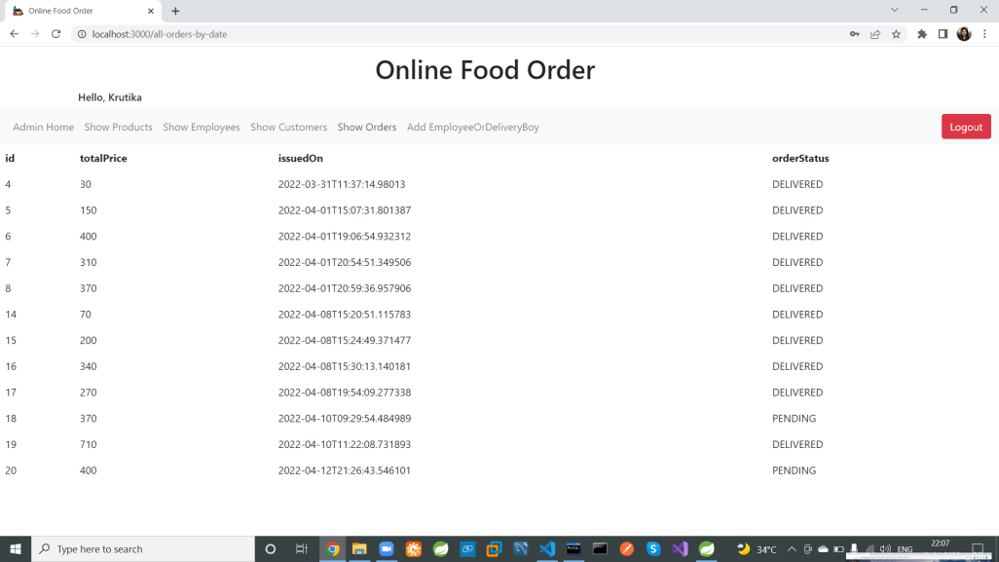

Slide 54
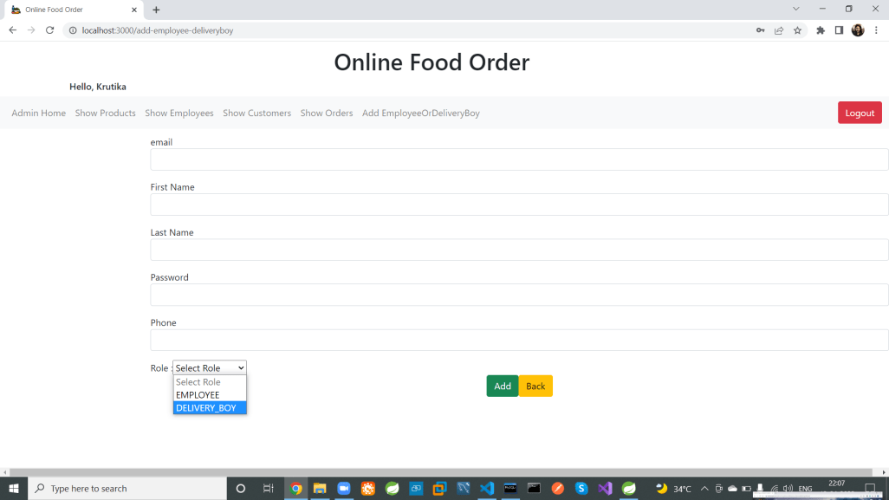

Slide 55
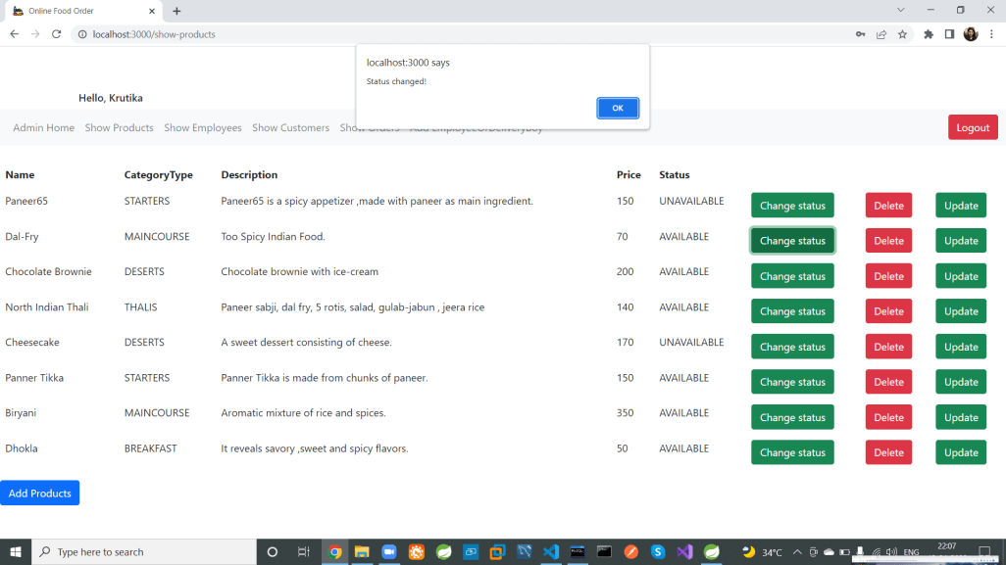

Slide 56
Delivery Boy Login

Slide 57
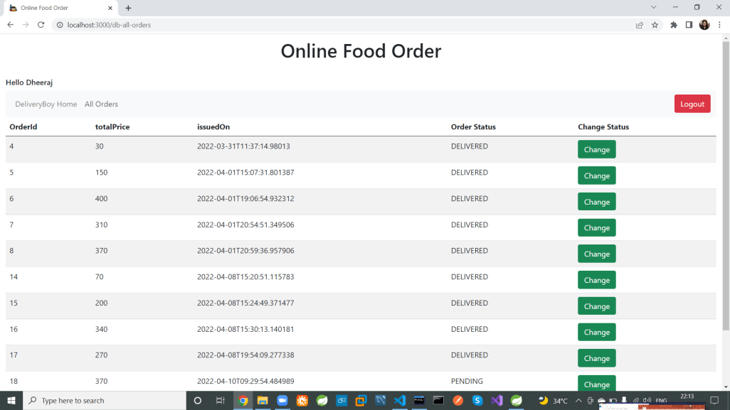

Slide 58
Thank You

