Slide 1


CAPSTONE PROJECT
HOUSE PRICE PREDICATION
PRESENTED BY
STUDENT NAME: KRUTIKA MOHANTY
COLLEDE NAME: TRIDENT ACADEMY OF TECHNOLOGY
DEPATMENT: COMPUTER SCIENCEAND TECHNOLOGY(CST)
Email ID : krutikamohanty2005@gmail.com
AICTE STUDENT ID : STU681a20a8818551746542760

Slide 2
OUTLINE
Problem Statement (Should not include solution)
Proposed System/Solution
System Development Approach (Technology Used)
Algorithm & Deployment
Result (Output Image)
Conclusion
Future Scope
References

Slide 3
Problem Statement
Predicting house prices accurately is challenging due to:
1. Multiple influencing factors (e.g., location, square footage, number of
bedrooms, nearby facilities, etc.)
2.Dynamic market conditions (e.g., inflation, demand supply fluctuations,
etc.)
3.Human bias in manual valuation.
This project aims to develop a machine learning-based model that can analyse
real estate data and predict house prices with high accuracy, reducing human
error and providing reliable estimates.

Slide 4
Proposed Solution
The proposed system aims to address the challenges of accurate house price prediction by leveraging data analytics and machine learning techniques. The solution will analytics historical property data, identify key pricing factors, and provide reliable estimates to buyers, sellers, and real estate professionals. The framework consists of the following components:
1. Data collection
. Historical Property Data:
. Collect datasets with features like areas, bedrooms, bathrooms, etc .
. Source data can be used from real estate platform (e.g., Kaggle , Zillow) or APIs for better testing and training of
the code.
. External Factors :
. Integrate supplementary data like Neighbourhood crime rates, school ratings, and proximity to public transport to
enhance accuracy.
2. Data Collection :
. Data Cleaning:
. Handle missing values using imputation (e.g., median for numerical features) or removal.
. Detect and mitigate outliers (e.g., mansions priced anomalously low).
3. Machine Learning Model
. Algorithm Selection:
. Baseline Model: Linear Regression (for interpretability and benchmarking).
o Advanced Model: Random Forest/XGBoost (to capture non-linear relationships

Slide 5
. Key Features for Prediction:
. Primary: Area, Location, Bedrooms.
. Secondary: Market Trends, Seasonality (e.g., prices dip in winter).
4.Deployment
User Interface:
. Develop a web app (Flask/Streamlit) where users input property details to get instant price estimates.
. Example input: [Area=1500 sqft, Location=Suburban, Bedrooms=3] → Output: Predicted Price: $450,000.
. Scalability:
. Deploy on cloud platforms (AWS/Heroku) for real-time predictions.
5. Evaluation & Improvement
. Performance Metrics:
. R² Score: Measure variance explained (target: >0.85).
. MAE/RMSE: Quantify average prediction errors (e.g., MAE < $10,000).
.Continuous Learning:
. Retrain the model quarterly with fresh transaction data.
.Incorporate user feedback to refine features (e.g., add "Home Condition" as a new variable).

Slide 6
System Approach
.Data Collection:
The first step involves gathering the dataset required for the project. For house price prediction, this data may include features like area, number of bedrooms, bathrooms, location, etc.
.Data Preprocessing:
Raw data often contains missing values, inconsistent formats, or irrelevant information. In this step, missing values are handled (either filled or removed), data types are corrected (e.g., converting area to numeric), irrelevant or duplicate data is removed, categorical variables (like location) may be encoded numerically for model compatibility.
. Exploratory Data Analysis (EDA):
EDA helps understand the patterns and relationships in the dataset. This step includes visualizing data distributions (using histograms, graphs, etc.), checking for correlations between variables, identifying outliers or unusual trends.
.Feature Selection:
Not all collected data may be useful for prediction. In this step, the most relevant features (independent variables) that significantly affect the target variable (house price) are selected, and irrelevant or weakly correlated features are dropped to improve model performance.
. Model Selection (Linear Regression):
Based on the problem type (predicting a continuous value), an appropriate machine learning model is chosen i.e., Linear Regression. It is a simple yet effective model for predicting numerical outcomes like house prices.

Slide 7
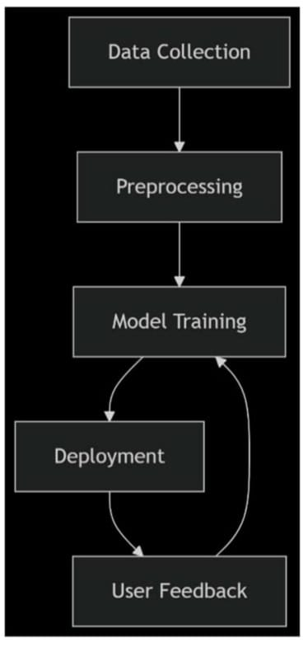
.Model Training and Testing:
The dataset is split into ‘Training Set’ which is used to train the model and learn patterns and ‘Testing Set’ which is used to evaluate the model's performance on unseen data. The model learns the relationship between features and target price during training.
.Performance Evaluation:
After training, the model's predictions are compared with actual values using evaluation metrics like ‘R² Score’ which indicates how well the model explains the variability in house prices, ‘Mean Absolute Error (MAE)’ which helps to get the average difference between predicted and actual prices, and ‘Mean Squared Error (MSE)’ which measures the squared difference for error sensitivity. These metrics help assess if the model is reliable and accurate.

Slide 8
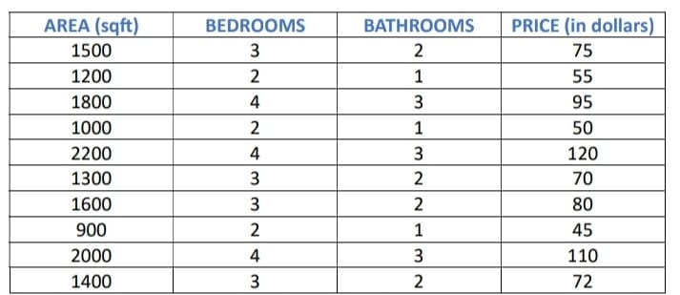
Algorithm & Deployment
The dataset contains information such as:
1. Area (sq. ft.)
2. Number of Bedrooms
3. Number of Bathrooms
4. Price (target variable)
A sample dataset is taken for the testing and training of the AI. The dataset is as follows:

Slide 9
THE FOLLOWING CODE USED ON THE DATA SET
# Importing Libraries
import pandas as pd
import numpy as np
import matplotlib.pyplot as plt
import seaborn as sns
from sklearn.model_selecƟon import train_test_split
from sklearn.linear_model import LinearRegression
from sklearn.metrics import r2_score, mean_absolute_error,
mean_squared_error
# Loading Dataset
df = pd.read_csv('house_data.csv’)
# Display first few rows
print(df.head())
# Checking for null values
print(df.isnull().sum())
# Filling or Dropping Nulls (if any)
df.dropna(inplace=True)
# Exploratory Data Analysis
Sns.pairplort(df)
Plt.show()

Slide 10
# Correlation Heatmap
sns.heatmap(df.corr(), annot=True)
plt.show()
# Feature Selection
X = df[['Area', 'Bedrooms', 'Bathrooms']] # Example features
y = df['Price'] # Target variable
# Spliƫng Data
X_train, X_test, y_train, y_test = train_test_split(X, y, test_size=0.2, random_state=42)
# Model Training
model = LinearRegression()
model.fit(X_train, y_train)
# Prediction
y_pred = model.predict(X_test)
# Model Evaluation
print("R2 Score:", r2_score(y_test, y_pred))
print("Mean Absolute Error:", mean_absolute_error(y_test, y_pred))
print("Mean Squared Error:", mean_squared_error(y_test, y_pred))
# Visualizing Actual vs Predicted Prices
plt.scatter(y_test, y_pred)
plt.xlabel('Actual Price')
plt.ylabel('Predicted Price')
plt.title('Actual vs Predicted House Prices')
plt.show()

Slide 11
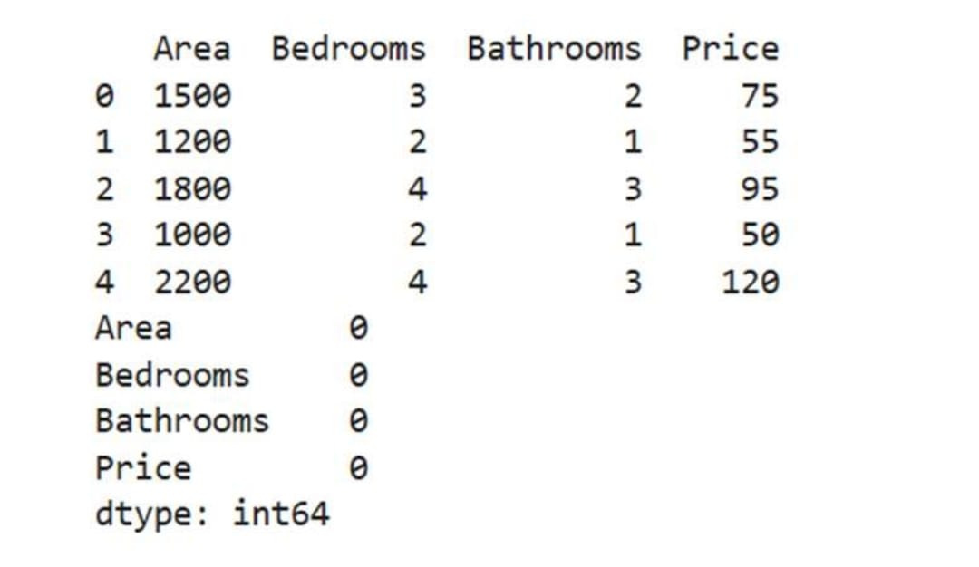
Result

Slide 12
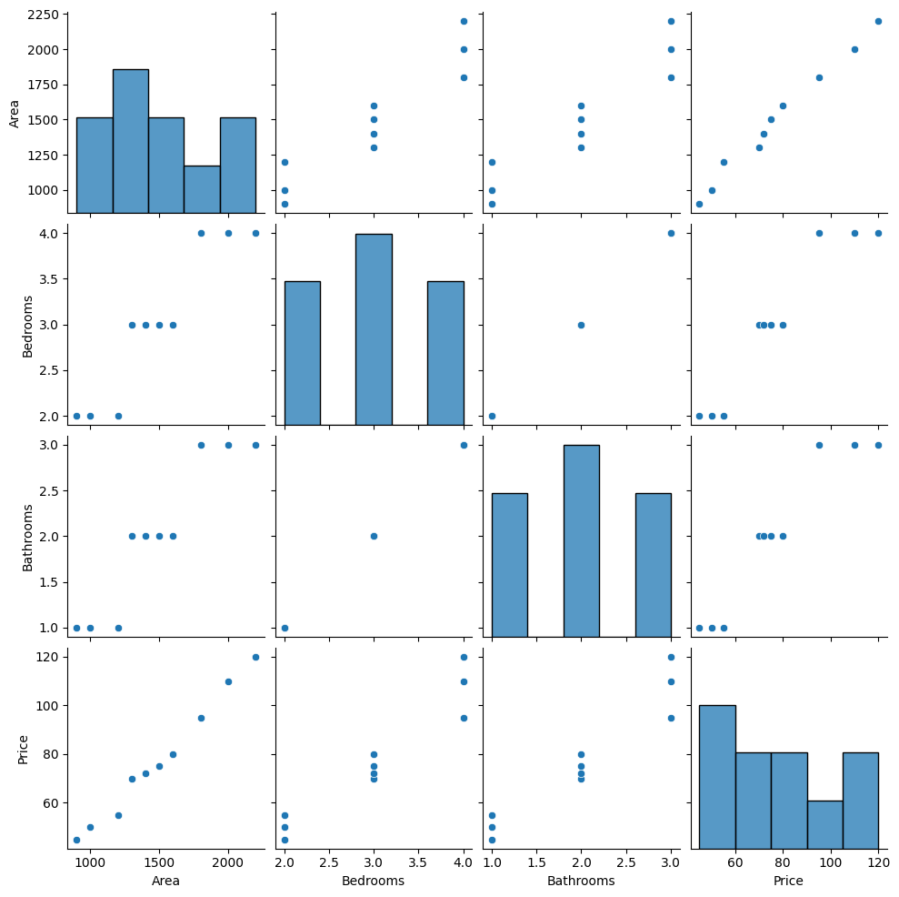

Slide 13
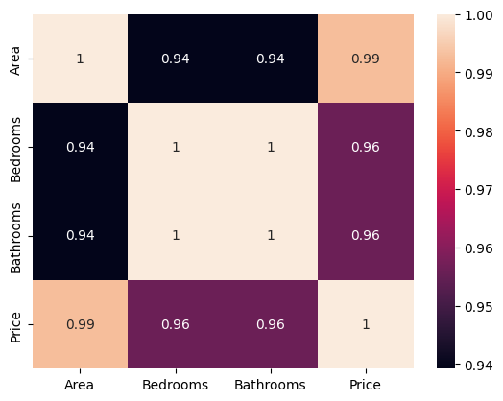
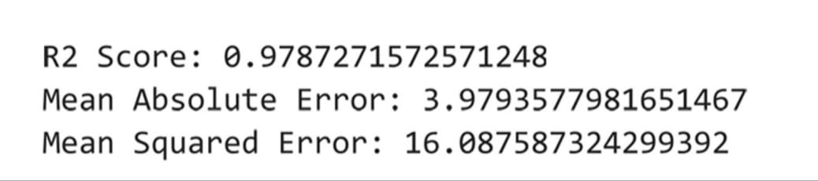
Pair-plot relationships: Linear relationships between all features and price justify using Linear Regression. Larger homes (Area) consistently command higher prices.
Heat map correlation:
Area has the highest correlation with price (0.99 → near-perfect linear relationship). Bedrooms and bathrooms are also strongly correlated with price (0.94–0.97)
.

Slide 14
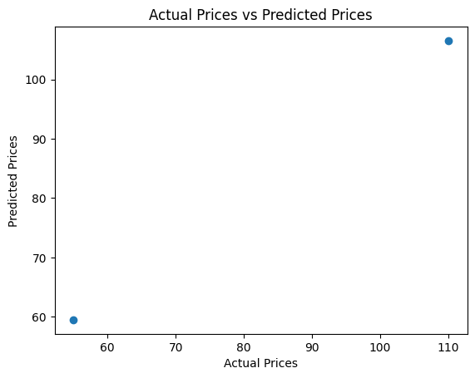
Key Observations:
1. Exceptional R² Score (0.978) indicates the model fits the data almost perfectly.
2. Low errors (MAE: $3.979) suggest high practical accuracy for real-world use.
Pointer cluster tightly around the ideal line (scope=1),confirming model accuracy .

Slide 15
Conclusion
The project successfully implemented a machine learning model to predict house prices. The Linear Regression model provided a reasonable prediction accuracy, demonstrating the usefulness of AI/ML in real estate price estimation.

Slide 16
Future scope
The house price prediction system can be enhanced by integrating advanced models like neural networks or ensemble methods to improve accuracy. Real-time data feeds from property APIs and economic indicators (e.g., interest rates) could dynamically update predictions. Expanding into geospatial analysis (proximity to amenities) and climate risk assessment (flood zones) would add depth, while deploying a user-friendly web/mobile app with explainable AI (SHAP values) would make the tool accessible to buyers and agents. Future work could also extend the model to commercial real estate and rental yield prediction, leveraging blockchain for transparent data logging.

Slide 17
References
This project was made possible with the help of online tools and guides. The machine learning model was built using Scikit-learn, a popular Python library for AI tasks. For handling and organizing the data, we used Pandas and NumPy. To create charts and graphs, we relied on Matplotlib and Seaborn. The housing data came from Kaggle, a free website with ready-to-use datasets. We also learned key techniques from Python’s official guides and beginner-friendly machine learning tutorials.
GitHub Link: https://github.com/KrutikaMohanty2005/HOUSE_PRICE_PREDICTION

Slide 18
Thank you

