Slide 1
Plum
Assignment –Data Analyst

Slide 2
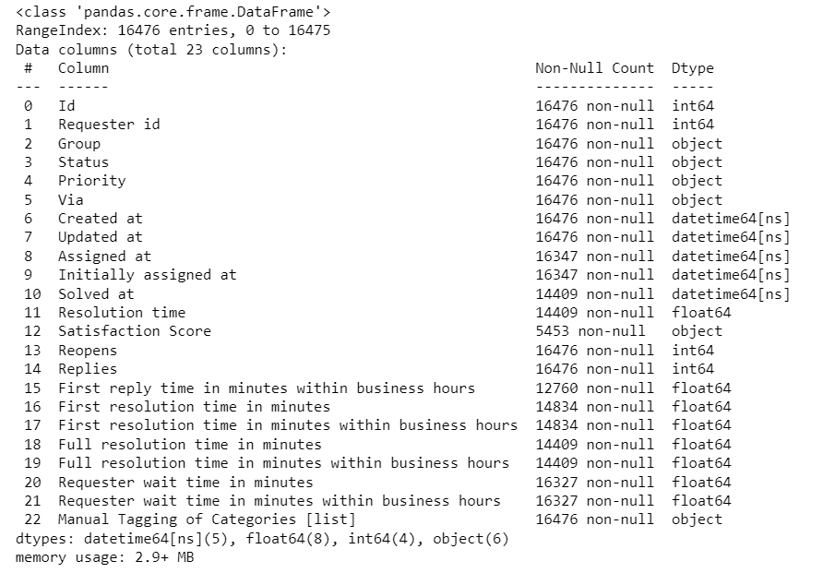
About Dataset
There are 16476 rows and 23 rows.
Data info()
We have converted Created At, Solved At, Updated At Assigned At, and Initially assigned at into datetime64[ns] datatype.

Slide 3
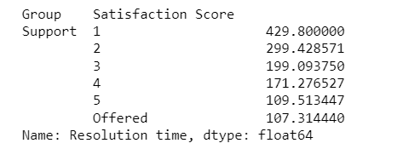
How are the efficiency numbers looking like? Can you share your views?
Efficiency can be measured based on different factors or variables within the dataset.
We can calculate efficiency by Satisfaction Score, First resolution time in minutes within business hours, First reply time in minutes within business hours, and Replies.
The “Satisfaction score“ and “Resolution time” columns provide the satisfaction of a ticket solved by the group. You can calculate the average or median “Resolution time” it to get an overall efficiency measure. Considering 1 as the least Satisfaction score and offered as the highest which would indicate higher efficiency.

Slide 4
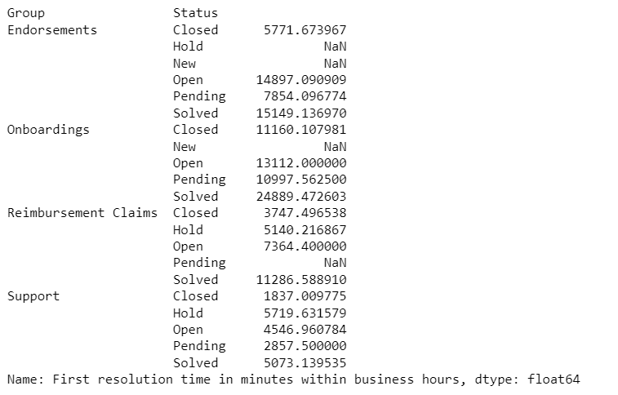
The “ Status“ and “First resolution time in minutes within business hours” columns could provide the time taken to provide the first resolution time to a ticket. You can calculate the average “First resolution time in minutes within business hours” to get an overall efficiency measure by groups and the status of the ticket. Lower first resolution times would indicate higher efficiency.

Slide 5
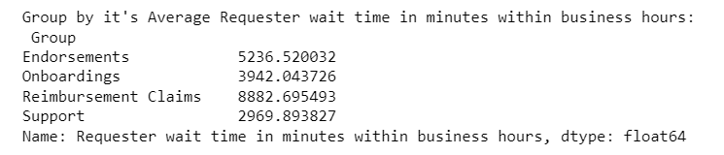
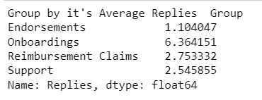
The "Requester wait time in minutes within business hours" column represents the time a requester had to wait before receiving a resolution or reply. Calculating the average or median requester wait time can provide an efficiency measure. Lower wait times would indicate higher efficiency.
The "Replies" column indicates the number of replies made to a ticket. You can calculate the average or median number of replies per ticket to assess efficiency. A lower number of replies may suggest more efficient ticket handling.

Slide 6
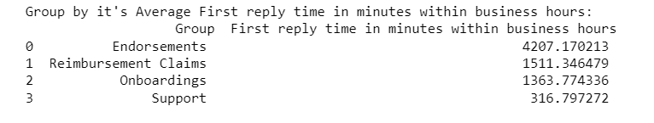
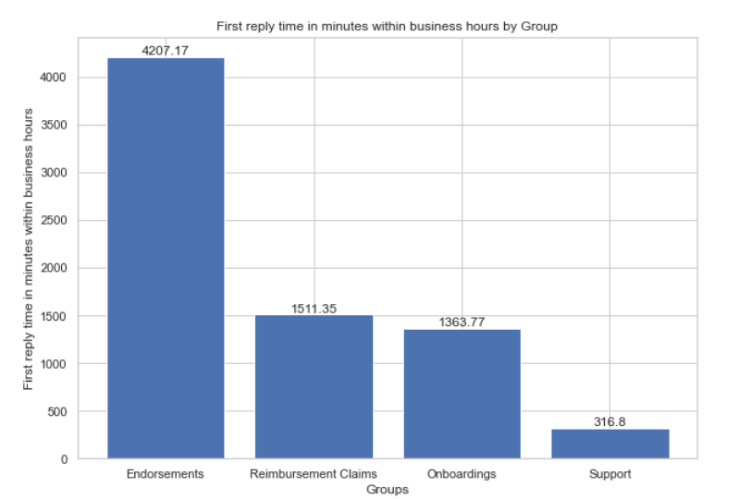
Another measure of efficiency could be the time taken to provide the first reply to a ticket. The "First reply time in minutes within business hours" column provides this information. Similar to resolution time, you can calculate the average or median first reply time to assess efficiency. Lower first reply times would indicate higher efficiency.

Slide 7
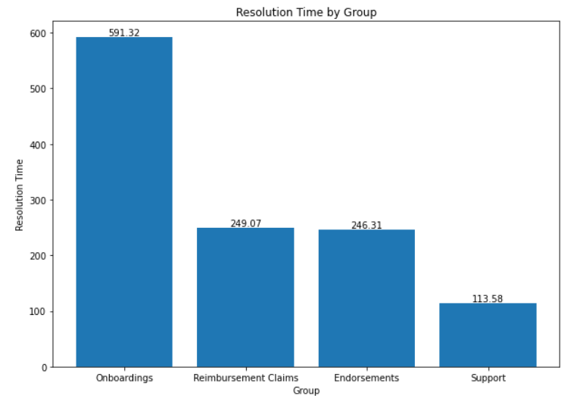
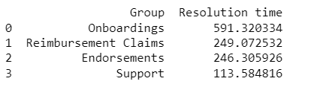
Which groups are quick, slow etc. Create a table + relevant charts?
To determine which groups are quick or slow based on the dataset, we can calculate the average resolution time for each group. We can get an idea that Onboarding and Reimbursement claims have the highest average resolution that is they are the slowest group and Endorsement and Support the quickest group according to resolution.

Slide 8
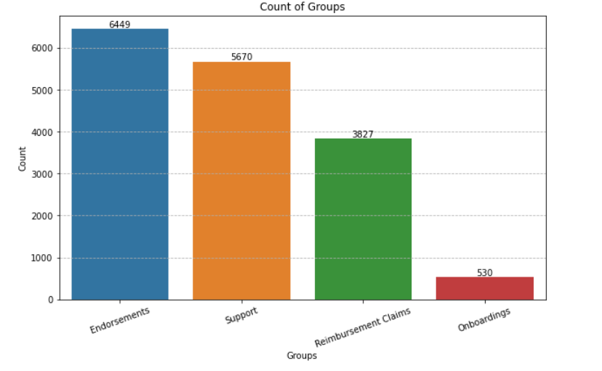
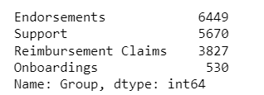
Another measure of quick and slow is we can count the number of tickets per group. The highest number of tickets assigned to the particular group can tell how fast the ticket is solved number of tickets solved.
Thus we can say that Endorsement and Support groups are quick as the number of tickets are high.

Slide 9
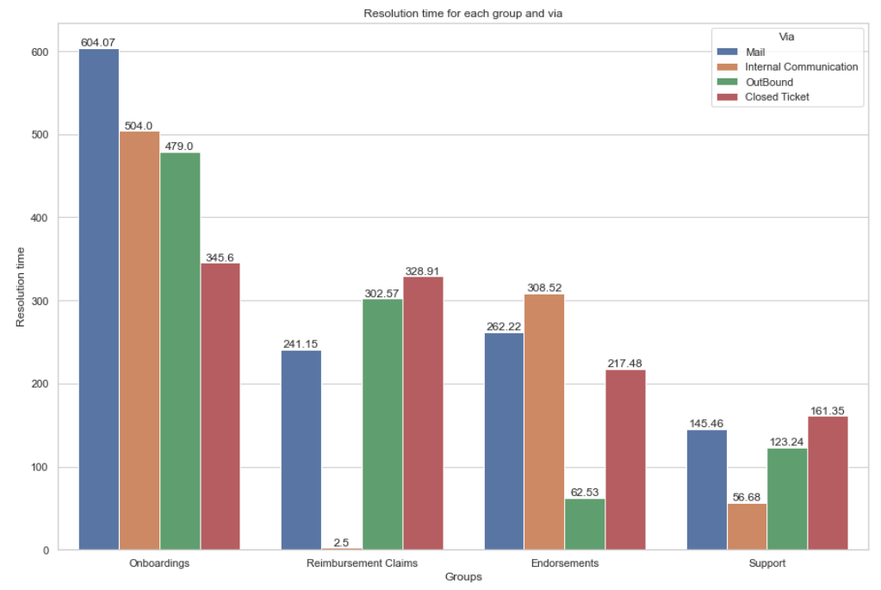
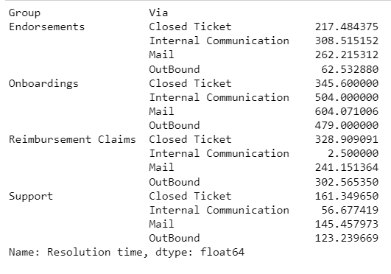
Similarly, we can observe this by resolution time by groups and via. This gives us a detailed view of each group with resolution time and the ticket communication channel.

Slide 10
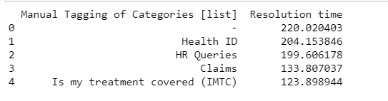
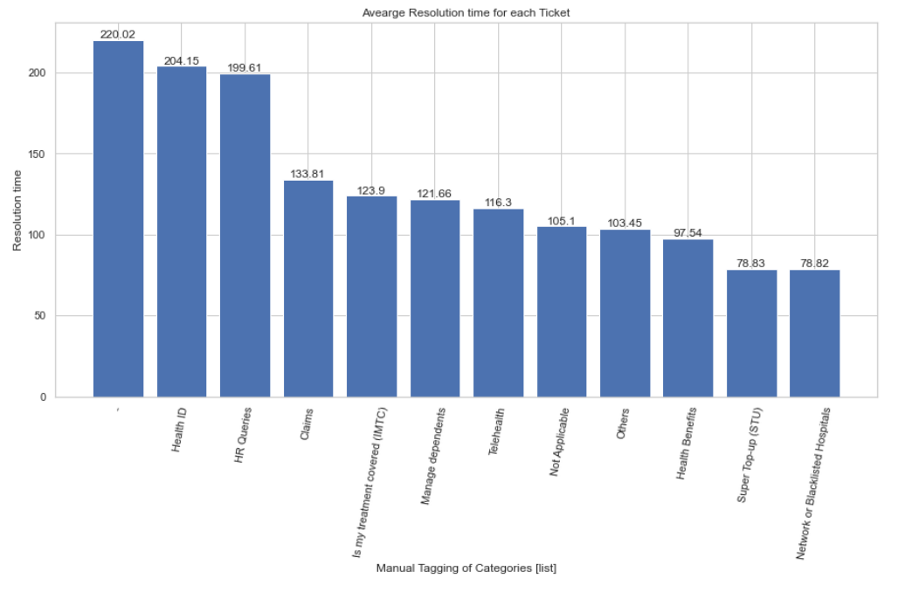
What type of tickets are taking the most time to resolve? Create a table + relevant charts?
To determine which type of tickets are taking the most time to resolve based on the dataset provided, you can analyze the average resolution time for each category or group of tickets. We can get an idea that ‘-’ i.e unknown and ‘Health ID’ have the highest average resolution that is they are the ticket that takes the most time to resolve and ‘ HR Queries’, ‘Claims’, and ‘Is my treatment covered (IMTC)’ are the tickets which solves in less time in comparative to other.

Slide 11
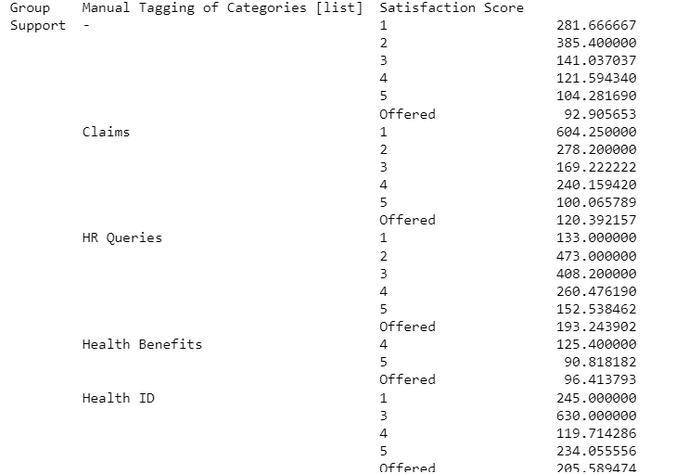
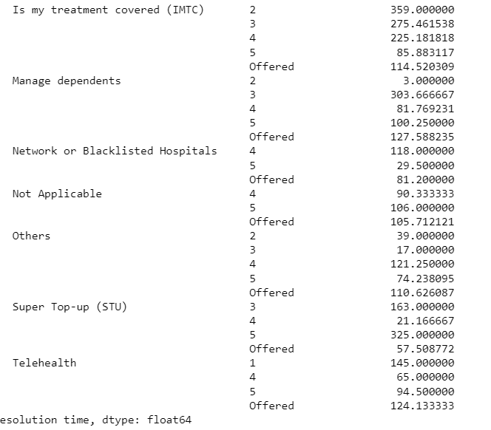
Similarly, we can observe the tickets by resolution time based on their groups and satisfaction Score. This gives us a detailed view of each ticket with resolution time and satisfaction score for each.

Slide 12
Create the different type of data types we can infer from this data.
Here are some data types that can be inferred from the dataset:
Integer (int): The columns "Id," "Requester id," "Reopens," "Replies," and other similar columns are likely to represent counts, IDs, or numerical identifiers. These are typically stored as integers.
Object (or string): The columns such as "Group," "Status," "Priority," "Via," and "Satisfaction Score" are likely to contain text or categorical information and are typically stored as object or string data types.
Datetime (datetime64[ns]): The columns "Created at," "Updated at," "Assigned at," "Initially assigned at," "Solved at," and other similar columns represent dates and timestamps. These are typically stored as datetime data types.
Float (float64): The columns "Resolution time," "First reply time in minutes within business hours," "First resolution time in minutes," and other similar columns are likely to represent durations or decimal values. These are typically stored as floating-point numbers.
List (list): The column "Manual Tagging of Categories [list]" indicates a list data type. It may contain a list of manually assigned categories or tags associated with each entry.

Slide 13
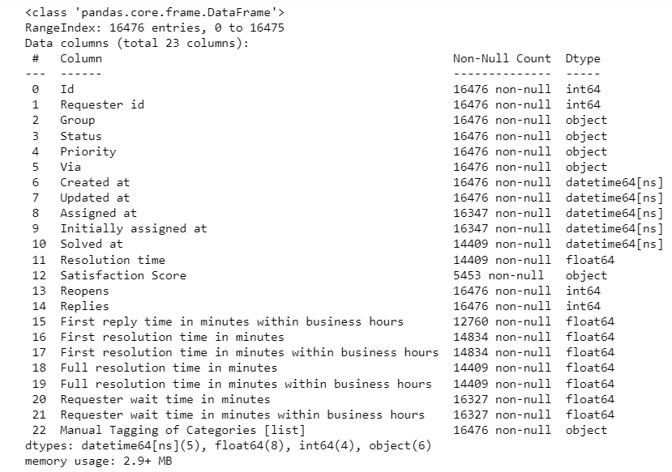

Slide 14
The assignment is completed in Python using libraries NumPy, pandas, matplotlib, seaborn and datetime.
Link for the Python file
https://github.com/KrutikaRajpure/Plum/blob/main/Plum.ipynb
By: Krutika Rajpure
Email: krutikar2514@gmail.com

