Slide 1
Anomaly Detection in Proxy Logs Using Machine Learning
A Modular Approach to Identifying Malicious User-Agents
Krutika Sapkal

Slide 2
Problem Statement
What is the problem?
Proxy logs contain both benign and malicious user-agents.
Need to automatically detect anomalies in real-time.
Why is it important?
Helps improve cybersecurity by flagging suspicious activities.
Manual detection is slow and ineffective.

Slide 3
Data Overview & EDA (Exploratory Data Analysis)
Source of data: GitHub proxy logs dataset
Data distribution: How many benign vs. exploit user-agents?
Key insights:
Unique user-agents count
Benign = 9955
Exploit = 97

Slide 4
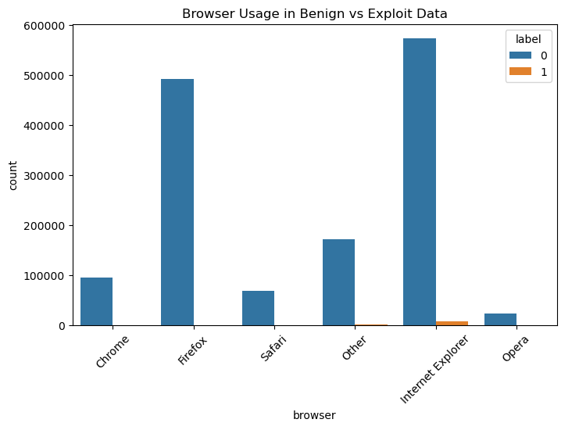
Data Overview & EDA (Exploratory Data Analysis)
Most common browsers

Slide 5
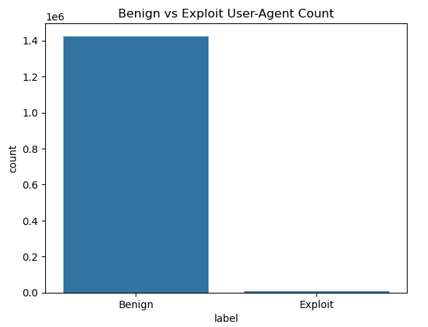
Data Overview & EDA (Exploratory Data Analysis)
Frequency of benign vs. exploit user-agents

Slide 6
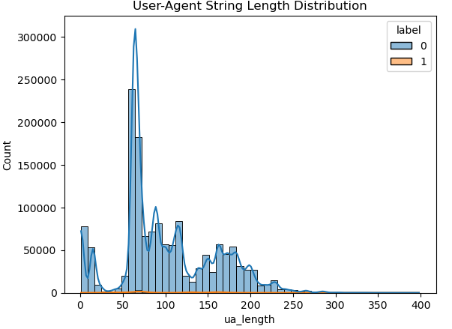
Data Overview & EDA (Exploratory Data Analysis)
Top 5 Most Common User-Agents:
Mozilla/5.0 (Windows NT 6.1; rv:5.0) Gecko/20100101 Firefox/5.0... -> 65234 times
Mozilla/5.0 (Windows NT 5.1; rv:5.0.1) Gecko/20100101 Firefox/5.0.1... -> 61364 times
Mozilla/5.0 (Windows NT 5.1; rv:5.0) Gecko/20100101 Firefox/5.0... -> 54245 times
Shockwave Flash... -> 48811 times
Mozilla/5.0 (compatible; MSIE 9.0; Windows NT 6.1; Trident/5.0)... -> 46531 times

Slide 7
Approach & Model Selection
Data Preprocessing Steps
Extract user-agent strings
Convert them into numeric features (TF-IDF, Hashing, or Word Embeddings)
Handle class imbalance (SMOTE, undersampling, manual duplication)
Models Considered:
K-Nearest Neighbors (KNN)
One-Class SVM (Sigmoid Kernel)
Isolation ForestModel
Selection Strategy:
Compared models using Precision, Recall, F1-score, and AUC-ROC.

Slide 8
Approach & Model Selection
Outcomes of the model training
Isolation Forest - Precision: 0.00, Recall: 0.00, F1: 0.00, AUC: 0.61
One-Class SVM - Precision: 0.02, Recall: 0.20, F1: 0.03, AUC: 0.57
kNN (1st Nearest Neighbor) - Precision: 0.77, Recall: 0.61, F1: 0.68, AUC: 0.78
🏆 Best Model Selected: kNN (1st Nearest Neighbor)
Anomaly Detection Rate in Exploit Data: 5.15%

Slide 9
API for Real-Time Scoring
Overview of the API
Receives a new user-agent string.
Returns a score/classification (Benign or Anomalous).
Sample API Call (cURL)
curl -X POST "http://localhost:5000/predict" -H "Content-Type: application/json" -d '{"user_agent": "Mozilla/5.0..."}’
Response Format
{
"user_agent": "Mozilla/5.0 (Windows NT 10.0; Win64; x64) AppleWebKit/537.36 (KHTML, like Gecko) Chrome/91.0.4472.124 Safari/537.36",
"is_anomalous": false
}

Slide 10
Key Findings & Next Steps
Findings
KNN one nearest neighbour performed best.
Data imbalance was a major challenge.
Feature engineering (TF-IDF) improved model performance.
Next Steps
Fine-tune hyperparameters further.
Deploy as a real-time detection system.
Experiment with deep learning models.

