Slide 1
Checkers
The cdm-16 project
made by Gaev V & Masolygin M & Efimov S

Slide 2
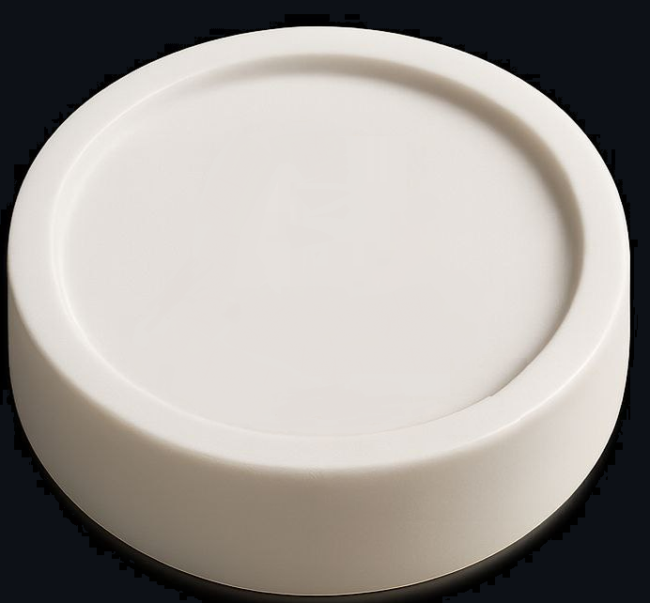
Table of Contents
01. Introduction
02. Execution plan
03. Hardware
04. Software
05. Questions

Slide 3
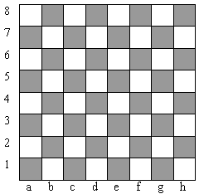
Introduction
Our project has implemented an English version of the Checkers game. Important clarifications:
The difference between the demo and the regular figure is the ability to walk and chop backwards.
If a player has the opportunity to cut down a piece during his turn, then he is obliged to do so.
The first move begins with black pieces.

Slide 4
Execution plan
1 Step
2 Step
3 Step
4 Step
5 Step
Determine what functionality the hardware and software part will have
Implement the hardware part
Implement the software part
Connect both parts
Optimize and ensure correct and error-free operation of the entire game

Slide 5
Hardware
Logisim
CDM-16
Checking the correctness of the player's move.
Key input.
Rendering of the playing field and the changes that have occurred on it.
Announcement of the game results.
Displaying the progress queue.
Choosing the optimal move for the bot.
Storing and changing the situation on the field.
Transmitting the game state to the hardware.
Control of the turn queue.

Slide 6
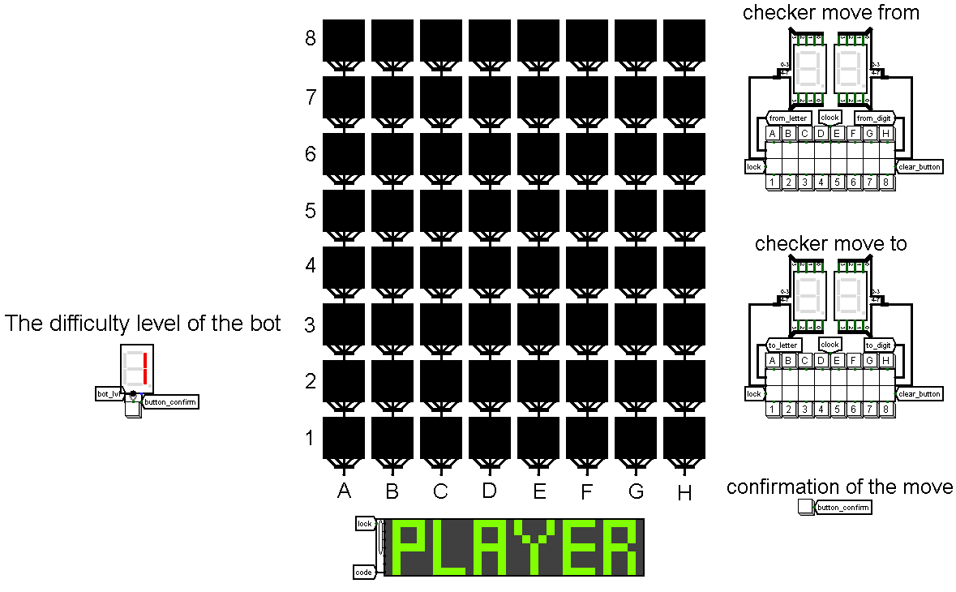
"
Game board

Slide 7
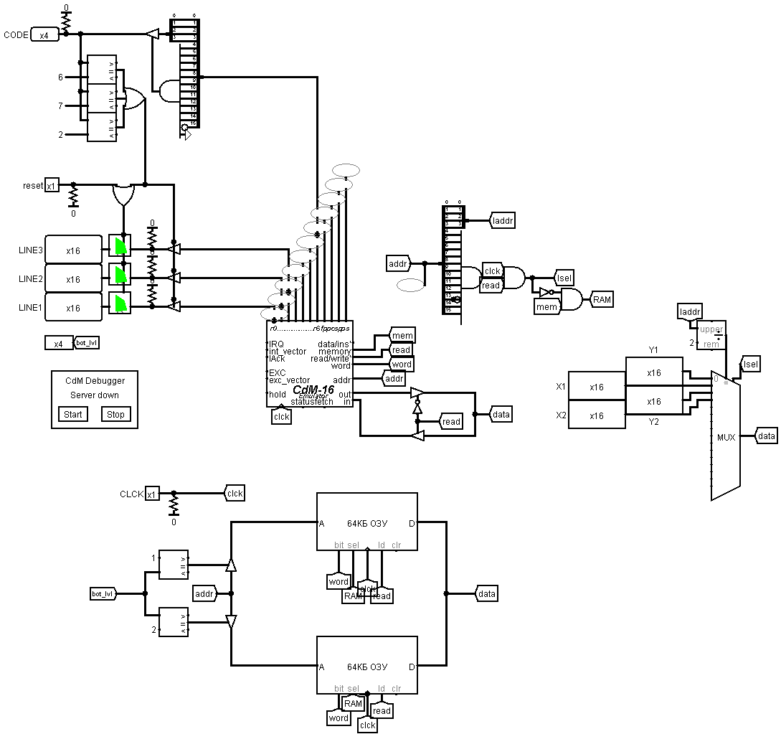
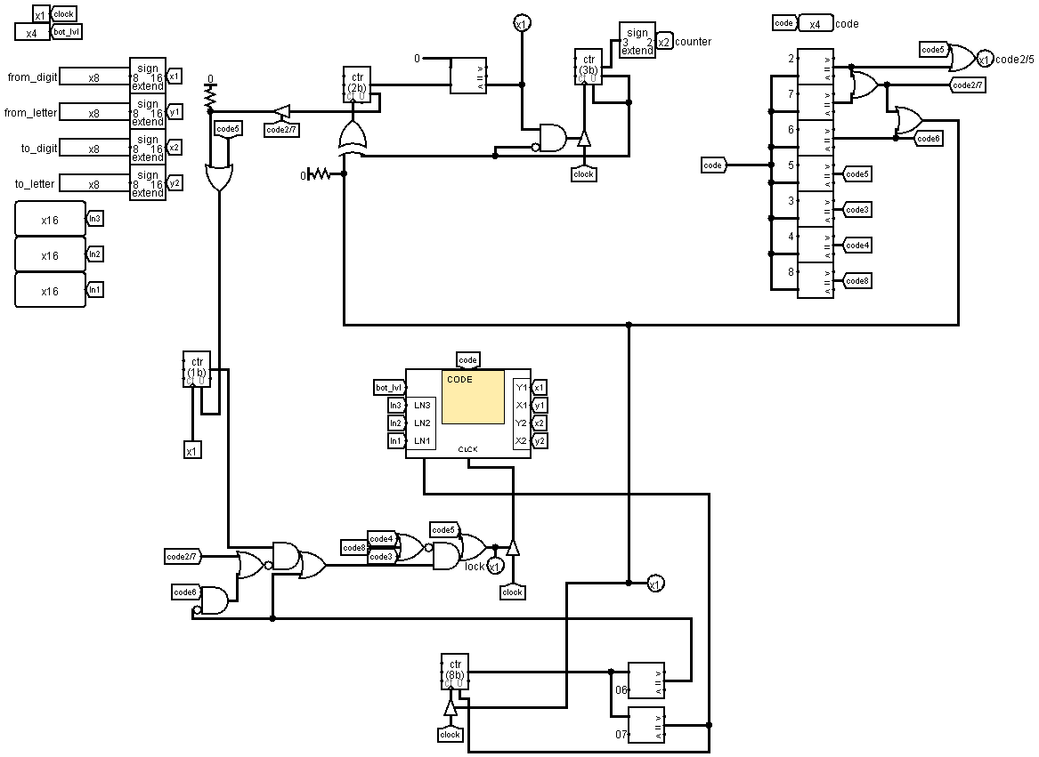
"
Processor

Slide 8
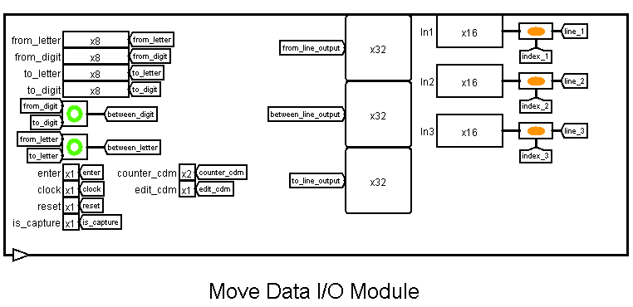
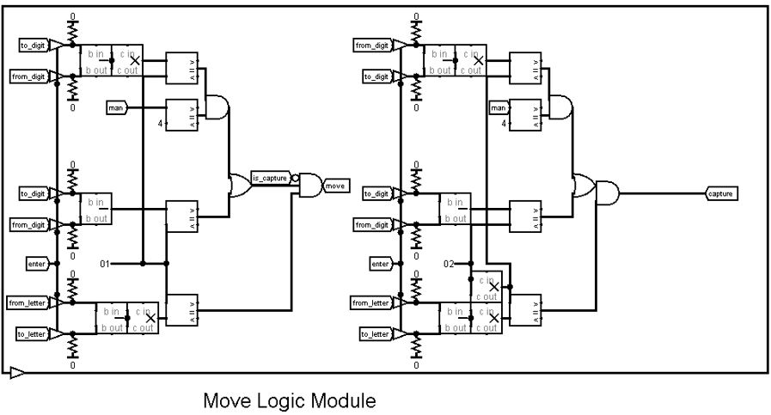
"
Checking the correctness of the move
8

Slide 9
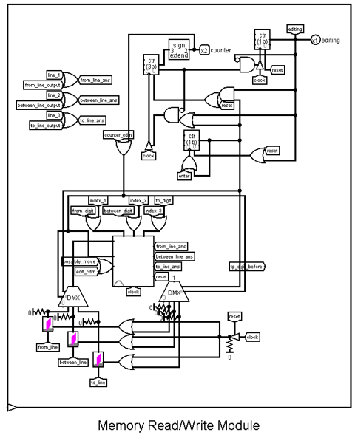
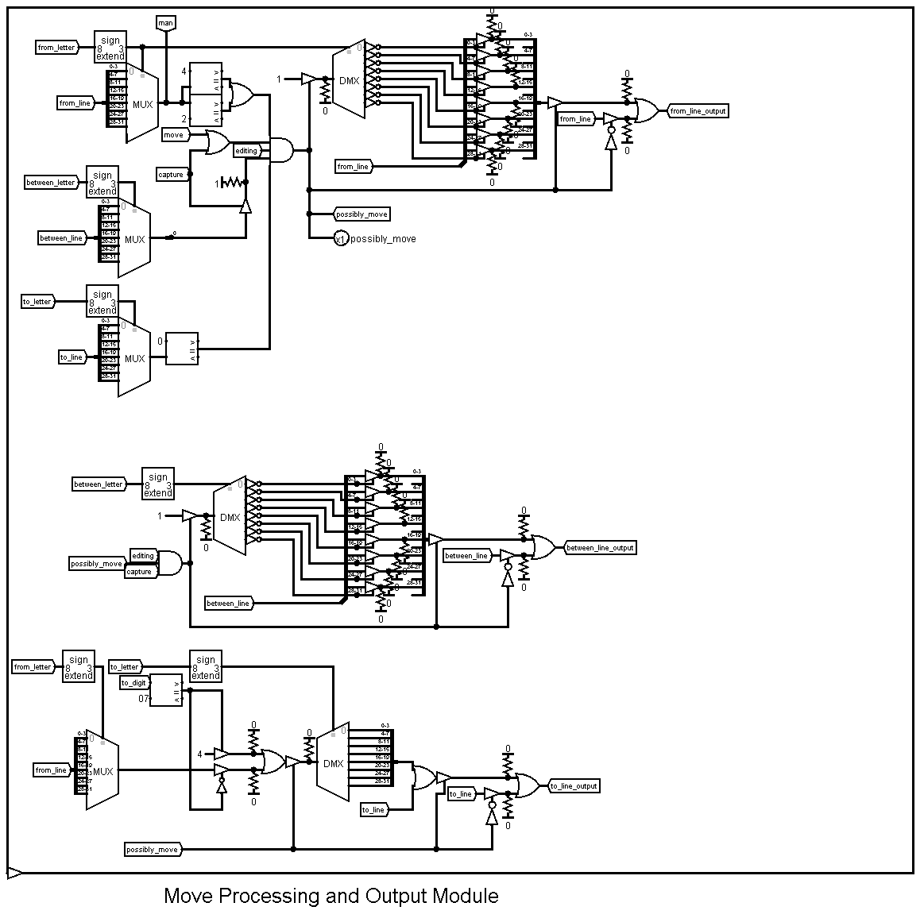
"
Checking the correctness of the move
9

Slide 10
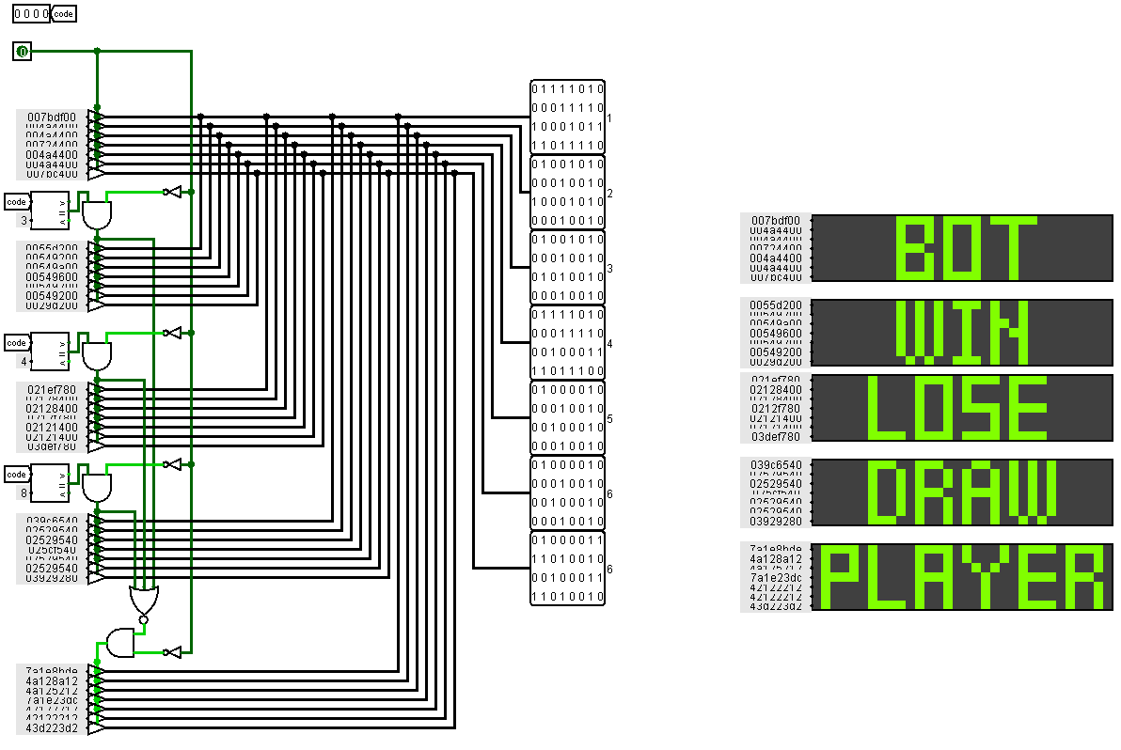
"
Game States
10

Slide 11
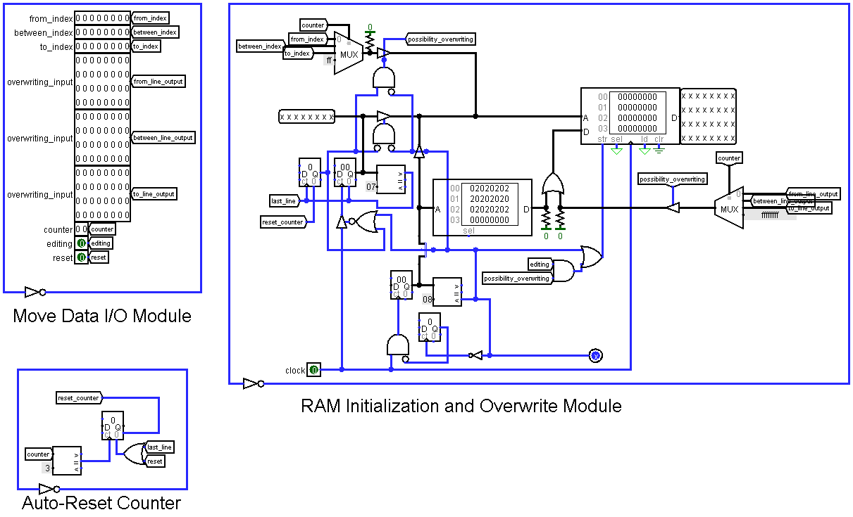
"
Board
11

Slide 12
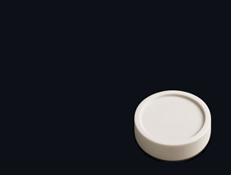
"
Global variables
// Auxiliary variables (used within various functions)
char id, midX, midY, dirY, backDirY, startX, startY, newX, newY;
char enemyIndex, startIdx, endIdx, curColor, checkCount;
char tx, ty, x1, x2, y1, y2, wasKing, color, lastCap, moveCount;
char moves[64];
int bestScore;
char bestMoveId;
char packedStart;
char packedEnd;
char inf;
char cap;
char key, val1, val2, val3; // MiniMax search depth
char DEPTH = 1; // Precomputed material values
char PAWN_VALUE = 10;
char KING_VALUE = 30; // Precomputed positional values (distance from edge)
char POS_VALUE[8] = {0, 1, 2, 3, 3, 2, 1, 0}; int score;
int blackMaterial;
int whiteMaterial; // Buffer array for sorting
char temp[4]; // Variables for processing output data
int LINES[3];
char checkersLine[4];
char cntLine;
char swift;
char GAMEMODE = 0; // 0 – black to move, 1 – white to move // Checker positions (indices 0–11: black, 12–23: white)
char checkerX[24] = {
0,2,4,6, 1,3,5,7, 0,2,4,6, // black men start
1,3,5,7, 0,2,4,6, 1,3,5,7 // white men start
};
char checkerY[24] = {
0,0,0,0, 1,1,1,1, 2,2,2,2, // black men start
5,5,5,5, 6,6,6,6, 7,7,7,7 // white men start
};
char checkerIsKing[24] = {0}; // 0 = man, 1 = king
char checkerIsAlive[24] = {
1,1,1,1, 1,1,1,1, 1,1,1,1, // blacks alive
1,1,1,1, 1,1,1,1, 1,1,1,1 // whites alive
}; // Index table: maps board coordinates to checker array index or -1 if empty
char TABLE_INDEX[8][8] = {
{ 0, -1, 1, -1, 2, -1, 3, -1 },
{-1, 4, -1, 5, -1, 6, -1, 7 },
{ 8, -1, 9, -1, 10, -1, 11, -1 },
{-1, -1, -1, -1, -1, -1, -1, -1 },
{-1, -1, -1, -1, -1, -1, -1, -1 },
{-1, 12, -1, 13, -1, 14, -1, 15 },
{16, -1, 17, -1, 18, -1, 19, -1 },
{-1, 20, -1, 21, -1, 22, -1, 23 }
}; // X-offsets for diagonal moves (left, right)
const char dirX[2] = { -1, +1 }; // Counters of remaining checkers for each side: [0]=black, [1]=white
char countCapture[2] = { 12, 12 }; // State flag for multi-capture continuation
char canContinueCapture = 0;
// Variables for working with a transposition table
#define TT_SIZE 256 // small hash table
unsigned char tt_hash[TT_SIZE];
char tt_depth[TT_SIZE];
int tt_score[TT_SIZE];

Slide 13
"
Packing/Unpacking Functions
static inline char packCoords(char x, char y)
{
return (x << 4) | (y & 0x0F);
}
static inline char unpackX(char p)
{
return (p >> 4) & 0x0F;
}
static inline char unpackY(char p)
{
return p & 0x0F;
}
static inline char packCaptureInfo(char capId, char wasKing)
{
return (capId << 1) | (wasKing & 0x01);
}
static inline char getCaptureId(char info)
{
return (info >> 1) & 0x7FFF;
}
static inline char getWasKing(char info)
{
return info & 0x01;
}
static inline int pack_pair(char low, char high)
{
return ((low & 0x7) << 3) | ((high & 0x7));
}
static inline int pack_word(char pair01, char pair23, char x)
{
return (pair23 << 4) | (pair01 << 10) | ((x & 0xF));
}

Slide 14
"
Checking the possibility of capturing a shape
char hasCapture(char x, char y, char color)
{
dy = (color == 0) ? +1 : -1;
// normal capture
for (char i = 0; i < 2; i++)
{
mx = x + dx[i], my = y + dy;
if (mx < 0 || mx >= 8 || my < 0 || my >= 8)
continue;
eid = TABLE_INDEX[my][mx];
if (eid < 0 ||
(color == 0 && eid < 12) ||
(color == 1 && eid >= 12))
continue;
tx = x + (dx[i] << 1), ty = y + (dy << 1);
if (tx < 0 || tx >= 8 || ty < 0 || ty >= 8)
continue;
if (TABLE_INDEX[ty][tx] == -1)
return 1;
}
// a situation for queens with a reverse move
idx = TABLE_INDEX[y][x];
if (idx >= 0 && checkerIsKing[idx])
{
dy = -dy;
for (char i = 0; i < 2; i++)
{
mx = x + dx[i], my = y + dy;
if (mx < 0 || mx >= 8 || my < 0 || my >= 8)
continue;
eid = TABLE_INDEX[my][mx];
if (eid < 0 ||
(color == 0 && eid < 12) ||
(color == 1 && eid >= 12))
continue;
tx = x + (dx[i] << 1), ty = y + (dy << 1);
if (tx < 0 || tx >= 8 || ty < 0 || ty >= 8)
continue;
if (TABLE_INDEX[ty][tx] == -1)
return 1;
}
}
return 0

Slide 15

"
Movement
char move(char pStart, char pEnd)
{
char x1 = unpackX(pStart), y1 = unpackY(pStart);
char x2 = unpackX(pEnd), y2 = unpackY(pEnd);
id = TABLE_INDEX[y1][x1];
char wasKing = checkerIsKing[id];
char color = (id < 12) ? 0 : 1;
char lastCap = -1;
if (ABS(y2 - y1) == 1 && ABS(x2 - x1) == 1)
{
// ordinary move
checkerX[id] = x2;
checkerY[id] = y2;
TABLE_INDEX[y2][x2] = id;
TABLE_INDEX[y1][x1] = -1;
}
else if (ABS(y2 - y1) == 2 && ABS(x2 - x1) == 2)
{
// capturing a figure
midX = ((x1 + x2) >> 1) & 0x7FFF;
midY = ((y1 + y2) >> 1) & 0x7FFF;
lastCap = TABLE_INDEX[midY][midX];
checkerIsAlive[lastCap] = 0;
checkerX[lastCap] = checkerY[lastCap] = -1;
checkerX[id] = x2;
checkerY[id] = y2;
TABLE_INDEX[y2][x2] = id;
TABLE_INDEX[y1][x1] = TABLE_INDEX[midY][midX] = -1;
canContinueCapture = hasCapture(x2, y2, color);
}
// coronation
if ((id < 12 && y2 == 7) || (id >= 12 && y2 == 0))
{
checkerIsKing[id] = 1;
}
return packCaptureInfo(lastCap, wasKing);
}

Slide 16
"
Going back
void undoMove(char pStart, char pEnd, char info)
{
char x1 = unpackX(pStart), y1 = unpackY(pStart);
char x2 = unpackX(pEnd), y2 = unpackY(pEnd);
char lastCap = getCaptureId(info);
char wasKing = getWasKing(info);
id = TABLE_INDEX[y2][x2];
checkerX[id] = x1;
checkerY[id] = y1;
TABLE_INDEX[y1][x1] = id;
TABLE_INDEX[y2][x2] = -1;
checkerIsKing[id] = wasKing;
if (lastCap >= 0)
{
midX = ((x1 + x2) >> 1) & 0x7FFF;
midY = ((y1 + y2) >> 1) & 0x7FFF;
checkerIsAlive[lastCap] = 1;
checkerX[lastCap] = midX;
checkerY[lastCap] = midY;
TABLE_INDEX[midY][midX] = lastCap;
}
}

Slide 17
"
Search for possible moves
void checkCapture(char dx, char dy, char moves[])
{
mx = cx + dx;
my = cy + dy;
if (mx < 0 || mx >= 8 || my < 0 || my >= 8)
return;
enemyIndex = TABLE_INDEX[my][mx];
if (enemyIndex < 0 ||
(curColor == 0 && enemyIndex < 12) ||
(curColor == 1 && enemyIndex >= 12))
return;
nx = cx + (dx << 1);
ny = cy + (dy << 1);
if (nx < 0 || nx >= 8 || ny < 0 || ny >= 8 ||
TABLE_INDEX[ny][nx] != -1)
return;
id = checkCount << 2;
moves[id + 0] = 'a' + cx;
moves[id + 1] = '1' + cy;
moves[id + 2] = 'a' + nx;
moves[id + 3] = '1' + ny;
checkCount++;
}
void checkMove(char dx, char dy, char moves[])
{
nx = cx + dx;
ny = cy + dy;
if (nx < 0 || nx >= 8 || ny < 0 || ny >= 8 ||
TABLE_INDEX[ny][nx] != -1)
return;
id = checkCount << 2;
moves[id + 0] = 'a' + cx;
moves[id + 1] = '1' + cy;
moves[id + 2] = 'a' + nx;
moves[id + 3] = '1' + ny;
checkCount++;
}

Slide 18
"
Search for possible moves
char getMoves(char color, char moves[])
{
curColor = color;
checkCount = 0;
if (color == 0)
{
startIdx = 0;
endIdx = 12;
dirY = +1;
backDirY = -1;
}
else
{
startIdx = 12;
endIdx = 24;
dirY = -1;
backDirY = +1;
}
// captures first
for (char i = startIdx; i < endIdx; i++)
{
if (!checkerIsAlive[i])
continue;
cx = checkerX[i];
cy = checkerY[i];
for (char j = 0; j < 2; j++)
checkCapture(dx[j], dirY, moves);
if (checkerIsKing[i])
checkCapture(dx[0], backDirY, moves),
checkCapture(dx[1], backDirY, moves);
}
if (checkCount)
return checkCount;
// If there were no captures, just moves.
for (char i = startIdx; i < endIdx; i++)
{
if (!checkerIsAlive[i])
continue;
cx = checkerX[i];
cy = checkerY[i];
for (char j = 0; j < 2; j++)
checkMove(dx[j], dirY, moves);
if (checkerIsKing[i])
checkMove(dx[0], backDirY, moves),
checkMove(dx[1], backDirY, moves);
}
return checkCount;
}

Slide 19
"
Assessment
char evaluateBoard(char color)
{
// Calculated values for the material
static const char PAWN_VALUE = 10;
static const char KING_VALUE = 30;
// Precomputed values for the position (distance from the edge)
static const char POS_VALUE[8] = {0, 1, 2, 3, 3, 2, 1, 0};
char score = 0;
char blackMaterial = 0, whiteMaterial = 0;
// Quick exit with obvious positions
if (cntCapture[0] == 0)
return -100;
if (cntCapture[1] == 0)
return 100;
for (char i = 0; i < 12; i++)
{
if (checkerIsAlive[i])
{
blackMaterial += PAWN_VALUE + (checkerIsKing[i] ? (KING_VALUE - PAWN_VALUE) : 0);
// Position Bonus
blackMaterial += POS_VALUE[checkerX[i]] + POS_VALUE[checkerY[i]];
// Bonus for promotion to the ladies
if (!checkerIsKing[i])
blackMaterial += checkerY[i];
}
}
for (char i = 12; i < 24; i++)
{
if (checkerIsAlive[i])
{
whiteMaterial += PAWN_VALUE + (checkerIsKing[i] ? (KING_VALUE - PAWN_VALUE) : 0);
// Position Bonus
whiteMaterial += POS_VALUE[checkerX[i]] + POS_VALUE[checkerY[i]];
// Bonus for advancing to the end of the field
if (!checkerIsKing[i])
whiteMaterial += (7 - checkerY[i]);
}
}
score = blackMaterial - whiteMaterial;
return color == 0 ? score : -score;
}

Slide 20
"
Algorithm minimax
for (int i = 0; i < moveCount; i++)
{
char x1 = moves[i * 4 + 0] - 'a';
char y1 = moves[i * 4 + 1] - '1';
char x2 = moves[i * 4 + 2] - 'a';
char y2 = moves[i * 4 + 3] - '1';
char packedStart = packCoords(x1, y1), packedEnd = packCoords(x2, y2);
char inf = move(packedStart, packedEnd);
int sc = minimax(depth - 1, 1 - color, alpha, beta);
undoMove(packedStart, packedEnd, inf);
if (color == 0)
{
if (sc > bestScore)
bestScore = sc;
if (sc > alpha)
alpha = sc;
}
else
{
if (sc < bestScore)
bestScore = sc;
if (sc < beta)
beta = sc;
}
if (beta <= alpha)
break;
}
tt_hash[key] = key;
tt_depth[key] = depth;
tt_score[key] = bestScore;
return bestScore;
}
int minimax(char depth, char color, int alpha, int beta)
{
unsigned key = getHashKey();
if (tt_hash[key] == key && tt_depth[key] >= depth)
return tt_score[key];
if (depth <= 0)
return evaluateBoard(color);
char moves[64];
char moveCount = getMoves(color, moves);
sortMoves(moves, moveCount, color);
int bestScore = (color == 0) ? -100 : +100;

Slide 21
"
Assessment and Sorting
char scoreMove(char *move, char color)
{
x1 = move[0] - 'a';
y1 = move[1] - '1';
x2 = move[2] - 'a';
y2 = move[3] - '1';
// Takeaways are always a priority
if (ABS(x2 - x1) == 2)
return 100;
// The movement towards becoming a lady
if ((TABLE_INDEX[y1][x1] < 12 && y2 > 5) ||
(TABLE_INDEX[y1][x1] >= 12 && y2 < 2))
return 50;
// Moving towards the center
return (3 - ABS(x2 - 3)) + (3 - ABS(y2 - 3));
}
void sortMoves(char *moves, char moveCount, char color)
{
for (char i = 0; i < moveCount - 1; i++)
{
for (char j = 0; j < moveCount - i - 1; j++)
{
if (scoreMove(&moves[j * 4], color) < scoreMove(&moves[(j + 1) * 4], color))
{
// Swap moves
for (char k = 0; k < 4; k++)
temp[k] = moves[j * 4 + k];
for (char k = 0; k < 4; k++)
moves[j * 4 + k] = moves[(j + 1) * 4 + k];
for (char k = 0; k < 4; k++)
moves[(j + 1) * 4 + k] = temp[k];
}
}
}
}

Slide 22
"
Game cycle
else
{ // The bot's move
while (canContinueCapture)
{
canContinueCapture = 0;
// The bot chooses the best move using minimax
botMove(); // The function of executing the bot's move
if (canContinueCapture)
{
// We return the CONTINUED code and load the data from LINES into registers 1,2,3
}
else
{ if (hasAllCapture())
{
// We return the HASCAPTURE code and load the data from LINES into registers 1,2,3
}
else
{
// We return the FINAL BOT code and load the data from LINES into registers 1,2,3
}
}
}
GAMEMODE = 0; // Player's turn
} if (countCapture[0] == 0)
{
// Returning the LOSE code
break;
}
if (countCapture[1] == 0)
{
// Returning the WIN code
break;
}
}
return 0;
}
int main(void)
{
GAMEMODE = 0; // The blacks begin
while (1)
{
canContinueCapture = 1;
if (GAMEMODE == 0)
{ // Player's turn
while (canContinueCapture)
{
// Returning the MOVE code
canContinueCapture = 0;
// Retrieve the move coordinates from the hardware input data
playerMove();
if (canContinueCapture)
{
// Returning the CONTINUE code
}
}
GAMEMODE = 1; // The bot's move
}

Slide 23

Questions

