Slide 1
Early Cancer Detection with Machine Learning
Team 2: Bryan Kee Tze Ren, Daniel Leong Zhi Kai, Lau Ming Jie, Soh Kai Le
1

Slide 2
01.
Problem Statement and Dataset Challenges
Limitations of traditional cancer detection methods.
2

Slide 3






Challenges and Project Goals
350
90%
Objective
All Cancers
(25% of all deaths)
Quantitative features from a DNA blood sample
Detectable cancers
with early screening
Of the response variable belong to the positive (cancer) class
Cancers with low false positives
Cancers with non-invasive screening methods
Detect as many cancers as possible with minimal misdiagnosis
3
Notes:
Bryan
Cancer is the leading cause of death in Singapore, accounting for 25% of deaths
Early detection is crucial for improving survival, but traditional screening methods face significant challenges.
First, not all cancers can be caught early (eg. pancreatic and stomach cancers are usually only detected in late stages).
So in Singapore only a few cancers have established screening programs.
But some early screening methods are prone to false positives (eg. prostate cancer, 50% of women undergoing mammograms will get a false positive).
This means a smaller subset of cancers can be screened accurately.
However, this accuracy often comes at the cost of invasive tests (eg. colonoscopies for colon cancer or pap smears for cervical cancer)
These challenges mean that only a select few cancers can currently be detected early, accurately, and in a non-invasive way
Therefore, our machine learning project aims to use a less invasive approach to detect a wide range of cancers with minimal misdiagnosis
Our dataset presents 2 major challenges: We have too many features and our dataset is imbalanced with 90% belonging to the cancer class.

Slide 4
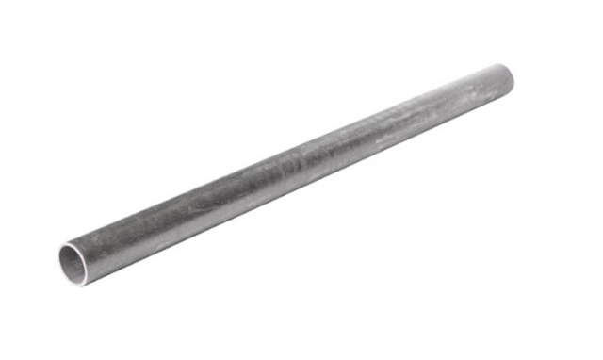
Project Pipeline
Principal Component Analysis
Hyperparameter Tuning
Reduce dimensionality of dataset and retain important features
Grid Search to find parameters that optimize TPR and minimize FPR
Feature Scaling
Feature Selection
Synthesize Data
Model Training
Model Testing
Standardization
Synthetic Minority Over-Sampling Technique
Evaluation
Ensure features contribute equally to distance calculations in PCA & SVM
Receiver Operating Curve
Precision Recall Curve
Handle class imbalance
4
Notes:
Bryan
This is our project pipeline that outlines how we tackled the two key issues mentioned earlier.
Kai Le and I will focus on data preparation
We standardized the features and conducted PCA to reduce the number of input variables for modeling
To address class imbalance, we synthetically created the minority class
Afterwards, Daniel and Mingjie will talk how they trained various machine learning models
They will also cover the evaluation metrics used to assess the performance of these models.

Slide 5
02.
Data Processing
Feature Scaling, Selection & Visualization Class Imbalance
5
Notes:
Bryan

Slide 6
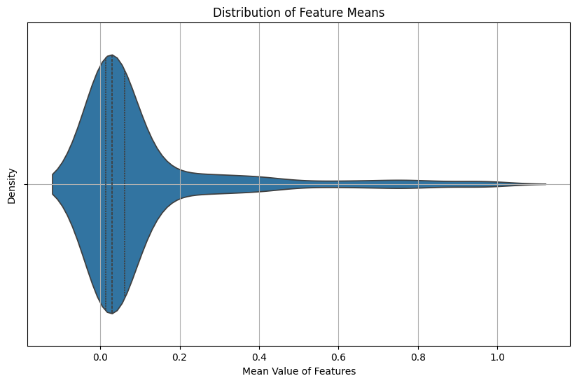

Feature Scaling
 | Outlier Category | Feature Count
0 | High Outliers | 210
1 | Low Outliers | 140
Outlier Summary using Modified Z-score
Violin Plot of Feature Means and Outliers
6
Notes:
Bryan
Since we intended to use algorithms that rely on distance metrics, such as PCA and SVM, we needed to determine if feature scaling was necessary.
We utilized a violin plot to investigate the distribution of feature means. Many features had similar magnitudes around 0.1 but some features had magnitudes as high as 1.0, indicating significant variability.
This variation confirmed that feature scaling was necessary for our analysis.
Next, we needed to select an appropriate feature scaling method.
We applied the Modified Z-score formula to identify features with high outliers and our analysis showed that 210 out of the 350 features had outliers exceeding 3 standard deviations from the median.
Consequently, we determined that normalization was not suitable and opted for standardization instead.

Slide 7
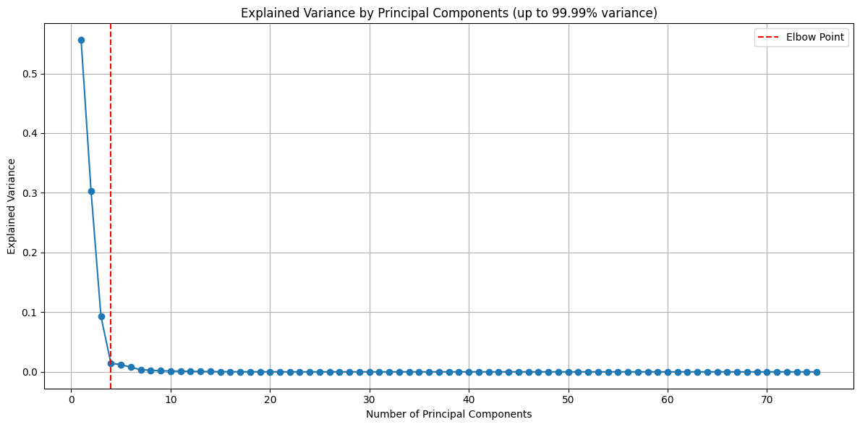
Principal Component Analysis (PCA)
JUPITER
PCA Selection Process
SATURN
NEPTUNE
Jupiter is the biggest planet of them all
Transformation: 350 PCs
99.99% Variance: PCs 1 - 75
Elbow method: PCs 1 - 3
However, using PCs 1 - 3 led to poor performance …
Saturn is composed of hydrogen and helium
Explained Variance of Principal Components
7
Notes:
Bryan
The next step was to reduce the dimensionality of our dataset from 350 features to a more manageable number.
We performed PCA on input variables and extracted the PCs which explained 99.99% of the variance.
This yielded 75 PCs which was still too many, so we plotted the explained variance and noted that PC4 and beyond contributed very little.
Using the elbow method, we decided to retain only PCs 1, 2, and 3 for our analysis.
Despite this reduction, we encountered poor model performance, with accuracy falling below 80%, even though we used PCs that captured the majority of the variance.
Kai Le will now discuss the limitations of selecting only PCs with high variance and the strategies we implemented to address this issue.

Slide 8
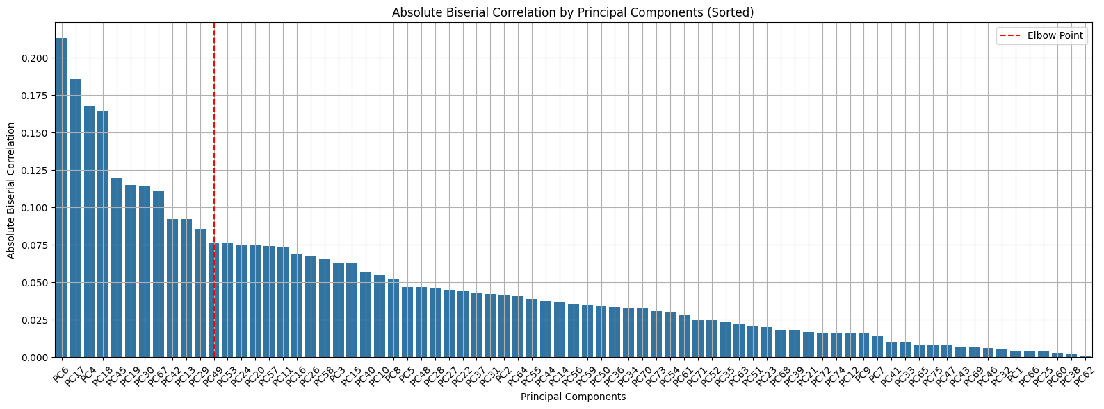
Point Biserial Correlation (Feature ranking)
Elbow method
Biserial Correlation of Principal Components
8
Notes:
Kai Le
Thank you Bryan, I will now continue on from where Bryan has left us. Which is the interesting question of why selecting principle components known as PCs, based on explained variance
alone is insufficient. Well, according to a paper done by Sharma and Saroha in 2015, one limitation of selecting PCs from PCA that they identified, is that explained variance does not necessarily indicate that they are the most relevant features for predicting the response variable.
Hence, there is a need to add some further ranking of PCs to truly select the most important features. In Sharma and Saroha’s case they used Pearson’s correlation which most of us are familiar with. However, since Pearson correlation is normally used to measure a linear relationship between 2 continuous variables, it does not quite fit here. Although our input features representing DNA fragment length are of the continuous type, our response variable is binary in nature where 0 stands for healthy and 1 stands for cancerous.
Hence we used Point Biserial correlation which is better suited at accounting for correlation between these data types. Point biserial correlation is actually just a modification of Pearson’s correlation that works by taking into account the mean and standard deviation of the continuous variable within each binary group.
After applying both dimensional reduction from PCA and feature selection of point biserial correlation. We then use the elbow method to select a suitable cut-off point which ensures that the final selected features gives us the best trade-off to ensure high explained variance and correlation between our features and response variable.

Slide 9
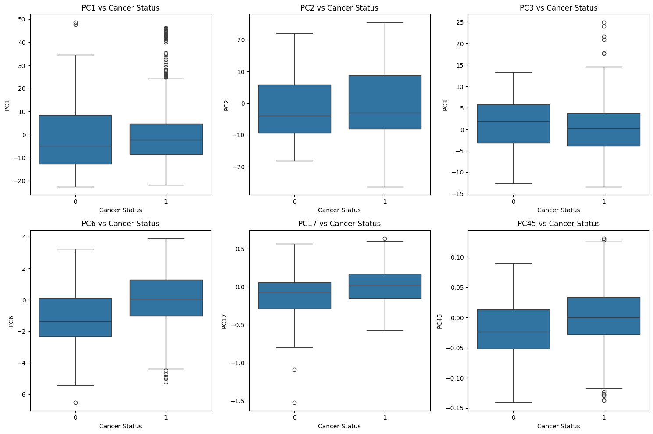

Visualizing Principal Components
Selected PC for Models:
1, 2, 3
6, 17, 4, 18, 45, 19, 30, 67, 42, 13, 29
High Variance + High Correlation
Box Plots of Selected Principal Components
9
Notes:
Kai Le
The cut-off then returns to us the best 14 features by importance which is far from the original 350 we started with. From that final 14, we then chose to look at the distribution of each individual input variable with relation to the response variable of which I have selected 6 to show in the slides today.
From the boxplot of the selected features, we can see that 5 out of the 6 of the input features shown have more than or equal to 3 outliers which verifies the result of the high number of outliers found within our dataset using the modified z-score method explained earlier. Not only that we can also see that the range per feature which is the difference between the maximum and minimum data points and therefore the inter quartile range for each feature also differs greatly contributing to the large variability with some in the magnitude in the 10s such as in PC1 where it goes from -20 to 50 to as low as 0.1 in PC45 which goes from -0.15 to 0.1.

Slide 10
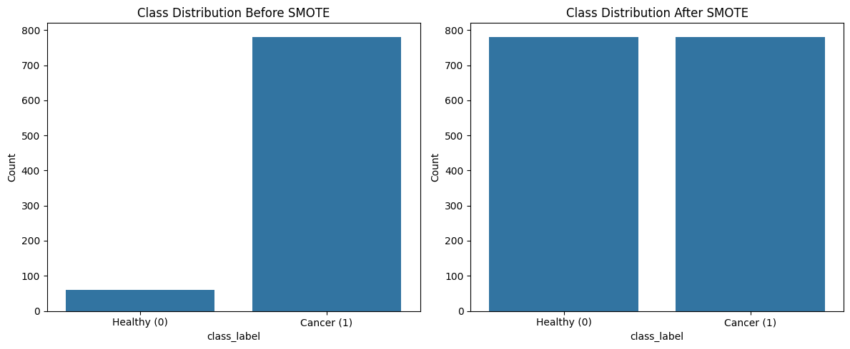
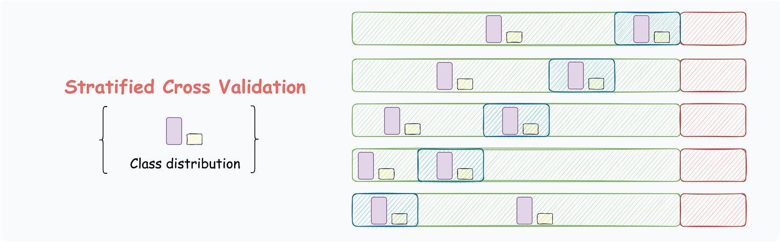
Addressing Class Imbalance with SMOTE & Stratified K-Fold Cross Validation
Balancing Class Distribution with SMOTE
Stratified 5-Fold Cross Validation
10
Notes:
Kai Le
Next, I will move on to the final step of our data preparation which is to address class imbalance. As Bryan pointed out earlier our data has a minority of healthy response, at only 10% of the data set. Hence there is a need to tackle this which is done by using Synthetic Minority Over-sampling Technique also known as SMOTE. SMOTE does this by selecting instances of our minority data which have a healthy response then identifies it K-nearest neighbours, where K is usually 5. It then selects one of the 5 randomly and interpolates a datapoint between the original and the neighbour rather than just a copy which creates variation resembling the true spread of the minority sample and reduces the likelihood of overfitting. These synthetic samples then help to balance out the distribution of the data set’s cancerous response.
After SMOTE is done, we then use stratified 5-fold cross validation specifically, to divide the data set into 5 folds with the same distribution, preventing the validation folds from reverting to the original imbalance. This ensures that the evaluation of our model’s performance remains accurate and that data integrity is maintained. Now I will pass the time to Ming Jie who will expand upon the methods and models we chose to use. Ming Jie, please.

Slide 11
03.
METHODS
Logistic Regression
Random Forest
Support Vector Machine
11
Notes:
Ming Jie
So for the next part, we will talk about the different models that we have used.

Slide 12
LOGISTIC REGRESSION
Hyperparameter | Param Grid
C | 0.02, 0.04, 0.06, 0.08, 0.10
Penalty | L1, L2
Solver | liblinear, saga
Max Iterations | 100, 200, 300, 400, 500
Class Weight | balanced
Hyperparameter | Param Grid
C | 0.02, 0.04, 0.06, 0.08, 0.10
Penalty | L1, L2
Solver | liblinear, saga
Max Iterations | 100, 200, 300, 400, 500
Class Weight | balanced
Probabilistic Output
Feature Coefficient Analysis
12
Notes:
Starting with Logistic Regression – We chose this model as a baseline for its simplicity and interpretability.
Logistic Regression outputs probability scores, which can help us gauge cancer risk clearly.
For each of the three models, we used GridSearchCV to tune and find the best hyperparameters.
For the regularization parameter ‘C’, which controls the balance between fitting the training data and keeping the model generalized. By using values from 0.02 to 0.1, we aimed to strike this balance—lower values of ‘C’ provide stronger regularization, which can reduce overfitting, while slightly higher values allow more flexibility.
We also considered penalty types (L1 and L2), which control how strongly certain features impact the model. L1 penalty performs feature selection by setting some coefficients to zero, making it useful if we want a sparse model, while L2 maintains all features with reduced impact, promoting a smoother decision boundary.
Finally, the solvers ‘liblinear’ and ‘saga’ were chosen for their efficiency with small datasets and ability to handle different types of regularization, respectively, while controlling the number of iterations to avoid excessive computation.
After using GridSearchCV, these were the best hyperparameters we obtained.
First is C = 0.1, which provided a good balance between bias and variance.
Then we have L2 for the penalty type, as it maintained all features in the model while reducing their impact to create a more generalizable decision boundary.
For the solver, ‘liblinear’ performed best, offering computational efficiency and compatibility with L2 regularization.

Slide 13
RANDOM FOREST
Hyperparameter | Param Grid
N Estimators | 5, 10, 15
Max Depth | 5, 10, 15
Min Samples Split | 5, 10, 15
Min Samples Leaf | 5, 10, 15
Max Features | log2, sqrt
Criterion | gini, entropy
Class Weight | balanced
Hyperparameter | Param Grid
N Estimators | 5, 10, 15
Max Depth | 5, 10, 15
Min Samples Split | 5, 10, 15
Min Samples Leaf | 5, 10, 15
Max Features | log2, sqrt
Criterion | gini, entropy
Class Weight | balanced
Powerful in Identifying Non-Linear Patterns
Robustness to Overfitting
13
Notes:
Moving on to Random Forest – We selected this model for its ability to handle complex, non-linear relationships, which are often present in medical data.
Since Random Forest builds an ensemble of decision trees, it’s particularly well-suited to capture interactions among features.
For hyperparameters, first is the number of trees (‘n_estimators’). Using values like 5, 10, and 15 allowed us to test models that weren’t overly complex but still captured enough patterns, as each tree adds to the model’s robustness.
We also tuned ‘max_depth’ to control how deep each tree could grow, which impacts overfitting; shallower depths reduce complexity and the risk of overfitting, while deeper trees increase it.
Similarly, we adjusted ‘min_samples_split’ and ‘min_samples_leaf’, setting minimum samples required for a split and minimum samples in each leaf node, respectively.
These settings help ensure that splits aren’t made on overly small data samples, which improves generalization.
For ‘max_features’, we tested ‘log2’ and ‘sqrt’ to limit the number of features considered at each split, helping reduce correlation between trees and improve model robustness.
Same as before, GridSearchCV gave us these hyperparameters.
15 for n_estimators was the optimal number, providing stability without overfitting.
The maximum depth (‘max_depth’) was best set to 15, which allowed each tree to grow deep enough to capture intricate patterns in the data.
min_samples_split and min_samples_leaf were both best set at 5, ensuring that splits were made only when nodes contained enough data, which improved generalization.
For max_features, we found that using ‘sqrt’ helped limit the number of features considered per split, which reduced correlation between trees and enhanced robustness.
Lastly, ‘entropy’ was chosen for the criterion, as it helps the model capture information gain, enhancing the interpretability of splits."

Slide 14
SUPPORT VECTOR MACHINE
Hyperparameter | Param Grid
C | 4.0, 4.2, 4.4, 4.6, 4.8, 5.0
Kernel | linear, rbf, sigmoid
Class Weight | balanced
Hyperparameter | Param Grid
C | 4.0, 4.2, 4.4, 4.6, 4.8, 5.0
Kernel | linear, rbf, sigmoid
Class Weight | balanced
Effective Boundary Creation for Classification
Kernel Flexibility
High Accuracy in High-Dimensional Data
14
Notes:
Lastly, we included Support Vector Machine (SVM), a model known for its effectiveness in high-dimensional spaces.
Given that our dataset has many features, SVM is great for finding an optimal separating hyperplane.
We tuned the regularization parameter ‘C’ to control the margin around the decision boundary.
A higher ‘C’ value allows the model to correctly classify more training points but risks overfitting, so we tested a range from 4.0 to 5.0 to find an ideal balance.
We also experimented with different kernel functions: the linear kernel for simpler boundaries, the radial basis function (RBF) kernel for capturing non-linear patterns, and sigmoid, which can model complex data relationships similarly to a neural network.
Testing these options allowed us to see how well each kernel aligned with our dataset’s structure and choose the one that fit best.
With GridSearchCV, the best C value was 5, which allowed the model to draw a tighter boundary around the training points while still generalizing well to new data.
For the kernel function, ‘linear’ provided the best fit, as it produced a straightforward separation in high-dimensional space.
This combination of high regularization with a linear kernel was effective in distinguishing between cancerous and healthy samples while minimizing overfitting.
Next, Daniel will talk about the results that we got from our testing.

Slide 15
04.
Results
Model performance evaluated on testing data using ROC AUC and Precision-Recall metrics.
15
Notes:
Daniel start

Slide 16
Model Performance
Machine Learning Models | Training ROC-AUC | Testing ROC-AUC | Testing PR-AUC
Logistic Regression | 0.919 | 0.857 | 0.979
Random Forest | 0.991 | 0.867 | 0.982
Support Vector Machine | 0.955 | 0.882 | 0.982
16
Notes:
After systematically tuning the hyperparameters and using cross-validation, we evaluated each model on both training and testing datasets. We measured model performance using ROC AUC and Precision-Recall AUC metrics to assess the quality of classifications. Here’s a summary of our models’ testing metrics:
Logistic Regression: ROC AUC of 0.857 and Precision-Recall AUC of 0.979, indicating it was a good baseline but struggled with more complex data patterns.
Random Forest: Achieved a higher ROC AUC of 0.867 and Precision-Recall AUC of 0.982, though it exhibited signs of overfitting.
Support Vector Machine (SVM): Outperformed the others with a ROC AUC of 0.882 and Precision-Recall AUC of 0.982, achieving optimal sensitivity and specificity.
This slide sets the stage for identifying SVM as the best-performing model."

Slide 17
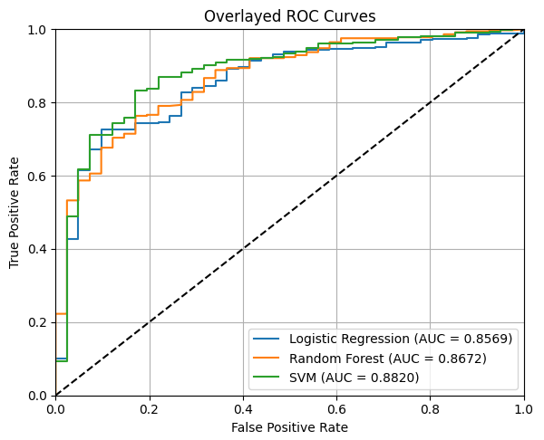
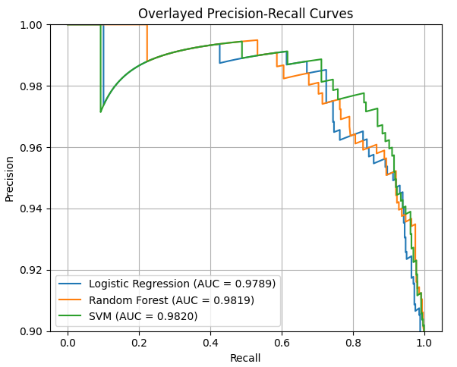
Performance Visualization
Receive Operating Characteristic Curve
Curves Precision Recall Curve
17
Notes:
Here, we illustrate the performance of each model using two primary visual tools:
Receiver Operating Characteristic (ROC) Curves – These show the trade-off between sensitivity and specificity. Notably, the SVM model maintained a True Positive Rate above 80% with a False Positive Rate below 20%.
Precision-Recall Curves – These curves underscore the high performance across models, particularly the SVM's capability in high-precision classifications, which is critical in our context.
These visualizations highlight SVM’s suitability for the task, given its optimal balance of accuracy and recall.”

Slide 18
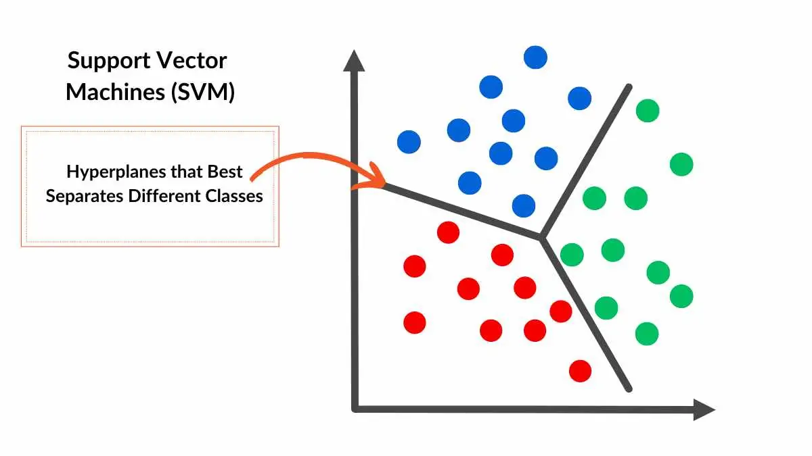
Best Model
Support Vector Machine
Highest Testing ROC AUC
Enhanced by PCA and SMOTE
Effective for complex classification tasks with imbalance
18
Notes:
Our results indicate that SVM is the most effective model for our classification task. The optimal configuration included:
Regularization parameter of 5.0
Balanced class weights
Linear kernel
This configuration allowed the SVM to achieve the highest ROC AUC and Precision-Recall AUC, while effectively maintaining high sensitivity and specificity. This model's robust performance was further enhanced by PCA and SMOTE, which helped manage dimensionality and class imbalance.

Slide 19
Societal Impact
PCA-based features may lack specific genomic interpretability, limiting real-world application in genomics
01.
02.
Potential for both job displacement and augmentation
03. Potentially save the lives of many
19
Notes:
Our project’s societal implications are multifaceted:
Interpretability Challenge: The use of PCA introduces abstract feature combinations, which may be difficult for genomics experts to interpret when pinpointing specific genes. This could impact the model's acceptance in the medical field.
Impact on Jobs: While machine learning in diagnostics can streamline workflows and improve accuracy, it may also disrupt traditional roles in diagnostics. However, it also opens up opportunities for professionals to focus on more complex cases and leverage data insights for improved patient care.
Saving lives

Slide 20
THANK YOU
TEAM MEMBERS’ CONTRIBUTION
BRYAN
25%
25%
KAI LE
DANIEL
25%
25%
MING JIE
20
Notes:
In summary, the Support Vector Machine (SVM) emerged as the best model for our cancer detection task, with the highest ROC and Precision-Recall AUC scores. Techniques like PCA and SMOTE were instrumental in refining our results, especially for high-dimensional, imbalanced data.
This project highlights the potential of machine learning in early cancer detection, balancing robust accuracy with real-world application challenges. Moving forward, focusing on interpretability will be key to enhancing its utility in medical settings.
Thank you for your attention, and we welcome any questions!

