Slide 1
IRIS
One brain. Two bodies.
A desktop AI assistant that talks, acts on your PC, and drives a robot with a face — free-first, offline-first, private.
two 128×64 OLED eyes, live
TEAM FRIDAY
Prajjwal Prasad · Shivnandan Sahu · Payal Gupta
TechRoot 4.0 · Working Model
IRIS · Team Friday · TechRoot 4.0
01
Notes:
Good morning. We are Team Friday and this is IRIS — a personal AI assistant that does not live in a chat box. It runs on a laptop, talks and listens in English, Hindi and Hinglish, controls the computer, and drives a robot that has a face. One brain — the laptop — and two bodies: the wheeled base and the face-and-sensor board. Everything you will see today runs on a phone hotspot with no internet needed for the commands.

Slide 2



01 · THE IDEA
Every assistant lives in a chat box. Ours lives on your desk.
Talks
Acts
Moves & senses
Voice or text, in English, Hindi or Hinglish. Wake it with “Hey Iris”. It replies out loud, in the language you used — and remembers what you tell it, across restarts.
Opens apps and sites, controls volume and windows, takes screenshots, sets reminders and routines, writes documents, slide decks and code. 77 tools, most of them fully offline.
Drives a four-motor robot and wears a face: two OLED eyes that react to what it says, plus four distance sensors, temperature, motion, gas and flame.
Free-first: every command works with zero API keys. Private by design: nothing leaves your network unless you add a key.
IRIS · Team Friday · TechRoot 4.0
02
Notes:
The problem we started from: assistants like Siri or ChatGPT answer questions, but they cannot open your files, they cannot lock your PC, and they certainly cannot roll across the room. We wanted one assistant that does three things: talks like a person, acts on the computer, and has a physical body. And two rules: it must work with zero paid services — a student budget — and it must be private: nothing leaves your own network unless you choose to add an API key.

Slide 3
02 · BY THE NUMBERS
What's actually in it
77
80
3
tools it can call
commands understood offline, in milliseconds
languages — English, Hindi, Hinglish
0
1,466
14
API keys required
automated tests, all passing
eye expressions on the robot's face
IRIS · Team Friday · TechRoot 4.0
03
Notes:
Some numbers so you know this is a working system, not a mock-up. 77 tools the assistant can call. 80 sentence patterns it understands instantly and offline — those never touch the internet. Three languages. Zero API keys are required: with none, commands still work; adding any one free key unlocks open conversation. 1,466 automated tests run on every change, and both firmwares compile-verified. The face knows 14 expressions.

Slide 4



03 · ARCHITECTURE
One brain, two bodies
THE BRAIN
UDP 8267 · HTTP
BODY ONE
Your laptop
The robot base
ESP32 · two BTS7960 drivers · four DC motors, skid steer · calibrates from its own web page
IRIS (Python)
voice → understanding → tools → speech
LLM router · memory · scheduler
web interface · phone pairing
The only place that thinks.
phone hotspot
2.4 GHz
BODY TWO
The face & senses
UDP 8267 · HTTP
ESP32-S3 · two OLED eyes · four ultrasonics · DHT22 · PIR · MQ-2 gas · flame · light
Every board is a body: no AI on it, it does what it is told and reports what it senses.
IRIS · Team Friday · TechRoot 4.0
04
Notes:
The architecture in one picture. The brain is a Python application on the laptop: speech-to-text, the understanding layers, the tools, the model router, memory, scheduler and the web interface. The bodies are two ESP32 boards on the same WiFi — in our case a phone hotspot. Body one is the robot base: an ESP32 with two BTS7960 motor drivers and four DC motors. Body two is an ESP32-S3 with the two OLED eyes and all the sensors. The boards have no AI on them at all: they do what they are told over one UDP packet and report what they sense. That keeps them cheap, fast and replaceable.

Slide 5
04 · UNDERSTANDING
How a sentence becomes an action
1
2
3
4
5
Wake word
Memory
Small talk
Commands
The model
“Hey Iris, …” is stripped. Works offline, no model.
“remember my budget is $500” — saved to disk, survives a restart.
Greetings, jokes, “who are you” — answered instantly.
80 sentence rules → the tool runs directly. ~8 ms, offline.
Anything else goes to a free LLM that can chain all 77 tools.
EXAMPLE
“robot forward” → rule robot_move → tool device_motor → one UDP packet to the board → 8 ms, measured.
IRIS · Team Friday · TechRoot 4.0
05
Notes:
This is the part we are proudest of, because it is why IRIS is fast and free. Every sentence goes through five layers in order, and stops at the first one that handles it. Layer one strips the wake word. Layer two catches memory sentences — 'remember my budget is 500 dollars' is saved to a database and survives a restart. Layer three is small talk: greetings, jokes, 'who are you'. Layer four is the important one: 80 hand-written sentence patterns that map straight to a tool. 'Robot forward' matches a rule and the motor command is on its way in about eight milliseconds — no model, no internet. Only what nothing else understood reaches layer five, a free language model that can chain any of the 77 tools itself.

Slide 6



05 · THE MODEL LAYER
Free first, never stuck
OpenRouter
Groq
Gemini
Cerebras
Mistral
…
Offline engine
tried in order · a provider that rate-limits is skipped for two minutes · the offline engine always answers
Any one free key unlocks conversation
A circuit breaker keeps the demo alive
Keys never leave the laptop
Without a key every command still works — the 80 offline rules never call the network. Add one key and IRIS starts chatting and chaining tools.
Free tiers meter tokens per minute. A failing provider is cooled down, the rest keep answering, and the transcript is always valid.
They live in a local .env, are never written to logs, and the robot boards never see them — a board only ever receives a command.
IRIS · Team Friday · TechRoot 4.0
06
Notes:
When a sentence does need a language model, IRIS does not depend on any one company. It has a list of providers with free tiers — OpenRouter, Groq, Google AI Studio, Cerebras, Mistral and more — and tries them in order. If one rate-limits us, a circuit breaker puts it in a two-minute cooldown and the next one answers; if all of them fail, an offline engine still replies. So a demo never stalls. Keys stay in a local .env file on the laptop. They are never logged and never sent to the robot.

Slide 7




06 · SAFETY
It can drive your whole desktop — so it is guarded in depth
Risk-graded permissions
Filesystem sandbox
Every tool declares its level — read, desktop action, confirm-required, high-risk. Shutdown needs an opt-in flag AND a confirmation click. Deletes always confirm.
File tools reach only your workspace and standard folders. ~/.ssh, key files and .env are blocked by pattern; symlinks are resolved before the check.
Command policy
Network boundaries
The shell tool is off by default. Even enabled, a hard denylist refuses rm -rf, fork bombs and curl | sh regardless of what any model says — and “run shutdown” cannot sneak through the app opener.
Device commands go only to private addresses. Phone and LAN access need a bearer token; the boards' own link needs a second, separate token.
IRIS · Team Friday · TechRoot 4.0
07
Notes:
An assistant that can open files and shut down a PC needs guard rails, and ours has four layers. Every tool declares a risk level; shutdown and restart need both an opt-in setting and a confirmation click. The filesystem is sandboxed: only your workspace and standard folders, and secrets like SSH keys are blocked by pattern. The shell tool is off by default and even when on, a hard denylist refuses destructive commands no matter what a model says — we also made sure 'run shutdown' cannot sneak through the app launcher. And the robots only accept commands from private addresses; remote access needs a token.

Slide 8
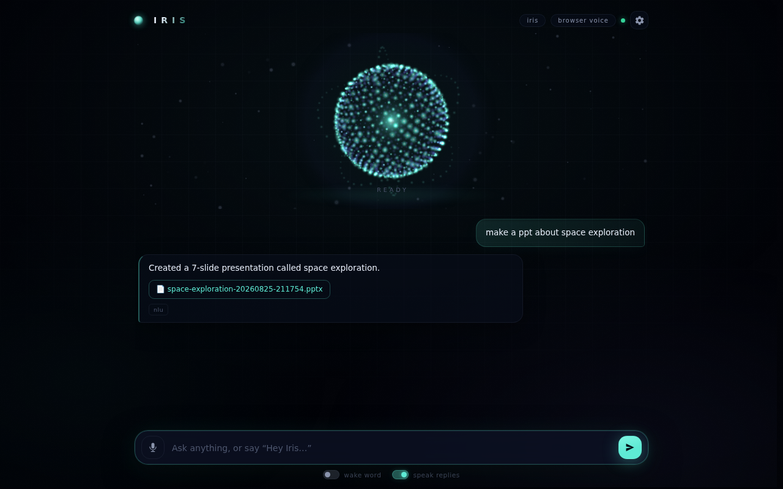



07 · THE INTERFACE
A face on the screen, too
A sphere that shows its state
Drifts when idle, blooms when listening, swirls while thinking, pulses as it speaks.
Five specialists
Operator, Scout, Scribe, Relay, Sentinel — the one whose tools are running lights up.
Any browser, any phone
Pair a phone by QR. Voice works with zero installs. A Telegram bot reaches it from anywhere.
IRIS · Team Friday · TechRoot 4.0
08
Notes:
This is the web interface — it runs in any browser, on the laptop or a phone paired by QR code. The particle sphere in the middle is alive: it drifts when idle, blooms when listening, swirls while thinking and pulses while speaking, so you always know what state it is in. Around it orbit five specialists — Operator, Scout, Scribe, Relay and Sentinel — and the one whose tools are running lights up. Here you can see a real exchange: 'make a ppt about space exploration' produced a seven-slide deck as a downloadable file, offline, in a few seconds.

Slide 9
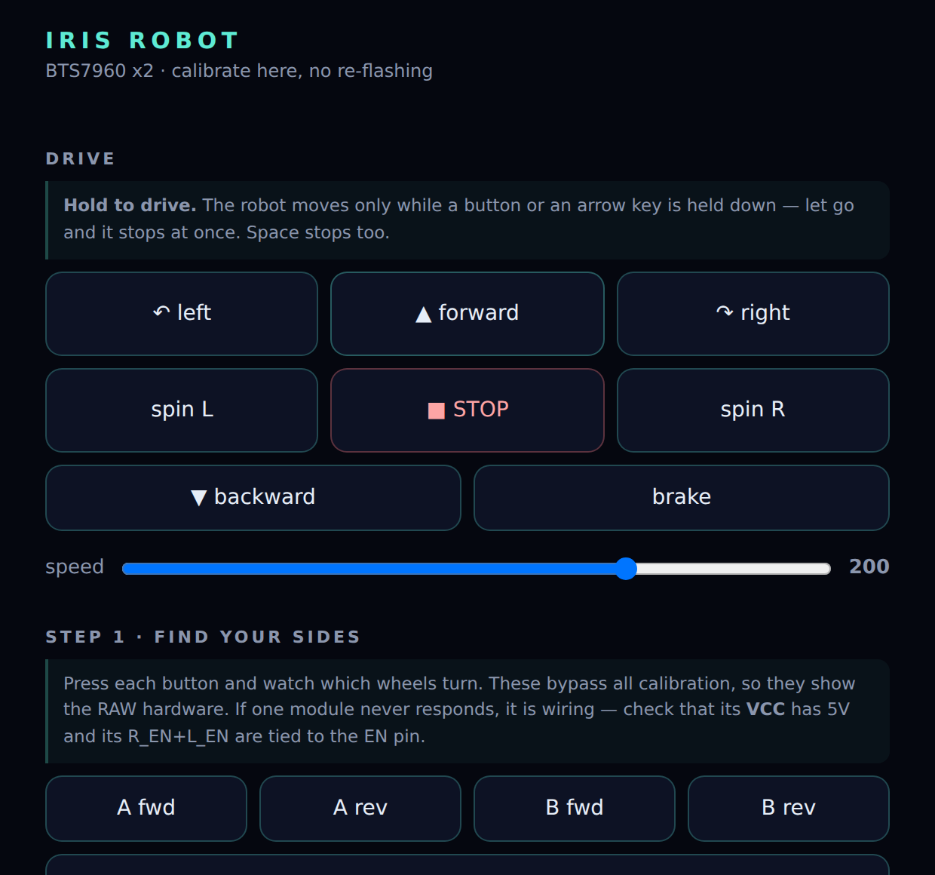




08 · BODY ONE
The robot base
ESP32 + two BTS7960 drivers
Four DC motors, two per side, skid steer. 20 kHz PWM so nothing whines.
Fail-safe on the board
Every move carries a deadline. Lose WiFi mid-drive and it stops by itself — the laptop is never trusted to say stop.
Soft ramp, 90 ms
Four motors starting at once would brown out the board. A short ramp makes it snappy without the reset.
Calibrate from its own page
Swap sides, invert, trim, ramp — saved to flash. Wrong-way wheels are fixed in a browser, never with a soldering iron.
the robot's own calibration page
IRIS · Team Friday · TechRoot 4.0
09
Notes:
The base is a skid-steer chassis: four DC motors, two per side, each side driven by a BTS7960 high-current driver from an ESP32. Safety is on the board, not on the laptop: every move carries a deadline, so if WiFi drops mid-drive the robot stops on its own. Motors ramp up over 90 milliseconds so four of them starting at once do not brown out the board. And the thing that saved us the most time: calibration happens on the robot's own web page — swap sides, invert a side, trim a faster side — saved to flash, no re-flashing, no re-wiring.

Slide 10
09 · LATENCY
Making it feel instant
BEFORE
AFTER
One client at a time. Arduino's web server held an idle browser socket for up to 5 s — every drive command waited behind an open tab.
43 ms before a packet left. IRIS built a fresh HTTP client per command: reading proxy settings, building an SSL context it never used.
One UDP datagram. The command is the URL's tail — “/motor?dir=forward” — answered on the board in the same loop pass, about a millisecond.
0.19 ms on the laptop. One client, reused, no proxy lookup. HTTP stays as the fallback, so nothing that worked before breaks.
5,000 ms
8 ms
10–25 ms
old worst case — one open browser tab
chat box → board, measured on a LAN
end to end on a phone hotspot
IRIS · Team Friday · TechRoot 4.0
10
Notes:
The robot used to feel laggy, and the reason was not the motors. Arduino's web server serves one client at a time and waits up to five seconds for a socket that has connected but not spoken — and browsers open exactly those idle sockets. So having the calibration page open queued the next drive command behind it. On the laptop side, every command was also building a fresh HTTP client, 43 milliseconds of CPU before a packet even left. Now a command is one UDP datagram to port 8267, answered on the board in the same loop pass, and the client is reused. Measured: eight milliseconds from the chat box to the board on a LAN, ten to twenty-five on a hotspot.

Slide 11
10 · BODY TWO
A face that reacts to what it says
neutral
IT READS ITS OWN SENTENCE
“Done! Your presentation is ready.”
→ excited
“Sorry, I could not find that file.”
→ sad
surprised
“Let me check the weather…”
→ thinking
“That is not allowed.”
→ angry
wake word heard
→ listening
“ho gaya, file mil gaya”
→ excited
sleepy
Between sentences it breathes, blinks (sometimes twice), glances around — and dozes off after three minutes of silence.
14 expressions · 40 fps · Hindi and Hinglish understood too
IRIS · Team Friday · TechRoot 4.0
11
Notes:
The face is two 128 by 64 OLED panels, one per eye, driven by an ESP32-S3. It knows fourteen expressions, but the trick that makes it feel alive is that you never have to command them: every time IRIS speaks, it reads its own sentence and sets a matching mood — 'Done!' is excited, 'Sorry, I couldn't' is sad, 'Let me check' is thinking — and bounces the eyes for as long as the sentence takes to say. Between sentences it breathes, blinks at random, glances around, and after three minutes of silence it dozes off. It runs at forty frames per second and the sensors never interrupt it.

Slide 12






11 · THE SENSES
Six senses on one board
TOP VIEW
4× HC-SR04 distance
DHT22
front-left 44 cm
front-right 42 cm
fired one at a time, timed by interrupts — never blocks the eyes
temperature and humidity, every 2.5 s
PIR motion
MQ-2 gas
“is anyone there?” — motion held for 30 s
alarm pushed the instant it trips
rear-left 118 cm
rear-right no echo
Flame (IR)
LDR light
fire yes/no — IRIS says it out loud, unasked
ambient light level
“42 cm ahead, 118 cm behind on the left.”
IRIS · Team Friday · TechRoot 4.0
12
Notes:
The same S3 board carries the senses. Four ultrasonic rangefinders — two facing forward, two backward — so IRIS can answer 'how far is the object' with a sentence: forty centimetres ahead, twelve behind on the left. They fire one at a time, timed by interrupts, so a measurement never freezes the eyes or delays a command. A DHT22 gives temperature and humidity, a PIR sees motion, an MQ-2 smells gas, an IR module sees flame, an LDR reads light. Flame and gas do not wait to be asked: the board pushes the alert the instant it appears and IRIS says it out loud with the eyes going wide.

Slide 13
12 · TALK TO IT
Say it any way you like
ENGLISH
HINGLISH
“robot forward”
“robot aage”
“stop the robot”
“robot ruko”
“what's the temperature”
“kitna garam hai”
“is there a fire”
“aag lagi hai kya”
“look happy”
“khush ho jao”
“how far is the object”
“kitna door hai”
also: “remind me every weekday at 9 to check email” · “make a ppt about space exploration” · “what's in my clipboard” · “lock my pc”
IRIS: “40 cm ahead, 12 cm behind on the left.”
IRIS · Team Friday · TechRoot 4.0
13
Notes:
You do not learn a command language; IRIS learns yours. Every one of these works offline, and every one has a Hinglish twin, because that is how we actually speak. And the answers are sentences, not numbers: ask how far the object is and it says 'forty centimetres ahead, twelve behind on the left', naming a side only when it matters.

Slide 14



13 · WHAT BROKE, AND WHAT IT TAUGHT US
Anything that can say “OK” without doing the thing, eventually will
A function that called itself
One open tab, five-second lag
The board answered 200 to every drive command and never moved a motor. Indistinguishable from unpowered drivers — we bisected the wiring for hours before reading the code.
Not the motors: the web server serves one client at a time and waits 5 s on an idle socket. Fixed with a UDP fast path the page never touches.
The chip, not the wiring
Two OLEDs, one address
GPIO 11–20 cannot read a voltage while WiFi is on. GPIO 19/20 belong to the USB port and must be taken back in code. Neither is fixable with a wire.
Every SSD1306 answers at 0x3C; on one bus they show one picture. So twin panels are a mode, and a second bus buys the wink.
The rule we build by now: refuse instead of defaulting. A missing argument is an error — never a silent stop.
IRIS · Team Friday · TechRoot 4.0
14
Notes:
We want to be honest about the hard part, because it is where we learned the most. Four bugs, each of which looked like a hardware fault and was not. A function that called itself: the board answered 200 to every drive command and never wrote a single duty cycle — we bisected the wiring for hours before reading the code. An open browser tab that queued every command for five seconds. Chip facts we had to learn: pins 11 to 20 cannot read analog while WiFi is on, and 19 and 20 belong to the USB port. And two OLEDs at the same address on one bus can only ever show one picture — which we turned into a feature. Our rule now: the firmware refuses instead of defaulting. A missing argument is an error, never a silent stop.

Slide 15
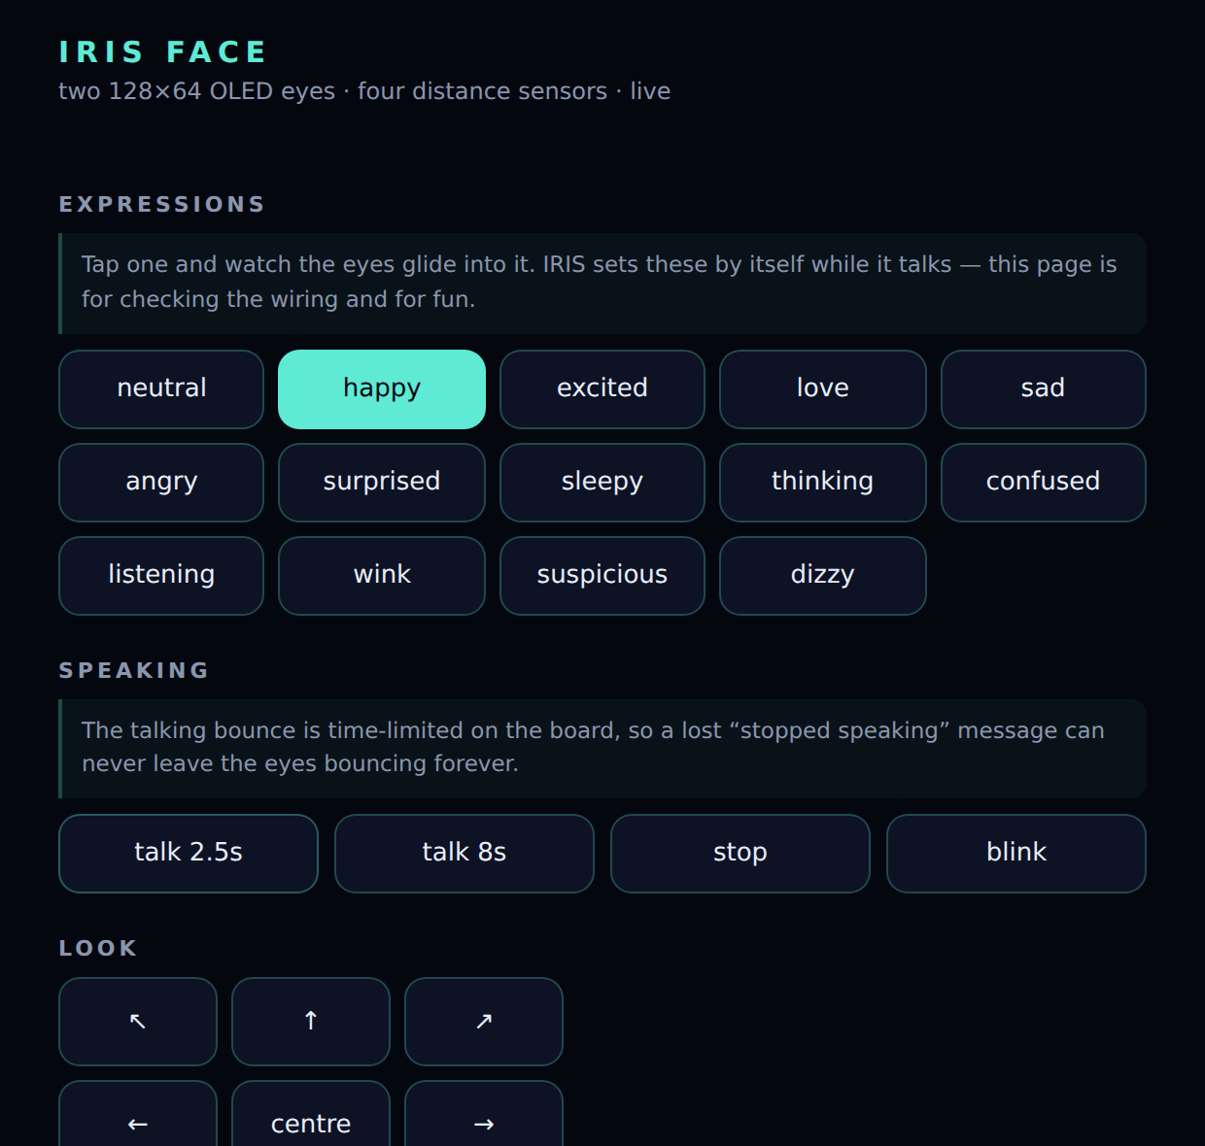
14 · LIVE DEMO
What we will show you
1
Drive by voice
“Hey Iris, robot forward” — then “robot ruko”. Eight milliseconds, offline.
2
Change its mood
“look happy” — the eyes glide into the expression; “wink” if the second bus is fitted.
3
Ask its senses
“what's the temperature” · “how far is the object” — answered as a sentence.
4
Make it speak up unasked
A hand in front of the PIR, a lighter near the flame module — IRIS reports it by itself, eyes wide.
5
Use the desktop
the face board's own page — every expression is a button
“make a ppt about space exploration” — a real .pptx in seconds, with no API key.
IRIS · Team Friday · TechRoot 4.0
15
Notes:
Now the live part. First, driving by voice: 'Hey Iris, robot forward', then 'robot ruko'. Second, the face: 'look happy' and watch the eyes glide into it. Third, the senses: ask the temperature, ask how far the object is. Fourth, an alert without asking: a hand in front of the motion sensor, and a lighter near the flame sensor — IRIS speaks up on its own. Fifth, the desktop side: 'make a ppt about space exploration' — a real PowerPoint file in a few seconds, no key needed. Everything runs on this phone's hotspot.

Slide 16



15 · NEXT, AND WHO
Where it goes from here
Voice on the robot
An I2S microphone and speaker on the face board — talk to the robot, not to the laptop. The firmware already carries the hooks.
TEAM FRIDAY
Prajjwal Prasad
Shivnandan Sahu
Payal Gupta
Autonomy
Four distance sensors, two ahead and two behind, are enough to steer around obstacles on their own.
Health
github.com/Kryn-devv/Iris_AI
A pulse oximeter on the same board turns IRIS into a home health assistant — readings by voice, alerts unasked.
open source · runs on a laptop and a phone hotspot
Thank you.
IRIS · Team Friday · TechRoot 4.0
16
Notes:
Three things come next. Voice on the robot itself, with an I2S microphone and speaker, so you talk to the face and not to the laptop. Autonomy: four distance sensors are enough to steer around obstacles on their own. And health: the same sensor board can carry a pulse oximeter, turning IRIS into a home health assistant. We are Team Friday — Prajjwal, Shivnandan and Payal. The whole project is open source at github.com/Kryn-devv/Iris_AI. Thank you — questions, or come and talk to it.

