Slide 1
Drift-Sense
AI-Powered Navigation-Error Recovery for Wafer Inspection Tools
A Siamese dense-correlation deep-learning localizer with a global-context head, trained on a physically-grounded synthetic DRAM-SEM generator, that locates a 100x reference patch inside a 10x search image to sub-pixel accuracy.
Team: KryonixNova
Members: [MEMBER NAME - ROLE] | [MEMBER NAME - ROLE] | [MEMBER NAME - ROLE]
College: [COLLEGE NAME]
Contact: [CONTACT EMAIL / PHONE]
SEMI x IESA Hackathon 2026 -- Applied Materials Problem Statement

Slide 2
Problem Understanding
Why navigation-error recovery matters in wafer inspection
• Semiconductor wafers contain highly repetitive, periodic microscopic structures (DRAM cell arrays: word lines, bit lines, storage-node contacts).
• Inspection tools must repeatedly revisit the same relative location across dies -- stage drift, vibration, and thermal effects cause the tool to land away from the intended site.
• Recovery is visual: given a previously-captured 100x close-up reference image, find the same structure inside a wider, lower-resolution 10x search image and return its centre coordinates.
• The core difficulty is not just matching -- it's disambiguation: a small reference patch can look near-identical to dozens of other lattice repeats. Simple template matching (e.g. classical ZNCC) frequently locks onto the wrong repeat with high confidence.
• Getting this wrong means the tool inspects, measures, or processes the wrong die location -- a real cost in a production inspection pipeline.
Drift-Sense -- KryonixNova

Slide 3
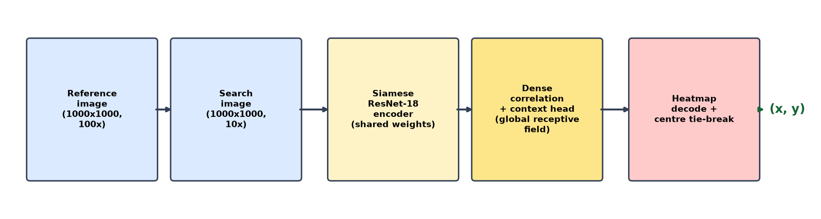
Proposed End-to-End Workflow
• generate_dataset.py builds physically-grounded synthetic reference/search pairs with recorded ground truth (see slide 4).
• localize.py runs the trained model on a pair or an evaluator-supplied batch, no source-code edits between modes.
• scripts/validation_report.py scores the pipeline across noise x geometry conditions and produces the required accuracy/runtime/failure-case report.
Drift-Sense -- KryonixNova

Slide 4
Synthetic-Data Design
DRAM-style structures, chosen and validated end-to-end
• Architecture: DRAM-style (folded-bitline 1T-1C array) -- word lines, bit lines, and a checkerboard of storage-node contacts (one per 2 cells, matching real folded-bitline layouts, not a naive full grid).
– Non-proprietary by construction: cell_pitch_nm, word/bit-line width, and contact size are free parameters. No specific process node is implied -- backed by public 1T-1C DRAM literature (see slide 5's citations).
• 6 distinct DRAM presets (dram_1x/dense/loose/wide/compact/legacy) drawn per mat, tiled in independent m x n grids separated by routing-strip material for realistic die-layout diversity.
• Every pair records: random seed, architecture, transformations (scale/rotation), noise settings, and true target-centre coordinates -- full per-pair metadata for reproducibility.
– FinFET pattern code (src/patterns/finfet.py) exists in the repository but was not wired into training for this submission -- DRAM was the chosen, validated architecture (see Limitations, slide 11).
Drift-Sense -- KryonixNova

Slide 5
Noise, Blur, Scale & Rotation Modelling
Every augmentation choice backed by a public source
• Imaging degradation (two severity profiles, normal/harsh): Poisson shot noise (dose-driven electron-count proxy), detector noise, astigmatism, vignetting, barrel distortion, charging streaks, beam-drift jitter, speckle, salt-and-pepper.
• Scale robustness: reference crops jittered 0.9x-1.1x (an effective 9:1-11:1 relationship against the nominal 10:1), matching the spec's stated test range.
• Rotation robustness: +/-1-2 degree rotation applied to reference crops post-imaging, simulating real capture calibration/stage drift -- ground truth is unaffected, only the reference's content is perturbed.
• Citations:
– imec, "DRAM peripheral transistors technology platform" -- 1T-1C cell structure.
– SemiAnalysis, "The Memory Wall: Past, Present, and Future of DRAM" -- word/bit-line array structure.
– "Correction of SEM Imaging Artifacts..." (Experimental Mechanics, PMC) -- drift/charging-driven image distortion.
– "SEM Image SNR Monitoring for Micro-Nanomanipulation" (HAL) -- Poisson shot-noise physical basis.
– Two arXiv papers on training-time rotation/scale augmentation for deep template matching and orientation invariance in feature matchers.
Drift-Sense -- KryonixNova | full citations in references/CITATIONS.md

Slide 6
Localization Method & Decision Rule
Deep learning: dense correlation + global context
• Siamese ResNet-18 encoder (destrided, no pretrained weights) -- shared weights encode both the reference and search images into feature maps.
• Dense depthwise cross-correlation slides the reference feature template across the search feature map, producing a correlation heatmap over candidate locations.
• 9-layer dilated convolution context head with a global receptive field -- this is what a purely local encoder/correlation step cannot do: resolve which of several identical-looking lattice repeats is the true match, using mat/die boundaries and aperiodic imaging noise as disambiguating context.
• Training targets: Gaussian heatmap peak + sub-cell offset regression. Loss: focal heatmap loss + offset L1 + a hard-negative margin term.
• Decode: NMS peak extraction, with an explicit centre-tiebreak rule -- if multiple valid matches exist, the candidate closest to the search image's centre is chosen, exactly matching the spec's tie-break requirement.
• Confidence is a peak margin, not a raw score -- the classical ZNCC baseline scored misleadingly high (0.9+) even when wrong ~35% of the time, so absolute score alone doesn't separate right from wrong for this task.
Drift-Sense -- KryonixNova

Slide 7
Implementation & Execution
Runs without manual edits, on a fresh machine
• Setup:
– pip install -r requirements.txt
• Generate a dataset (architecture, sample count, output dir all parameterized):
– python generate_dataset.py --split test --num-samples 30 --output-dir ./output
• Run inference on a single pair (the script Applied Materials will run):
– python localize.py --reference ref.png --search search.png --xy-only
• Run inference on an evaluator-supplied batch manifest:
– python localize.py --manifest manifest.csv --output predictions.csv
• Reproduce the full validation report (accuracy, runtime, failure case):
– python scripts/validation_report.py --checkpoint checkpoints/production_v3/best.pt --n-per-condition 50 --out-dir results
• Generator (generate_dataset.py) and inference (localize.py) are separate, independently-runnable Python scripts -- not a single notebook.
Drift-Sense -- KryonixNova

Slide 8
Experiment Setup & Test Diversity
• scripts/validation_report.py: 200 independently-generated pairs (50 per condition) across all 4 imaging-noise x geometric-profile combinations (normal/normal, harsh/normal, normal/drift, harsh/drift).
• results/sample_dataset/: a committed, concrete 32-pair example (8 per condition) run end-to-end through generate_dataset.py -> localize.py, combined ground-truth + prediction CSV.
• Diversity covered per the spec's validation requirements:
– Noise levels: normal and harsh imaging-noise profiles.
– Target positions: random reference-crop placement per canvas, every sample.
– Scale: 0.9x-1.1x reference jitter (9:1-11:1 effective ratio).
– Rotation: +/-1-2 degree reference rotation.
– 6 DRAM presets, multiple m x n mat-tiling configurations.
• All test samples drawn from a canvas-disjoint seed range, never overlapping training/validation seeds.
Drift-Sense -- KryonixNova

Slide 9
Results: Accuracy, Error Statistics & Runtime
Condition | n | Mean err (px) | Median err (px) | pass@5px | pass@4px | pass@2px | pass@1px
normal / normal | 50 | 0.64 | 0.57 | 1.000 | 1.000 | 1.000 | 0.860
harsh / normal | 50 | 4.32 | 3.59 | 0.640 | 0.540 | 0.340 | 0.220
normal / drift | 50 | 0.67 | 0.59 | 1.000 | 1.000 | 1.000 | 0.860
harsh / drift | 50 | 4.28 | 3.44 | 0.640 | 0.540 | 0.340 | 0.220
• Pooled: n=200, mean error = 2.47px.
• Runtime: median 22.0ms per pair (model.predict() only, wall-clock via time.perf_counter()) on an NVIDIA GeForce RTX 5060 Ti, Python 3.12.13 -- excludes one-time model-load cost and PNG decode, reported separately.
• results/sample_dataset/ (32-pair committed example): mean error 2.00px, pass@5px = 0.906.
Drift-Sense -- KryonixNova | checkpoint: production_v3

Slide 10
Robustness Comparison & Ablations
• Baselines (scripts/evaluate_localizer.py): B0 classical ZNCC template matching, B1 10x10 grid search, vs. this model (dense correlation + context head) on identical canvas-disjoint samples -- ZNCC scores misleadingly high confidence even when wrong ~35% of the time; this model's margin-based confidence does not share that failure mode.
• Checkpoint trade-off (an honest, load-bearing finding, not a footnote):
Checkpoint | Pooled mean err | harsh/normal pass@5px | Notes
production_v3 (default) | 2.47px | 0.640 | Consistent across all 4 tested conditions
production_v5 (AFB fine-tune) | 41.06px | 0.260 | 100% on real AFB imagery, but lost most harsh-noise robustness
• production_v5, fine-tuned on 5000 real AFB-rendered samples, reaches 100% accuracy at every tested tolerance on an independent 2000-sample AFB test set -- but this same validation matrix shows it lost most of production_v3's harsh-noise robustness in the process. Since sponsor test-data noise characteristics are unknown, production_v3's consistency is the safer default (see README section 4/6).
• A1 ablation (ablation_jitter.py): tests whether the model relies on synthetic noise fingerprints rather than genuine aperiodicity -- a normal->shifted accuracy drop would indicate overfitting to one noise distribution instead of learning aperiodicity in general.
Drift-Sense -- KryonixNova

Slide 11
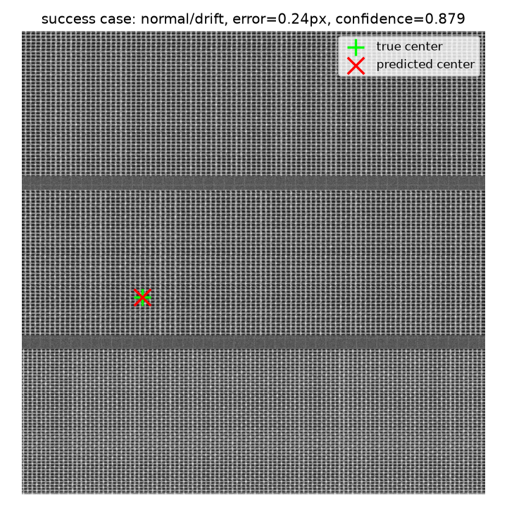
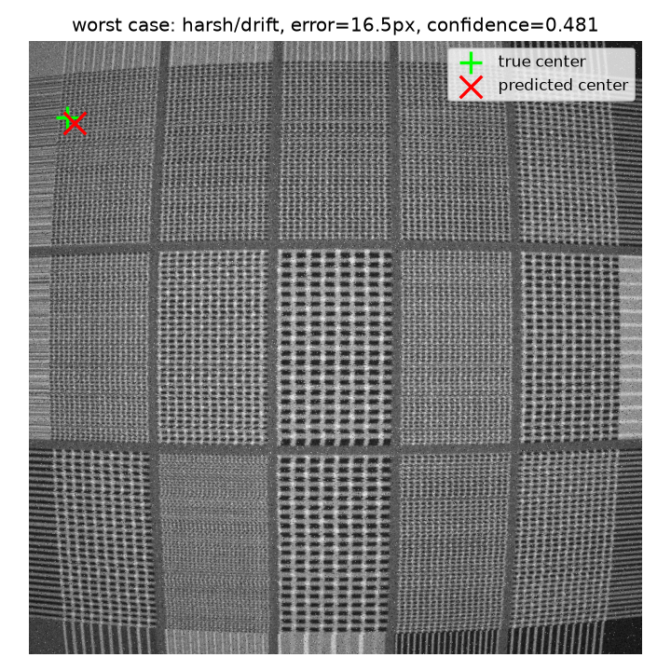
Failure Case, Limitations & Learnings
• SUCCESS (left): normal noise, drift geometry -- 0.24px error, confidence 0.879.
• HONEST FAILURE (right): harsh noise, drift geometry -- 16.5px error, confidence 0.481. The model stayed moderately confident despite the large error, suggesting a genuine structural look-alike (periodic-pattern ambiguity) rather than an easily-flagged low-confidence guess -- exactly the failure mode the context head is designed to reduce, not eliminate.
• Limitations: DRAM-only training (FinFET unwired); harsh-noise conditions remain the hardest case (pass@1px ~0.22); production_v5 shows a real, measured generalization-vs-robustness trade-off, not yet resolved.
• Learning: catastrophic forgetting appeared twice on different axes -- narrowing training to specific DRAM presets, and fine-tuning on real AFB data -- motivating future work on training that preserves broad robustness while adding new capability.
Drift-Sense -- KryonixNova

Slide 12
Conclusion & Next Steps
• Drift-Sense demonstrates that a Siamese dense-correlation model with an explicit global-context head reliably resolves periodic-DRAM-lattice ambiguity that simple template matching cannot -- 2.47px pooled mean error, 22ms median runtime per pair.
• Every structural, noise, and augmentation choice is backed by public sources and documented per-pair generation metadata (references/CITATIONS.md).
• Next steps:
– Wire src/patterns/finfet.py into the training pipeline for genuine dual-architecture support.
– Investigate mixed real+synthetic fine-tuning to recover production_v5's AFB generalization without losing production_v3's noise robustness.
– RGB optical-image extension (bonus criterion) once the grayscale SEM task is fully hardened.
•
• Repository: https://github.com/nihaltodurkar-cms/puthere
• Demo video (optional): [VIDEO LINK]
Drift-Sense -- KryonixNova

