Slide 1
Enhancing Autonomous Navigation Robustness in Unstructured Environments using Quantum-Seeded Procedural Maze Generation
Batangas State University - College of Informatics and Computing Sciences
Antony, Aldrich Ryan V. | Baricante, Mark Angelo R. | Mirabel, Kevin Hans Aurick S.
Adviser: John Richard M. Esguerra, MSCS
April 8, 2026

Slide 2
Overview of the Study
Background
Procedural Content Generation (PCG) relies on PRNGs to create diverse training environments for Deep Reinforcement Learning agents
Quantum Random Number Generators (QRNGs) provide true randomness from quantum phenomena — but have never been tested in PCG
Research Problem
Does the source of seed-level randomness affect maze structural diversity and DRL agent generalization?
Motivation
DRL agents overfit to training environments; structural randomization is underexplored compared to visual domain randomization

Slide 3
Research Gap
Existing PCG studies exclusively use PRNGs — no empirical evaluation of QRNG in procedural generation
Domain randomization research focuses on visual changes (textures, lighting, colors), not structural randomization of the environment itself
No study has tested whether true quantum entropy improves DRL zero-shot generalization in navigation tasks
This study bridges the gap: first empirical benchmark of QRNG-seeded procedural generation for DRL training environments

Slide 4
Objectives of the Study
General Objective
Evaluate the impact of QRNG vs. PRNG seeds on procedural maze generation and DRL agent navigation robustness
Specific Objectives
1. Determine how different sources of randomness (PRNGs and QRNGs) influence the structural metrics — path length, tortuosity, dead-end count — and overall diversity of maze training environments
2. Determine the extent to which QRNG-based sources impact the training of autonomous navigation models in terms of success rate and rewards over episodes
3. Evaluate the performance of DRL agents trained in QRNG-seeded vs. PRNG-seeded mazes on unseen environments, in terms of success rate, reward, efficiency, and generalization

Slide 5
Conceptual Framework
INPUT
• PRNG Seeds (Mersenne Twister, 64-bit) • QRNG Seeds (ANU Quantum API, 64-bit) • Recursive Backtracking Algorithm
PROCESS
• Maze Generation & Feature Extraction • Maze Structural Evaluation • DRL Model Training (A2C, DQN, PPO) • Generalization Testing
OUTPUT
• Maze Structure Comparison • RL Performance Evaluation • QRNG Suitability Assessment • Benchmarking Framework
Control Group (Agent_PRNG)
Trained on PRNG-seeded mazes 10M timesteps × 3 trials Baseline for comparison
Experimental Group (Agent_QRNG)
Trained on QRNG-seeded mazes 10M timesteps × 3 trials Tests quantum entropy hypothesis

Slide 6
Methodology: Overall Pipeline
1
Generate Seeds
PRNG: Mersenne Twister (64-bit) QRNG: ANU API → bitwise concat to 64-bit
2
Validate Seed Quality
Shannon Entropy Autocorrelation (lag 0–100)
3
Generate Mazes
Recursive Backtracking 20×20 grid, 71,800 per group
4
Extract Maze Metrics
Path length, tortuosity, dead-ends Junction proportions, corridor analysis
5
Train DRL Agents
A2C, DQN, PPO 10M timesteps, 3 trials each
6
Evaluate Generalization
1,000 unseen mazes per condition Intra-domain + Cross-domain
7
Statistical Comparison
Shapiro-Wilk → Mann-Whitney U PERMANOVA (p=0.05)

Slide 7
Model / Algorithm Design
Environment Configuration
DRL Architectures
Maze: 20×20 grid, recursive backtracking
Observation: 10-dim vector (8 LiDAR rays + 2D target)
Action space: {Up, Down, Left, Right}
Episode limit: 500 steps
Input(10) → MLP Hidden Layers → Output(4 actions)
A2C — Actor-Critic Hybrid
MLP(64, 64) LR: 7×10⁻⁴ Entropy Coeff: 0.0
Reward Structure:
Goal Achieved: +250
Wall Collision: -0.75
Step Penalty: -0.005
New Cell Exploration: +2.0
Progress Reward: +0.5 × improvement
Timeout: -7
DQN — Value-Based
MLP(256, 256) LR: 1×10⁻³ ε-greedy: 1.0→0.05
PPO — Policy Gradient
MLP(256, 256) LR: 3×10⁻⁴ Entropy Coeff: 0.01
Three DRL families to benchmark the randomness source, not the model

Slide 8
Experimental Setup
Dataset
71,800 PRNG seeds (Mersenne Twister) + 71,800 QRNG seeds (ANU Quantum API)
143,600 total 20×20 mazes generated via recursive backtracking
~35,000–40,000 training mazes per condition | 1,000 unseen evaluation mazes per condition
Algorithm-Specific Configurations
Parameter | DQN | A2C | PPO
Learning Rate | 1 × 10⁻³ | 7 × 10⁻⁴ | 3 × 10⁻⁴
Batch Size | 512 | N/A (rollout) | 512
Network | MLP(256, 256) | MLP(64, 64) | MLP(256, 256)
Exploration | ε-greedy (1.0→0.05) | Entropy: 0.0 | Entropy: 0.01
Timesteps / Trials | 10M / 3 | 10M / 3 | 10M / 3
Tools: Python | Stable-Baselines3 | Gymnasium | scipy.stats | ANU Quantum Random Number API

Slide 9
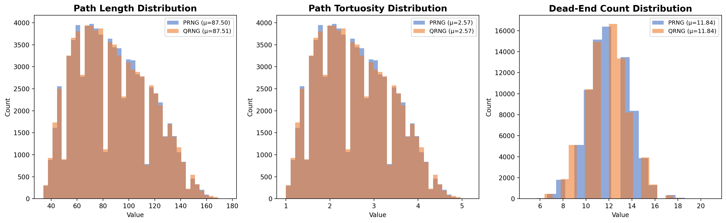
Maze Structural Analysis: PRNG vs QRNG
Key Metrics
Path Length: PRNG μ=87.50 | QRNG μ=87.51
Tortuosity: Both μ=2.57, Md=2.47
Dead-Ends: Both μ=11.84, Md=12.00
Statistical Validation
Mann-Whitney U: all p > 0.05
PERMANOVA: p = 0.7493
ERA Hull: PRNG=0.0131, QRNG=0.0125
The maze generation algorithm — not the seed source — determines structural output

Slide 10
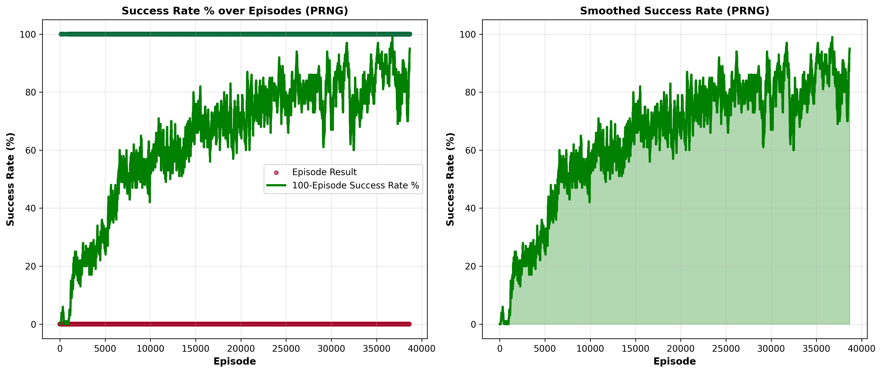
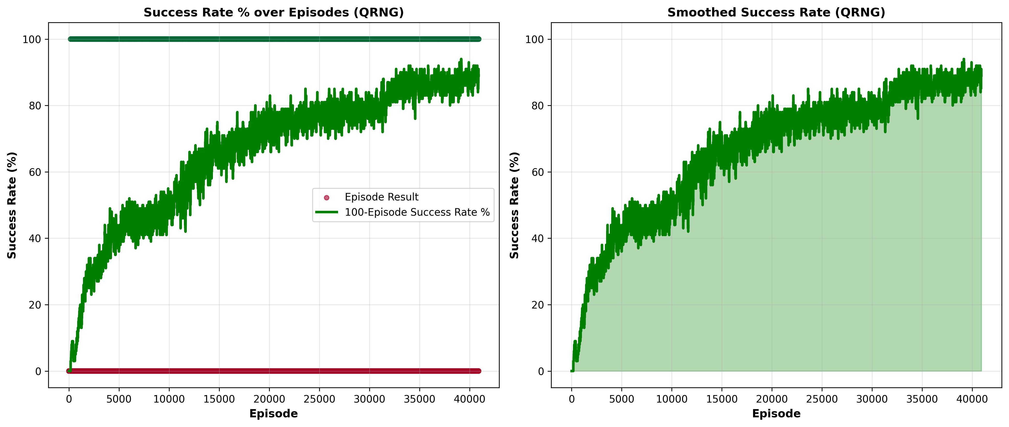
DRL Agent Performance: QRNG vs PRNG
PPO Training Curves (Success Rate)
PRNG: Higher variance, 1 trial collapsed
QRNG: Tighter clustering, consistent
Generalization Evaluation (Intra vs Cross-Domain)
Algorithm | Agent | Intra SR | Cross SR | Gap (pp)
A2C | PRNG | 61.20% | 60.30% | +0.90
A2C | QRNG | 58.70% | 59.50% | -0.80
DQN | PRNG | 11.03% | 12.37% | -1.33
DQN | QRNG | 9.80% | 8.97% | +2.57
PPO | PRNG | 73.27% | 71.53% | +1.74
PPO | QRNG | 72.43% | 74.00% | -1.57

Slide 11
Key Findings & Interpretation
What Improved?
Why No Significant Difference?
Limitations
QRNG-trained agents showed tighter inter-trial convergence (PPO, A2C)
QRNG-trained PPO showed slight negative generalization gap (-1.57 pp) — marginally better cross-domain transfer
Recursive backtracking algorithm acts as a structural bottleneck
Constrains output diversity regardless of seed entropy quality
Both seed sources passed identical randomness validation (Shannon entropy = 1.0)
Limited to 20×20 2D mazes and one generation algorithm
DQN poorly suited to partial observability (LiDAR-based POMDP)
QRNG constrained by API rate limits (71,800 seeds)

Slide 12
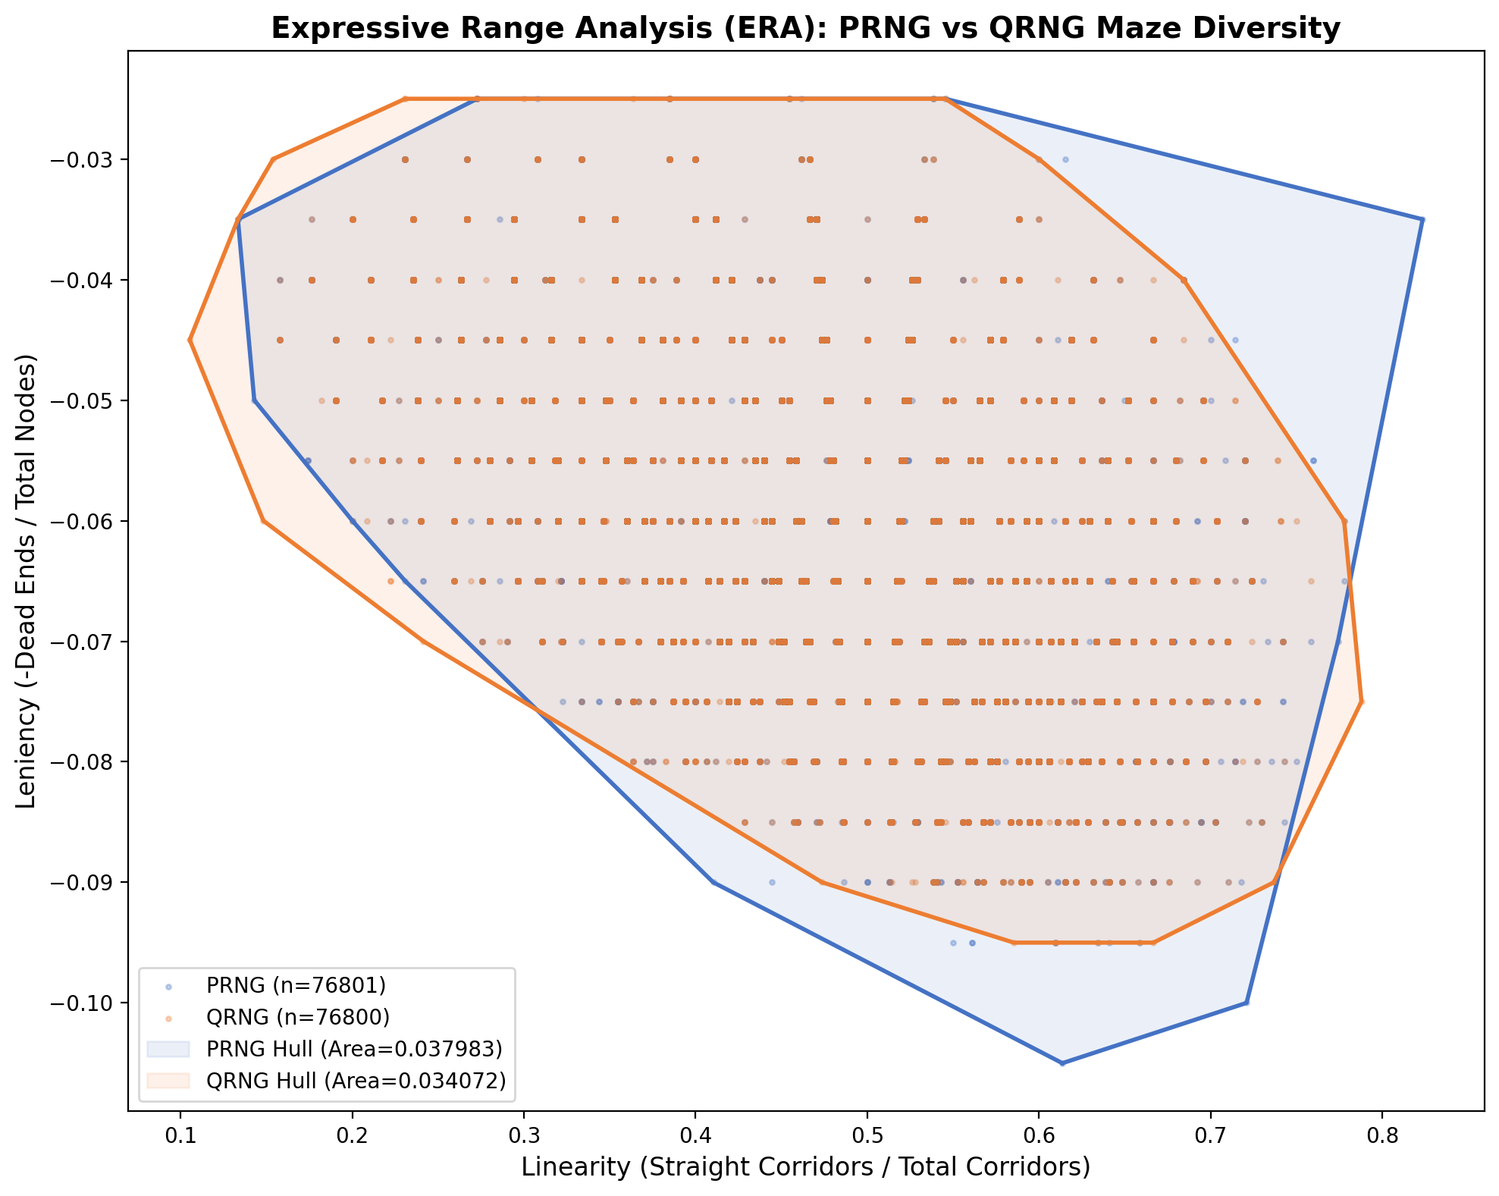
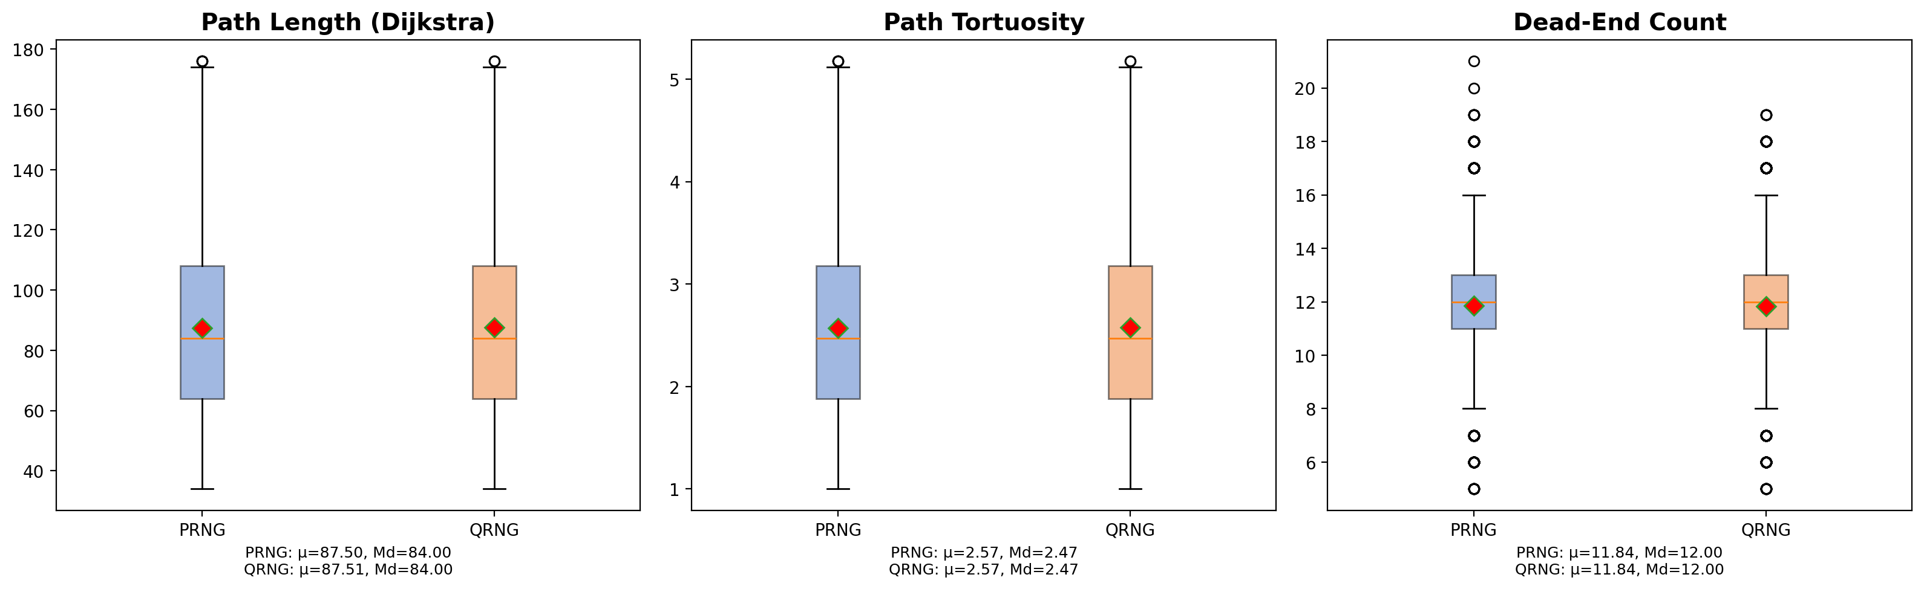
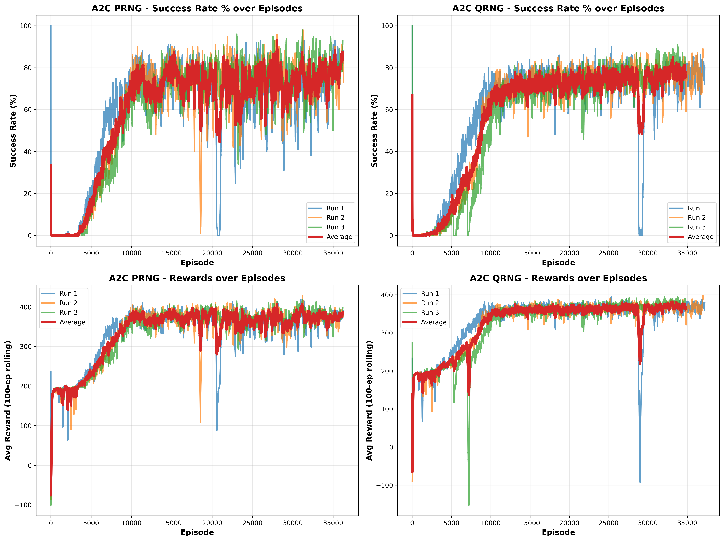
Implementation Evidence

Slide 13
Conclusions
Objective 1: Structural Diversity
Fail to reject H₀ — No significant structural difference between PRNG and QRNG mazes (Mann-Whitney U: all p > 0.05, PERMANOVA: p = 0.7493) The generation algorithm is the primary determinant of structural output.
Objective 2: Training Impact
Fail to reject H₀ — Both seed conditions produced comparable training success rates and reward progression across A2C, DQN, and PPO over 10M timesteps.
Objective 3: Generalization
Fail to reject H₀ — All generalization gaps within ±2.6 percentage points across all architectures. Seed-level randomness has no measurable impact on zero-shot generalization.
The recursive backtracking algorithm — not the entropy source — is the critical bottleneck for structural diversity in procedural maze generation.

Slide 14
Recommendations for Future Work
1
Use QRNG directly in maze generation via custom Fisher-Yates shuffle — bypass the Mersenne Twister intermediary entirely
2
Test alternative generation algorithms (Wilson's, Prim's) that impose fewer structural constraints on output diversity
3
Scale to larger mazes (30×30, 40×40) where structural memorization becomes harder and seed entropy may matter more
4
Replace DQN with DRQN (recurrent variant) to fairly evaluate value-based methods under partial observability
5
Investigate QRNG's training stability effect — the tighter PPO/A2C convergence clustering warrants study with 10+ trials

Slide 15
Thank You
Antony, Aldrich Ryan V. | Baricante, Mark Angelo R. | Mirabel, Kevin Hans Aurick S.
Adviser: John Richard M. Esguerra, MSCS
We are ready for your questions.

