Slide 1
Enhancing Autonomous
Navigation Robustness
in Unstructured Environments using
Quantum-Seeded Procedural Maze Generation
Batangas State University — College of Informatics and Computing Sciences
Antony, Aldrich Ryan V. · Baricante, Mark Angelo R. · Mirabel, Kevin Hans Aurick S.
Adviser: John Richard M. Esguerra, MSCS · April 8, 2026

Slide 2



Overview of the Study
Background
Research Problem
Motivation
PCG relies on PRNGs to create diverse DRL training environments.
QRNGs provide true randomness from quantum phenomena — but have never been tested in PCG.
Does the source of seed-level randomness affect maze structural diversity and DRL agent generalization?
DRL agents overfit to training environments. Structural randomization is underexplored vs. visual domain randomization.

Slide 3
Research Gap
1
Existing PCG studies exclusively use PRNGs — no empirical evaluation of QRNG in procedural generation
2
Domain randomization research focuses on visual changes (textures, lighting, colors), not structural randomization of the environment itself
3
No study has tested whether true quantum entropy improves DRL zero-shot generalization in navigation tasks
This study bridges the gap: first empirical benchmark of QRNG-seeded procedural generation for DRL training environments.

Slide 4
Objectives of the Study
General Objective
Evaluate the impact of QRNG vs. PRNG seeds on procedural maze generation and DRL agent navigation robustness.
01
Determine how different sources of randomness influence maze structural metrics — path length, tortuosity, dead-end count — and overall diversity
02
Determine the extent to which QRNG-based sources impact the training of autonomous navigation models in terms of success rate and rewards
03
Evaluate the performance of DRL agents trained in QRNG-seeded vs. PRNG-seeded mazes on unseen environments, in terms of generalization

Slide 5

Conceptual Framework
INPUT
PROCESS
OUTPUT
PRNG Seeds (Mersenne Twister, 64-bit)
QRNG Seeds (ANU Quantum API, 64-bit)
Recursive Backtracking Algorithm
Maze Generation & Feature Extraction
Maze Structural Evaluation
DRL Model Training (A2C, DQN, PPO)
Generalization Testing
Maze Structure Comparison
RL Performance Evaluation
QRNG Suitability Assessment
Benchmarking Framework
Control Group (Agent_PRNG)
Experimental Group (Agent_QRNG)
Trained on PRNG-seeded mazes
32M timesteps × 3 trials
Baseline for comparison
Trained on QRNG-seeded mazes
32M timesteps × 3 trials
Tests quantum-entropy hypothesis

Slide 6
Methodology Pipeline
1
Generate Seeds
PRNG: Mersenne Twister (64-bit)
QRNG: ANU API → bitwise circuit to 64-bit
2
Validate Seed Quality
Shannon Entropy
Autocorrelation (lag 0–300)
3
Generate Mazes
Recursive Backtracking
20×20 grid, 71,800 per group
4
Extract Maze Metrics
Path length, tortuosity, dead-ends
Junction proportions, corridor analysis
5
Train DRL Agents
A2C, DQN, PPO
32M timesteps, 3 trials each
6
Evaluate Generalization
1,000 unseen mazes per condition
Intra-domain + Cross-domain
7
Statistical Comparison
Shapiro-Wilk → Mann-Whitney U
Permutation test (p<0.05)

Slide 7
Model & Algorithm Design
Environment Configuration
DRL Architectures
Maze: 20×20 grid, recursive backtracking
Observation: 10-dim vector (8 LiDAR rays + 2 goals)
Action space: {Up, Down, Left, Right}
Episodes: 32M timesteps per training run
A2C
Actor-Critic Hybrid
MLP(64, 64)
LR: 7×10⁻⁴
Entropy Coeff: 0.0
DQN
Value-Based
Reward Structure
MLP(64, 64)
LR: 1×10⁻⁴
ε-greedy: 1.0→0.05
Goal Achieved
+100
Wall Collision
-0.75
Step Penalty
-0.065
PPO
Policy Gradient
New Cell Exploration
+1.5
Progress Reward
+0.5
MLP(256, 256)
LR: 3×10⁻⁴
Entropy: 0.0
Timeout
-7

Slide 8
Experimental Setup
Dataset
71,800
71,800
143,600
PRNG seeds
QRNG seeds
total 20×20 mazes
Algorithm-Specific Configurations
Parameter | DQN | A2C | PPO
Learning Rate | 1×10⁻⁴ | 7×10⁻⁴ | 3×10⁻⁴
Batch Size | 512 | N/A (rollout) | 512
Network | MLP(64, 256) | MLP(64, 64) | MLP(256, 256)
Exploration | ε-greedy (1.0→0.05) | Entropy: 0.0 | Entropy: 0.0
Timesteps / Trials | 32M / 3 | 32M / 3 | 32M / 3
Tools: Python | Stable-Baselines3 | Gymnasium | numpy/stats | ANU Quantum Random Number API

Slide 9
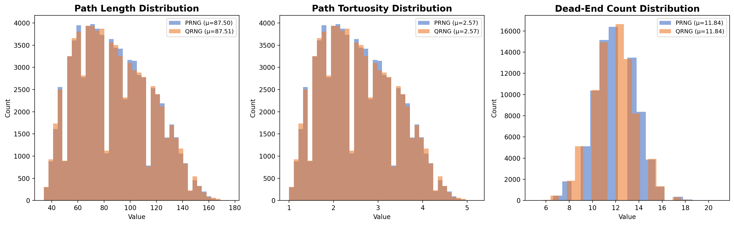
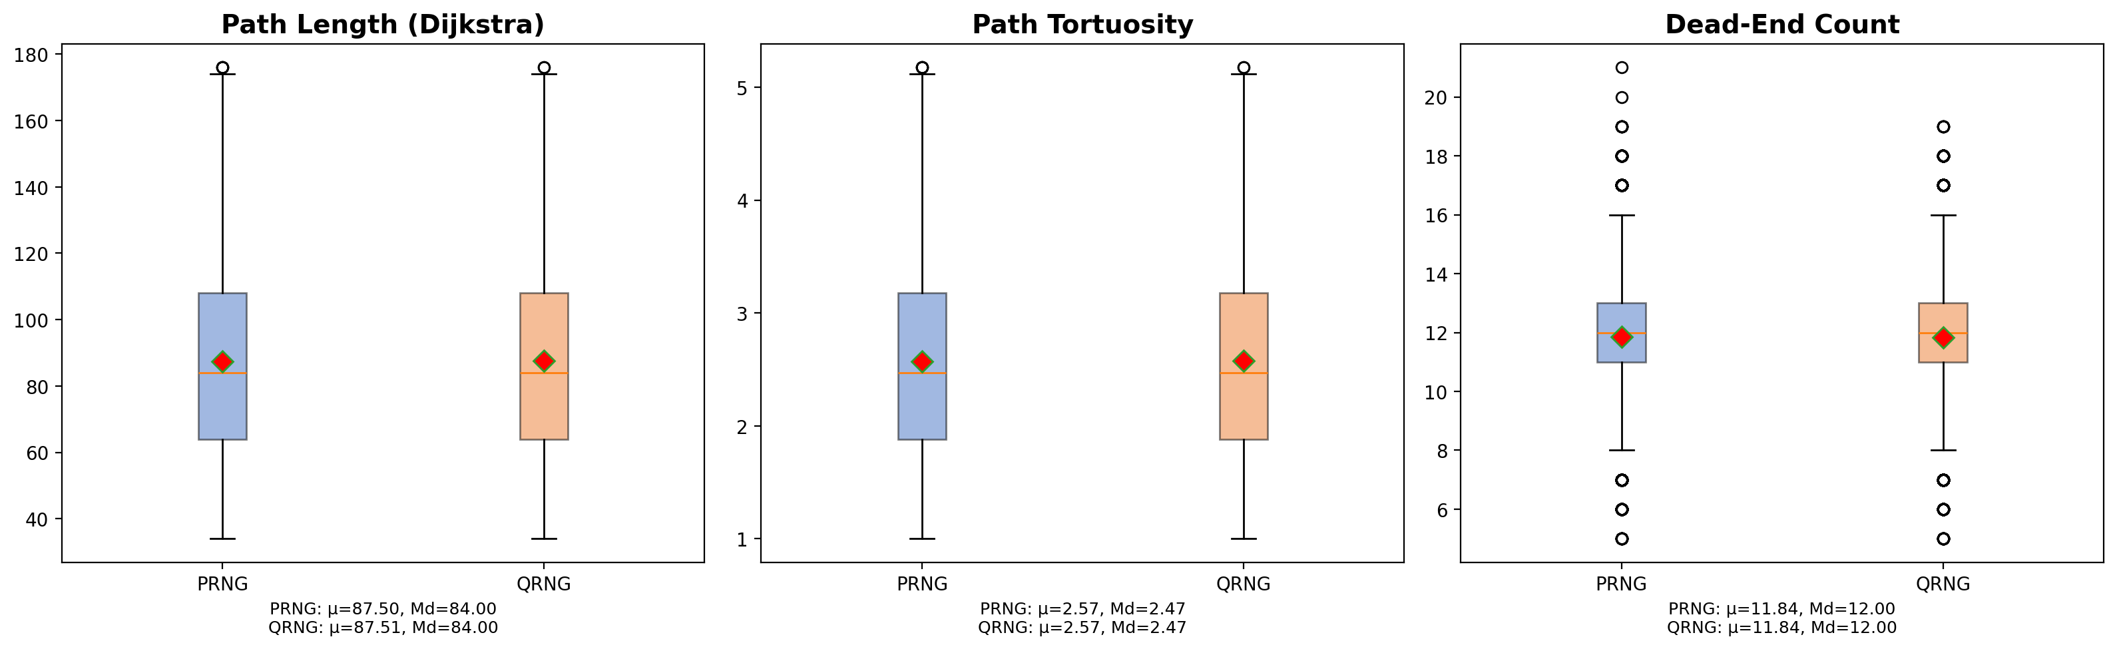
Maze Structural Analysis
PRNG vs QRNG
Key Metrics
Path Length: PRNG μ=87.50 | QRNG μ=87.51
Tortuosity: Both μ≈2.57
Dead Ends: Both μ=11.84, Md=12.00
Statistical Validation
Mann-Whitney U: p>0.05
Permutation: p>0.05
ESA test: PRNG=0.0131, QRNG=0.0125
No significant structural
difference detected.
The maze generation algorithm — not the seed source — determines structural output.

Slide 10
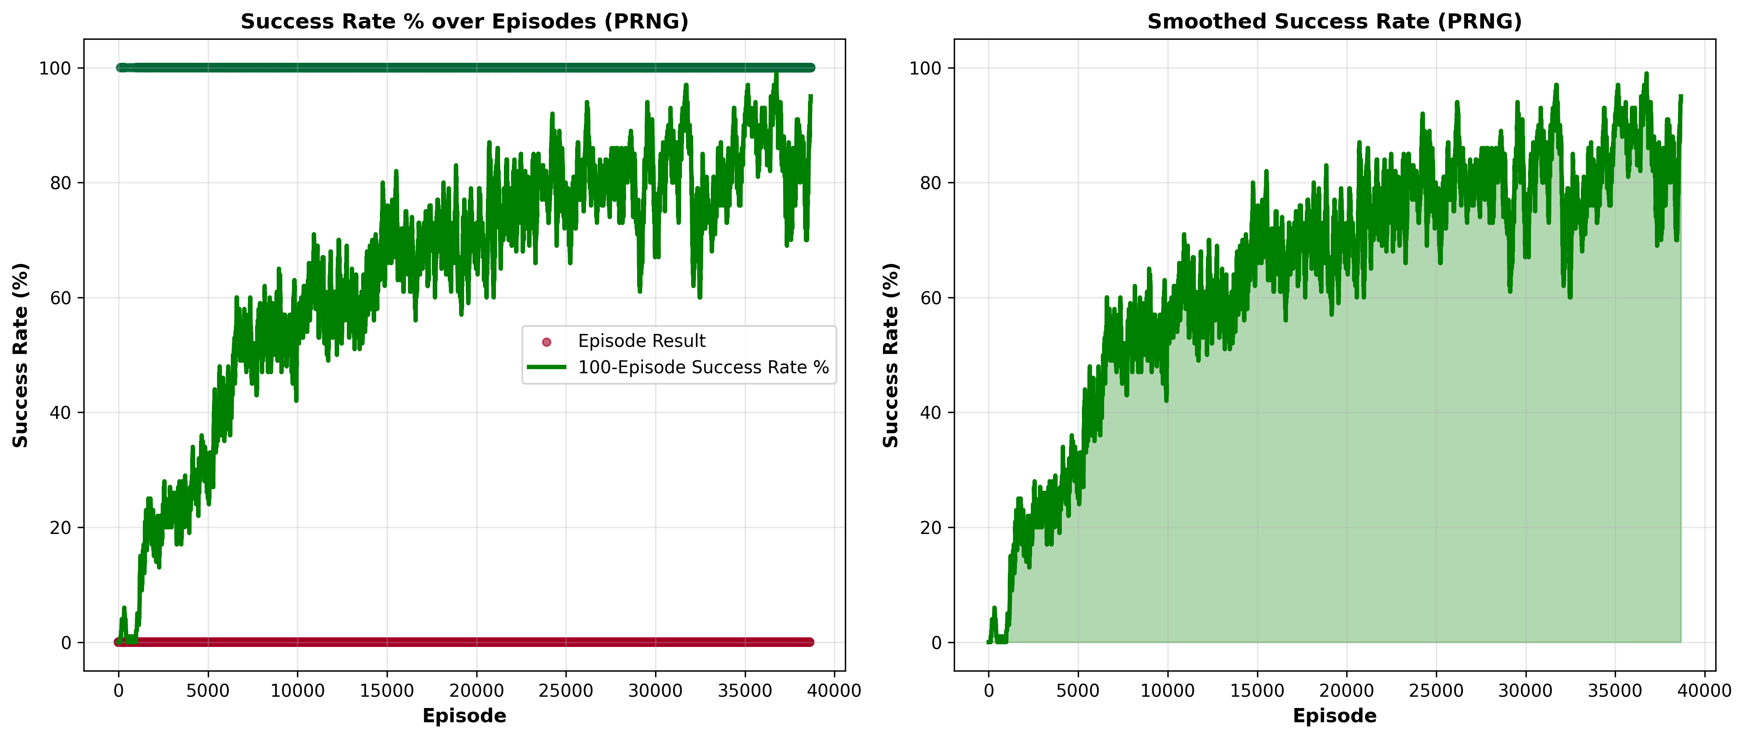
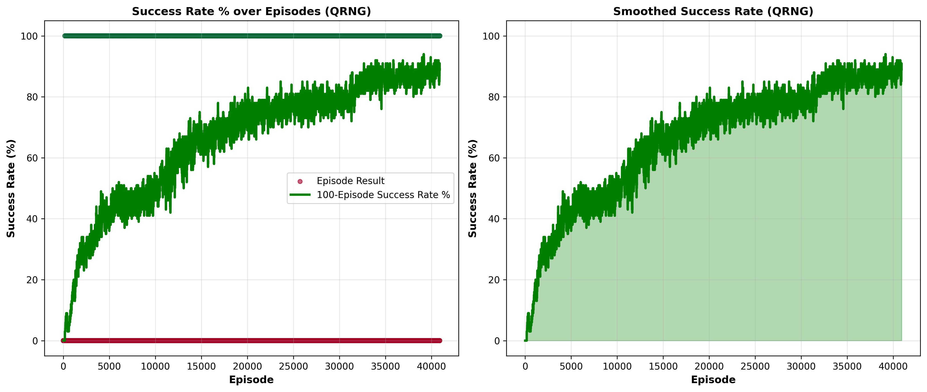
DRL Agent Performance
QRNG vs PRNG
PPO Training Curves (Success Rate)
PRNG: higher variance, 1 trial collapsed
QRNG: tighter clustering, consistent
Generalization Evaluation (Intra vs Cross-Domain)
Algorithm | Agent | Intra SR | Cross SR | Gap (pct)
A2C | PRNG | 51.23% | 60.00% | -8.68
A2C | QRNG | 58.70% | 59.03% | -0.33
DQN | PRNG | 13.07% | 12.57% | +0.50
DQN | QRNG | 9.80% | 8.07% | +1.73
PPO | PRNG | 72.43% | 74.00% | -1.57
PPO | QRNG | 72.43% | 74.00% | -1.57

Slide 11
Key Findings & Interpretation
What Improved?
Why No Significant Difference?
Limitations
QRNG-trained agents showed tighter inter-trial convergence (PPO, A2C)
QRNG-source PPO showed slight negative generalization gap (~1.57 pct) — marginally better cross-domain transfer
Recursive backtracking algorithm acts as a structural bottleneck
Constrains output diversity regardless of seed entropy sufficiency
Both seed sources passed identical randomness validation (Shannon entropy ≈ 1.0)
Limited to 20×20 mazes and one generation algorithm
VQR purely visual; no partial observability (LiDAR-based POMDP)
QRNG constrained by API rate limits (71,800 seeds)

Slide 12
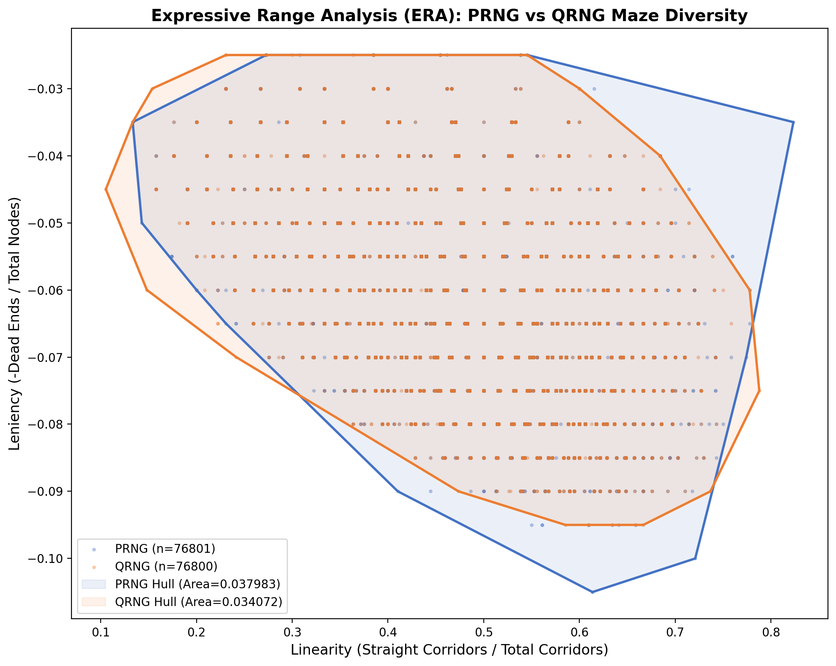
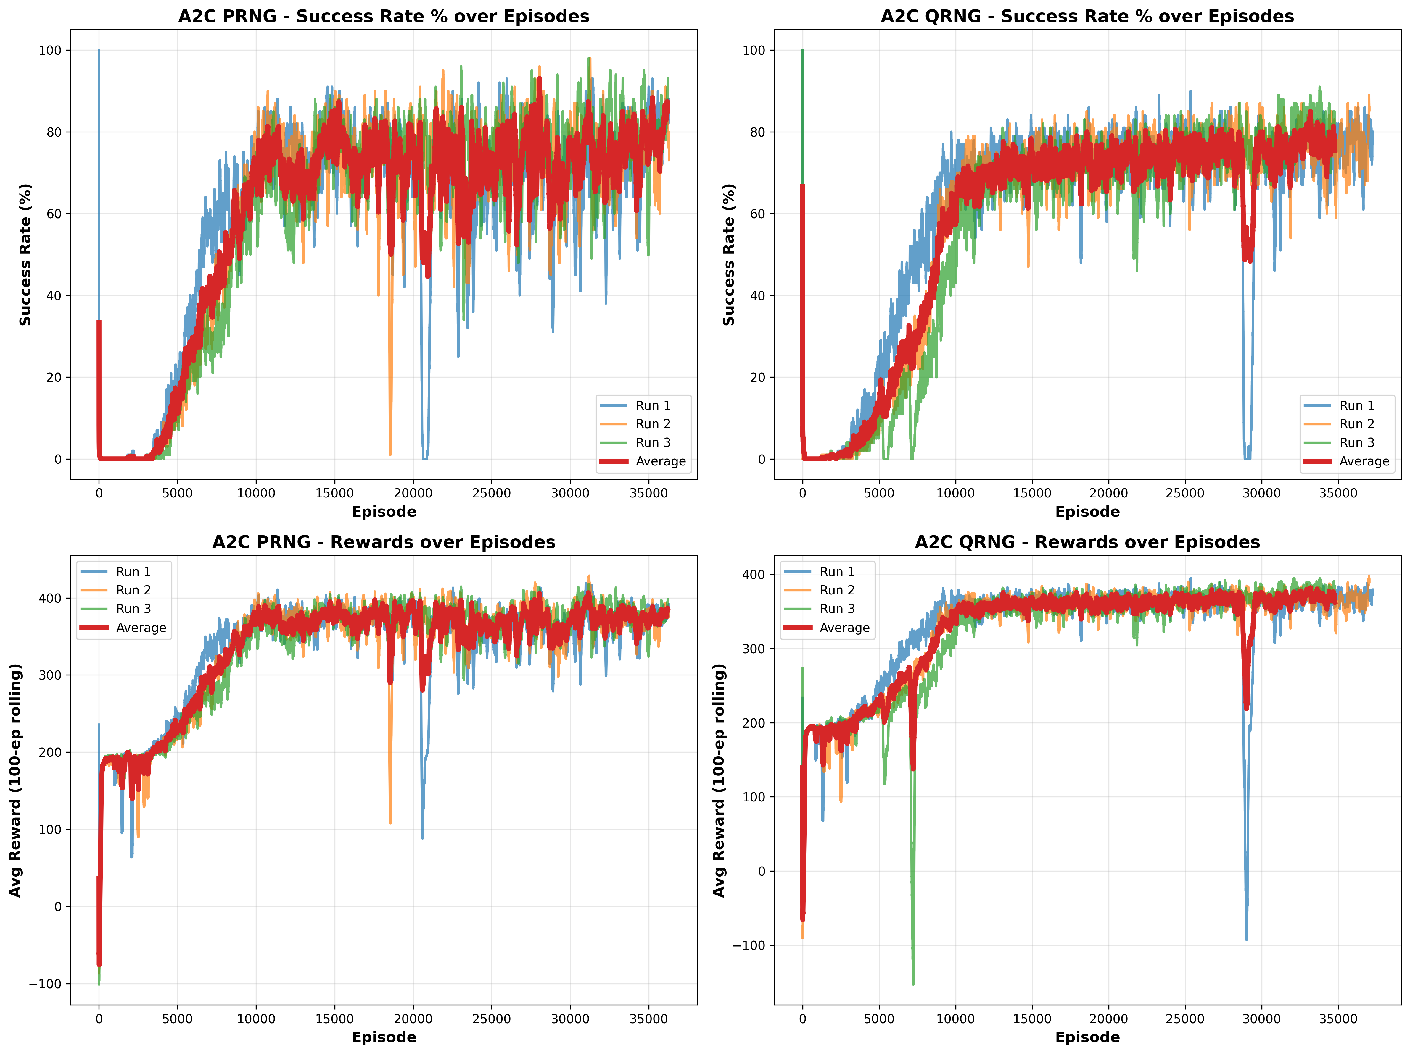
Implementation Evidence
A2C Training: Success Rate & Rewards
ERA convex hull areas nearly identical:
PRNG = 0.0380 | QRNG = 0.0341
Overlapping distributions confirm no structural divergence.

Slide 13
Conclusions
Objective 1: Structural Diversity
Fail to reject H₀
No significant structural difference between PRNG and QRNG mazes.
Mann-Whitney: p=0.326, Permutation: p=0.1463
Objective 2: Training Impact
Fail to reject H₀
Both seed conditions produced comparable training success rates and reward progression across A2C, DQN, and PPO over 32M timesteps.
Objective 3: Generalization
Fail to reject H₀
All generalization gaps within 11.6 percentage points across all architectures.
Seed-level randomness has no measurable impact on zero-shot generalization.
The recursive backtracking algorithm — not the entropy source — is the critical bottleneck for structural diversity in procedural maze generation.

Slide 14
Recommendations for Future Work
1
Use QRNG directly in maze generation via custom Fisher-Yates shuffle — bypass the Mersenne Twister intermediary entirely
2
Test alternative generation algorithms (Wilson's, Prim's) that impose fewer structural constraints on output diversity
3
Scale to larger mazes (30×30, 40×40) where structural memorization becomes harder and seed entropy may matter more
4
Replace DQN with DRQN (recurrent variant) to fairly evaluate value-based methods under partial observability
5
Investigate QRNG's training stability effect — the tighter PPO/A2C convergence clustering warrants study with 10+ trials

Slide 15
Thank You
Antony, Aldrich Ryan V. · Baricante, Mark Angelo R. · Mirabel, Kevin Hans Aurick S.
Adviser: John Richard M. Esguerra, MSCS
We are ready for your questions.

