Slide 1
Robotic Task Learning From Human Demonstrations Using Spherical Representations Masters Thesis
Daniel Caraballo-Rivera
Supervisor: H. Furkan Kaynar
Prof Dr. –Ing. Eckehard Steinbach
Notes:
Good afternoon, My name is Daniel Caraballo and I will be presenting my Thesis work on Robotic Task Learning From human demonstrations using spherical representations.

Slide 2
Outline
Motivation and Introduction
Related Works
Goals
Dataset selection, creation and preprocessing
Model Part I
Baseline + Problems
Final Model + Results
Model Part II
Training Algorithm and related
Model + Results
Conclusion
Future Works + Discussion on Results
Notes:
The general outline of my presentation shall be divided into 5 parts.
Umm, First I will discuss the motivation and provide an introduction to the thesis topic.
Then, I will talk about the dataset used and the preprocessing done to obtain the final version used for training.
After this, I will introduce Model Part I and Model part II which were the two modular components constructed.
Finally I will discuss the conclusion any interesting results and potential avenues to continue this research.

Slide 3
Motivation
1) Human-like grasp vs any grasp
Human support via Demonstrations
Limited Data
Explore new methods for Low Data learning
2) Extendibility to new data
Notes:
Sothe Motivation.
So the primary goal of this thesis was to have our network be capable of distinguishing human like grasps from any other grasp.
This was opposed to many autonomous methods which provide ALL feasible grasps without regard to the task.
And ideally this was to be done using very limited human demonstrated data.
So, obviously, we needed to explore methods that enabled for low data learning.
And the chosen method would ideally allow us to introduce new data and tasks that the network has not previously been introduced to.
So ultimately, it should be extendable to new data.

Slide 4
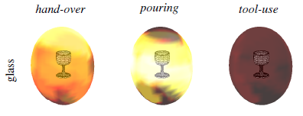
Related Works
Bayesian network Spherical structure learning, Song et al. (2011)
Joint Training of a Convolutional Network and a Graphical Model for Human Pose Estimation, Tompson et al. (2014)
Model-Agnostic Meta-Learning for Fast Adaptation of Deep Networks, Finn et al. (2017)
Likelihood of grasp given object features using Bayesian networks , Song et al. (2011)
Notes:
Now there are some important related works that ought to be mentioned as they helped influence many initial decisions made:
The first work by Song works on structure learning of some known object model using Bayesian networks. They then extend their structure learning, to task specific robotic grasping to create probability maps. This work was like ours, but a main difference is that my work aims to be adaptable towards unknown objects and should be quickly trainable to new tasks and parameter sets.
The second work by Tompson had a direct impact on Model part I as it introduced a method to create heatmaps using CNNs. We ultimately, end up basing our baseline model on the model introduced here.
Finally, The paper by finn introduces a meta-learning algorithm. This algorithm was the base that we aimed to implement in Model Part II as it showed much promise and allowed for a model flexibility.

Slide 5
Introduction
Data Preprocessing
Model Part I:
Positional Heatmap
Predictor
RGB-D
Input Image
Spherical Image
Positional
Heatmap
Model Part II:
Few-Shot, Meta Learned, Orientation Predictor
Orientations
+
Heatmap
Notes:
So what was the network that was designed?
Well, First, we created the data that was needed for training.
Second, we moved to the creation, training and optimization of the first half of the model, which I label here as model part 1.
Then after model Part I was completed we moved onto creating Model part II.
The output of model Part I, were the positional likelihoods associated with an input object.
These likelihoods were then provided as priors to Model part II which would serve as an aid its prediction process.
Ultimately, we aimed to have Model Part II update the likelihoods predicted in Model part I and provide the correct orientations for a grasp; all based on human demonstration.

Slide 6
Dataset Selection, Creation and Preprocessing
Dataset Criteria:
Point Cloud or mesh object representations
Large and diverse range of objects
Many recorded grasps
Easily accessible
Grasps are diverse
Ease of Use
➔ ACRONYM + ShapeNet Dataset
Notes:
However, before model selection could occur, we needed to determine the best dataset to be used.
For this, the dataset selected had to meet the following criteria.
1….6
And for this we found that a combination of the ShapeNet Dataset along with the ACRONYM dataset would sufficiently fit these critea

Slide 7
Dataset Selection, Creation and Preprocessing
Chosen Datasets:
ShapeNetCore:
Collection of 51,300 unique object meshes
ACRONYM:
Extension of ShapeNetCore
200 parallel-jaw grasps for 8872 objects from 262 unique categories.
Generalizes better to unseen objects when compared to GraspNet (Eppner et al. 2015)
Notes:
ShapeNet was a large collection of Mesh Objects and
ACRONYM was an extension of the ShapeNet dataset and had simulated grasps done on over 8000 objects.
Should be noted that the paper that introduced ACRONYM mentioned that models that were trained with ACRONYM generalized better than model’s trained with GraspNet. Therefore, we were further inclined to move on with ACRONYM.

Slide 8
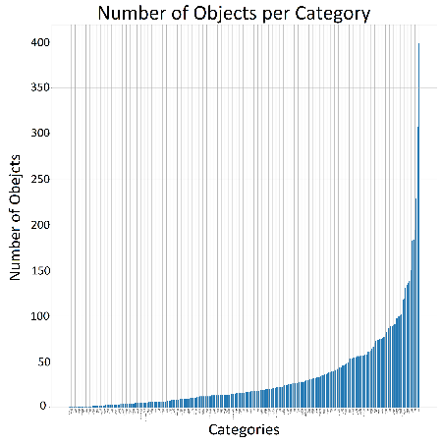
Dataset Selection, Creation and Preprocessing
Categorical Object Skew
Trained on 15 objects per category
Categories with less than 15 objects reserved for testing
Notes:
That being said, There were problems with this dataset combination.
Mainly that there was an uneven skew between the number of object models and the number of categories.
To fix this, we decided that we would only take 15 objects per category for training. This was chosen so that the model would be able to generalize to a variety of categories, rather than to a select few.
Categories with less than 15 objects were then reserved as the test set.

Slide 9
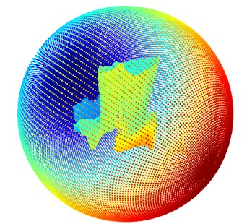
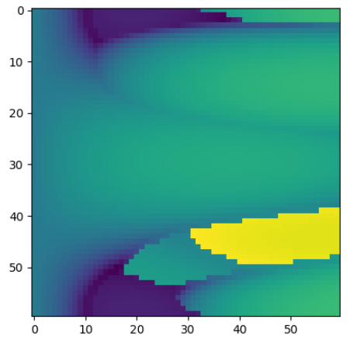
Dataset Selection, Creation and Preprocessing
Hemispherical Projection
Enclose ShapeNet
Mesh in sphere
Hemispherical Projection
From Sphere, cast ray
vectors towards center
Record Hit Distance from
Sphere to mesh
Extract a hemisphere as data
Hemispherical
Image Projection
Notes:
Now for the preprocessing done on the Datasets just mentioned.
We wanted to convert our object mesh to a 2d image through a spherical projection.
We achieved this by first:
Enclosing the mesh in a sphere
Casting ray vectors from the sphere towards the center of the sphere.
Recording hit distances to a 2d matrix
Then extracting a hemisphere.
We extract a hemisphere because when the actual robot would examine a scene, it would only ever have front facing information.
This hemisphere extraction would therefore imitate the information loss on the object.

Slide 10
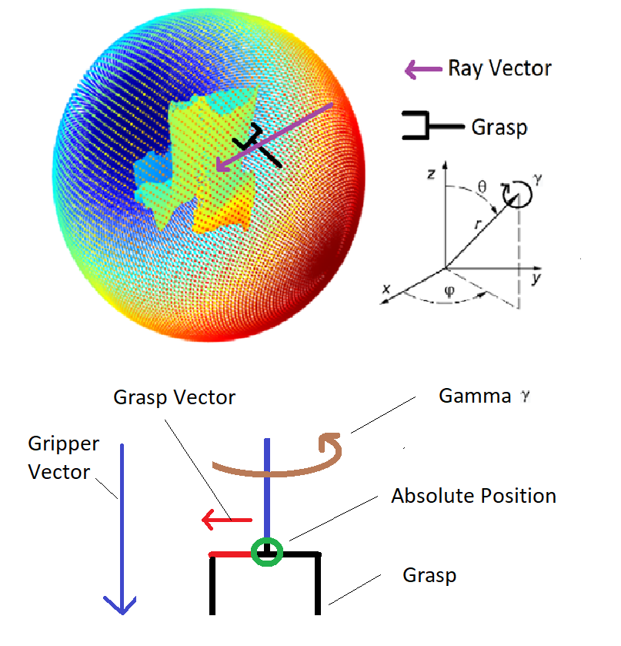
Dataset Selection, Creation and Preprocessing
Map absolute grasp position to closest ray vector
Using ray vector, rotate the ray vector until the ray vector aligns with the gripper vector
Record angles Θ and ϕ (azimuth and elevation) used for rotation
Using the grasp, ray and orthogonal vector from gripper in direction of ray vector, determine Gamma
Notes:
However, we also needed to transform the 3-D grasps on the object in a similar way.
Therefore:
For the absolute position of a grasp: we mapped it to the nearest ray.
Then for the orientation of that grasp:
We use the ray vector that it was mapped to, and using the spherical angles azimuth and elevation, we move the ray vector until it aligns with orientation of the grasp.
We then record those angles as theta phi and rotation angle gamma.
And like that, we were able to record the position and orientation of the grasps in planar way.

Slide 11
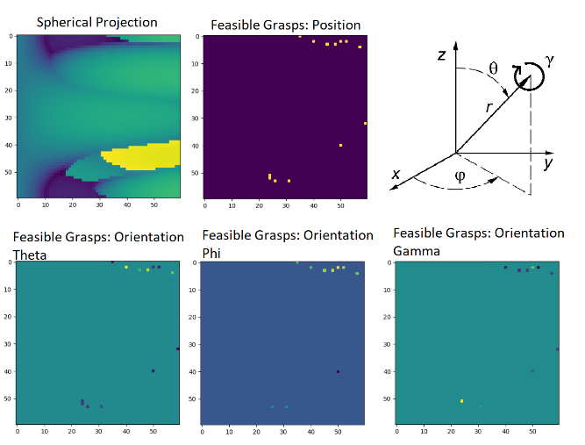
Dataset Selection, Creation and Preprocessing
Notes:
Hence, we were able to reduce the dimensionality of the 3-D mesh into the following representation.

Slide 12
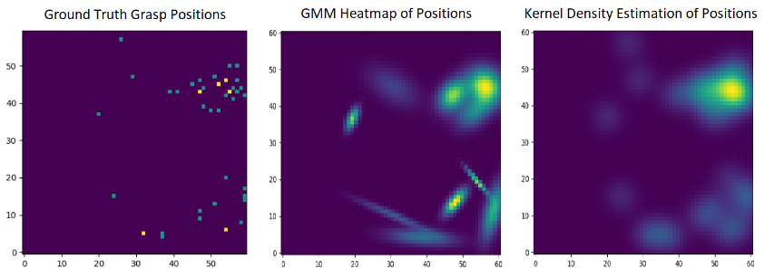
Model Part I:
Recall:
RGB-D Input Image
RGB-D to Spherical projection via Ray Casting
Hemispher-ical Image
Model Part 1:
Positional Heatmap
Predictor
Predicted
Positional Heatmap
Notes:
Now for Model part I.
Recall from the original Black box pipeline, Model part I would be tasked with predicting the spatial likelihoods of all absolute positions of feasible grasps.
To do this, we had to apply a data augmentation to the labeled positions to create a likelihood map that would serve as the true likelihoods.
This was done with a Gaussian Mixture Model to Obtain the image seen here.

Slide 13
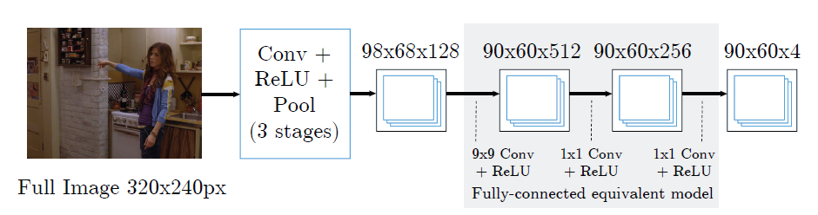
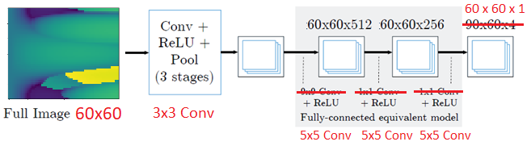
Model Part I: Baseline Creation
Original Model from Tompson et al. (2014)
Altered Model To fit our work:
5x5 Conv
Notes:
To proceed with Model Part I, we first needed to find a baseline that could serve as both a starting point as well as offer some direction. Therefore, we chose the heatmap model first introduced by tompson seen here.
Changes had to be made to the original model in order to make it compatible with our data.
For our work, since we only needed one heatmap, parts of the original model had to be changed, otherwise, the model would often result in unsuable predictions.
The main changes were done to the kernel sizes. We had to remove the 1x1 Conv layers and replace with 5x5. Additionally, since we only had one output heatmap, the expected output heatmap had to be changed as well.

Slide 14
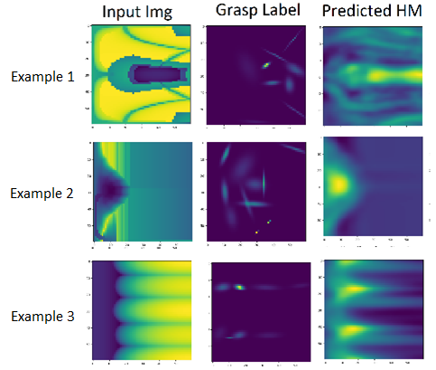
Model Part I: Visual Results Baseline
Notes:
When testing the baseline and observing its predictions. We notice that it acted more as an edge detector. Not capable of distinguishing non-critical edges from critical edges. . In fact, it appears to just associate stronger edges with higher probabilities. To attempt to fix this inefficiency in prediction, variations in model architecture were implements

Slide 15


Model Part I: Fixing Persistent Prediction Issue
We attempted to find solution to heatmap problem through 4 variations:
Highpass-Lowpass Branch Architecture
Multi-resolution CNN Branches
Simple Gradient Boost concept to CNN
Spherical CNN implementation
Cohen et al. (2018)
Ultimately, Less-than ideal results from Trials:
Revisit Assumptions on Data
Attempted baseline again with new data
Significant improvement
Notes:
Such variations included a Highpass lowpass architecture, a multi-resolution architection, a XGBoost inspired variation and using finally implementing Spherical CNNs instead of Planar ones.
As seen, these variations led to results that didn’t fix this problem in prediction. So we revisted our data and found that through a simple change in how we created the likelihood heatmaps, prediction results would see a large increase in performance.

Slide 16
Model Part I: Previous Data Labels vs Newly Created Data Labels
Notes:
The solution was to remove the use of Gaussian Mixture Models for the creation of the likelihoods and replace it with just a Kernel density estimation.
This resulted in fewer instances where spatial information regarding grasps were lost. It also removed instances where false grasps were identified to exist due to GMM requiring a finite number of clusters to be predetermined.

Slide 17
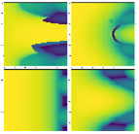
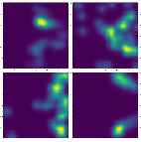
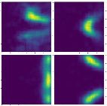
Baseline revisited + Final model for part I
Change in labeled data yielded positive results ➔Baseline performed better
Altered pipeline to achieve best performance
Input Data Labeled Data Predicted Heatmap
Final Model Example Heatmaps (on test set):
Notes:
Using the newly created labels led to the newfound success in the baseline.
Since we were now able to progress forward, we made changes to the baseline to improve performance and finally achieve the results seen here.
As you can see, aside from a few examples, the predicted heatmaps closely resemble the labeled data.

Slide 18
The final model for Part I:
5x5
5x5
CNN
LeakyReLu
MaxPool
BatchNorm
x3
1 → 8
8 → 32
32 → 128
CNN
LeakyReLu
BatchNorm
128 → 256
5x5
5x5
CNN
LeakyReLu
X2
256 → 256
256 → 32
Fixed
Gaussian CNN
UpSampling
Factor 2
Dense Layer 2
ReLu
Dense Layer 1
LeakyReLu
Notes on Training:
SGD optimizer
MSE Loss
LeakyReLu + Cyclical LR → ~50% reduction in training time
Batch Norm increases convergence and helps model to learn correctly
Dense Layers = 12% performance gain
Notes:
This was the final model. From the baseline, there are definite structural similarities. However we changed a few things. First was the addition of batch normalization which was strongly responsible for enabling the network to more accurately predict the likelihoods.
Additionally, we added a dense layer that was designed in a bottle neck fashion, which was shown to increase performance by nearly 12% and a fixed gaussian CNN which led to further loss reduction.
Ultimately, we were able to further speed up convergence by using a leakyRelu + cyclical LR which allowed us to reduce training time by roughly 50%.
Gaussian Layer removes pepper-like noise resulting from dense layers
Notes on training:
Batch-Normalization speeds up training by roughly a factor of 3.
Without batch-normalization, the model doesn’t correctly learn the necessary features
LeakyRelu, a Cyclical Learning Rate and SGD optimizer leads to the fastest convergence.
LeakyReLu or Cyclical LR do not improve performance if used without the other.
The mid-pipeline up-sampling operation is critical for further gains in performance.
Dense layers are trained with Dropout
These layers provide a ~12% drop in loss when compared to the network without the Dense layers
Training with the MSE Loss Function.

Slide 19
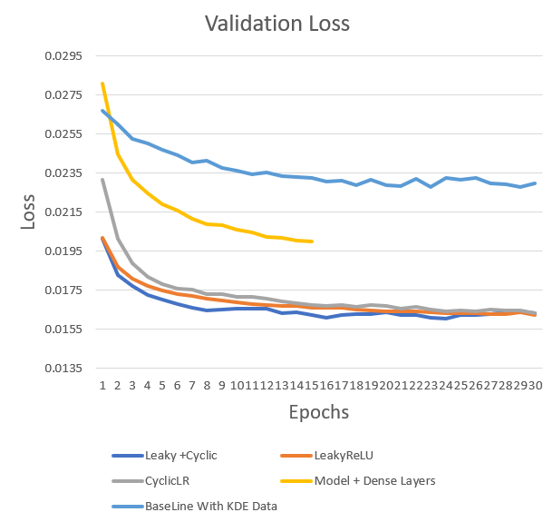
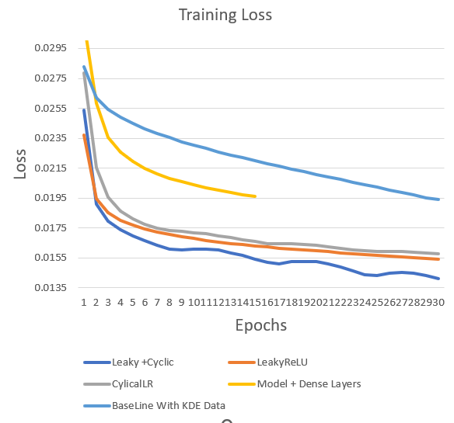
Training Curves
30% reduction in Validation loss between
baseline and Final Model Part I
Notes:
Here are the training curves. As you can see there is a significant change in validation loss between the baseline model and the final model as I just presented.
Note that the model begins to overfit at around epoch 15
Jump in performance between Model + Dense layer and lower 3: Gaussian layer

Slide 20
Model Part II: Meta-learned Model
Model Part II:
Meta Learned, Orientation Predictor via Heatmap Regressor
Orientations
+
Heatmap
Over-arching Goals of Model Part 2:
Achieve task related predicted grasp
Obtain orientation and updated position heatmap
Heatmap predictor in Model part I:
Provides prior information to Model Part II
Acts as a filter
Notes:
Now With Model Part I providing predictions on all feasible grasps locations. We were able to move to Model Part II.
To reiterate, Model Part II was designed with the following in mind:
It was to predict task specific grasps by providing the appropriate orientation angles as well as the task specific updated Heatmap.

Slide 21
Model Part II: Outline
Outline
MAML Complexity → FOMAML
Notorious Problems with MAML/FOMAML
Meta-Data Augmentation (Task Augmentation)
Model Selection → Required Changes
Loss Function Required
Results per Task Augmentation
Final Attempts at Remedying a Persistent Problem
Future Work / Outlook

Slide 22
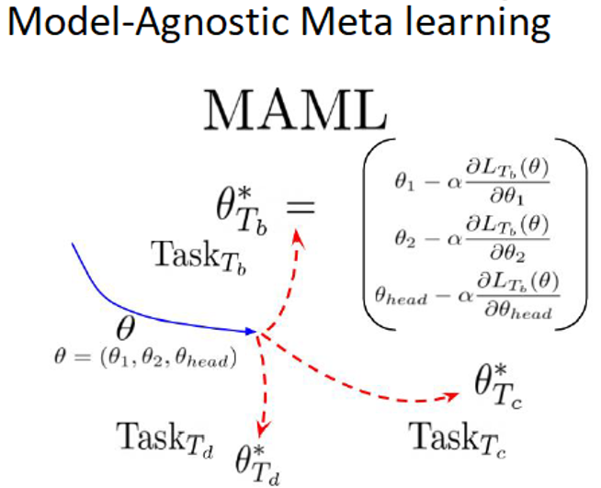
Model Part II:
Task Specific Grasp Goal:
Implement a Meta-Learning Algorithm for image-to-image regression
Determines optimal initialization
Quick convergence on task data
Issues/solutions and result to be discussed:
Model Selection
MAML Computational Complexity
MAML based overfitting
Required New Loss Function
General Principle of MAML,
Finn et al. (2017)
Notes:
In order to achieve the goal of obtaining task-specific grasps, we initial aimed to implement the meta-learning algorithm known as MAML.
MAML was promising as it was shown to provide both an optimial initialization parameter set and as such, allow to a quick convergence to task data.
MAML, as the name suggests, was also Model agnostic. This meant that as long a Model was trainable with SGD, MAML could be applicable.
With this in mind, the remainder of the presentation will focus on Model Selection, MAML’s Computational Load, Meta-learning based overfitting and the new loss function.

Slide 23
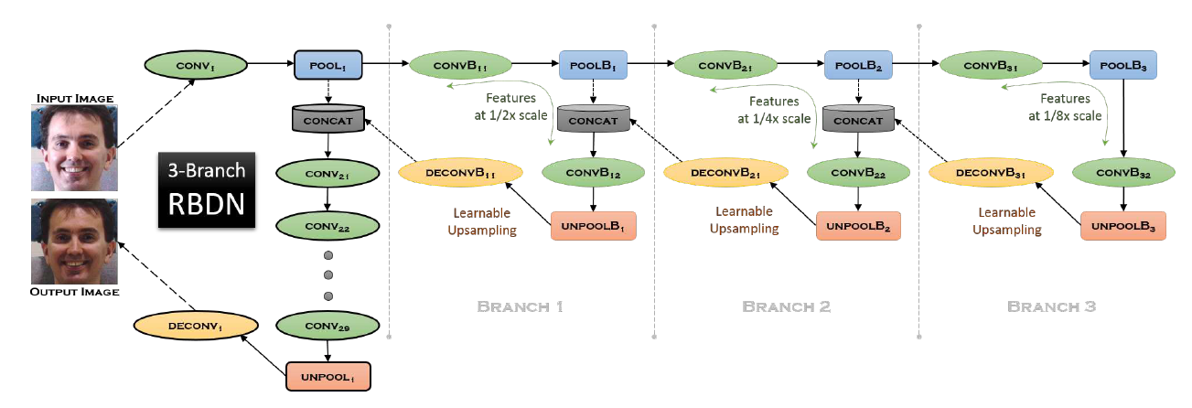
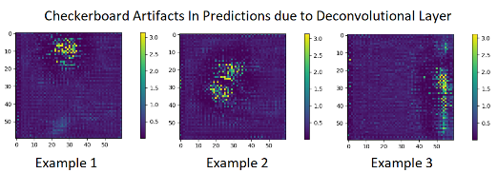
Model Part II: Model Selection
RBDN introduced by Santhanam et al. (2017)
Problems with Model Given
Strong Checkerboarding due to deconvolutional layers
Constant Size during forward pass
Notes:
The Model chosen for Model Part II was based of a Recursively Branched Deep Neural Network introduced by, Santhanam,
It provided cheap multi-context image representation through the early recursive branching.
But the model as proposed here introduced a few problems that were unacceptable given our data type.
Specifically spatial checkerboarding induced by the deconvolutional layer in the upsampling operation and the Constant size in the forward pass.

Slide 24
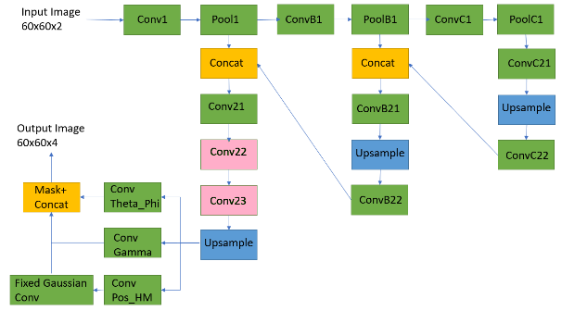
Model Part II: Update To RBDN
Dilation in Pink Layers
Removal of Deconvolutional layers
Replaced with bilinear Upsample + convolutional layer
Channel Specific layers + masking towards end
Notes:
The checkerboarding artifacts were removed through the replacement of the deconvolutional layers with a bilinear upsampling operation followed by standard Convolution layers.
Additionally, as seen in pink here, by adding a dilation factor to the kernel size, we were able to increase the receptive field which helped the network identify larger local features without increasing the number of parameters.
We also added three parallel convolutional layers at the output for each specific output channel before applying mask derived from the likelihoods.
Explain the Masking Process

Slide 25




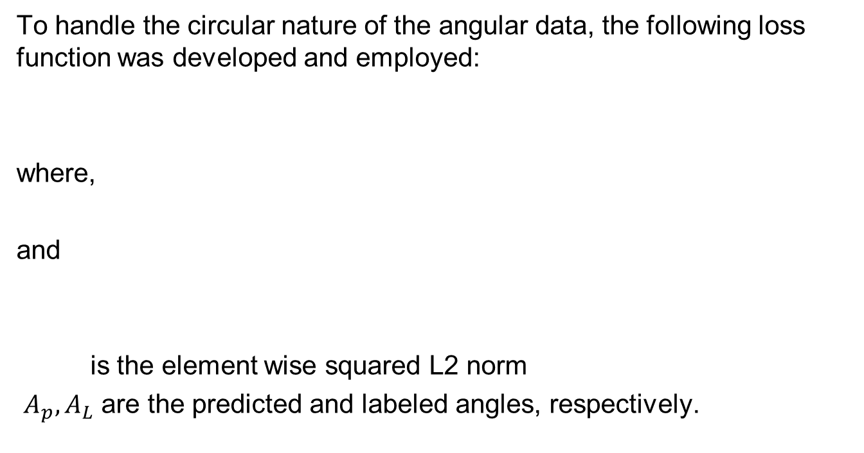
Model Part II: Custom Loss
To handle the circular nature of the angular data, the following loss function was developed and employed:
where,
and
is the element wise squared L2 norm
$A_{p},A_{L}$ are the predicted and labeled angles, respectively.
Notes:
With the model determined, we also had to fix the loss function employed. Unlike in Model Part I, we could not use the general element wise squared L2 norm, or MSE. This loss would fail due to the circular nature of the data. Hence we had to develop a loss to compensate.
To do so, we created a loss for the spherical angles and a loss for the gamma rotation. Since the spherical angles are circularly in the range of –pi to pi and the angles for the gripper rotation gamma was between 0 to pi. The losses here were created
Explain that each loss is channel wise

Slide 26
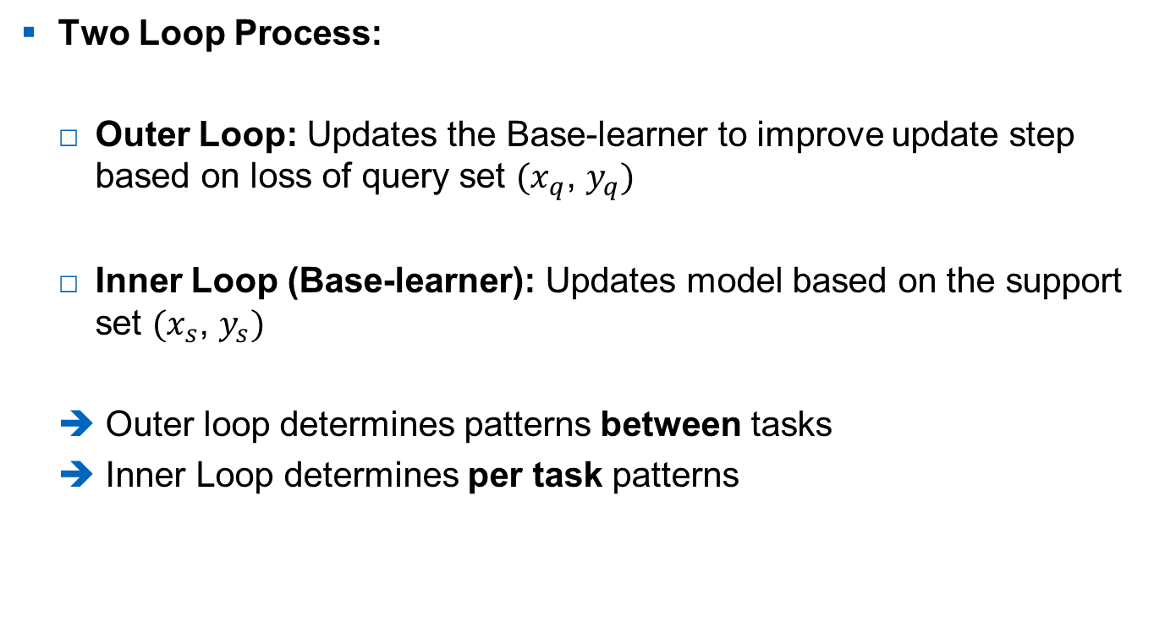
Model Part II: MAML
Two Loop Process:
Outer Loop: Updates the Base-learner to improve update step based on loss of query set $(x_{q}$, $y_{q})$
Inner Loop (Base-learner): Updates model based on the support set $(x_{s}$, $y_{s})$
Outer loop determines patterns between tasks
Inner Loop determines per task patterns
Notes:
Now for the Meta-Learning Algorithm known as MAML.
This algorithm can basically be broken into a two loop process. An Outer loop which updates the base learner and an Inner Loop which updates the model.
In general, this means that the outer loop’s gradient optimizes to determine the relations between tasks and the inner loop optimizes per task patterns.

Slide 27

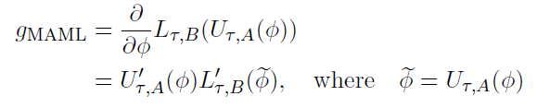
Model Part II: MAML Complexity
MAML optimizes for generalization via:
where this loss is optimized through stochastic gradient descent by computing:
Jacobian Matrix of
Update operation
➔
High Complexity
➔
Solution: First-Order MAML
(FOMAML)
Nichol et al. (2018)
Notes:
Unfortunately, MAML is quiet costly in terms of computational resources.
As you can see here, for maml to optimize the loss, it has to calculate the following jacobian. These second derivatives are very expensive to calculate and as a result lead to an increase in time per iteration.
Therefore to fix this problem, we introduce the algorithm introduced by Nichol The First Order MAML.

Slide 28
Model Part II: FOMAML
From
FOMAML replaces the Jacobian with the Identity Matrix
Results:
At a slight loss of gradient information ➔ Large decrease in complexity
Performs nearly as well as MAML
Therefore, we proceed with the FOMAML algorithm
Notes:
In the First order MAML, the Jacobian is replaced with the Identity Matrix. And although this results in a loss of gradient information. The paper that introduced FOMAML shows that it performs almost as well as MAML in both regression and classification tasks.
So given this and our time constraints, we decided to proceed with the FOMAML algorithm as our primary meta-learning method.

Slide 29
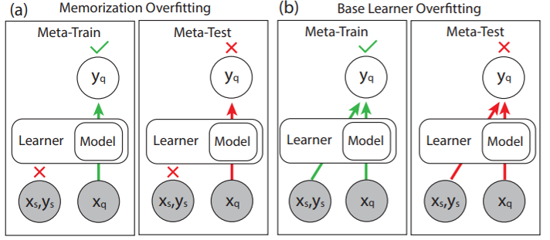
Model Part II: Meta Learning Overfitting
Memorization overfitting: Fit to training task but base-learner failed to be utilized
Learner Overfitting: Both Model and Learner fit to training but fail during testing
Notes:
Now, within the realm of meta-learning through MAML and FOMAML, there are two notorious and annoying types of overfitting that have been known to occur. Memorization overfitting and Learner Overfitting.
As seen here Memorization overfitting occurs when the inner-loop or Learner, is not being used during prediction. Hence it becomes unable to adapt to new tasks during the meta-test.
Learner overfitting is more similar to the standard sense of overfitting. Where a model is able to predict well during train time, but fails to generalize during testing.

Slide 30
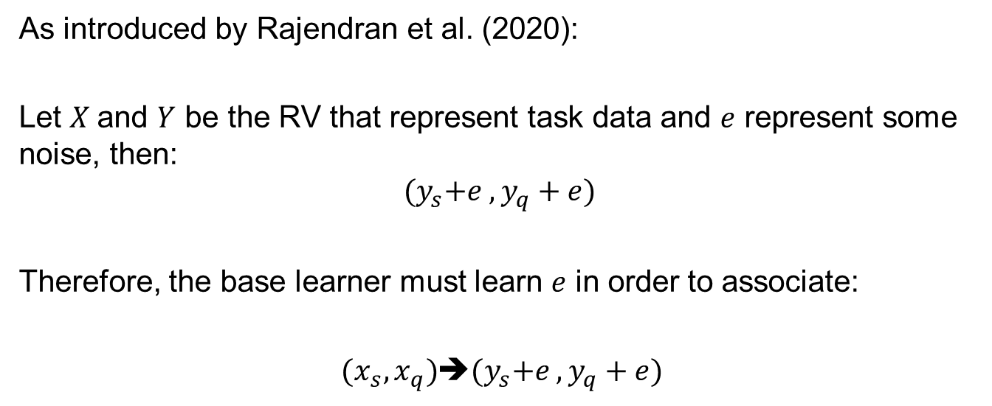
Model Part II: Task Augmentation
As introduced by Rajendran et al. (2020):
Let $X$and $Y$ be the RV that represent task data and $e$ represent some noise, then:
$${(y}_{s}+e , y_{q}+e)$$
Therefore, the base learner must learn $e$ in order to associate:
$(x_{s},x_{q})$➔${(y}_{s}+e , y_{q}+e)$
Notes:
To combat both learner overfitting and memorization overfitting. I implement the meta-data-augmentation method introduced by Rajendran. It is a task augmentation method that aims to push the system to utilize the base-learner more consistently.
It does that by creating constant noise key, represented here as epsilon. This key varies from iteration to iteration in the outer loop. But ultimately, what this additional noise key does, is that it creates a situation, where given an input, in order for the model to accurately predict the augmented output, the base-learner must recover this noise key. Thereby creating a parameter set that is flexible to new information.

Slide 31
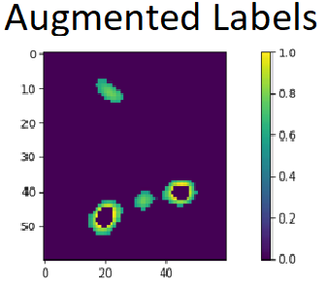
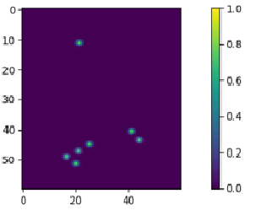
Model Part II: Implemented Task Augmentations
Discrete Noise to Labeled Angular Data
Spherical Angle Noise set [-5,-4,-3 … ,20]
Rotation Angle Noise set [-2, -1, … 10]
Zero Masking to Probability Labeled Data
Choose few random points on labeled likelihoods to imitate human demonstrations. Zero out the non-chosen points
Zero masking Noise
Random Point Select
Notes:
Using this task augmentation method, we then created and tested three types of task augmentations.
The first one was to add discrete noise to the angular data to promote the base-learner to be adaptable to the angular data.
Then to attempt the push the model to be adaptable to the updating of the likelihoods, we introduced a zero-masking method and a random point method.
The zero mask method, zero’d out a chosen probability range. This chosen zero-range would hopefully be learnable by the base-leaner.
The random point method was based on the idea that a human could demonstrate a wide variety of tasks on an object. So a few random points were chosen on the label probalities and the remaining, non-chosen points would be zero’d out. This would then be representative of human demonstrations on some random and unknown task.
Ultimately, Both of these methods for trying to coerice the base-learner to update would change the concept of noise; from being a random numerical additions to more of a masking process.

Slide 32
Model Part II: Results
Considerations on results:
Training was stopped at 1000 iterations
Average training time ~ 36-48 hours per 1000 iterations
Given the setup used
Optimal results are not expected
Sinusoid estimation meta-learning ~2000-10000 iterations depending on hyperparameters
Goal:
Is task adaptability feasible?
Can model learn the data?
Notes:
So now, we can move onto the results, however, before I can continue, we must consider the following.
Despite FOMAML being computationally quicker than MAML, the combination of our model and the algorithm still resulted in an average training time of 36-48 hours per 1000 iterations. For this reason, we tried to quit training at 1000 iterations.
Additionally, when looking at previous works, many regressions using maml are done on 1-D functions, and even during those functions, a extremely large number of iterations were required.
Therefore, we did not expect to achieve optimal results but rather, we were looking to answer two questions. First, could the model learn the data? And, Is it flexible to new tasks?
With that in mind, we can now move onto the results.

Slide 33
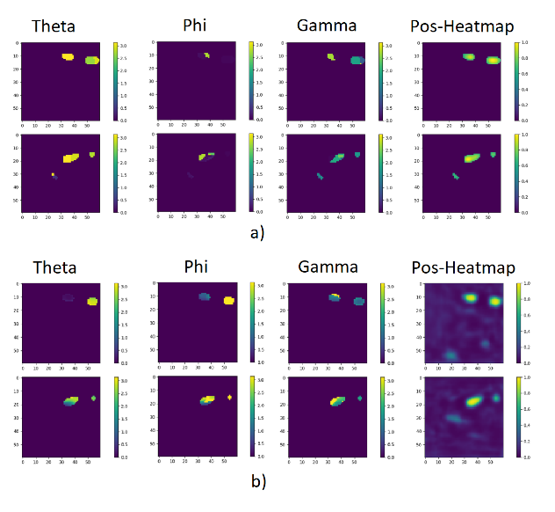
Model Part II: Results, No Task Augmentation
EX1
EX2
EX1
EX2
Labeled
Data
Predicted
Data
Notes:
First we observe the model done with no task augmentation. Here we discover that the model architecture was capable fitting the data and that it was able to start to converge towards a parameter set that enables accurate orientation predictions. But we also see that without any augmentations, the model heavily experiences memorization overfitting. For when we tried to introduce task specific demonstrations, the model does not adapt to the new demonstrations. Hence the base learner was not being utilized.
Therefore, we learned two things. 1, the model was able to learn the data correctly, and 2. That regularization and task augmentation was needed.

Slide 34
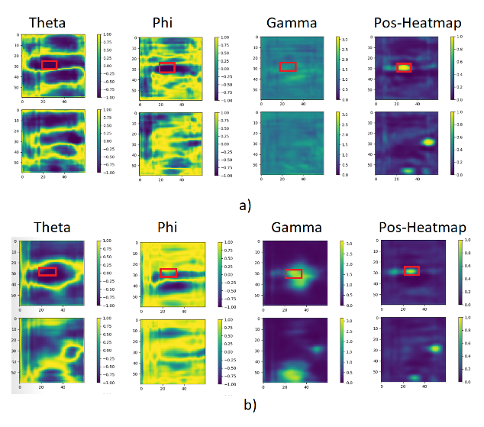
Model Part II: Results, Discrete Noise Augmentation
EX1
EX2
EX1
EX2
No Noise
Noise
Added
Notes:
So we first implemented the discrete noise augmentation. Here we remove the mask that is normally created by the predicted likelihoods to better see the effect of the noise addition.
We first seethat the Gamma Angles obtain clearer predictions when compared to when no noise was added. Furthemore, we comparing the no-noise data predictions and the noise added predictions, we note that the losses are very similar, which indicated that the base-learner was capable of picking up on the introduced discrete noise key.
Hence, we were able to conclude that by introducing discrete noise, the base learner showed higher utilization ub adapting the angular data. Which showed that it would be task-adaptable for the orientation angles.

Slide 35
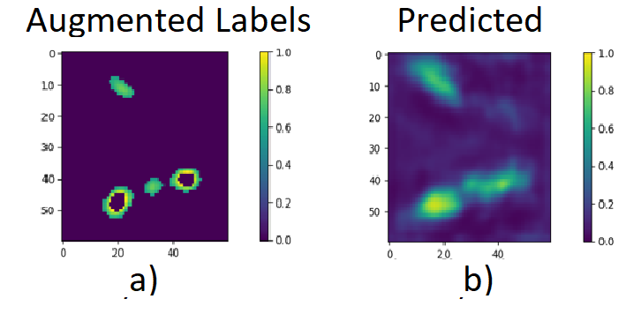
Model Part II: Zero-Masking Augmentation
Example of labels vs prediction (all predictions had the same issue)
Clear Memorization overfitting ➔ Base Learner Not adapting Heatmaps
Notes:
Seeing that the angular data was becoming adaptable, we now needed the base-learner to update the likelihood predictions based on some demonstrations. For this we first tried to to introduce the zero-masking augmentation. However, we see that, although the demonstrations now introduced a zero-masking key, the baselearner was not able to adapt to this, and still predicted data as though it was not there. Hence, the prediction on the likelihoods were still incapable of being updated.

Slide 36
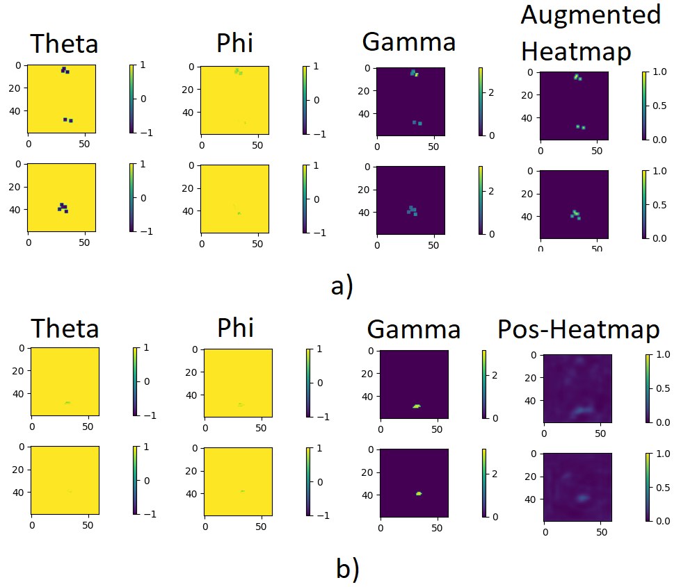
Model Part II: Point Augmentation
EX1
EX2
EX1
EX2
Labeled
Data
Predicted
Data
Notes:
Further attempts to introduce flexibility in the heatmap predictions was done through the point augmentations. Here random points were chosen on the input likelihood map in an attempt for the model to focus in on the areas chosen. However, when predicting, we notice that the baselearner ignores these updates and still tries to predict the heatmap according to the input data. The base learner also began driving the predictions towards zero due to the increased sparsity of the orientations.
To fix this, larger kernels were used to increase the area of the chosen points, however this was shown to have no impact in prediction ability.

Slide 37
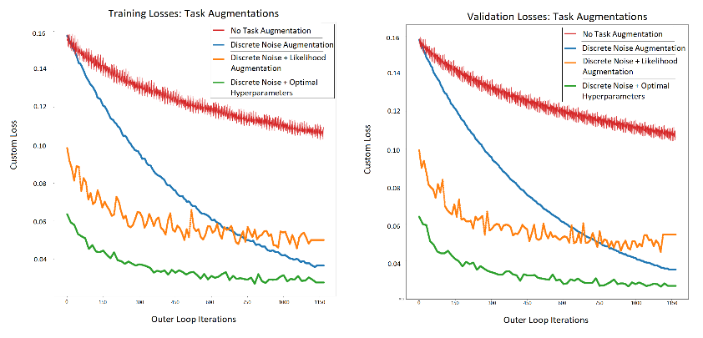
Model Part II: Results Post Augmentations
Adaptability possible in Angular Data Predictions
Unable to Adapt Likelihood Maps
Notes:
Here we see a representation of the effect that the task augmentations had on the loss of the model. We see that through the use of the discrete data with optimal hyperparameters, we see a roughly 70% decrease in loss when compared to the model trained without task augmentation. This was likely due to base-learner utilization.
So ultimately, the results were split. On one hand, we determined that FOMAML was capable of updating the angular data based on task data, but on the other hand, it was incapable of updating the likelihood positions. So despite the updated angles, we would still be incapable of determining the grasp area.

Slide 38
Model Part II: Remedy Attempts
Retraining Model Part I with FOMAML
Result: Model Part I prediction encounters Mode Collapse normally seen in GANs. Vanishing Gradient
Train Model Part II without prior Likelihoods:
➔ Result: Model Loses ability to predict without priors. Loses spatial focusing
Notes:
Finally, we tired to remedy this problem in the likelihoods through two more final attempts.
First, by retraining model part I with FOMAML and second by training MODEL Part I without the prior likelihoods.
When retaining part I, we notice that the model consistently encountered an issue similar to Mode Collaspe.
In model II, we notice that without the likelihoods, the model loses its ability to predeict due to the lack of spatial focusing the priors provided.

Slide 39
Conclusion: Results Reiterated
Model Part I
Final Model Part I reduces loss by 30% when compared to baseline
Capable of predicting positional likelihoods on unknown object categories using hemispherical representation.
Model Part II
Angular Data Adaptable, shown through discrete noise capturing
Task Augmentation reduces loss, ~70%
Not currently capable of adapting likelihoods based on task
→ Cannot determine grasps

Slide 40
Conclusion: Outlook / Future Work
TaskNorm (Bronskill et al. 2020)
Continual BackProp (Dohare et al. 2021)
Fix Mode Collapse in Model Part I → Working network
Treat likelihoods as a segmentation problem → Prototypical networks (Snell et al, 2017)
FOMAML with Generative models.
More flexibility to generative models focus on how data was generated

Slide 41
Thank you for listening

Slide 42
Model Part I: Resolving Prediction Error
Previous Data Preprocessing Assumptions
Assumption I: Grasps position follow a gaussian distribution
Assumption II: Grasps therefore clusterable.
Problems with assumption:
Loss of spatial information
Creation of False Grasps
Updated Data Preprocessing Assumptions
Assumption I: Same as before
Assumption II: Few clusters are not sufficient representation of data
Solution:
Use Kernel Density Estimation and not a Gaussian Mixture Model

Slide 43
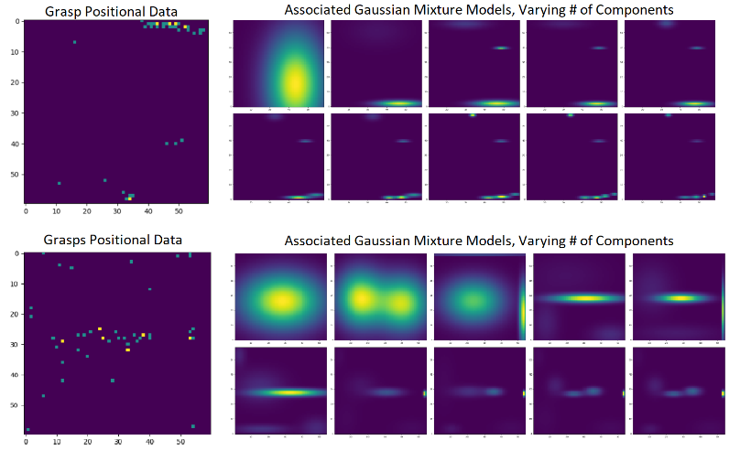
Ground Truth Heatmaps
Notes:
We verify this briefly through visual inspection where we see that at around 6-10, the number of components begin to explain the distribution in a clearer manner.

Slide 44
Implemented variations
Highpass-Lowpass Branch Architecture
HP Filter
CNN + ReLu + Pool X3
Spherical image
CNN + ReLu
Output Heatmap
LP Filter
CNN + ReLu + Pool X3
Multi-resolution Branch Architecture [3]
1:1
CNN + ReLu + Pool X3
Spherical image
2:1
CNN + ReLu + Pool X3
CNN + ReLu
Output Heatmap
Reshape
4:1
CNN + ReLu + Pool X3

Slide 45


Implemented variations cont.
Simple Gradient-Boost concept to CNN
Let be the edge prioritizing network
Let be the network that learns from the removal of edges
Train with and x
Then, is the new output function
Using same structure as baseline, implement the spherical CNN as described by Cohen [1].
According to author, each planar CNN should easily be replicable by the spherical CNN.
Spherical CNN implementation

Slide 46
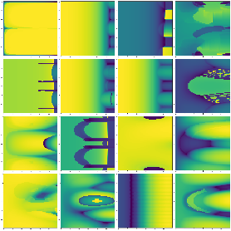
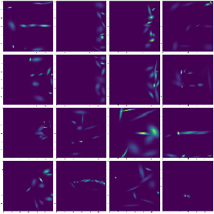
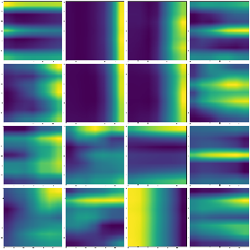
Variation Results/Conclusions cont.
Multi-resolution Branch Architecture:
Input Image Grasp Labels Predicted HM
Input Image Label Data Predicted Heatmap
Notes:
Very strong and incorrect horizontal and vertical predications.
No longer purely an edge detector, however, heatmaps no longer as concise and they have a much too large of a spread.

Slide 47
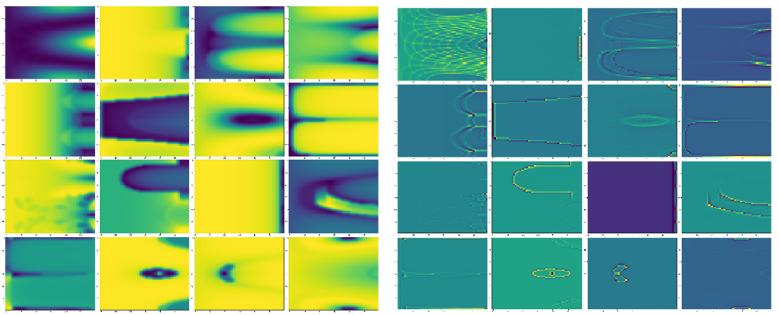
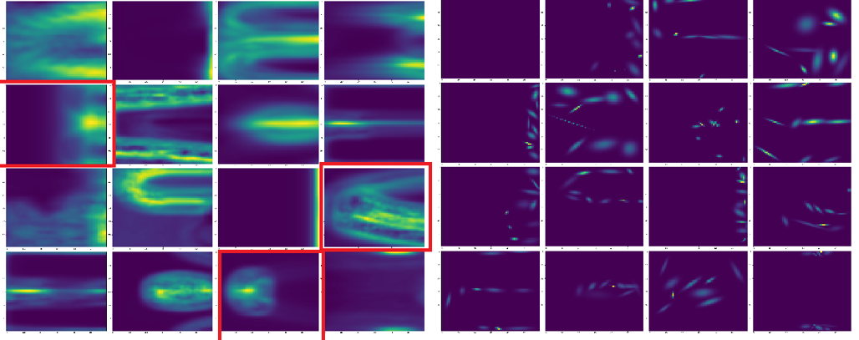
Variation Results/Conclusions cont.
Highpass-Lowpass Branch Architecture:
Stronger focus on edges than before.
Low pass branch appears to add in mainly noise.
Spherical CNN implementation:
Unfortunately, due to performance issues, not suitable for spatial regression.
Lowpass Input High Pass Input
Predicted Heatmap Grasp-labels
Notes:
When looking at the High-Pass lowpass branch architecture. We also experienced disappointing results. Here the branch separation never correctly worked as intended. Rather the low pass branch simply appeared to add noise to the output and the highpass branch gave very strong preference to edges. As a result the predicted heatmaps were even more focused on edges than before.
As for the spherical CNN. Here we experienced one of the most disappointing results, as even though the research paper it was introduced in showed much promise, actual implementation was unfeasible as it was quickly shown to be too computationally complex for spatial regression. It is great for classification but for the moment, not suited for this task. Perhaps in the future.

Slide 48
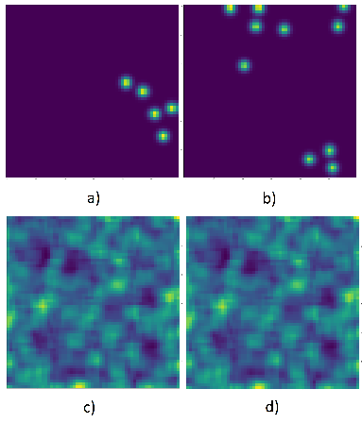
Mode Collaspe

