Slide 1

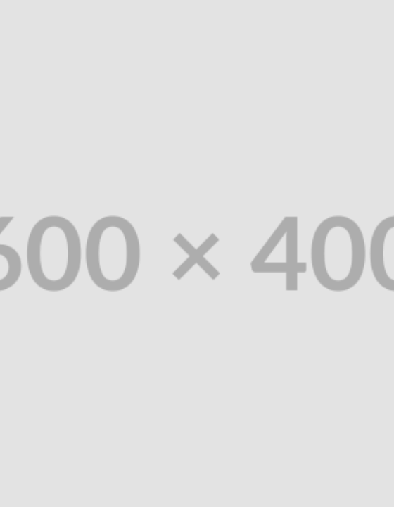
DATASET ANALYSIS
Heart Failure Clinical Records
Predictive modeling and statistical analysis of patient mortality events.

Slide 2



PROBLEM STATEMENT
Dataset Scope & Context
The Cohort
The Outcome
The Features
299 patient clinical records.
96 recorded death events.
13 clinical and demographic variables.

Slide 3
PROJECT GOALS
Core Objectives
Identify Markers: Find clinical types associated with mortality.
Evaluate Models: Test machine learning classification algorithms.
Statistical Rigor: Analyze outcomes using foundational statistics.
Academic Insight: Expand understanding of heart failure records.

Slide 4
PROBLEM TYPE
Target Variable
Supervised Binary Classification
DEATH_EVENT
The models predict a discrete categorical outcome based entirely on clinical features.
1
0
Mortality Event
Patient Survival
Models: Logistic Regression, Random Forest

Slide 5




ETHICAL SCOPE
Usage Considerations
Demographic Bias
Slight over-representation of older males (194 M / 105 F).
Patient Consent
Retrospective medical study published for academic purposes.
Strictly Non-Clinical
Autonomous clinical diagnosis is strictly prohibited.

Slide 6
Data Preparation & EDA
Cleaning, Transformation, and Foundational Statistics

Slide 7
PIPELINE STEP 1
Data Ingestion & Quality Check
import pandas as pd
# Load the dataset
df = pd.read_csv("heart_failure.csv")
# Quality checks
print(df.shape)
print(df.isna().sum().sum())
print(df.duplicated().sum())
pd.read_csv()
Loads the CSV file into a Pandas DataFrame structure in memory for programmatic manipulation.
.shape & .isna()
shape validates dimensions (299 rows, 13 cols). isna() and duplicated() confirm the dataset is clean with 0 missing values.

Slide 8
PIPELINE STEP 2
Feature & Target Isolation
target = "DEATH_EVENT"
# Extract features (X) and label (y)
X = df.drop(columns=[target])
y = df[target]
# Prevent data leakage
X = X.drop(columns=["time"])
df.drop()
Removes the target variable from the input matrix to prevent the model from learning the answers during the training phase.
Data Leakage Prevention
Dropping the time (follow-up duration) column ensures the model predicts based strictly on initial clinical assessment, not future observation.

Slide 9
CLASS BALANCE
Target Imbalance
df['DEATH_EVENT'].value_counts(normalize=True)
No Death Event (0)
203 Patients
67.9% of Cohort
Death Event (1)
96 Patients
32.1% of Cohort

Slide 10
DATA VISUALIZATION
Distribution & Outlier Analysis
sns.histplot(data=df, x="age", kde=True)
plt.title("Age Distribution")
Age Distribution (Simulated Histplot)
sns.histplot()
Visualizes the distribution spread via Seaborn. Identifies skewed variables and flags potential extreme observations mathematically using IQR bounds.
40
50
60
70
80
90

Slide 11
INFERENTIAL STATISTICS
Mortality Group Differences
Unadjusted Welch T-Tests:
stats.ttest_ind(group_0, group_1, equal_var=False)
+6.5
+0.66
-6.8%
Years Older
Serum Creatinine
Ejection Fraction
Average age increase in events.
Higher average in events.
Lower average in events.

Slide 12
SUMMARY
Key Takeaways
Class Imbalance: 32.1% baseline mortality rate requires metric adjustments.
Age Factor: Age positively correlates with mortality events.
Ejection Fraction: Negatively correlates with death events.
Serum Creatinine: Significantly elevated in the mortality group.
Note: Associations establish correlation, not causal evidence.

Slide 13


End of Analysis
Heart Failure Clinical Records Dataset
Predictive Modeling & Foundational Statistics

