Slide 1
TRIALPILOT / HACKHARVARD 2026
01 / 12
TrialPilot
Clinical trial choices.
Visible assumptions.
Evidence you can inspect.
Planning • synthetic operations • software validation
MIT prototype | Local real-API demo | No production or clinical outcome claim
Notes:
TrialPilot is an MIT-licensed hackathon prototype for inspecting operational consequences of study-design choices. Cost, site workload, patient travel and timeline come before carbon. We demonstrate local software behavior; no clinical outcomes, savings, production deployment or regulatory acceptance are claimed. [Build and scope](../README.md).
Full narrative and sources: docs/DECK.md. Evidence snapshot: validation/out/clean-clone/20261017T041438Z. Science source: science/out/results.json at e5c386b1fb0b6edf362bf5d37b97cc17066dfd07. Captures are the actual local app with real API; operations are synthetic; identities are fictional demos.

Slide 2
TRIALPILOT / HACKHARVARD 2026
02 / 12
Decisions with real operational cost
$19.0m
Procedures and site activity are major historical cost drivers
Historical median estimated direct cost
per pivotal trial
Monitoring and supply choices change resource needs
Start with workload and timing, then inspect carbon
138 trials • 59 approvals • 2015–2016 cohort
Moore et al., JAMA Internal Medicine (2018)
Prototype • tested code e5c386b • details and sources in speaker notes
Notes:
The $19.0m figure is the historical median estimated direct cost per pivotal trial: 138 trials supporting 59 FDA approvals in 2015–2016. It is not a current invoice or TrialPilot saving. ASPE's 2014 report provides additional cost-driver context. Original Regeneron sheets were not supplied. [Moore et al.](https://pmc.ncbi.nlm.nih.gov/articles/PMC6248200/), [ASPE](https://aspe.hhs.gov/sites/default/files/migrated_legacy_files//44516/rpt_erg.pdf), [claim ledger](EVIDENCE.md).
Full narrative and sources: docs/DECK.md. Evidence snapshot: validation/out/clean-clone/20261017T041438Z. Science source: science/out/results.json at e5c386b1fb0b6edf362bf5d37b97cc17066dfd07. Captures are the actual local app with real API; operations are synthetic; identities are fictional demos.

Slide 3
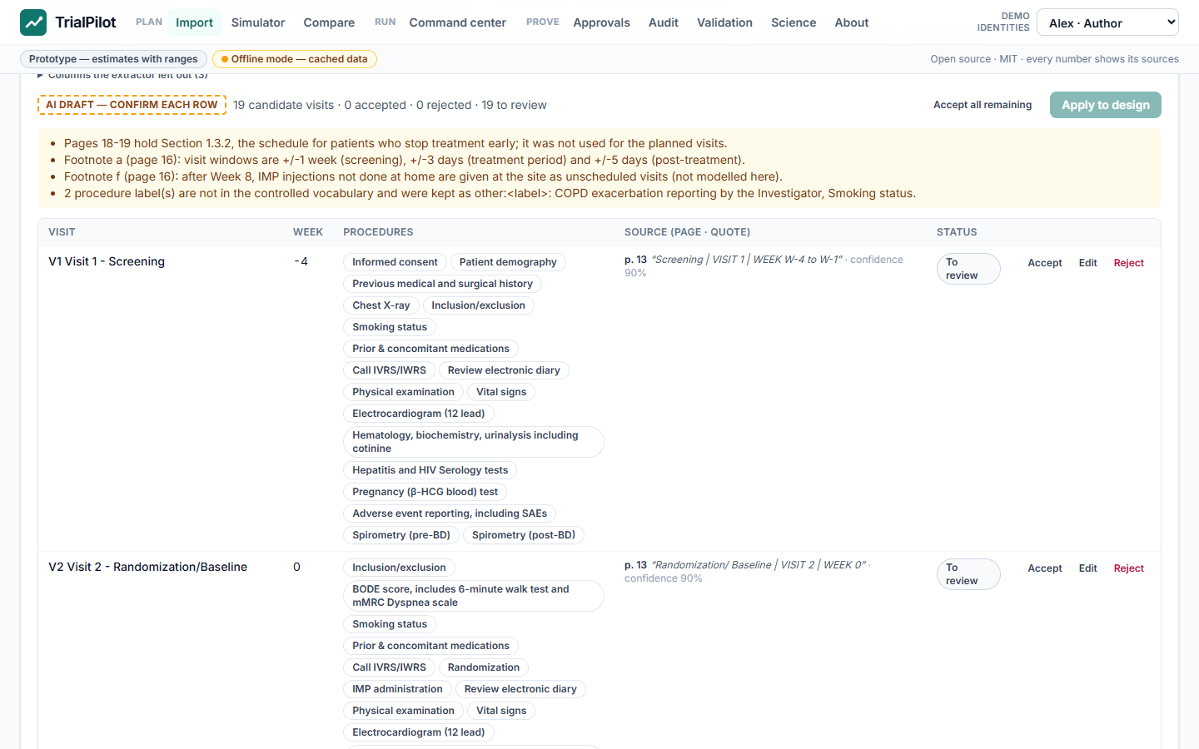
TRIALPILOT / HACKHARVARD 2026
03 / 12
Import, review, save the design
Registry facts stay separate from missing inputs
Protocol candidates expose page and quotation
Apply reviewed rows to a new saved design version
Prototype • tested code e5c386b • details and sources in speaker notes
Notes:
The recording imports BOREAS NCT03930732 and uses a cached protocol transcription, not a measured live LLM extraction. Accept all remaining records bulk acceptance; it does not establish accuracy or clinical review. Empty weeks are rejected. Re-import preserves an already confirmed protocol unless the user explicitly requests replacement. The final regression also covers previously unseeded NOTUS NCT04456673. [Runbook](DEMO_RUNBOOK.md), [A4](../handoffs/A4.md).
Full narrative and sources: docs/DECK.md. Evidence snapshot: validation/out/clean-clone/20261017T041438Z. Science source: science/out/results.json at e5c386b1fb0b6edf362bf5d37b97cc17066dfd07. Captures are the actual local app with real API; operations are synthetic; identities are fictional demos.

Slide 4
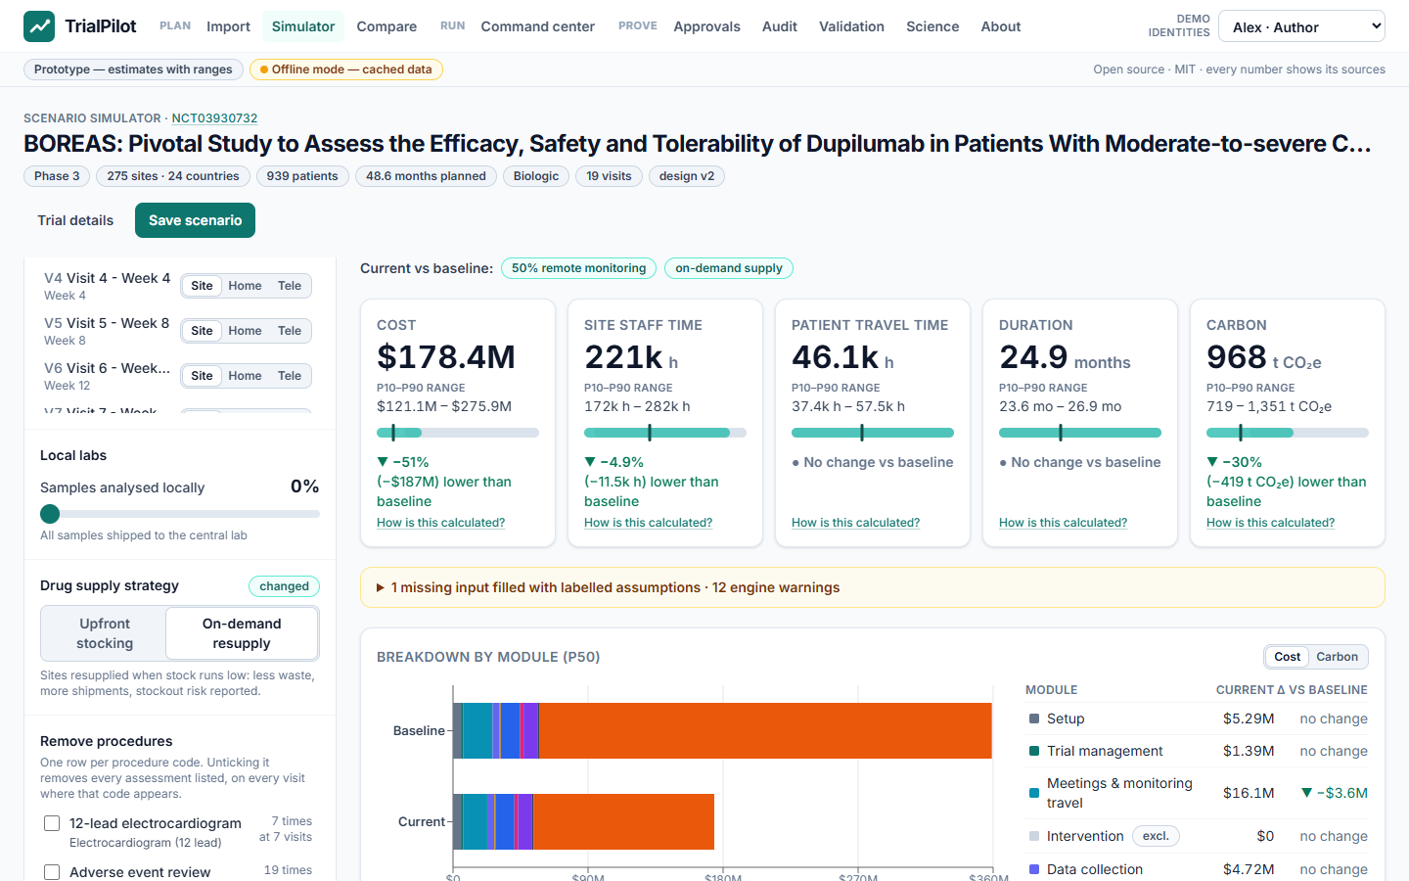
TRIALPILOT / HACKHARVARD 2026
04 / 12
Compare the consequences
Cost, site hours, patient travel, duration and carbon
50% remote monitoring plus on-demand supply in this demo
Calculation and saved result use the same design version
Prototype • tested code e5c386b • details and sources in speaker notes
Notes:
The choices are hypothetical operating inputs, not a clinical recommendation. We avoid changing patient visits or removing procedures without eligibility review. Read computed ranges as model output, never observed savings. The frontend disables saving during a pending calculation and saves the computed levers and explicit design version; stale design edits receive a visible conflict. [Frontend evidence](../handoffs/FRONTEND_FINAL.md).
Full narrative and sources: docs/DECK.md. Evidence snapshot: validation/out/clean-clone/20261017T041438Z. Science source: science/out/results.json at e5c386b1fb0b6edf362bf5d37b97cc17066dfd07. Captures are the actual local app with real API; operations are synthetic; identities are fictional demos.

Slide 5
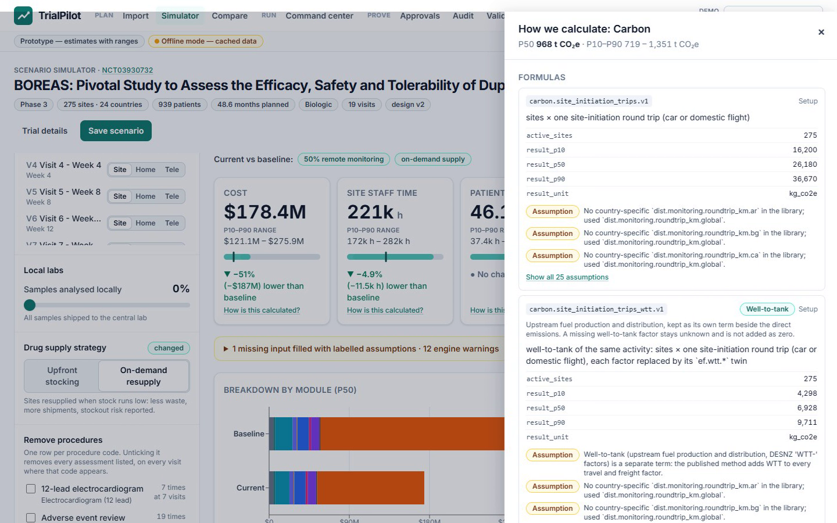
TRIALPILOT / HACKHARVARD 2026
05 / 12
Inspect every estimate
Open formulas, inputs, cited parameters and assumptions
Forecast and supply report requested and actual draw counts
Missing data stays unknown; curve gaps remain gaps
Prototype • tested code e5c386b • details and sources in speaker notes
Notes:
P10/P50/P90 are conditional model quantiles without demonstrated real-world coverage. Forecast and supply have distinct sampling paths; use the displayed counts, not an assumed 2,000 everywhere. Recruitment, dropout, supply look-ahead and stockout limitations remain. [Engine method](model.md), [forecast and supply method](model_forecast.md), [sources](sources.md).
Full narrative and sources: docs/DECK.md. Evidence snapshot: validation/out/clean-clone/20261017T041438Z. Science source: science/out/results.json at e5c386b1fb0b6edf362bf5d37b97cc17066dfd07. Captures are the actual local app with real API; operations are synthetic; identities are fictional demos.

Slide 6
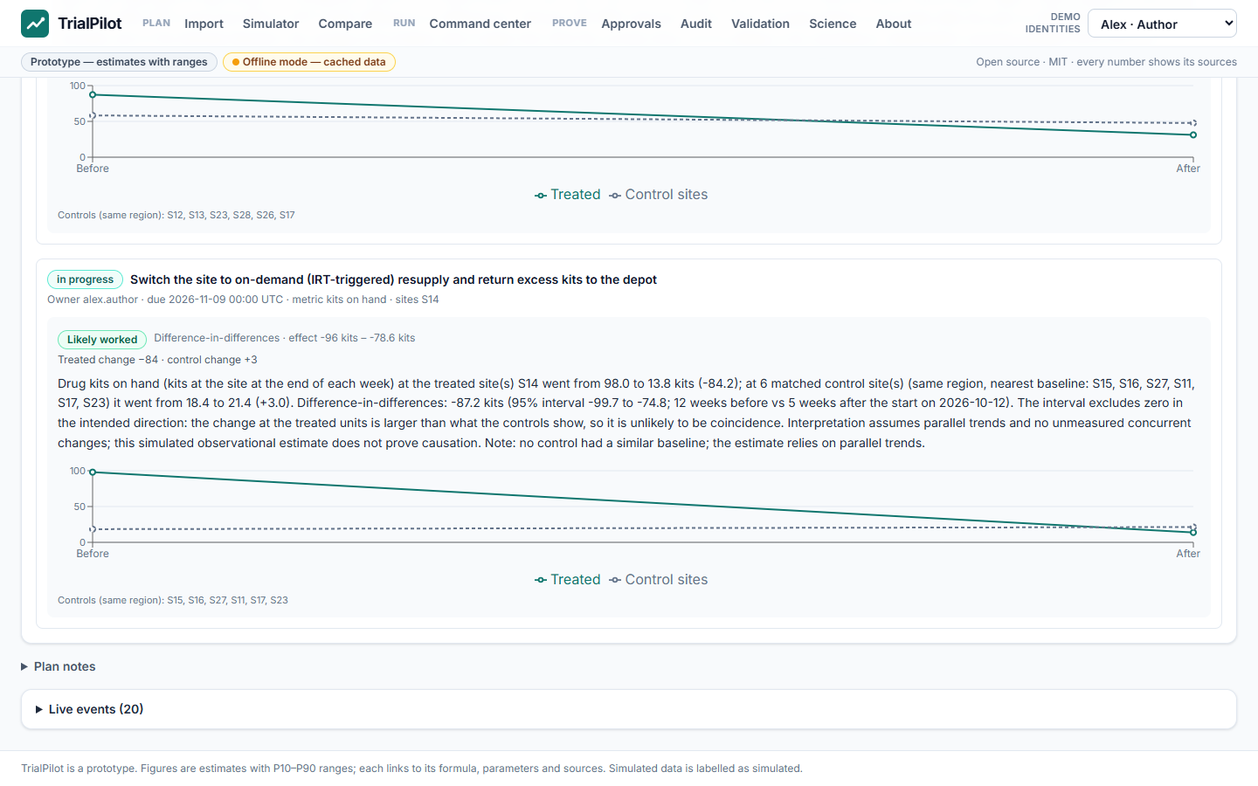
TRIALPILOT / HACKHARVARD 2026
06 / 12
Act on a synthetic signal
Sites and countries show completed-week enrollment
Acknowledge overstock, assign an intervention, start it
Advance six simulated weeks and inspect the effect interval
Prototype • tested code e5c386b • details and sources in speaker notes
Notes:
The 40-site demonstration combines synthetic EDC, CTMS, IRT, travel and courier feeds. The open week is excluded from completed-week curves; country bands sum site bands, and backup-site plans remain zero. A difference-in-differences estimate relies on its comparison group and assumptions. Its verdict is not a clinical causal conclusion. [Methods](model_forecast.md), [runbook](DEMO_RUNBOOK.md).
Full narrative and sources: docs/DECK.md. Evidence snapshot: validation/out/clean-clone/20261017T041438Z. Science source: science/out/results.json at e5c386b1fb0b6edf362bf5d37b97cc17066dfd07. Captures are the actual local app with real API; operations are synthetic; identities are fictional demos.

Slide 7
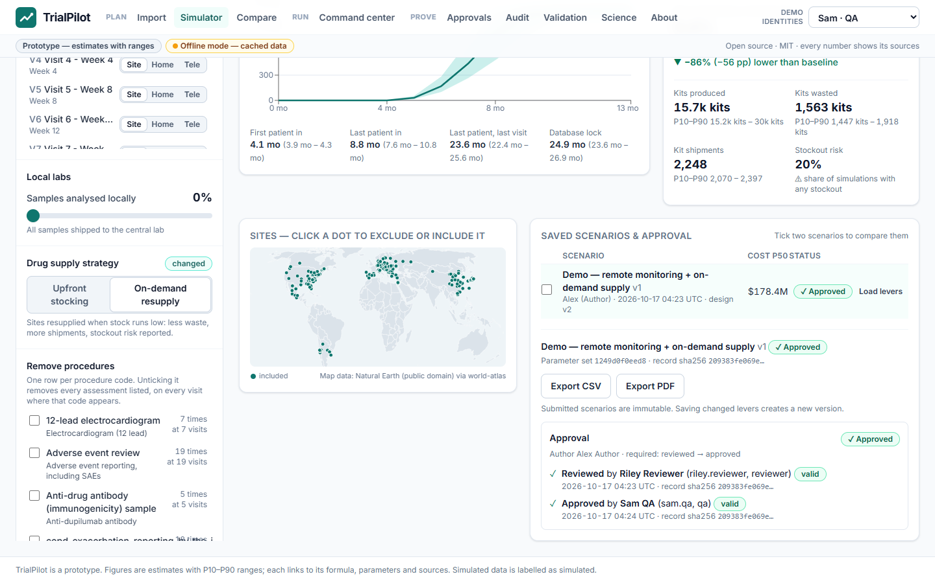
TRIALPILOT / HACKHARVARD 2026
07 / 12
Bind review to the saved record
Self-approval is rejected by the real API
Reviewer then QA demo signatures bind the record hash
Verify the current audit chain and inspect its entries
Prototype • tested code e5c386b • details and sources in speaker notes
Notes:
Alex, Riley and Sam are fictional identities exercised by automation. An Approved scenario in this video demonstrates workflow controls, not human QA approval of TrialPilot or the validation report. A role switcher is not production authentication; a hash chain does not prevent a privileged rewrite of the entire database. [Frontend checks](../handoffs/FRONTEND_FINAL.md), [validation scope](EVIDENCE.md).
Full narrative and sources: docs/DECK.md. Evidence snapshot: validation/out/clean-clone/20261017T041438Z. Science source: science/out/results.json at e5c386b1fb0b6edf362bf5d37b97cc17066dfd07. Captures are the actual local app with real API; operations are synthetic; identities are fictional demos.

Slide 8
TRIALPILOT / HACKHARVARD 2026
08 / 12
Science: show the remaining gap
kg CO2e | Published | Engine P50 | P10–P90 | Gap
CASPS | 71,938.8 | 88,758.48 | 64,601–123,510 | +23.38%
PRIMETIME | 89,360.2 | 109,685.91 | 87,891–142,686 | +22.75%
Engine + library factors; excludes drug_supply extension
Seed 7 • 2,000 draws • parameter set 1249d0f0eed8
Paper arithmetic: +0.01% / −0.16%. Module gaps remain; range coverage is not model validation.
Prototype • tested code e5c386b • details and sources in speaker notes
Notes:
Source is science/out/results.json, parameter set 1249d0f0eed8, seed 7, 2,000 draws. CASPS: published 71,938.8 kg; engine/library P10 64,601.50, P50 88,758.48, P90 123,510.08 kg CO2e. PRIMETIME: published 89,360.2 kg; engine/library 87,891.34 / 109,685.91 / 142,685.69 kg. Drug_supply is excluded from this comparison. Paper arithmetic separately gives +0.01% / −0.16%; library-factor ledger checks are different from full-engine checks. Direct and WTT components are counted once each. PRIMETIME visits cover all 1,962 rather than the 1,623 subgroup; hospital utilities, some sample activity and audits are missing. Old +5%/+7% results are obsolete. Carbon checks do not validate cost or forecast accuracy. [Generated results](../science/out/results.json), [published method, CC BY 4.0](https://pmc.ncbi.nlm.nih.gov/articles/PMC10823997/), [backend version](../handoffs/BACKEND_FINAL.md).
Full narrative and sources: docs/DECK.md. Evidence snapshot: validation/out/clean-clone/20261017T041438Z. Science source: science/out/results.json at e5c386b1fb0b6edf362bf5d37b97cc17066dfd07. Captures are the actual local app with real API; operations are synthetic; identities are fictional demos.

Slide 9
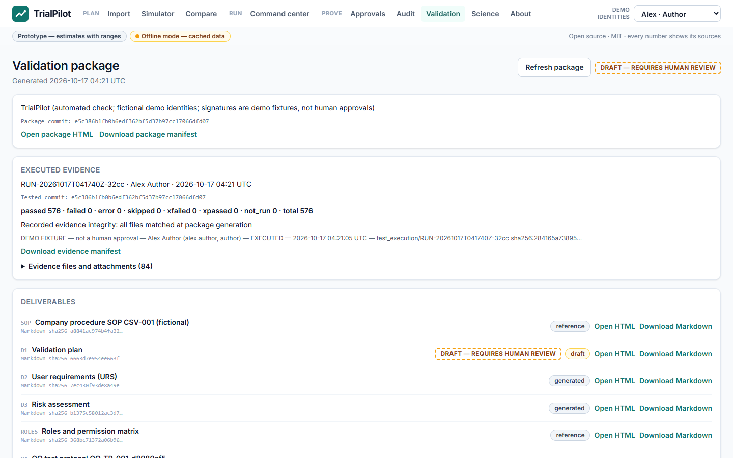
TRIALPILOT / HACKHARVARD 2026
09 / 12
Evidence with its exact scope
Read the package's actual tested commit and counts
Keep failed checks and traceability gaps visible
Download evidence; report remains awaiting QA approval
Prototype • tested code e5c386b • details and sources in speaker notes
Notes:
The Validation page reads the package metadata, not hardcoded historical counts. Inspect execution, failures, artifact hashes and QA state. Automated fixture signatures do not establish human sign-off. The historical 6/6 planted-defect experiment at d616645 was not blind and is not a result for this code. Human effort and live LLM accuracy remain unmeasured. [Final execution scope](EVIDENCE.md), [package path](../handoffs/BACKEND_FINAL.md).
Full narrative and sources: docs/DECK.md. Evidence snapshot: validation/out/clean-clone/20261017T041438Z. Science source: science/out/results.json at e5c386b1fb0b6edf362bf5d37b97cc17066dfd07. Captures are the actual local app with real API; operations are synthetic; identities are fictional demos.

Slide 10
TRIALPILOT / HACKHARVARD 2026
10 / 12
Three challenge workflows
Brief-provided challenge title | Demonstrated workflow
Choose Your Timeline | Version-bound scenarios + forecast assumptions
One Screen to Rule Them All | Synthetic site / country signals + interventions
Software Speedrun | Executed checks + downloadable evidence
Original sponsor sheets were not supplied; title attribution remains unverified.
Prototype • tested code e5c386b • details and sources in speaker notes
Notes:
Challenge titles come from the supplied A11 brief. The original sponsor sheets remain unavailable; this mapping does not verify their exact wording or submission rules. Each workflow shown has real API browser evidence, with synthetic and draft boundaries retained. [Missing sheet evidence](EVIDENCE.md#unavailable-sheet-evidence).
Full narrative and sources: docs/DECK.md. Evidence snapshot: validation/out/clean-clone/20261017T041438Z. Science source: science/out/results.json at e5c386b1fb0b6edf362bf5d37b97cc17066dfd07. Captures are the actual local app with real API; operations are synthetic; identities are fictional demos.

Slide 11
TRIALPILOT / HACKHARVARD 2026
11 / 12
Existing tools, an inspectable prototype
Existing category | Example
Multi-metric design / carbon | Evinova; SHC / iLCCT calculator
Clinical monitoring | Medidata centralized monitoring / RBQM
Validation lifecycle | ValGenesis iVal
Our focus: an inspectable MIT implementation connecting these workflows.
Prototype • tested code e5c386b • details and sources in speaker notes
Notes:
These are vendor descriptions, not a head-to-head evaluation or a claim of first-of-kind capability. SHC/iLCCT's calculator was developed with Pistoia participation. [Evinova](https://evinova.com/dds), [carbon offering](https://evinova.com/carbon), [Pistoia](https://pistoiaalliance.org/news/launches-sustainability-initiative/), [Medidata](https://www.medidata.com/en/clinical-trial-products/clinical-operations/rbqm/centralized-monitoring/), [ValGenesis](https://www.valgenesis.com/blog/valgenesis-vlms-5.0-next-gen-validation-lifecycle-management).
Full narrative and sources: docs/DECK.md. Evidence snapshot: validation/out/clean-clone/20261017T041438Z. Science source: science/out/results.json at e5c386b1fb0b6edf362bf5d37b97cc17066dfd07. Captures are the actual local app with real API; operations are synthetic; identities are fictional demos.

Slide 12
TRIALPILOT / HACKHARVARD 2026
12 / 12
A bounded pilot, with open gaps
Calibrate against permitted sponsor and site data
Measure live extraction quality and human review effort
Add production identity, deployment checks and independent QA
Next: a permitted-data pilot with sponsor and site teams.
Notes:
No deployment URL, Docker validation, real LLM accuracy, human review timing or human QA approval is established. Keep any final performance failure visible. A pilot needs prospective acceptance criteria and clinical review of allowed changes. SMI reporting mapping remains future work, not demonstrated conformity. [Limitations](../README.md#limitations), [SMI context](https://a.storyblok.com/f/109506/x/0245e71cdc/smi-ceo-cro-letter-_-february-2025.pdf), [final handoff](../handoffs/FRONTEND_FINAL.md).
Full narrative and sources: docs/DECK.md. Evidence snapshot: validation/out/clean-clone/20261017T041438Z. Science source: science/out/results.json at e5c386b1fb0b6edf362bf5d37b97cc17066dfd07. Captures are the actual local app with real API; operations are synthetic; identities are fictional demos.

