Slide 1
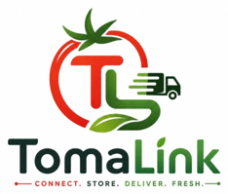
REDUCING POST HARVEST TOMATO LOSSES IN NIGERIA THROUGH SMART TECHNOLOGY
A hackathon solution built by farmers' logic, not just code
TECHYJAUNT HACKATHON
July 2026
Presented by Group 6

Slide 2
THE PROBLEM
Nigeria grows enough tomatoes to feed itself, yet nearly half never reach a plate
3.8 to 4.0M
40 to 45%
Over 50%
metric tonnes of tomatoes produced in Nigeria every year, which is the largest output in sub Saharan Africa
of that harvest is lost after it leaves the farm, before it ever reaches a consumer or processor
is lost during peak harvest season alone, when market glut and storage shortages hit hardest
In plain terms, for every 100 baskets a farmer harvests, roughly 40 to 60 of them never earn a single naira. Nigeria still imports large volumes of tomato paste because so much of its own fresh harvest spoils before it can be sold or processed.
Source: FAOSTAT, Federal Ministry of Agriculture and Food Security, National Bureau of Statistics
02

Slide 3
Six weak links that breaks the chain between farm and market
ROOT CAUSES
1
2
3
Poor transportation
Inadequate storage
Poor packaging
Tomatoes travel long distances on rough roads in overloaded, non refrigerated vehicles, bruises and cracks which speed up spoilage before produce even reaches a market.
Most smallholders have no access to cold storage. Tomatoes sit at open air temperatures, ripening and decaying within days of harvest.
Woven baskets and sacks offer little protection. The weight of the produce crushes tomatoes at the bottom, and damage spreads to healthy fruit nearby.
4
5
6
Market glut and price crashes
Pests and disease
Weak market coordination
During peak harvest, supply outpaces demand, with nowhere to store the surplus, farmers are forced to sell at a loss or watch produce spoil unsold.
Fungal infection, bacterial rot and insect damage spread quickly wherever sanitation, harvesting and handling of product is poor.
Farmers in remote areas struggle to find buyers quickly. The longer produce sits unsold, the more of it spoils.
03

Slide 4
OUR OWN PILOT DATA
The numbers behind TomaLink's pilot confirm the scale of the problem
15.75M kg
4M kg
22.62%
₦10.08bn
₦5.90bn
Total tomatoes harvested across our pilot sample
Total quantity lost before reaching a buyer
Weighted post harvest loss rate across the pilot
Total revenue generated from what was actually sold
Total profit realised across all pilot farmers
These figures come directly from TomaLink's own pilot loss and impact dashboard, built on real farm level records across five tomato producing states.
04

Slide 5
WHAT OUR DATA SHOWS
Storage method is the single biggest lever we can pull
Open air storage loses nearly double the produce that a cold room does.
Every step-up in storage quality buys back real, sellable produce, Moving farmers from open air to even basic warehousing already cuts loss by roughly a third. Cold rooms nearly halve it again.
This is exactly why cold storage and warehouse booking sit at the core of what TomaLink offers, not as an add on feature.
05

Slide 6
2.0 WHAT OUR DATA SHOWS
How the loss is spread almost evenly across five causes
Mechanical damage and delay top the list, at roughly 20.8% and 20.7% of losses, but pests, packaging and heat all sit close behind.
This spread matters strategically. A platform that only fixes one weak point, only storage, or only transport, would still leave most of the loss untouched. Real impact requires addressing handling, timing, packaging and storage together, in one coordinated flow.
This is the core argument for an integrated platform rather than a single point solution.
06

Slide 7
WHY THIS MATTERS
Post harvest loss does not stay on the farm, it moves down the whole chain
National Economy
Farmers
Nigeria loses hundreds of billions of naira annually to tomato spoilage, weakening agriculture's contribution to GDP and forcing continued paste imports that drain foreign exchange.
When produce spoils, farmers lose both the harvest and everything already spent on seeds, fertiliser, labour and transport, making it harder to repay loans or reinvest the next season.
Consumers
Businesses
Reduced supply pushes prices up, especially off season, limiting affordable access to a vegetable that is central to Nigerian diets and nutrition.
Processors run below capacity due to inconsistent supply, traders absorb losses on unsold stock, and transporters lose revenue on rejected, damaged produce.
07

Slide 8
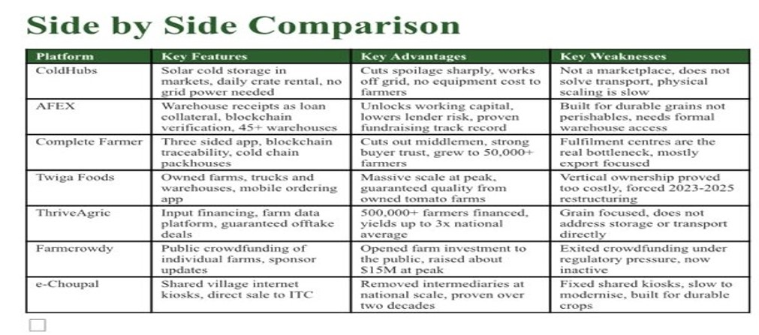
MARKET LANDSCAPE
Every existing platform solves one piece, none solve the whole chain
Each platform above addresses a single link, storage, financing, trading or logistics, in isolation. TomaLink brings storage, transportation, a verified marketplace and live tracking into one connected platform, so a farmer never has to leave the app to solve the next problem in the chain.
08

Slide 9
OUR VALUES
Innovation
Solving old problems with new, practical technology
Reliability
ABOUT US
A platform farmers and buyers can depend on every season
TomaLink is a technology driven post harvest solution that connects farmers to cold storage, warehousing, logistics and markets. By reducing post harvest losses, TomaLink helps farmers earn more, minimises food waste, and strengthens Nigeria's tomato value chain.
Sustainability
Reducing waste across the whole value chain, not just one link
Farmer Empowerment
Putting pricing power and market access back in farmers' hands
Transparency
TAGLINE
Clear pricing, verified buyers, visible transactions
From Farm to Market, Fresh Every Step.
Collaboration
Every stakeholder working from the same shared platform
09

Slide 10
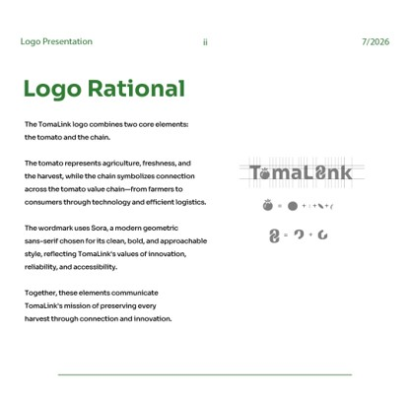
OUR BRAND
A tomato and a chain, the two ideas at the heart of TomaLink
10

Slide 11
OUR APPROACH
One platform, four connected services, a single farmer journey
Store
Move
Sell
Track
Book verified cold storage and warehouse space near the farm the moment harvest happens, instead of leaving produce exposed.
Schedule refrigerated transport with transparent pricing, so tomatoes travel cold instead of bruised and overheated.
List produce directly to verified buyers, wholesalers, retailers and processors, with live market prices guiding every decision.
Follow every shipment from pickup to delivery in real time, with proof of delivery and ratings closing the loop.
Existing solutions only address one part of the supply chain. TomaLink integrates storage, transportation, marketplace and tracking into one seamless platform.
11

Slide 12
What success looks like, for the business and for the people using it
OBJECTIVES
BUSINESS OBJECTIVES
USER OBJECTIVES
Reduce post harvest losses by 30% within the first year
Give farmers and traders easy access to nearby cold storage
Increase average farmer income by 20% within 12 months
Let users search, compare and book storage and transport in one place
Cut the average farm to market time by 25%
Connect farmers directly with verified buyers, cutting out unnecessary middlemen
Onboard 5,000 farmers, 1,000 buyers, 100 logistics providers and 50 storage partners in year one
Show live prices, storage availability and delivery status at all times
Build sustainable revenue through commissions on bookings and sales
Keep the whole experience simple, transparent and fast to use
12

Slide 13
WHO USES TOMALINK
Five roles, one coordinated platform
Farmer
Buyer
Transporter
Warehouse Owner
Administrator
Registers harvests, lists produce, requests transport, books storage, tracks sales and receives payment.
Searches available produce, places orders, pays securely, tracks delivery and rates farmers.
Accepts requests, schedules pickups, updates delivery status and confirms completed deliveries.
Lists storage capacity, accepts bookings, monitors stored produce and flags nearing expiry.
Verifies accounts, approves partners, resolves disputes and oversees the whole platform.
13

Slide 14
CORE FEATURES
The ten must have features that define the MVP
01
User Registration & Authentication
02
User Profile Management
03
Cold Storage Booking
04
Warehouse Booking
05
Logistics Booking
06
Marketplace
07
Order Management
08
Shipment Tracking
09
Payment Integration
10
Admin Dashboard
14

Slide 15
THE FARMER JOURNEY
From sign up to a successful sale, in seven simple steps
Sign Up
Book Cold Storage
Sell on Marketplace
Rate Experience
1
2
3
4
5
6
7
Complete Profile
Schedule Logistics
Track Delivery
Each step closes a gap where produce is normally lost. Booking storage the moment harvest happens prevents open air spoilage, scheduling refrigerated transport prevents bruising in transit, and live tracking means a shipment is never simply lost to silence.
15

Slide 16
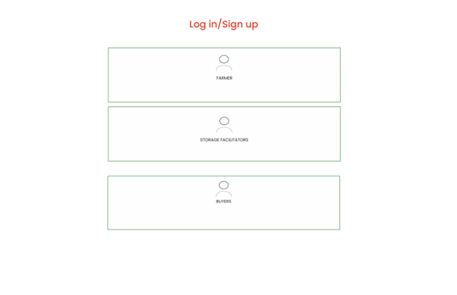
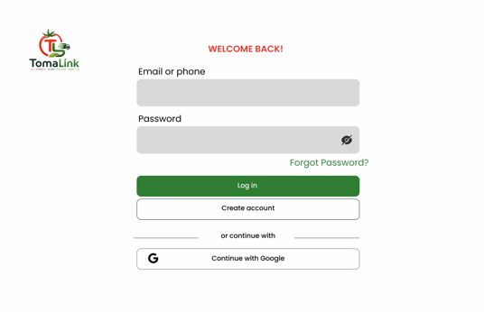
INSIDE THE PRODUCT
Getting started takes under a minute
Choose a role, Farmer, Storage Facilitator or Buyer
Sign in with phone, email or Google
16

Slide 17
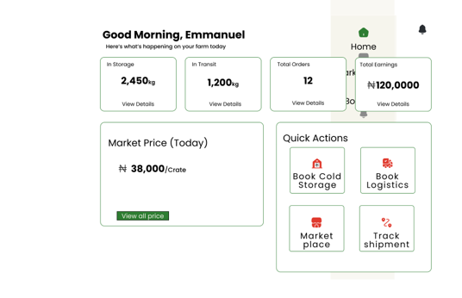
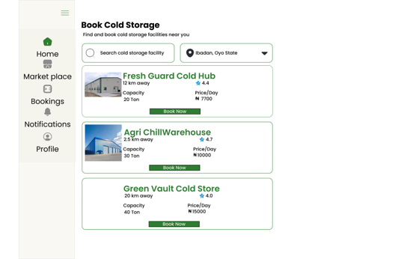
3.0 INSIDE THE PRODUCT
One dashboard, then storage booked in a few taps
A single home screen for storage, logistics, market and sales
Compare nearby cold storage by price, capacity and distance
17

Slide 18
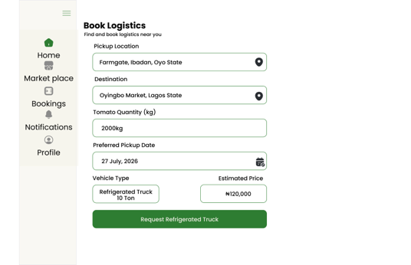
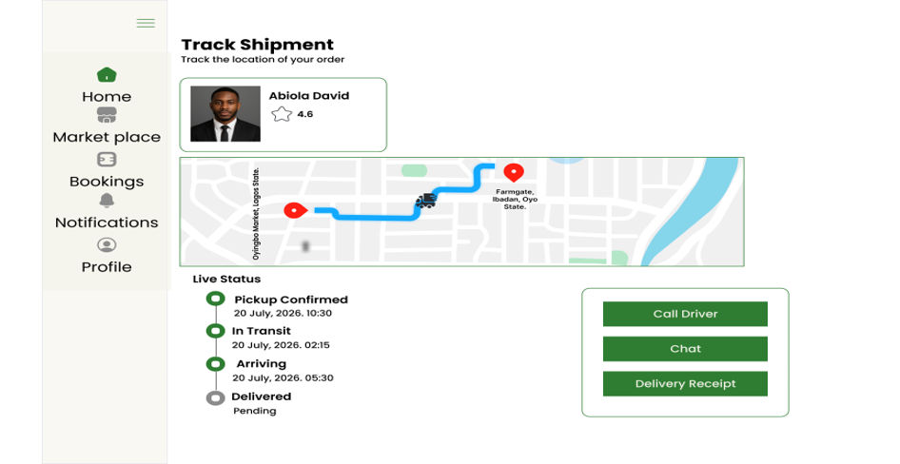
INSIDE THE PRODUCT
Book a refrigerated truck, then watch it move in real time
Request a refrigerated truck with a clear price upfront
Live GPS tracking from pickup confirmed to delivered
18

Slide 19
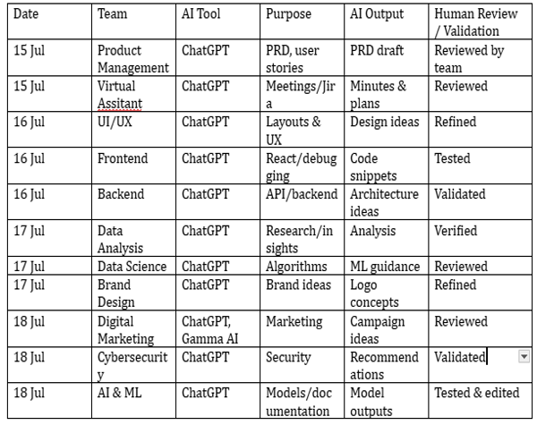
HOW WE BUILT IT
A modern stack, secured by design, built with AI as a reviewed co-pilot
TECHNOLOGY STACK
Frontend: HTML, CSS, JavaScript, React
Backend: Node.js, Express
Database: MongoDB
Workflow: Jira, GitHub, Figma, Canva, Google Workspace
SECURITY HIGHLIGHTS
Secure authentication and password protection
Role based access for each of the five user types
Data encryption and privacy protection throughout
Active threat mitigation on all user facing endpoints
Every AI assisted output across product, design, engineering and marketing was reviewed, tested or validated by a team member before use, logged here for full transparency.
19

Slide 20
ROADMAP & GO TO MARKET
Six months from research to a national launch
Six months from research to a national launch
Discovery
& Planning
UX / UI
Design
MVP
Development
Testing
& QA
Pilot
Launch
Public Launch
& Scale
Wks 1-2
Wks 3-6
Wks 7-14
Wks 15-16
Wks 17-18
Wks 19-24
GO TO MARKET, THREE PHASES
Awareness
Landing page, social campaigns, farming community outreach. Target: 2,000+ waitlist signups.
Landing page, social campaigns, farming community outreach. Target: 2,000+ waitlist signups.
4 weeks
4 weeks
Pilot Launch
Live in Kaduna, Kano, Plateau and Jos with free first bookings. Target: 500 active users, 100 bookings.
Live in Kaduna, Kano, Plateau and Jos with free first bookings. Target: 500 active users, 100 bookings.
2 weeks
2 weeks
Public Launch
Launch event, press coverage, referral programme and NGO partnerships. Target: 5,000 users in year one.
Launch event, press coverage, referral programme and NGO partnerships. Target: 5,000 users in year one.
Ongoing
Ongoing
20

Slide 21
SUCCESS METRICS
How we will know TomaLink is working
6,000+
≥ 85%
₦50M+
registered users within Year 1
booking completion rate
annual transaction value
≥ 60
30%
20%
Net Promoter Score
reduction in post harvest losses
increase in average farmer income
21

Slide 22
EXPECTED IMPACT
Better outcomes for every stakeholder in the chain
Farmers
Businesses
Nigeria
Higher income, lower spoilage, direct access to buyers
Efficient logistics, reliable supply, improved produce quality
Reduced food waste, stronger food security, digital agriculture adoption
22

Slide 23
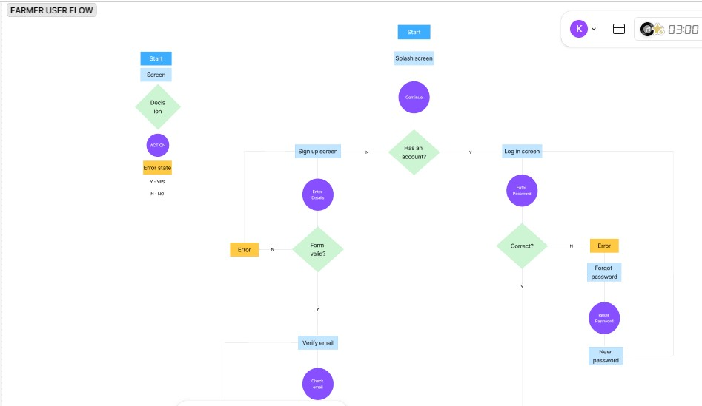
UI/UX, FARMER USER FLOW
Onboarding and sign in, before a farmer ever reaches the dashboard
02

Slide 24
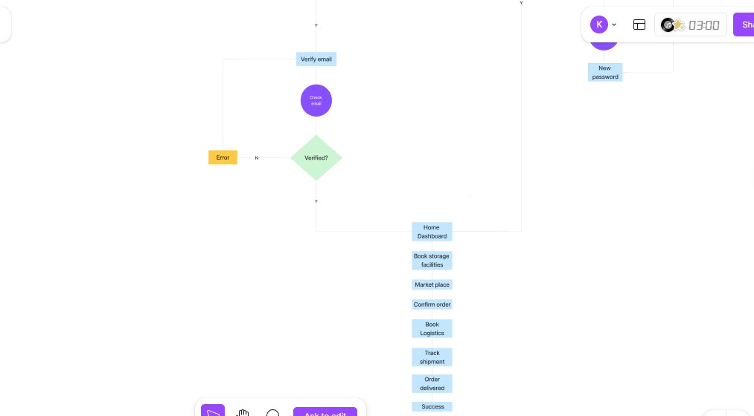
UI/UX, FARMER USER FLOW
From email verification through to a listed harvest
03

Slide 25
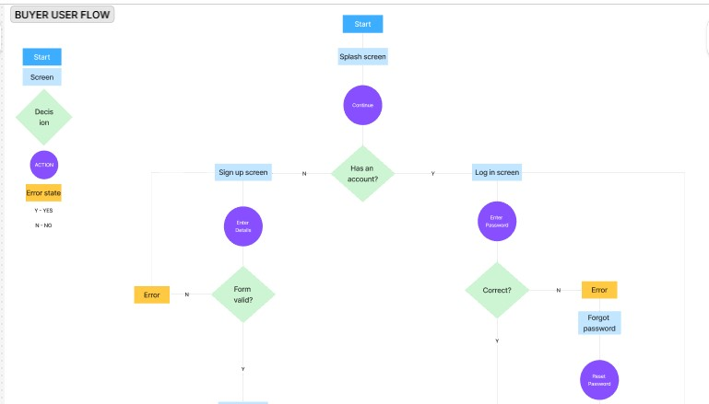
UI/UX, BUYER USER FLOW
The same trusted onboarding pattern, built for buyers
04

Slide 26
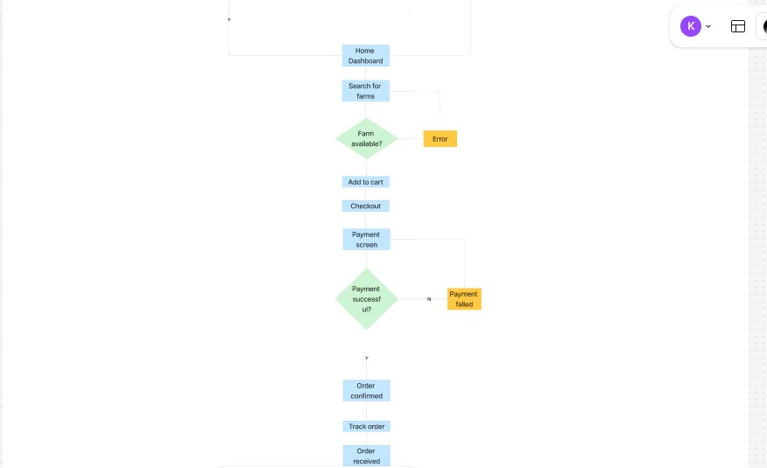
UI/UX, BUYER USER FLOW
From browsing the marketplace through to a received order
05

Slide 27
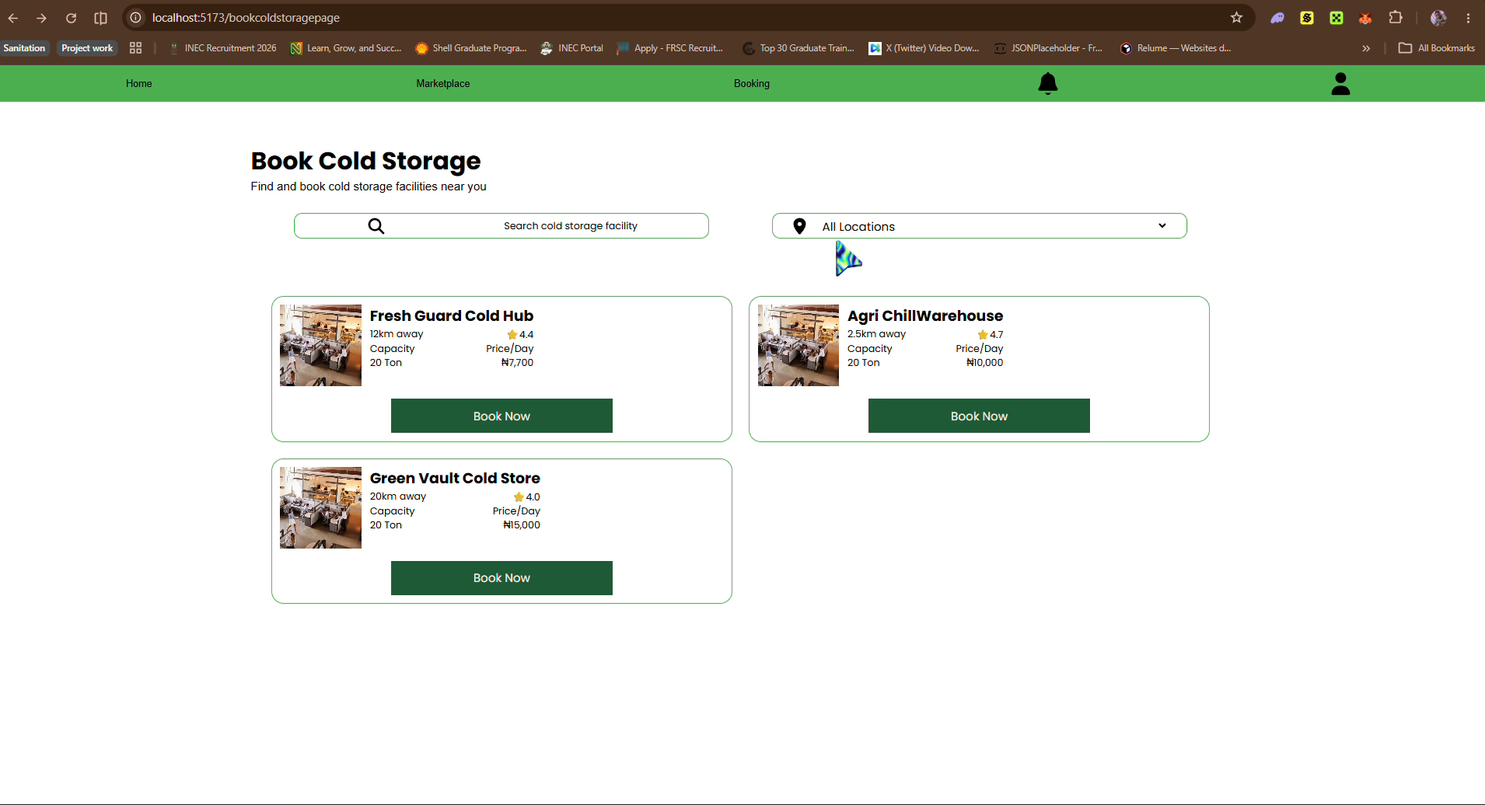
LIVE PRESENTATION

Slide 28
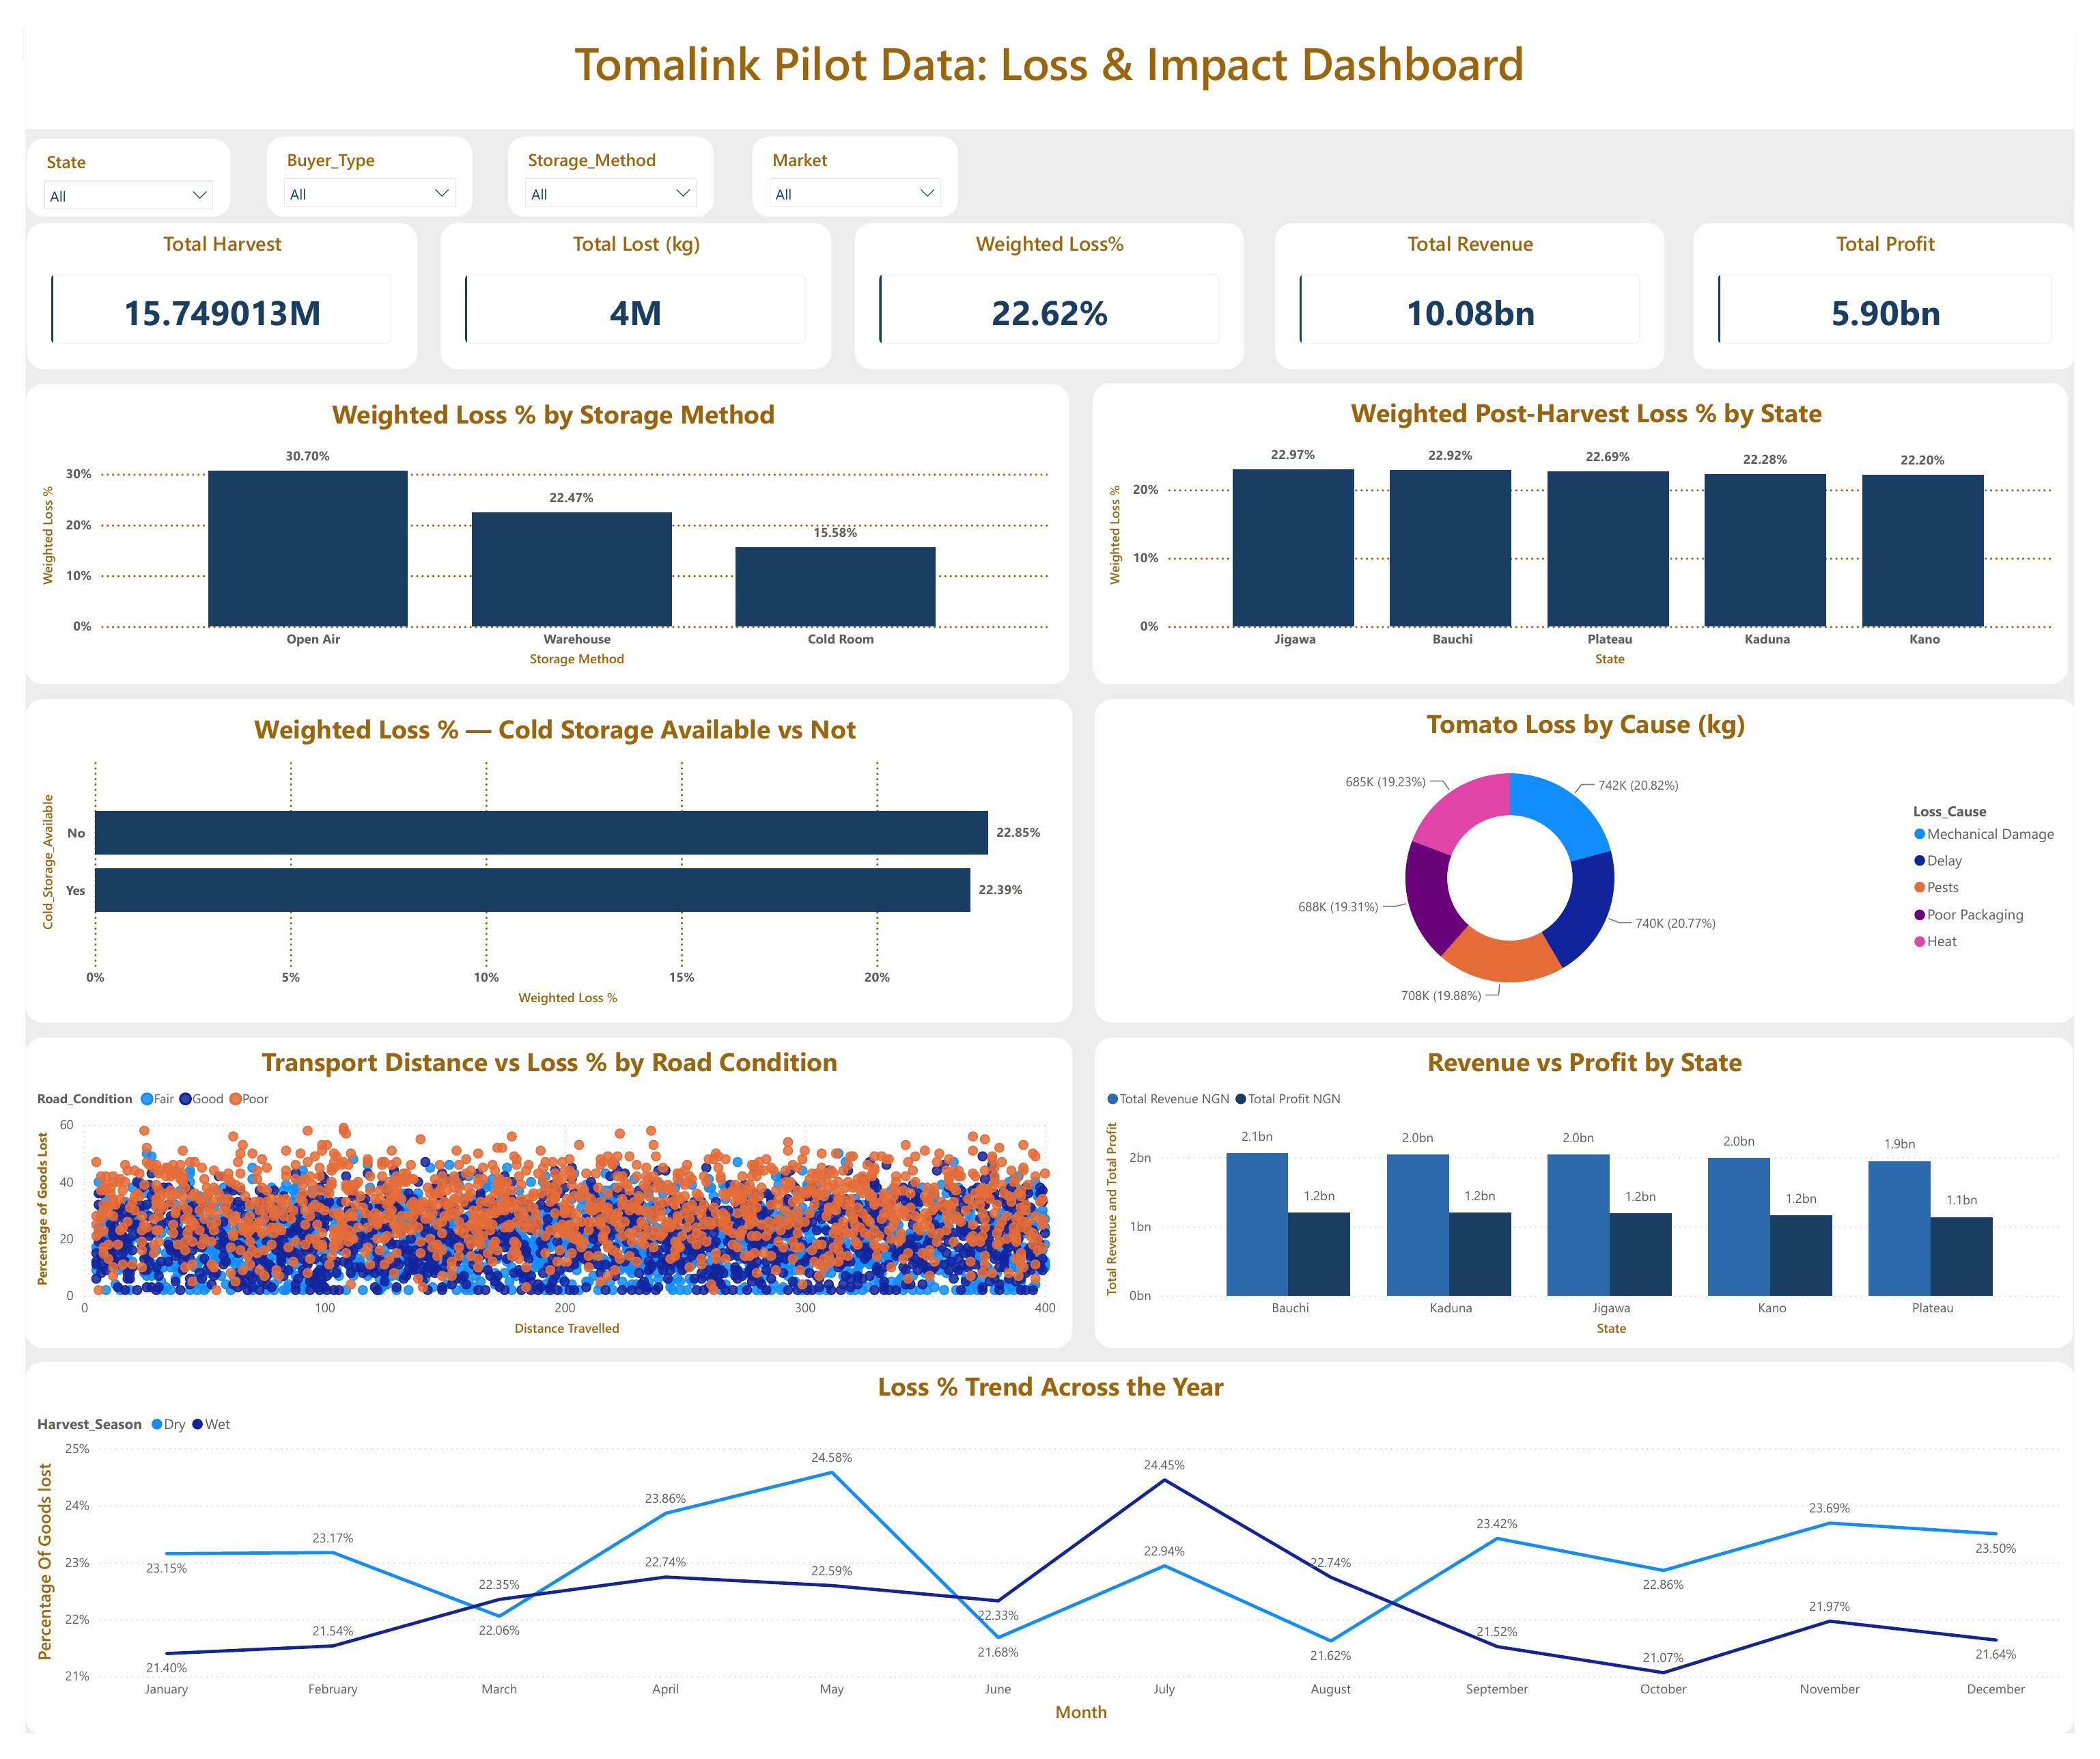
DATA ANALYSIS
One pilot dashboard, turning raw loss data into a clear story
Built from real pilot records across five tomato producing states, covering harvest volume, loss causes, storage method, transport conditions and profitability.
06

Slide 29
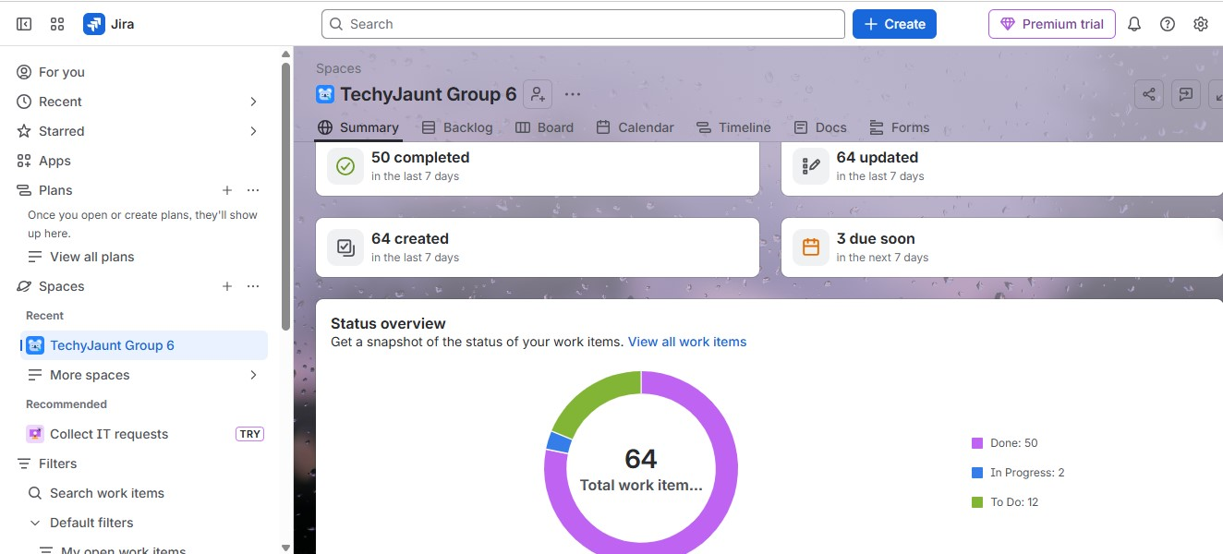
VIRTUAL ASSISTANT, PROJECT COORDINATION
Sprint activity tracked and coordinated end to end in Jira
50 tasks completed and 64 updated in the last 7 days, with 64 total work items tracked across the team.
07

Slide 30
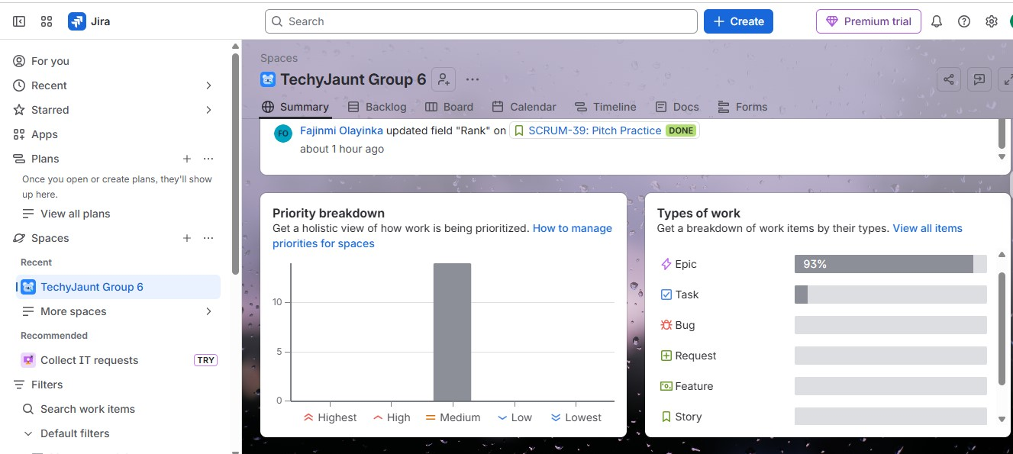
VIRTUAL ASSISTANT, PROJECT COORDINATION
Work was prioritised and typed for full visibility across teams
Nearly all work items were tagged Medium priority, and the majority were tracked as Epics spanning each department's larger deliverables.
08

Slide 31
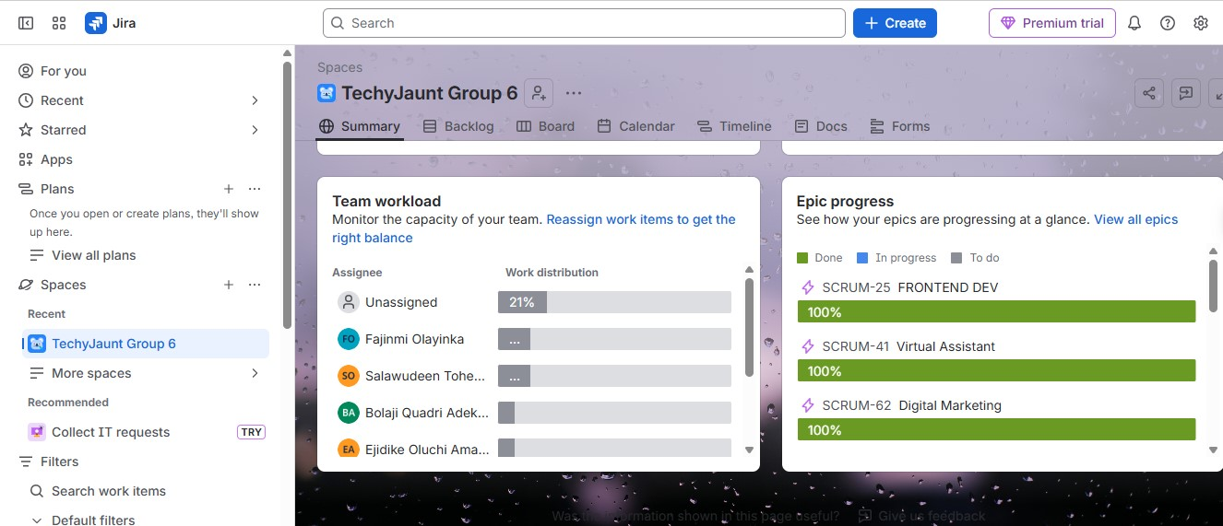
VIRTUAL ASSISTANT, PROJECT COORDINATION
Every department's epic closed out at full completion
Frontend Development, Virtual Assistant and Digital Marketing epics each reached 100% completion, with workload monitored and rebalanced across the team throughout.
09

Slide 32
BACKEND DEVELOPER
Oluchi Ejidike
CONTRIBUTION
• Built APIs
• Authentication
• Database connection
• Business logic
PRODUCT MANAGERS
Salawudeen Toheeb Olalekan
Elizabeth Oluwabusola Sonola
Vanessa Adetoro osarobo
Michael Alao
CONTRIBUTION
• Product planning
• Sprint management
• Requirements gathering
• Team coordination
VIRTUAL ASSISTANTS
Akinpade Jesudarasimi
Fajinmi Olayinka
Olawunmi Funmilola
Esther Orji
Norah Egwakhide
Precious Temidayo
CONTRIBUTION
• Meeting scheduling
• Documentation
• Reports
• Team communication
• Sprint coordination
• Project tracking
DATA SCIENTISTS
Hassan Mariam
CONTRIBUTION
• Dataset preparation
• Data cleaning
• Exploratory Data Analysis
• Feature engineering
• Prepared data for Machine Learning
FRONTEND DEVELOPER
Osazuwa Kelvin
Olayiwola Rokanmi
CONTRIBUTION
• Developed the application’s user interface
• Connected screens • Improved user experience

Slide 33
UI/UX DESIGNERS
Oni Samuel
Ndubuisi Victor
CONTRIBUTION
• User research
• Wireframes
• High-fidelity designs
• Prototype
DIGITAL MARKETING Atokoh Naomi Nwaduito Ademola Raifu
Angela Silas
CONTRIBUTION
• Branding
• Marketing Strategy
• Go-To-Market Plan
DATA ANALYSTS
Suleiman Titilayo Khadijat Eunice Istifanus Ishaku
Ulasi Chukwuma Obinna Ogwu Joel Edike
Chiziterem Ugorji
Orija Rasheedah
CONTRIBUTION
• Research
• Market analysis
• Dashboard
• Insights
• Validation of solution
AI & ML MODULE
Aminullahi Zainab Olamide
CONTRIBUTION
• Built predictive model
• Tested ML algorithms
• Generated spoilage predictions
CYBERSECURITY
Bolaji Quadri Reign-El Alajemba
CONTRIBUTION
• Risk Assessment
• Authentication
• Data Privacy
• Security Recommendation

Slide 34
THANK
YOU
FOR
LISTENING

