Slide 1
C++
Michalina Janowska
Krystian Krasnodębski
1A

Slide 2
programming language
A programming language is a tool that allows you to communicate with computers by giving them instructions. In our presentation, we will discuss the C++ language, which is a general-purpose language and an extension of the C language. Unlike the C language, it supports object-oriented programming. This feature made C++ multi-paradigm. C++ combines low-level programming with high-level programming. There are many object-oriented languages, but C++ differs in terms of performance. It is compiled into low-level code that can be run directly by the computer's processor. It is a portable, popular language and designed for most operating systems.

Slide 3
Difference between python and C++
PYTHON | C++
Python is known for its simplicity and readability. Its syntax is clear and easy to learn, making it an excellent choice for beginner programmers | It has a more complex syntax than Python and requires the programmer to manage memory, which can lead to more difficult learning and more bugs in the code
Python is a language where code is executed line by line, which makes testing and debugging easier, but may result in lower performance | C++ is a compiled language, which ensures higher performance and speed of execution. This is crucial in applications requiring high computing power, such as computer games or real-time systems
Used in many fields, from web development to artificial intelligence and data science | Used in operating systems, computer games, desktop applications, and embedded systems

Slide 4
use of c++
Computer game development - for creating game engines and real-time software. (e.g. Fortnite, Minecraft Bedrock Edition)
Operating systems - in low-level programming and system kernel development. (e.g. Windows partly, Linux partly)
Graphics processing applications - in graphics processing and rendering tools. (e.g. Adobe Photoshop)
Financial applications - in transaction systems and high-performance data analysis. (e.g. Bloomberg Terminal)
System software development - in the creation of compilers, programming tools and database systems. (e.g. MySQL)

Slide 5
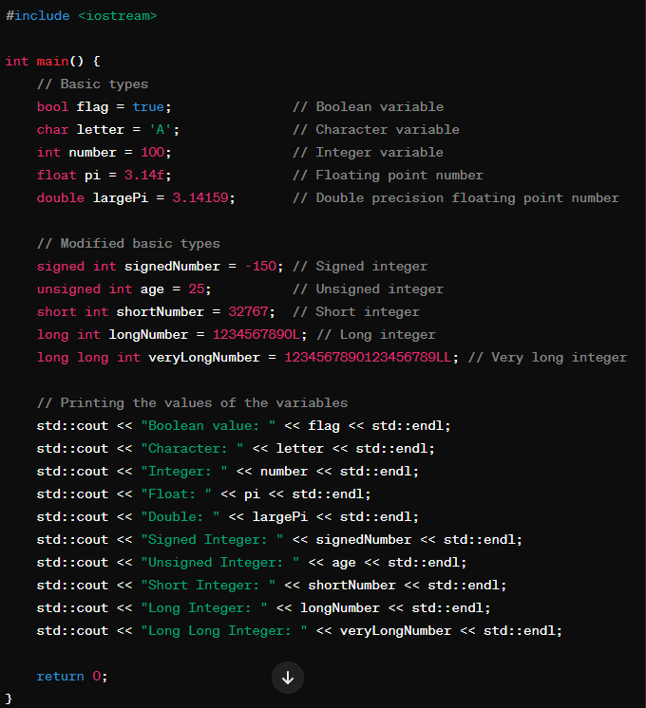
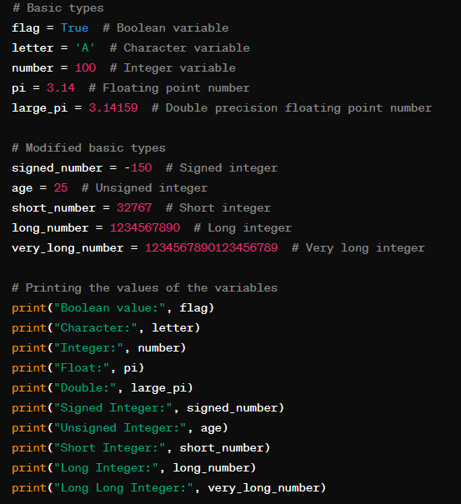
c++ variable types
A variable in programming is a basic element that is used to store data in computer memory while a program is running. A variable is assigned to a specific data type, which determines the type of data that can be stored in it, for example numbers, texts, logical values, etc.

Slide 6
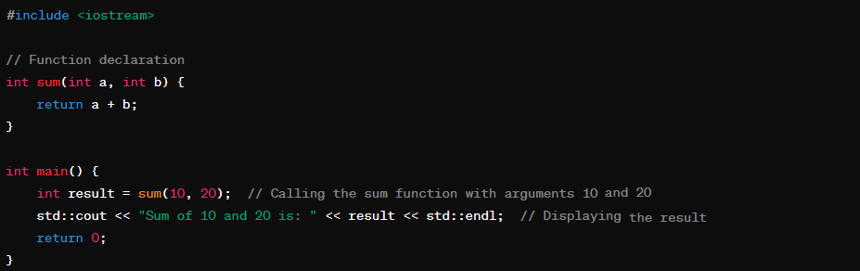
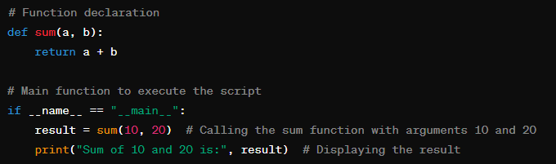
Functions in c++
A function in C++ is a method without referring to a class, a named piece of code that performs a specific task. It can accept data, process it and return a result. Functions allow code to be modular and organized, making it easier to read and reuse.

Slide 7
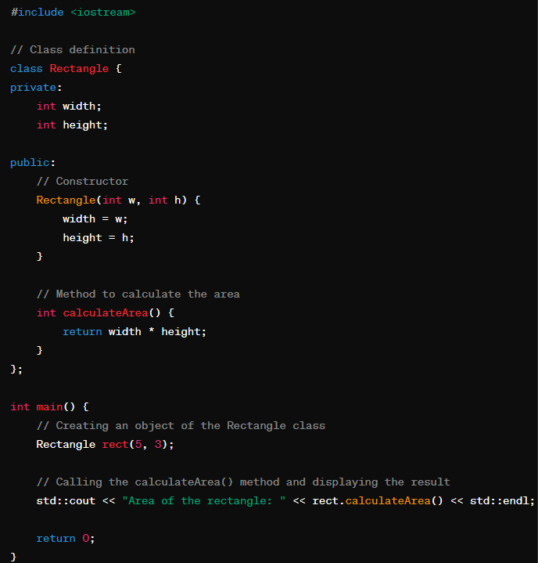
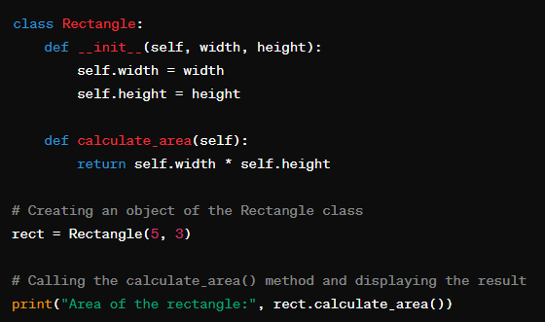
method in c++
A method is the definition of an action that is assigned to a specific type of data or object. A method is a function associated with a class or object that performs specific operations on data or performs a specific task.

Slide 8
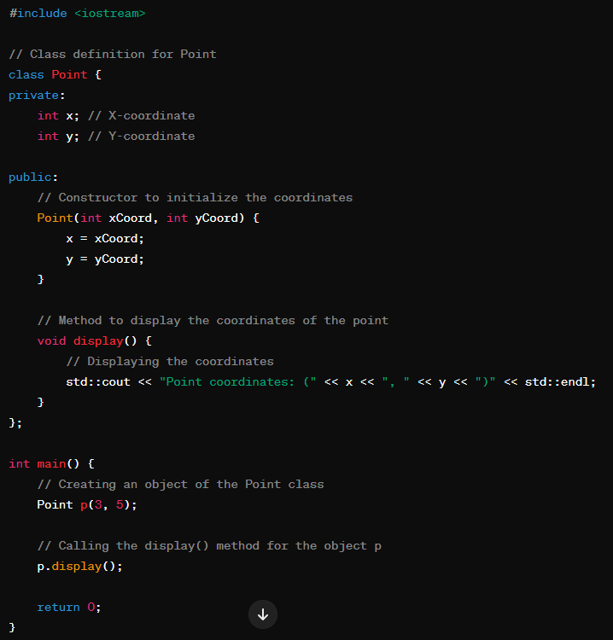
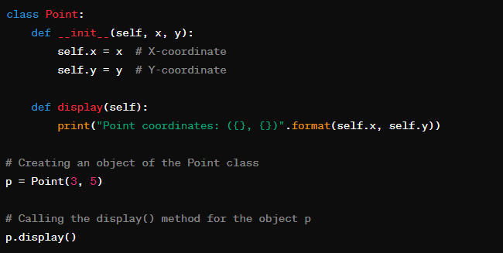
class in c++
A class is a structure that describes the characteristics and behaviors of a specific type of object. A class is the basic organizational unit in object-oriented programming and defines the properties (fields) and behaviors (methods) of objects belonging to this class. A class can be understood as a kind of form on the basis of which you can create specific representatives (objects) having specific features and behaviors defined by this class.

Slide 9
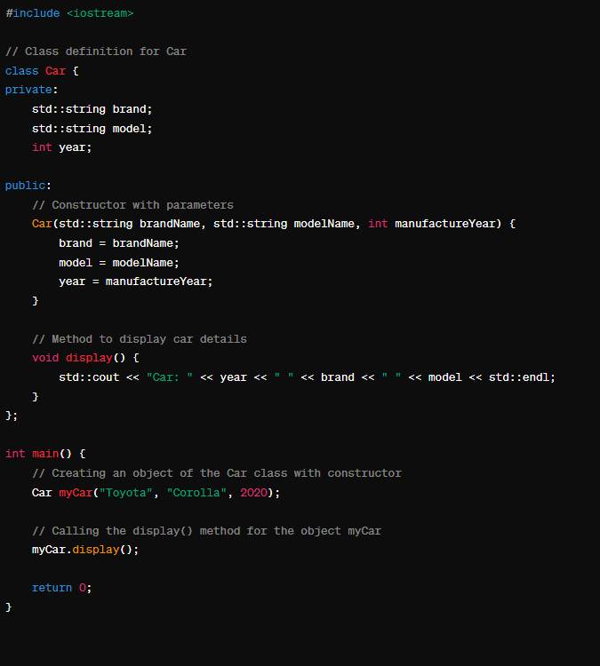
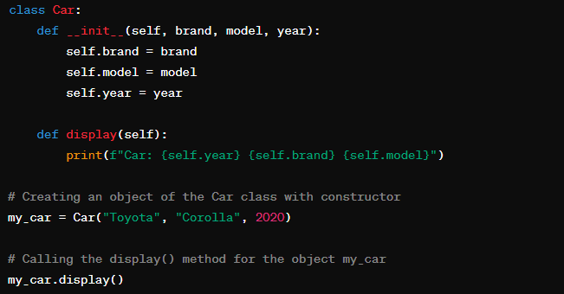
constructor in c++
In programming, a constructor is a special method of a class that is called automatically when a new object of that class is created. Its main purpose is to initialize the state of an object by setting its initial values or performing other operations necessary for the proper operation of the object.

Slide 10
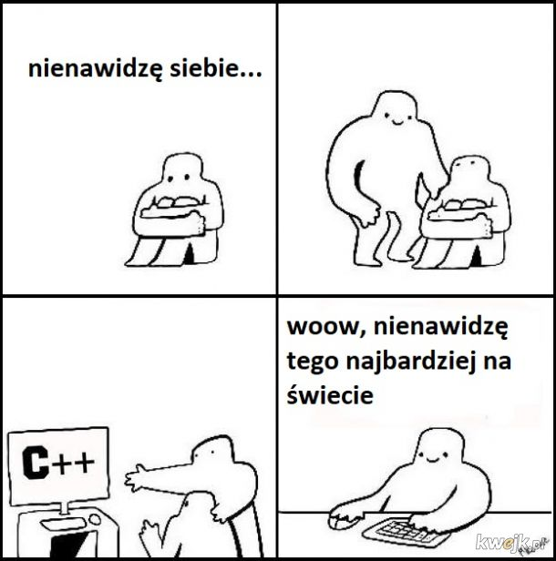

Thank you for your attention

