Slide 1


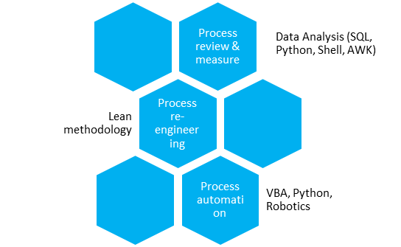






Krystian
Piłat Project Manager
ASSISTANT VICE PRESIDENT
Poland, Olsztyn
Zamenhofa 13 10-280 Olsztyn
krystianpilat@gmail.com
0048 669 020 654
Introduction
Information technology professional with wide data analysis and project management experience gained in multiple global projects, where act as part of project team or project leader. Experienced in back-office operations re-engineering with Lean methodology.
Last two years leading several projects in Security & Pricing Department. Where acting as project manager, business analyst or developer.
Securities pricing system decommission, where responsible for data mining and analyses. Acting as project lead and required solution developer (Python).
Pricing process Book of Work leader
Pricing reports migration, responsible for all Operations related activities end to end leading (initiating, BRD creation, test coordination)
Robotics Process Automation, Department POC creation. Acting as project lead (APAC region) and developer of solution (Automation Anywhere)
Working remotely as part of bigger international team with direct manager located in London and rest of the team in Belfast and Manila.
Work well independently or in a group, providing in-depth knowledge in: process improvement, analysis, business intelligence, data mining (Python, Unix Shell/Bash, SQL) and visualization, technical support.
Developed skills and tools allow me to review process, simplified it and create low cost office automation with usage VBA, Python or Automation Anywhere.
Interested in: data visualization, data science (currently learning R programing language), NBA and boxing.
Process improvement skills
2011
Citi Handlowy
Chargeback Team (Specialist)
Work
Education
Project Management
Process migration from Warsaw to Olsztyn
Client experience
Client communication
Analysis and investigation
2011
2012
UWM in Olsztyn master degree in the Faculty
of Law and Administration
2012
Citi Handlowy
Production readiness Team (Analyst)
2012
ICG Credit Card system production readiness
Process migration from Warsaw to Olsztyn
Project Management
Test performing & conducting
Analysis
Requirements writing
2013
SGGW in Warsaw
computing and Information Technology
2013
Profile
2014
Citi Handlowy
MIS & Strategic Projects Team (Project Manager)
2014
Solution oriented
Continuous improvement
Proactive
Excellent communicator
Team player
Workforce monitoring implementation
Process reengineering
Management Information Reporting
Project Management
Presentations
Requirements writing and analysis
Vendor Management
Data Governance
2015
2016
Citi Europe Security & Pricing
Strategic Projects Team (Project Manager)
Legacy pricing system decommission
Pricing reports migration & decommission
Robotics POC development
Project Management
Data Mining
Development
Requirements writing
Reengeneering workshops
2016
Skills
Skills level
Plan
2017
English
Project Management
Shell, Bash, AWK
Python
2018
2018
In progress
PMI certification
SQL
Excel VBA
MS Office
Proces re-engineering
Presentation
Robotics (Automation Anywhere)
Test coordination
March 18, 2018

