Slide 1
SaaS Platform Analysis
Author: Krystian Walczak

Slide 2
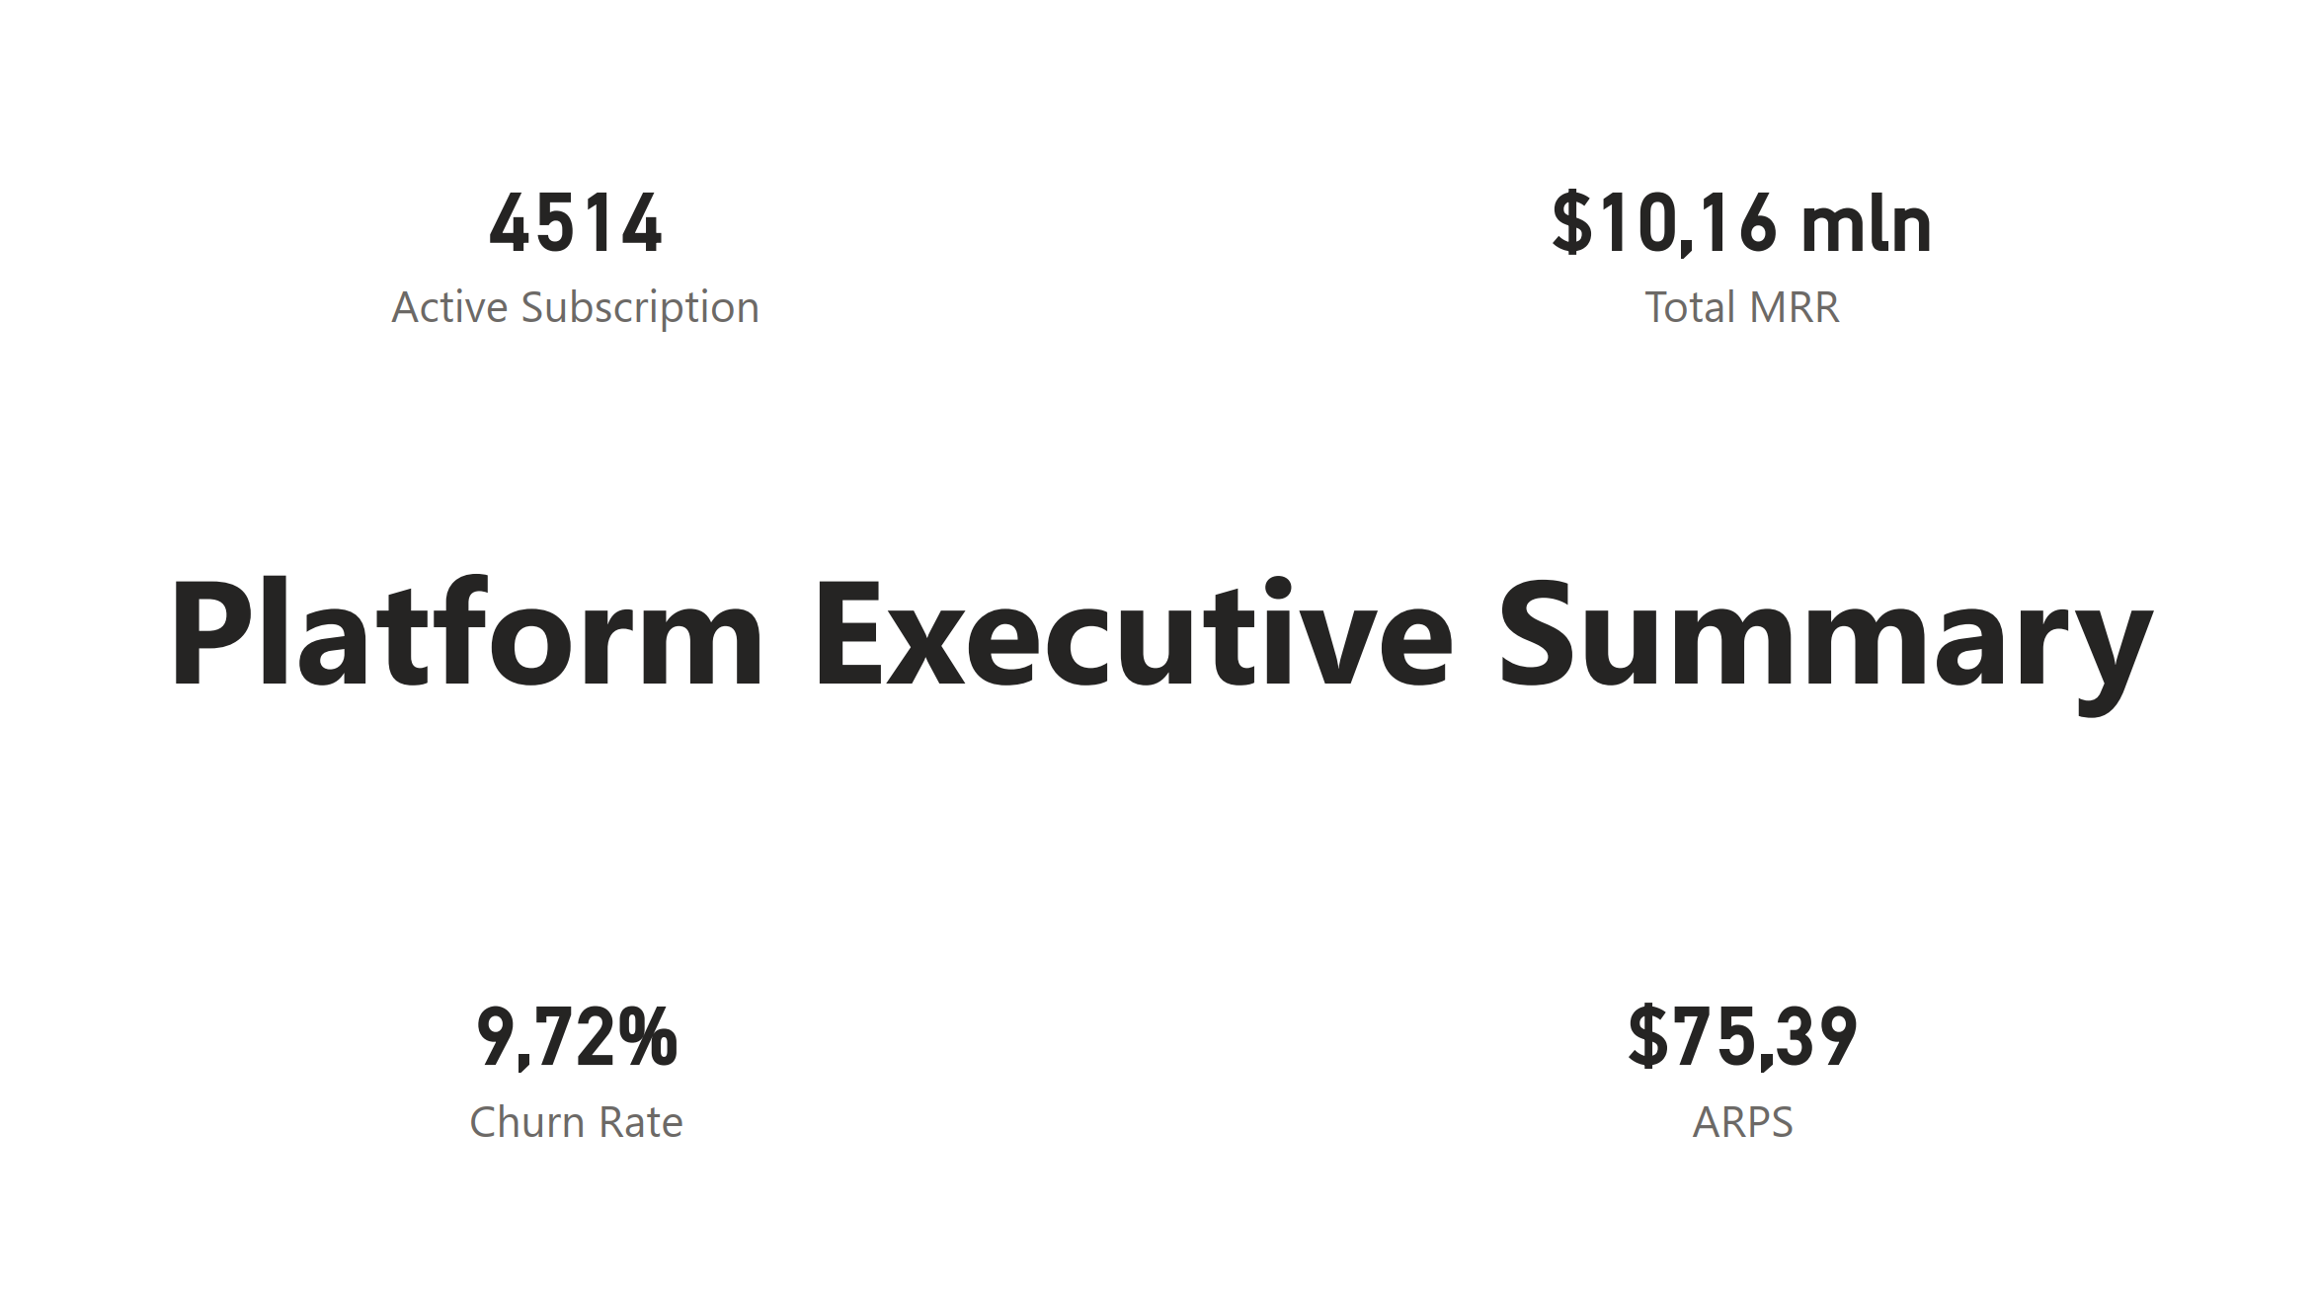

Slide 3
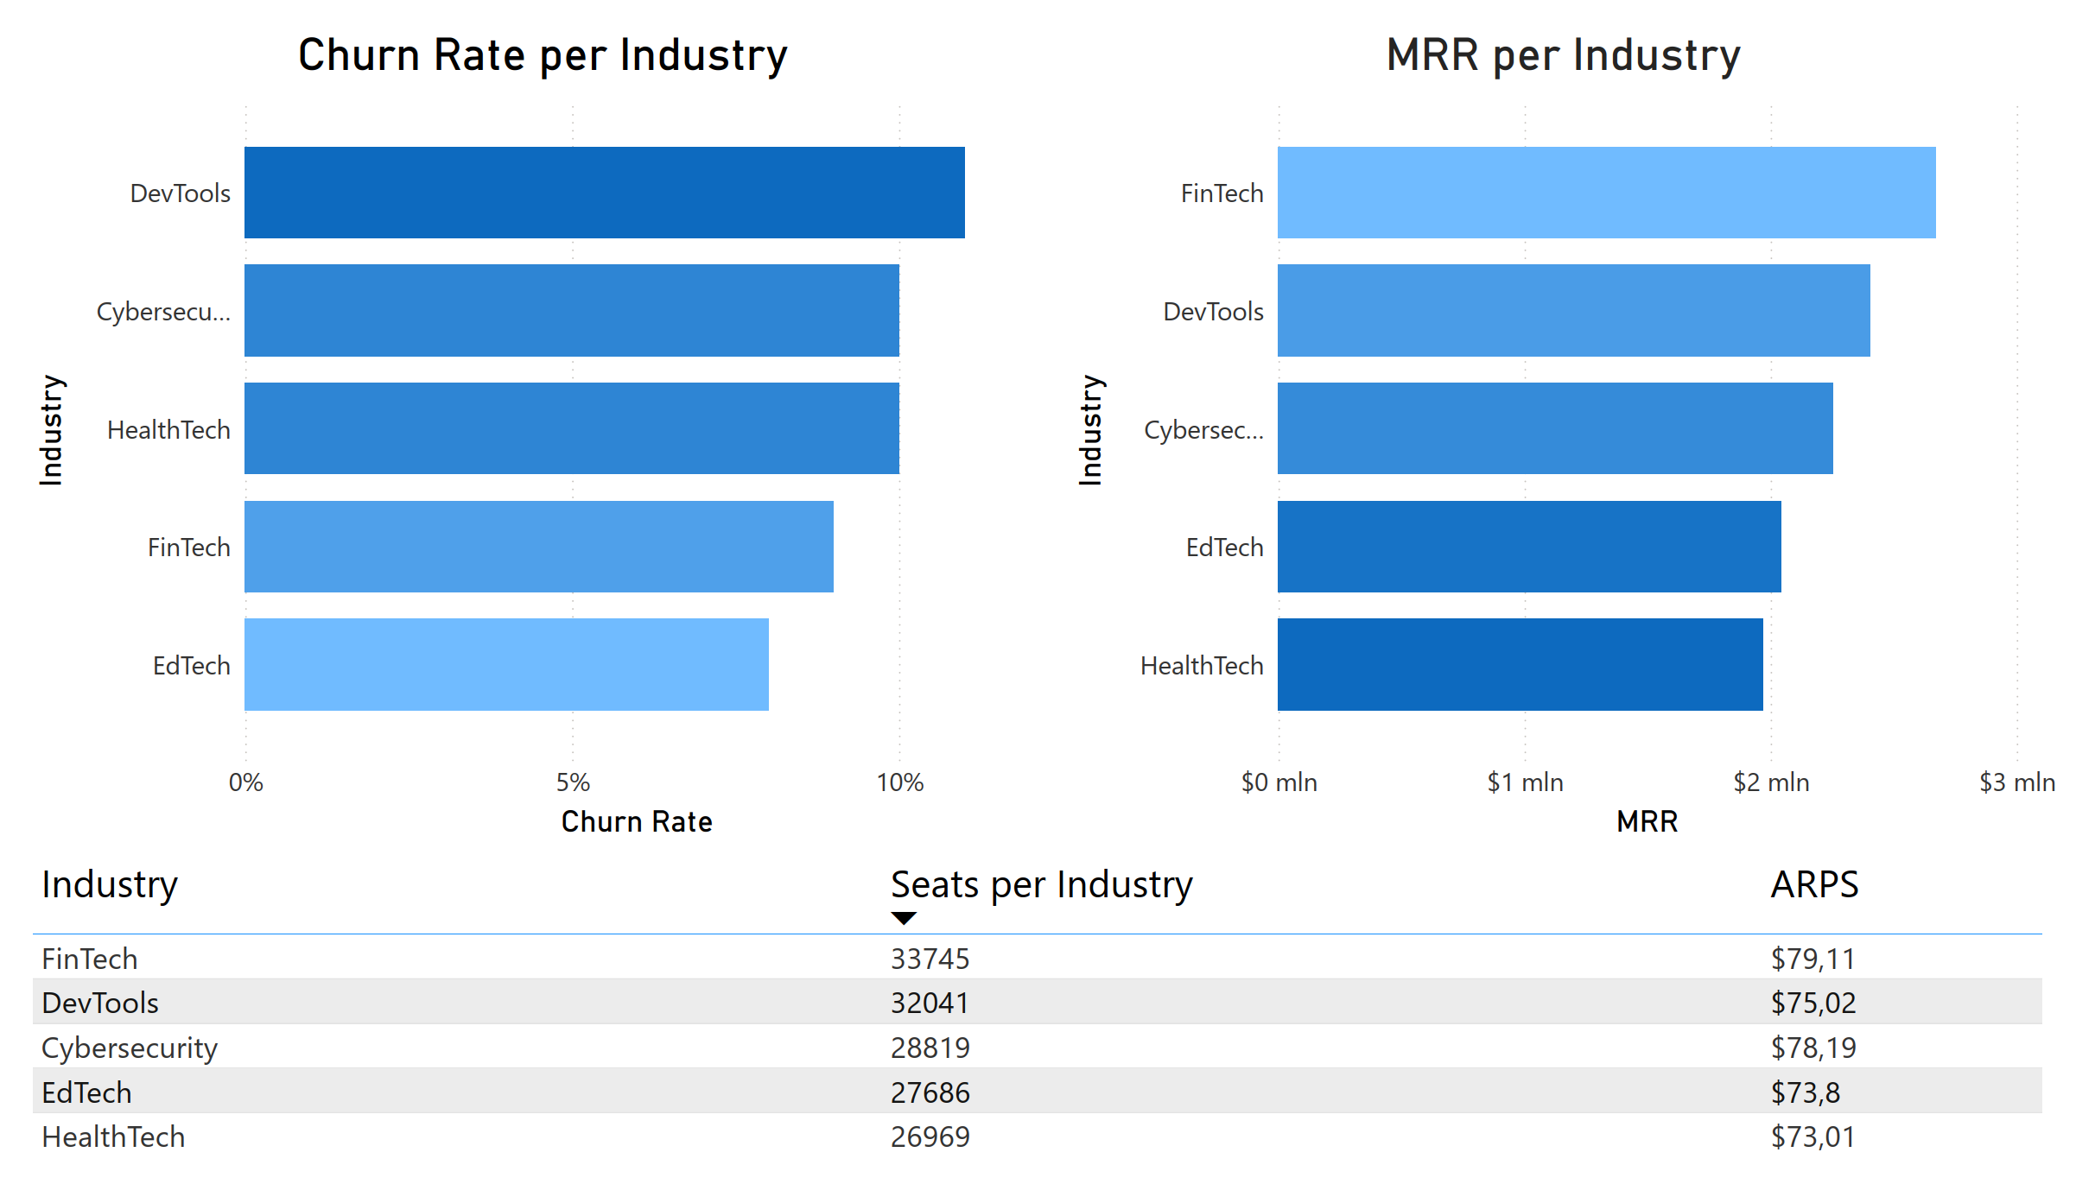
FinTech is the strongest segment: highest MRR with one of the lowest churn rates.
FinTech leads in MRR and ARPS
FinTech has high scale (seats) and healthy retention

Slide 4
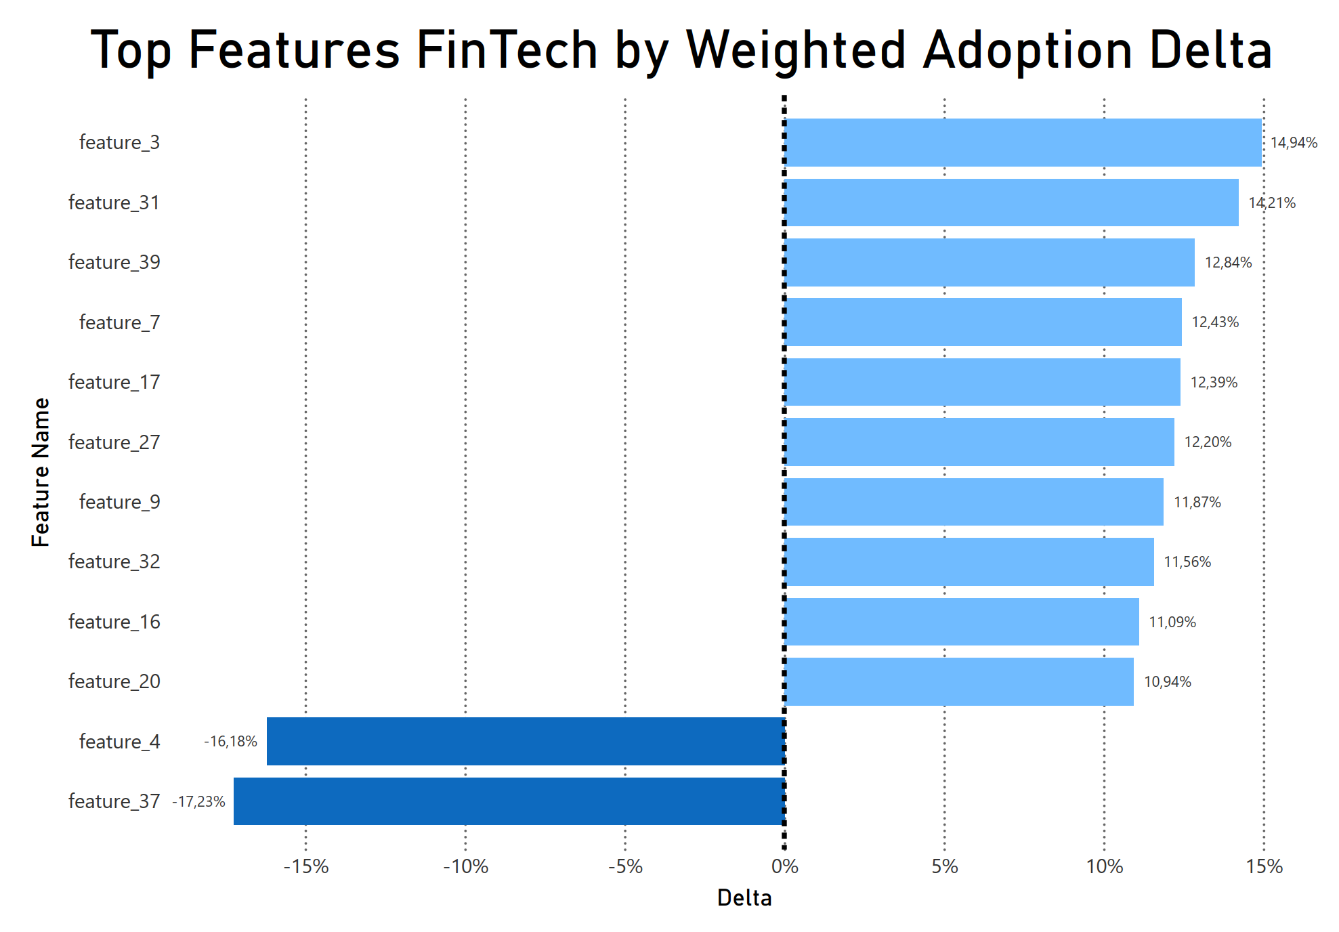
FinTech drives adoption of the most impactful features, reinforcing it as the “core product fit” segment
Weighted delta reduces small-sample bias
FinTech contains multiple high-uplift features

Slide 5
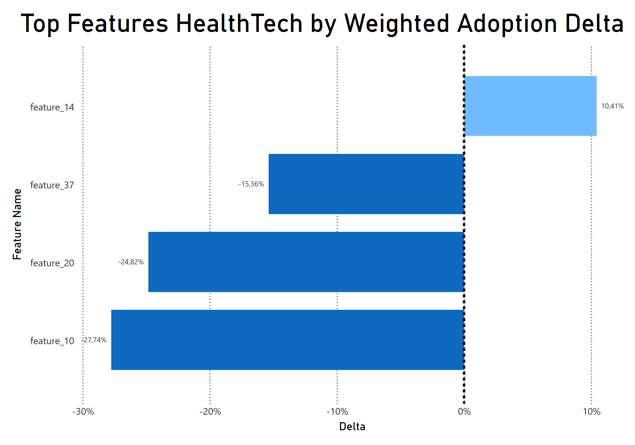
HealthTech has the lowest product–market feature fit
Only one feature drives strong positive adoption in HealthTech
HealthTech also contains the lowest-performing feature across all industries

Slide 6
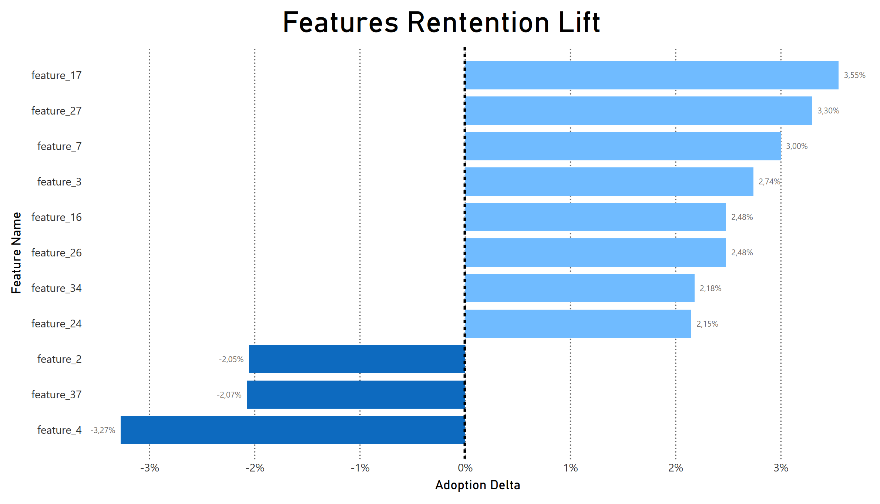
Churn is associated with feature mix, not feature volume
Some features show strong positive delta (used more by active users)
Some features are more common among churned users (negative delta)
Some features are more common among churned users (negative delta)

Slide 7
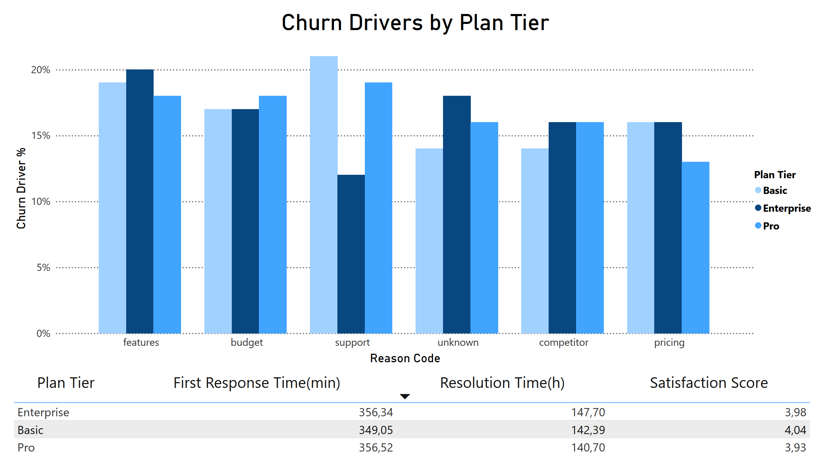
Churn reasons remain consistent across plan tiers; support does not appear to be the primary operational issue.
“Features” and “Budget” frequently appear among churn reasons
Support metrics are similar across tiers - perceived value / expectations may drive churn

Slide 8
Recommendations
Drive adoption of retention-positive features (top uplift)
Prioritize FinTech segment (highest MRR, low churn, strong adoption)
Current features are not strongly aligned with HealthTech users’ needs and may not support long-term retention
Churn is not driven by how many features users try, but rather which specific features they adopt
Improve churn reason data quality to enable more actionable retention insights

