Slide 1
D.C. Capital BikeShare
Krystin Sinclair
ksinclair7@gwu.edu

Slide 2
Abstract
Many cities have implemented a bike sharing system. The bikes can be used for daily commutes, touring a city, or exercise. There are different modes of thought on the rationale for bike share, from public health reasons to traffic and congestion mitigation. User perception of a bike sharing system benefits and negatives may impact the success of the system. Analysis has shown that where bike sharing has been implemented traffic has decreased, however it is unclear if there is an overall positive benefit to public health. There are various reasons to utilize bike share in the cities that they have been implemented in. Understanding how and why citizens and tourists are utilizing the bicycles will enable policy makers to properly promote and make changes to the system.

Slide 3
Analysis
Urban Planners should do background research and analysis on users
DC Capital BikeShare
Use Transit data to identify
Day of the week
Hourly
Members
Use information to determine if trips of more likely to be recreational or daily commutes

Slide 4
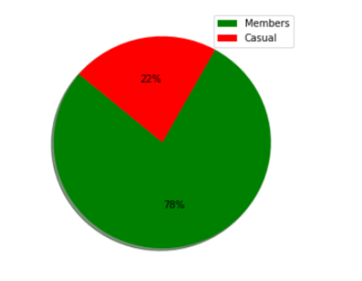
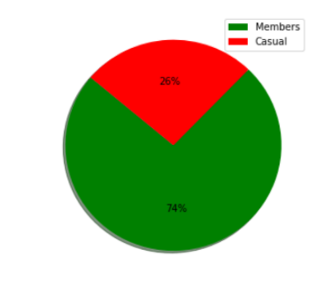
Membership
2016
2017

Slide 5
Duration in seconds(minutes)
Year | Longest | Shortest | Average
2016 | 86357 (1439) | 60 (1) | 1150 (19)
2017 | 86394 (1440) | 60 (1) | 1153 (19)

Slide 6
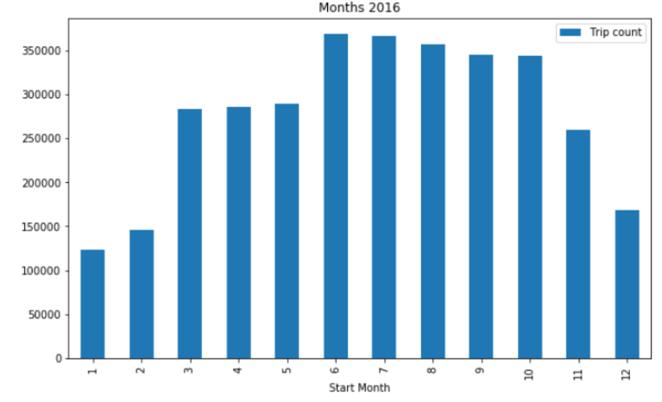
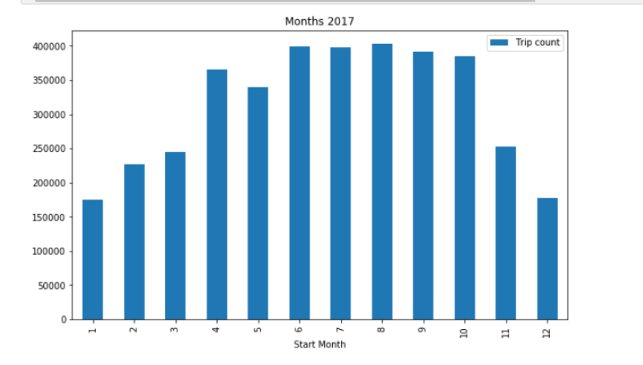
Monthly

Slide 7
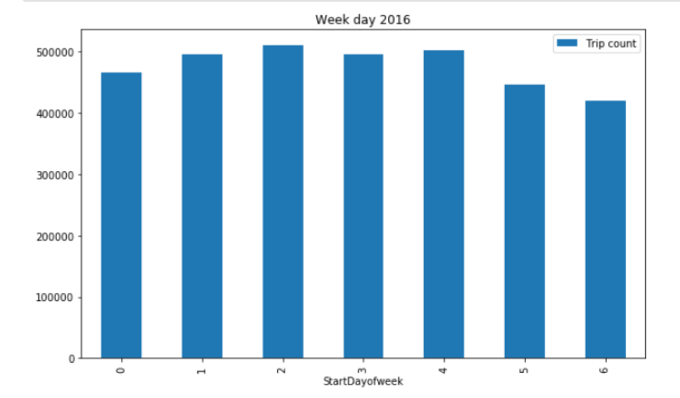
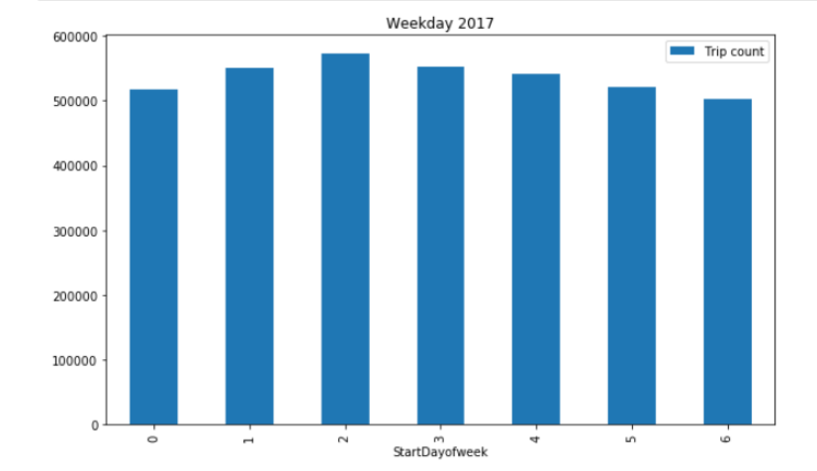
Day of the week

Slide 8
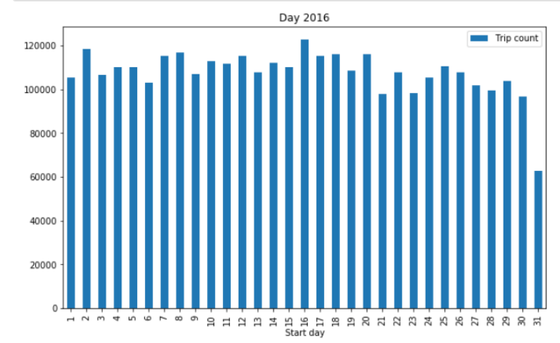
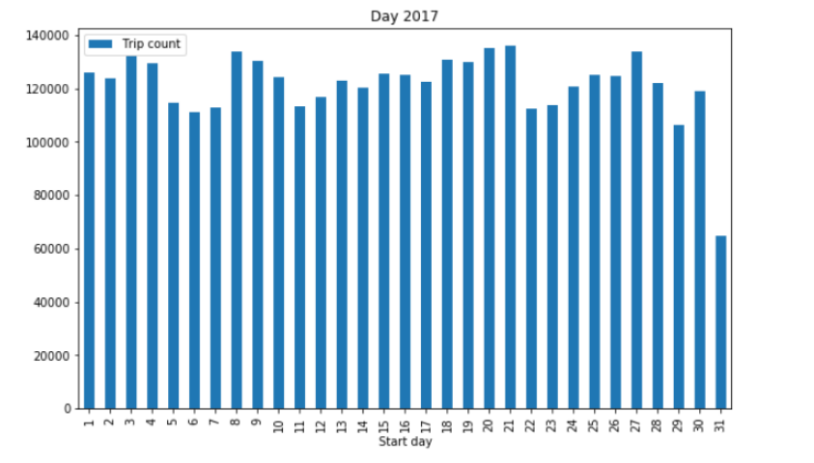
Day of the month

Slide 9
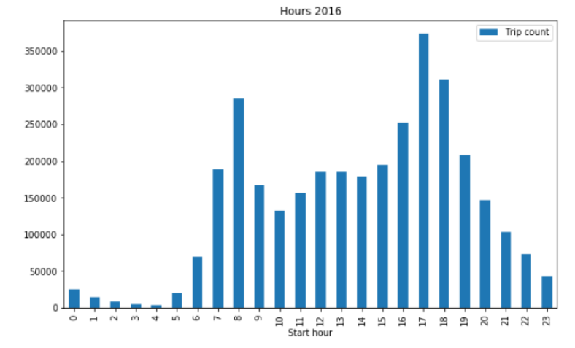
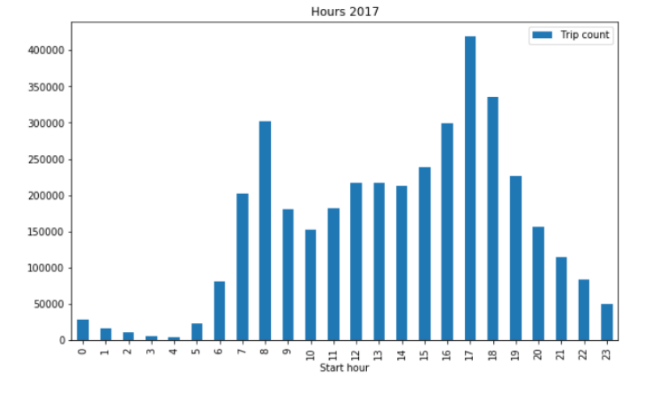
Hourly

Slide 10
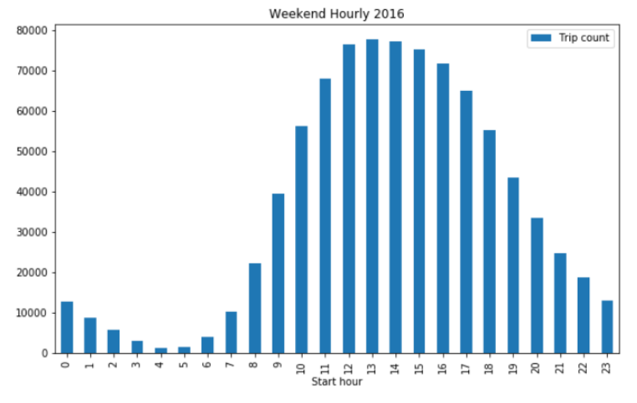
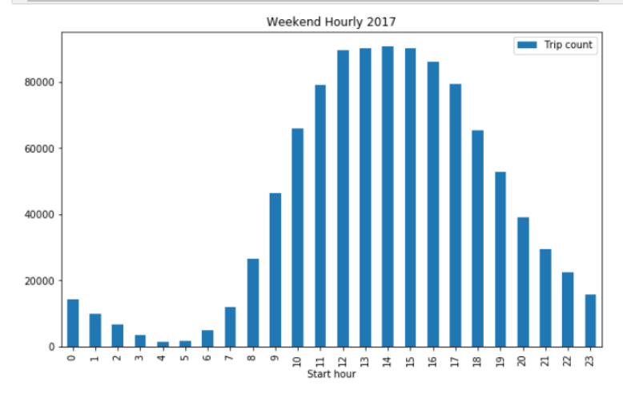
Hourly data weekends

Slide 11
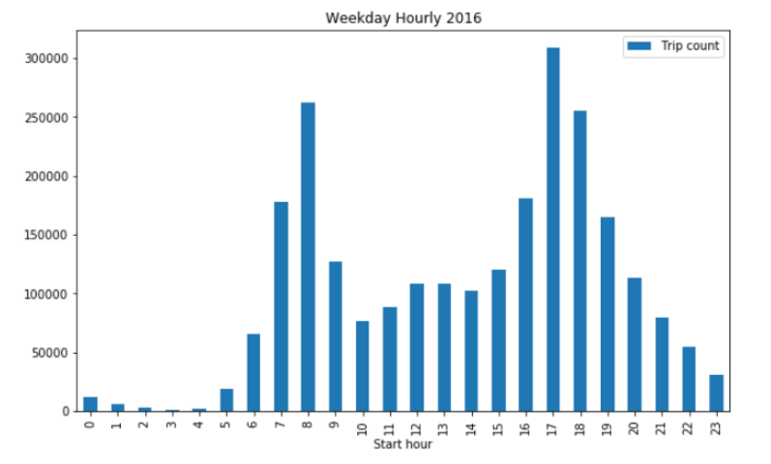
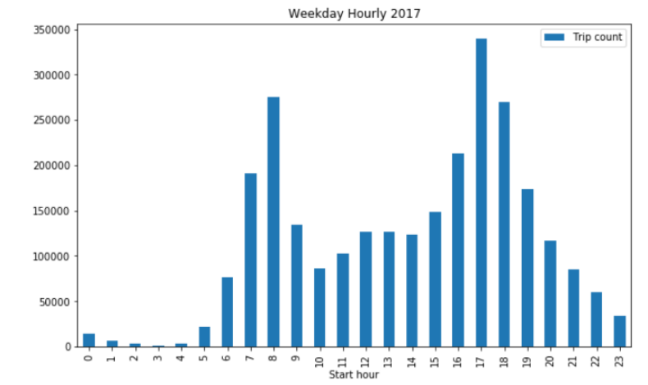
Hourly data for weekdays

Slide 12
Conclusion
Popularity
Member
Warmer Months
Rush Hour
Policy Makers should realize that it is mostly for inhabitants, not tourists
Installation of docks or bike refurbishment should occur before summer
Spikes during rush hour, used for daily commuting

Slide 13
Appendix

Slide 14
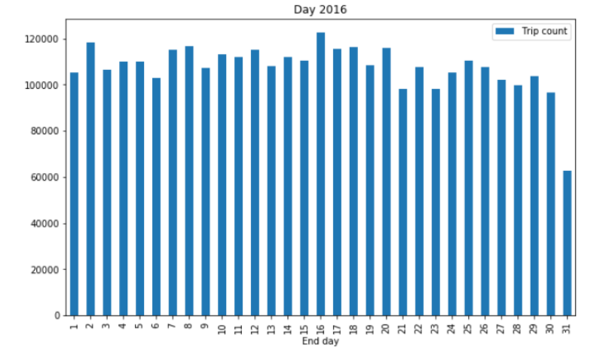
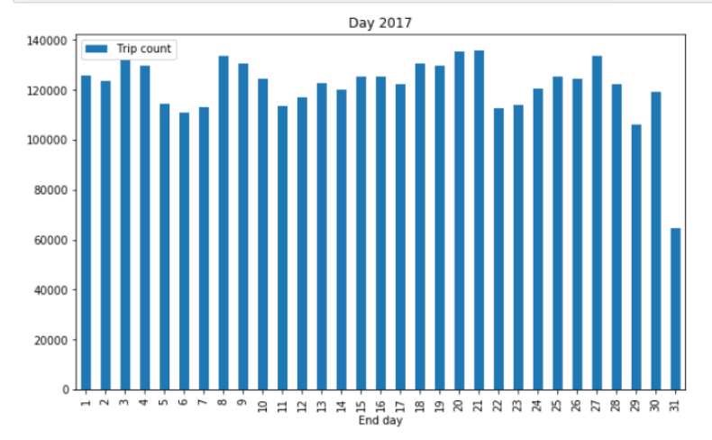
Day of the month

Slide 15
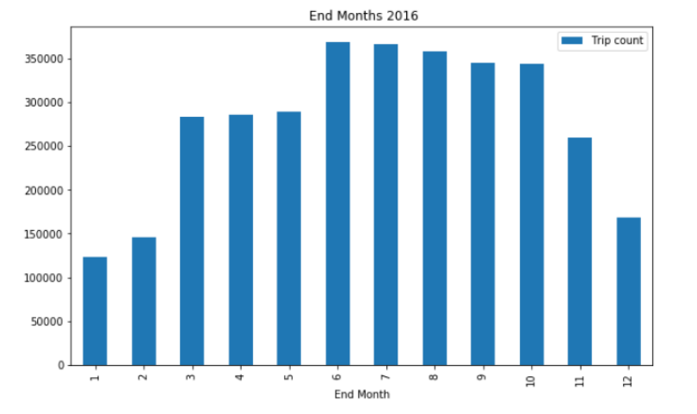
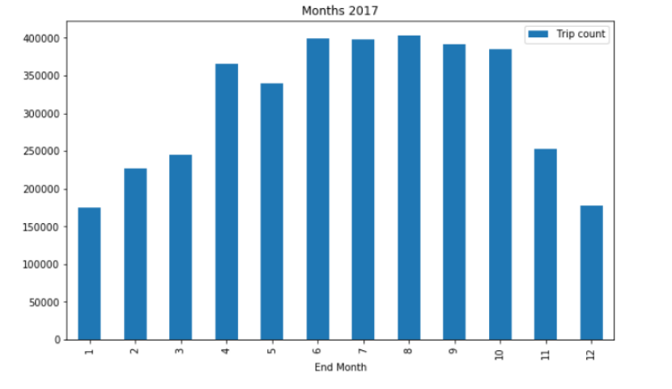
Monthly

Slide 16
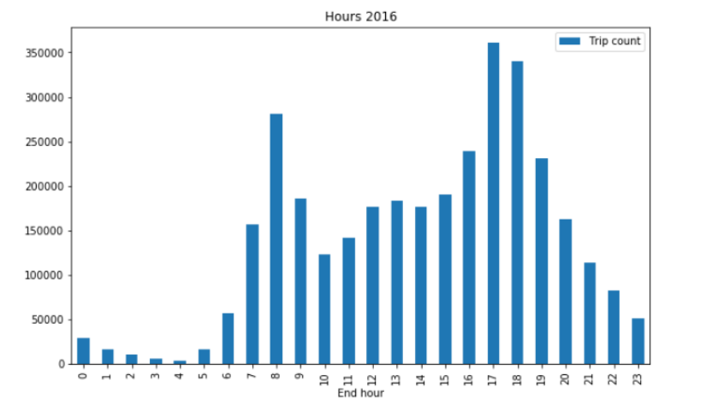
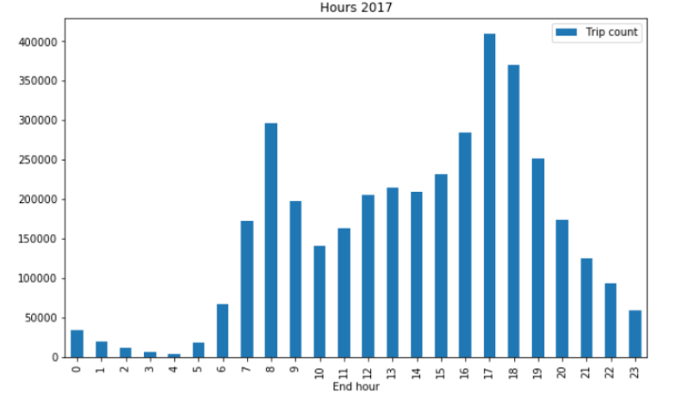
Hourly

Slide 17
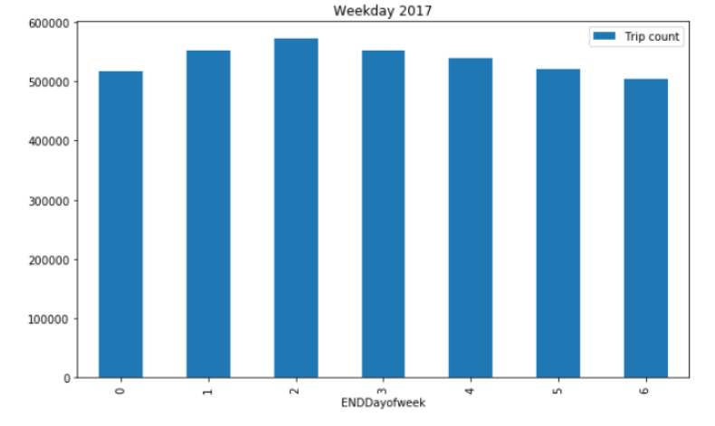
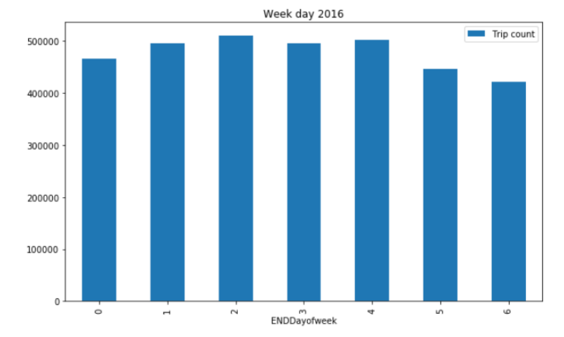
Day of the week

Slide 18
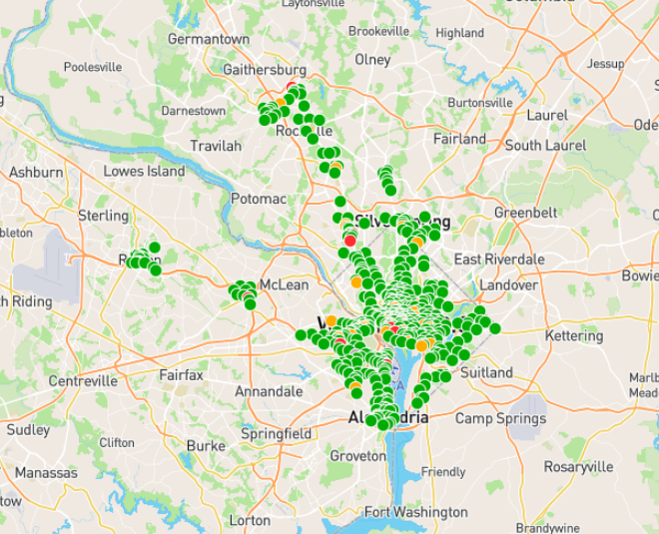
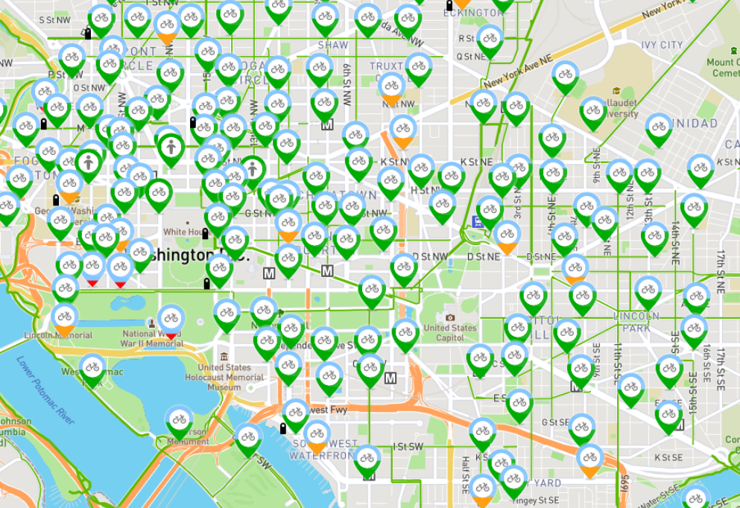
Location

Slide 19
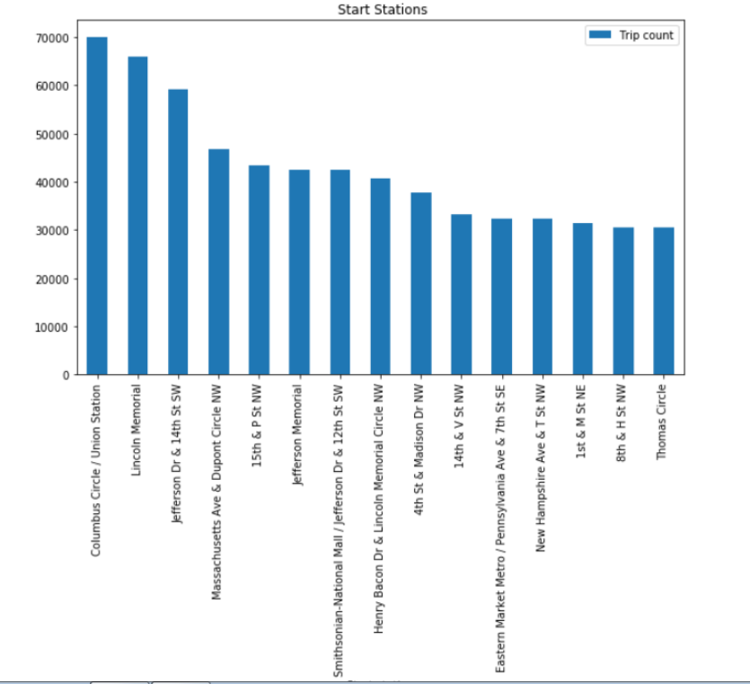
Top Starting points 2017

Slide 20
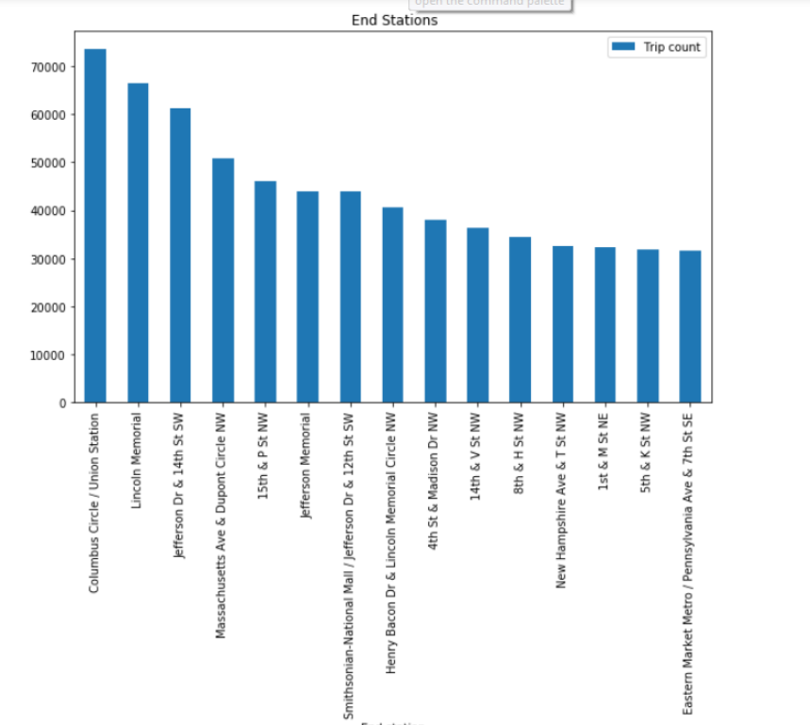
Top Ending points 2017

Slide 21
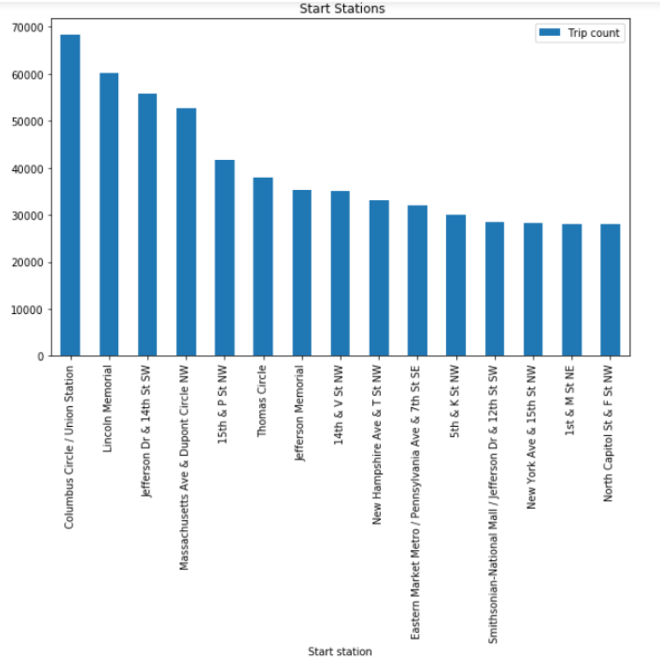
Top starting stations 2016

Slide 22
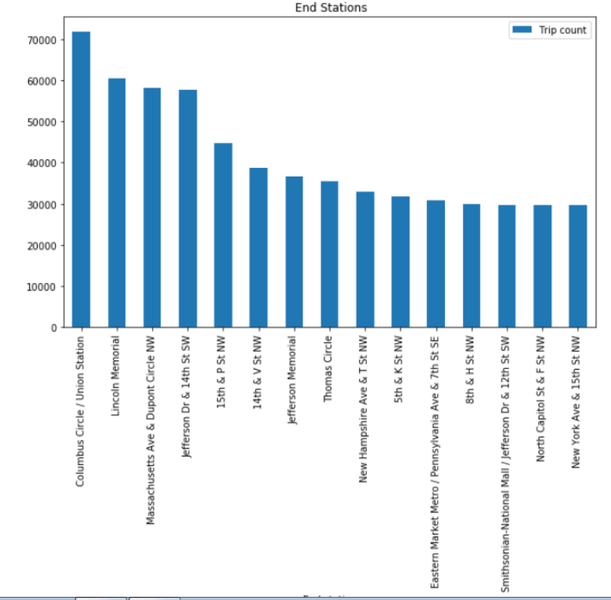
Top End Stations 2016

