Slide 1
DATS 6103-Individual Project 1-Krystin Sinclair
Military Expenditure

Slide 2

Source of Data
SIPRI
https://www.sipri.org/databases/milex
Subset DATA
Top 15 countries based on military expenditure in current USD from 2016
Using years 2006-2016
*All Military Expenditure will be shown in Millions

Slide 3
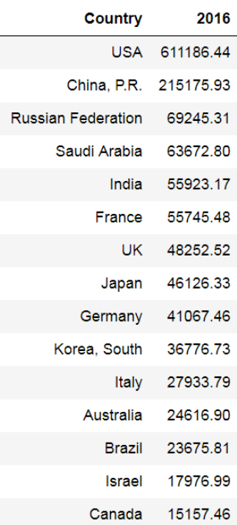
Subset DATA
Country | Total | Rank
USA | $ 6,925,431 | 1
China, P.R. | $ 1,536,346 | 2
Russian Federation | $ 704,909 | 3
Saudi Arabia | $ 593,455 | 6
India | $ 472,409 | 9
France | $ 671,541 | 4
UK | $ 642,011 | 5
Japan | $ 538,226 | 7
Germany | $ 489,976 | 8
Korea, South | $ 339,520 | 11
Italy | $ 375,503 | 10
Australia | $ 244,317 | 13
Brazil | $ 305,746 | 12
Israel | $ 165,906 | 15
Canada | $ 198,511 | 14
Notes:
This shows the Military spending for the subset of data that I choose.
This also shows the total spending for all years 2006-2016 and that that rank is slightly different than 016.

Slide 4
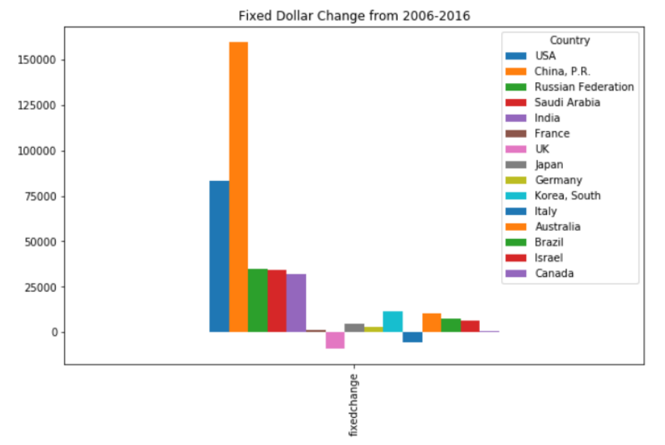
Change over time(fixed dollar amount)
China increased the most
Notes:
This shows the change from 2006-2016 in a fixed dollar amount. We can see that China has increased their spending the most. WE can also see that UK and Italy have decreased their spending.

Slide 5
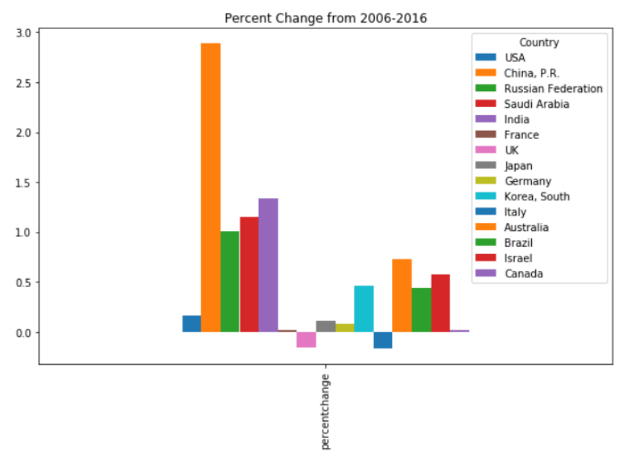
Change over time(as a percent)
China increased the most
Notes:
This shows the change from 2006-2016 as a percentage. We can see that china is still the country that increased their spending the most and that both Italy and the UK have decreased their spending. WE can also tell that Canada and France have remained relatively flat. This graph is quite similar to the previous one. I would like to point out that the US looks like they have increased by much less when we think of it as a percent.

Slide 6
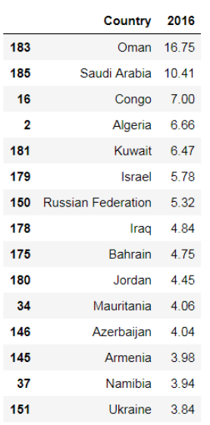
Military expenditure as percent of GDP
Top15 by %GDP
Top15 by current USD
Only Saudi Arabia is in the top 15 countries if we sort it by military expenditure as a percent of GDP and military expenditure in current USD
Notes:
I wanted to see which countries would be the top spenders if we look at them ranked by military spending as a percent of GDP. The only country that remains from the original group is Saudi Arabia.

Slide 7
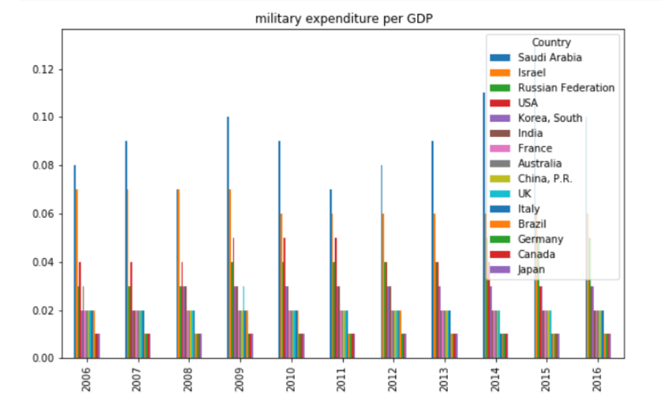
Military Expenditure % GDP
Notes:
This graph makes it a bit easier to see year by year. We can see that pretty much every year the same countries spend the most per GDP.

Slide 8
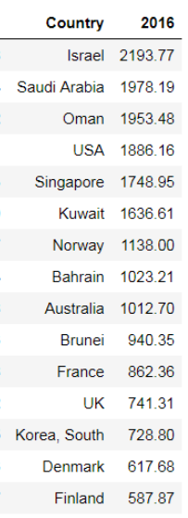
Per Person Military Expenditure
Top15 by per person
Top15 by current USD
Many Countries are in the top 15 if we sort by Current USD or if we sort be per capita
Israel, Saudi Arabia, USA, Australia, France, UK, South Korea
*Russian Federation does not exist in this table from SIPRI database
Notes:
I wanted to see what countries would be the top spenders if we looked it at by spending per capita. WE can see that quite a few countries are on this list and the original lists.

Slide 9
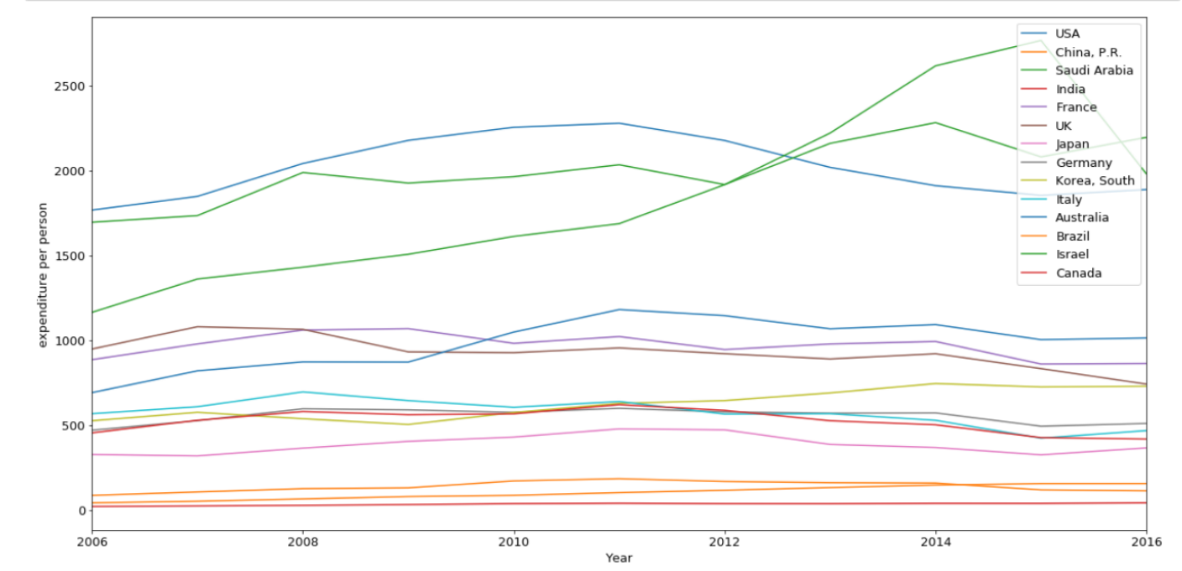
Expenditure per Person
Israel, Saudi Arabia, and USA top three for 2006-2016
Notes:
This gives us a view of the countries over time spending per capita. We can see that most countries appear to be relativity flat. However Saudi Arabia and Israel spiked after 2012.

Slide 10
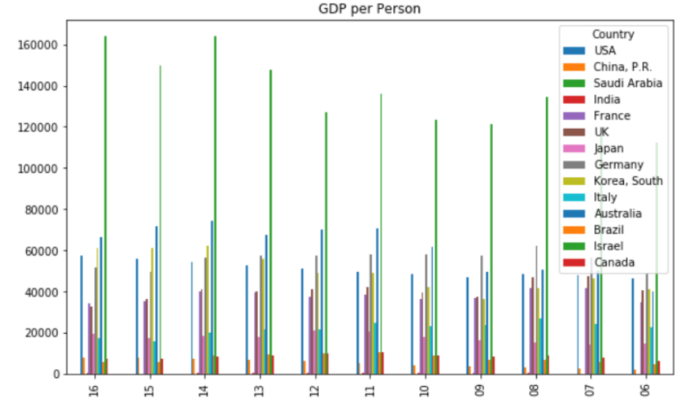
GDP/Person
Israel ranks #1 for 2006-2016
Notes:
GDP per person shows us that Israel is the top earner

Slide 11
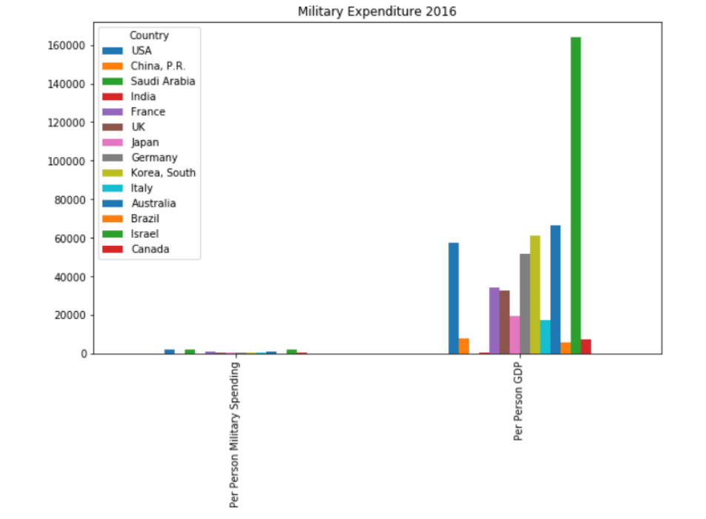
Military Spending /person, GDP / Person
Spending per person is much smaller than GDP per person
Notes:
This shows us that Military per person is quite a bit les than per person GDP. That means that all countries are earning more in 2016 than spending on the military.

Slide 12
Per Person GDP rank 2016
Country | Per Person Military Spending(1) | Per Person GDP(2) | Rank(1) | Rank(2)
USA | $ 1,886.16 | $ 57,283.32 | 3 | 4
China, P.R. | $ 155.74 | $ 8,061.57 | 12 | 11
Saudi Arabia | $ 1,978.19 | $ 19,002.78 | 2 | 9
India | $ 42.14 | $ 404.67 | 14 | 14
France | $ 862.36 | $ 34,496.44 | 5 | 6
UK | $ 741.31 | $ 32,617.65 | 6 | 7
Japan | $ 365.40 | $ 19,660.53 | 11 | 8
Germany | $ 509.33 | $ 51,501.57 | 8 | 5
Korea, South | $ 728.80 | $ 61,215.97 | 7 | 3
Italy | $ 467.45 | $ 17,618.01 | 9 | 10
Australia | $ 1,012.70 | $ 66,642.39 | 4 | 2
Brazil | $ 112.97 | $ 5,730.66 | 13 | 13
Israel | $ 2,193.77 | $ 163,811.84 | 1 | 1
Canada | $ 417.76 | $ 7,231.86 | 10 | 12
Appears to be similarities in ranking between per person military spending and per person GDP

Slide 13
Findings
USA has highest level of military expenditure
China has increased military expenditure the most since 2006
Saudi Arabia has highest military expenditure as % GDP
Israel has most military spending per person
Israel has most GDP per person

Slide 14
Appendix

Slide 15
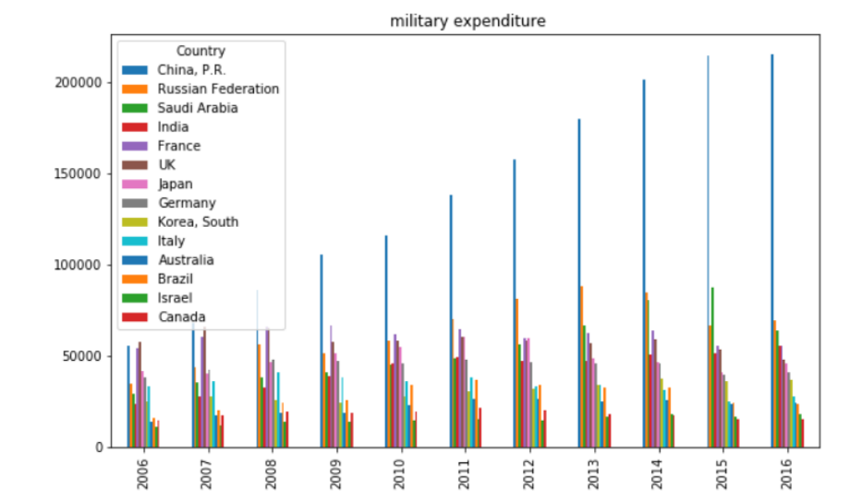
Time Series without USA
China outspends other countries
Notes:
In order to get a better look at the countries, the US has been removed from the grid, so that the scale can be adjusted. Now we can easily see that China is out spending the rest of the countries.

Slide 16
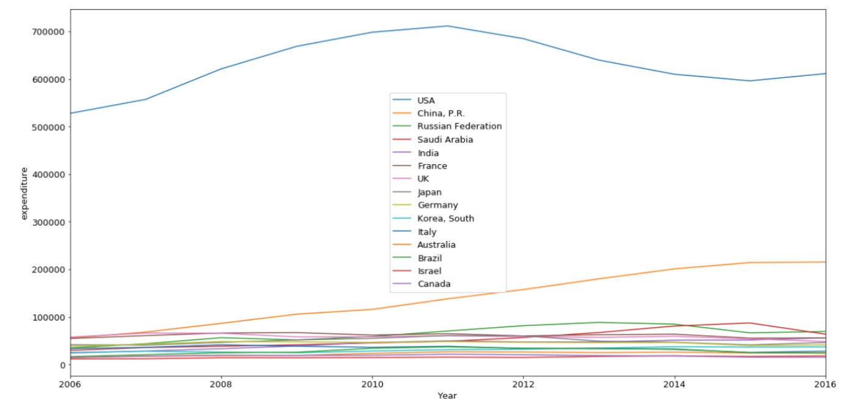
Time Series-Military Expenditure
US far outspends other countries, from 2006-2016
Notes:
This shows that for every year the US outspends the other countries.

Slide 17
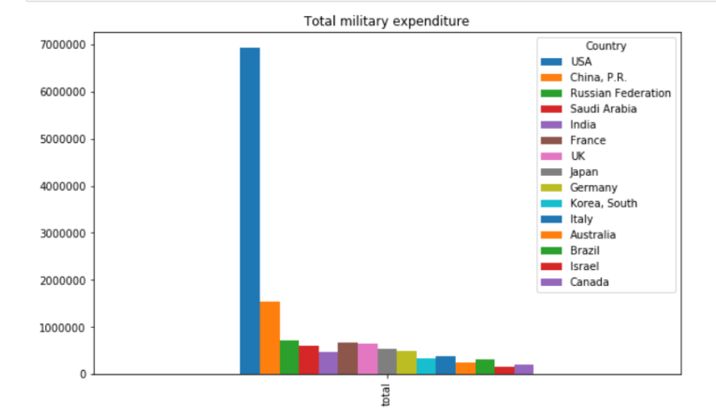
Totals
US far outspends other countries
Notes:
We can see that the US by far out paces the other countries.

Slide 18
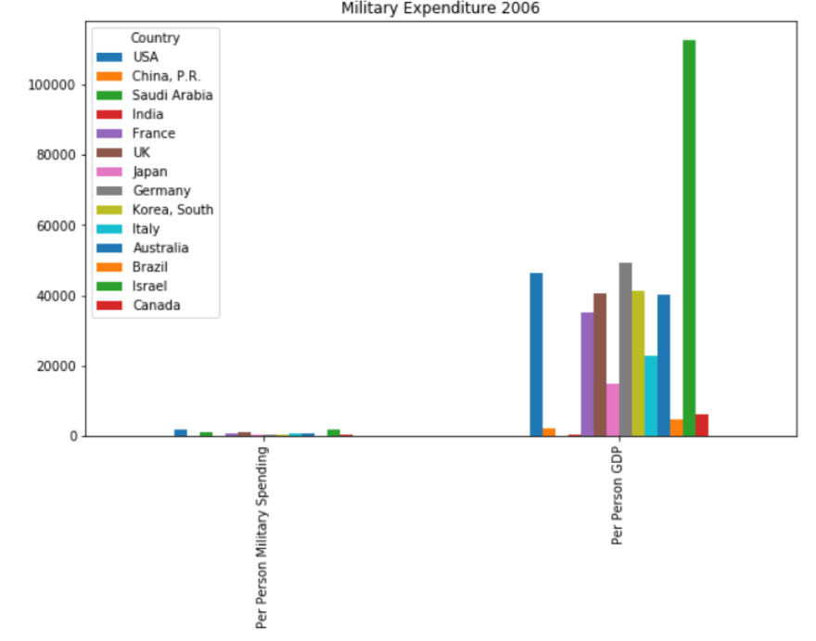
Military per person, GDP per Person
Notes:
2006 and the other years look quite similar to 2016. This is a pattern throughout time.

Slide 19
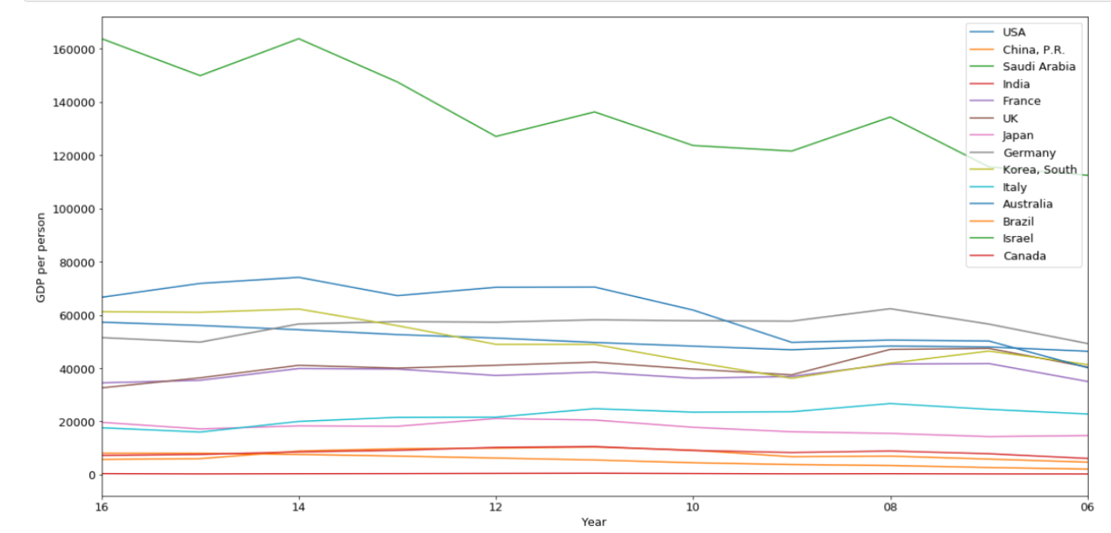
GDP/Person
Notes:
We can see that Israel is on top over the past few years

Slide 20
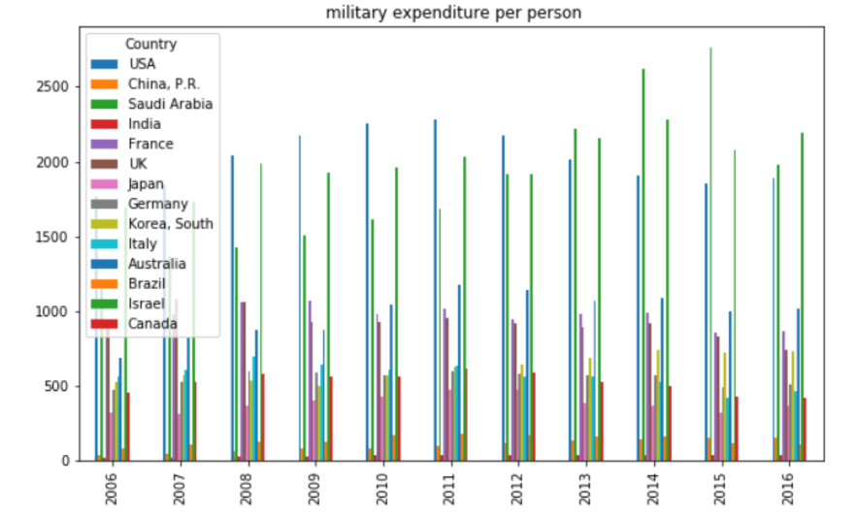
Expenditure per capita
Notes:
This gives us a better view of a year by year comparison for countries military spending per person. We can see that USA, Saudi Arabia and Israel seem to be the top spenders each year over the past ten years .

Slide 21
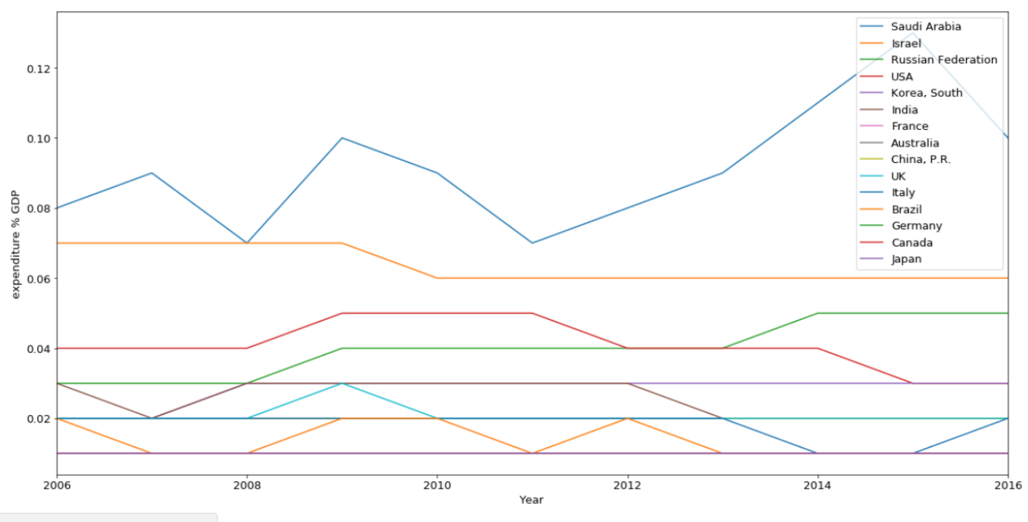
Military Expenditure % GDP
China increased the most
Notes:
When we view Military Expenditure as a percent of GDP, we can see that the USA no longer tops the charts. Saudi Arabia is the lead now. USA comes in as number four, so still at the top.

Slide 22
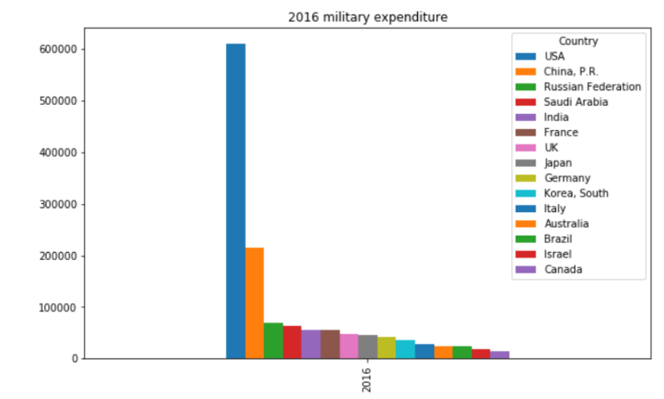
2016

Slide 23
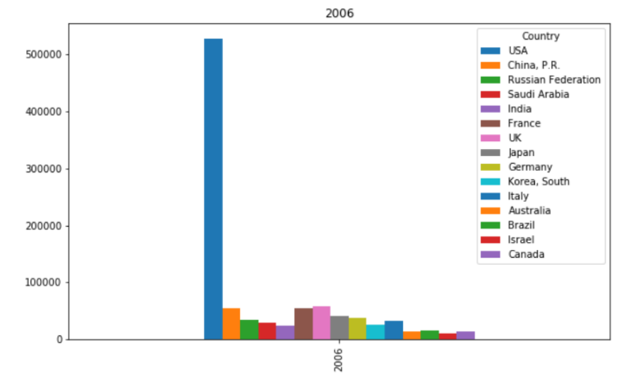
2006

